Slide 1
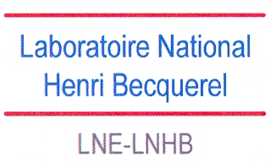
Decay data activities at the Laboratoire National Henri Becquerel (LNHB)
Mark A. Kellett
2nd RCM, Nuclear Data for Charged-particle Monitor Reactions and Medical Isotope Production, IAEA, Vienna, 8 – 12 December 2014

Slide 2
Actions allocated at 1st RCM
Actions – All Involve Evaluating Decay Data
Monitor Reactions:
Evaluate ⁶¹Cu decay scheme.
Positron emitters:
Evaluate ⁶⁴Cu decay scheme due to a discrepancy in the weak gamma line.
Therapeutic alpha emitters:
Evaluate ²³⁰U decay schemes (eight nuclei).

Slide 3
Monitor reactions: ⁶¹Cu
New Evaluation Completed in 2013
Half-life:
Evaluated value of 3.366 (33) h, from a set of four measured values, which are discrepant.
Expanded uncertainty used to cover the most accurate measured value of 3.333 (10) h – Grütter (1982Gr10).
β+/EC feeding to the ground state:
Main problem is establishing the feeding to the ground state, where have β⁺/EC in competition.
Found β⁺ feeding of 51.6 (25) % and EC feeding of 16.3 (8) %.
Decay scheme consistency:
Sum of all decays is 2238 (46) keV, compared to 2237.5 (10) keV from the adopted Q value (from Wang et al., 2012).
Conclusion:
Further half-life measurements would be useful, as would β⁺/EC feeding to the ground state, but current evaluation is consistent and complete.

Slide 4
Positron emitters: ⁶⁴Cu
New Evaluation Requested, but Current Evaluation is Valid
Half-life:
Evaluated value of 12.7004 (20) h, from a set of nine measured values.
β-/β+/EC branches:
Determined through independent measurements (spectra, 4πβ-γ, LSC) and mass spectrometry.
Both techniques yield consistent values.
Comparison of derived quantities, e.g. Pβ-/Pβ+, Iγ/Pβ+, with measurements are consistent.
Iγ (1345.77 keV) intensity:
Seven published values (one outlier with a very large uncertainty) which allow a consistent weighted mean to be calculated.
Conclusion:
Following from the findings of a EURAMET project in 2012, the current data is consistent and there appears to be no reason to question the current evaluation.

Slide 5
Therapeutic α emitters: ²³⁰U decay chain
Eight New Evaluations – Collaboration Between LNHB & IFIN
²³⁰U(α)²²⁶Th(α)²²²Ra(α)²¹⁸Rn(α)²¹⁴Po(α)²¹⁰Pb(β−)²¹⁰Bi(β−)²¹⁰Po(α)206Pb(stable)
IFIN will evaluate the first two, LNHB the other six
Current status of LNHB commitment:
²¹⁰Po: evaluation completed
²¹⁰Bi: evaluation completed
²¹⁰Pb: evaluation almost completed
²¹⁴Po: evaluation in progress
²¹⁸Rn: evaluation to be done
²²²Ra: evaluation to be done
Conclusion:
Evaluations at LNHB are well underway, and will be completed during 2015.

Slide 6
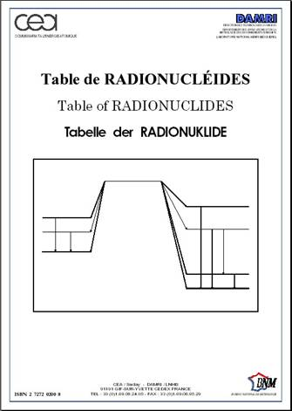
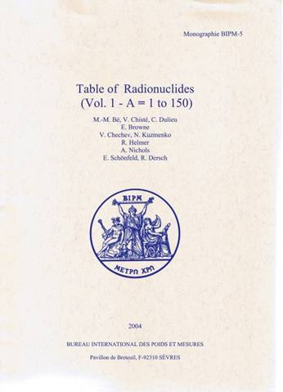
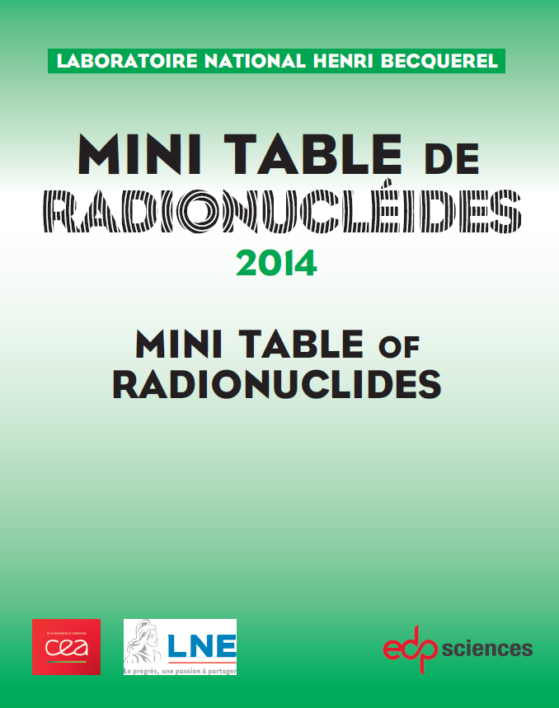
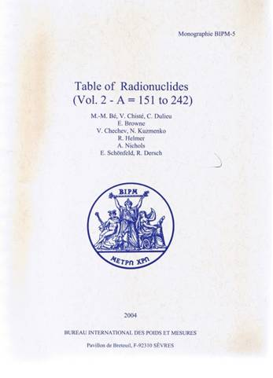
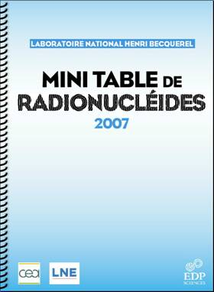
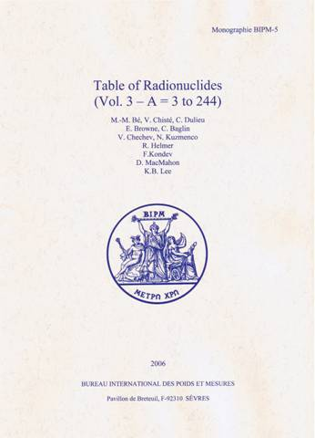
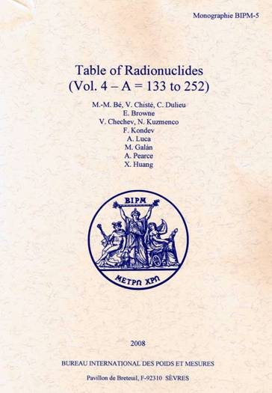
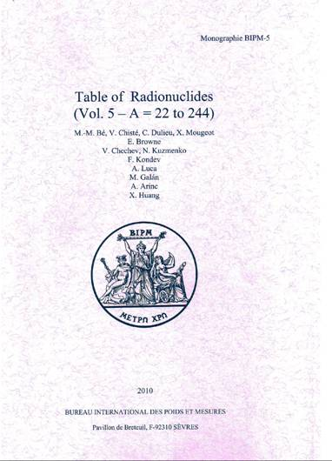
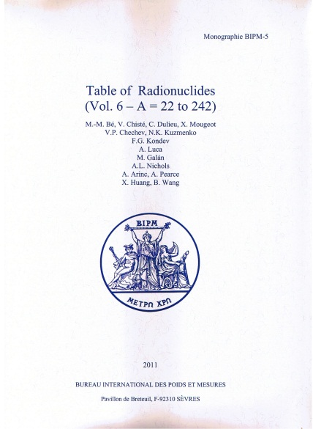
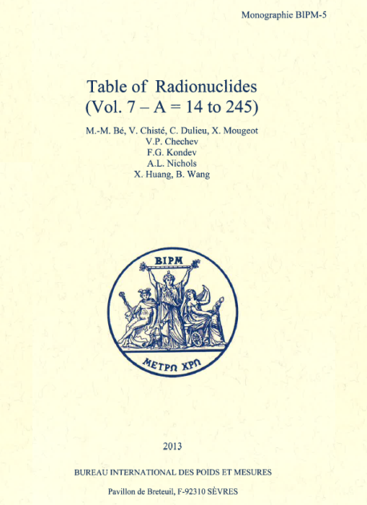
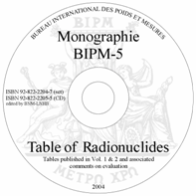
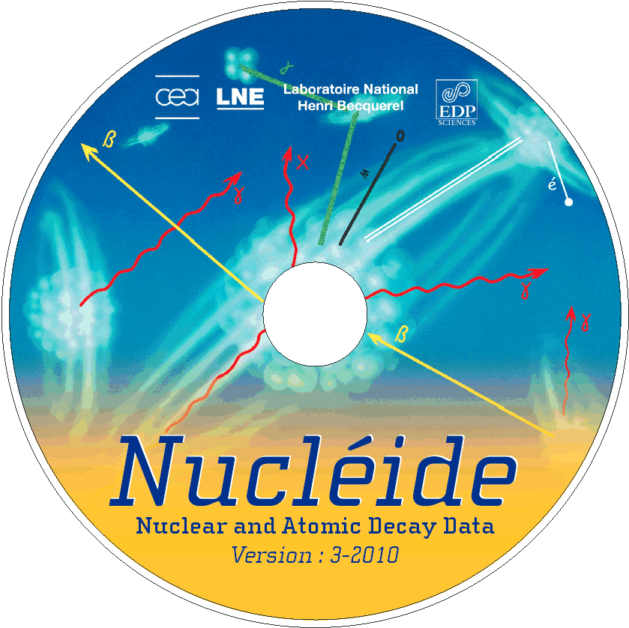


LNHB Publications of decay scheme data
EDP Sciences
Volume 8 to be published by mid-2015
http://www.bipm.org/fr/publications/monographie-ri-5.html

Slide 7
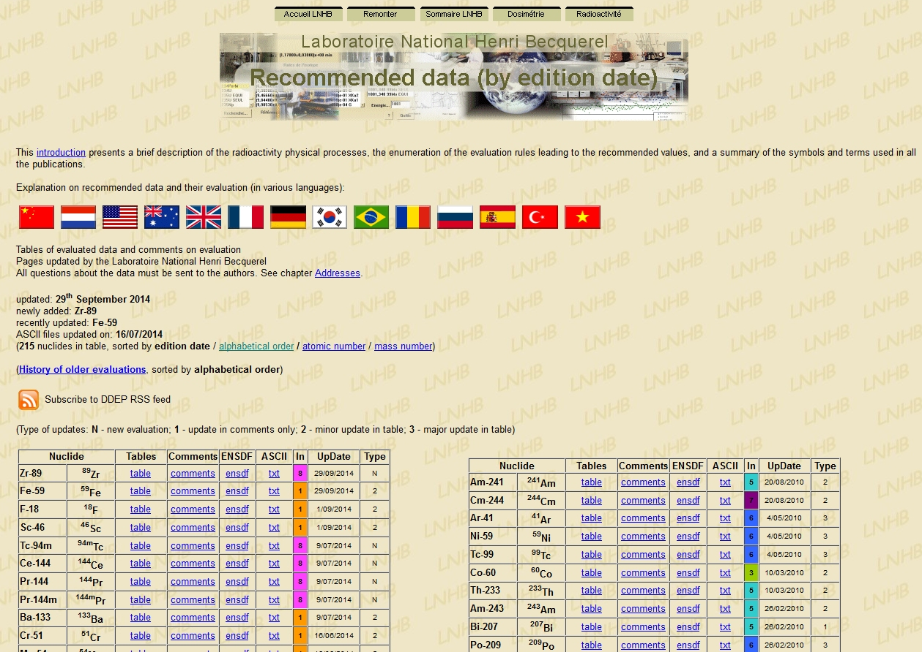
LNHB Online access to decay scheme data (1)
www.nucleide.org
www.nucleide.org

Slide 8
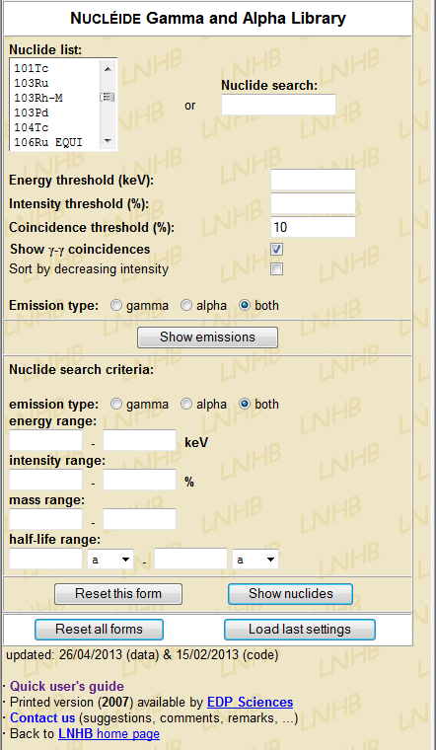
LNHB Online access to decay scheme data (2)
Practical Tool for Alpha and Gamma spectrometry
http://laraweb.free.fr/
List of 400 nuclei:
Nucléide database +
Nuclear Data Sheets (ENSDF)
Simple query – information for a given nuclide
Energy and/or intensity thresholds
Information about coincidence
More advanced query – for multiple nuclei

Slide 9
LNHB Beta spectra calculations and measurements
Development of a Code (BetaShape) to Calculate All Beta Transitions
Required for:
Metrology (e.g. LSC detector efficiencies)
Decay heat in nuclear reactors
Dose calculations
Fundamental research (e.g. neutrino spectra)
Validated against Measurement
PhD thesis just finished in which a detector system was developed to accurately measure beta spectra

Slide 10
Mark A. KELLETT
Email: mark.kellett@cea.fr
Thank you for your attention
Commissariat à l’énergie atomique et aux énergies alternatives
CEA/LIST/DRT/DM2I/LNHB/CDF
Centre de Saclay | 91191 Gif-sur-Yvette Cedex
T. +33 (0)1 69 08 27 76 | F. +33 (0)1 69 08 26 19
  Etablissement public à caractère industriel et commercial | RCS Paris B 775 685 019

