Slide 1
Nuclear Data for Charged-particle Monitor Reactions and Medical Isotope Production
Alan Nichols
Department of Physics
University of Surrey
Guildford, UK
&
Manipal University
Karnataka, India

Slide 2
Intermediate-term Nuclear Data Needs for Medical Applications: Cross Sections and Decay Data
Relevant recent past:
Cross sections − IAEA-NDS CRP 1995−2000: Charged Particle Cross-Section Database for Medical Radioisotope Production: Diagnostic Radioisotopes and Monitor Reactions, IAEA-TECDOC-1211, May 2001
Cross sections − IAEA-NDS CRP 2003−2010: Nuclear Data for the Production of Therapeutic Radionuclides, IAEA Technical Reports Series No. 473, IAEA, Vienna, Austria, December 2011
Immediate past and future:
Cross sections and decay data:
High-Precision Beta-intensity Measurements and Evaluations for Specific PET Radioisotopes
(see IAEA report INDC(NDS)-0535, 2008)
Improvements in Charged-particle Monitor Reactions and Nuclear Data for Medical Isotope Production (see IAEA report INDC(NDS)-0591, 2011)
First Coordinated Research Meeting on Nuclear Data for Charged-particle Monitor Reactions and Medical Isotope Production (see IAEA report INDC(NDS)-0630, 2013)
Intermediate-term Nuclear Data Needs for Medical Applications: Cross Sections and Decay Data (see IAEA report INDC(NDS)-0596, 2011)

Slide 3
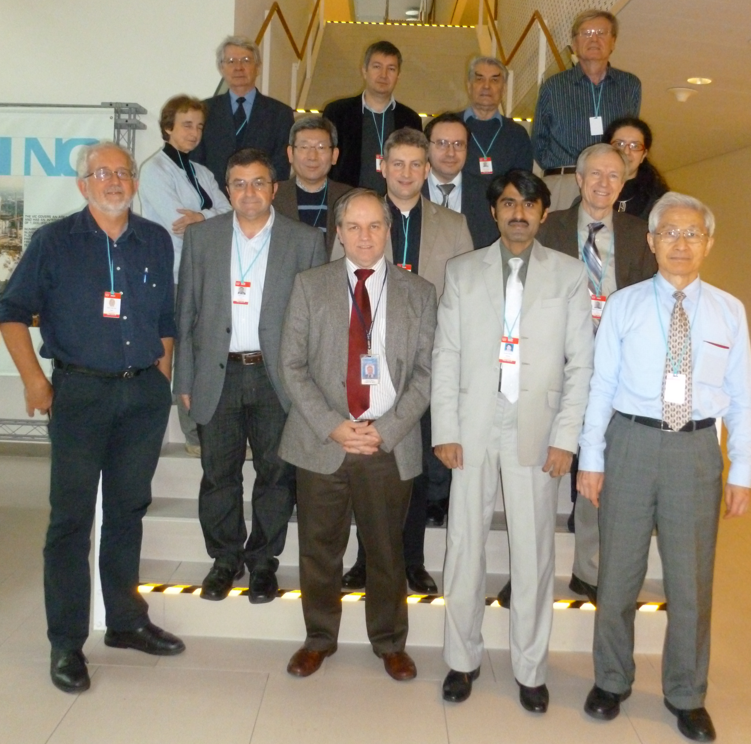
NUCLEAR DATA FOR CHARGED-PARTICLE MONITOR REACTIONS
AND MEDICAL ISOTOPE PRODUCTION
First Research Coordination Meeting, 3-7 December 2012
IAEA report INDC(NDS)-0630
Marie-Martine Bé Laboratoire National Henri Becquerel, CEA Saclay, France
Brett Carlson Instituto Tecnologico de Aeronautica, Brazil
Mazhar Hussain Government College University, Lahore, Pakistan
Anatoly Ignatyuk Institute for Physics and Power Engineering, Obninsk, Russia
Guinyun Kim Kyungpook National University, Republic of Korea
Filip Kondev Argonne National Laboratory, USA
Ondrej Lebeda Nuclear Physics Institiute, Academy of Sciences, Rez, Czech Republic
Aurelian Luca National Institute of Physics and Nuclear Engineering, Romania
Yasuki Nagai Osaka University, Japan
Haladhara Naik Bhabha Atomic Research Centre, India
Alan Nichols University of Surrey, UK [Co-Chairman and Rapporteur]
Meiring Nortier Los Alamos National Laboratory, USA
Ingo Spahn Forschungszentrum Jülich, Germany
Ferenc Tarkányi Hungarian Academy of Sciences, Hungary [Co-Chairman]
Roberto Capote IAEA Nuclear Data Section [Scientific Secretary]

Slide 4
NUCLEAR DATA FOR CHARGED-PARTICLE MONITOR REACTIONS
AND MEDICAL ISOTOPE PRODUCTION
Alan Nichols
DECAY DATA EVALUATIONS:
ACTIONS AND ACTIVITIES
as agreed and defined in IAEA report INDC(NDS)-0630
January 2013 to December 2014,
and plans for 2015

Slide 5
Nuclear Data for Charged-particle Monitor Reactions and Medical Isotope Production
work undertaken in 2013/14, and planned for 2015
Cross sections | Decay data | Commitments
monitor reactions |  | Completed nuclear decay data evaluation, 2013:
^{nat}Cu(p,x)^{62,63,65}Zn | ⁶³Zn | Evaluation of ⁶³Zn decay scheme
β⁺ emitters |  | Completed nuclear decay data evaluations, 2014:
⁷⁵As(p,3n)⁷³Se ⁷²Ge(α,3n)⁷³Se | ⁷³Se | (Positron intensities: measurements and) evaluation of ⁷³Se decay scheme
⁸⁹Y(p,n)⁸⁹Zr ⁸⁹Y(d,2n)⁸⁹Zr ^{nat}Y(α,x)⁸⁹Zr | ⁸⁹Zr | Evaluation of ⁸⁹Zr decay scheme
⁹⁴Mo(p,n)⁹⁴Tc^{m} ⁹²Mo(α,x)⁹⁴Tc^{m} | ⁹⁴Tc^{m} | Evaluation of ⁹⁴Tc^{m} decay scheme
β⁺ emitters – 2015 |  | Planned nuclear decay data evaluations, 2015:
⁷⁶Se(p,n)⁷⁶Br ⁷⁷Se(p,2n)⁷⁶Br ⁷⁵As(α,3n)⁷⁶Br | ⁷⁶Br | (Positron intensities: measurements and) evaluation of ⁷⁶Br decay scheme
¹²⁰Te(p,n)¹²⁰I ¹²²Te(p,3n)¹²⁰I | ¹²⁰I | Evaluation of ¹²⁰I decay scheme

Slide 6
Nuclear Data for Charged-particle Monitor Reactions and Medical Isotope Production
work undertaken in 2013/14
Auger-electron emitters | Commitments‡
 | On-going, December 2014:
⁹⁹Tc^{m} | Evaluation of ⁹⁹Mo/⁹⁹Tc^{m} nuclear decay data, followed by focus on Auger electrons (ANU/ANL)
 | Completed nuclear decay data evaluations, 2013:
¹⁰³Pd | Evaluation of ¹⁰³Pd/¹⁰³Rh^{m} nuclear decay data, followed by focus on Auger electrons (ANU/ANL)
¹¹¹In | Re-evaluation of ¹¹¹In/¹¹¹Cd^{m} nuclear decay data, followed by focus on Auger electrons (ANU/ANL)
‡Tibor Kibedi (ANU), Filip Kondev (ANL), Alan Nichols (University of Surrey), agreed at discussions on 31 January 2013, ancillary to IAEA meeting of the International Network of Nuclear Structure and Decay Data Evaluators, Kuwait.

Slide 7
Nuclear Data for Charged-particle Monitor Reactions and Medical Isotope Production
Summary
Radionuclide | Decay Scheme: Comments
⁶³Zn | 20EC/8β⁺, 64γ(+2 unplaced)
⁷³Se | 16EC/6β⁺, 53γ(+11 unplaced)
⁷⁶Br | [28EC/19β⁺, 124γ(+38 unplaced) → evaluation planned for 2015]
⁸⁹Zr | 5EC/β⁺, 5γ
⁹⁴Tc^{m} | 16EC/7β⁺, 52γ(+6 unplaced)
⁹⁹Mo/⁹⁹Tc^{m} | content to be defined on completion of evaluation → early 2015
¹⁰³Pd/¹⁰³Rh^{m} | 4EC, 9γ
¹¹¹In/¹¹¹Cd^{m} | 2EC, 3γ
¹²⁰I | [40EC/40β⁺, 82γ(+72 unplaced) → evaluation planned for 2015]

Slide 8
NUCLEAR DATA FOR CHARGED-PARTICLE MONITOR REACTIONS
AND MEDICAL ISOTOPE PRODUCTION
ND2013 – International Conference on Nuclear Data for Science and Technology,
4-8 March 2013 , Sheraton New York Hotel & Towers, New York, USA
Nuclear Data for Medical Applications – Recent Developments and Future Requirements, A.L. Nichols and R. Capote*
verbal presentation
*corresponding author: R.CapoteNoy@iaea.org
also published in Proc. Int. Conf. on Nuclear Data for Science and Technology, Editors: M. Herman, S.D. Hoblit, T.D. Johnson, E.A. McCutchan, A.A. Sonzogni, Nuclear Data Sheets, 120 (2014) 239-241

Slide 9
NUCLEAR DATA FOR CHARGED-PARTICLE MONITOR REACTIONS
AND MEDICAL ISOTOPE PRODUCTION
Alan Nichols
DECAY DATA EVALUATIONS:
ACTIONS AND ACTIVITIES
IAEA contractual service agreements
first - 15 December 2012 to 14 December 2013
second - 20 December 2013 to 19 August 2014
third - CRP activities of retiree (ALN), 2015
decay-data evaluations for ⁷⁶Br and ¹²⁰I

