Slide 1
Nuclear Data for Charged-particle Monitor Reactions and Medical Isotope Production
2nd Research Coordination Meeting
09. December 2014 | Ingo Spahn

Slide 2
Projects resulting from 1st Meeting
⁶¹Ni(p,n)⁶¹Cu ⁶⁸Zn(p,n)⁶⁸Ga ⁶⁵Cu(α,n)⁶⁸Ga
^{nat}Ge(p,xn)⁷²As ⁷⁶Se(p,n)⁷⁶Br ⁷⁷Se(p,2n)⁷⁶Br
⁴⁴Ti/^{44m+g}Sc
Results nobody asked for:
^{nat}Ti(d,x)⁴⁸V and ^{nat}Ti(d,x)⁴⁶Sc;
⁶⁵Cu(α,n)^{66,67}Ga
Results nobody is interested in (?): ⁶³Cu(p,x)⁶¹Cu; ^{nat}Se(d,xn)^{75,76,77,82}Br

Slide 3
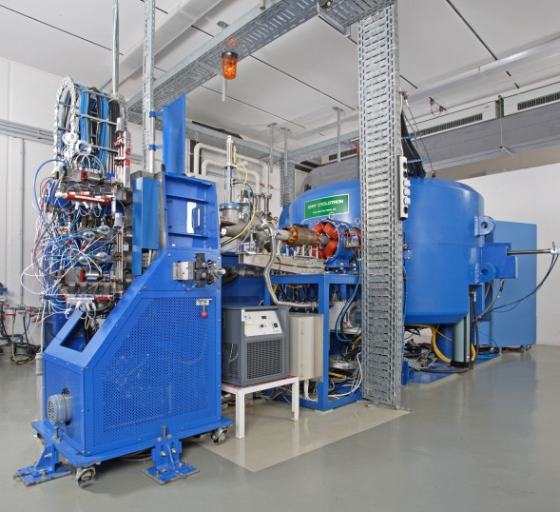
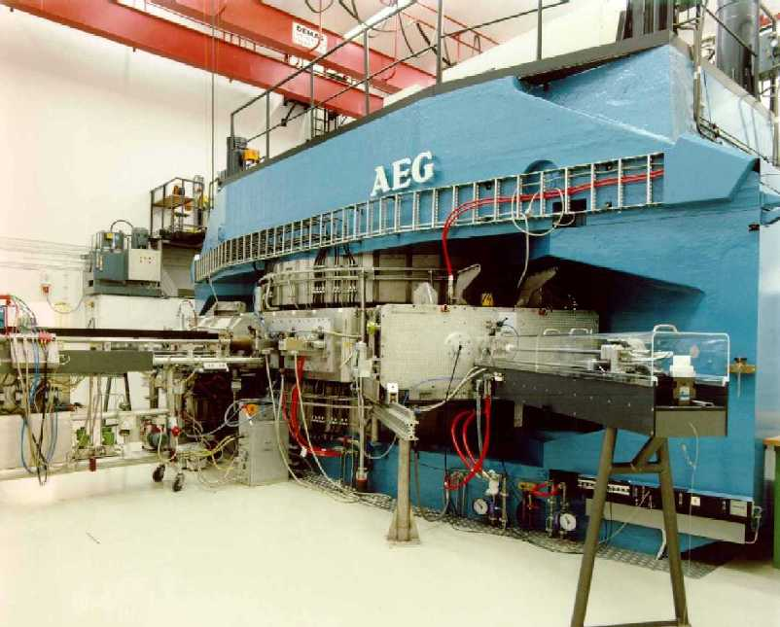
Accelerators for Radionuclide Development
Baby Cyclotron
BC 1710
17 MeV H⁺
(8 – 10 MeV ²H⁺)
JULIC
Injector for COSY
45 MeV ¹H⁻
76 MeV ²H⁻

Slide 4
The new IBA Cyclone 30XP
Beam current up to 350 μA (50 μA for α-beam)
Protons: 15 – 30 MeV
Deuterons: 7 – 15 MeV
α-particles: 30 MeV
Always in motion is the future …
 Replacement of the old BC 1710
 Improvement of existing irradiation capacities

Slide 5
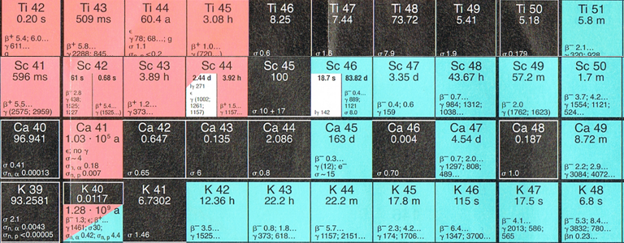
⁴⁴Ti/^{44g}Sc – Assessment of Cross Sections

Slide 6
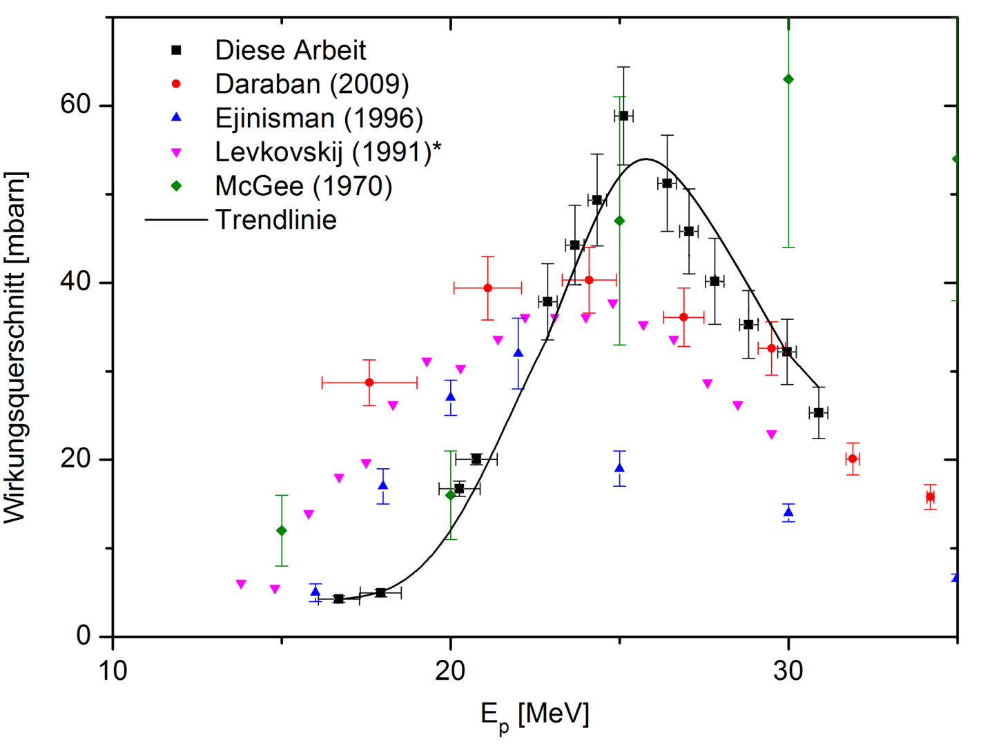
⁴⁴Ti/^{44g}Sc – Generator
Alternative production route of ^{44g}Sc.
+ Availability of ^{44g}Sc outside cyclotron centres
+ No contaminations (no ^{44m}Sc).
Long half-live of ⁴⁴Ti and low cross section
Cross section [mbarn]
Additional cross section measurements are needed for thorough assesment

Slide 7
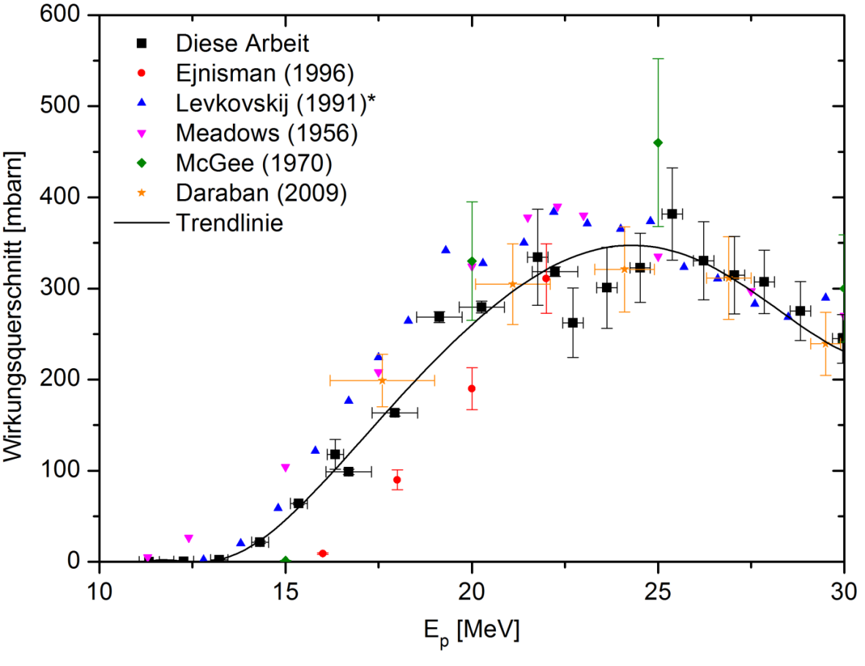
Cross Section Measurements on the ^{nat}Sc(p,pn)^{44g}Sc Reaction
Cross section [mbarn]

Slide 8
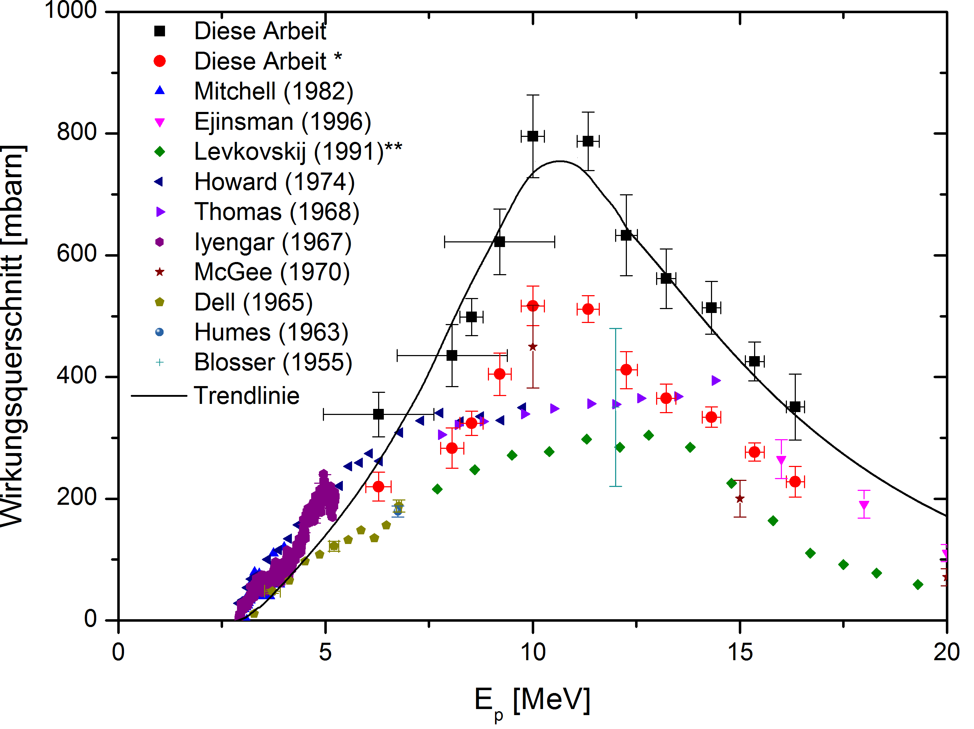
Co-production of ⁴⁵Ti via ⁴⁵Sc(p,n)-reaction
Cross section [mbarn]

Slide 9
Co-production of ⁴³Sc via ⁴⁵Sc(p,p2n)-reaction
Cross section [mbarn]

Slide 10
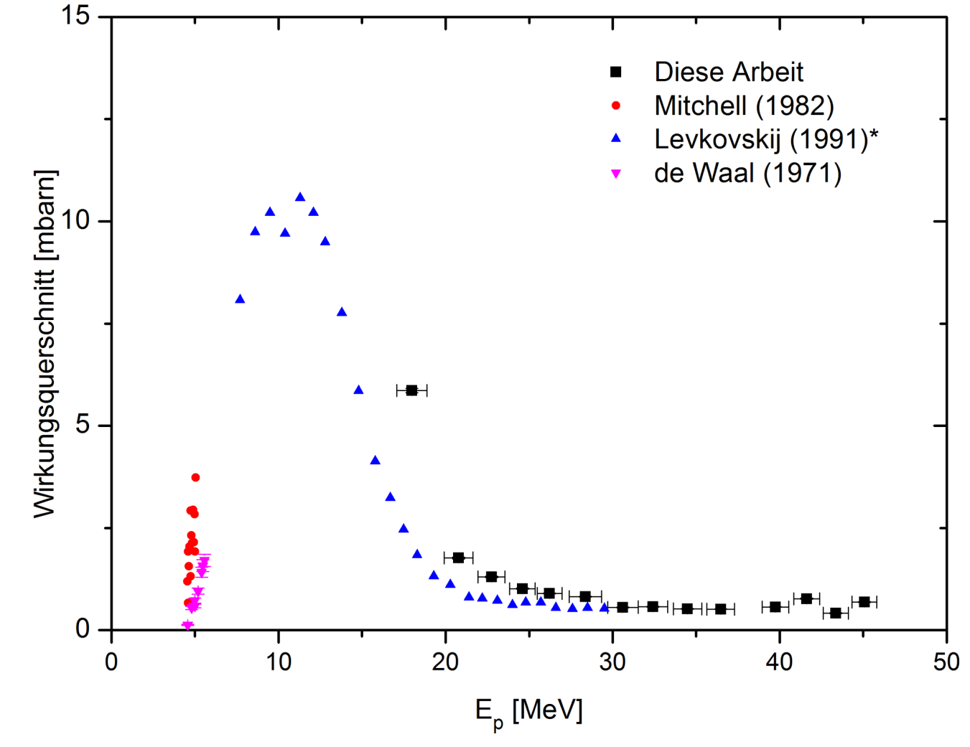
^{nat}Ca(p,x)^{44g}Sc
Cross section [mbarn]

Slide 11
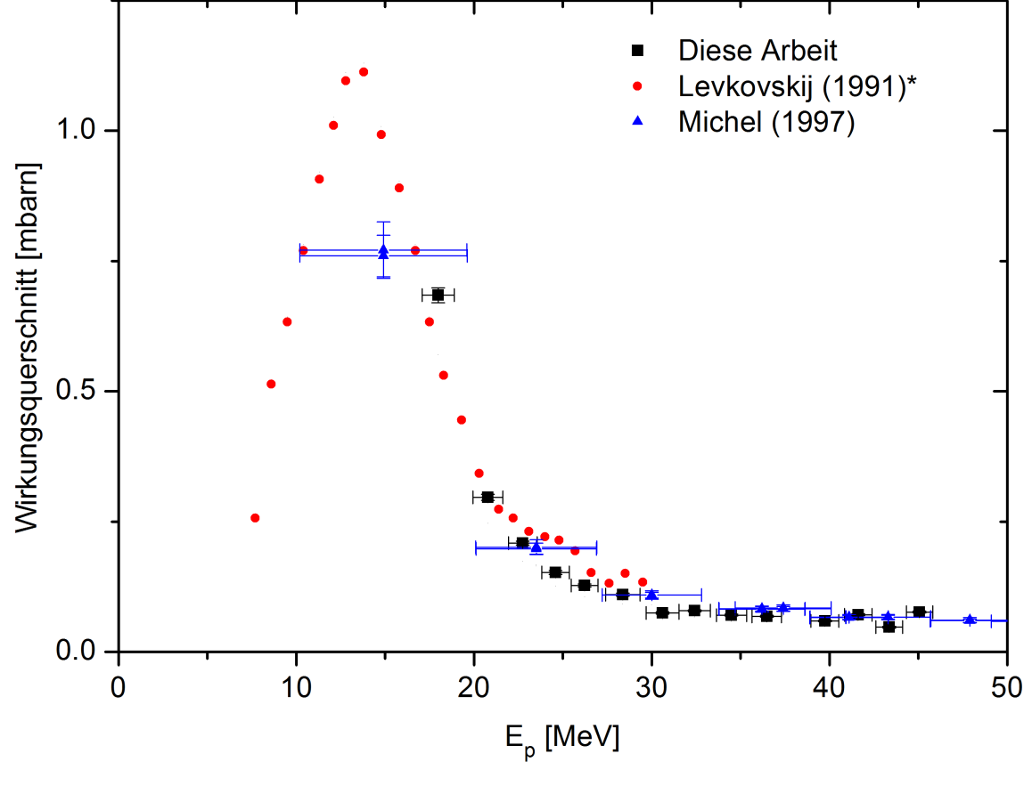
^{nat}Ca(p,x)^{44m}Sc
Cross section [mbarn]

Slide 12
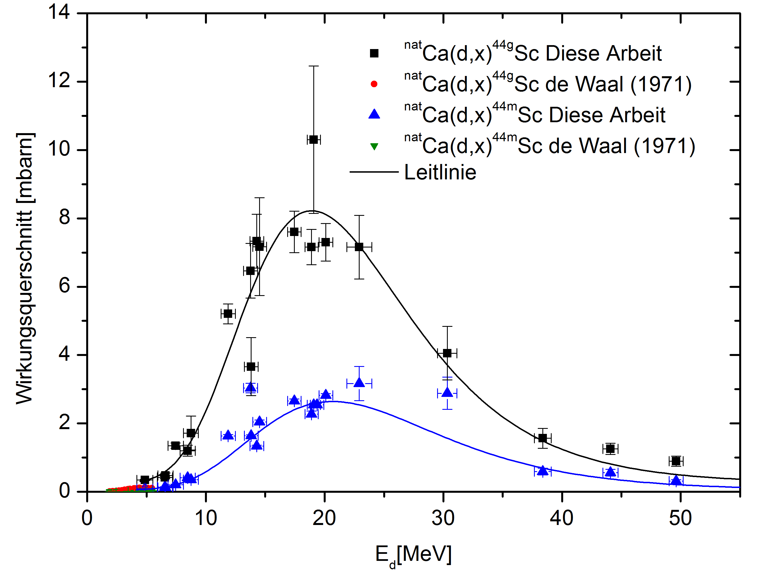
^{nat}Ca(d,x)^{44m+g}Sc
Cross section [mbarn]

Slide 13
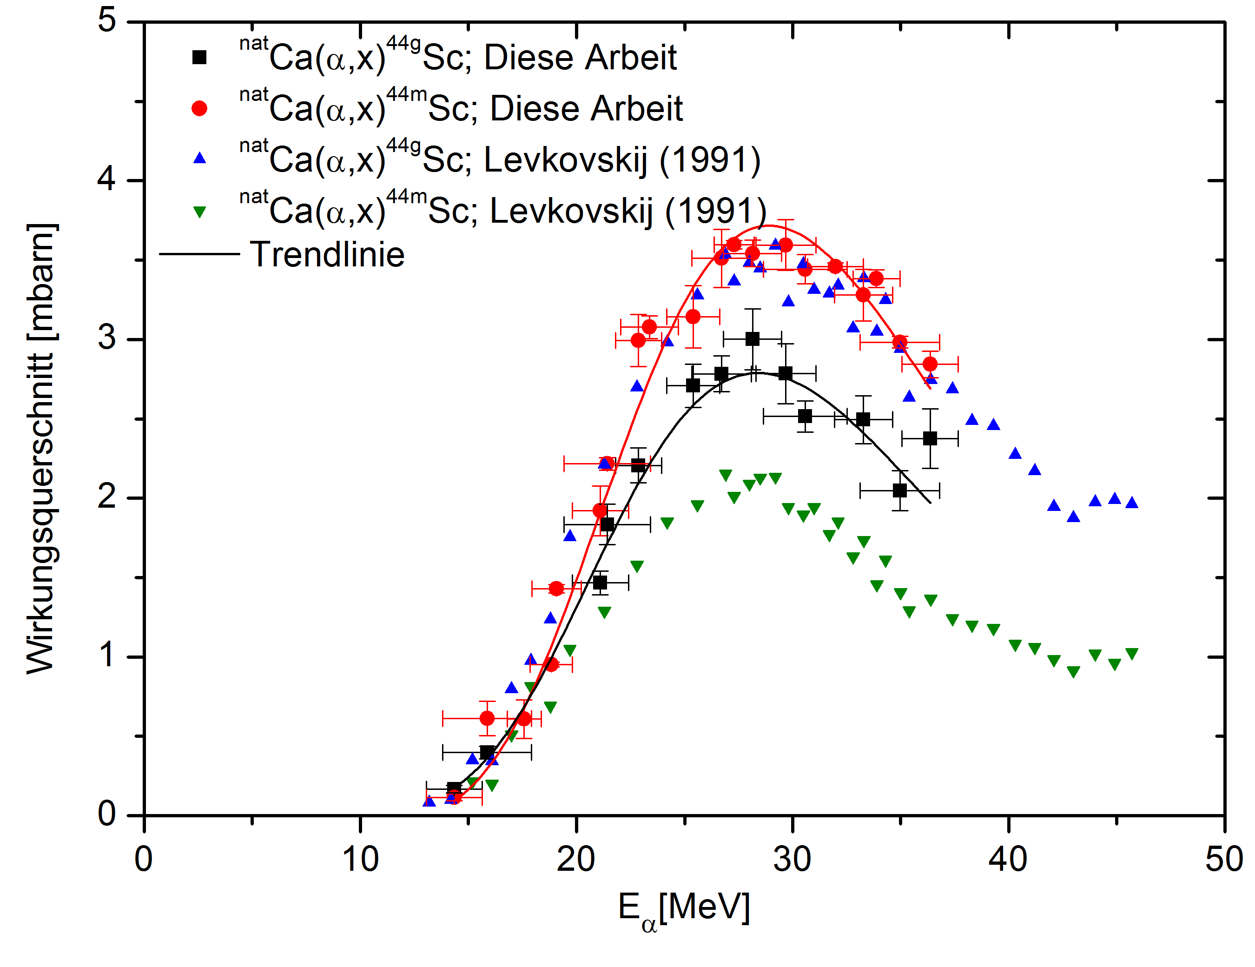
^{nat}Ca(α,x)^{44m+g}Sc
Cross section [mbarn]
Production using natural target material: minimal Yield
Co-production of ^{44m}Sc.
Co-produced longer-lived contaminants (^{46,47,48}Sc).
13

Slide 14
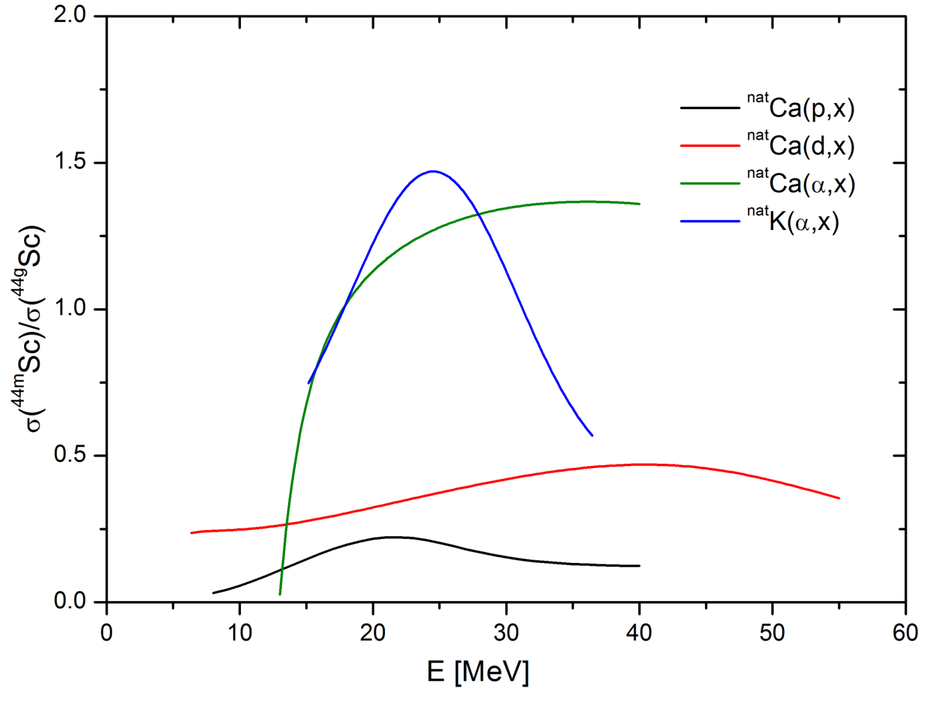
Comparison of ^{44m}Sc/^{44g}Sc-ration depending on production route

Slide 15
⁶⁸Zn(p,n)⁶⁸Ga
Comparative study on the production of ⁶⁸Ga from proton induced reactions on different targets: Evaluation of experimental data and model calculations
A. Azzam / M. Al-abyad / A. H. M. Solieman
Physics Department, Nuclear Research Centre, Atomic Energy Authority, Cairo, Postal Code 13759, Egypt
Radiochimica Acta. ISSN (Online) 2193-3405, ISSN (Print) 0033-8230, DOI: 10.1515/ract-2013-2220, November 2014
Published Online:
2014-11-12

Slide 16
Radioisotopes for medical applications
⁷⁵Br
1.5 h
β⁺ 76%
β_{max} 1.7 MeV
⁷⁶Br
16 h
β⁺ 57%
β_{max} 3.4 MeV
⁷⁷Br
57 h
EC > 99%
^{80m}Br
4.42 h
IT 100%
molecular imaging
(PET)
Auger therapy / ⁷⁷Br for SPECT
Notes:
80m: which decays via Isomeric Transition to ist groundstate 77Br SPECT

Slide 17
Results supposed to be available:
⁷⁶Se(p,n)⁷⁶Br and ⁷⁷Se(p,2n)⁷⁶Br
Enriched material is available but is misused for production purposes (aiming for fame and prosperity, etc.)
Results which are available:
^{nat}Se(d,xn)^{75,76,77,82}Br

Slide 18
Cross sections for ^{nat}Se(d,xn)^{75,76,77,82}Br
Notes:
Bei 82Br nicht vergessen zu erwähnen excluding (d,Gamma)reactions!!

Slide 19
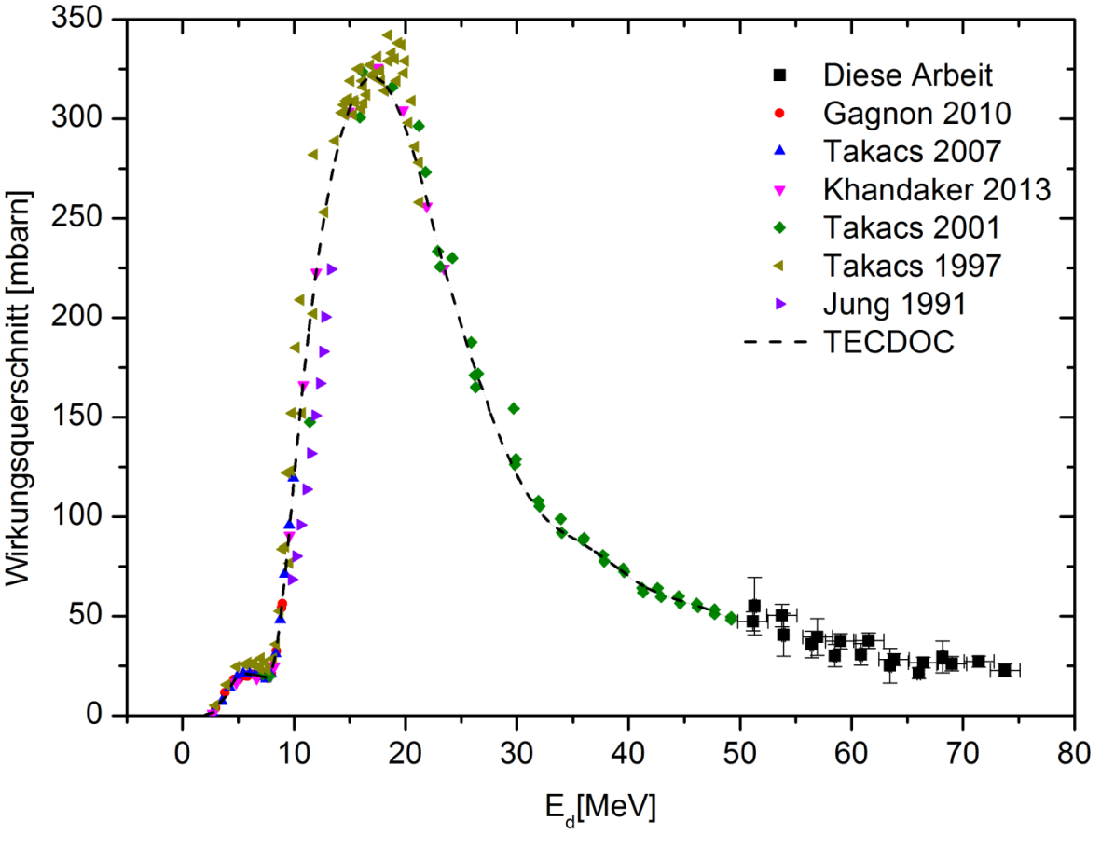
Results nobody asked for:
^{nat}Ti(d,x)⁴⁸V
Cross section [mbarn]

Slide 20
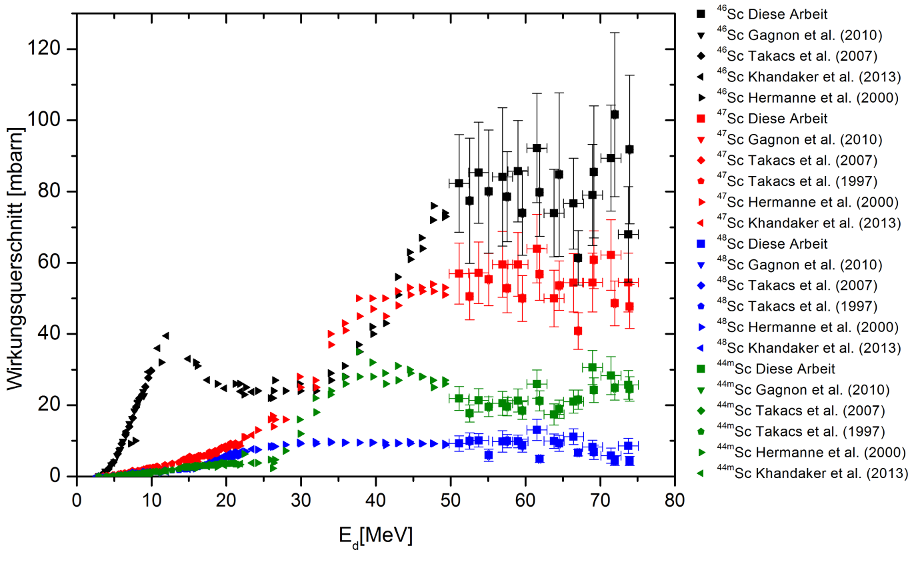
Results nobody asked for: ^{nat}Ti(d,x)
Cross section [mbarn]

Slide 21
Ongoing work
⁶⁵Cu(α,n)⁶⁸Ga
Irradiation experiments have been done at VUB
E_{α}: 20 → 40 MeV
Spectra have been recorded and evaluation has been started

Slide 22
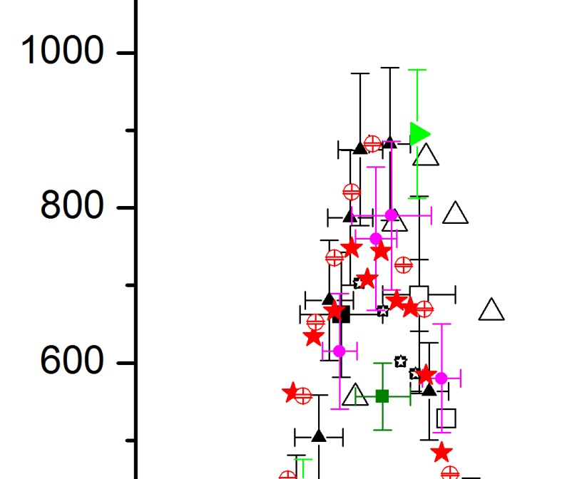
⁶⁵Cu(α,n)⁶⁸Ga

Slide 23
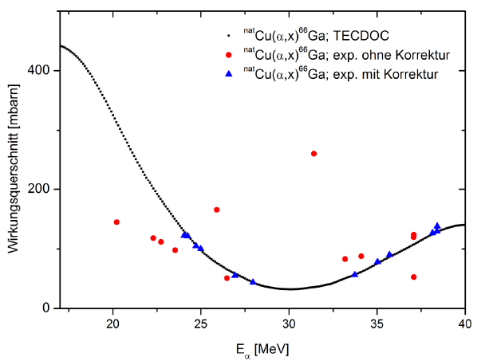
Cross section [mbarn]
Reaction cross section as function of alpha-particle energy.
Red: Data resulting from Faraday-cup measurement of particle flux.
Blue: Results obtained using monitor foils and monitor radionuclide ratios.

Slide 24
Results nobody is interested in (?): ^{nat}Cu(p,x)⁶¹Cu
Cross section [mbarn]

Slide 25
New Year’s Pledges for 2015
⁶¹Ni(p,n)⁶¹Cu : measurement & assessment
Funds have been acknowledged (verbally)
⁷⁶Se(p,n)⁷⁶Br and ⁷⁷Se(p,2n)⁷⁶Br:
Material available. Focus and manpower have to be shifted.
^{nat}Ge(p,xn)⁷²As:
Beamtime at external cyclotron needed.
General: Work harder! (or get more students)

