Slide 1
Need for accurate
Zirconium inelastic xs
for LWR applications
+ 1 question ☺
IAEA/INDEN, december 14th, 2021
D. Bernard

Slide 2
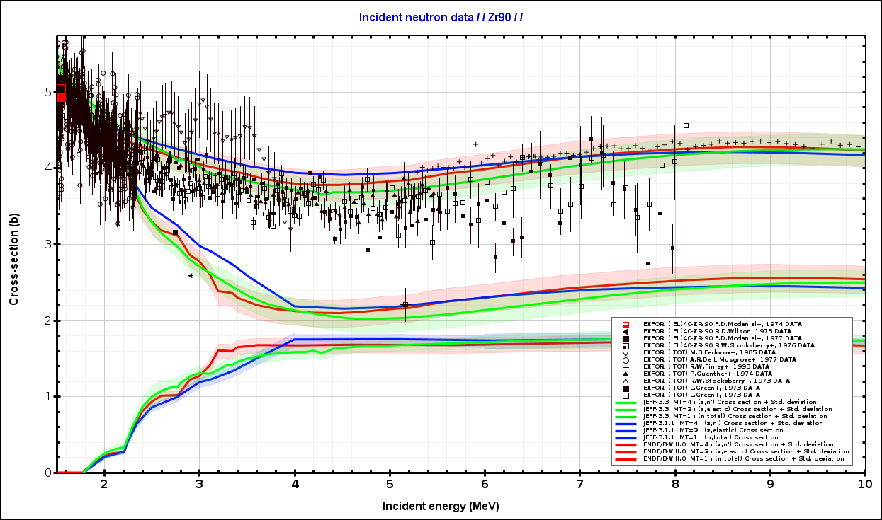
No fluctuations → effective decrease of inelastic xs.

Slide 3
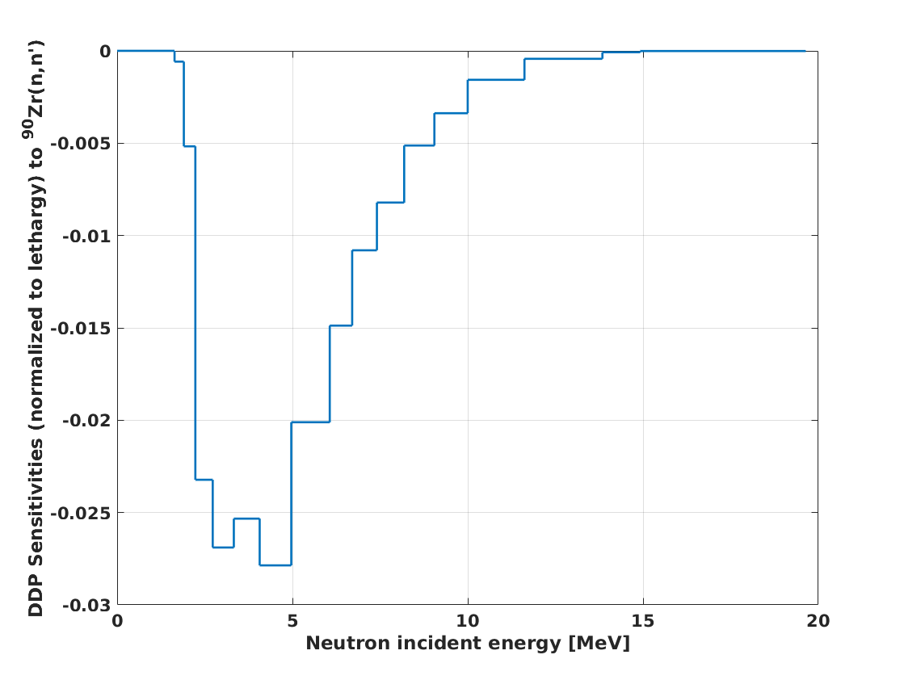
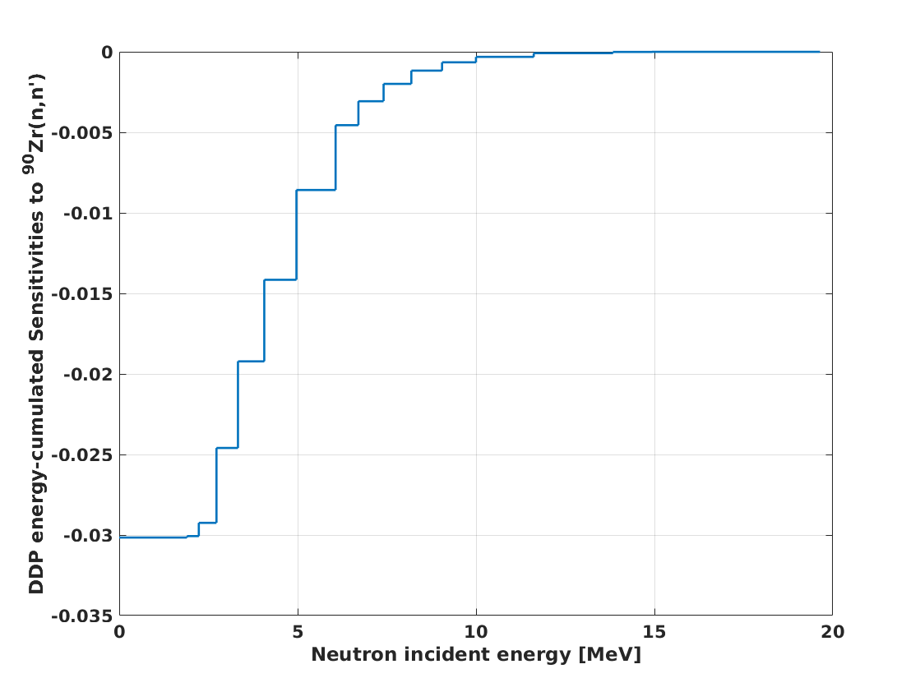
Generalized Theory of Pertubations (using J311) of radial power maps (DDP) for ⁹⁰Zr inelastic in LWR (full core calculations)
Sensitivity profiles
btw 2.2 and 6.1 MeV
80% of the sensitivity
btw 2.2 MeV and 6.1 MeV
with JEFF-3.1.1 !!!
Direct TRIPOLI-4® Monte Carlo calculations give the same sensitivity values for discrete inelastic and for the continuum inelastic xs (for JEFF-3.1.1 !)
S(Radial –Center to Periph- Power Maps / nn’_{i & c}) = +1.2(0.2)% / -50% = -0.024(0.004)%/%
After ²³⁸U, ⁹⁰Zr is the second sensitive nucleus to DDP calculations (inelastic process) at these incident nrjs !

Slide 4
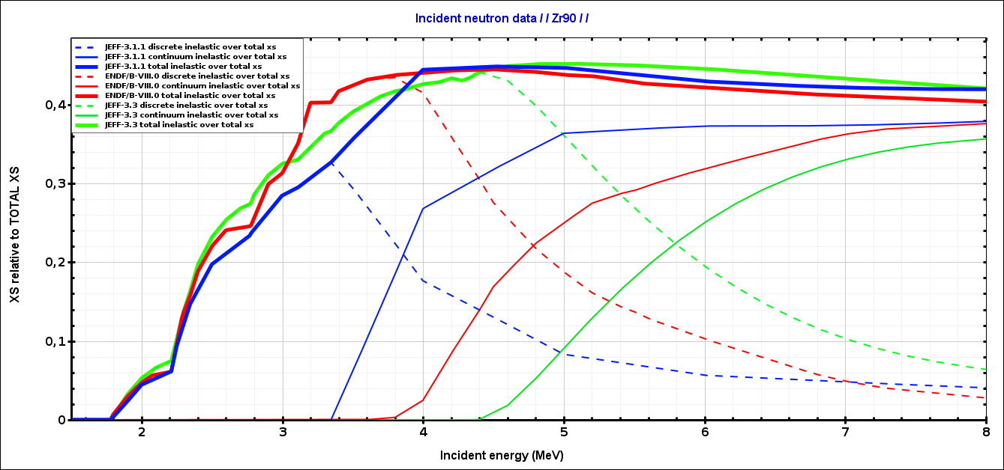
(n,n’) divided by (n,tot) : $P≈\frac{1}{1+\frac{σ_{nn}}{σ_{nn′}}}$
JEFF-3.1.1: 7 discrete levels
ENDF/B-VIII.0: 9 discrete levels
JEFF-3.3: 20 discrete levels
« inelastic Pandemonium »
The continuum thresholds are differents, then, sensitivities of radial power maps are differents for JEFF-3.3, B8…

Slide 5
Open question:
As far as I know (I maybe wrong), in nuclear physic codes (EMPIRE, TALYS…):
there is an imposed boundary condition for nrj-integrated xs as a function of incident energy (flux of discrete and continuum channels), through total xs conservation for instance.
but there is no similar boundary conditions for differential xs for discrete and continuum inelastic regimes.
That is to say: from discrete (MF4) to continuum (MF6), does secondary energy neutron distributions continous/linked/bound ?
Application to ²³⁸U:
Does level density increase that much ? (Avoiding the opening of pre-equilibrium/RPA reactions)

