Slide 1






























Comments on Fe fast region evaluations
R. Capote (IAEA) and Andrej Trkov (JSI)
https://www-nds.iaea.org/INDEN

Slide 2
Fe evaluations – Status
New information from integral testing since CIELO (ENDF/B-VIII.0) release & publications
Neutron transmission: any new/unexpected findings? Yes, 30% leakage underest. 1-7 MeV
Known deficiencies/gaps:
Fe-56: . Elastic too low (vs Geel data), (n,inl) too high from 2-8 MeV,
. New experiments at Gelina, nELBE (tot, elast,transm, inel)
. (n,tot) minima poorly described (27 keV,~300keV, ...). Update of the ORNL ⁵⁶Fe planned
. (n_{th},γ) fixed to JEFF-3.2 value
. (n,nonel) reduced above 40 MeV (TIARA)
Fe-54
. ORNL updated evaluation
(false resonances) & trials
Fe-57
. RRR: inelastic, too low on
average vs Negret (PRC 2017)
. New trial evaluation ^{56,57}Fe (IAEA INDEN);
. Updated evaluations planned by
ORNL/IAEA/BNL/LANL
²⁵²Cf(sf) neutron leakage
⁵⁴Fe(n,g)
ENDF/B-VII.1
JEFF-3.3
ENDF/B-VIII.0
IAEA (new)
IPPE 60 cm sphere
²⁵²Cf(sf) spectra ~ fast reactor !

Slide 3
Fe-57

Slide 4
Optical model defects below 4 MeV
Optical models in
RIPL do not describe
neutron scattering cross
sections on iron isotopes
below 4 MeV
- Koning Delaroche (SPH)
- Soukhovitskii et al. (CC)
⁵⁷Fe(n,inl)

Slide 5
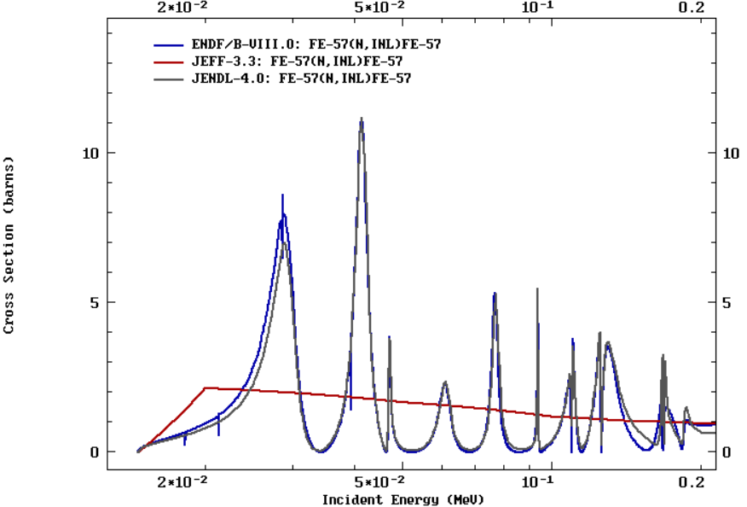
Inconsistencies between RP and average cross sections: ⁵⁷Fe(n,inl)
Sizable impact
on criticality

Slide 6
Fe-56

Slide 7
Problems with ENDF/B-VIII.0 (CIELO) ⁵⁶Fe
Up to 30% underestimation of neutron leakage for En=1-6 MeV
Fig. 32, 35, Nuclear Data Sheets,148 (2018) 214-253

Slide 8
Fe 14 MeV – problem
Independent
confirmation @ CIAE
Polyethylene (C₂H₄)_{n}
Fe
Ф13 cm×5 cm
Ф13 cm×6 cm
Fe
Ф13 cm×15 cm
Y. Ding et al, EPJ WoC 239 (2020) 18010 (ND2019)

Slide 9
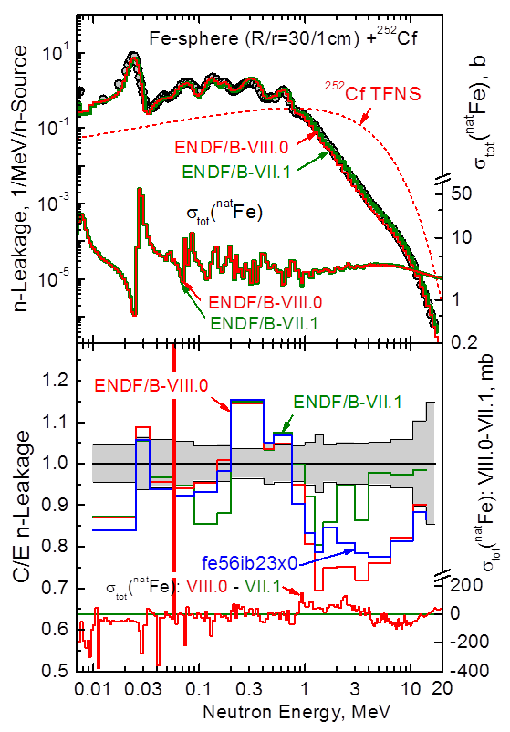
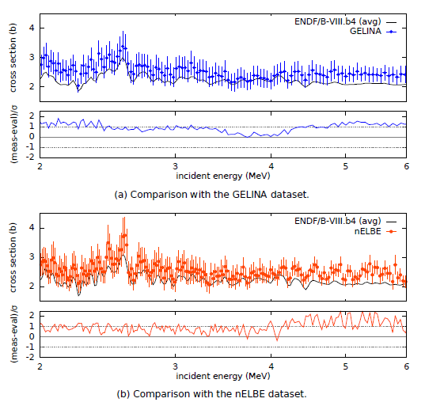
⁵⁶Fe evaluation
New measurements ⁵⁶Fe(n,el)
E. Pirovano et al,
Phys.Rev.C99 (2019) 024601

Slide 10
Elastic angular distribution good !
New measurements ⁵⁶Fe(n,el) @ nELBE & GELINA
E. Pirovano et al, Phys.Rev.C99 (2019) 024601

Slide 11
Inelastic angular distributions
New measurements ⁵⁶Fe(n,el) @ nELBE & GELINA
E. Pirovano et al, Phys.Rev.C99 (2019) 024601

Slide 12
Inelastic angular distributions
New measurements ⁵⁶Fe(n,n’1l) @ nELBE
E. Pirovano et al, Phys.Rev.C99 (2019) 024601
(n,inl) difficult to extract, need to check (n,el)+(n,inl) directly

Slide 13
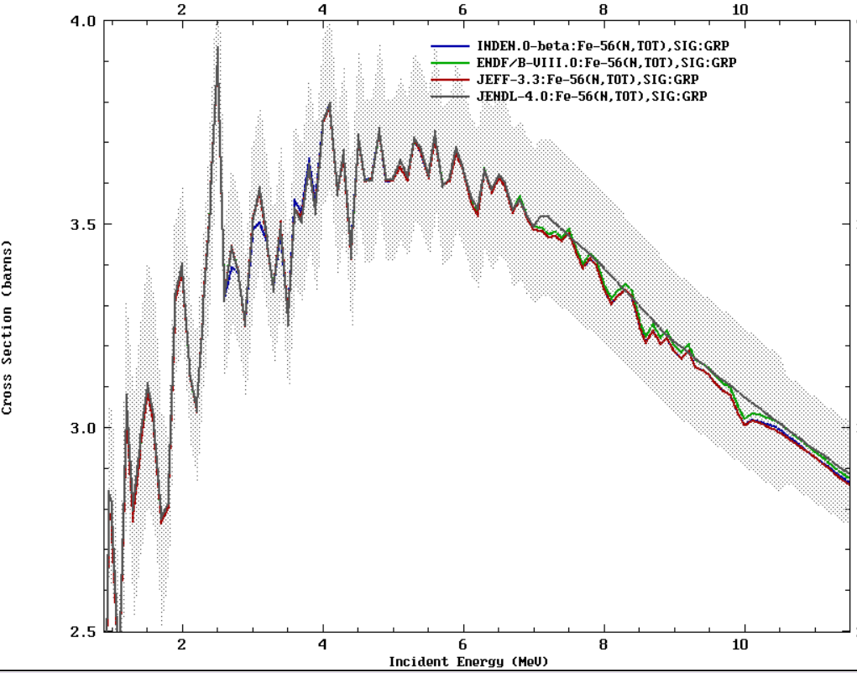
Patching the Fe-56 evaluation: TOTAL

Slide 14
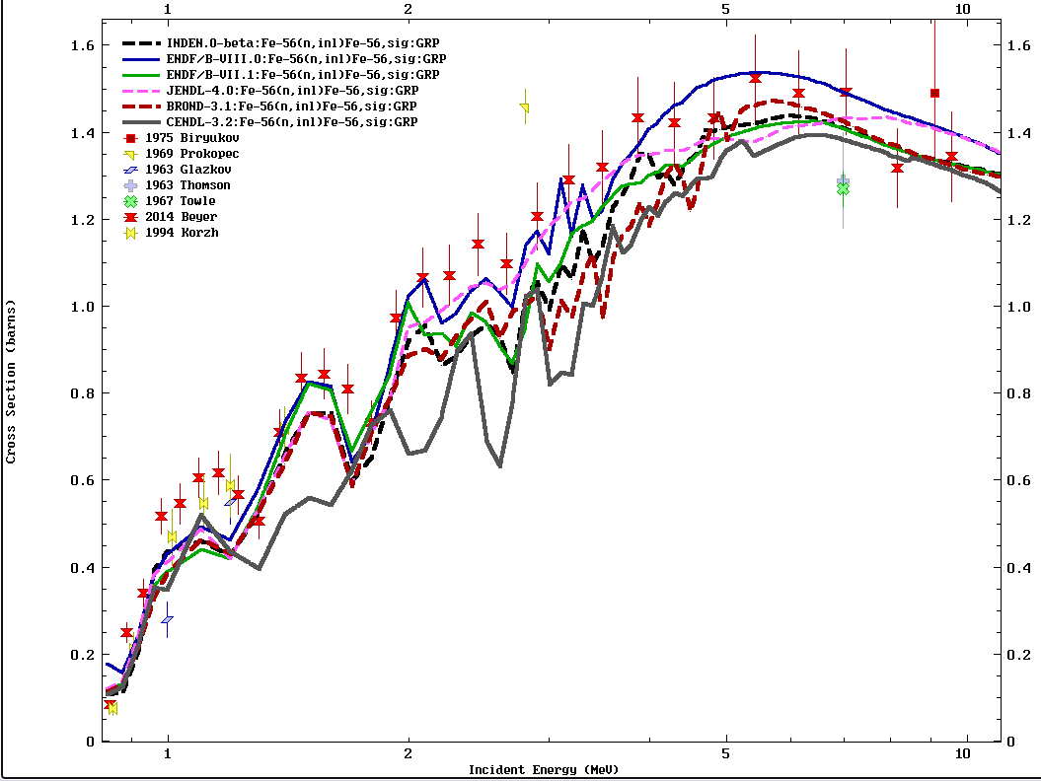
New INDEN files
Patching the ⁵⁶Fe evaluation:
(n,inl)

Slide 15
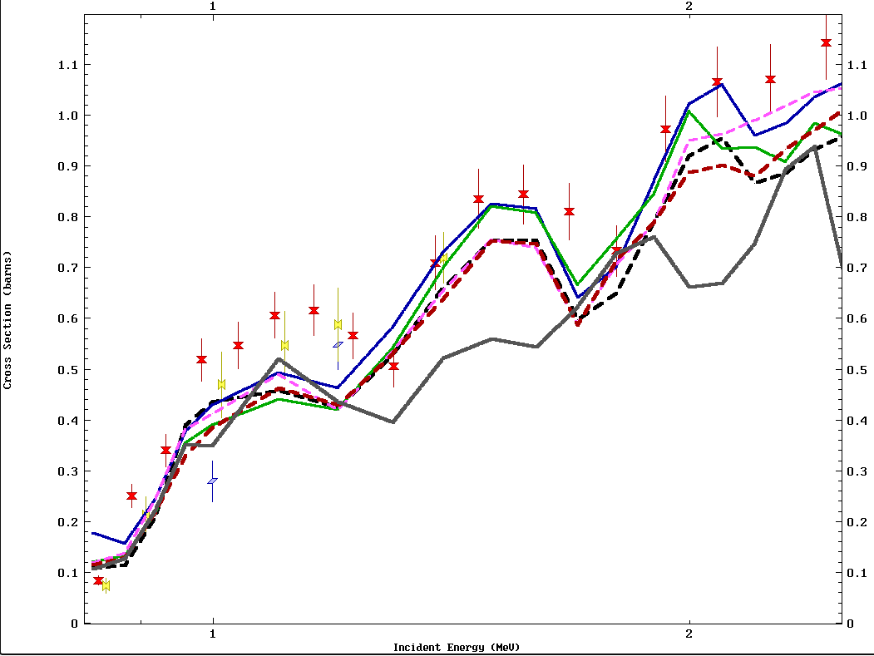
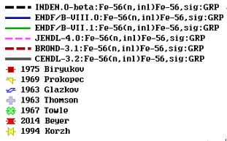
Patching the ⁵⁶Fe evaluation:
(n,inl)

Slide 16
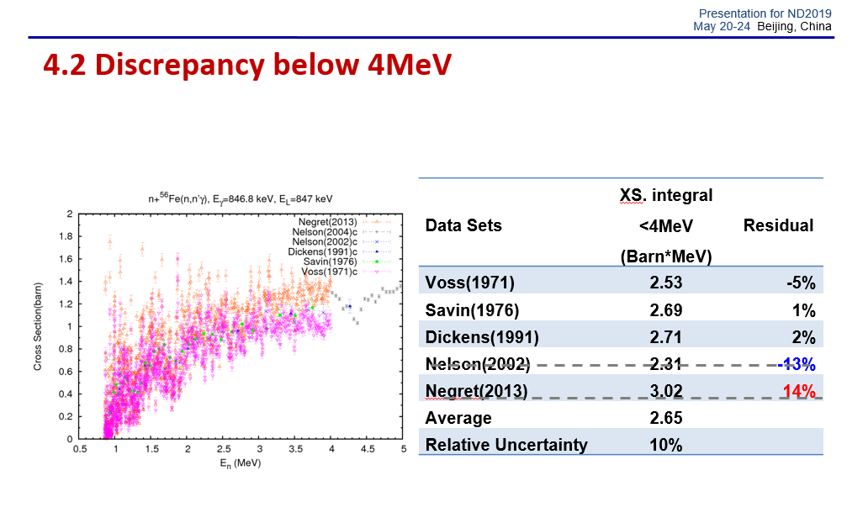
Normalization issue ? Wu H., ND2019
⁵⁶Fe(n,inl) data

Slide 17
Improvements to CIELO ⁵⁶Fe evaluation
Total cross sections are trusted
New measurements by E. Pirovano et al at IRMM/nELBE support a higher elastic cross section
Capture is too small to play a role
→Conclusion: measured inelastic likely too high
Inelastic cross section was scaled down by 10-15%, assigning the difference to elastic (exact comparison of cross sections is difficult due to strong fluctuations)
Thermal capture from JEFF adopted (2.58 b) following Firestone discussions

Slide 18
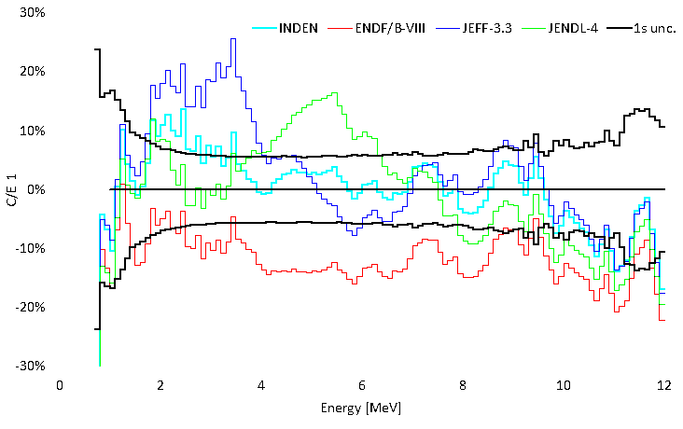
INDEN updated “structural” evaluations:
see nds.iaea.org/INDEN/ - Validation
Fe isotopes (IAEA/JSI), fe54e80o, fe56e80X29r41, fe54e80o
Cr isotopes, BNL/ORNL/IAEA/JSI/CEA, v2.3.2
Kostal et al,
priv. com.
stilbene meas.
n,γ
discr.
Stainless steel, neutron leakage (Rez, CZ, 11/2021)

Slide 19
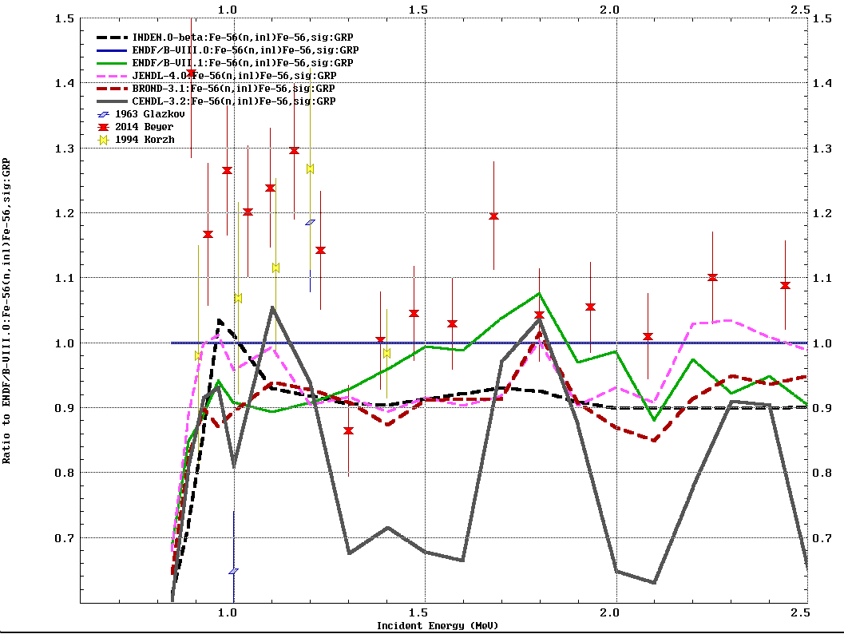
Ratio to
ENDF/B-B/VIII.0

Slide 20
INDEN updated “structural” evaluations:
see nds.iaea.org/INDEN/ - Validation
Fe isotopes (IAEA/JSI), fe54e80o, fe56e80X29r41, fe54e80o
Cr isotopes, BNL/ORNL/IAEA/JSI/CEA, v2.3.2
Kostal et al,
priv. com.
stilbene meas.
 | 58Ni(n,p SACS
Measured | 7.49E-31 | 8.3%
INDEN | 7.40E-31 | -1.2%
ENDF/B-VIII | 6.35E-31 | -15.2%
JEFF-3.3 | 7.95E-31 | 6.1%
JENDL-4 | 7.35E-31 | -1.8%
 | 115In(n,n')
Measured | 4.33E-30 | 2.7%
INDEN | 4.14E-30 | -4%
ENDF/B-VIII | 3.71E-30 | -14%
JEFF-3.3 | 4.29E-30 | -1%
JENDL-4 | 3.99E-30 | -8%
n,γ
discr.
Stainless steel, neutron leakage (Rez, CZ, 11/2021)

Slide 21
Conclusions
Reduced inelastic in Fe-56 deserves further experimental and/or theoretical investigations
New R-matrix fit needed for Fe-56 with the following constraints:
New nELBE and Harvey thick-target transmission data
Total capture obtained in ENDF/B-VIII.0 (CIELO) both below 50keV and above 400 keV (direct capture ??). Background has been validated, not clear the origin
Additional experimental and evaluation work needed on elastic/inelastic below 3.5 MeV
Fix thermal capture gammas
New R-matrix fit needed for Fe-57 considering data published by Negret et al (PRC)

