Slide 1
Analysis of the Post-CIELO Fe-56 Evaluation
Andrej Trkov and Roberto Capote

Slide 2
Background
Problems were identified with the Fe-56 CIELO (=ENDF/B-VIII.0) evaluation in the resonance range:
Capture in the region below the 27 keV resonance
Elastic in the minima between the resonances, particularly near 300 keV

Slide 3
Problems with ENDF/B-VIII.0 (CIELO) ⁵⁶Fe
Underestimation of neutron leakage at 1-4 MeV, overestimation near 300 keV
Fig. 32, 35, Nuclear Data Sheets,148 (2018) 214-253

Slide 4
Capture cross section near 27 keV resonance
1/v background added ~ direct (n,γ) ?
ZPR 9/34 (hmi001) criticality reduced by ~1%

Slide 5
²⁵²Cf(sf) neutron leakage: 100 cm sphere
Up to 30% overestimation of neutron leakage for En~300 keV
(B. Jansky et al., CVR, Rez, Czechia,EPJ WoC 239 (2020) 18005, ND2019)

Slide 6
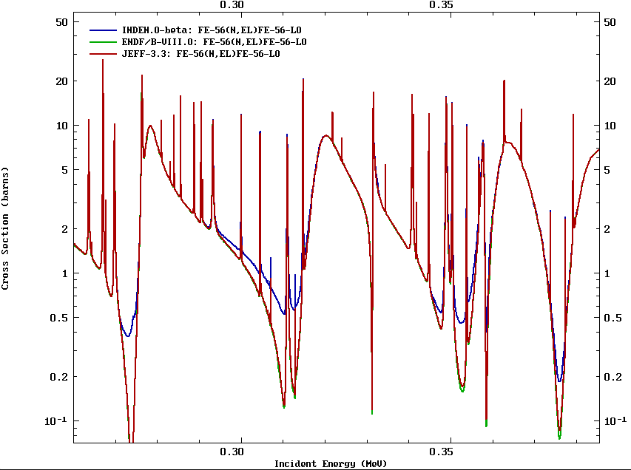
Patching the Fe-56 evaluation: elastic x.s.
Sensitive to transmission through thick samples (>5 cm)

Slide 7
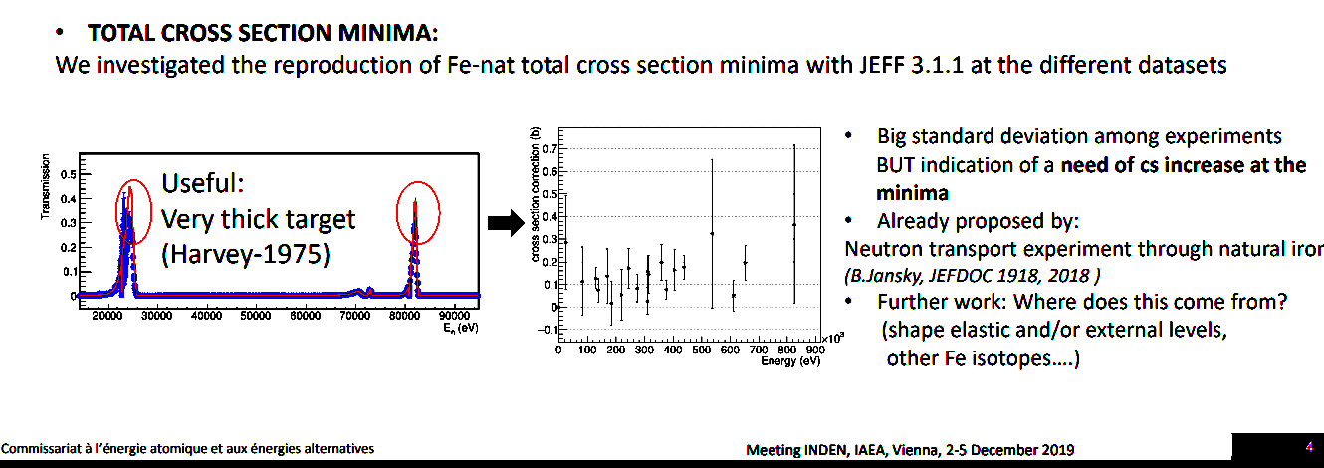
Similar observation by M. Diakaki
Sensitive to transmission through thick samples (>5 cm)

Slide 8
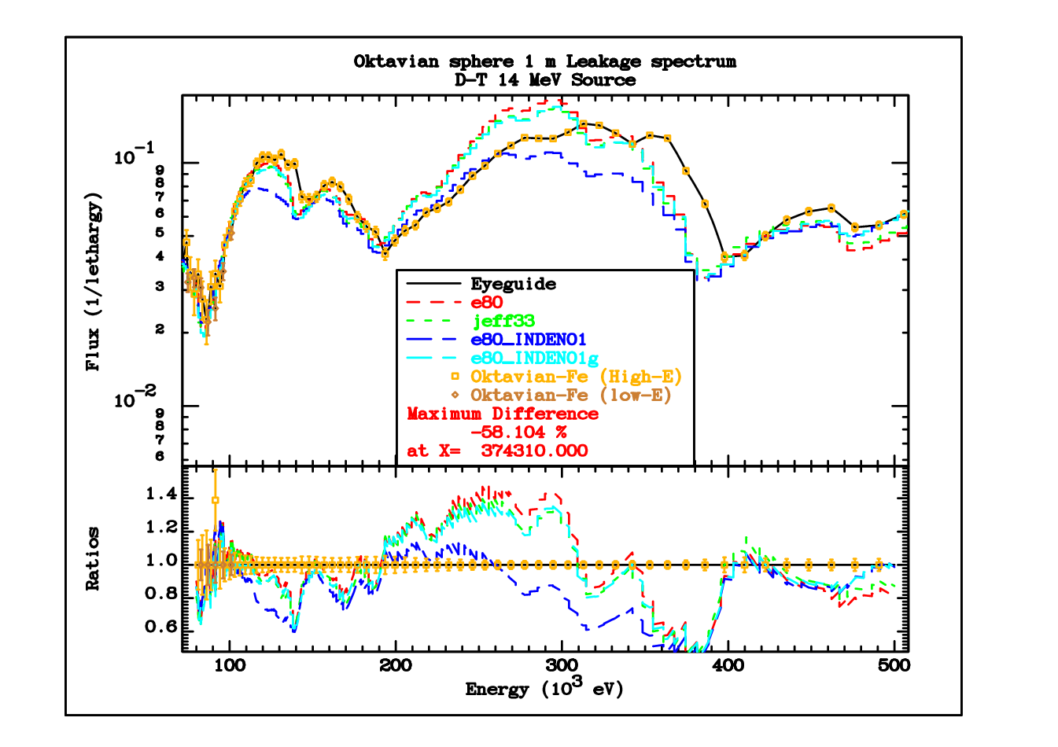
Reduced overshoot of the spectrum in the Oktavian benchmark

Slide 9
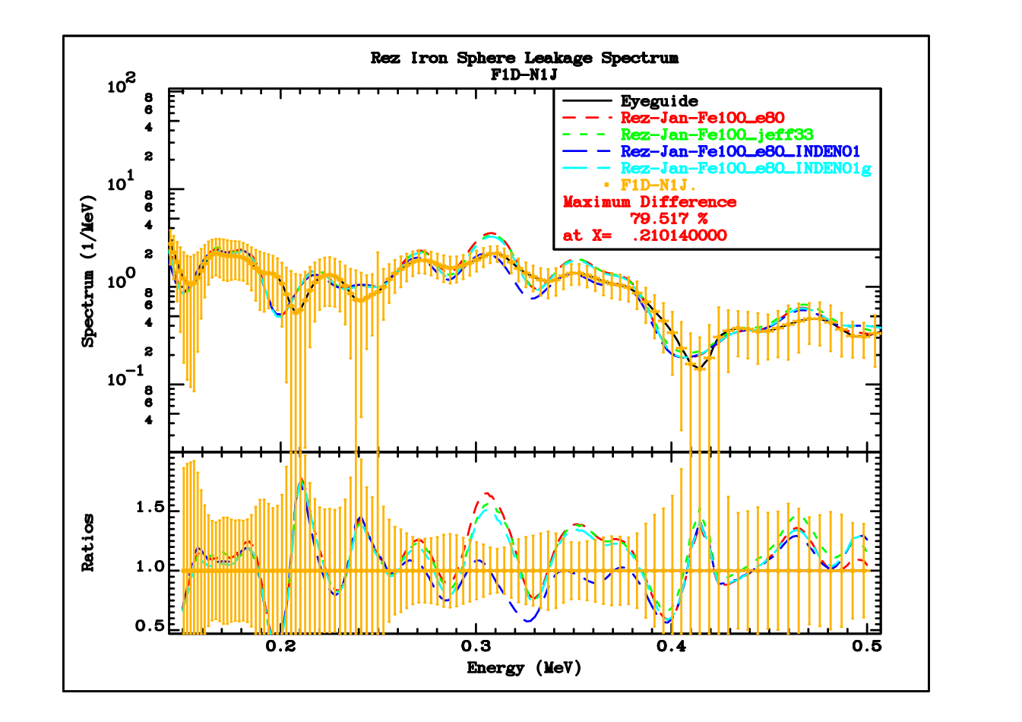
Similarly for the 100 cm Rez sphere…

Slide 10
… and the IPPE sphere with D-T source

Slide 11
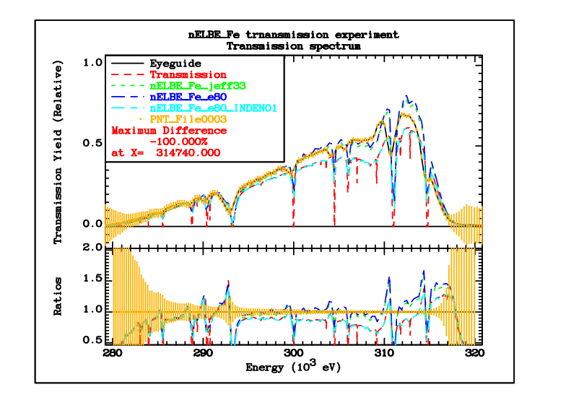
However: new 9 cm thick transmission measurement on iron at nELBE

Slide 12

Observation
Current INDEN patch to fill the minima is not supported by the nELBE measurement
To decrease the spectrum peak (at the cross section minimum) the cross section needs to be increased
Flux attenuation for a narrow collimated beam is:
  $T=e^{−ndσ_{tr}}$ ; $σ_{tr}=σ− μσ_{el}= σ_{a}+σ_{el}\left(1−μ\right)$
  Cross section can be increased by increasing $σ_{el}$ or decreasing $μ$
The effect of increasing $μ$ is too small

Slide 13
Implications of the nELBE measurement
Analytical transmission function based on INDEN data agrees with Monte Carlo simulation, showing that:
  Multiple scattering is negligible
  Self-shielding is not applicable
Only a very small increase of cross section near 312 keV can be accommodated
Possible effect of the angular distributions is too small
Spectrum overshoot in the resonance “windows” remains unresolved

Slide 14
Conclusions
Capture below the 27 keV resonance seems to be under control
Issues regarding the elastic cross sections in the minima between resonances (near 300 keV and higher) remain unresolved

