Slide 1
Patch to INDEN Fe-56,57
Andrej Trkov
INDEN Structural Materials
IAEA, 13-17 December 2021

Slide 2
Patching the minima in the elastic x.s. of iron
A new transmission measurement was performed at nELBE in Germany by A. Junghans et al., which shows that the INDEN patch to Fe-56 is wrong.
Restoring the elastic background to the original CIELO values, only an increase of about 0.2 barns in the total cross section of Fe-nat is needed in the energy range 310-317 keV with the peak near 314 keV (slide 3), to improve agreement with the transmission measurement.
The minor-isotope total cross sections could play a role:
Fe-54 with abundance of 5.845% contributes 0.4 barns over a narrow energy range at the peak. There is no room for significant changes in the Fe-54 resonance data.
Fe-58 with abundance of 0.282% contributes 0.07 barns at the peak; this is too small.
Fe-57 with abundance 2.119% has resonances only up to 200 keV (at most). Above this energy the cross section is flat and contributes 0.08 barns over a broad energy interval (see slide 4), but experimental data suggest distinct resonance structure (see slide 5).

Slide 3
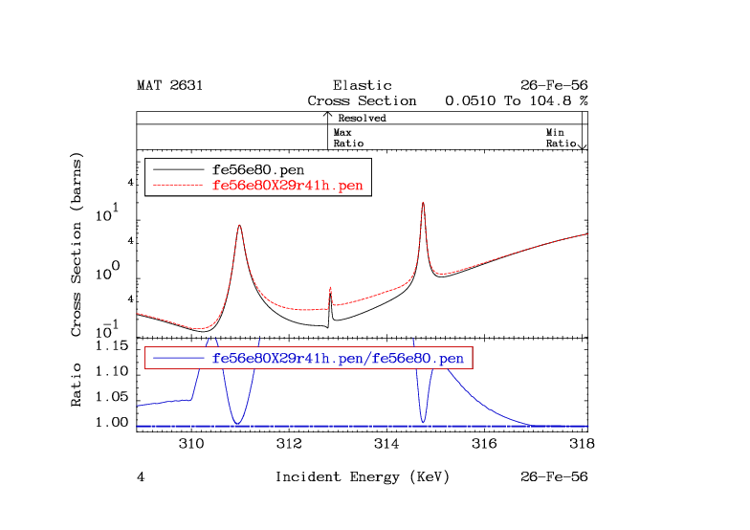

Slide 6
Test calculations (Slide 7)
Transmission: analytical calculation of transmission from reconstructed total cross section of INDEN.
Simple MCNP model of the experiment was prepared (no resolution-broadening effects) based on different libraries:
“e80” ENDF/B-VIII.0
“jeff33” JEFF-3.3
“INDEN01” total cross sections from INDEN (original)
“INDEN01h” patch to the total cross section adding 0.2 barns in the interval 310-317 keV with a peak at 314 keV (trial)
The impact on Oktavian and Rez iron sphere benchmarks is shown in Slides 8 and 9.

Slide 7
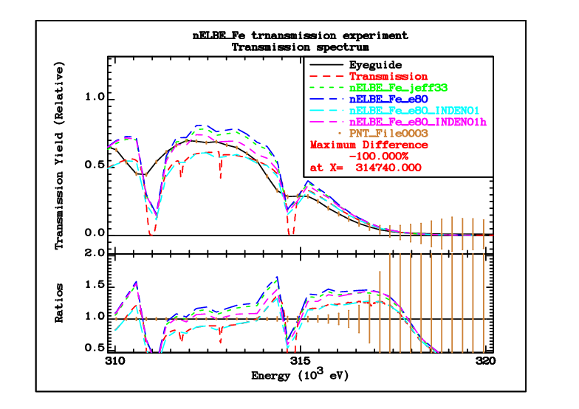

Slide 8
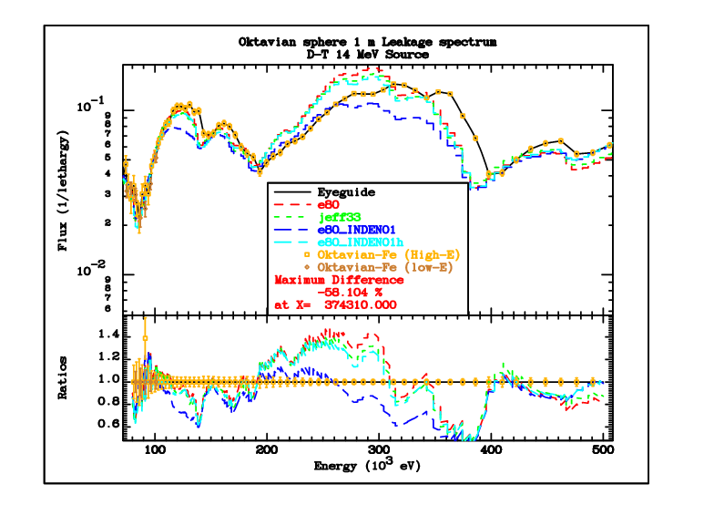

Slide 9
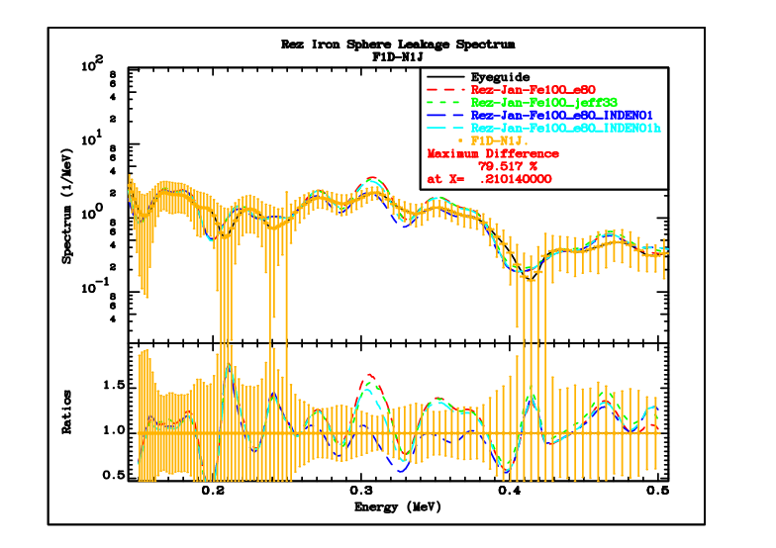

Slide 10
After correction to Fe-57 total cross section
The impact on the total cross section of the reconstructed Fe-nat is similar to the previous simple patch on Fe-56 (compare Slides 3 and 11).
Comparison of the simulation calculations of the nELBE transmission experiment with the original and the new INDEN files is shown in Slide 12.
A slight overestimation of the spectrum near 313 keV still exists (Slide 13), but it is greatly diminished.
The updated INDEN files (ENDF and the ACE) are available on the INDEN web site https://www-nds.iaea.org/INDEN/ .The relevant filenames with suffixes ENDF and ACE for the respective file formats are:
fe56fe56e80X29r44
fe57e80m

Slide 11
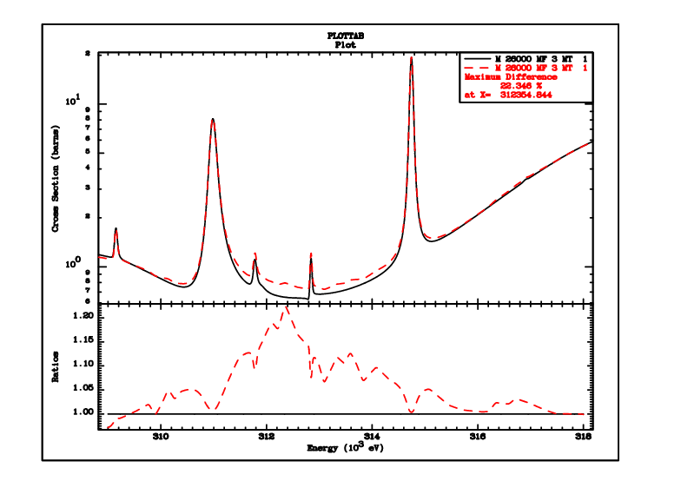
Fe-nat (total) with corrected Fe-57 (red)

Slide 12
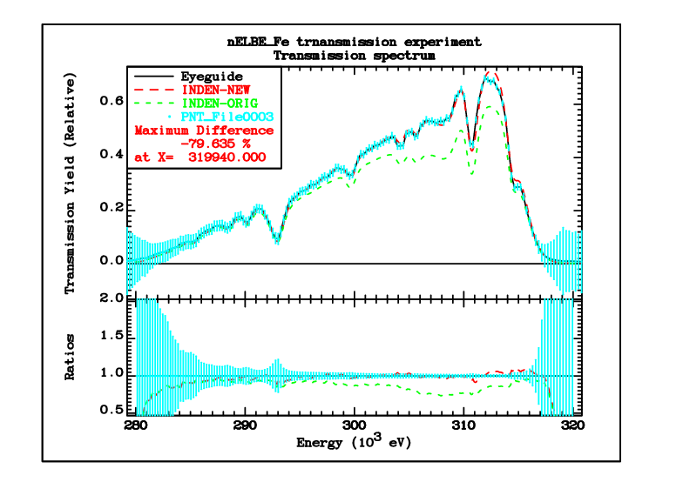

Slide 13
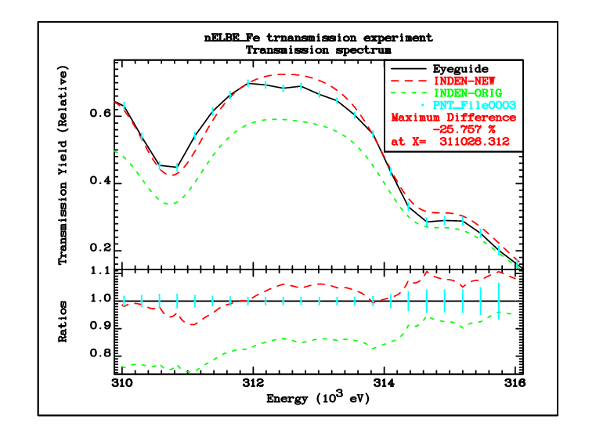

Slide 14
Impact on shielding (integral) benchmarks
A small reduction of the spectrum peak is observed in both, the Oktavian and the Rez iron sphere leakage benchmarks (Slides 15, 16) However:
Although the Oktavian spectrum was measured by the ToF technique, the available “measured” data were converted to energy. The details of the conversion are not given, so the simulation (performed in the time domain) cannot be reproduced exactly.
The spectrum at Rez was measured by a proton recoil detector.
It is clear that there are “wiggles” in the measured spectrum in the energy regions, where there are no strong resonances (e.g. 30-60 keV, Slide 17, 18).
It is possible that some of the structure in the measured data is an artefact of the spectrum deconvolution process.
Likewise, it might be that some structure in the spectrum was lost for the same reason. Applying resolution broadening to the calculated results improves the agreement between measurement and calculations (Slide 19)

Slide 15
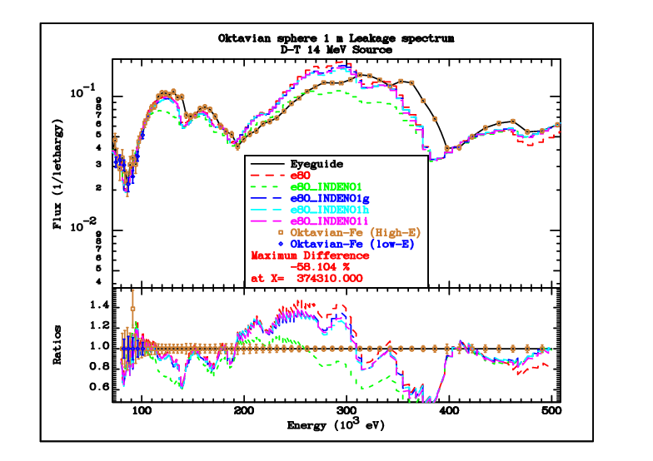

Slide 16
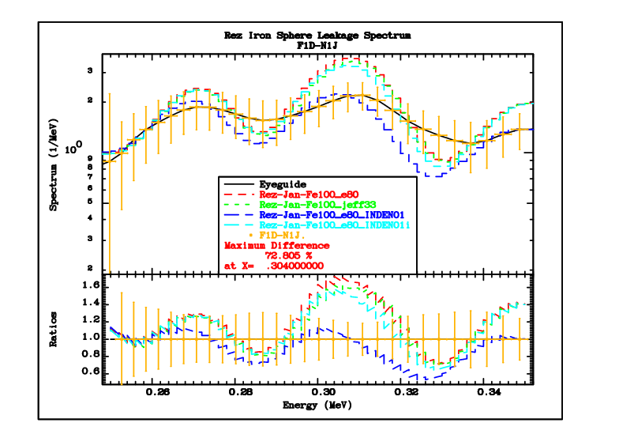

Slide 18
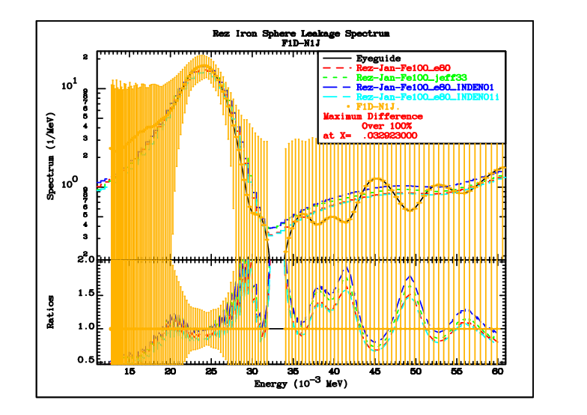

Slide 19
Unbroadened
Resol.Broadened

Slide 20
Conclusions
In the INDEN Fe-56 evaluation “fe56e80X29r41” the patches to the resonance minima are NOT VALID, as shown by the nELBE transmission measurement.
The Fe-56 elastic cross sections from the original CIELO evaluation were restored in the “fe56e80X29r44” file.
Nevertheless, some discrepancies with the transmission measurement (e.g. near 300 keV) remained.
The problem was traced to all evaluations neglecting the measured structure in the Fe-57 total cross section above ~200 keV (upper end of resolved resonance range).
Fe-57 file “fe57e80m” was produced featuring measured total cross sections by Pandey up to 850 keV, assigning the difference to the elastic cross sections.
The updated Fe-56,57 files are available from https://www-nds.iaea.org/INDEN/

