Slide 1


Inelastic scattering on major actinides
R. Capote (IAEA/NDS, Vienna), E. Soukhovitskii (JINER, Minsk),
M. Sin (Univ. Bucharest), and A. Trkov (IAEA/NDS)

Slide 2
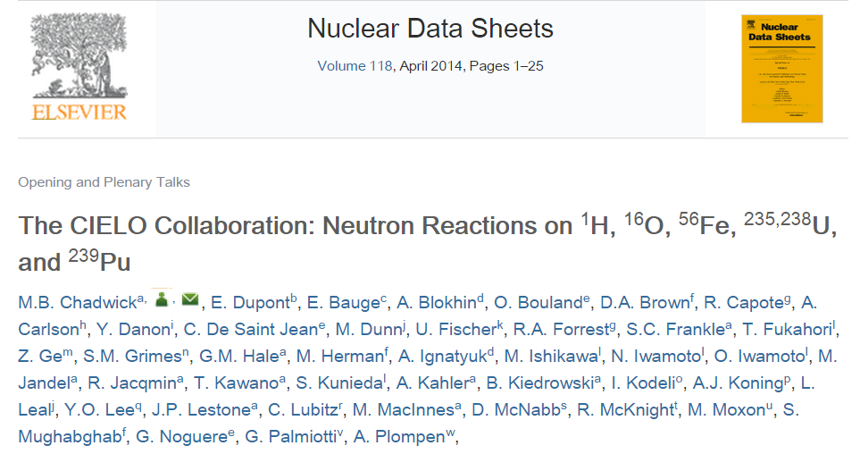
OUTLOOK
Motivation, RPI benchmark
²³⁸U DCCOMP + HF + HRTW +”EW” – u238-b44
²³⁵U DCCOMP + HF + HRTW – u235-b2
New multi-band coupling DCCOMP

Slide 3
Motivation
Data
High accuracy requirements were placed on inelastic cross-sections ²³⁸U(n,inl) in the whole energy range up to 20 MeV (OECD/NEA WPEC Subgroup 26, NEA, 2008 ).
Changes in PFNS may lead to changes in evaluated inelastic cross sections which are discrepant (cf. INDC(NDS)-0597 (2012))
Physics
Better nuclear structure should be used in reaction calculations for heavy nuclei (beyond rigid-rotor and vibrational models)
Extended multi-band coupling needed with “consistent” coupling
(i.e. able to reproduce OM observables for a given CC scheme)

Slide 4
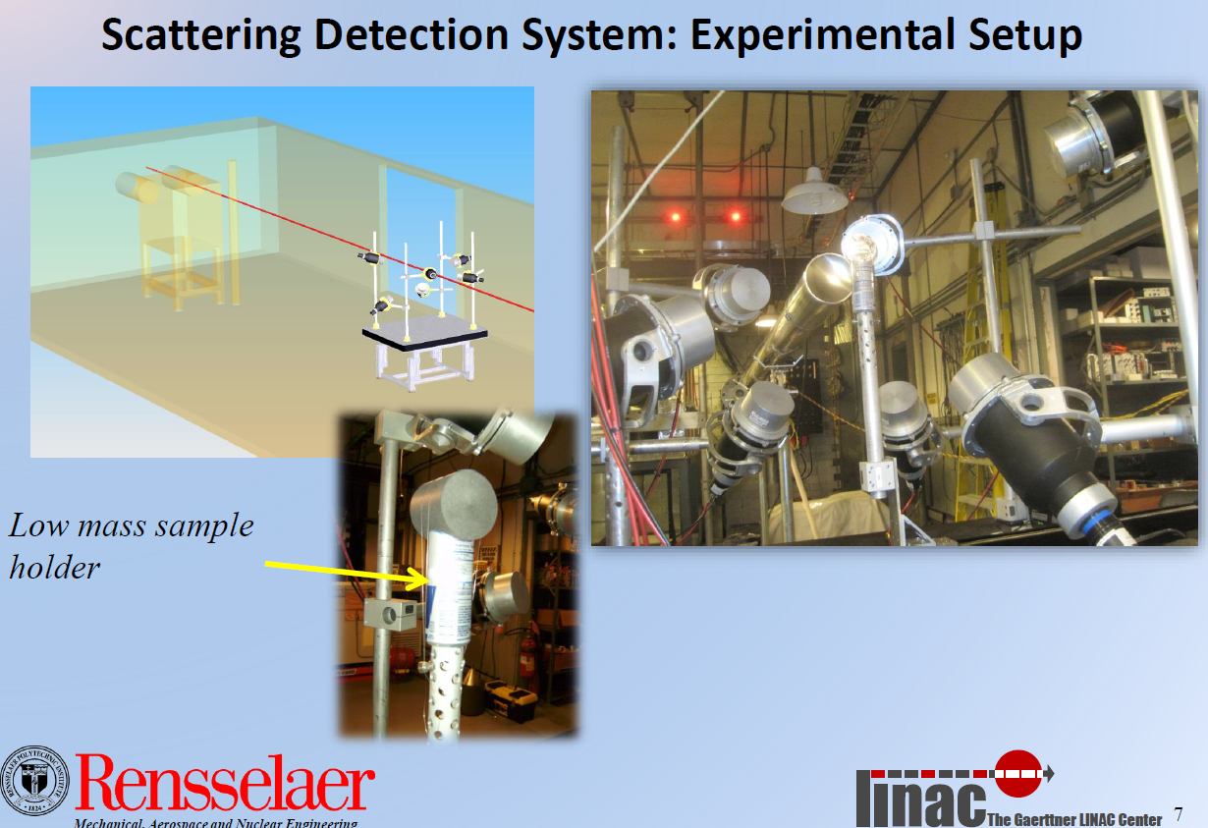
Danon et al, RPI quasi-integral benchmark U-238

Slide 5
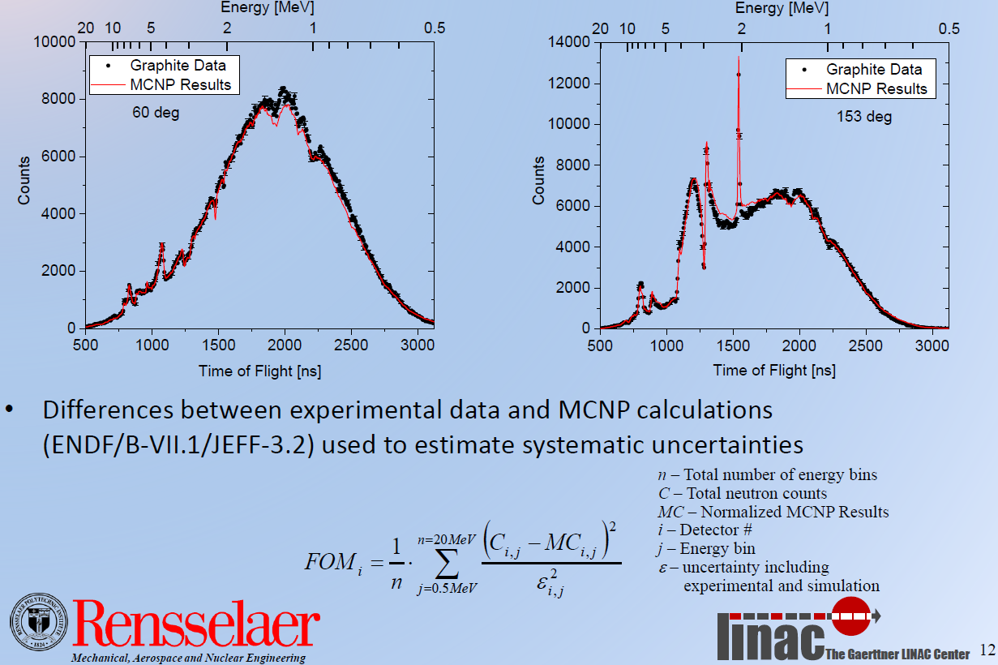
Graphite RPI benchmark (syst. uncert)

Slide 6
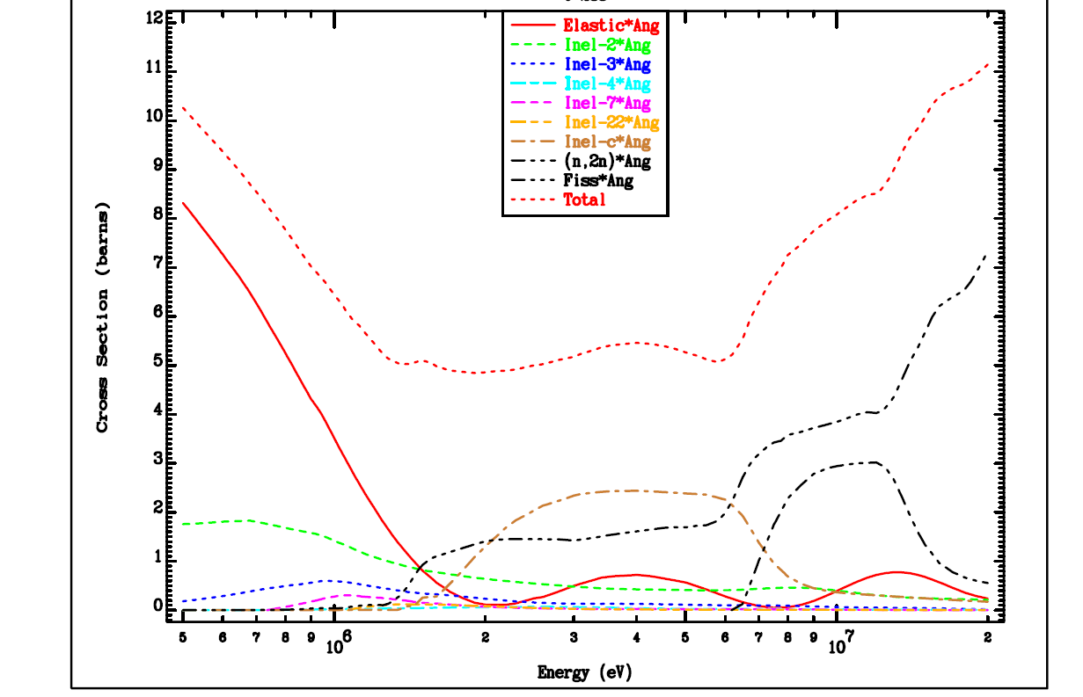
RPI sensitivity to evaluated cross sections
²³⁸U, 60 deg

Slide 7
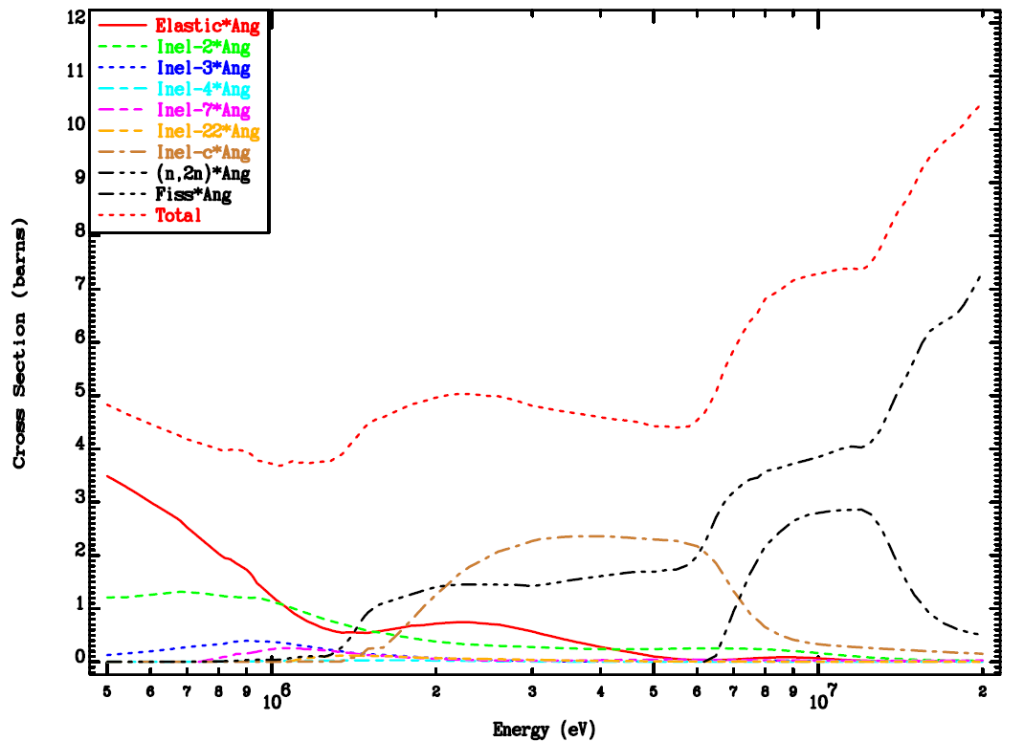
RPI sensitivity to evaluated cross sections
²³⁸U, 153 deg

Slide 8
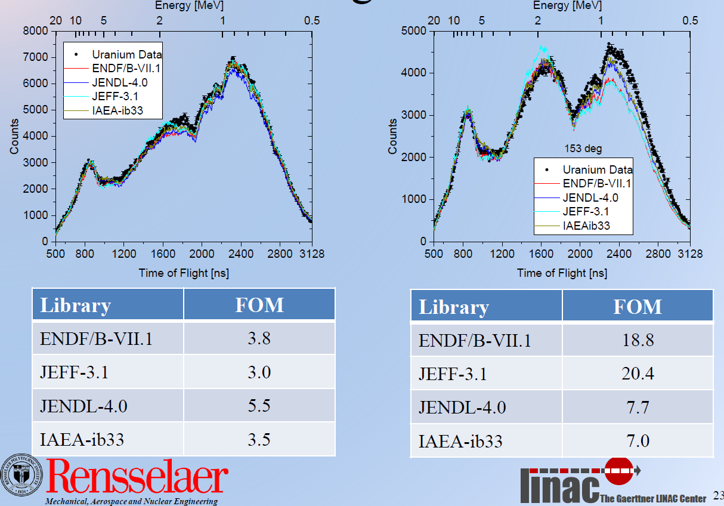
60 deg

Slide 9
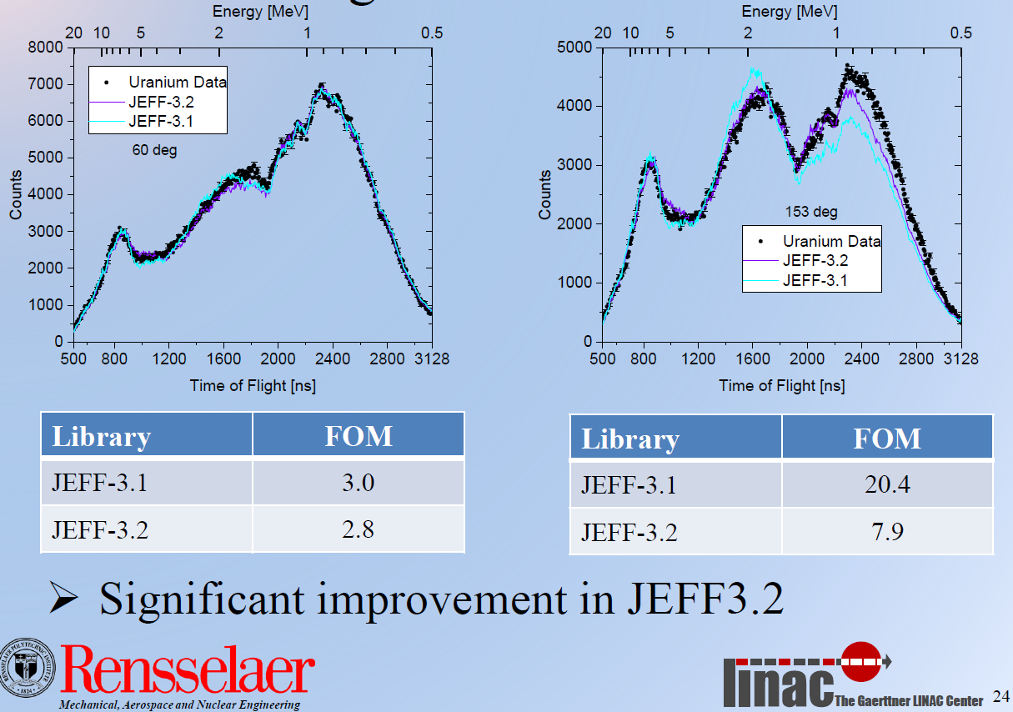
60 deg

Slide 10
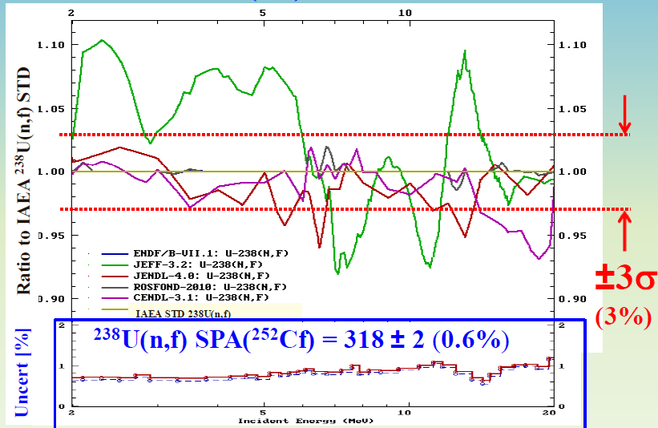
Evaluated ²³⁸U(n,f) vs. IAEA STD cross section

Slide 11
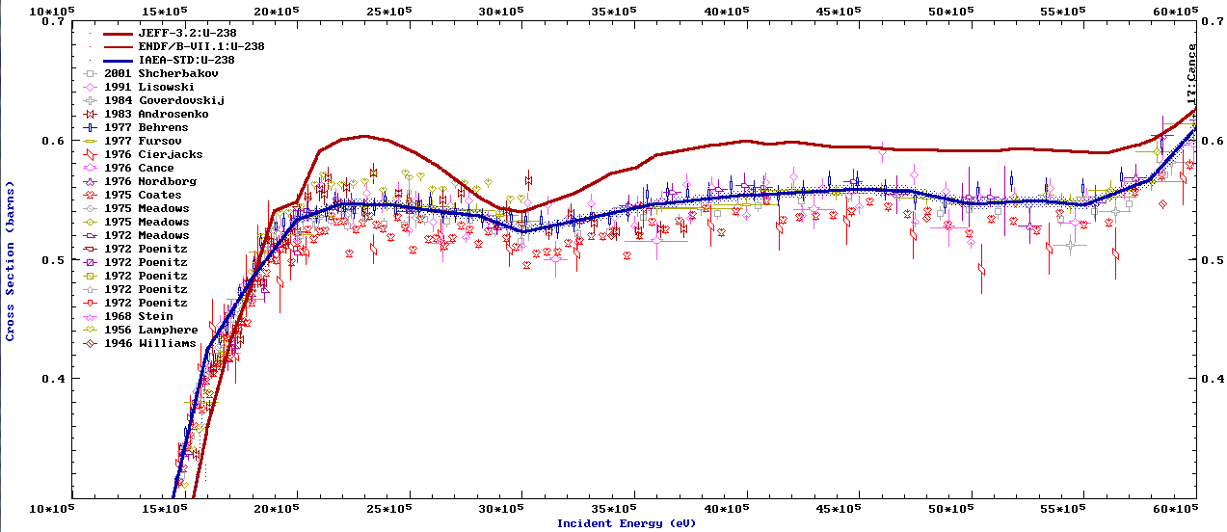
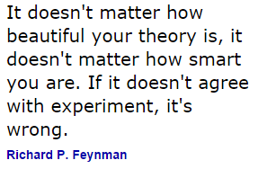
Evaluated ²³⁸U(n,f) vs. IAEA STD cross section
raw EXFOR ratio data U8/U5, U5 std

Slide 12
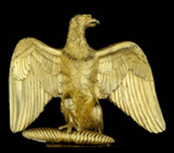
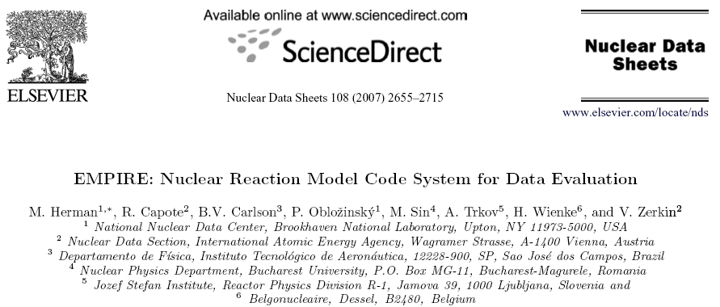
Nuclear Data Sheets 108 (2007) 2655
+ recent relevant modelling advances
Dispersive Lane consistent coupled-channel OMPs*:
neutron inelastic scattering to discrete levels;
CN-DIR interference effects (as predicted by Moldauer);
neutron inelastic scattering to the continuum;
improved fission formalism (descriptive capability)
*J.M. Quesada et al., EPJ Web of Conferences 42 02005 (2013)
J.M. Quesada et al., ND2013 conference

Slide 13
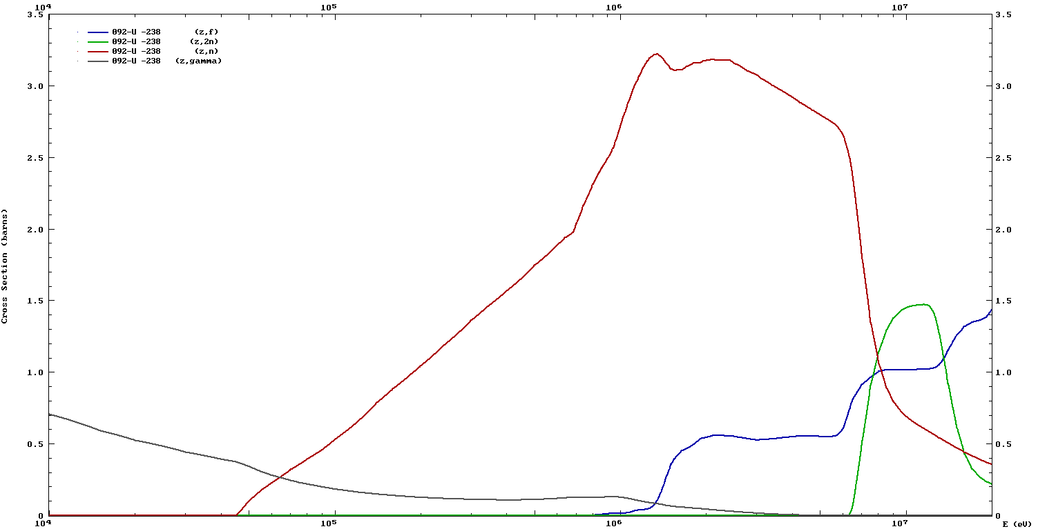
Evaluated ²³⁸U(n,f) ib44 (IAEA)

Slide 14
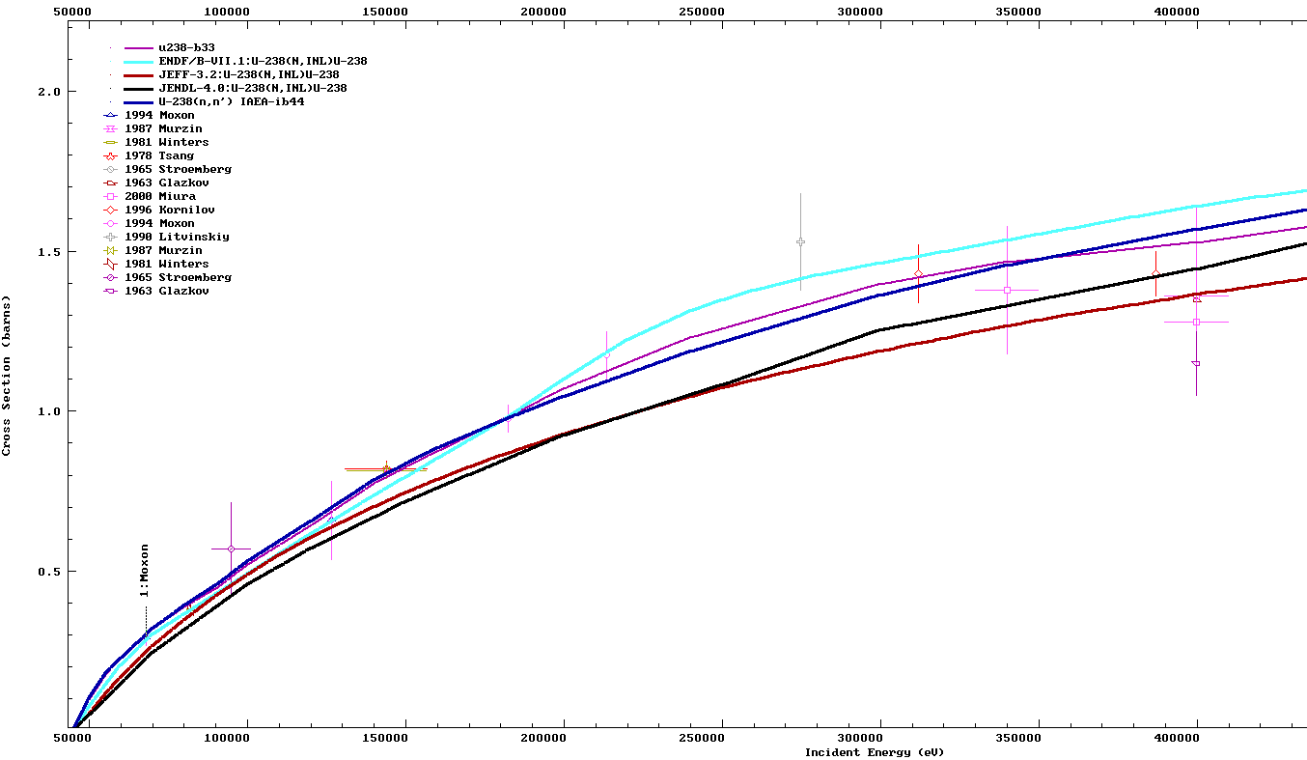
Impact of CN-DIR interference (EW transf.)
Suggested Capote et al, ND2013
Confirmed Kawano et al, Varenna 2015

Slide 15
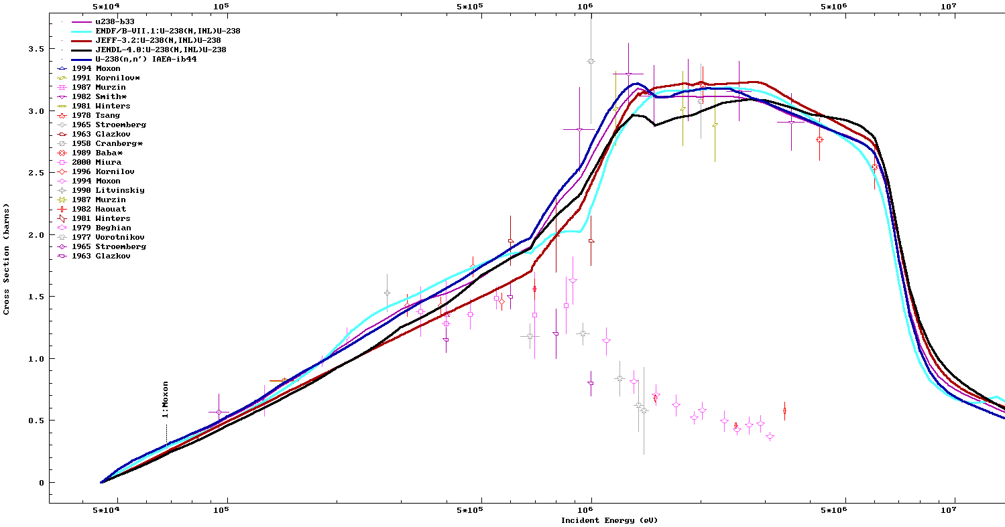
Differences in the maximum: ²³⁸U(n,inl)

Slide 16
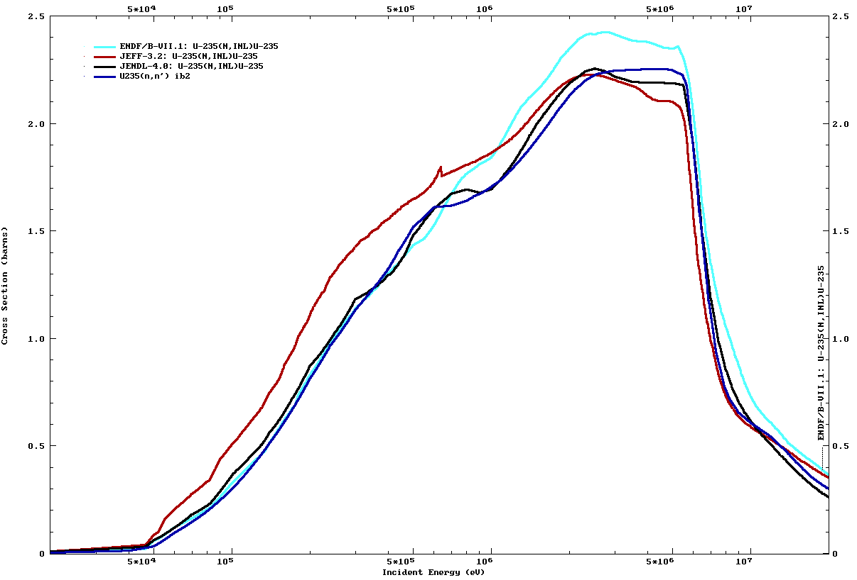
Differences: ²³⁵U(n,inl)
²³⁵U ib2 – rr OMP
Impact on
thermal
assemblies
Impact on
fast assemblies

Slide 17
Impact of ²³⁵U DCC multi-band coupling

Slide 18
NEW DCCOMP
Multi-band coupling
Odd and even-even targets

Slide 19
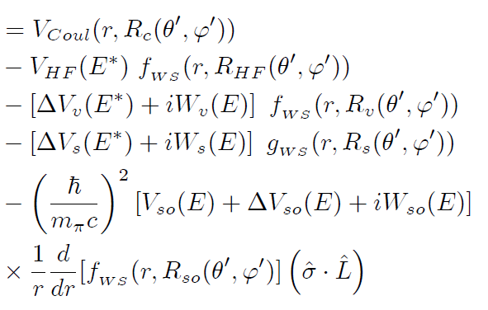

Lane consistent nucleon dispersive OMP
Coupling models:
Rigid rotor, soft rotor, vibro-rotational model
Coupled: levels of the ground state band/excited bands

Slide 20
Expanded coupling scheme
Vibrational-rotational model (even-even nuclides)
D.W.Chan et al, PRC26 (1982) 841; PRC26 (1982) 861 .
E.Sheldon. L.E.Beghian, D.W.Chan et al, J.Phys.G:Nucl. Phys. 12, 443 (1986).
T. Kawano, N. Fujikawa and Y. Kanda, INDC(JPN)-169 (1993) JENDL-3.2
Soft (non-axial) rotor (even-even nuclides)
Yu.V.Porodzinkij and E. Soukhovitskii, Phys. At. Nuclei 59 (1996) 228-237
V.M. Maslov et al., J. Nucl. Sc.Tech. Supl.2 (2002) 148-151
CHALLENGE:
Derive a dispersive coupled channel potential
(Lane consistent) with multiple-band coupling scheme valid for even-even and odd actinides

Slide 21
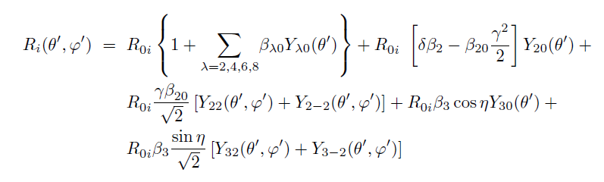
Nuclear shape parameterization
Small param.
Rigid rotor + dynamical corrections
A.Bohr, Mat. Fys. Medd. Dan. Vid. Selsk. 26, No. 14 (1952):
Body-fixed frame aligned with principal axes: β_{2,1}=β_{2,−1}=0; β_{2,2}=β_{2,−2} => β, γ
P.O. Lipas and J.P. Davidson, Nucl. Phys. 26, 80-90 (1961): Octupolar vibrations with even projection better describe low-lying negative parity states
β_{3,1}=β_{3,−1}=β_{3,3}=β_{3,−3}=0 => λ=3 ; μ=0,±2

Slide 22
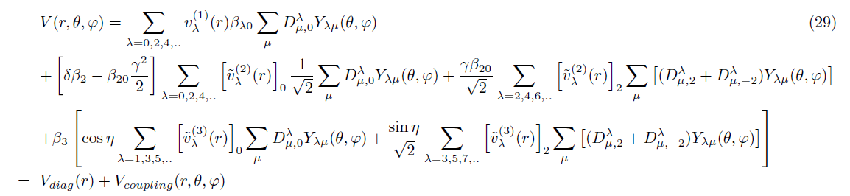
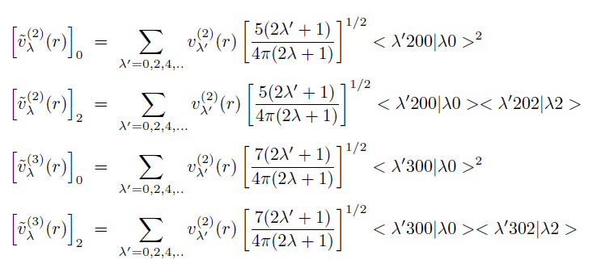
Optical model potential

Slide 23
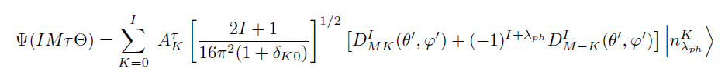
Even-Even Nucleus
...
Δn_{λ} =0, ±1 : vibrational rule; next spin rules
Intraband transitions:
Quadrupolar-GS:
Octupolar-GS:
Selection rules:
ΔΚ=μ

Slide 24
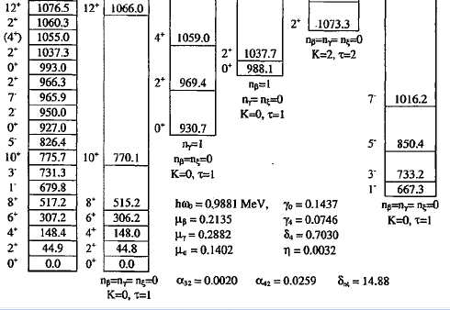
Rigid rotor with soft-rotor (vibr.) corrections
1166.9
(+8.4%)
non-axial
β
γ
822.8
(+6.0%)
U-238
(similar for ²³²Th)
538.6
314.2
149.6
octupole
44.9
0.0
~J(J+1)
rigid
gsb
OMP with multiple band coupling
Yu.V.Porodzinkij and E. Soukhovitkii, Phys. At. Nuclei 59 (1996) 228-237

Slide 25
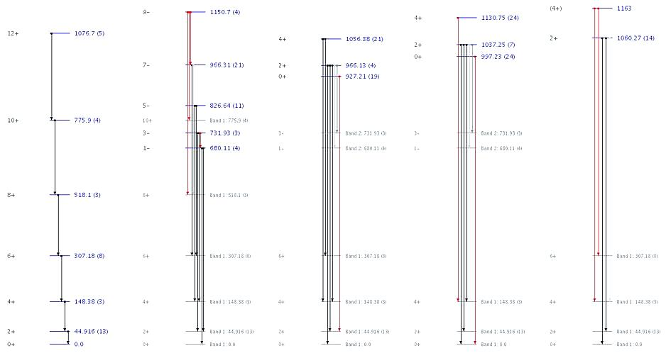
²³⁸U (CC)

Slide 26
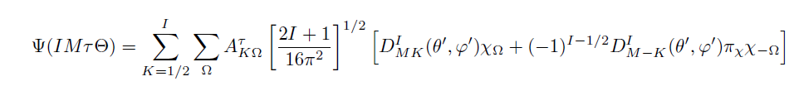
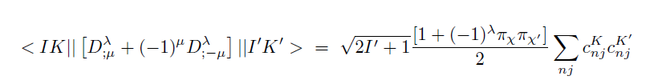
Nuclear shape parameterization-odd
...
Intraband transitions:
Interband-transitions:
Spin selection rules
ΔΚ=μ;

Slide 27
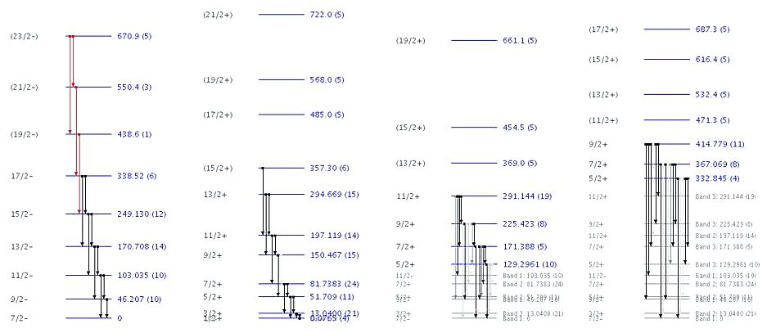
²³⁵U (not coupled bands)
K^{π}=7/2-
K^{π}=5/2+
K^{π}=5/2+
K^{π}=1/2+
Ground state
rigid rotor
ΔΚ=3,ππ’=-1
<β₃₃>=0
isomer
ΔΚ=1,ππ’=-1
<β₃₁> =0
ΔΚ=1,ππ’=-1
<β₃₁>=0

Slide 28
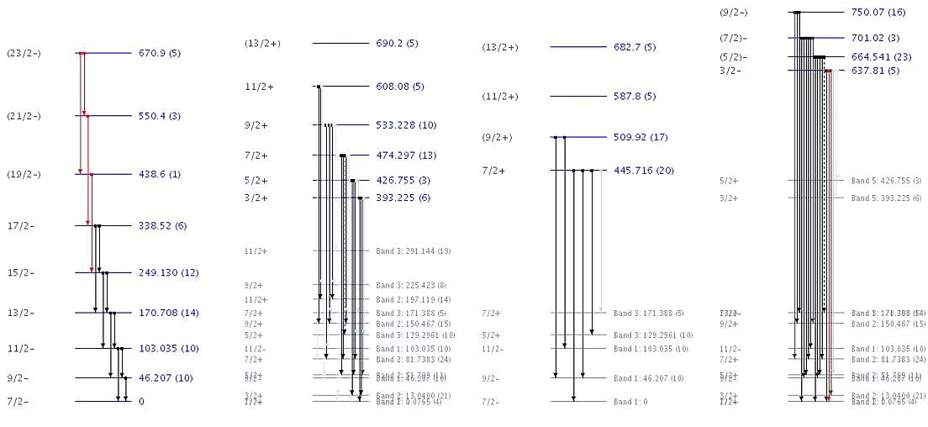
²³⁵U (Coupled bands)
K^{π}=7/2-
K^{π}=3/2+
K^{π}=7/2+
K^{π}=3/2-
Ground state
rigid rotor
ΔΚ=2,ππ’=-1
< β₃₂> non-axial
ΔΚ=0,ππ’=-1
< β₃₀> axial
ΔΚ=2,ππ’=+1
< β₂₂> non-axial

Slide 29
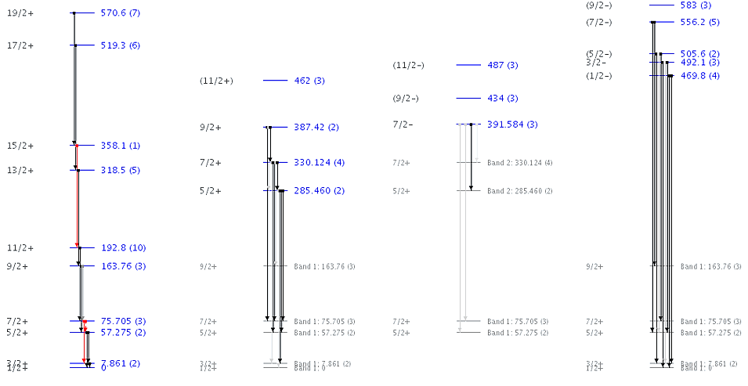
²³⁹Pu (coupling scheme)
GS, Kπ=1/2+
ΔΚ=2,ππ’=+1
< β₂₂> non-axial
ΔΚ=3,ππ’=-1
< β₃₃> = 0
ΔΚ=0,ππ’=-1
< β₃₀> axial

Slide 30
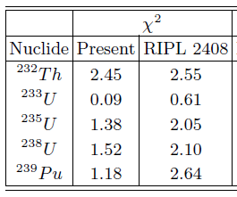
DCC OMP LSQ fit for all “optical“ observables (n,n);(p,p);(p,n)
RIPL 2408 OMP: rigid rotor
R.C., S.Chiba, E.Sh. Soukhovitskii, J.M. Quesada, E. Bauge, Jnst 45 (2008) 333–340

Slide 31
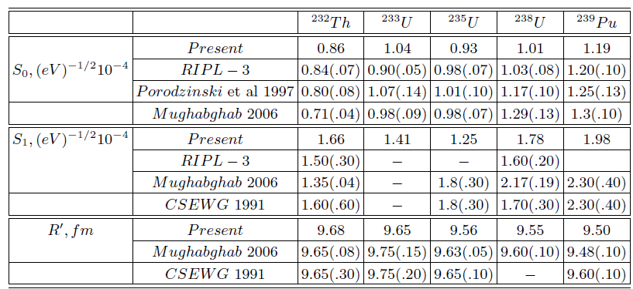
DCC OMP low-energy observables
RIPL-3: R.C. et al, Nucl. Data Sheets 110 (2009) 3107–3214, online at http://www-nds.iaea.org/RIPL-3
Yu.V. Porodzinskij, E.Sh. Sukhovitskij and V.M. Maslov, INDC(BLR)-012, IAEA, 1997
S.F. Mughabghab, Atlas of Neutron Resonances, 5th edition, Elsevier, Amsterdam, 2006.
Cross Section Evaluation Working Group 1991 Report BNL-NCS-17541 (ENDF201).

Slide 32
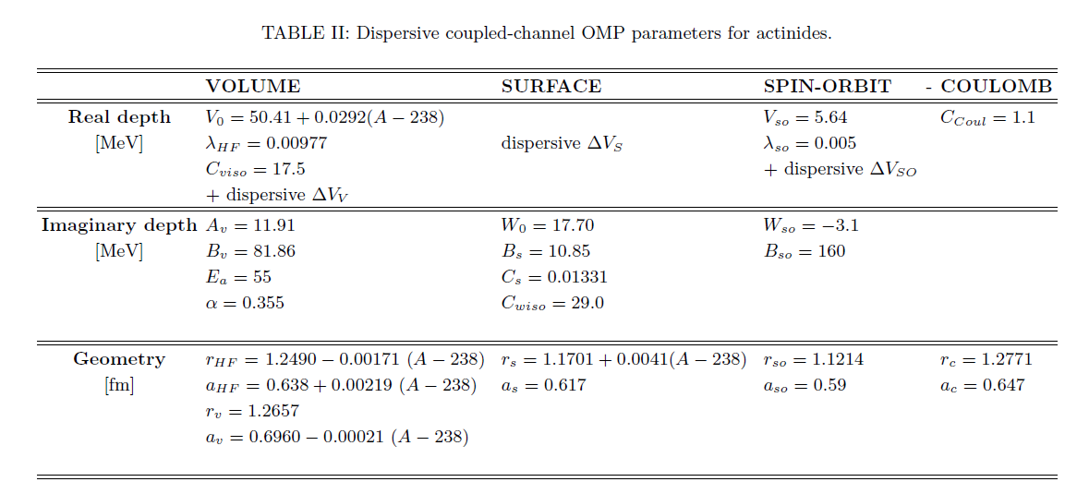
New DCC OMP parameterization

Slide 34
Total cross section differences

Slide 36
CONCLUSIONS
New DCC OMP with multiple-band coupling derived
for nucleon scattering on actinides: ^{233,235,238}U, ²³⁹Pu, and ²³²Th
OMP highlights:
  Based on dispersive relations and Lane consistent.
  Least-squares fit of a regional set of OMP parameters from (n,n),(p,p) & (p,n) IAS.
  CC couplings based on rigid rotor with dynamical corrections with derived selection rules for rotational bands built on vibrational (even-even) or single-particle band-heads (odd nuclei).
  Energy independent geometry.
  Ground state deformations close to those
  predicted by Nix and Moller (FRDM)

Slide 38

Dispersive relations W<-> V

Slide 39
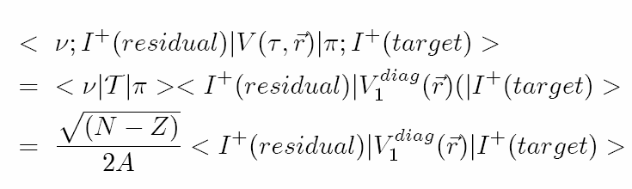
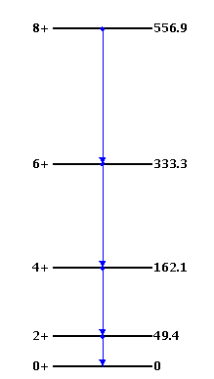
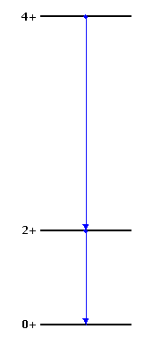
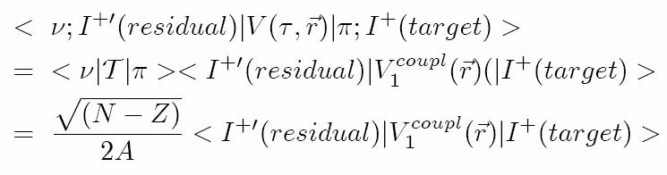
Couplings in (p,n) IAS reactions
IAS
Δ_{C}=1.444Z/A^{1/3} -1.13 MeV
Δ_{C}
Δ_{C}~20 MeV for actinides
Ground state

