Slide 1
Compensating Effects due to Nuclear Reaction and Material Cross Correlations:
NEA Activities and NEA Tools
Bayesian Approach for Compensating Effects
Analysis of Keff Sensitivity Profiles
O.Cabellos
NEA Data Bank
oscar.cabellos@oecd.org

Slide 2
I. Introduction: Compensating effects
“Uncertainties associated with various physics models within the code may cancel giving compensating effects…” .
“With integrated experiments, it is difficult to distinguish an error in the coupling between component physics from an error in the individual components themselves. This is called a compensating error.”
(“White Paper on Verification, Validation, and Uncertainty Quantification” by R.I. Klein and P. J. Turinsky)
In Nuclear Safety Analysis
It can be found compensating effects in burnup calculations between fission products and heavy metals contributions for criticality safety analysis.
In Nuclear Data Libraries
In general, “neutron cross sections in current libraries (ENDF/B, JEFF, JENDL,…) perform quite well. However, this performance is the result of large compensations among different parameters. This can induce unexpected biases and large uncertainties.” (A. Stanculescu, INL)

Slide 3
Compensating effects in ENDF
The knowledge of neutron induced cross sections is based on differential and integral experiments as well as nuclear reaction models.
The current evaluations may embody compensating errors between the roles of fission (cross sections, average number of prompt neutrons, and neutron spectra), capture, inelastic scattering and elastic scattering.
A major challenge to nuclear data evaluation community on nuclear data is to remove these error compensations.
“Good overall integral behaviour with deviations among Evaluations, with compensating effects…”
JEFF/DOC-1485, B. Morillon

Slide 4
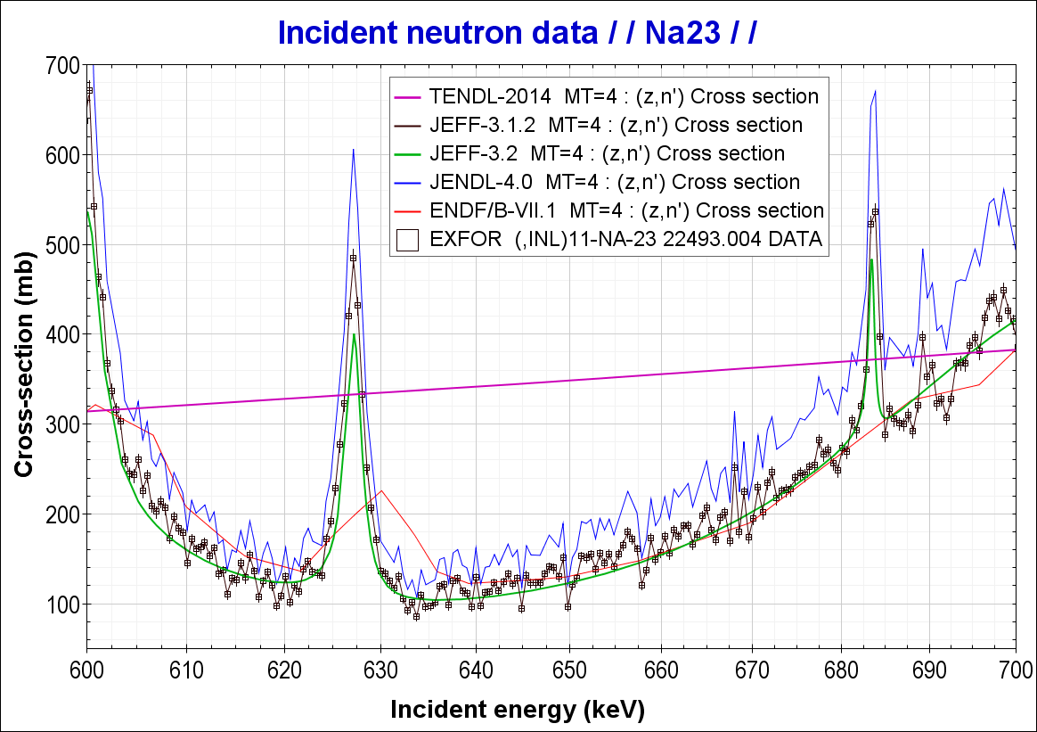
Example of Compensating Effect: Na²³JENDL4.0
Documented in the ENDF file
Compensating effect base on “integral benchmark” as a private communication
mt=4, 51-78, 91 Inelastic scattering 1125 1451
The cross sections were calculated by using the TNG code /6/. 1125 1451
The direct cross sections were taken into account for mt=51,52, 1125 1451
53,56. The deformation parameters were estimated by a weak 1125 1451
coupling model. 1125 1451
For mt=51, the TNG calculations were replaced with the following1125 1451
data: 1125 1451
Threshold - 2.15 MeV: Maerten et al./7/ multiplied by 1.25 1125 1451
The factor of 1.25 was derived from 1125 1451
a benchmark test made by N. Yamano/8/.1125 1451
2.15 - 4.0 MeV : JENDL-3.2 mt=51 1125 1451
1125 1451
JEFF-3.1.2 evaluation = Maerten et al./7/ EXFOR Data
(In fact, evaluation is the EXFOR Data)
JENDL-4.0 evaluation =1.25* JEFF-3.1.2

Slide 5
Role of WPEC/SG39
Aim of this SG:
“Develop a methodology for avoiding compensations in the adjustment of nuclear data and give more reliable feedback to evaluator”
In many cases, the adjustment can produce untrustworthy results in terms of adjusted cross sections, when some forms of compensation exist.
Compensations can have different causes:
It is possible that some reaction variations of the same isotope compensate each other (e. g. ²³⁹Pu-χ and inelastic) or that different isotope cross section variations have opposite and compensating effects (e.g. U-238 capture increase associated to Pu-239 fission increase)
Lack of reactions and cross correlations in the covariance matrix
Inadequate values in the covariance matrix that in an adjustments lead to correct certain cross sections more than others
Very few experiments able to discriminate among parameters

Slide 6
Role of WPEC/SG39
Remedies for compensations
Static Method: Use of specific experiments for a better for adjustment
“Flat” or “steep” adjoint flux reactivity experiments (to separate inelastic from absorption cross sections)
Neutron transmission of leakage experiments (sensitive mostly for inelastic)
Reaction rate distribution (sensitive mostly for elastic and inelastic)
Reaction rate ratio (sensitive mostly for specific reactions)
Sample oscillations
Dynamic Method: Physical interpretation of adjustments
To understand the mechanism of adjustments (if the compensation effect is reasonable and physical, we may rely on the adjustment results)
Use the “adjustment motive force” and “adjustment potential” (to identify the most influential experiment to the alteration of the specific cross section )
It works for limited cases, for example, a small case which uses a few of experiments
More sophisticated method is needed to settle this issue
First method approach: a progressive incremental adjustment (PIA methodology)
See: “SG39: Summary of Methodology” (https://www.oecd-nea.org/science/wpec/sg39/Meeting_May2015/SG39_1_KY.pdf)

Slide 7
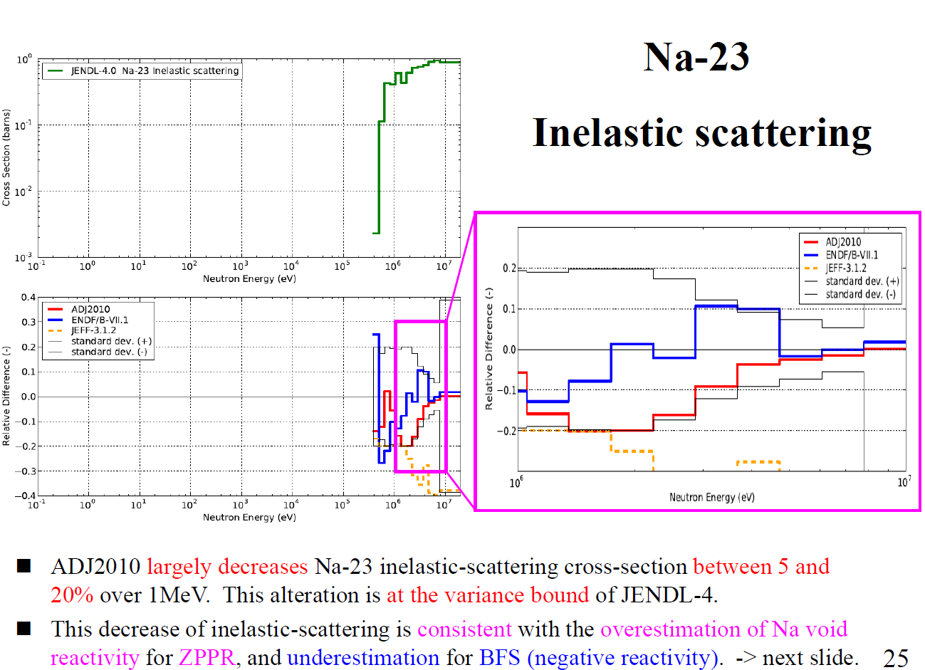
Case: Na23

Slide 8
Compensations in current adjustments
Compensations in current adjustments:
239Pu Chi, 23Na(n,n’), 238U(n,n’), 239Pu(n,n’)
PFNS: “The analysis of thermal solution benchmarks indicates that some reactivity gain due to the softer PFNS can be compensated by lowering the inelastic cross section. This is supported by recent evaluations of other actinides using advanced nuclear models”. (by A. Trkov, IAEA/NDS)
The analysis of current adjustments trends can also helping in guiding CIELO work.
“To identify possible physically-important guidance that comes from these integral data (criticality, reaction rates, and so on), so as to improved the underlying nuclear cross sections and remove compensating errors”.

Slide 9
II. Role of NEA Tools
DICE (DATABASE for ICSBEP )
https://www.oecd-nea.org/science/wpncs/icsbep/dice.html
NDAST
The Nuclear Data Sensitivity Tool (NDaST) brings together the existing capabilities of both DICE and JANIS, allowing retrieval of specified benchmark sensitivity data and subsequent performance of calculations.
http://www.oecd-nea.org/ndast/
New Sensitivity Data
Tools using sensitivity data to identify useful benchmarks
Load your own keff data into DICE
Improved accessibility

Slide 10
DICE Sensitivity Data….Recently much improved!
Handbook Edition | Number of Unique Cases | Sources
2012 | 727 | TSUNAMI1D+TSUNAMI3D [VALID]+ MMK-KENO
2013 | 3575 | Previous + Non VALID cases SCALE6.0 from Balance Inputs
2014 | 4011 | Previous + MCNP6 + SCALE6.2BClutch
 | THERM | INTER | FAST | MIXED
PU | 525/608 | 4/10 | 114/121 | 9/9
HEU | 664/895 | 21/32 | 383/403 | 75/84
IEU | 142/180 | 5/21 | 31/43 | 7/23
LEU | 1424/1612 | 0/0 | 1/1 | 5/5
U233 | 186/197 | 29/29 | 8/10 | 8/8
MIX | 323/436 | 2/7 | 40/67 | 1/26
SPEC | 0/0 | 0/0 | 4/20 | 0/0

Slide 11
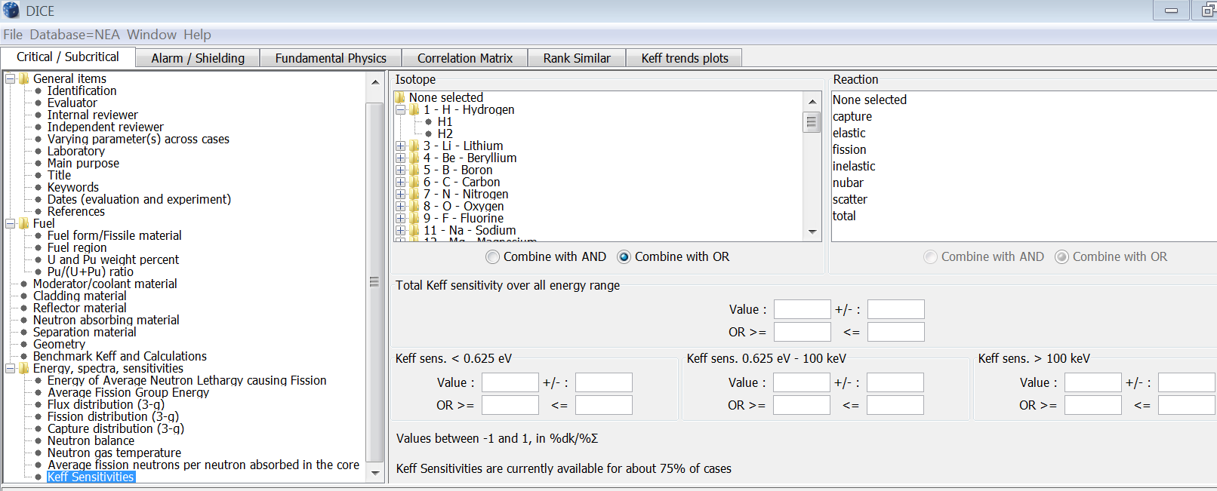
Searching by Sensitivity in DICE
3 Group search, full 238 Group SDF’s are stored
Set Threshold
Also used!

Slide 12
Table of Benchmarks With Sensitivity Above Threshold
Element or Isotope | Threshold(pcm/%∑) | Benchmark Cases
Deuterium | >100 | HST001(1-2), HST004(3-6),HST020(1-5), HCI006(6), HCT017(1-9), HCM002(7,10,11,20), LMT001(1),LMT002(1-12), LMT015(1-22)
Fe | <-100 >100 | PMF015(1),PMF026(1),PMF028(1),PMI002(1),HMF021(1),HMF085(3),HMI001(1), IMF005(1),MMI003(1),SPECMF014(1),HMI001(1)
Cu | >100 | PMF013(1),HMF072(1-3),HMF073(1),HMF085(1-2),HMI006(1-4),IMF020(2,4-5)
Gd¹⁵⁷ | <-100 | PST034(3-6),HST014(3),HST016(2,3),LCT005(3,4,9-11), LCT052(1-6),MST006(4-6),MST007(3-7),MMCT004(4-6)
W | <-50 and >50 | HMF060(1),HMF067(1-2),HMF070(1-3),IMF014(2),PMF005(1),HMF003(8-11), HMF049(3),HMF050(1),HMF084(14),HMF085(6)

Slide 13
Nuclear Data Sensitivity Tool (NDaST) Flowchart
Select / load benchmarks
Sensitivities (S) & C/E data
DICE
IDAT
Personal
Numerical Benchmarks
User Input Perturbation (P)
isotope/reaction/energy cross section
S*P
Δk_{eff} for selected cases
C/E output plot grouped by criteria
Covariance data via JANIS (C)
Built in processed data for major libraries
Load personal (coverx)
M energy groups (fixed)
S*C*S^{T}
U_{C(XS)} for selected cases
Additional uncertainty on output plot grouped by criteria
Matrix plot showing individual contribution to U_{C(XS)} by isotope-reaction
AND/OR
JANIS MF33: ENDF/B-VII.1 = 2138 files, JEFF-3.2 = 5688 files JENDL-4.0 = 2155 files TENDL-2013 = 77811 files

Slide 14
“How to” NDaST. Case for HMF-008-001
Sensitivities Panel:
data needs to be added in order to provide the cases for which the subsequent calculations will be carried out.
DICE/IDAT Databases or ‘New Benchmark’

Slide 15
“How to” NDaST. Case for HMF-008-001
Sensitivities Panel:
Data needs to be added in order to provide the cases for which the subsequent calculations will be carried out.
DICE/IDAT Databases or ‘New Benchmark’

Slide 16
“How to” NDaST. Case for HMF-008-001
Sensitivities Panel:
‘Add selected search results to your benchmark set’ at bottom left of the panel

Slide 17
“How to” NDaST. Case for HMF-008-001
Perturbations Panel:
Data representing perturbations to a nominal ‘original’ set of nuclear data
With a -9% adjustment across all energies for U235 MT4

Slide 18
“How to” NDaST. Case for HMF-008-001
Go! and Output Results Panel
Data representing perturbations to a nominal ‘original’ set of nuclear data
Δk/k = -0.00729
Δk/k = -0.00671
(there are 2 sensitivity files giving slightly different results).

Slide 19
“How to” NDaST. Case for HMF-008-001
Covariances Panel :
Search covariances and press ‘ok’

Slide 20
“How to” NDaST. Case for HMF-008-001
Now, with covariances
Δk/k perturbation (red)
Δk/k benchmark uncertainty (blue)
Δk/k based on the ENDF7.1 covariance file (green)
~680 pcm
~920 pcm
Only inelastic ENDF/B-VII.1
All ENDF/B-VII.1 covariances

Slide 21
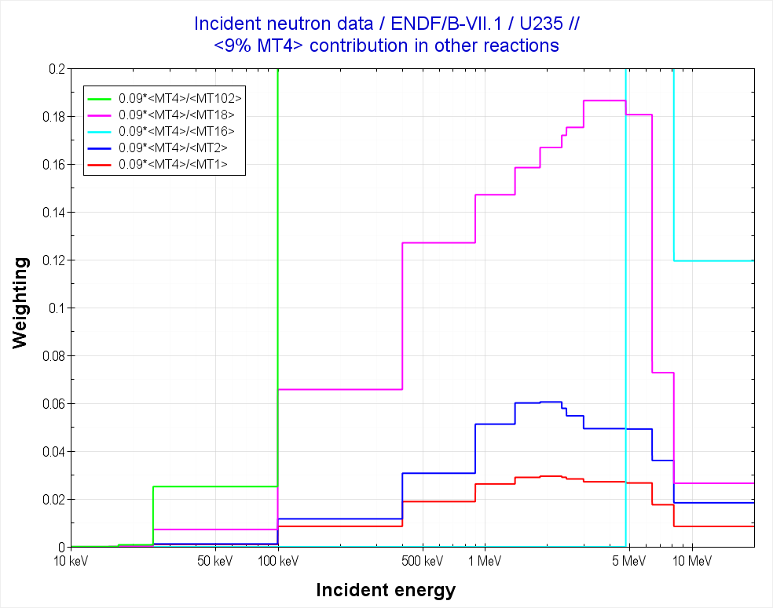
III. Compensating effects. An example: σ_{i}^{U235}
Figure shows the partial contribution in different cross-section of lowering inelastic cross section by 9%
6% elastic
3% total

Slide 22
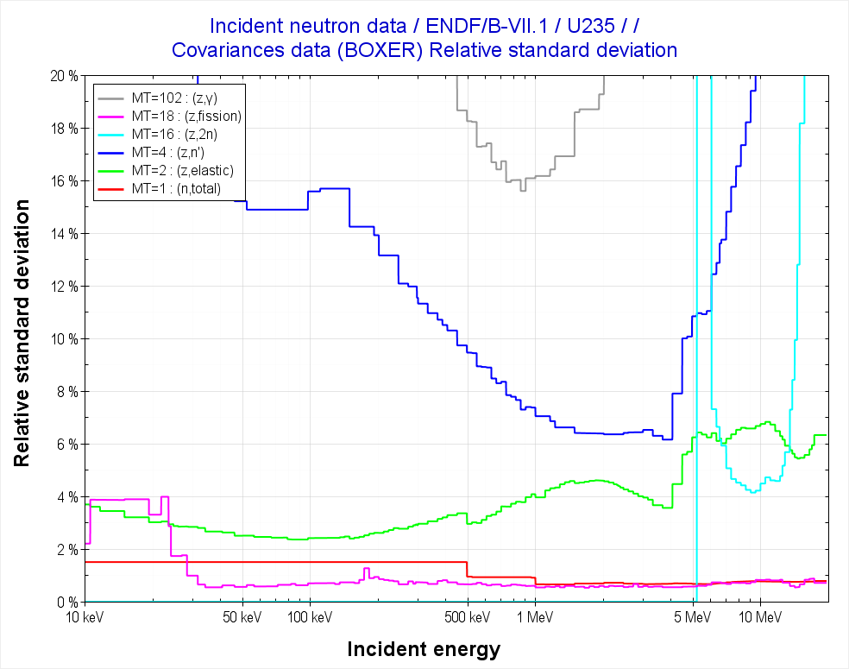
Relative standard deviation (in %)
6% inelastic
4% elastic
<1% total

Slide 23
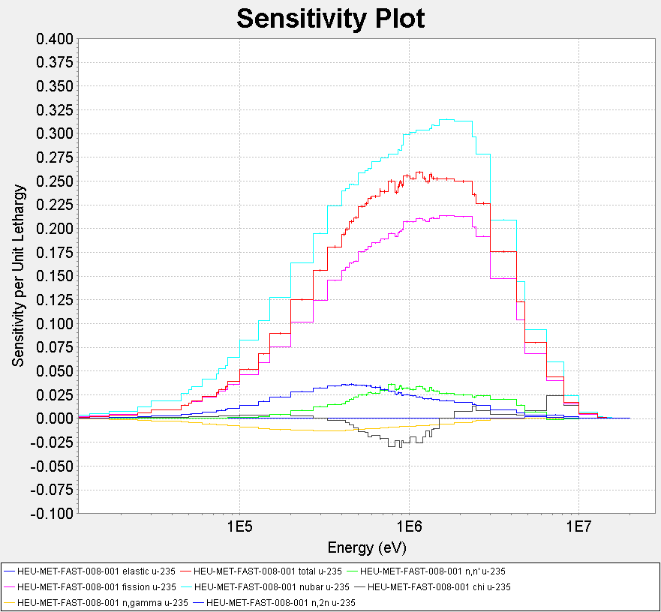
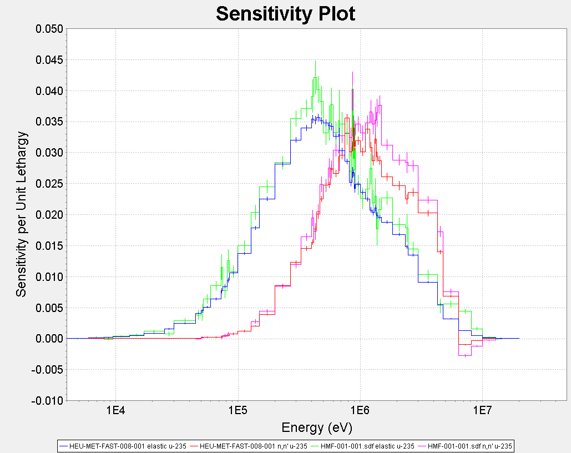
Sensitivity profiles
HMF-008-001
HMF-008-001 .vs. HMF-001-001
HMF1
Inelastic
HMF8
Elastic

Slide 24
To assess compensating effects: Bayes’ Theorem
Generalized least square approach
Updating procedure
Prior
(ENDF/B-VII.1)
Constraint
σ_{t}=σ_{e}+σ_{i}+σ_{n,2n}+σ_{fiss}+…
Observable
(σ_{i})
New information
(0.91σ_{i})
GLS Method

Slide 25
Covariances in ENDF/B-VII.1: U235
 | σ_{t} | σ_{e} | σ_{i} | σ_{n,2n} | σ_{n,3n} | σ_{fiss} | σ_{γ} | ν_{total} | ν_{promt} | χ
σ_{t} | X | X |  |  |  | X | X
σ_{e} | X | X | X | X | X | X | X
σ_{i} |  | X | X
σ_{n,2n} |  | X |  | X
σ_{n,3n} |  | X |  |  | X
σ_{fiss} | X | X |  |  |  | X
σ_{γ} | X | X |  |  |  |  | X
ν_{total} |  |  |  |  |  |  |  | X
ν_{promt} |  |  |  |  |  |  |  |  | X
χ |  |  |  |  |  |  |  |  |  | X

Slide 26
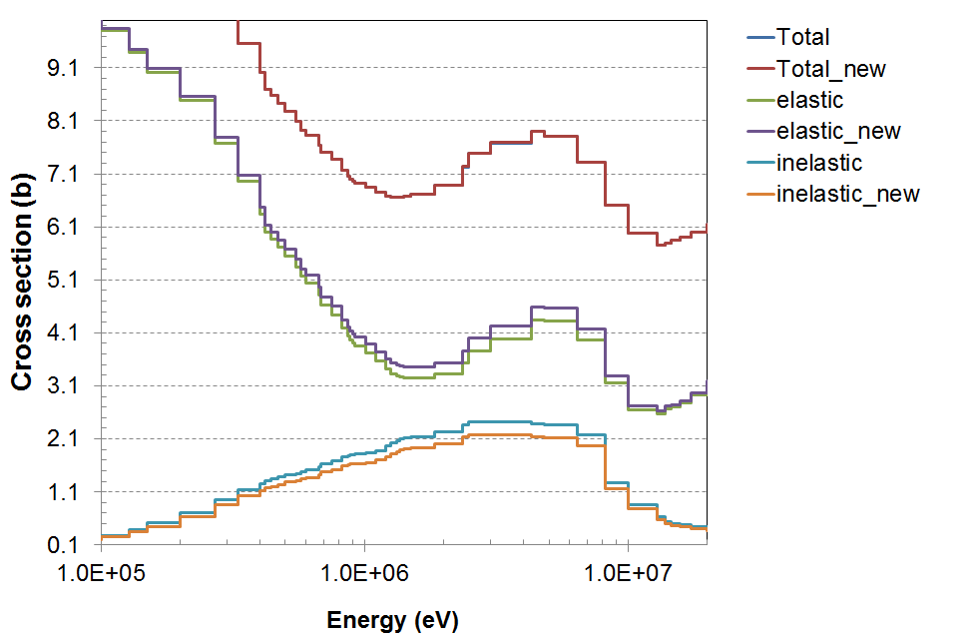
Updating procedure
6% elastic
-9% inelastic

Slide 27
Δk/k with Bayes’ approach: U235
 | Contribution to Δk/k (pcm)
 | σ_{t} | σ_{e} | σ_{i} | σ_{n,2n} | σ_{fiss} | σ_{γ} | SUM
HEU-MET-FAST-008-001 | -2 | 262 | -671 | 0 | 0 | -6 | -416
HEU-MET-FAST-001-001 | -2 | 293 | -740 | 0 | 0 | -6 | -455
All HEU cases in DICE (mean value) | -1 | 53 | -188 | 0 | 0 | -5 | -141
STD | 115 | 141 | 117 | 314 | 129 | 101 | 109
Importance of energy correlation | (calculation without energy correlation)
HEU-MET-FAST-008-001 | 0 | 241 | -614 | 0 | 0 | 0 | -371
HEU-MET-FAST-001-001 | 0 | 270 | -677 | 0 | 0 | 0 | -407

Slide 28
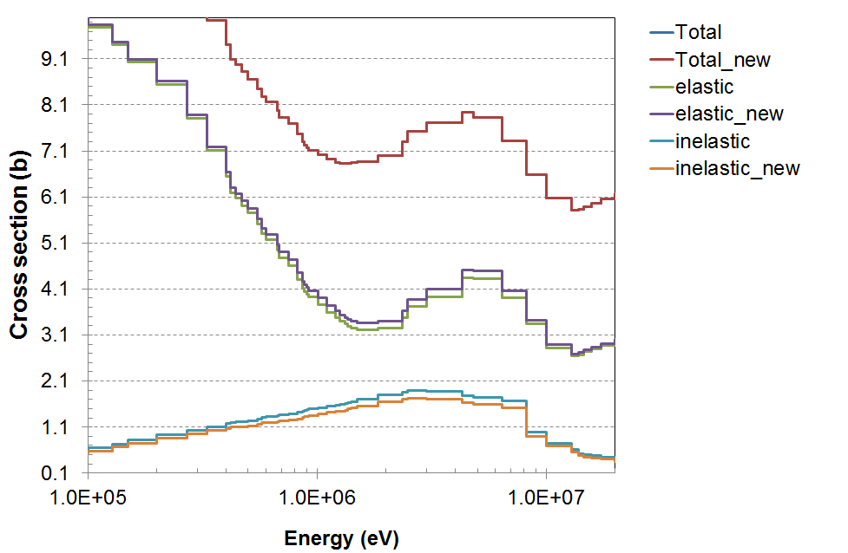
Δk/k with Bayes’ approach: Pu239
 | Contribution to Δk/k (pcm)
 | σ_{t} | σ_{e} | σ_{i} | σ_{n,2n} | σ_{fiss} | σ_{γ} | SUM
PU-MET-FAST-001-001 (-9% inel) | -1 | 158 | -323 | 0 | 0 | 0 | -166
PU-MET-FAST-001-001 (-18% inel) | -3 | 316 | -646 | 0 | 0 | 0 | -333
PU-MET-FAST-001-001 * (-9% inel) | 0 | 159 | -323 | 0 | 0 | 0 | -164
(*no energy correlation)
4% elastic
-9% inelastic

Slide 29
Assess compensating effects: Bayes’ Theorem
Updating procedure: χ(E) ?
Prior
(ENDF/B-VII.1)
Constraint
Observable
(σ_{i})
New information
(0.91σ_{i})
GLS Method
(based on Pronyaev’s idea, 18/09/2015)

Slide 30
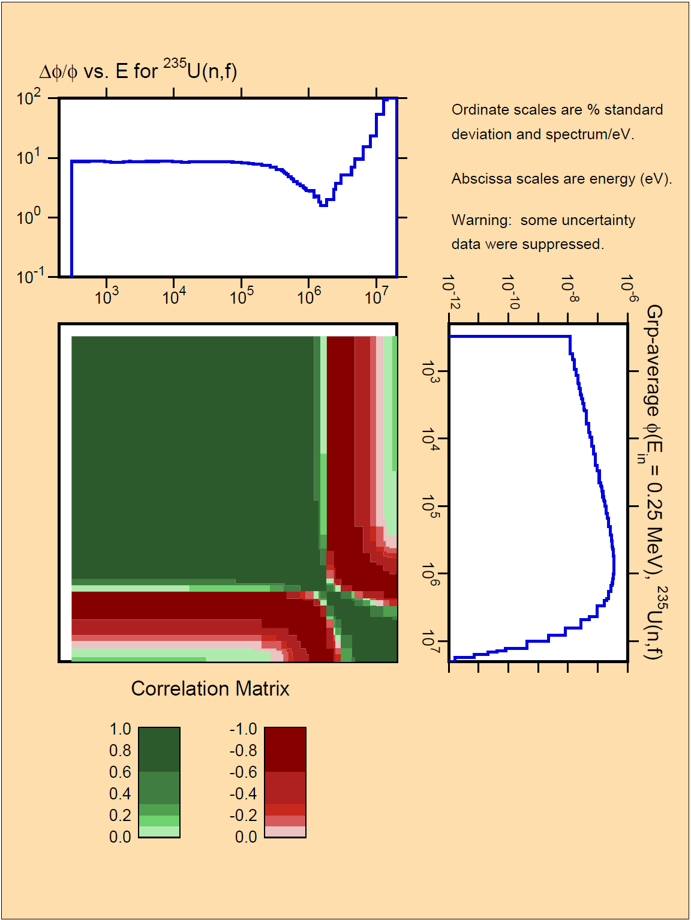
Constraints:
- Normalization
- PFNS average energy
A priori covariance data (V_{a}):
E_{in} =0.25 MeV
ENDF/B-VII.1
New information (η):
Normalization=1
PFNS avg. energy: 0.95*<E>_{prior}
It decreases ∼ 22.5 keV
Relative error for constraints:
STD norm ∼0
STD PFNS average energy : 0.5%

Slide 31
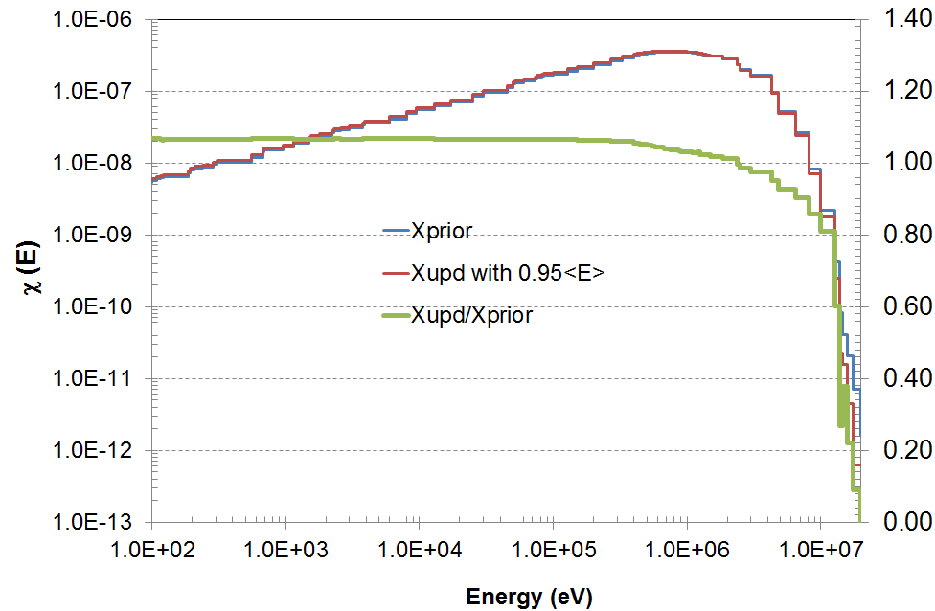
Updating PFNS Average Energy: “0.95 <E>”
 | Contribution to Δk/k (pcm)
 | χ(E)
HEU-MET-FAST-008-001 | -273

Slide 32
IV. Analysis of keff Sensitivity Profiles
“Compensation effects” might be generated by adjustment results with criticality integral experiments
S_{keff,j} (sensitivity coefficient for keff and j-cross section
Compensating effect for any reaction ( ) vs ( ) and/or material cross-correlations
if Δk/k=0
+1%

Slide 33
Jezebel case: FISSION
1 2 3 4 5 6 7 8 9 10 11
7.6 15.2 33.6 103.1 55.9 15.8 75.9 83.7 110.1 132.5 78.3
ig= 1 (2.000E+07-8.187E+06) 7.6 -1.000 -0.497 -0.225 -0.073 -0.136 -0.480 -0.100 -0.090 -0.069 -0.057 -0.097
ig= 2 (8.187E+06-6.434E+06) 15.2 -2.012 -1.000 -0.453 -0.148 -0.273 -0.966 -0.201 -0.182 -0.138 -0.115 -0.195
ig= 3 (6.434E+06-4.800E+06) 33.6 -4.442 -2.208 -1.000 -0.326 -0.602 -2.132 -0.443 -0.402 -0.306 -0.254 -0.430
ig= 4 (4.800E+06-3.000E+06) 103.1 ******* -6.764 -3.063 -1.000 -1.845 -6.531 -1.359 -1.231 -0.936 -0.778 -1.317
ig= 5 (3.000E+06-2.479E+06) 55.9 -7.377 -3.666 -1.660 -0.542 -1.000 -3.540 -0.736 -0.667 -0.508 -0.422 -0.714
ig= 6 (2.479E+06-2.354E+06) 15.8 -2.084 -1.036 -0.469 -0.153 -0.282 -1.000 -0.208 -0.189 -0.143 -0.119 -0.202
ig= 7 (2.354E+06-1.850E+06) 75.9 ******* -4.979 -2.255 -0.736 -1.358 -4.807 -1.000 -0.906 -0.689 -0.573 -0.969
ig= 8 (1.850E+06-1.400E+06) 83.7 ******* -5.493 -2.488 -0.812 -1.498 -5.304 -1.103 -1.000 -0.761 -0.632 -1.069
ig= 9 (1.400E+06-9.000E+05) 110.1 ******* -7.223 -3.271 -1.068 -1.970 -6.974 -1.451 -1.315 -1.000 -0.831 -1.406
ig= 10 (9.000E+05-4.000E+05) 132.5 ******* -8.694 -3.937 -1.285 -2.371 -8.394 -1.746 -1.583 -1.204 -1.000 -1.693
ig= 11 (4.000E+05-1.000E+05) 78.3 ******* -5.137 -2.326 -0.759 -1.401 -4.960 -1.032 -0.935 -0.711 -0.591 -1.000
ig= 12 (1.000E+05-2.500E+04) 12.1 -1.603 -0.797 -0.361 -0.118 -0.217 -0.769 -0.160 -0.145 -0.110 -0.092 -0.155
ig= 13 (2.500E+04-1.700E+04) 0.7 -0.098 -0.049 -0.022 -0.007 -0.013 -0.047 -0.010 -0.009 -0.007 -0.006 -0.010
ig= 14 (1.700E+04-3.000E+03) 0.9 -0.119 -0.059 -0.027 -0.009 -0.016 -0.057 -0.012 -0.011 -0.008 -0.007 -0.012
ig= 15 (3.000E+03-5.500E+02) 0.1 -0.009 -0.004 -0.002 -0.001 -0.001 -0.004 -0.001 -0.001 -0.001 0.000 -0.001
ig= 16 (5.500E+02-1.000E+02) 0.0 0.000 0.000 0.000 0.000 0.000 0.000 0.000 0.000 0.000 0.000 0.000
ig= 17 (1.000E+02-3.000E+01) 0.0 0.000 0.000 0.000 0.000 0.000 0.000 0.000 0.000 0.000 0.000 0.000
ig= 18 (3.000E+01-1.000E+01) 0.0 0.000 0.000 0.000 0.000 0.000 0.000 0.000 0.000 0.000 0.000 0.000
ig= 19 (1.000E+01-8.100E+00) 0.0 0.000 0.000 0.000 0.000 0.000 0.000 0.000 0.000 0.000 0.000 0.000
ig= 20 (8.100E+00-6.000E+00) 0.0 0.000 0.000 0.000 0.000 0.000 0.000 0.000 0.000 0.000 0.000 0.000
ig= 21 (6.000E+00-4.750E+00) 0.0 0.000 0.000 0.000 0.000 0.000 0.000 0.000 0.000 0.000 0.000 0.000
ig= 22 (4.750E+00-3.000E+00) 0.0 0.000 0.000 0.000 0.000 0.000 0.000 0.000 0.000 0.000 0.000 0.000
ig= 23 (3.000E+00-1.770E+00) 0.0 0.000 0.000 0.000 0.000 0.000 0.000 0.000 0.000 0.000 0.000 0.000
ig= 24 (1.770E+00-1.000E+00) 0.0 0.000 0.000 0.000 0.000 0.000 0.000 0.000 0.000 0.000 0.000 0.000
ig= 25 (1.000E+00-6.250E-01) 0.0 0.000 0.000 0.000 0.000 0.000 0.000 0.000 0.000 0.000 0.000 0.000
ig= 26 (6.250E-01-4.000E-01) 0.0 0.000 0.000 0.000 0.000 0.000 0.000 0.000 0.000 0.000 0.000 0.000
ig= 27 (4.000E-01-3.750E-01) 0.0 0.000 0.000 0.000 0.000 0.000 0.000 0.000 0.000 0.000 0.000 0.000
ig= 28 (3.750E-01-3.500E-01) 0.0 0.000 0.000 0.000 0.000 0.000 0.000 0.000 0.000 0.000 0.000 0.000
ig= 29 (3.500E-01-3.250E-01) 0.0 0.000 0.000 0.000 0.000 0.000 0.000 0.000 0.000 0.000 0.000 0.000
ig= 30 (3.250E-01-2.750E-01) 0.0 0.000 0.000 0.000 0.000 0.000 0.000 0.000 0.000 0.000 0.000 0.000
-1.3 % in g=8
Pu²³⁹_fiss.vs.Pu²³⁹_fiss
+1%
Compensating effects in one reaction

Slide 34
Jezebel case: (n,n’)- χ
+
-
1 2 3 4 5 6 7 8 9 10 11
3.9 5.4 4.1 6.5 3.5 1.4 5.3 3.1 -6.8 -17.9 -7.7
ig= 1 (2.000E+07-8.187E+06) 0.1 -0.022 -0.016 -0.021 -0.013 -0.024 -0.061 -0.016 -0.027 0.012 0.005 0.011
ig= 2 (8.187E+06-6.434E+06) 0.2 -0.054 -0.040 -0.052 -0.032 -0.061 -0.153 -0.040 -0.068 0.031 0.012 0.027
ig= 3 (6.434E+06-4.800E+06) 1.5 -0.386 -0.281 -0.371 -0.230 -0.433 -1.084 -0.287 -0.485 0.220 0.084 0.195
ig= 4 (4.800E+06-3.000E+06) 5.3 -1.371 -0.996 -1.318 -0.818 -1.536 -3.848 -1.018 -1.722 0.782 0.298 0.692
ig= 5 (3.000E+06-2.479E+06) 3.0 -0.758 -0.551 -0.729 -0.452 -0.849 -2.128 -0.563 -0.953 0.433 0.165 0.383
ig= 6 (2.479E+06-2.354E+06) 0.8 -0.193 -0.140 -0.185 -0.115 -0.216 -0.541 -0.143 -0.242 0.110 0.042 0.097
ig= 7 (2.354E+06-1.850E+06) 3.7 -0.959 -0.697 -0.922 -0.572 -1.075 -2.692 -0.712 -1.205 0.547 0.209 0.484
ig= 8 (1.850E+06-1.400E+06) 4.3 -1.091 -0.792 -1.048 -0.651 -1.222 -3.061 -0.810 -1.370 0.622 0.237 0.551
ig= 9 (1.400E+06-9.000E+05) 6.3 -1.618 -1.176 -1.556 -0.965 -1.813 -4.542 -1.202 -2.033 0.923 0.352 0.817
ig= 10 (9.000E+05-4.000E+05) 7.6 -1.957 -1.422 -1.881 -1.167 -2.192 -5.491 -1.453 -2.458 1.117 0.426 0.988
ig= 11 (4.000E+05-1.000E+05) 3.3 -0.839 -0.610 -0.807 -0.501 -0.940 -2.355 -0.623 -1.054 0.479 0.183 0.424
ig= 12 (1.000E+05-2.500E+04) 0.2 -0.053 -0.038 -0.051 -0.031 -0.059 -0.148 -0.039 -0.066 0.030 0.011 0.027
ig= 13 (2.500E+04-1.700E+04) 0.0 -0.002 -0.001 -0.002 -0.001 -0.002 -0.006 -0.002 -0.003 0.001 0.000 0.001
ig= 14 (1.700E+04-3.000E+03) 0.0 -0.002 -0.001 -0.002 -0.001 -0.002 -0.005 -0.001 -0.002 0.001 0.000 0.001
ig= 15 (3.000E+03-5.500E+02) 0.0 0.000 0.000 0.000 0.000 0.000 0.000 0.000 0.000 0.000 0.000 0.000
ig= 16 (5.500E+02-1.000E+02) 0.0 0.000 0.000 0.000 0.000 0.000 0.000 0.000 0.000 0.000 0.000 0.000
ig= 17 (1.000E+02-3.000E+01) 0.0 0.000 0.000 0.000 0.000 0.000 0.000 0.000 0.000 0.000 0.000 0.000
ig= 18 (3.000E+01-1.000E+01) 0.0 0.000 0.000 0.000 0.000 0.000 0.000 0.000 0.000 0.000 0.000 0.000
ig= 19 (1.000E+01-8.100E+00) 0.0 0.000 0.000 0.000 0.000 0.000 0.000 0.000 0.000 0.000 0.000 0.000
ig= 20 (8.100E+00-6.000E+00) 0.0 0.000 0.000 0.000 0.000 0.000 0.000 0.000 0.000 0.000 0.000 0.000
ig= 21 (6.000E+00-4.750E+00) 0.0 0.000 0.000 0.000 0.000 0.000 0.000 0.000 0.000 0.000 0.000 0.000
ig= 22 (4.750E+00-3.000E+00) 0.0 0.000 0.000 0.000 0.000 0.000 0.000 0.000 0.000 0.000 0.000 0.000
ig= 23 (3.000E+00-1.770E+00) 0.0 0.000 0.000 0.000 0.000 0.000 0.000 0.000 0.000 0.000 0.000 0.000
ig= 24 (1.770E+00-1.000E+00) 0.0 0.000 0.000 0.000 0.000 0.000 0.000 0.000 0.000 0.000 0.000 0.000
ig= 25 (1.000E+00-6.250E-01) 0.0 0.000 0.000 0.000 0.000 0.000 0.000 0.000 0.000 0.000 0.000 0.000
ig= 26 (6.250E-01-4.000E-01) 0.0 0.000 0.000 0.000 0.000 0.000 0.000 0.000 0.000 0.000 0.000 0.000
ig= 27 (4.000E-01-3.750E-01) 0.0 0.000 0.000 0.000 0.000 0.000 0.000 0.000 0.000 0.000 0.000 0.000
ig= 28 (3.750E-01-3.500E-01) 0.0 0.000 0.000 0.000 0.000 0.000 0.000 0.000 0.000 0.000 0.000 0.000
ig= 29 (3.500E-01-3.250E-01) 0.0 0.000 0.000 0.000 0.000 0.000 0.000 0.000 0.000 0.000 0.000 0.000
ig= 30 (3.250E-01-2.750E-01) 0.0 0.000 0.000 0.000 0.000 0.000 0.000 0.000 0.000 0.000 0.000 0.000
-2.033% in g=8, χ(E)
Pu²³⁹_n,n’ .vs. Pu²³⁹_χ
+1%
in g=9
(n,n’)
Compensating effects between two different reactions

Slide 35
Na cases: n,n’
1 2 3 4 5 6 7 8 9 10 11
-0.2 -0.4 -0.2 -1.4 -0.7 -0.1 -1.0 -1.2 -0.4 -1.8 0.0
ig= 1 (2.000E+07-8.187E+06) -0.1 ******* ******* ******* ******* ******* ******* ******* ******* ******* ******* 0.000
ig= 2 (8.187E+06-6.434E+06) -0.6 ******* ******* ******* ******* ******* ******* ******* ******* ******* ******* 0.000
ig= 3 (6.434E+06-4.800E+06) -2.3 ******* -5.552 ******* ******* ******* ******* ******* ******* ******* ******* 0.000
ig= 4 (4.800E+06-3.000E+06) -8.3 ******* ******* ******* ******* ******* ******* ******* ******* ******* ******* 0.000
ig= 5 (3.000E+06-2.479E+06) -6.0 ******* ******* ******* -4.247 ******* ******* -5.820 -5.086 ******* ******* 0.000
ig= 6 (2.479E+06-2.354E+06) -1.8 ******* -4.588 ******* -1.307 ******* ******* -1.791 -1.565 ******* ******* 0.000
ig= 7 (2.354E+06-1.850E+06) -8.0 ******* ******* ******* ******* ******* ******* ******* ******* ******* ******* 0.000
ig= 8 (1.850E+06-1.400E+06) -7.5 ******* ******* ******* -5.325 ******* ******* ******* -6.376 ******* ******* 0.000
ig= 9 (1.400E+06-9.000E+05) -3.6 ******* -9.240 ******* -2.599 -5.514 ******* -3.556 -3.110 ******* ******* 0.000
ig= 10 (9.000E+05-4.000E+05) -0.3 ******* ******* ******* ******* ******* ******* ******* ******* ******* ******* 0.000
ig= 11 (4.000E+05-1.000E+05) -5.3 ******* ******* ******* ******* -7.789 ******* -5.114 -4.474 ******* -2.903 0.000
ig= 12 (1.000E+05-2.500E+04) -1.4 ******* ******* -6.929 ******* ******* -9.793 ******* ******* ******* ******* 0.000
ig= 13 (2.500E+04-1.700E+04) 0.0 0.000 0.000 0.000 0.000 0.000 0.000 0.000 0.000 0.000 0.000 0.000
ig= 14 (1.700E+04-3.000E+03) 0.0 0.000 0.000 0.000 0.000 0.000 0.000 0.000 0.000 0.000 0.000 0.000
ig= 15 (3.000E+03-5.500E+02) 0.0 0.000 0.000 0.000 0.000 0.000 0.000 0.000 0.000 0.000 0.000 0.000
ig= 16 (5.500E+02-1.000E+02) 0.0 0.000 0.000 0.000 0.000 0.000 0.000 0.000 0.000 0.000 0.000 0.000
ig= 17 (1.000E+02-3.000E+01) 0.0 0.000 0.000 0.000 0.000 0.000 0.000 0.000 0.000 0.000 0.000 0.000
ig= 18 (3.000E+01-1.000E+01) 0.0 0.000 0.000 0.000 0.000 0.000 0.000 0.000 0.000 0.000 0.000 0.000
ig= 19 (1.000E+01-8.100E+00) 0.0 0.000 0.000 0.000 0.000 0.000 0.000 0.000 0.000 0.000 0.000 0.000
ig= 20 (8.100E+00-6.000E+00) 0.0 0.000 0.000 0.000 0.000 0.000 0.000 0.000 0.000 0.000 0.000 0.000
ig= 21 (6.000E+00-4.750E+00) 0.0 0.000 0.000 0.000 0.000 0.000 0.000 0.000 0.000 0.000 0.000 0.000
ig= 22 (4.750E+00-3.000E+00) 0.0 0.000 0.000 0.000 0.000 0.000 0.000 0.000 0.000 0.000 0.000 0.000
ig= 23 (3.000E+00-1.770E+00) 0.0 0.000 0.000 0.000 0.000 0.000 0.000 0.000 0.000 0.000 0.000 0.000
ig= 24 (1.770E+00-1.000E+00) 0.0 0.000 0.000 0.000 0.000 0.000 0.000 0.000 0.000 0.000 0.000 0.000
ig= 25 (1.000E+00-6.250E-01) 0.0 0.000 0.000 0.000 0.000 0.000 0.000 0.000 0.000 0.000 0.000 0.000
ig= 26 (6.250E-01-4.000E-01) 0.0 0.000 0.000 0.000 0.000 0.000 0.000 0.000 0.000 0.000 0.000 0.000
ig= 27 (4.000E-01-3.750E-01) 0.0 0.000 0.000 0.000 0.000 0.000 0.000 0.000 0.000 0.000 0.000 0.000
ig= 28 (3.750E-01-3.500E-01) 0.0 0.000 0.000 0.000 0.000 0.000 0.000 0.000 0.000 0.000 0.000 0.000
ig= 29 (3.500E-01-3.250E-01) 0.0 0.000 0.000 0.000 0.000 0.000 0.000 0.000 0.000 0.000 0.000 0.000
ig= 30 (3.250E-01-2.750E-01) 0.0 0.000 0.000 0.000 0.000 0.000 0.000 0.000 0.000 0.000 0.000 0.000
-3.110% in g=8, (n,n’) Na23
U²³⁸_n,n’ .vs. Na²³_n,n’
+1%
in g=9
(n,n’)
U238
Potential compensating effects between different isotopes

Slide 36
Case: LEU-SOL-THERM1
+
1 2 3 4 5 6 7 8 9 10 11
0.0 0.1 0.8 2.2 1.3 0.4 1.3 1.2 0.9 0.6 0.2
ig= 1 (2.000E+07-8.187E+06) -1.5 ******* ******* 1.860 0.687 1.219 4.000 1.149 1.271 1.667 2.808 7.957
ig= 2 (8.187E+06-6.434E+06) -3.8 ******* ******* 4.528 1.672 2.967 9.736 2.797 3.095 4.058 6.834 *******
ig= 3 (6.434E+06-4.800E+06) -10.5 ******* ******* ******* 4.666 8.281 ******* 7.807 8.637 ******* ******* *******
ig= 4 (4.800E+06-3.000E+06) -19.8 ******* ******* ******* 8.816 ******* ******* ******* ******* ******* ******* *******
ig= 5 (3.000E+06-2.479E+06) -6.9 ******* ******* 8.270 3.054 5.419 ******* 5.109 5.653 7.412 ******* *******
ig= 6 (2.479E+06-2.354E+06) -1.6 ******* ******* 1.884 0.696 1.234 4.050 1.164 1.287 1.688 2.843 8.057
ig= 7 (2.354E+06-1.850E+06) -3.4 ******* ******* 4.045 1.494 2.651 8.698 2.499 2.765 3.626 6.106 *******
ig= 8 (1.850E+06-1.400E+06) 2.1 ******* ******* -2.539 -0.937 -1.664 -5.459 -1.568 -1.735 -2.275 -3.832 *******
ig= 9 (1.400E+06-9.000E+05) 10.2 ******* ******* ******* -4.527 -8.034 ******* -7.574 -8.380 ******* ******* *******
ig= 10 (9.000E+05-4.000E+05) 19.1 ******* ******* ******* -8.503 ******* ******* ******* ******* ******* ******* *******
ig= 11 (4.000E+05-1.000E+05) 13.4 ******* ******* ******* -5.954 ******* ******* -9.961 ******* ******* ******* *******
ig= 12 (1.000E+05-2.500E+04) 2.2 ******* ******* -2.700 -0.997 -1.769 -5.805 -1.668 -1.845 -2.420 -4.075 *******
ig= 13 (2.500E+04-1.700E+04) 0.2 ******* -1.202 -0.192 -0.071 -0.126 -0.413 -0.119 -0.131 -0.172 -0.290 -0.821
ig= 14 (1.700E+04-3.000E+03) 0.2 ******* -1.499 -0.240 -0.088 -0.157 -0.515 -0.148 -0.164 -0.215 -0.362 -1.025
ig= 15 (3.000E+03-5.500E+02) 0.0 -1.198 -0.105 -0.017 -0.006 -0.011 -0.036 -0.010 -0.012 -0.015 -0.025 -0.072
ig= 16 (5.500E+02-1.000E+02) 0.0 -0.003 0.000 0.000 0.000 0.000 0.000 0.000 0.000 0.000 0.000 0.000
ig= 17 (1.000E+02-3.000E+01) 0.0 0.000 0.000 0.000 0.000 0.000 0.000 0.000 0.000 0.000 0.000 0.000
ig= 18 (3.000E+01-1.000E+01) 0.0 0.000 0.000 0.000 0.000 0.000 0.000 0.000 0.000 0.000 0.000 0.000
ig= 19 (1.000E+01-8.100E+00) 0.0 0.000 0.000 0.000 0.000 0.000 0.000 0.000 0.000 0.000 0.000 0.000
ig= 20 (8.100E+00-6.000E+00) 0.0 0.000 0.000 0.000 0.000 0.000 0.000 0.000 0.000 0.000 0.000 0.000
ig= 21 (6.000E+00-4.750E+00) 0.0 0.000 0.000 0.000 0.000 0.000 0.000 0.000 0.000 0.000 0.000 0.000
ig= 22 (4.750E+00-3.000E+00) 0.0 0.000 0.000 0.000 0.000 0.000 0.000 0.000 0.000 0.000 0.000 0.000
ig= 23 (3.000E+00-1.770E+00) 0.0 0.000 0.000 0.000 0.000 0.000 0.000 0.000 0.000 0.000 0.000 0.000
ig= 24 (1.770E+00-1.000E+00) 0.0 0.000 0.000 0.000 0.000 0.000 0.000 0.000 0.000 0.000 0.000 0.000
ig= 25 (1.000E+00-6.250E-01) 0.0 0.000 0.000 0.000 0.000 0.000 0.000 0.000 0.000 0.000 0.000 0.000
ig= 26 (6.250E-01-4.000E-01) 0.0 0.000 0.000 0.000 0.000 0.000 0.000 0.000 0.000 0.000 0.000 0.000
ig= 27 (4.000E-01-3.750E-01) 0.0 0.000 0.000 0.000 0.000 0.000 0.000 0.000 0.000 0.000 0.000 0.000
ig= 28 (3.750E-01-3.500E-01) 0.0 0.000 0.000 0.000 0.000 0.000 0.000 0.000 0.000 0.000 0.000 0.000
ig= 29 (3.500E-01-3.250E-01) 0.0 0.000 0.000 0.000 0.000 0.000 0.000 0.000 0.000 0.000 0.000 0.000
ig= 30 (3.250E-01-2.750E-01) 0.0 0.000 0.000 0.000 0.000 0.000 0.000 0.000 0.000 0.000 0.000 0.000
U²³⁵_χ.vs. U²³⁸_n,n’
+1%
²³⁵U-χ
-
“Softer PFNS can be compensated by lowering the (n,n’) ”

Slide 37
Conclusion
NEA Tools: DICE and NDaST
https://www.oecd-nea.org/science/wpncs/icsbep/dice.html
http://www.oecd-nea.org/ndast/
Bayesian approach for compensating effects
e.g.: -9% in U235 (n,n’)
Analysis of keff Sensitivity Profiles
Searching compensating effects in integral benchmarks due to nuclear reaction and material cross-correlations

