Slide 1
LANL Experience using ICSBEP Benchmarks for Cross Section Data Testing
A.C.(Skip) Kahler
Los Alamos National Laboratory
Consultant’s Meeting on Compensating Effects due to Nuclear Reaction and Material Cross Correlations in Integral Benchmarks
IAEA Headquarters, Vienna, Austria
September 28 – October 1, 2015

Slide 2
Abstract
We review results from criticality calculations with ICSBEP benchmarks obtained with various cross section data sets. This presentation shall focus on differences in calculated eigenvalues using ENDF/B-VII.1 cross sections and various CIELO candidate evaluations for ¹⁶O, ^{235,238}U and ²³⁹Pu.

Slide 3
Outline
Introduction & ICSBEP Review
LANL Data Testing
Concluding Remarks

Slide 4
Introduction & ICSBEP Overview
Testing of ENDF/B-x libraries has been an important CSEWG activity for decades.
Data testing has focused on criticality …
ENDF-230, “Benchmark Testing of ENDF/B-IV.
ENDF-311, “Benchmark Testing of ENDF/B-V.
???, ENDF/B-VI.x.
Chadwick et al, “ENDF/B-VII.0: Next Generation Evaluated Nuclear Data Library for Nuclear Science and Technology,” Nuclear Data Sheets 107, 2931 (2006).
Also van der Marck, “Benchmarking ENDF/B-VII.0,” Nuclear Data Sheets 107, 3061 (2006).
Kahler et al, “ENDF/B-VII.1 Neutron Cross Section Data Testing with Critical Assembly Benchmarks and Reactor Experiments,” Nuclear Data Sheets 112, 2997 (2011).
Also van der Marck, “Benchmarking ENDF/B-VII.1, JENDL-4.0 and JEFF-3.1.1 with MCNP6,” Nuclear Data Sheets 113, 2935 (2013).

Slide 5
Introduction & ICSBEP Overview
ICSBEP = International Criticality Safety Benchmark Evaluation Project
Initiated in 1992 by the US DOE Defense Programs (CSBEP).
Expanded to become an international activity in 1994.
Per http://icsbep.inel.gov/ (9/22/2015) the Handbook contains 558 evaluations representing 4798 critical, near-critical, subcritical or k∞ configurations.
Criticality configurations are defined in terms of fissile material (²³⁹Pu, ²³⁵U (and enrichment), ²³³U) , material composition (metal, compound, solution) and spectrum.
Ex. HEU-MET-FAST-001 = Highly enriched uranium, metal, fast spectrum.
LANL has created a suite of over 1100 MCNP input decks.
Larger suites have been developed by other data testers.

Slide 6
Introduction & ICSBEP Overview
ICSBEP benchmark calculated eigenvalues with ENDF/B-VII.1 cross sections for LANL MCNP models.
A nice “marketing” picture to show a lot of work was done, but not particularly useful without further details.
Need tools to filter this large collection into smaller subsets that categorize specific features of interest.

Slide 7
Introduction & ICSBEP Overview
ICSBEP benchmark calculated eigenvalues with ENDF/B-VII.1 cross sections for LANL MCNP models.
Many thermal and many fast benchmarks are defined; fewer intermediate spectrum benchmarks are available.

Slide 8
Introduction & ICSBEP Overview
ICSBEP benchmark calculated eigenvalues with ENDF/B-VII.1 cross sections for LANL MCNP models.
Many thermal and many fast benchmarks are defined; fewer intermediate spectrum benchmarks are available although “AEF” doesn’t distinguish among the spectrum categories as well as “Average Energy of Lethargy”.

Slide 9
LANL Data Testing
For “old fashioned” folks (nerds?) such as myself who have been fortunate enough to be involved with ICSBEP since the mid-1990s, and involved in data testing to support reactor design even longer, that tool is my brain!
Basic (common sense!) rules …
Critical Assemblies with simple geometry and a minimal number of well characterized materials.
LANL assemblies … Godiva, Jezebel, Flattops, Big-10
A suite of assemblies with minimal geometry and/or material changes that yield a wide variation in a relevant parameter of interest.
HMF7 = HEU with varying amounts of CH₂.
PMFx = metal ²³⁹Pu core with various reflectors.
HMFx = metal HEU with various interstitial and/or reflector materials.
LCTx = UO₂ lattice with varying pitch.

Slide 10
LANL Data Testing
Benchmark | Benchmark k_{eff} | endf/b-vii.1 (e71) | e71 + iaea "g6" ²³⁵U (06c) | e71 + iaea "g6" ²³⁵U (06c) + iaea "ib44" ²³⁸U (04c) | e71 but ²³⁵U pfns is trkov/capote thermal + talou/rising to 5 MeV + e71 (13c) | e71 + ²³⁵U (13c) + ib44 ²³⁸U (04c)
HMF1 (Godiva) | 1.0000 | 0.99989(3) | 0.99951(6) | 0.99950(8) | 1.00007(8) | 1.00014(8)
HMF28 (Flattop-25) | 1.0000 | 1.00284(3) | 1.00227(6) | 1.00356(9) | 1.00273(9) | 1.00383(9)
IMF7 (Big-10) | 1.0045 | 1.00448(5) | 1.00185(5) | 1.00321(7) | 1.00185(8) | 1.00328(7)

Slide 11
LANL Data Testing
HEU thermal solution benchmarks have been used in data testing since (at least) ENDF/B-IV.
E4*: b ≈ 0.994; m ≈ 0.03
E5: b ≈ 1.001; m ≈ 0.009
Changes to basic nuclear data need to preserve the good results obtained since ENDF/B-VI.3.
* J.Hardy, “ENDF/B Data Testing Results for Thermal Reactor Benchmarks,” in Proceedings: Thermal Reactor Benchmark Calculations, Techniques, Results and Applications, EPRI NP-2855, February, 1983.

Slide 12
LANL Data Testing
Observations from past HST data testing …
The slope is sensitive to pfns average energy.
Lower average energy = larger slope.
The slope is affected by oxygen cross sections.
New Hale evaluation tends to decrease the slope.
The intercept is sensitive to prompt ν(E).
Sadly, recent CIELO candidate evaluations tend to yield regression parameters that are worse …
IAEA “g6” ²³⁵U: m=+0.0073(84); b=1.0001(32).
IAEA “g6” + Hale ¹⁶O: m=+0.0051(86); b=1.0004(32).
IAEA “g6” + Hale ¹⁶O + IAEA “ib44” ²³⁸U: m=+0.0048(85); b=1.0004(32).
More recent IAEA ²³⁵U with changes to low energy ν_{prompt}(E) + Hale ¹⁶O + “ib44” ²³⁸U: m=+0.0086(85); b=0.9964(32).
LEAL ²³⁵U low energy RR tweak: m=+0.0052(90); b=0.9971(34).

Slide 13
LANL Data Testing
One (HEU) fuel system plus varying amounts of CH₂ moderator and reflector yield average energy variation that spans decades.
A potential benchmark candidate for intermediate spectrum data testing?

Slide 14
LANL Data Testing
Proper benchmark selection allows for data testing over energy intervals of many decades.

Slide 15
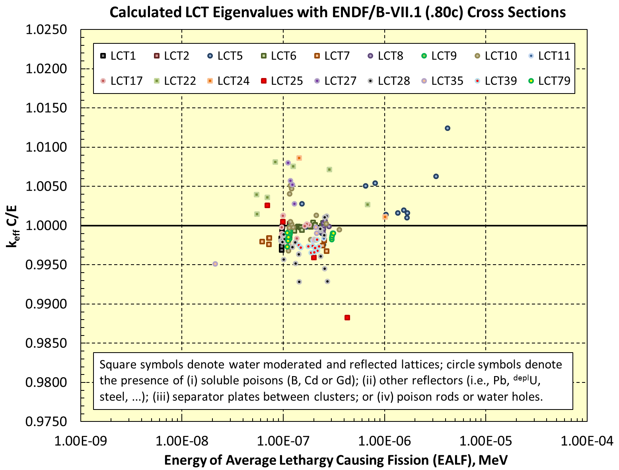
LANL Data Testing
The ICSBEP Handbook contains hundreds of LEU-COMP-THERM critical assemblies …
… but only need to calculate a small subset of these for data testing
… use detailed flux spectra as a filter …
… or focus on reflector material of interest …

Slide 16
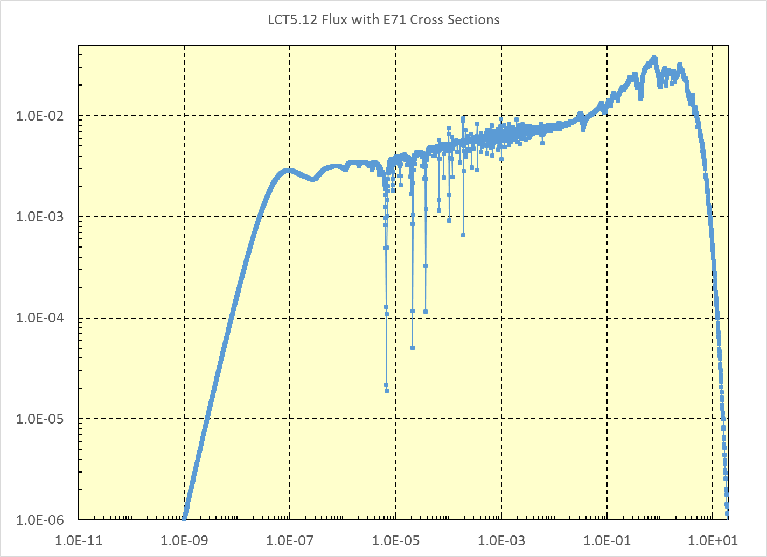
LANL Data Testing
Flux in UO₂; 250 equi-lethergy spaced energy points per decade.

Slide 17
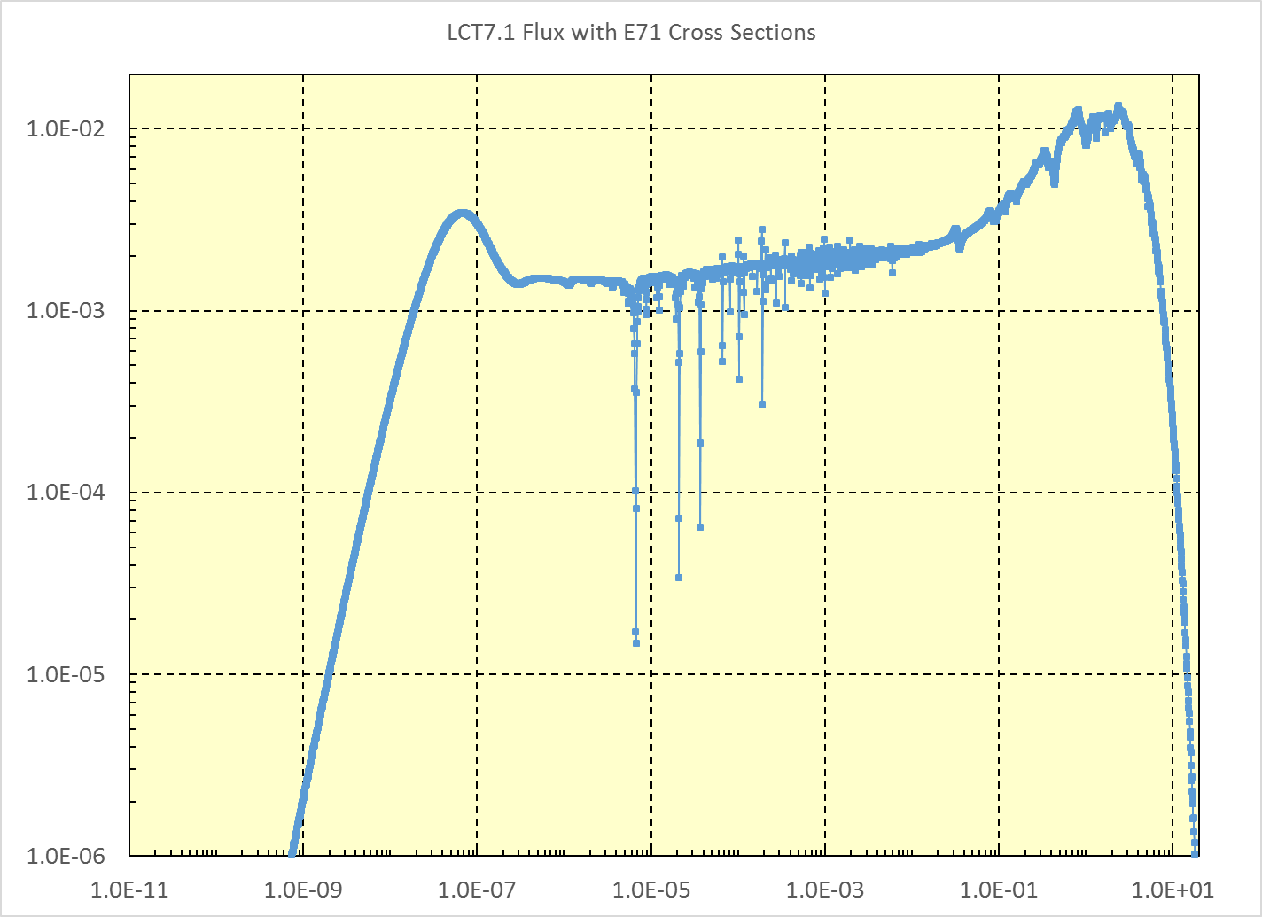
LANL Data Testing

Slide 18
LANL Data Testing
Benchmark | Benchmark k_{eff} | endf/b-vii.1 (e71) | e71 + CAB h-h₂o kernel (lwtr.00t) | e71 but ²³⁵U pfns is trkov/capote thermal + talou/rising to 5 MeV + e71 (13c) | e71 + 13c ²³⁵U + ib44 ²³⁸U (04c) | e71 + 13c ²³⁵U + ib44 ²³⁸U (04c) + Hale 16O (02c) | e71 + 14c ²³⁵U + ib44 ²³⁸U (04c) + Hale 16O (02c)
LCT5.1 | 1.00000 | 1.00265(2) | 1.00312(11) | 1.00513(11) | 1.00516(11) | 1.00401(11) | 1.00006(11)
LCT5.5 | 1.00000 | 1.00504(2) | 1.00573(11) | 1.00629(11) | 1.00632(11) | 1.00543(11) | 1.00155(11)
LCT5.12 | 1.00000 | 1.00645(2) | 1.00700(10) | 1.00697(11) | 1.00668(10) | 1.00638(10) | 1.00251(10)
LCT7.1 | 1.00000 | 0.99759(3) | 0.99807(11) | 0.99980(11) | 0.99983(11) | 0.99884(11) | 0.99440(11)
LCT7.2 | 1.00000 | 0.99884(2) | 0.99921(11) | 1.00153(11) | 1.00178(11) | 1.00042(11) | 0.99651(11)
LCT7.3 | 1.00000 | 0.99759(2) | 0.99793(10) | 0.99979(10) | 0.99987(10) | 0.99886(10) | 0.99501(10)
LCT7.4 | 1.00000 | 0.99810(2) | 0.99856(9) | 0.99948(9) | 0.99964(9) | 0.99886(9) | 0.99489(9)

Slide 19
LANL Data Testing
k_{calc} for PST benchmarks have been biased high for decades.
Largely eliminated in SG34, but there are still concerns about the ²³⁹Pu evaluation.

Slide 20
LANL Data Testing
Proposed at Fall, 2009 CSEWG meeting.
For more efficient data testing, a set of seven Pu-SOL-THERM benchmarks have been extracted from the larger PST set.
PST1.4 & PST12.13 span the ATLF space.
PST12.10 & PST34.15 span the ATFF space.
PST4.1 & PST18.6 span the ²³⁹Pu atom percent space.
PST12.10 & PST34.4 span the g Pu per liter space.
All benchmark experiments are performed in simple geometry
PST1.4 & PST4.1 are a water-reflected spheres.
PST18.6, PST34.4 & PST34.15 are water-reflected cylinders.
PST12.10 & PST12.13 are a water-reflected slabs.

Slide 21
LANL Data Testing
Benchmark | E71 (w/fixed ²³⁹Pu, 94239.62c) | E71 (including pfns & fixed mf3/mt18) + SG34 RR parms and nu-bar to 650 eV ²³⁹Pu (TK1a = 94239.02c) | E71 + TK1a ²³⁹Pu + Hale ¹⁶O (8016.02c) | E71 + TK1a ²³⁹Pu with hybrid Romano+e71+DN3 pfns (94239.07c). ²³⁹Pu sent to the IAEA. | E71 + TK1a ²³⁹Pu with hybrid Romano+e71+DN(8/25/2015) pfns + PT prompt&total nu tweak from 0.1-1.2 MeV (94239.23c) | E71 + TK1a ²³⁹Pu with hybrid Romano+e71+DN(8/25/2015) pfns (94239.23c) + PT prompt&total nu tweak from 0.1-1.2 MeV (94239.23c) + IAEA ib44 ²³⁸U + Hale ¹⁶O (8016.02c)
PMF1 (Jezebel, rev3) | 1.00061 | 1.00083 | 1.00083 | 1.00069 | 1.00024 | 1.00024
PMF6 (Flattop-Pu) | 1.00111 | 1.00109 | 1.00109 | 1.00098 | 1.00049 | 1.00164
PST1.4 | 1.00451 | 1.00209 | 1.00021 | 1.00089 | 1.00106 | 0.99901
PST4.1 | 1.00411 | 1.00052 | 0.99926 | 0.99918 | 0.99932 | 0.99784
PST12.10 | 1.00417 | 1.00078 | 0.99946 | 1.00011 | 1.00006 | 0.99897
PST12.13 | 1.00974 | 1.00623 | 1.00528 | 1.00591 | 1.00569 | 1.00504
PST18.6 | 1.00484 | 1.00195 | 1.00095 | 1.00152 | 1.00179 | 1.00062
PST34.4 | 1.00248 | 0.99933 | 0.99810 | 0.99845 | 0.99843 | 0.99733
PST34.15 | 0.99733 | 0.99719 | 0.99580 | 0.99669 | 0.99664 | 0.99515
PST average: | 1.00388 | 1.00116 | 0.99987 | 1.00039 | 1.00043 | 0.99914

Slide 22
LANL Data Testing
From WONDER-2012
Previous ²³⁹Pu benchmark results have focused upon THERMAL systems
Characterized by significant flux and production in the eV and sub-eV range.
Is all well at higher energies?
Sadly … no!
ENDF/B-VII.1 higher energy data are tuned so that the calculated eigenvalue for Jezebel (PMF1), a bare Pu metal “sphere” is virtually unity …
But we see trends in k_{calc} for all major libraries for fast Pu systems with various reflectors that influence the average fission energy.

Slide 23
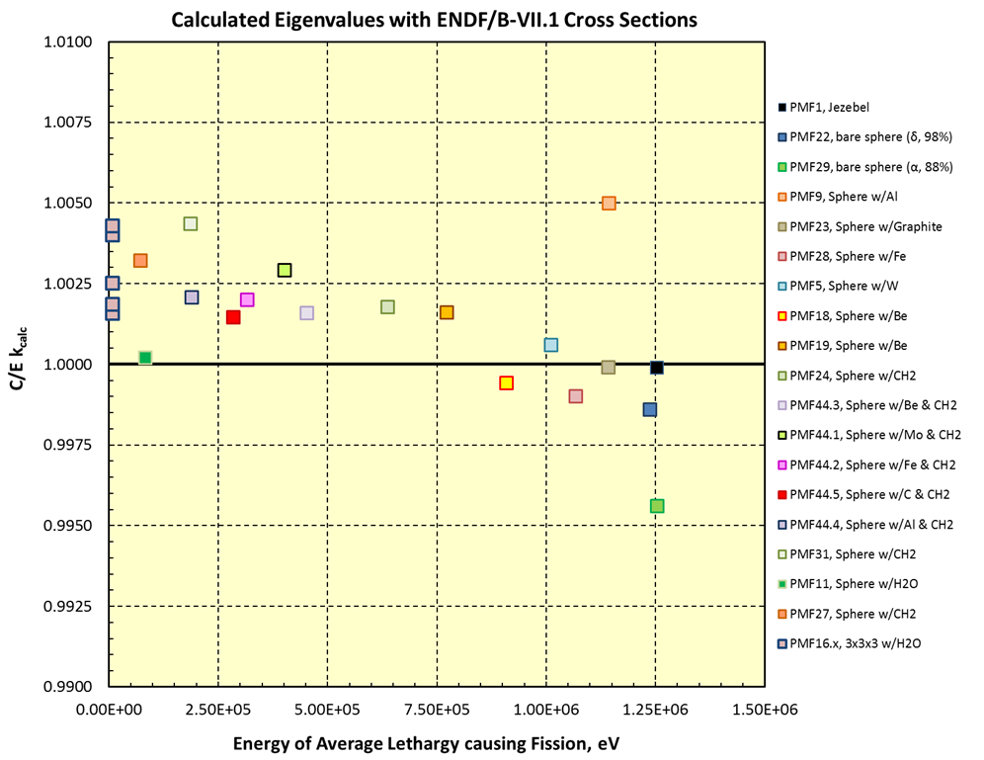
LANL Data Testing
From WONDER-2012
There is a clear trend of increasing k_{calc} bias with decreasing energy.
Can couple these results with PST benchmarks to cover the entire fast-to-intermediate-to-thermal energy range.

Slide 24
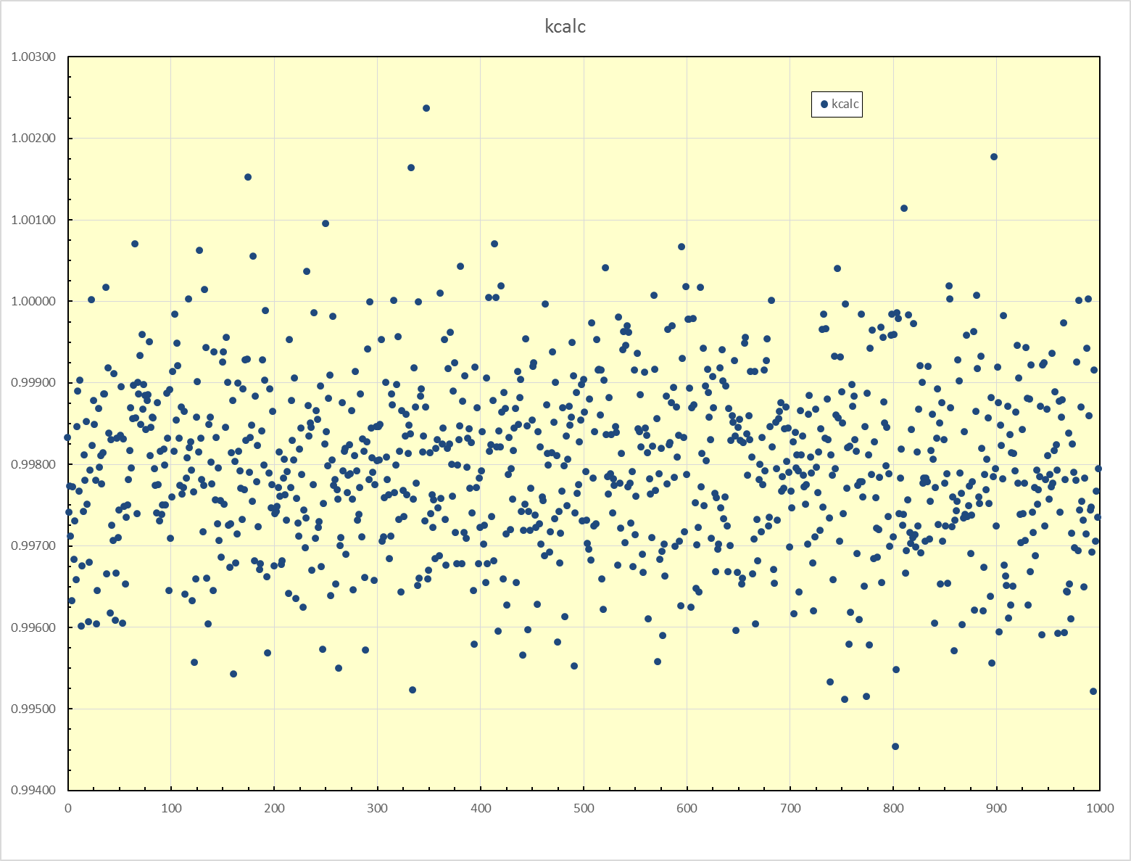
LANL Data Testing
Distribution σ is ~107 pcm.
For PMF1, the PFNS uncertainty yields a min-to-max range is 0.9945-to-1.0024, or ~800 pcm.

Slide 25
LANL Data Testing
k_{calc} variation for PST1.4, due to PFNS uncertainty, is 0.9987-to-1.0201, or 2140 pcm.
Standard deviation for this k_{calc} population is 283 pcm.
Impact of PFNS uncertainty on k_{calc} is larger than previously suspected.

Slide 26
Summary
ICSBEP benchmark data testing has been focused on CIELO candidate nuclides, particularly ¹⁶O, ^{235,238}U and ²³⁹Pu.
The general trend of softer pfns spectra for the major actinides represents a challenge to integral data testing.
Interpretation of past ¹⁶O (n,α) cross section measurements remains an open issue.
Other data testing sources (IRPhEP, SINBAD, Reaction Rate and other reactor parameters) remain an under utilized resource!

