Slide 1
GAIA : Nuclear data processing for transport and criticality safety calculations at IRSN
Luiz Leal, luiz.leal@irsn.fr
Wim Haeck, wim.haeck@irsn.fr

Slide 2
Outline
Introduction
GAIA 1.x.x
Processing path
Library QA procedures
GAIA 2
Overview and features
Application

Slide 3
Validation of neutronic simulations
ND Processing
Transport
GAIA 1.x.x
GAIA 2
MORET5
VESTA
S/U Analysis
MACSENS
BERING
Software
Nuclear Data
Integral Experiments
Application system k_{eff} + δk_{eff}

Slide 4
Nuclear data processing using GAIA
GAIA 1.x.x : An NJOY wrapper for data library QA
Uses either NJOY 99 or NJOY 2012
Inherently limited to ENDF formatted files
Current tool for application nuclear data library generation
Libraries for MORET5, MCNP(X) and VESTA : ACE and PENDF files
GAIA 2 : a nuclear data manipulation software framework
Multiple ways of using the software
As a standalone application
As an integrated component in other applications (e.g. VESTA 3)
Capable of reading and writing to and from various formats
ENDF, GND, ACE and other formats
Provide collaborative development without “heavy” source licenses

Slide 5
GAIA 1.x.x : An NJOY wrapper with QA

Slide 6
Making application libraries
Before nuclear data can be used it needs to be processed
Multiple tools exist: NJOY, PREPRO, AMPX
Degrades data and renders it code dependent (CE versus MG, etc.)
3 essential steps in preparing a library:
The library processing has been verified
NJOY processing path selection – justify and document everything
Examine NJOY output – understand everything and act accordingly
Perform other necessary tests – act accordingly
The library needs to be validated for use
Everything needs to be documented
NJOY is not a black box and should not be treated as such!

Slide 7
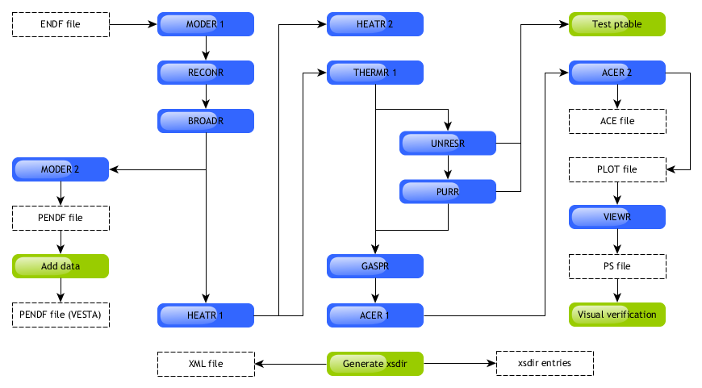
Processing path in GAIA 1.x.x

Slide 8
Processing path in GAIA 1.0.0x
moder
20 -25
reconr
-25 -21
'AM241 - 293.6 K - JENDL 4.0 (NJOY 99.259)'/
9543 0 0
0.001 0 0.01 5e-08
0 /
broadr
-25 -21 -22
9543 1 0 0 0
0.001 1e+06 0.01 5e-08
293.6
0 /
moder
-22 30
heatr
-25 -22 -21 /
9543 5 0 0 0 0 /
302 318 402 442 444 /
heatr
-25 -22 -23 /
9543 6 0 1 0 2 /
302 303 318 402 442 444 /
thermr
0 -21 -22 /
0 9543 16 1 1 0 1 221 2 /
293.6
0.001 5.0
gaspr
-25 -22 -21 /
unresr
-25 -21 -22
9543 1 9 1
293.6
1e+10 1e+8 1e+6 1e+4 1e+3 3e+2 1e+2 3e+1 1e+1
0 /
purr
-25 -22 -21
9543 1 9 20 64 1 0
293.6
1e+10 1e+8 1e+6 1e+4 1e+3 3e+2 1e+2 3e+1 1e+1
0 /
acer
-25 -21 0 40 41
1 0 1 .02 /
'AM241 - 293.6 K - JENDL 4.0 (NJOY 99.259)'/
9543 293.6
1 1
/
acer
0 40 42 40 41
7 1 1 -1 /
'AM241 - 293.6 K - JENDL 4.0 (NJOY 99.259)'/
viewr
42 43
stop

Slide 9
Library QA : NJOY output
An NJOY output file contains a wealth of useful information:
The RECONR resonance reconstruction error estimation
Various messages or errors to inform the user of certain situations
Output from the HEATR run for kinematic checks
Data from UNRESR that can be used to check results from PURR
And last but not least: the ACE consistency checks
It is important to understand everything and act accordingly when a problem is detected.

Slide 10
Library QA : NJOY output
Something is wrong with this output for elemental sulphur
Can you guess what it is?
The original evaluation dates back to 1979, as old as I am
It is not because it runs that it is correct.
Elemental sulphur with a non zero fission integral?
estimated maximum error due to
resonance integral check (errmax,errint)
upper elastic percent capture percent fission percent
energy integral error integral error integral error
1.00E-05
1.00E-04 2.26E+00 0.000 3.58E+01 0.000 1.24E-01 0.000
1.00E-03 2.26E+00 0.000 1.13E+01 0.000 3.92E-02 0.000
1.00E-02 2.26E+00 0.000 3.58E+00 0.000 1.24E-02 0.000
1.00E-01 2.26E+00 0.000 1.13E+00 0.000 3.92E-03 0.000
...
1.00E+05 1.10E+00 0.003 1.53E-03 0.038 2.01E-03 1.743
2.00E+05 5.86E+00 0.001 2.04E-03 0.247 1.30E-03 1.077
5.00E+05 2.48E+00 0.010 1.22E-03 0.866 6.59E-04 1.765
1.00E+06 1.52E+00 0.018 5.29E-04 1.057 2.69E-05 2.025

Slide 11
Library QA : NJOY output
The case of non-positive elastic cross sections – RECONR:
---message from emerge---nonpositive elastic cross sections found.
Due to resonance reconstruction and effects the following:
JEF 2.2: ⁶¹Ni, ¹²⁸Te, ¹⁵²Eu, ¹⁵⁴Eu, ¹⁵⁷Gd, ¹⁷⁶Lu, ¹⁸⁵Re, ²⁴⁰Pu, ²⁴¹Am, ²⁴⁴Cm
JEFF 3.1: ⁴⁰Ar, ⁶¹Ni, ¹¹¹Cd, ¹¹³Cd, ¹²⁸Te, ¹⁵⁷Gd, ¹⁸²W, ²⁴⁴Cm
ENDF/B-VI,8: ⁵⁶Fe, ⁵⁷Fe, ⁶¹Ni, ⁷⁴Se, ⁷⁸Kr, ⁸⁰Kr, ⁸⁴Kr, ⁸⁴Sr, ¹¹¹Cd, ¹¹³Cd, ¹¹²Sn, ¹¹⁴Sn, ²³⁰Th, ²³⁸Pu, ²⁴²Pu, ²⁴⁴Pu , ²⁴²Cm, ²⁴⁴Cm, ²⁴⁸Cm, ²⁵⁰Cf, ²⁵²Cf
What should you do?
Plot it to see how “bad” it is
Look at the other cross sections to see the overall influence

Slide 12
Library QA : ACER consistency tests
The case of ¹¹B from JEFF 3.1: No problems found
ace consistency checks
----------------------
check reaction thresholds against q values
check that main energy grid is monotonic
check angular distributions for correct reference frame
check angular distributions for unreasonable cosine values
check energy distributions
check photon production sum
check photon distributions
checking particle production sections
proton production:
checking energy distributions
alpha production:
checking energy distributions
no problems found

Slide 13
GAIA 2 : A nuclear data processing software framework

Slide 14
Objectives
GAIA : a nuclear data manipulation software framework
As a standalone application
As an integrated component in other applications
Objectives
Library generation for current (ACE and PENDF) and future tools
Capable of reading from multiple nuclear data evaluation formats
ENDF, GND and future formats
Manipulation of data outside of the scope of existing tools
Resonance reconstruction & Doppler broadening in a single step
Thermal scattering data
DPA and heating cross sections
Provide collaborative development without “heavy” source licenses

Slide 15
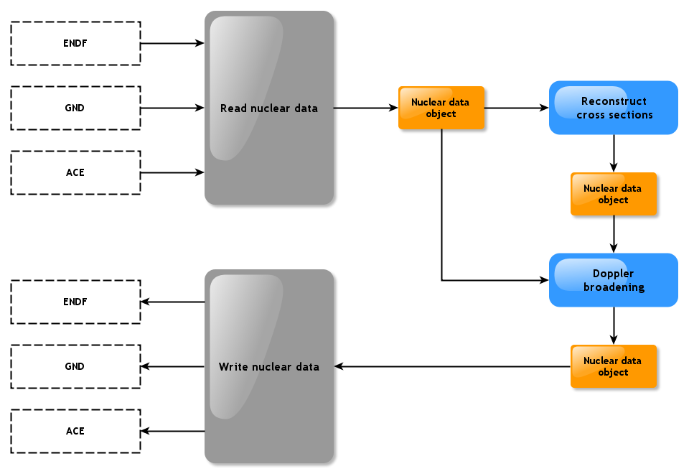
Using GAIA as a standalone tool
In short: sequential modules using an internal data object for information exchange

Slide 16
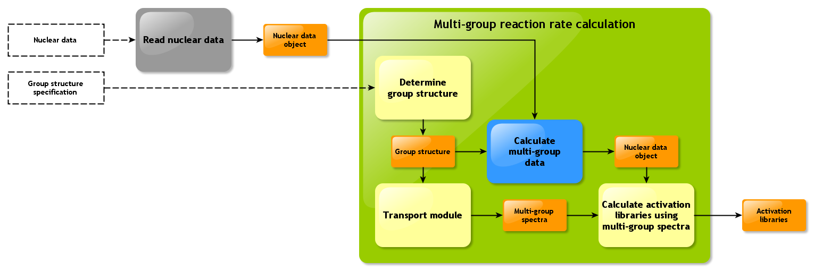
Using GAIA inside other software
In short: to manipulate the data or make it compatible with what the software needs

Slide 17
GAIA features
Prototyping and method development for independent capabilities at IRSN (G. Ferran and W. Haeck)
Resonance reconstruction based on R-matrix formalism
Multiple options for Doppler broadening including reconstruction
Fast Fourier transformations
Gauss quadrature
Calculation of angular dependent cross-section data from resonance parameters (Blatt and Biedenharn formalism)
Future developments
Unresolved resonance treatment
Thermal scattering law treatment - S(α,β)
Uncertainty processing: variance and covariance

Slide 18
GAIA features
ENDF
RECONR
GAIA 2
BROADR
PURR
ACER
ACE Library

Slide 19
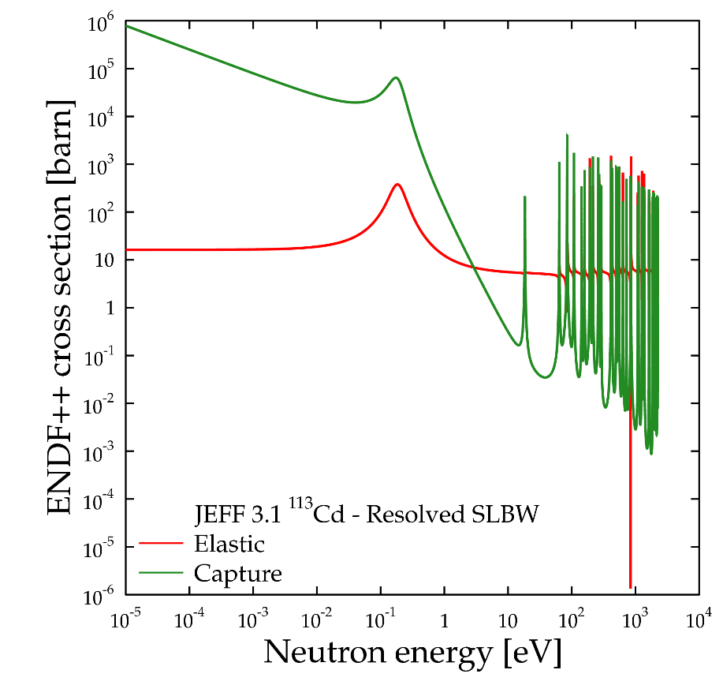
GAIA features
Single-Level Breit-Wigner
Multi-Level Breit-Wigner
Adler-Adler
Reich-Moore
Multipole
R-Matrix
R-Matrix Limited: ENDF format

Slide 20
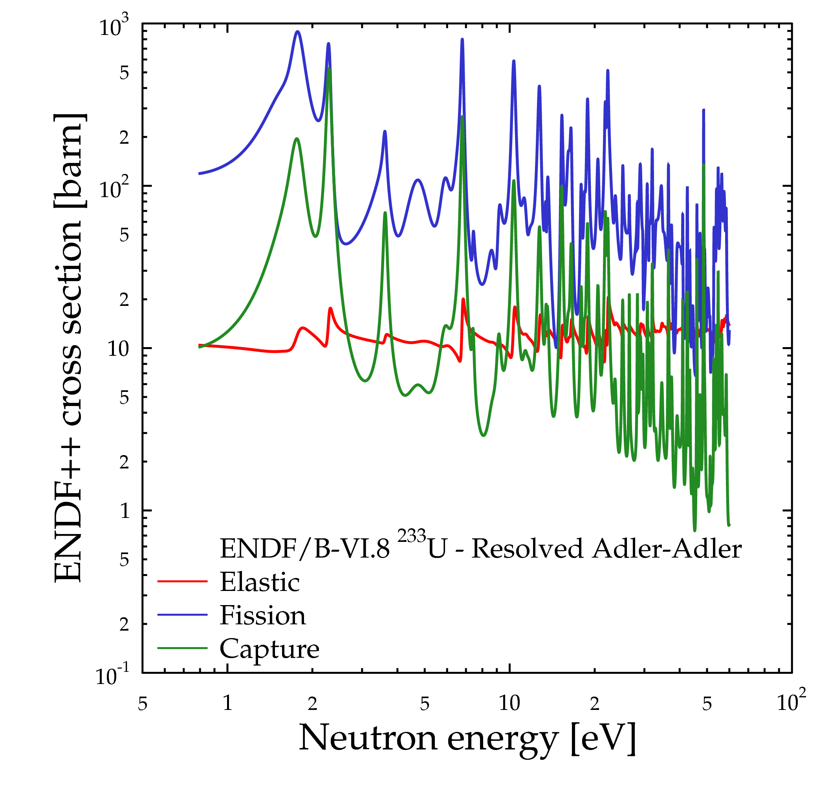
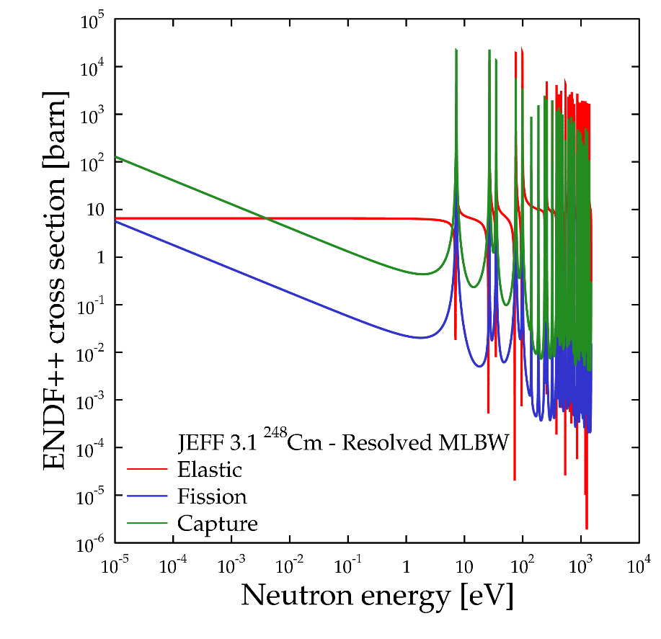
GAIA features

Slide 21
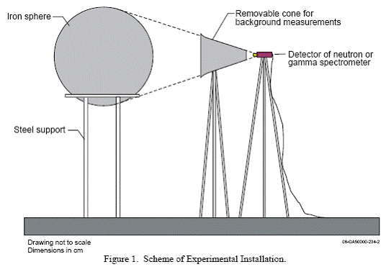
Application
Benchmark: ALARM-CF-FE-SHIELD-001 – ICSBEP – IPPE, Russia
Neutron and photon leakage spectra from Cf-252 source
Six iron spheres of diameters of 20, 30, 40, 50, 60, and 70 cm

Slide 22
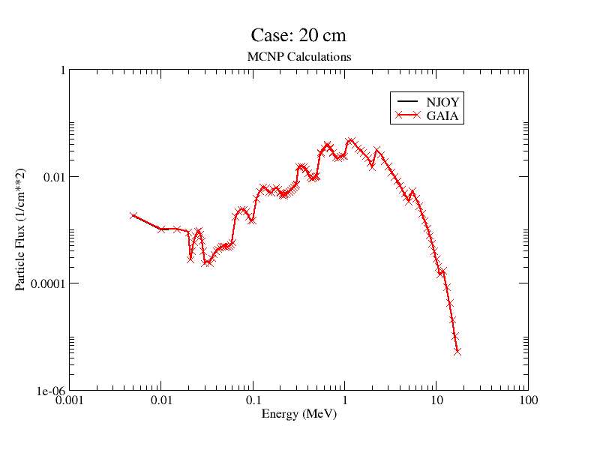
Application

