Slide 1
Nuclear data processing with Fudge and GND
Consultant’s Meeting on Data Processing Capabilities
Tuesday October 6, 2015
Caleb M Mattoon

Slide 2
FUDGE (For Updating Data and Generating Evaluations) provides nuclear data checking, fixing, manipulation and processing
Written primarily in Python, with extensions in c, c++ and Fortran for numerically intensive tasks
Python interface facilitates both interactive and batch processing. FUDGE can be quickly integrated into other workflows
Originally written to handle Livermore’s legacy ENDL format and related tools
this is ‘legacy’ FUDGE, of limited use except at LLNL
New FUDGE development focuses on Generalized Nuclear Data (GND)
This part of FUDGE is capable of handling ENDF-6 (by translating to GND), will be useful to the broader nuclear data community

Slide 3
FUDGE supports two-way translation between most ENDF-6 data and GND.
Types of data currently supported by translator:
Incident neutrons, gammas, charged particles
Fission product yields
Photo-atomic, electron and atomic relaxation data
Thermal neutron scattering (limited support)
Not yet supported:
Decay sub-library
Test fidelity of translation by comparing original ENDF-6 with retranslated file
Differences often indicate internal inconsistencies in original ENDF-6 files

Slide 4
Once data are translated to GND, FUDGE supports several processing options:
Resonance reconstruction
Doppler broadening
Average energy/momentum deposition
Grouping
Generating transfer matrices
Data manipulation, physics checking, visualization
More details:

Slide 5
Resonance reconstruction is built into Fudge, accelerated by NumPy and c extensions
Fudge supports (GND equivalents of) LRF=1,2,3 and LRF=7 with KRM=3 (Reich-Moore)
Reconstruction to user-specified accuracy
Results tested against RECENT and RECONR modules, found to be mostly in agreement (see next slide)
from fudge.gnd import reactionSuite
RS = reactionSuite.readXML(“n-017_Cl_035.gnd.xml”)
RS.reconstructResonances( styleName="reconstructed",
accuracy=0.001, thin=True )

Slide 6
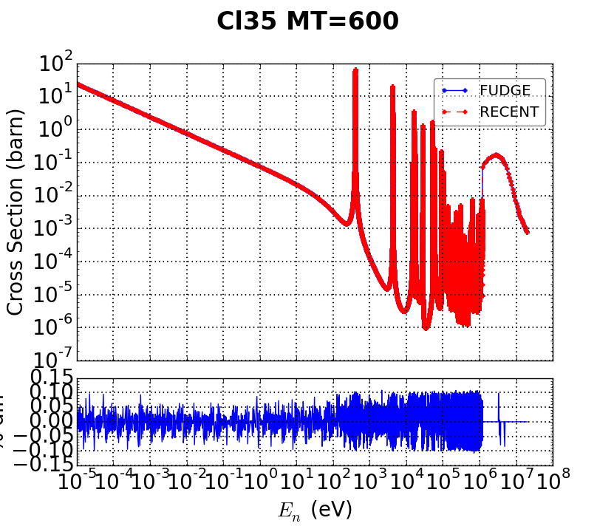
Sample comparison of FUDGE results with RECENT for ENDF-VII.1 evaluations:
Cl35 (n,p) cross sections (from LRF=7 reconstruction) agree to within 0.1%

Slide 7
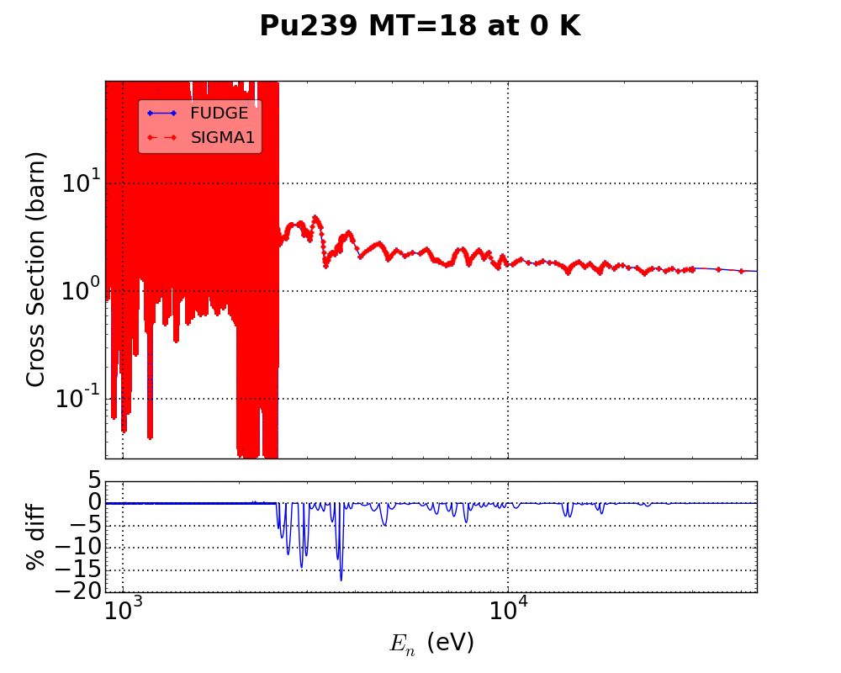
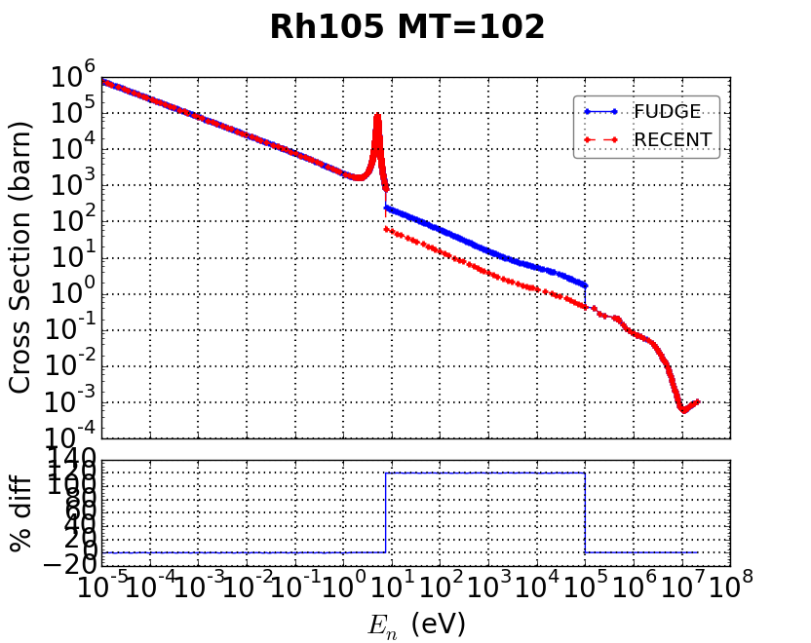
Sample comparison of FUDGE results with RECENT for ENDF-VII.1 evaluations:
Different treatment of interpolation in unresolved region (PREPRO interpolates widths, Fudge interpolates cross sections)
Rh105 results differ in URR: target spins are inconsistent! ENDF claims 1/2 in RRR, 7/2 in URR

Slide 8
FUDGE development for other resonance parameter applications is ongoing
Elastic angular distributions from resonance parameters:
complete for LRF=2 and 3, LRF=7 still TBD
Generating unresolved region probability tables
Thanks to Dave Brown for these contributions!

Slide 9
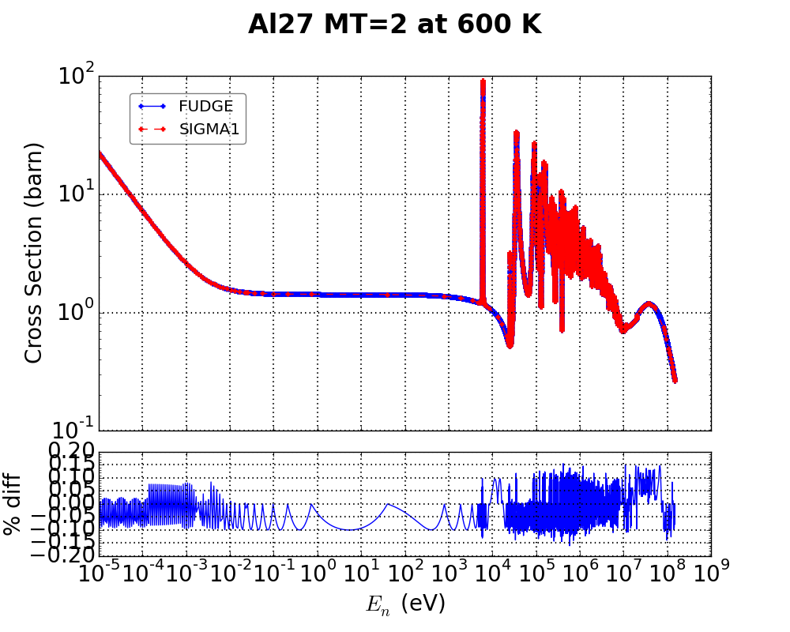
Doppler broadening provided by the module ‘crossSectionAdjustForHeatedTarget’
RS = reactionSuite.readXML(“n-094_Pu_239.gnd.xml”)
RS.reconstructResonances( … )
fissionXS = RS.getReaction(‘fission’).crossSection
heated = fissionXS.heat( RS, ‘600 K’, ‘1e-8 eV’ )
Sample results compared to SIGMA1:

Slide 10
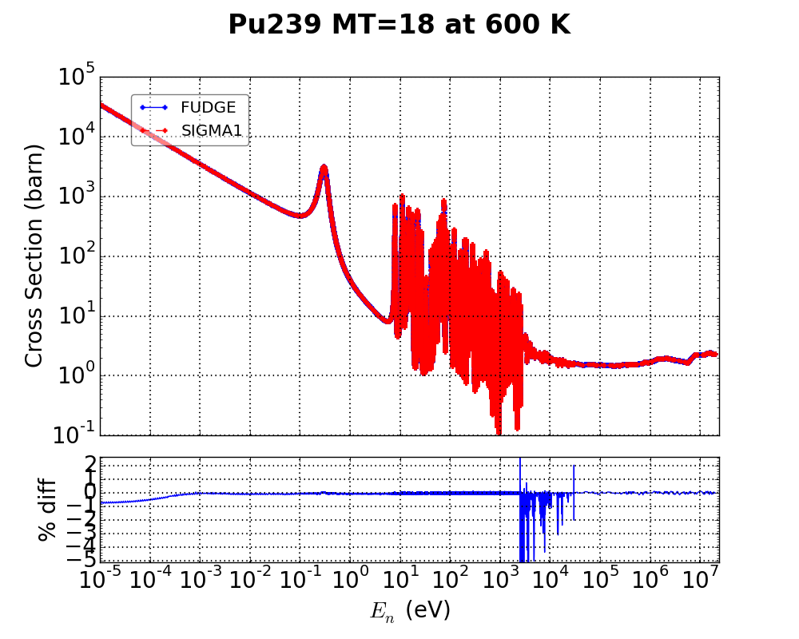
Doppler broadening provided by the module ‘crossSectionAdjustForHeatedTarget’
RS = reactionSuite.readXML(“n-094_Pu_239.gnd.xml”)
RS.reconstructResonances( … )
fissionXS = RS.getReaction(‘fission’).crossSection
heated = fissionXS.heat( RS, ‘600 K’, ‘1e-8 eV’ )
Sample results compared to SIGMA1:

Slide 11
FUDGE uses c library ‘numericalFunctions’ to handle 1-d XYs data and Legendre processing.
numericalFunctions capabilities:
Add/subtract/multiply/divide 1-dimensional functions
Automatically adds points to preserve user-specified accuracy when multiplying or dividing
Switch interpolations (adding points as necessary)
Integrate (grouping), convolute (Doppler broadening, Maxwellian averages)
Calculate moments (average energy/momentum deposition)

Slide 12
FUDGE uses c++ module ‘getTransferMatrix’ to generate deterministic transfer matrices
Produces transfer matrix for any reaction or decay product that has distributions specified
Handles all distribution types available in ENDF-6
Relativistic treatment for gammas (and other particles if requested by user)
Results for neutron products have been tested against NJOY and AMPX: helped identify issues in all three codes
Future work: test outgoing gamma matrices against other codes, implement corrections for thermal upscattering

Slide 13
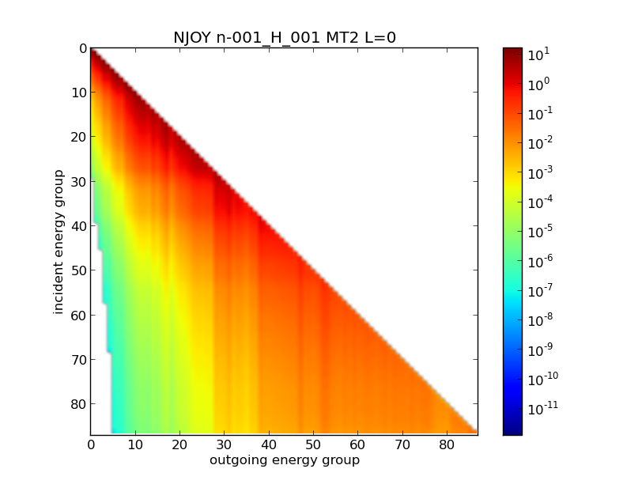
Transfer matrices: outgoing angle/energy spectra averaged over incident energy bins
Angular dependence is in Legendre expansion

Slide 14
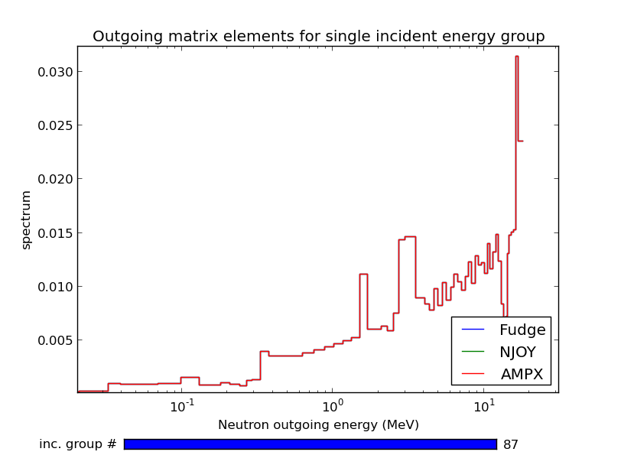
Transfer matrices: outgoing angle/energy spectra averaged over incident energy bins
Angular dependence is in Legendre expansion

Slide 15
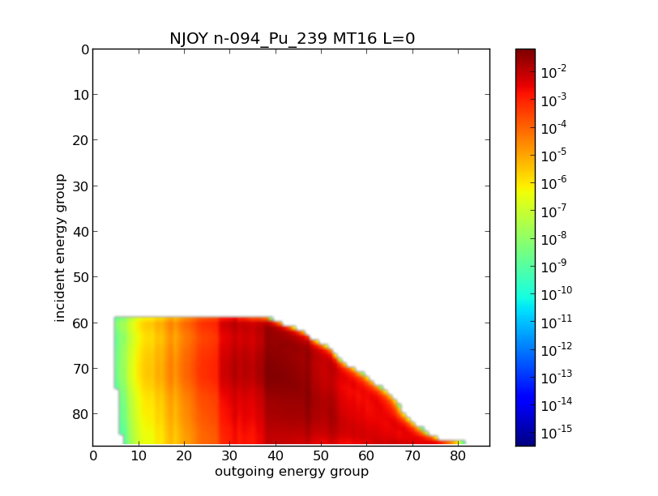
Processing codes don’t always agree, especially for double-differential distributions:

Slide 16
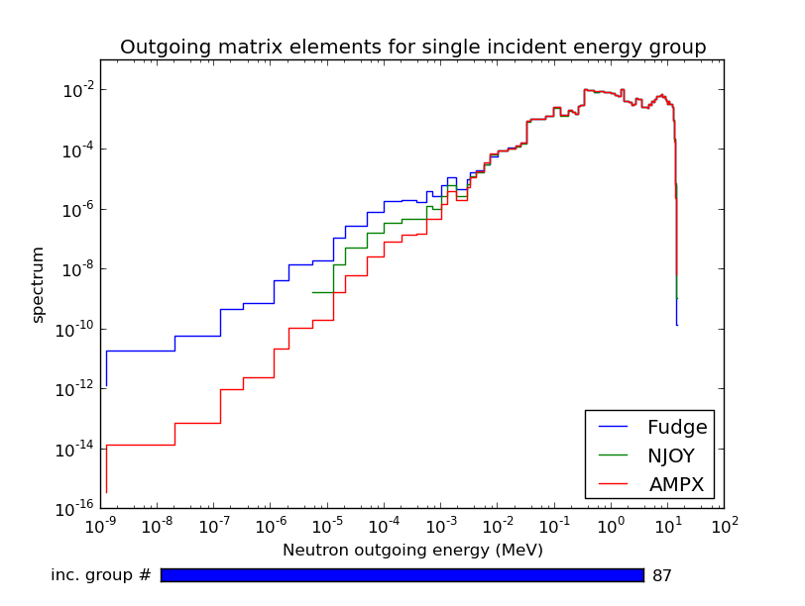
Processing codes don’t always agree, especially for double-differential distributions:

Slide 17
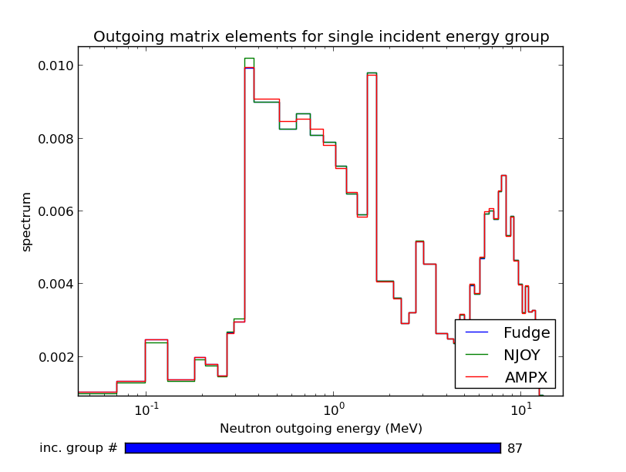
Processing codes don’t always agree, especially for double-differential distributions:

Slide 18
For Monte Carlo applications, FUDGE defers most processing until run time
Resonance reconstruction and Doppler broadening are done before-hand
Grouping, generating cumulative distribution functions, equi-probable bins are computationally inexpensive
Give users more flexibility by allowing them to change group structure, flux, etc. at run time
Monte Carlo application interface for GND (‘MCGIDI’) is being tested by LLNL’s Mercury developers
TBD: support for angle biasing (for variance reduction)

Slide 19
FUDGE provides tools to help evaluators improve the quality of nuclear data libraries
Physics checking
Internal consistency (total cross section = sum of other reactions, Q-values match thresholds, …)
Negative probabilities, un-normalized distributions
Energy balance (raises many warnings for all existing libraries!)
Visualization
plotEvals: plot same cross section for multiple evaluations (plus X4 and uncertainty band if available)
compareCrossSections: two evaluations + relative difference
Outgoing gamma spectra

Slide 20
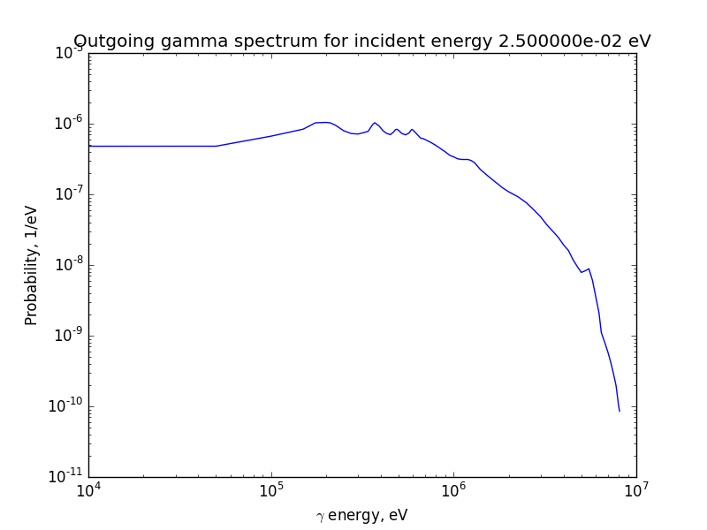
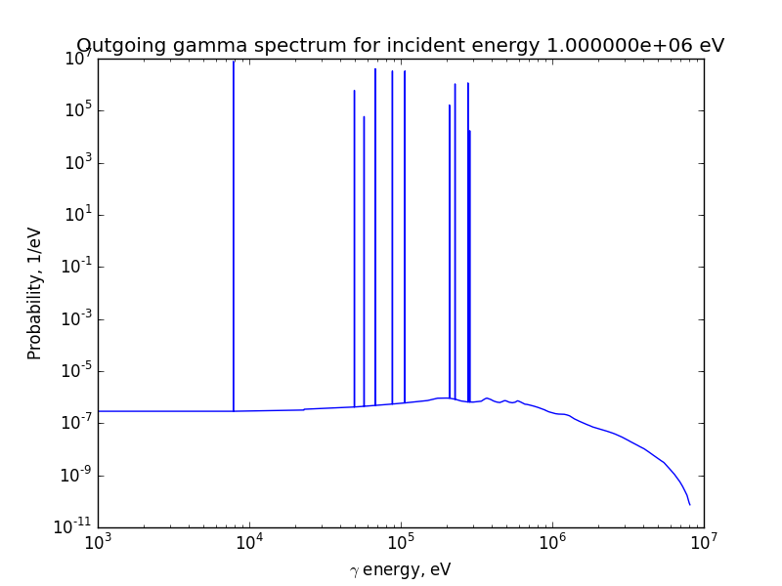
Gamma spectra in VII.1 are of mixed quality:
n + Pu239: discrete gammas at 1 MeV but not at thermal?

Slide 21
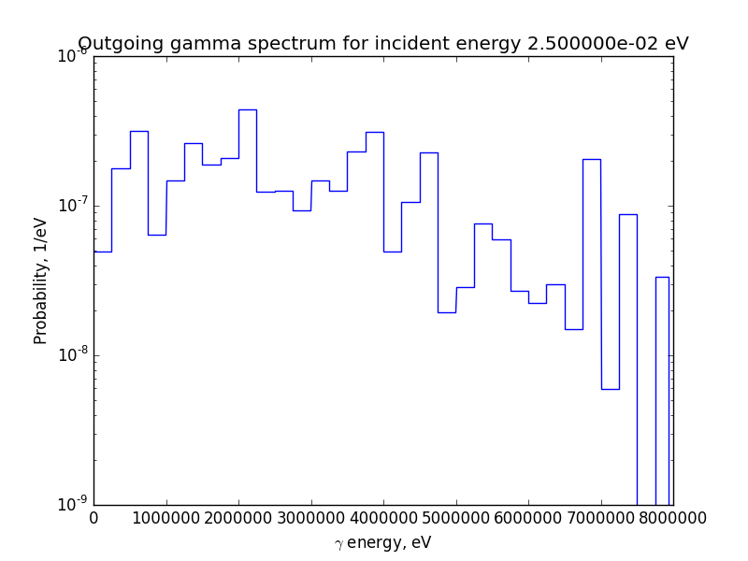
Gamma spectra in VII.1 are of mixed quality:
n + P31: histogram-style spectrum?

Slide 22
Future processing work at LLNL will be prioritized by needs of our users
Short term development goals:
Finalize a version of GND, establish format governance
Finish Monte Carlo API, implement deterministic API
Expand tools to help check / fix nuclear data
Migrate LLNL libraries to GND
Longer-term goals
Support other institutions in migrating to GND
Better treatment of thermal neutrons
Multi-pole expansion for resonances, on-the-fly Doppler broadening

