Slide 1
Opportunities, challenges and ways forward for nuclear data
A European perspective
Arjan Plompen
IAEA GC Side Event

Slide 2
European context, role for nuclear
European Green Deal
EC: CO₂ neutral by 2050, 55% reduction by 2030 (1990), plant 3 billion trees
Nuclear Energy contributes to neutrality (26% of electricity now, 13/27 MS)
Nuclear Alliance aims for 150 GWe by 2050 (50% of today’s electricity capacity)
Fusion – ITER, IFMIF-DONES, DEMO
European Research Infrastructure policy (ESFRI)
Open Access to Research Infrastructure and Data policies
Europe Beating Cancer Plan
A stronger Europe in the world …

Slide 3
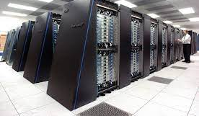
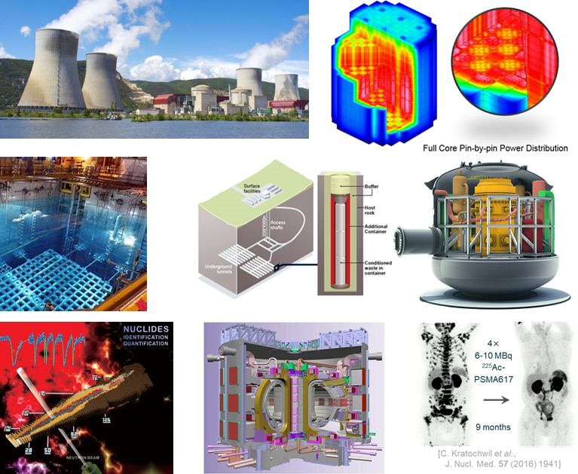
Role of nuclear data for tomorrow’s solutions
Modelling is needed at every step of nuclear development
Scoping, design, testing, operation, safety analyses, waste and spent fuel management
Good modelling allows savings and shortening of development
Good data are essential to good modelling

Slide 4
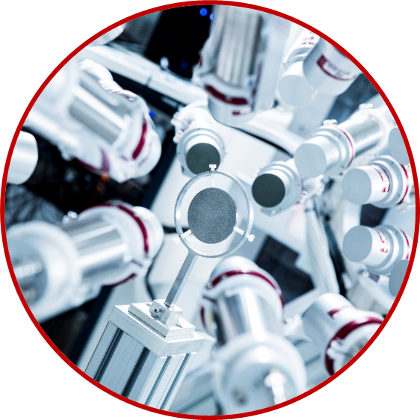
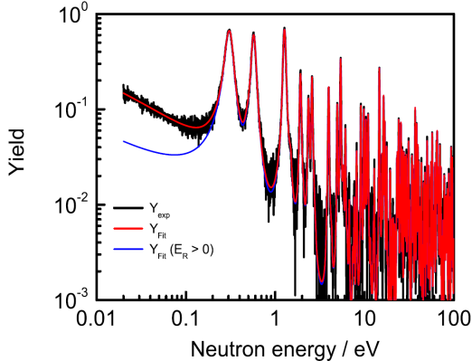
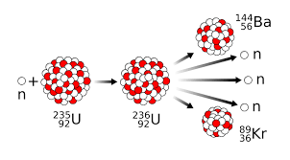
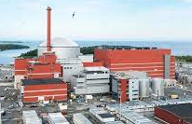
Nuclear data life cycle
Microscopic data
Research & Development
Evaluation, verification
&
validation
Theory
Data Library
Industry
Benchmark data
Regulatory bodies
JEFF
New needs
New projects

Slide 5
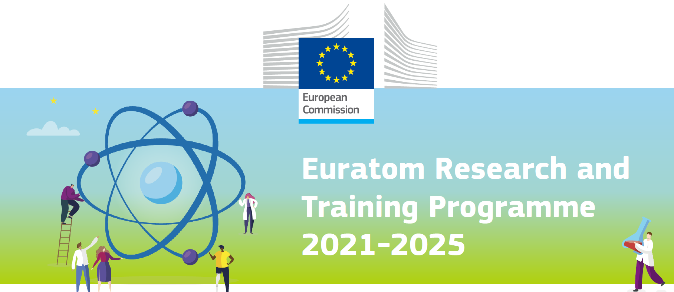
EU way of funding research
Fission
RTD, 266 M€/5y
JRC, 532 M€/5y
Fusion*
583 M€/5y
National budgets form the greatest part of the EU R&D budget.
EU funding aims at coordination and cohesion for EU priorities
95.5 G€/7y
*ITER receives 5600 M€/7y outside R&T program

Slide 6
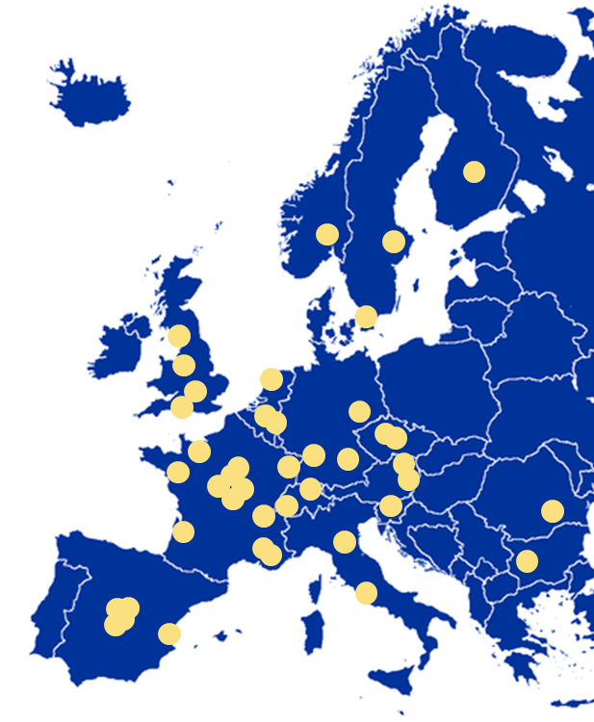
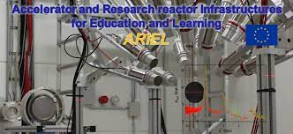
EU way of funding nuclear research
Nuclear data:
Structured voluntary collaboration
JEFF project (OECD-NEA Databank)
IAEA NDS CRPs, DDPs, CMs
European projects
Fission: SANDA, ARIEL, OFFERR
Fusion: EUROfusion ND WP
Horizon Europe: EURO-LABS
National organisations responsible for the greatest part of the nuclear R&D budget.
JEFF collaboration

Slide 7
From science to application (1, status)
A large part of nuclear scientific knowledge is not part of nuclear data libraries and hence not available for use in applications
Proton-induced and neutron-induced reaction data for spallation sources and dosimetry (MYRRHA, ESS, therapy, aircraft, space)
Photon-induced reaction data (Isotope production)
Alpha, deuteron induced neutron source and isotope production data
Reliable radioactive decay data (source term, dosimetry, medicine)
There is a considerable amount of nuclear scientific research where Europe is leading (CERN, GANIL, GSI, … - NUPECC).
There have been a number of European ND projects with the main emphasis on measurements.
However, the nuclear data life cycle leading from science to application is bound to fall short of the needs.
Also for the data in greatest need: neutron data

Slide 8
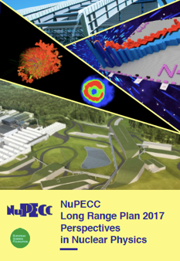
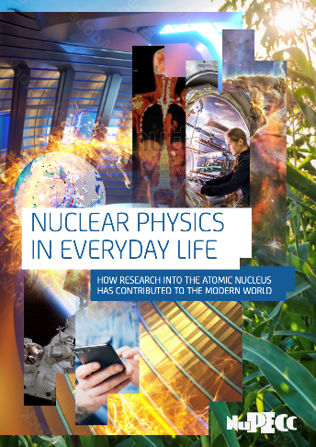
From science to application (2, what it takes)
A well-functioning nuclear data life cycle requires resources we can rely on in the form of skilled staff and research infrastructure for
Comprehensive accurate measurements
Evaluated nuclear data libraries
Established processing routes
Quality assurance through benchmarking and validation
Feedback-loops with users
As an example, we currently lack the experts for nuclear data evaluation:
Resonance analysis, (2 expts, 0.2? Fte)
Reaction modelling (7 expts, 1? Fte)
Fission yields (4 expts, 2? Fte)
Decay data (5 expts, 1? Fte)

Slide 9
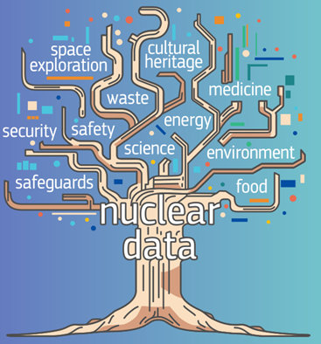
From science to application (3, improving)
We need a strong commitment to
Jointly plan and coordinate our resources to maintain the nuclear data life cycle
Develop and maintain an effective cooperation
Provide an attractive environment of nuclear data research and development for a new generation working in the interest of tomorrow’s nuclear solutions

Slide 10
Thank you
© European Union 2023
Unless otherwise noted the reuse of this presentation is authorised under the CC BY 4.0 license. For any use or reproduction of elements that are not owned by the EU, permission may need to be sought directly from the respective right holders.
Slide, source:
Notes:
Update/add/delete parts of the copy right notice where appropriate.
More information: https://myintracomm.ec.europa.eu/corp/intellectual-property/Documents/2019_Reuse-guidelines%28CC-BY%29.pdf

