Slide 1
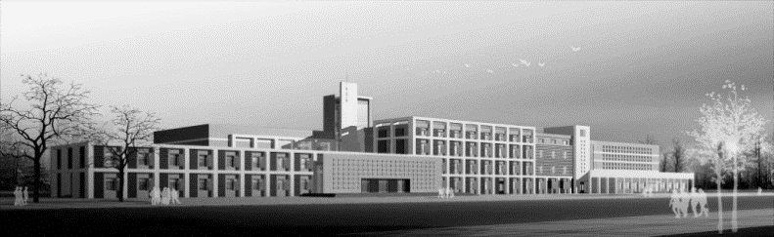
67th IAEA General Conference
25 – 29 September 2023, Vienna International Centre, Vienna
Challenges, opportunities and solutions in nuclear data for our future – a Chinese perspective (CIAE)
Speaker： WANG Wenming
China Nuclear Data Center
2023.9.26

Slide 2
OUTLINE
China nuclear data history
Nuclear data resources
Needs from application
Challenges
Suggestion for cooperation

Slide 3
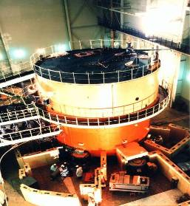
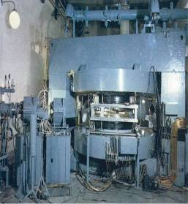
1.China nuclear data brief history
On June 13, 1958
reactor reached criticality
Nuclear data measurements started from 1960s with the 1st reactor and accelerator in China
The fission neutron multiplicity .
Cross sections for n+²³⁸U, n+²³⁵U and ²³⁹Pu reaction.
Fission yields for n+²³⁵U fission.
Cross sections for d+⁶Li and d+⁷Li reactions.
Excitation function: (n, γ), (n, n’), (n, 2n), (n, 3n)、(n, p), (n, d), (n, α) channels
…
The 1st reactor in China
The 1st accelerator in China
On Sep. 27, 1958
cyclotron provided beams

Slide 4
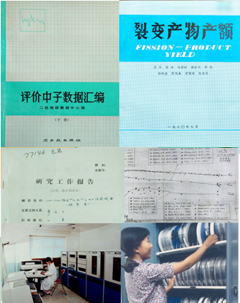
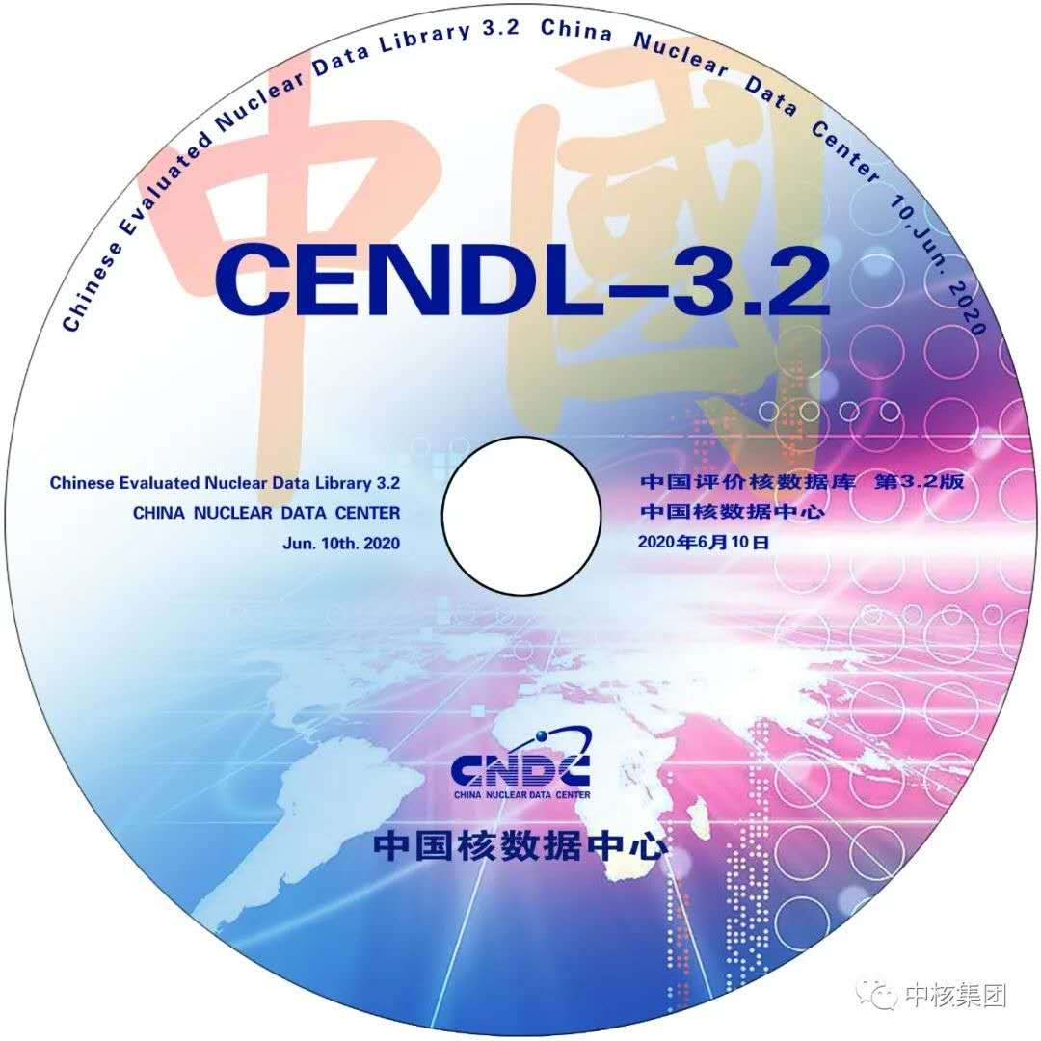
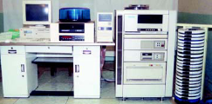

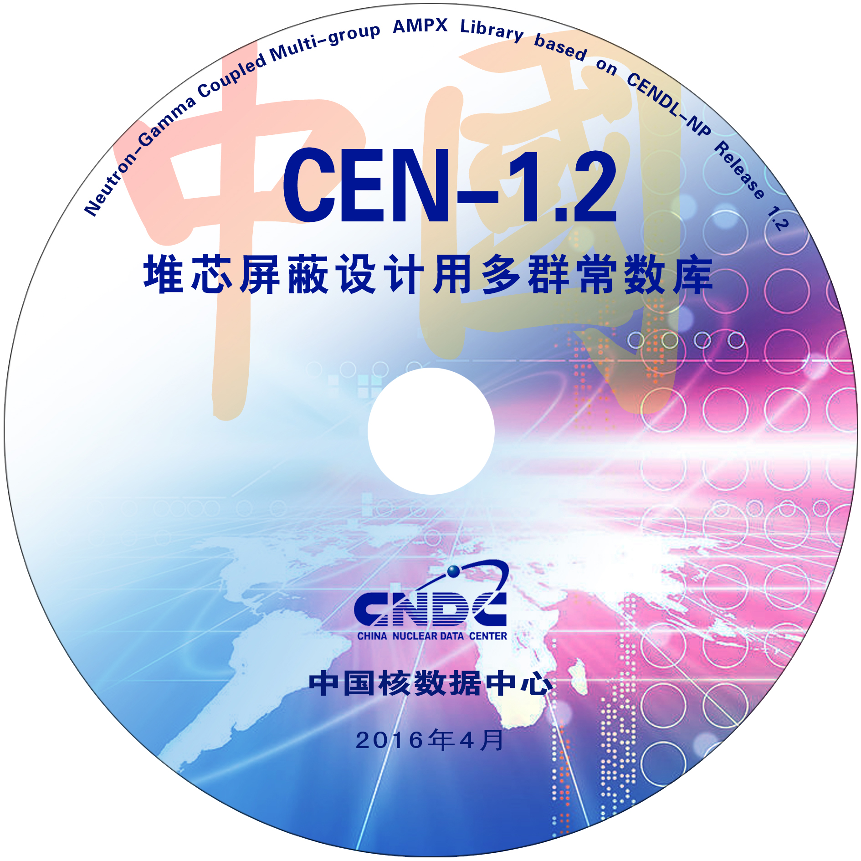
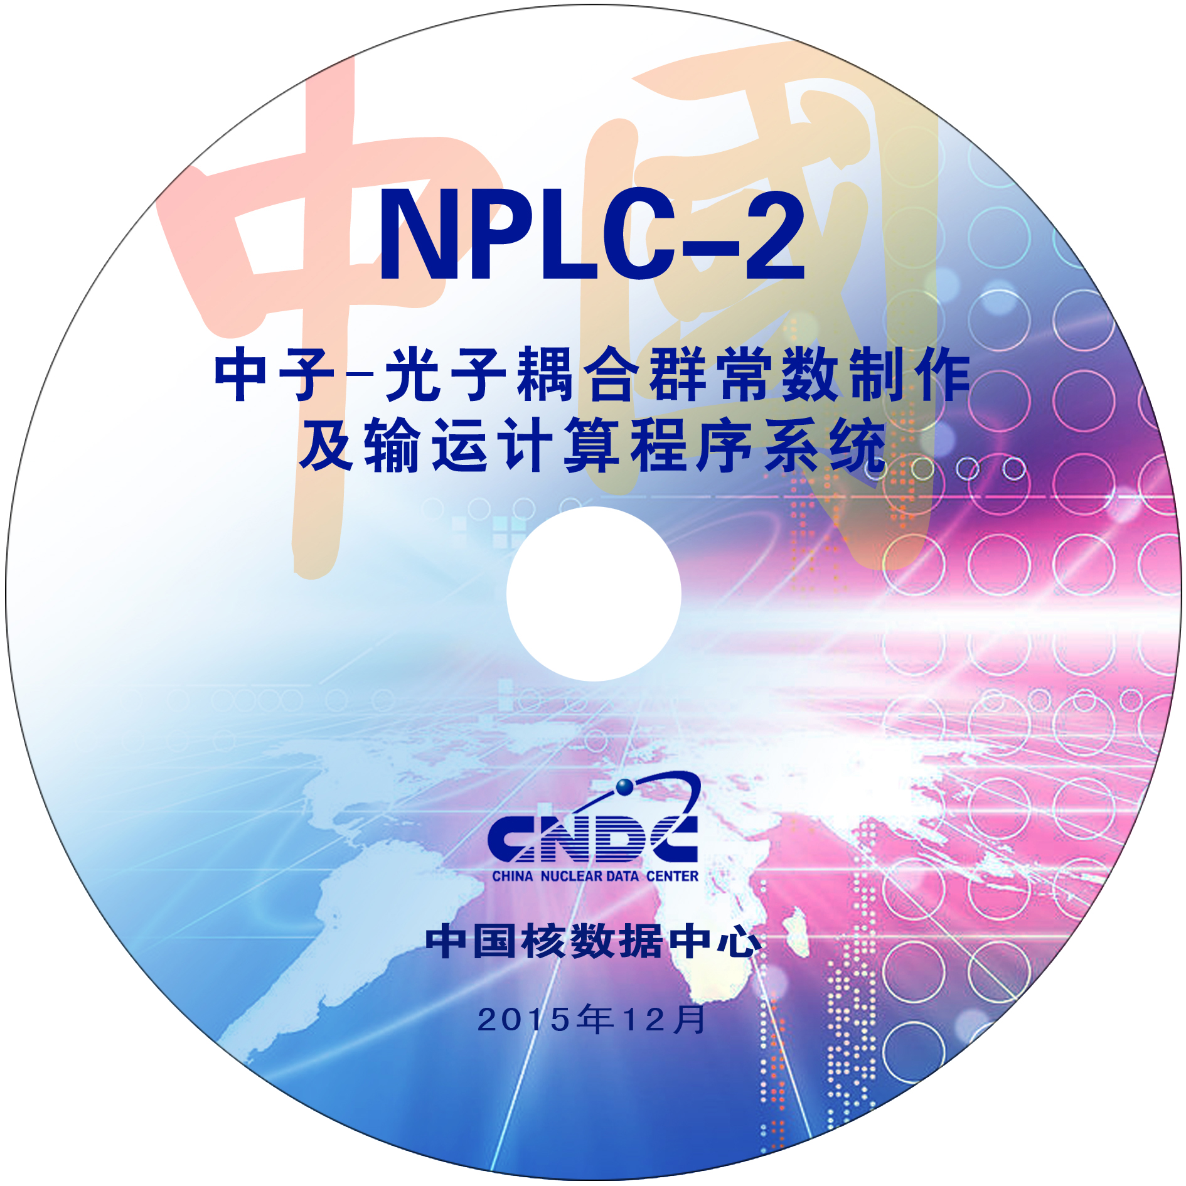
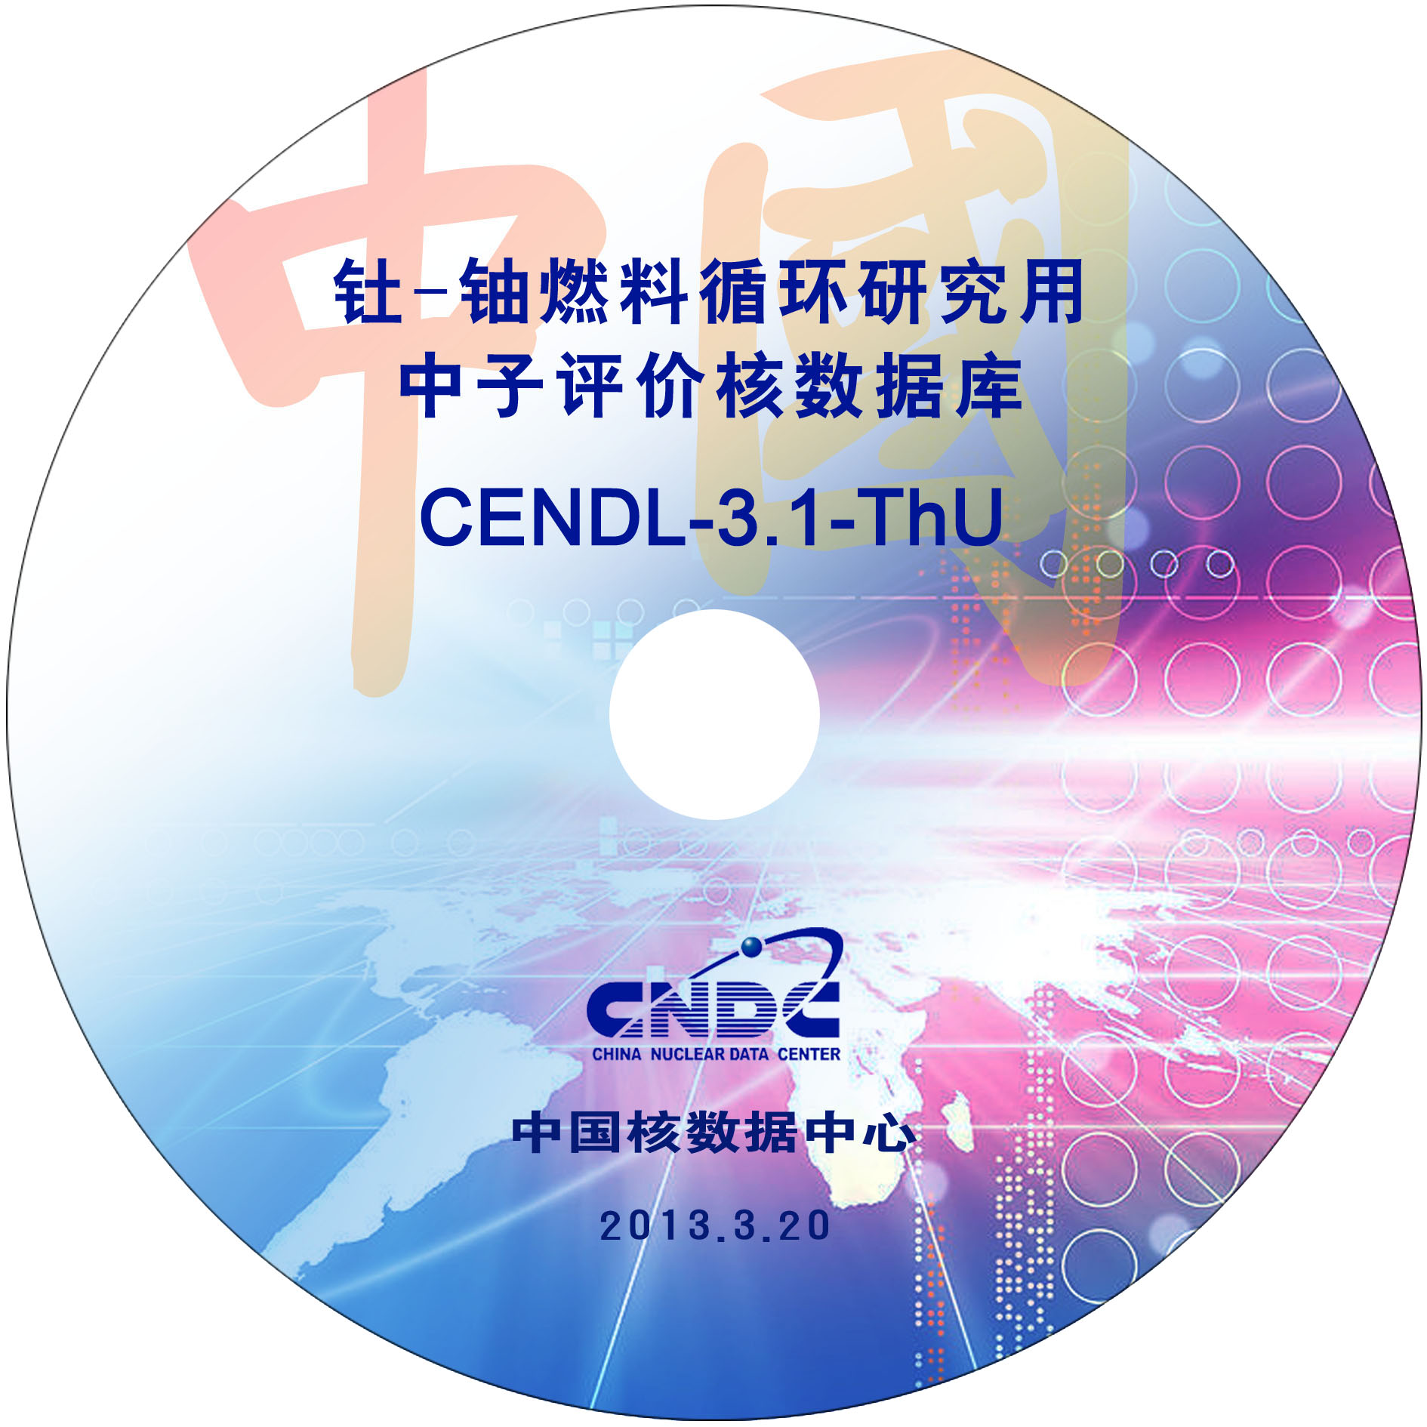
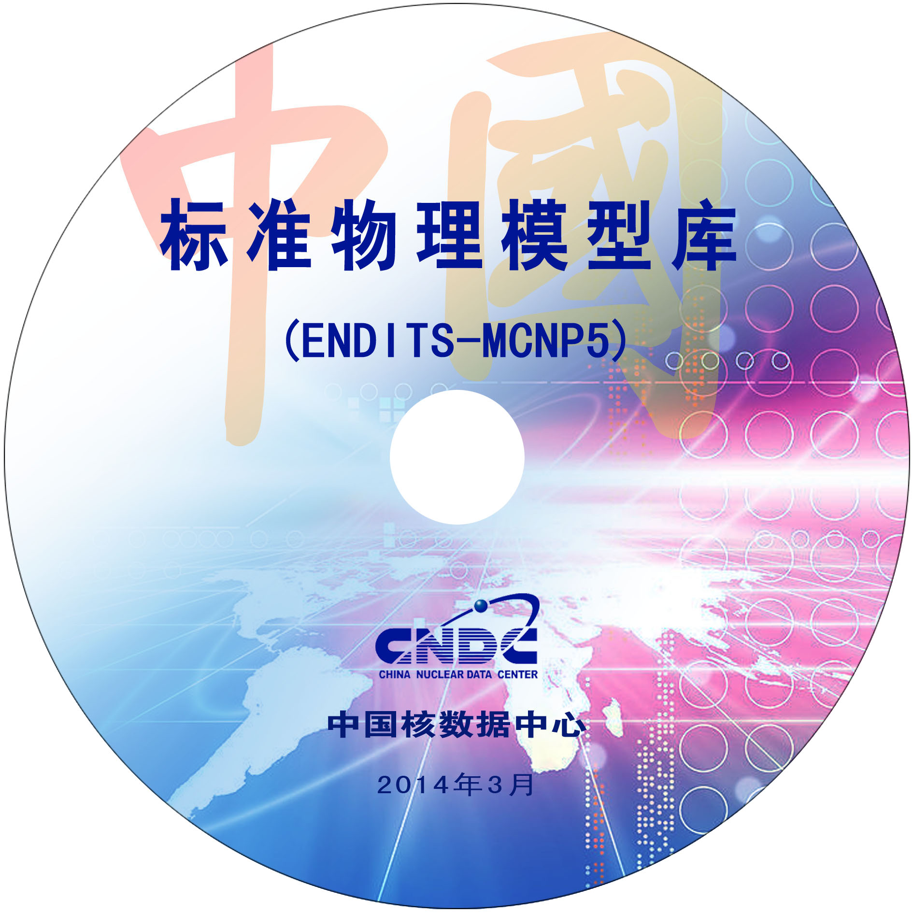
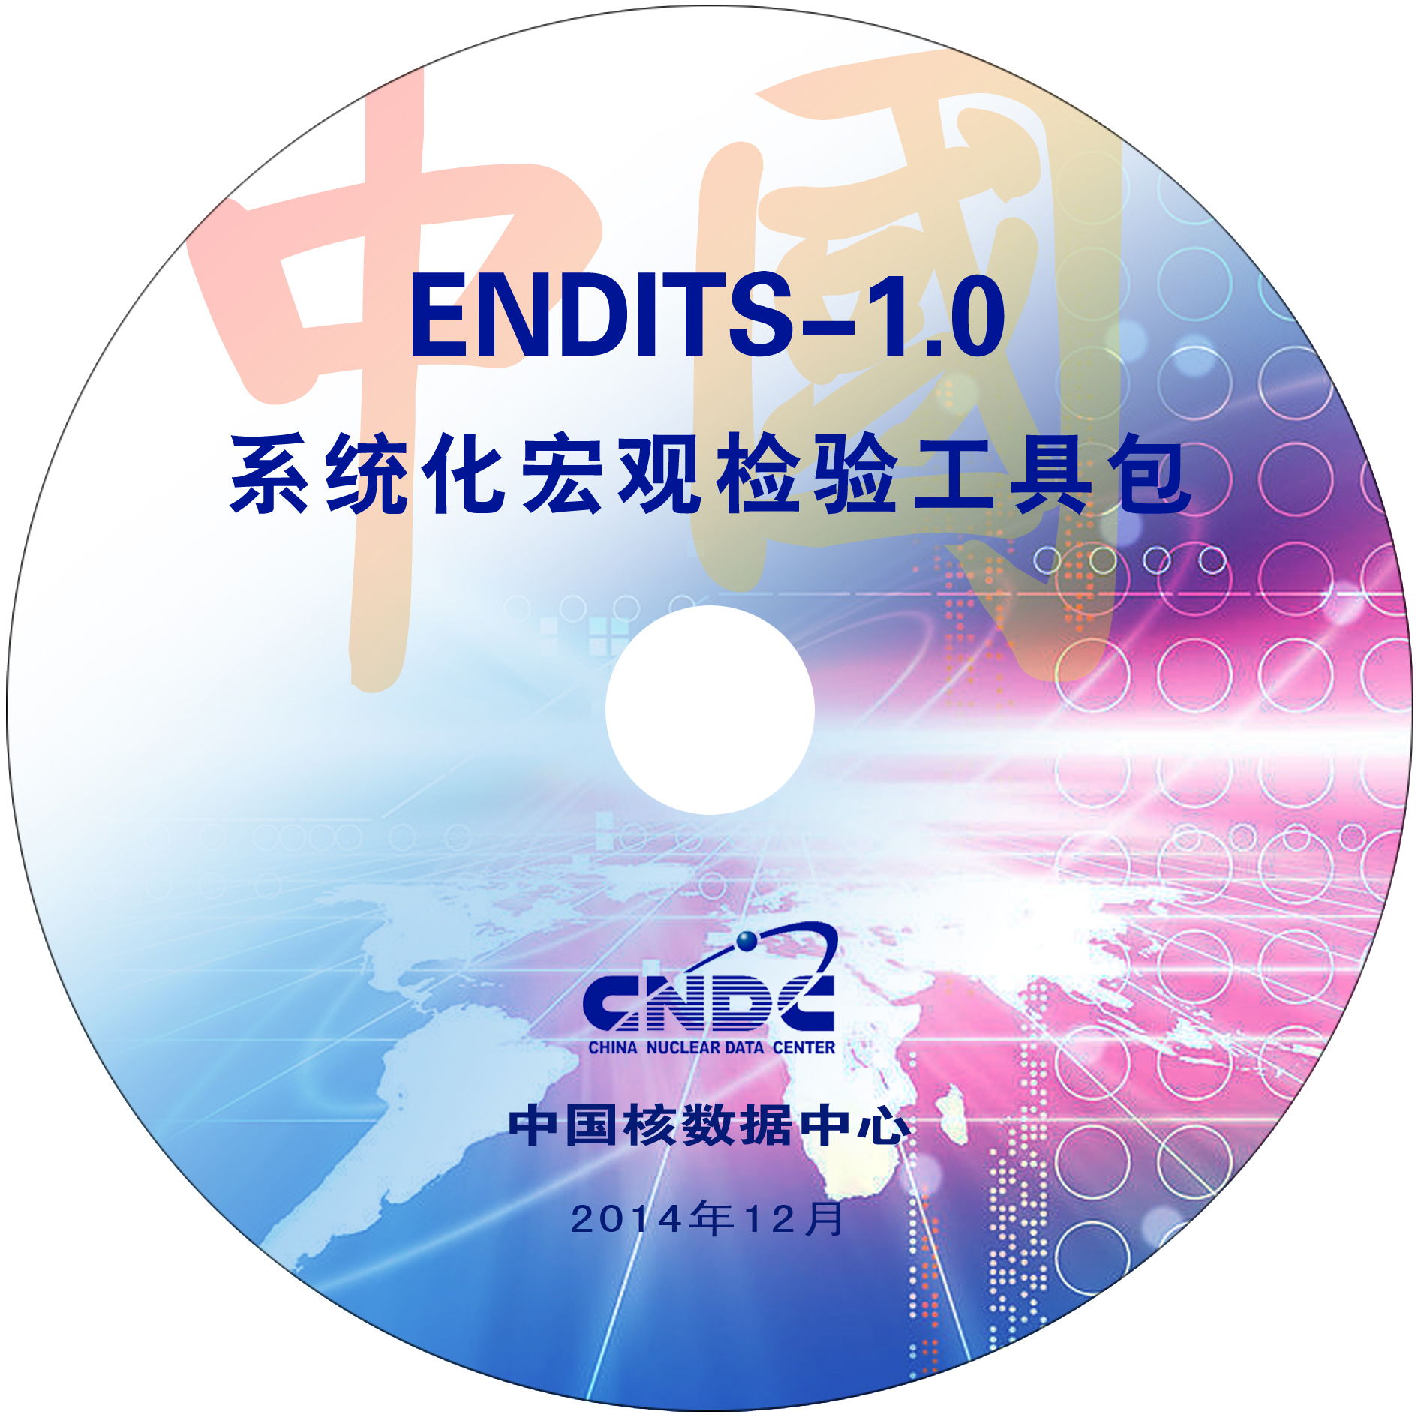
Nuclear data evaluation beginning from 1970s when the CNDC established
To feed the nuclear data needs for the development of nuclear industry, nuclear data evaluation started from 1970s, CNDC and Coordination Network were established, and the 16 evaluated completed neutron reaction data files for general purpose finished in 1978, which was the predecessors of the CENDL library.
Based on the measurements and evaluations collaborated with China Nuclear Data Coordination Network, the main output of CENDL project is the CENDL library.
CENDL-1 | 1985version | 36 |  | Nuclear Structure and Decay Data Library (NSDD)
CENDL-2 | 1992version | 68 |  | Fission Product Yield Data Library (FPYD)
CENDL-3 | 2000version | 214 |  | Charged-Particle Nuclear Data Library (CPND)
CENDL-3.1 | 2009version | 245 |  | Neutron Activation Dosimetry Data Library
CENDL-3.2 β0 | 2016version | 250 |  | Other Data Library……
CENDL-3.2 | 2019version | 272 | (June 12.2020)
4/50

Slide 5
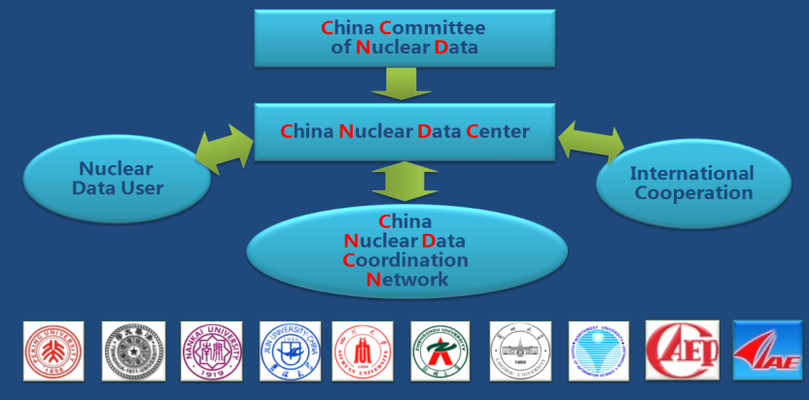
Nuclear data Organizations in China
More than 40 institutions joined the ND activities, and ~ 300 scientists and 100 students(Phd and master) coved the ND pipeline.
5/50

Slide 6
Milestone and importance activities
In 1956, Neutron Physics Lab was established in CIAE by Qin Sanqiang et al
Key reactions data such as d+⁶Li，n+⁶Li were measured around 1965-1966
In 1984，CNDC was established as the state Nuclear Data Center
In 1986
the China ND Commission was established to guide the China's nuclear data work
In 2009
CENDL-3.1 was released
The new generation neutron source represented by CSNS was put into operation in 2018.
In 2020
CENDL-3.2 was released
1956
1959-1964
1965-1966
1975
1984
1985
1986
1993
2009
2010
2018
2019
2020
In 1959-1964,
Important reaction data were measured such as the 235U, 238U, and 239Pu fission cross-sections
In 1975,
Nuclear Data Center of the Ministry of Nuclear Industry, as well as the Collaboration Network were established.
In 1985
CENDL-1 was released
In 1993
CENDL-2.1 was released
In 2010
The Key Lab of Nuclear Data Measurement and Evaluation Technology was officially operational
In 2019
Nuclear Data Conference held for the first time in China
PAGE: 6 / 80

Slide 7
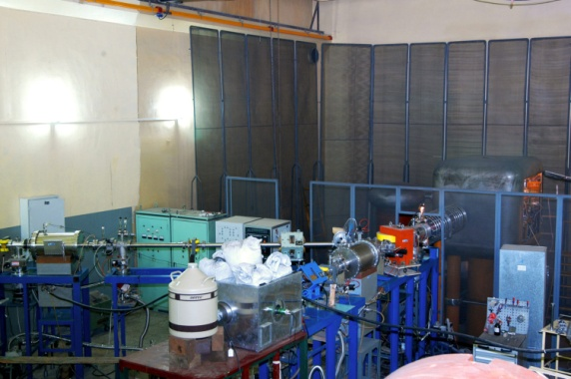
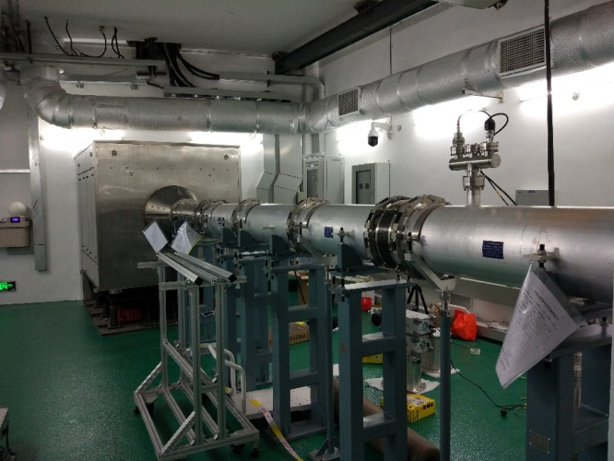
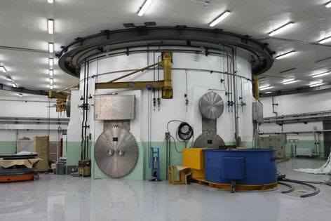
2.Nuclear Data Resources
 | Main neutron sources | Neutron energy | flux
1 | Reactors in CIAE, China Academy of Engineering Physics (CAEP), etc., | thermal neutron | 10¹⁴ n/cm²/s
2 | CIAE, HI-13 tandem accelerator | 4 to 42 MeV | 10⁶-10⁸ n/sr/s
3 | CIAE, 2x1.7MV small tandem | 0.03 to 6， 14 to 20 MeV | 10⁸-10⁹/n/sr/s
4 | CIAE, Lanzhou Uni., CAEP, etc., high-pressure multiplier | 2.5, 14 MeV | 10⁸，10¹⁰ n/sr/s
5 | Peking Uni., 4.5MV electrostatic accelerator | 0.03-7 MeV | 10⁷-10⁸ n/sr/s
6 | Sichuan Uni., 2x3MV Tandem Accelerator | 0.03 to 9, 15 to 22 MeV | 10⁸-10⁹n/sr/s
7 | Shanghai Ins. of Applied Physics, CAS, TMSR-PNS | Thermal - keV | 10⁴n/cm²/s
8 | Ins. of High Energy Physics, CAS, CSNS Back-n | Thermal- 300MeV | 10⁷n/cm²/s

Slide 8








Nuclear data measurement activities in China
Excitation function around 14 MeV
ADS related data (proton induced)
Excitation function, FY, γ production yields, DX and DDX, benchmark experiments, etc
西北核技术研究院
Decay data
Charged reaction measurement (n,LCP)
Integral experiments, other data measurement
Th-U cycle related data
Excitation function
CS measurement for wide energy

Slide 9

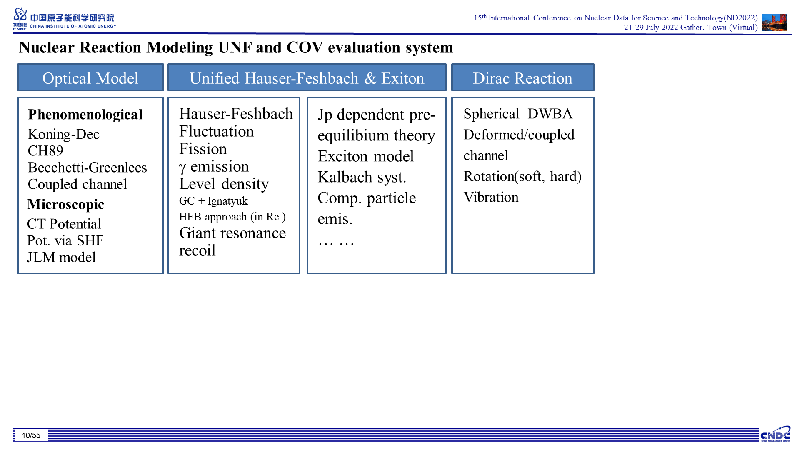
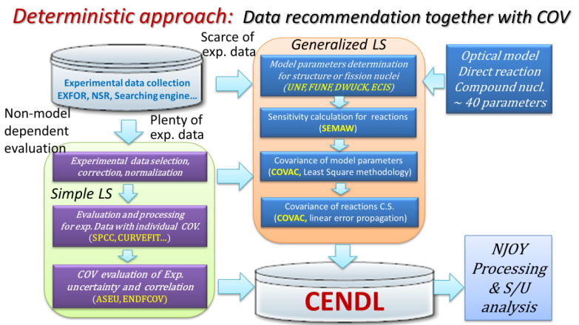
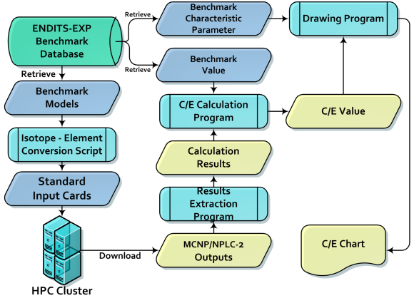
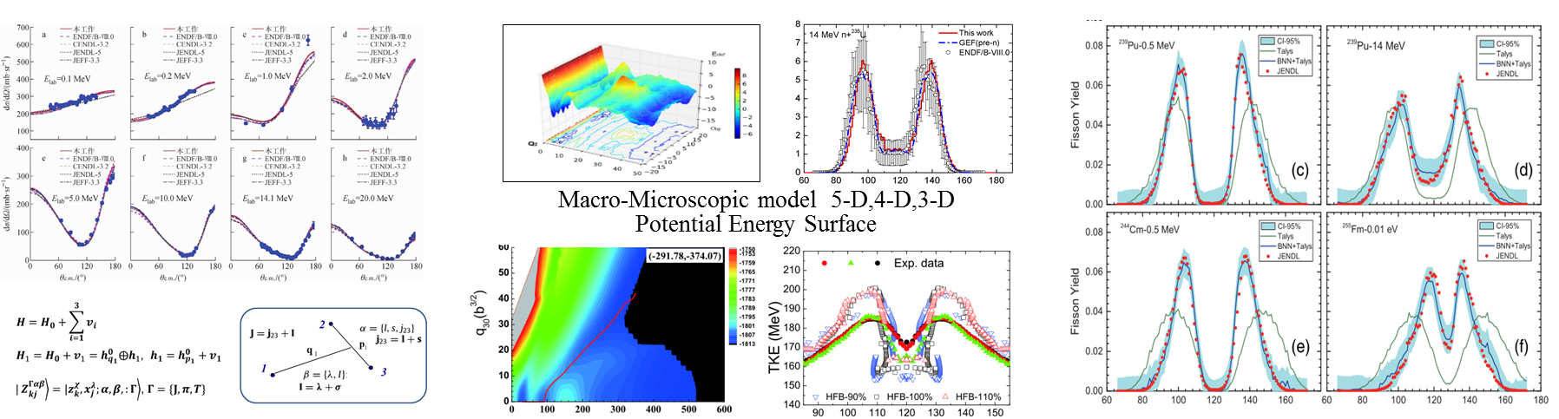
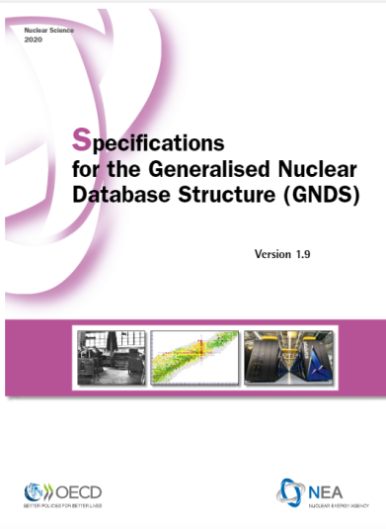
Eval. Methodology(MUP，UNF theoretical reaction code)
Faddevv-AGS approach
TDGCM + DFT
Machine Learning+BNN…
New Format
p:9/13

Slide 10
Nuclear data processing codes
Code | Institute
Ruler | China Nuclear Data Center
NECP-Atlas | Xi'an Jiaotong University
AXSP | North China Electric Power University
RXSP | Tsinghua University
ENDF/B-VIII.0, ENDF/B-VII.1
CENDL-3.2
JENDL-5
JEFF-3.2, JEFF-3.3
…
Evaluations
Memory stream
Function objects:
Reconstruction and linearization
Doppler broadening
Probability table in URR
Effective cross sections in URR
Thermal scattering cross section
Multi-group cross section
Ruler
Memory stream
Conventional formats
WIMS-D/E
ACE
Special formats
TPEX
…
Library

Slide 11
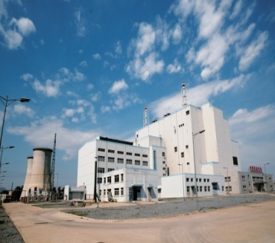
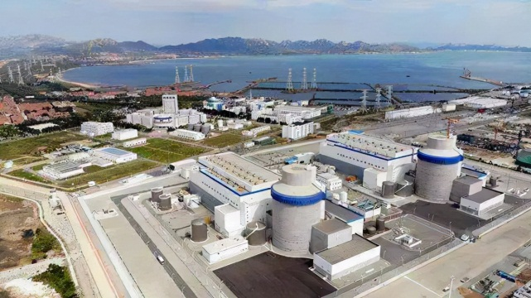
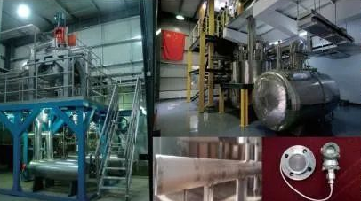
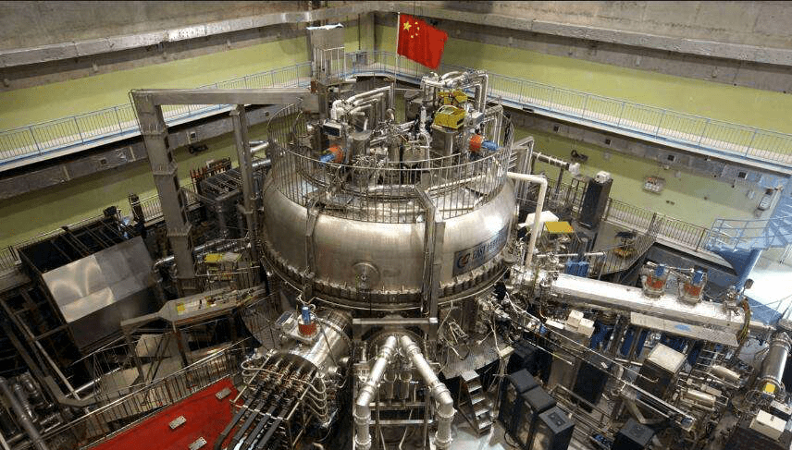
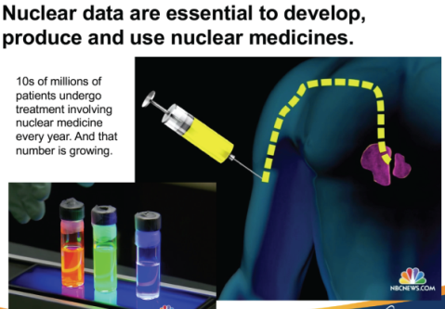
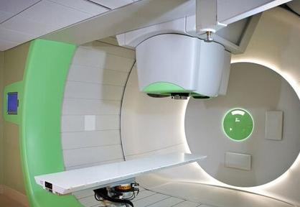
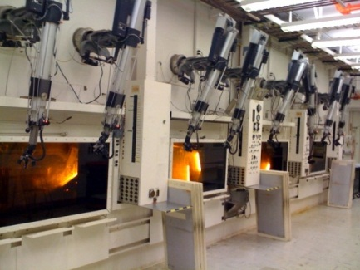
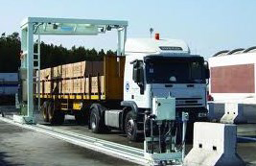
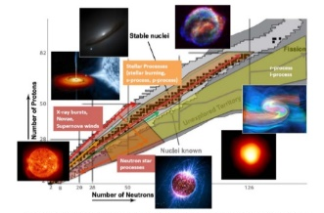
3.Needs from application
Nuclear Energy Application:
Evaluated completed neutron reaction data file
Activation cross sections
Fission yields
Decay data
G-IV reactor and fusion
1) For the SFR project research purpose,
2) For the TMSR project research purpose,
3) For the fusion study purpose.
The isotope production/ medicine and other fields
1) Isotopes production need which including the cross sections, decay data, half time etc.
2) For the medical isotopes purpose.
p:11/13

Slide 12
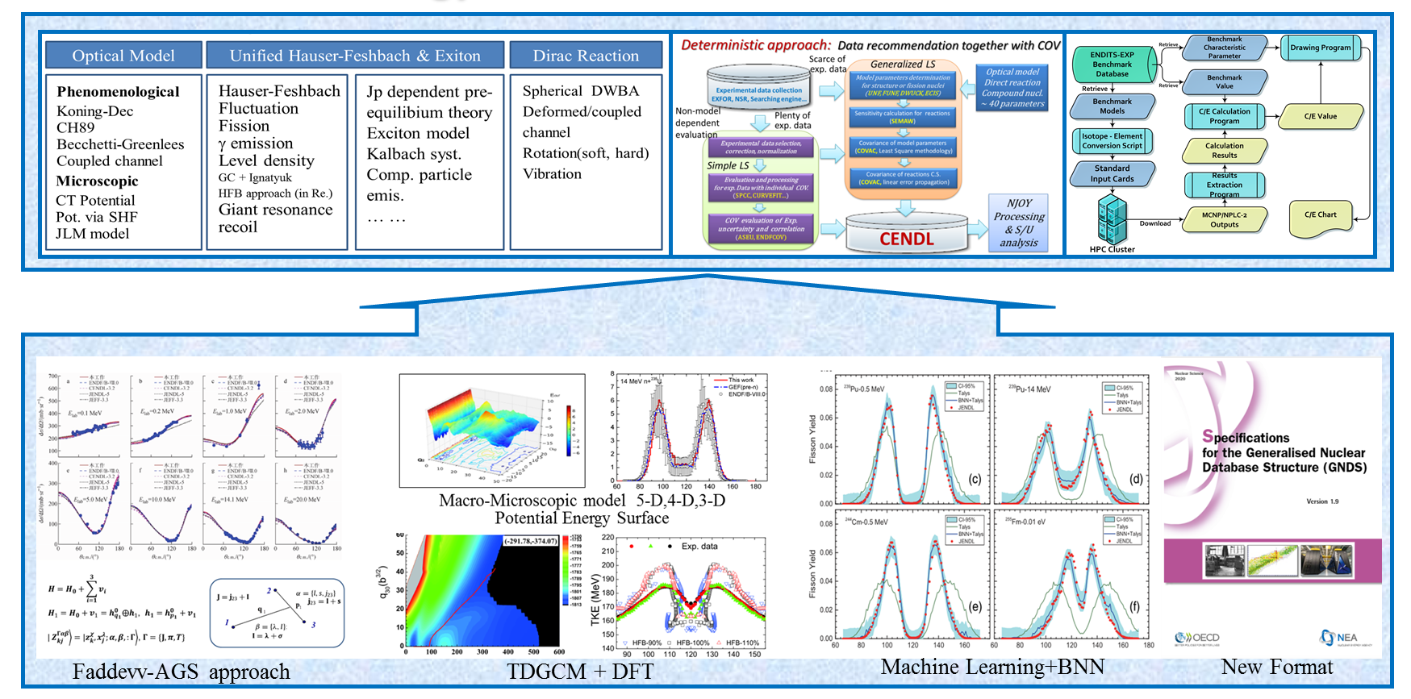

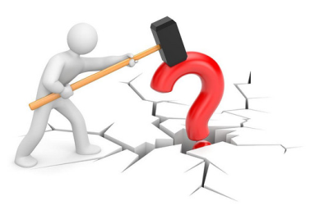
4.Challenges(puzzle?), what should we have to focus on…?
Application Need
Accurate Measurement?
Complicated Library?
Physics Theory?
New Eval. Way?
To feed the application need -> too complicated methodologies -> diversified data files ?
To push the fundamental study -> too simple and reasonable -> unified(standardized) database ?
Notes:
上页ppt的内含
我们面临的挑战：
核数据需求（种类、精度、能区、入射粒子种类等等）快速增长
目前的核数据产生方式 实验+测量
未来我们应该咋做？
1、完全以需求为牵引，继续修补现有的测量、评价和检验，产生更为复杂、庞大的微观数据，开展大量的宏观基准检验，再根据不同用户需求研制更多的应用数据库？
2、更多地从微观数据、甚至是基于更为基础的核物理实验与理论研究，研制更为可靠的基础（或标准）数据？然后鼓励用户端基于这个database产生更为合理的应用数据库解决实际应用问题。
3、1和2的复合研究，产生适当的微观数据获得适合的应用数据库。

Slide 13
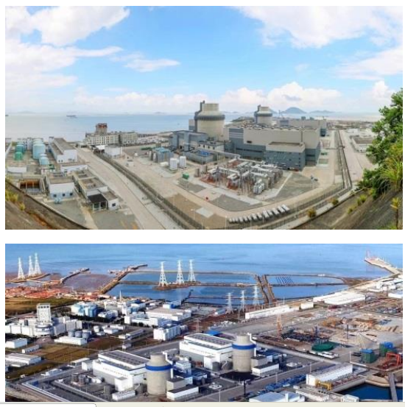
4.Challenges and resolution
Challenges:
The demand for nuclear data is growing rapidly with more types, higher accuracy, wider energy range, more types of incident particles, etc.
The current nuclear data generation methods of experiments and evaluations, cannot meet the requirements.
Resolution:
Driven by the needs, improve the technology for the nuclear data measurements, evaluations, and validations, and generate more advanced and complete data .
Developing more reliable basic (or standard) data from microscopic data, even based on more fundamental nuclear physics experiments and theoretical research. Then encourage users to generate more reasonable application databases based on this database to solve practical application problems.

Slide 14

5. Suggestion for nuclear data cooperation
Enhance the cooperation in the ND community
Share the evaluation methodology.
Share new experimental data and all information for important samples.
Share the ND processing methodology and new results of validation and benchmarking of ND for importance cases.
Remains the independent of the ND evaluations and databases to avoid systematic mistakes.
Strengthen the leadership, organizational, and training roles of the IAEA
Notes:
合作，
保持独立性
发挥IEA作用。
1人员名额
2承办一个会议，当地
3，互访 4人，每个季度
4. 10月份。
下午3点

Slide 15
Thank you for your attention !
Comments and suggestion welcome !

