Slide 1
Introduction to nuclear reaction and decay data
Arjan Koning, Head of Section
Nuclear Data Section, International Atomic Energy Agency
nds.contact-point@iaea.org

Slide 2
Nuclear Reaction
Nuclear Structure and Radioactive Decay
n
α
β
γ
Alpha decay
Beta decay
Gamma decay
Nuclear power
Homeland security
Nuclear fusion
Medical applications (therapy and isotopes)
etc.
Spent fuel and radioactive waste management
Radiography, Nondestructive assay
Safeguards
Etc.
Nuclear Data
Make high-quality data available in numerical databases

Slide 3
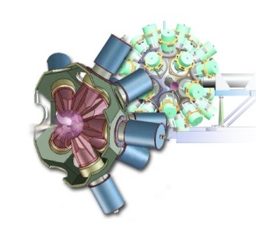
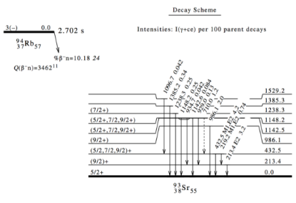
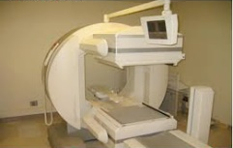
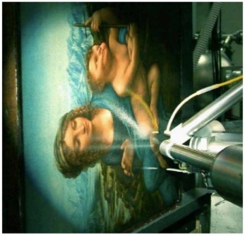
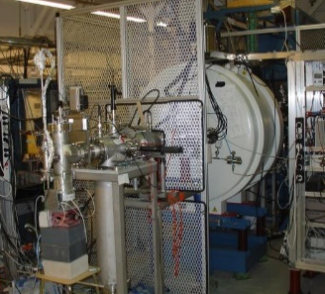
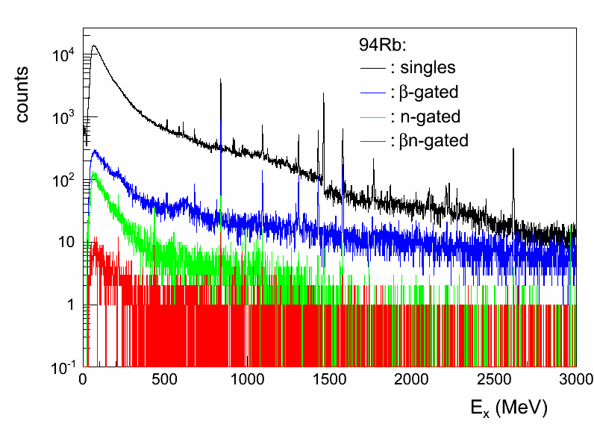
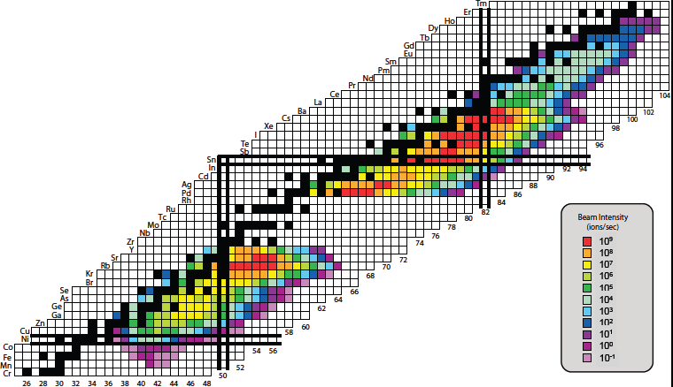
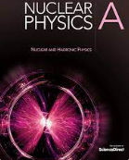
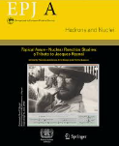
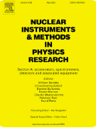
Nuclear physics research: experiment + theory
JYFLTRAP Penning trap
Applications:
organised
complete
recommended
traceable
easily retrievable

Slide 4
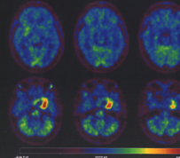
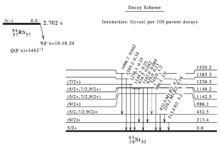
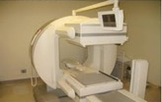
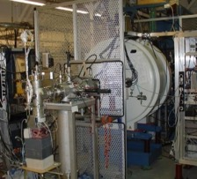
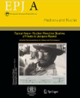
Nuclear data
Verification &
Validation
Dissemination
Data Compilation
Data Evaluation
JYFLTRAP Penning trap
Applications:
organised
complete
recommended
traceable
easily retrievable
Publication

Slide 5
Nuclear Data Pipeline
Verification/
Validation
Dissemination
Compilation
Evaluation
Publication
Experiments
Data Compilation
Data
Evaluation
Processing
Validation
Use
#experts decreasing
Unless measurements go through the nuclear data pipeline and are
incorporated in the nuclear databases they ARE NOT USED

Slide 6
Nuclear Data Section
Develops nuclear data through data development projects and international networks
Promotes research through international coordinated research projects & technical meetings
Enhances capacity building via training workshops and mentoring schemes
Provides services in dissemination of databases, web tools and technical documents
Reference Database for beta-delayed neutrons
Photonuclear Data and Photon Strength Functions
Fission Yield Data
Decay Data for Antineutrino Spectra and Applications
Joint ICTP-IAEA Workshops on:
Nuclear Structure and Decay Data
Nuclear Data Measurements for Science and Applications
Nuclear Reaction data for Applications

Slide 7
Nuclear Data Section: Databases and Web applications
Application | URL | Contents
Live Chart of Nuclide | https://nds.iaea.org/relnsd/vcharthtml | Nuclear structure and decay data, user-friendly graphical interface, Python API, mobile apps
Decay Portal | https://nds.iaea.org/relnsd/vcharthtml/decay_libs.html | Decay Data Library Comparison
International Database of Reference Gamma Spectra (IDB) | Internal testing | In collaboration with IAEA-SG
IAEA Handbook of Nuclear Data for Safeguards | https://nds.iaea.org/sgnucdat | A set of recommended nuclear data for safeguard (decay data, thermal neutron capture cross section, resonance integrals, fission product yield..etc)
Neutron Standards | https://github.com/IAEA-NDS/neutron-standards-database/ | The neutron cross section standards
Prompt Gamma-ray Neutron Activation Analysis | https://nds.iaea.org/pgaa | Prompt Gamma-ray Neutron Activation Analysis (PGAA) database and evaluated Gamma-ray Activation File (EGAF) for non-destructive nuclear method
Beta-Delayed Neutron Emission Database | https://nds.iaea.org/beta-delayed-neutron | Experimental beta-decay half-lives, beta-delayed neutron emission probabilities, and emission spectra
Electronic Stopping Power of Matter for Ions | https://nds.iaea.org/stopping | Collection of stopping power measurements (New database will be released soon)
Nuclear Electromagnetic Moments Database | https://nds.iaea.org/nuclearmoments | experimental information on nuclear magnetic dipole and electric quadrupole moments
Atomic Mass Data, AME & Nubase | https://nds.iaea.org/amdc | Nuclear properties: mass, isomeric excitation energy, half-life, spin, parity, decay modes and intensities
Medical Radioisotopes Production Portal | http://nds.iaea.org/medportal | Therapeutic Radionuclides, Gamma Emitters, Positron Emitters
Medical Isotope Browser | http://nds.iaea.org/mib | Medical radioisotopes production simulator
EXFOR | http://nds.iaea.org/exfor | Experimental nuclear reaction database
Compilation of Nuclear Data Experiments for Radiation Characterisation (CoNDERC) | https://nds.iaea.org/conderc/ | Decay Heat, incident particle spectra used world wide, origen Input for shielding calculation, thermal resonane data
Nuclear Reaction Data Explorer | https://nds.iaea.org/dataexplorer | Experimental and evaluated cross section and fission yield plotter
Various codes are available on https://github.com/IAEA-NDS

Slide 8
Live Chart of Nuclides
Nuclear structure and decay data (ENSDF) viewer
Available online and mobile app
Levels, decay radiation scheme, schema plot, gamma lines and energies, fission yields

Slide 9
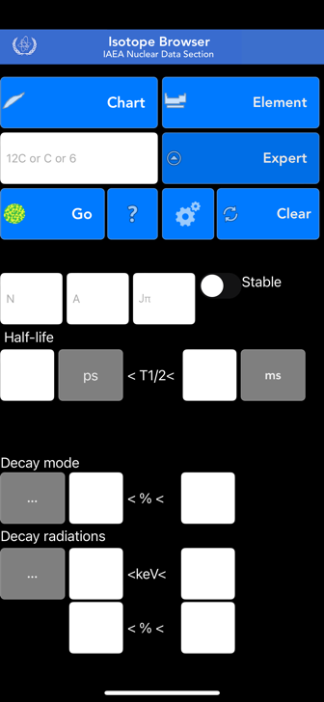
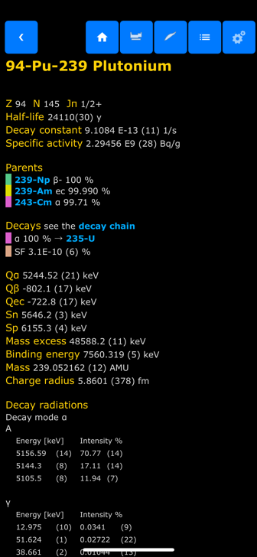
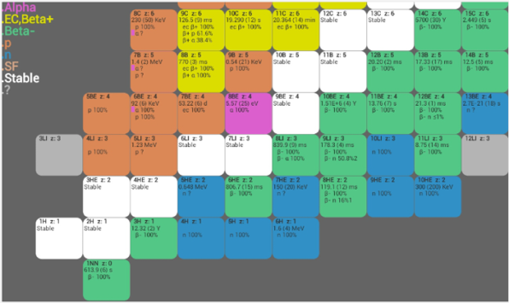
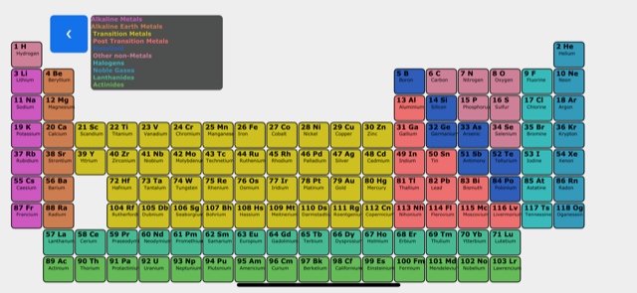
Isotope Browser – for Mobile Devices
App for Mobile Devices
Properties of over 4,000 isotopes
No internet connection needed
~180,000 downloads, 4.8 ⭐️
11 languages (Arabic, Chinese, English, French, Spanish, Russian, Japanese, Slovenian, Italian, Trad. Chinese, German)
Regularly updated with new features and data
Available for both
- Android
- Apple

Slide 10
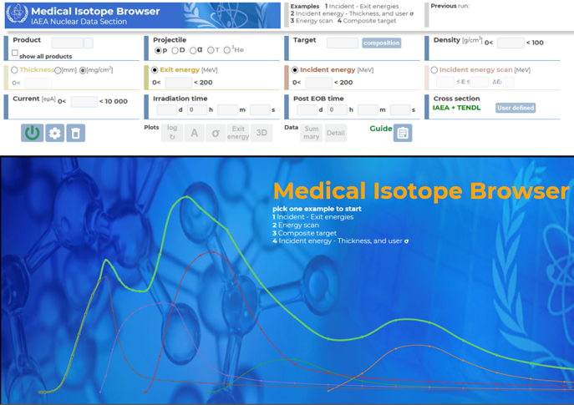
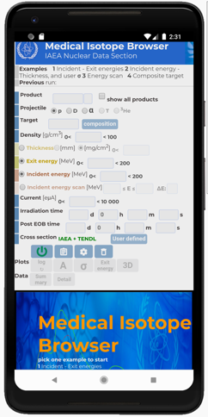
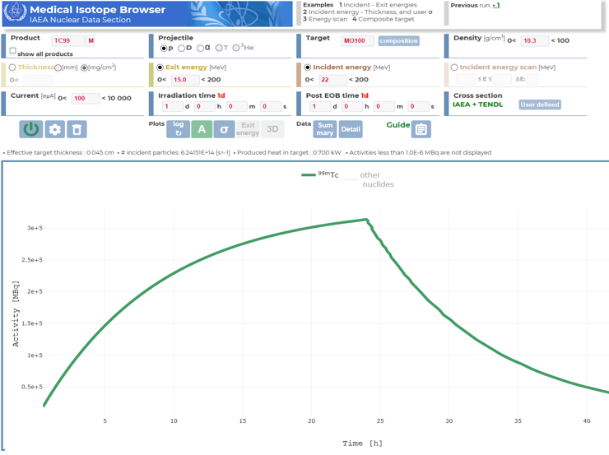
WebApp: Medical isotope browser
Medical isotope production simulator
Run the simulation online (accessible from any browser)
Setup target, projectile, the intensity and duration of irradiation, cooling time
p + ¹⁰⁰Mo → ^{99m}Tc

Slide 11
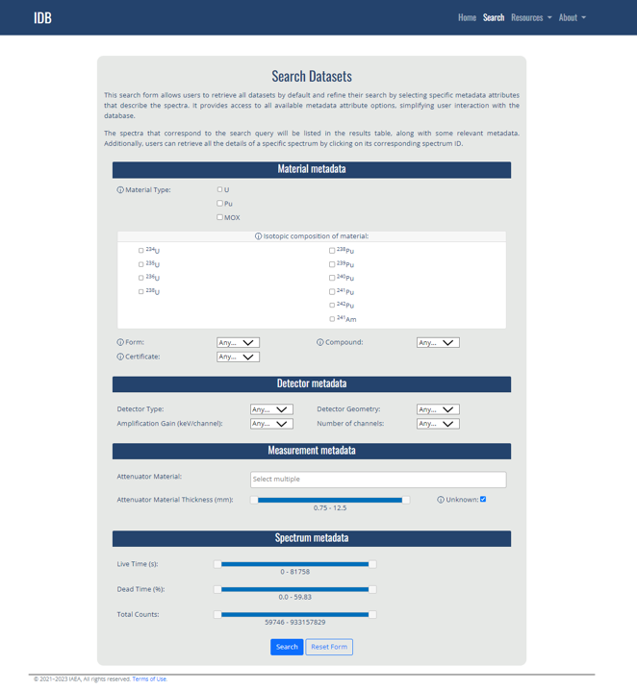
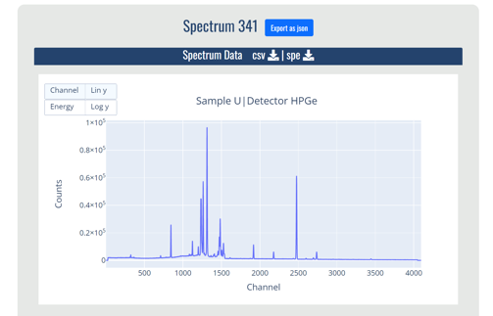
IDB: Support for nuclear safeguards
IAEA’s nuclear safeguards inspectors use various software codes for measurement of U and Pu isotopes based on gamma-spectroscopic measurements.
Development and deployment of International Database of Reference Gamma Spectra to support the objective of the Member States “Sustainability and Maintenance of Software for Pu-isotopic and U-Enrichments”
The joint task was collaboratively accepted by the United States (US SP), French (FRESPAS), and European Commission (EC SP) Support Programmes in 2008.
Current status : 1040 spectra (U.S.)
Updates (2023): ~550 spectra (IAEA)

Slide 12
Thank you!
Notes:
Thank you!

