Slide 1
OFFICE OF SCIENCE
US Perspectives on Nuclear Data
IAEA General Conference
27 September 2023
Keith Jankowski
Program Manager for Nuclear Data

Slide 2
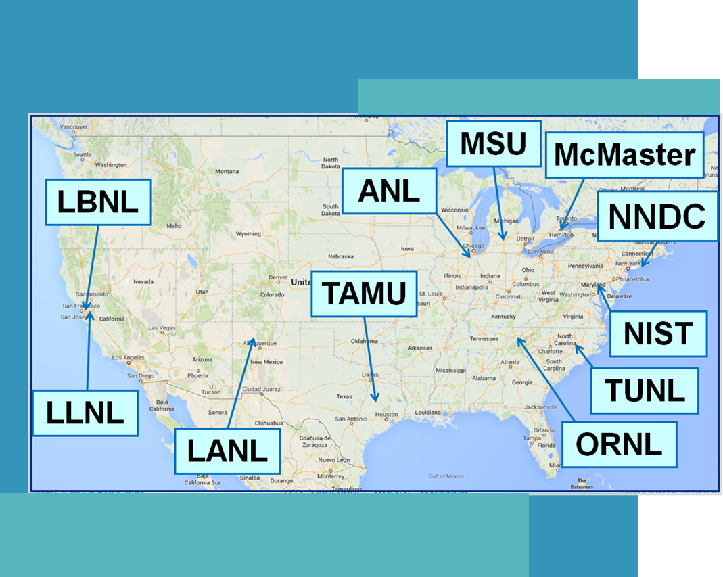
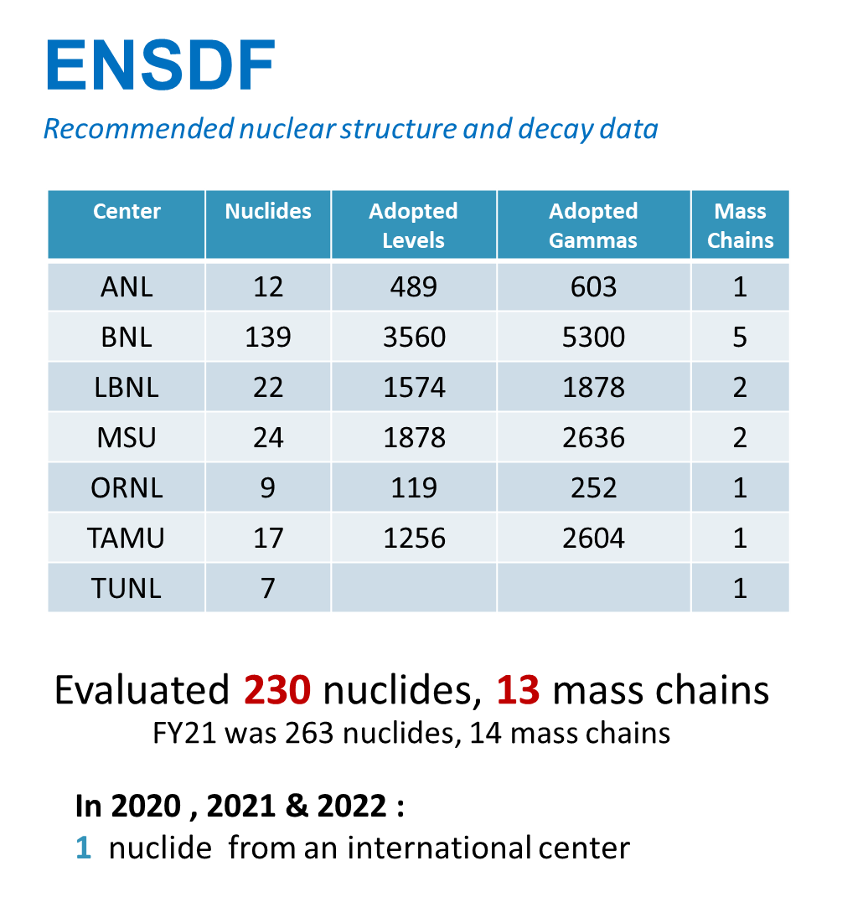
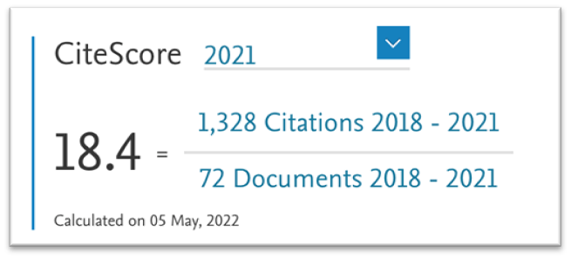
Nuclear Data in the US
The NP led US Nuclear Data Program (USNDP): works to get updated nuclear data into libraries for users. It covers the entire table of the isotopes and serves a critical role in basic research and applied missions

Slide 3
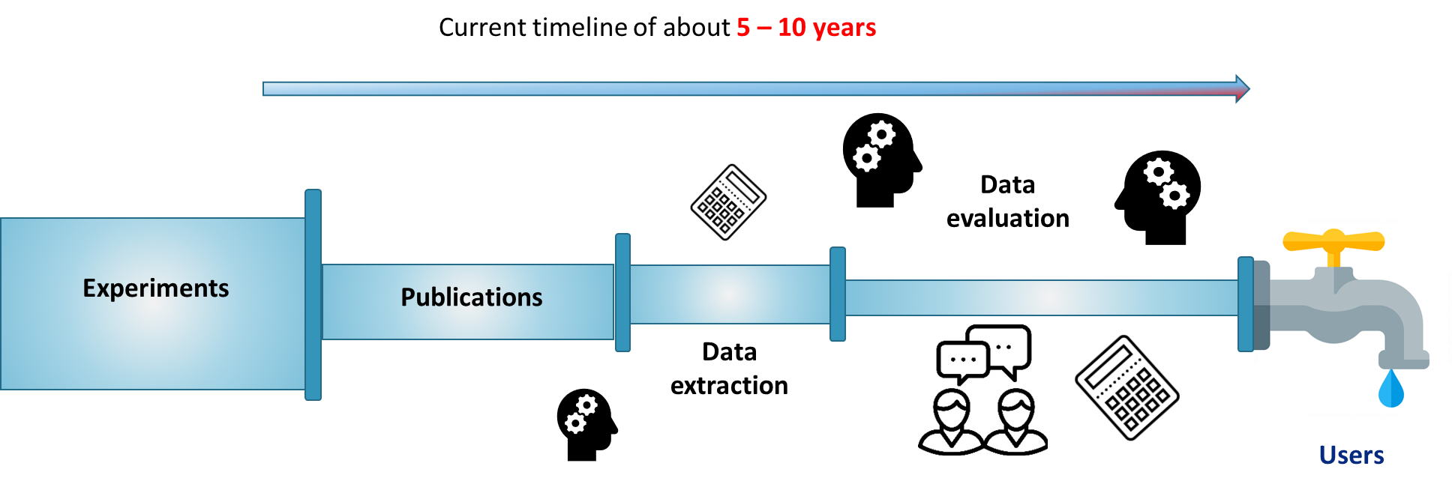
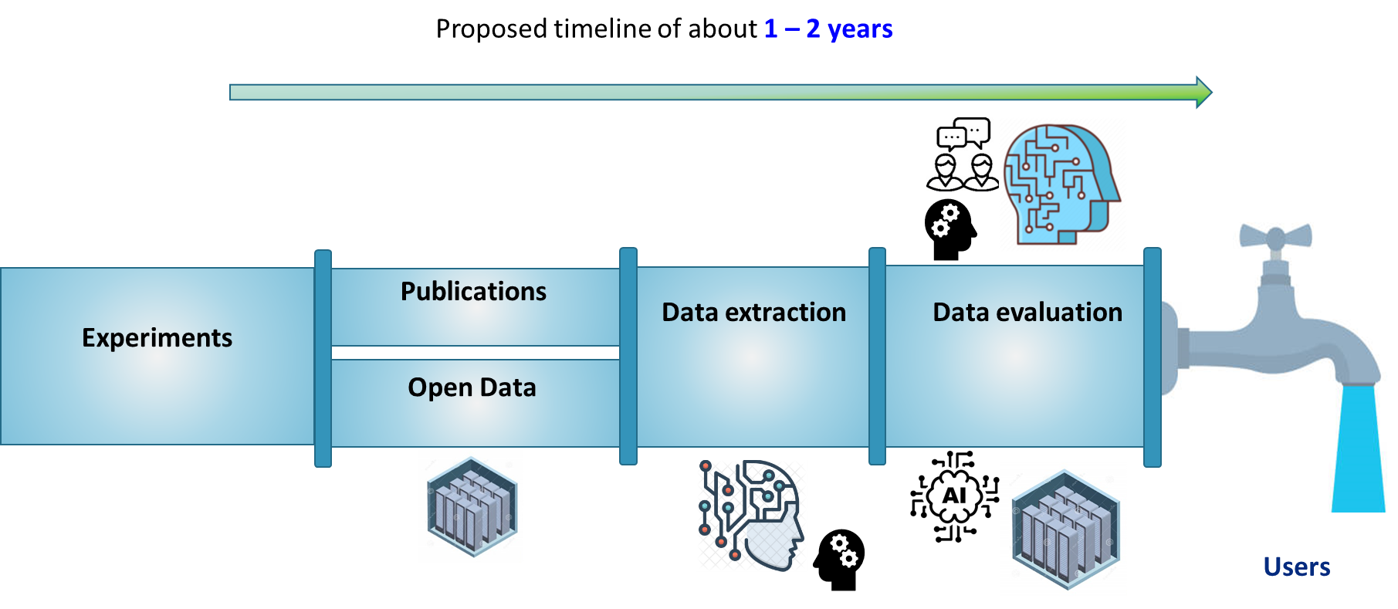
USNDP in more detail
Funding: ~$12M annually
FTE: ~13 scientific staff
Responsible for data compilation and evaluation for nuclear structure and reaction data
Leads working groups (Cross Section Evaluation Working Group) and actively participate in international groups such as IAEA (Nuclear Structure and Decay Data, Nuclear Reactions), OECD/NEA, Coordinated Research Projects, Atomic Mass Evaluation (collaborative with China)

Slide 4
A Major Challenge In Addition to Data Acquisition/Curation
The role of nuclear data is often hidden deep inside codes and end users often don’t know what they don’t know
“Modeling and simulation tools will still give an answer, even if there is only a theoretical extrapolation”
Only recently has greatly improved nuclear data provided much needed improved precision for:
Decay heat in reactors
Reactor anti-neutrino spectra
Beta decay data for “pandora” fission fragments
Users most often interact here

Slide 5
Nuclear Data Is Central to an Increasing Number of Federal Missions
Increased outreach:
Since March 2020, increased Nuclear Data Inter-Agency Working Group (NDIAWG) membership from 8 to 16
NDIAWG meets quarterly to coordinate and prioritize needs
Annual workshop with targeted sessions on needs
Nearly annual funding opportunity since 2015, with ~$50M (USD) invested through it so far
Additionally, ~$12M covers the USNDP. And other federal programs will invest in projects on their own too

Slide 6
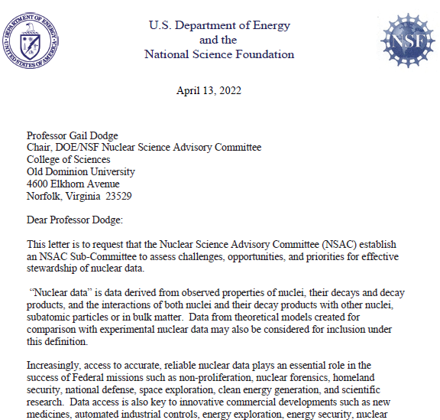
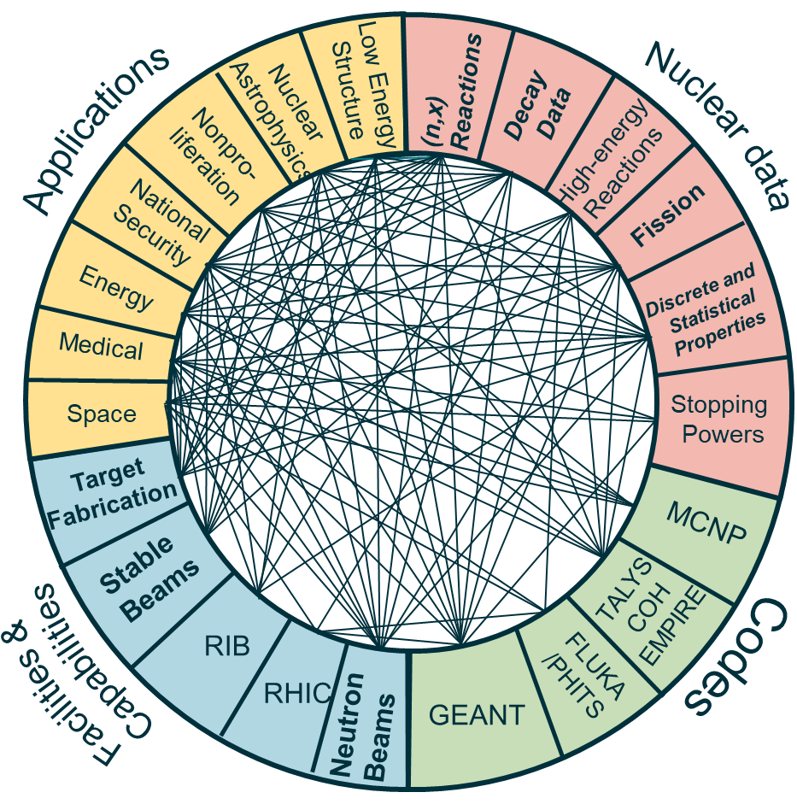
NSAC Nuclear Data Charge
The Nuclear Science Advisory Committee (NSAC)
was charged to form a subcommittee to address current status and opportunities in nuclear data
Two reports requested:
1) detail the current status of the USNDP, both domestic and internationally, and 2) articulate opportunities to enhance nuclear data for basic nuclear science and applications
Charge to NSAC on nuclear data
The cross-cutting nature of nuclear data is readily apparent

Slide 7
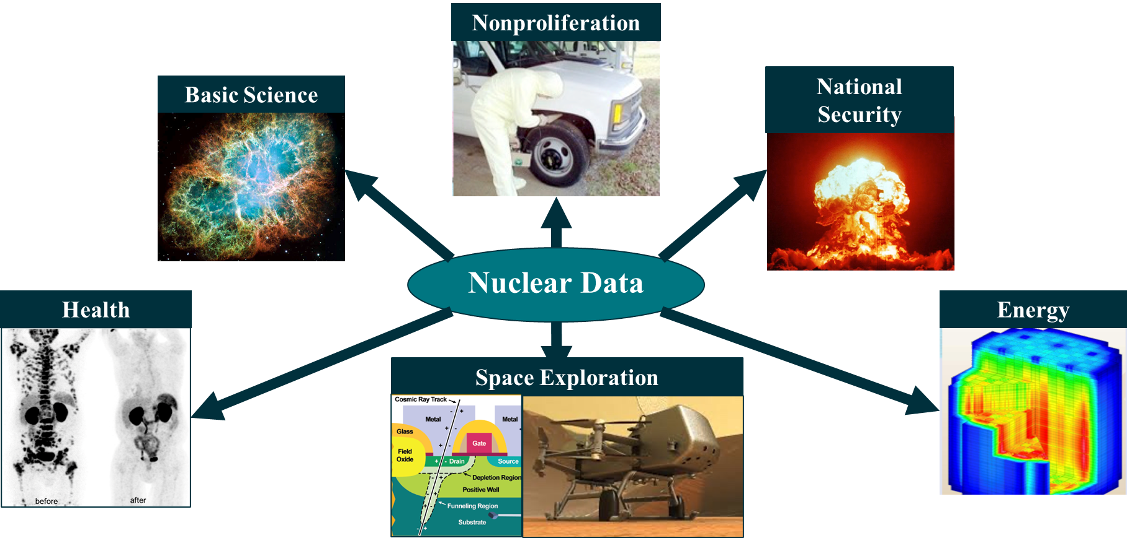
Opportunities Identified For Increased Impact/Stewardship
Cross-cutting themes emerged that are used by many applications
Workforce development
On-going fission evaluations
Accelerated decay data evaluations
Improved reaction modeling with better links to nuclear structure
Neutron induced data from low- to mid-energies
High energy reactions and material stopping power

Slide 8
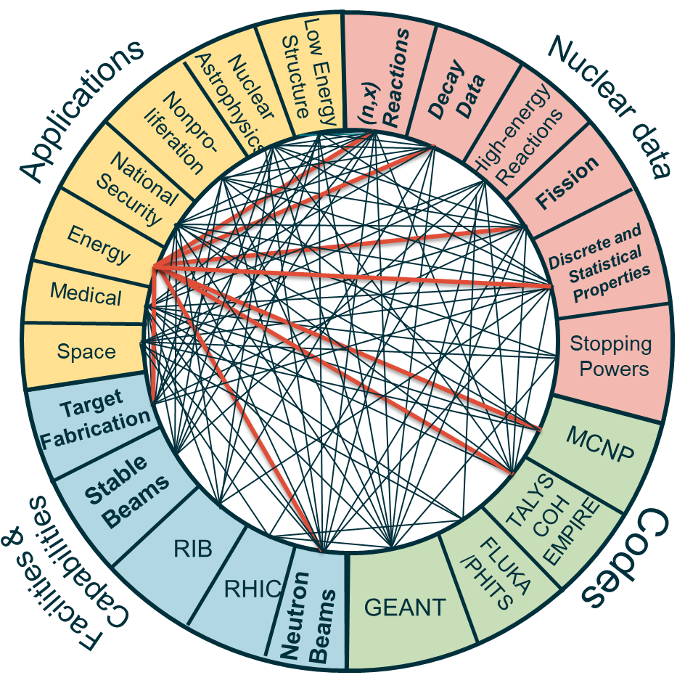
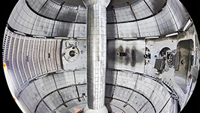
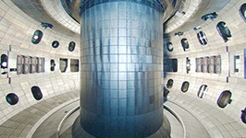
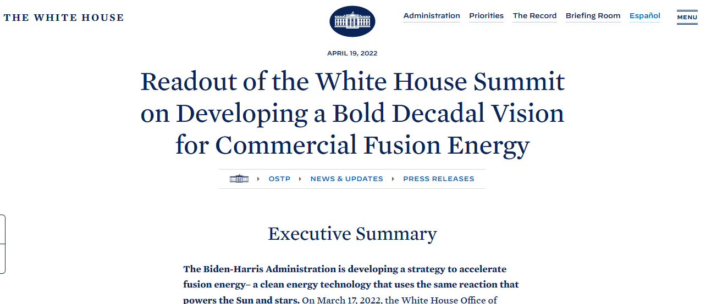
Opportunity 1: Fusion Energy
OSTP driven workshop on May 4 to discuss nuclear data needs for fusion
Follow-up on June 2 discussed more details
Urgent need for data on structural and superconducting magnet materials
Materials damage due to high energy neutrons → similar needs in other applications (fission, space)
Aligns with Administration Priority for developing a bold decadal vision for commercial fusion energy
NSTX-U
DOE/SC/FES User Facilities
DIII-D

Slide 9
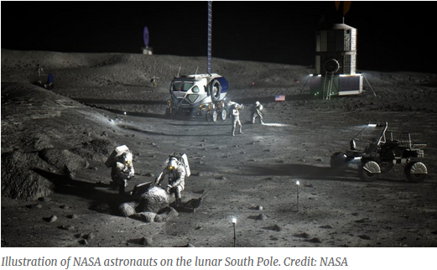
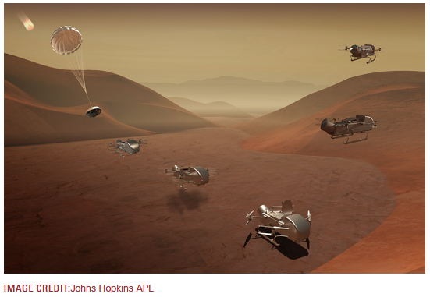
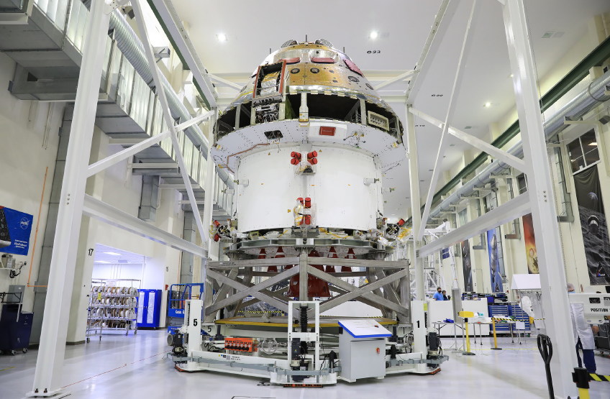
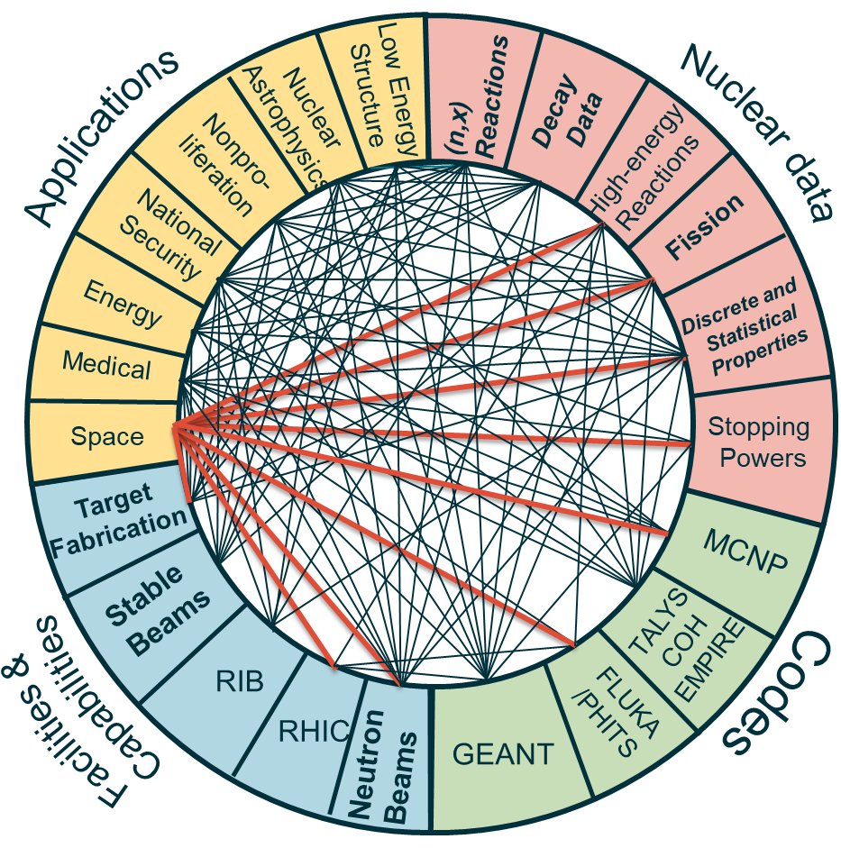
Opportunity 2: Space Exploration
Recent NP outreach to NASA led to needs in space exploration in human spaceflight, electronics protection, and planetary exploration
Human Spaceflight requires high energy data due to galactic cosmic rays hitting spacecraft → dose to astronauts
Data collection is possible at BNL/RHIC/STAR
Electronics Protection requires data on advanced electronics materials
Planetary Exploration requires data on a variety of elements that could be found on the Moon, Mars, and beyond
Aligns With Administration Priority on return to the moon and on to Mars
Graphics from presentation by J. Norbury (NASA), WANDA2022
Illustration of NASA moon mission
NASA Dragonfly mission to Saturn’s moon Titan, 2026
Orion spacecraft crew module

Slide 10
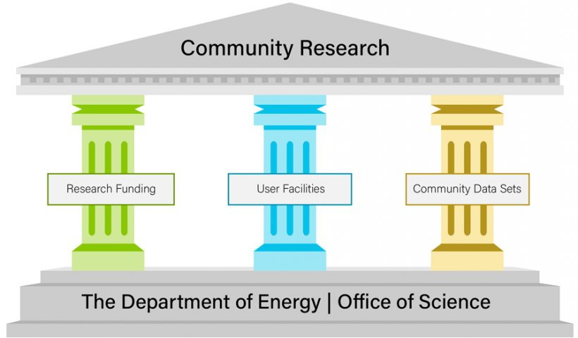
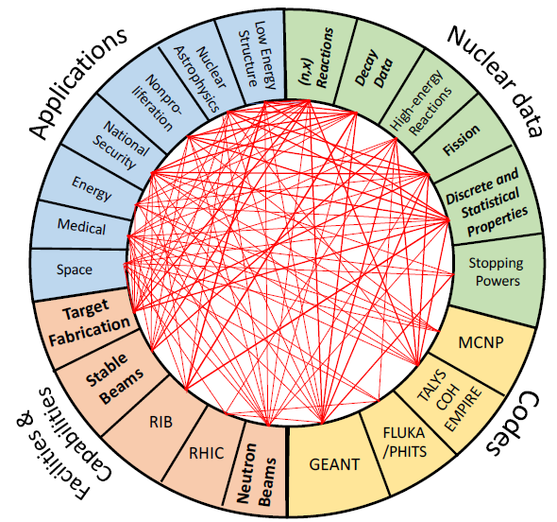
Opportunity 5: Infrastructure
Plan to boost nuclear data workforce and help keep up with pace of incoming data. A special focus on evaluators and embedded staff is planned.
Incorporation of AI/ML methods into the nuclear data production pipeline to reduce timeline from beginning to end
Modernize databases to accommodate modern data sets to enable data preservation and sharing as well as improved/facilitated access
Aligns with Administration priorities related to AI/ML and DEIA
https://science.osti.gov/Initiatives/PuRe-Data/Resources-at-a-Glance
Sponsored by the office Nuclear Physics (NP)
https://www.nndc.bnl.gov/

Slide 11
Outlook
Nuclear data plays a critical role in all areas of nuclear science, nuclear engineering, and applications of nuclear technology
Specific targets for increased investment and enhanced stewardship include:
Workforce development
On-going fission evaluations
Accelerated decay data evaluations
Improved reaction modeling with better links to nuclear structure
Neutron induced data from low- to mid-energies
High energy reactions and material stopping power
The role of nuclear data is often hidden by layers of abstraction (i.e., modeling/sim tools) so users can have difficulty knowing the quality going into their models
This needs to be worked through increased outreach, and
Infrastructure modernization to facilitate improved access and information for users
Although Nuclear Data is inherently cross cutting and NP is strongly promoting inter-agency cooperation, the SC Nuclear Data Program anchors this activity across all federal programs and is uniquely responsible for its stewardship.

Slide 12
OFFICE OF SCIENCE
Thank you!

