Slide 1
Providing the best nuclear data for tomorrow’s nuclear solutions
Side Event at the 67th IAEA General Conference
Michael Fleming
Head of the Data Bank
Side Event at the 67th IAEA General Conference

Slide 2
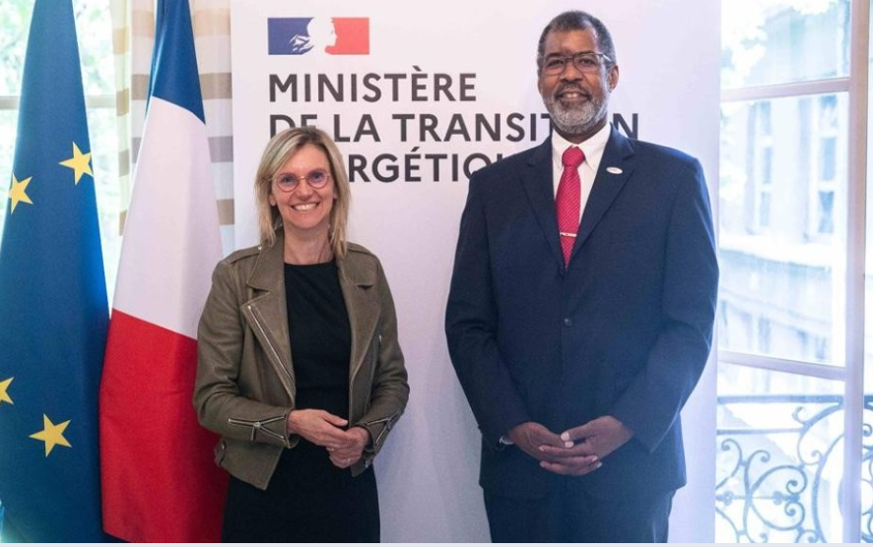
Global drivers for Nuclear Energy
NEA projections show that to successfully achieve net zero by 2050, nuclear energy capacity must at least double compared to current installed capacity.
Several NEA member countries are acting now to realise this deployment, including multilateral co-ordination at ministerial level.
Multiple technologies are part of these roadmaps, including a wide variety of SMRs enjoying significant resource allocation.

Slide 3
Some reminders
Nuclear data is an applications-driven field, delivering information for modelling and simulation solutions that must be collectively validated.
After decades of effort, nuclear data library projects have already achieved impressive results for their stakeholders, who use them in daily operations.
New systems and/or extrapolated scenarios (e.g. waste disposal, materials damage, high burnup) require more/different data than the past.
Rigorous processes are required to prioritise improvements that specifically meet application needs and will have an impact on users.

Slide 4
The pipeline
‘The pipeline’ (source: D. Brown) is exceptionally relevant for illustrating how data projects develop products – but let’s build in the user community more:
End-user community
Work with users to identify ND-related issues
Integrate into simulation systems
Quantify needs in terms of targets
Adjust or provide support for it
Preserve everything required to understand and reproduce the evaluation
S/U analysis to prioritize exp/eval
Document the application impact(s)

Slide 5
Stakeholder / user engagement
Last user engagement in 2019 Stakeholder meeting
Several user communities engaged for the first time
New issues raised and bilateral exchanges to quantify/address problems
Request: maximize participation from end-user communities to bring new perspectives / needs
Latest stakeholder meeting 20 September 2023
Topics considering:
Advanced reactors / fusion
Materials modelling
Source facilities
Waste and handling
Medical applications / isotopes
More
Necessary to conduct routinely and translate stakeholder engagement into quantifiable targets

Slide 6
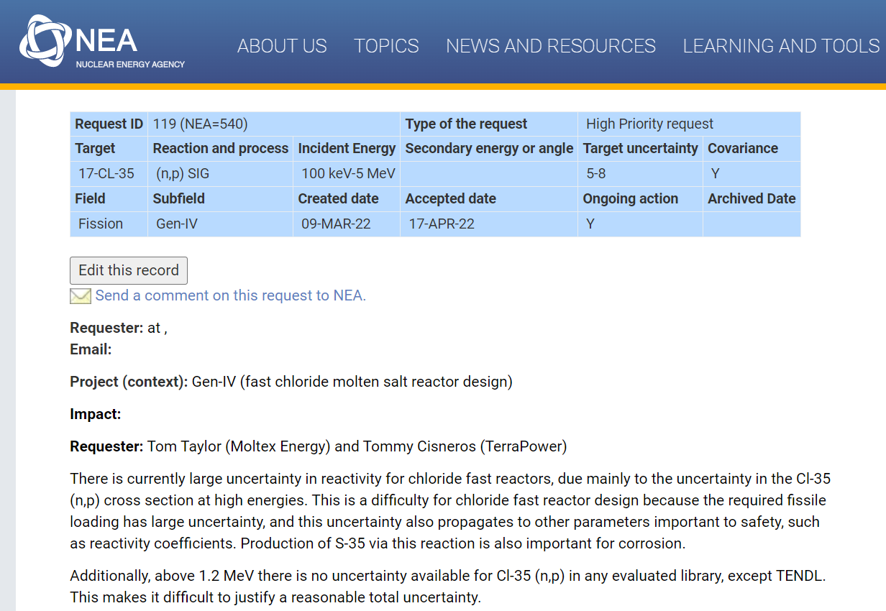
International co-operation through NEA
NEA facilitates international co-operation through several bodies including:
Joint Evaluated Fission and Fusion (JEFF) project
Working Party on Evaluation Co-operation (WPEC)
The High-Priority Request List (HPRL)
Numerous JEFF and WPEC subgroups / technical committees advancing individual projects

Slide 7
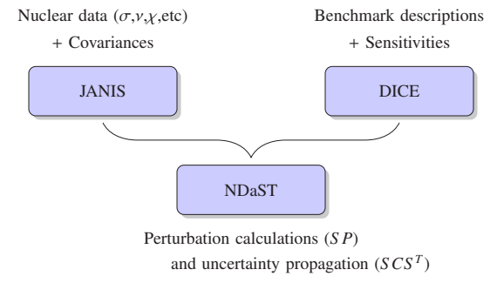
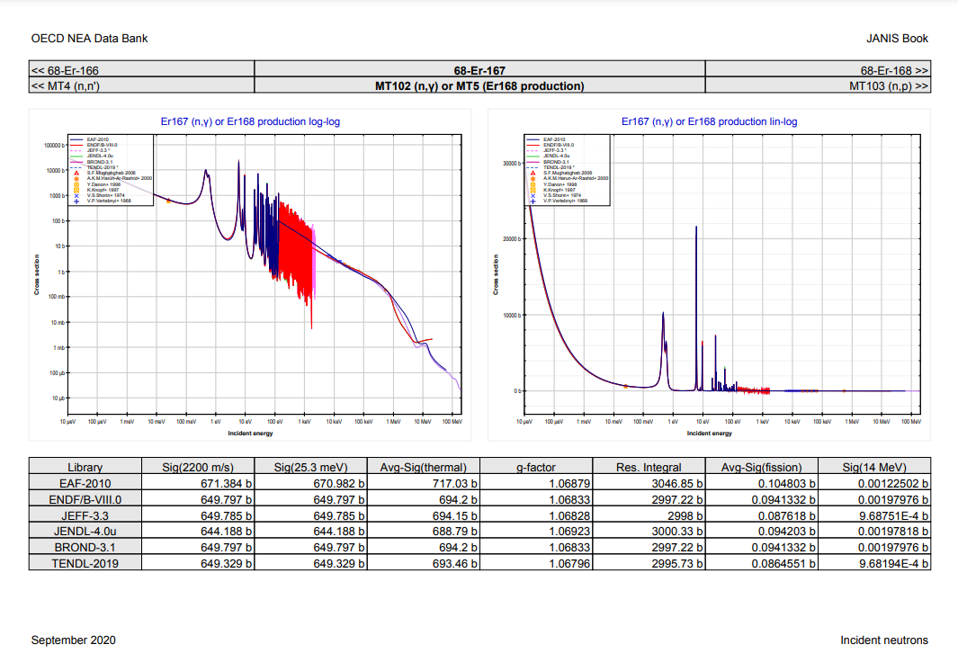
Demonstrating the impacts
NEA hosts the international benchmark databases for criticality safety, reactor physics, shielding, spent fuel, fuel performance, thermal hydraulics, and more
Coupled with databases and applications users can sift through experiments/data and perform analyses including S/U and perturbation
These tools allow users to identify representative systems and see the impact of new data
Coupled with direct data processing and integration with simulation systems, we can close the loop and feed the user community with data to address emerging needs

Slide 8
Parting observations
Challenging to create better data libraries that can convince users to update and prove their worth to the user communities
Target accuracies from end-users and peer-reviewed priority requests give concrete objectives that can direct data development and provide evidence for adoption
Maximizing the direct, automatic, reproducible link between data development and testing processes in all user communities is possible and necessary
The NEA and its Data Bank have a broad international mission, in co-operation with IAEA and other international partners, to assist in this crucial mission

Slide 9
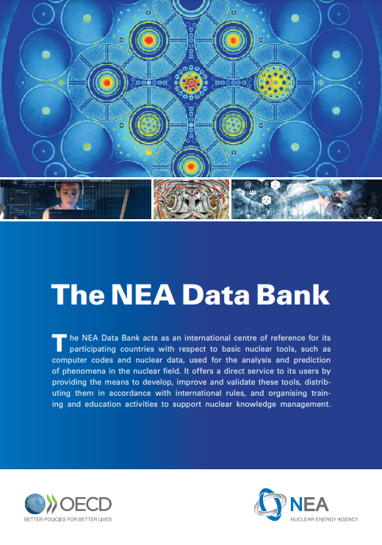
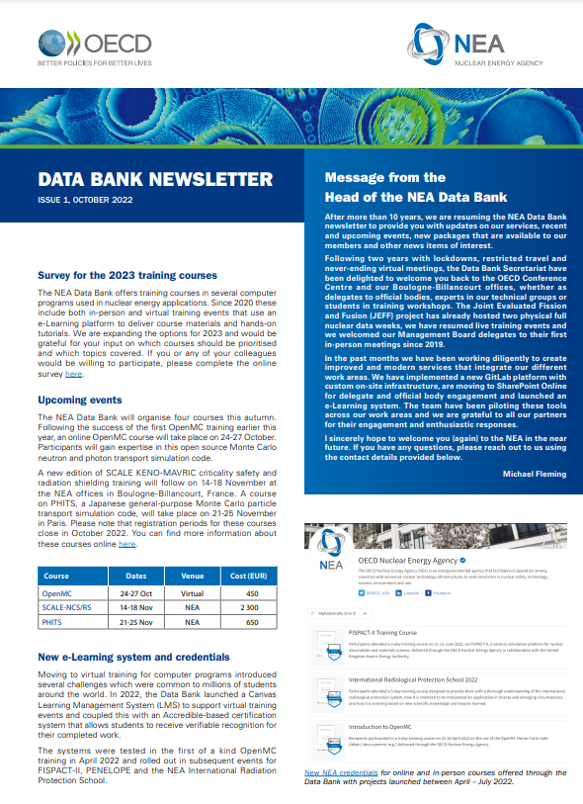
Thank you for your attention
michael.fleming@oecd-nea.org
oecd-nea.org/databank
data@oecd-nea.org
programs@oecd-nea.org

Slide 10
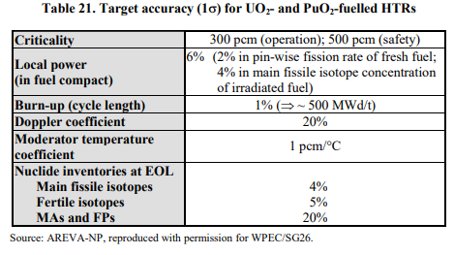
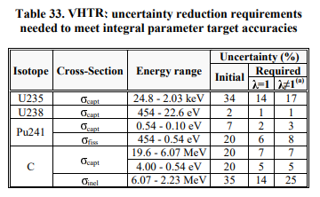
Target accuracy requirements
Target Accuracy Requirements (TARs) are required for each/any system with representative models
Several (any) parameters can be considered, k_{eff}, power peaking, reactivity swing, transmutation…
These are used with sensitivity and uncertainty (S/U) analyses to precisely identify needs
Several international efforts have yielded TARs and, through S/U analyses, actionable requests for the most impactful nuclear data quantities

Slide 11
S/U and prioritization
The High-Priority Request List is a process for creating requests requiring system, TAR and sensitivity analysis
Rigorous international peer-review with experimentalists and other experts (including feasibility)
Long-term WPEC Expert Group with IAEA partnership
Examples (c.f. oecd-nea.org/dbdata/hprl/) include:
U8 inelastic E-dep. targets for 5 different advanced concepts with different targets
K(n,*p) for Ar production @10% above 10MeV for material testing
Cl(n,p) and related data for MSR (c.f. WANDA22 presentation by O. Cabellos)
Er-167 capture and RPs for sHBRs
27 other active high-priority and 100+ others of lower priority

Slide 12
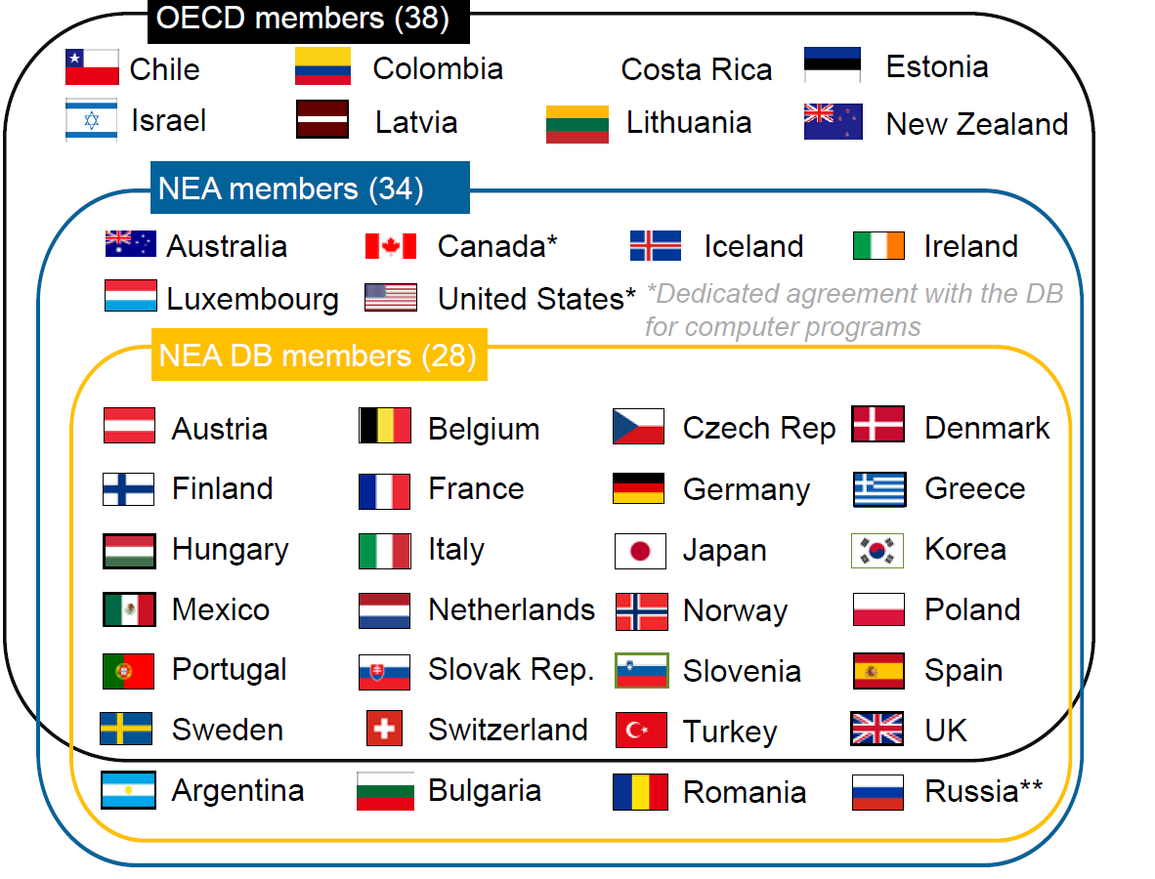
OECD Nuclear Energy Agency (NEA)
Founded 1958, 34 members**, 8 technical committees + Data Bank Management Board
74 Working Parties and Expert Groups, 26 international joint projects, multiple treaty-based organizations (e.g. GIF)
Host for JEFF library project, core EXFOR center, WPEC and Subgroups (CIELO, HPRL, GNDS, and more)
International software distribution and benchmark dev/distribution
**Russian membership suspended 11 May 2022
12
12

Slide 13
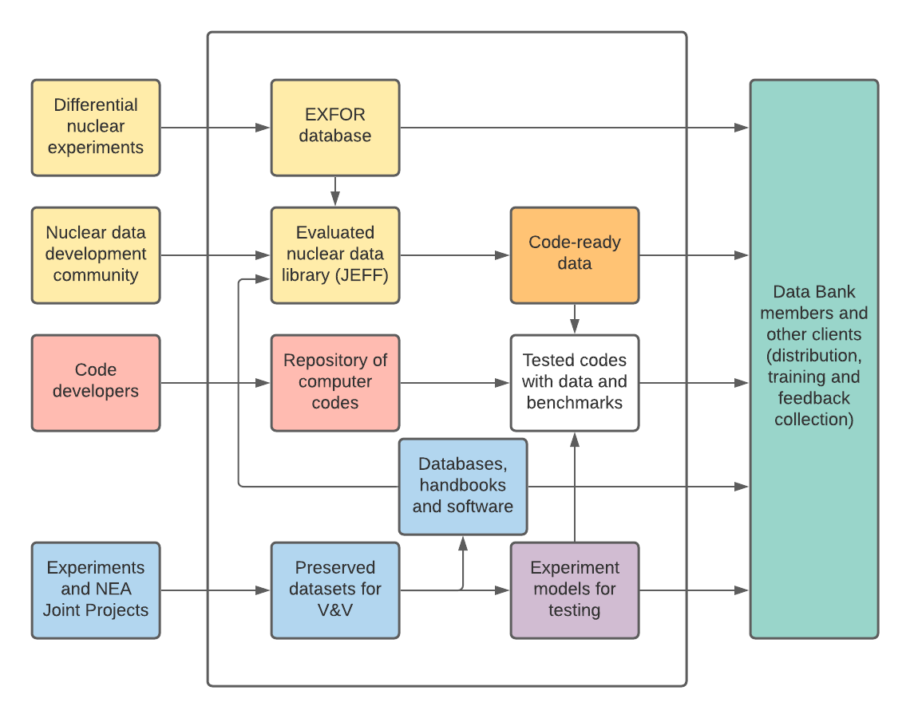
Automated integration with simulation system
Data centers have done a good job creating ACE files and running a suite of ICSBEP experiments
NNDC and Data Bank have moved to GitLab pipelines with trivial extensibility for other software systems (ideally with dev integration)
Downstream testing can/must be automated and can offer two- or one-way feedback

Slide 14
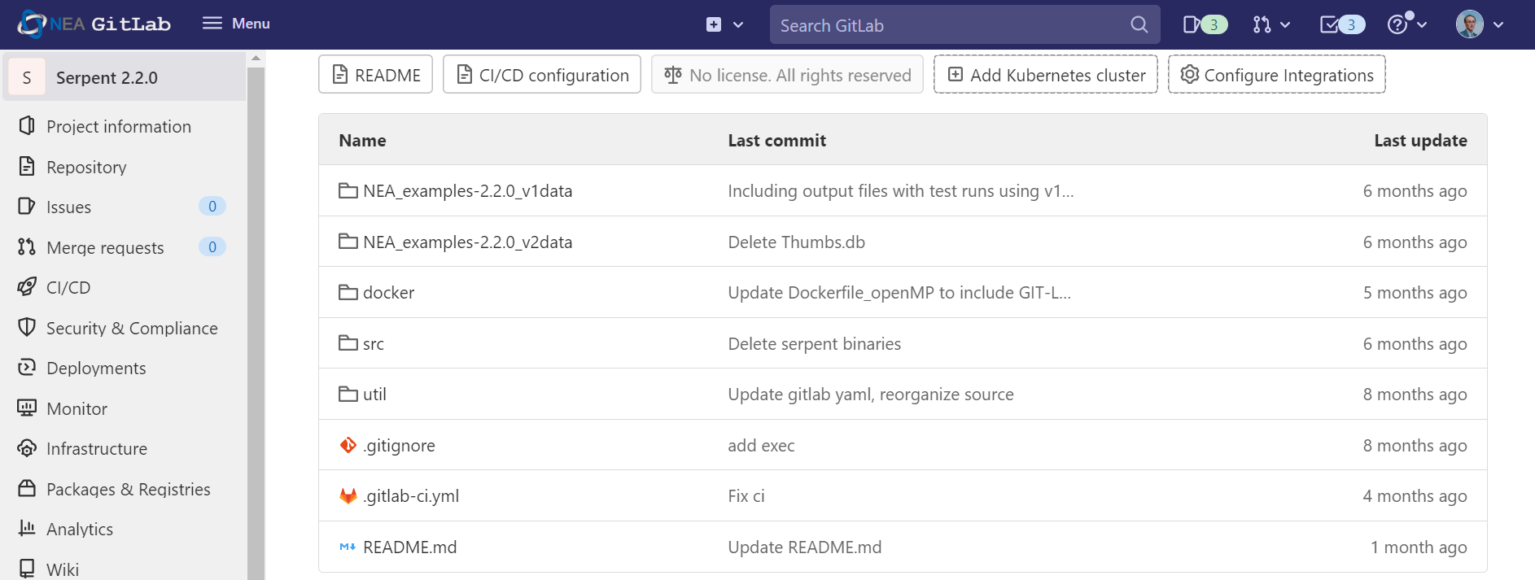
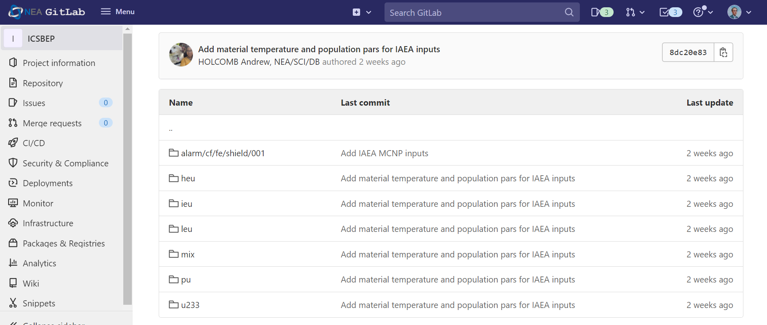
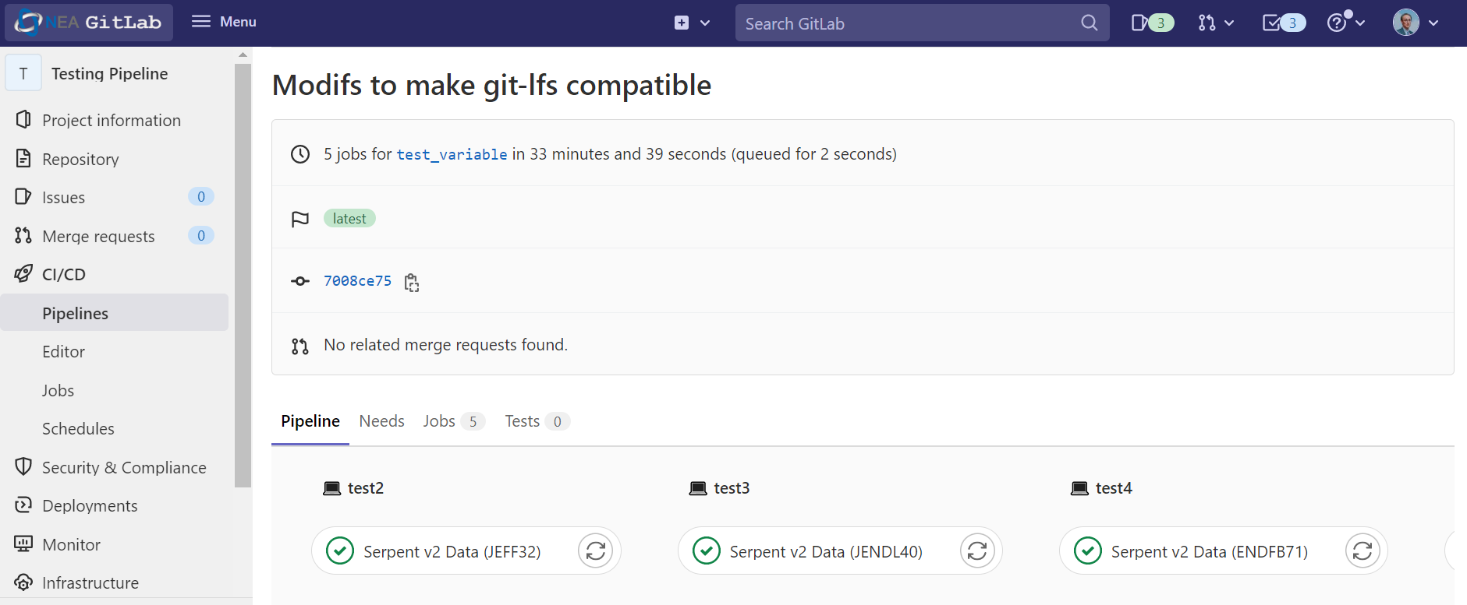
Automated integration with simulation system (II)
This is practical: Serpent-2 (VTT) source repository linked to JEFF and suite of ICSBEP inputs all in VC with pipelines and available for licensees (in DB member countries)
Direct value for developers, nuclear data community, and all users
10 CFR 810 is a challenge, since it excludes software from our NEA / US DOE bilateral agreement – now applying to MCNP and SCALE
Software source
Benchmark models
ND dev pipelines

