Slide 1
Study of Prompt Neutron energy spectra in fast neutron induced fission of ²³⁸U
ALOK SAXENA
Nuclear Physics Division, BARC and Nuclear Data Physics Centre of India

Slide 2
S. S. Kapoor, R. Ramanna and P. N. Rama Rao, Emission of prompt neutrons in the thermal
neutron fission of U235, Physical Review, Vol. 131, 283-296 (1963).
M.S. Samant, R.P. Anand, R.K. Choudhury, S.S. Kapoor, K. Kumar, D.M. Nadkarni and A. Saxena,
“Determination of nuclear level densities of neutron rich fragment nuclei from measurement of prompt neutron emission spectra,” pp.94-103 (1991)
in
"Nuclear Data for Neutron Emission in the Fission Process, Proceedings of a Consultants Meeting," INDC(NDS)-251, 1991; IAEA Nuclear Data Section, 252 pages. Compiled by S. Ganesan, Document available at
http://www-nds.iaea.or.at/reports-new/indc-reports/indc-nds/indc-nds-0251.pdf

Slide 3
M.S. Samant et al. Phys. Rev. C 51, 3127 – Published 1 June 1995

Slide 4

Pre-saddle delay
Saddle to Scission delay
A.Saxena et al,Phys.Rev C49
,932(1994)
α<α_{BG}
α>α_{BG}
Total fission delay
β=7x10²¹ s⁻¹
α<α_{BG}
τ_{tr} =8x10⁻²¹ s
α>α_{BG}
τ_{fo} =10-15 10⁻²¹ s
τ_{ss} = 5-30 x10⁻²¹ s
ω₁ = 1x10²¹ s⁻¹
Notes:
It is seen that Tfiss increases with fissility as expected from Tss dependence on fissility. It is interesting to see the bunching into groups corresponding
to two different mass asymmetry.

Slide 5
Measurements at LNL,Legnaro (Italy)
EXPERIMENTS PROPOSED BY BARC GROUP
470-630 MeV ⁸⁰Se + ²⁰⁸Pb
372 MeV ⁵⁶Fe+²³²Th
²⁸⁸₁₁₆
470-630 MeV
⁸⁰Se + ²³²Th
³¹²124
Measurement of fragment mass and kinetic energy
and neutron correlations
R.G.Thomas et al ,Phys.Rev.C75,024604(2007)

Slide 6
⁸⁰Se+²⁰⁸Pb
²⁸⁸116
⁸⁰Se+²³²Th
³¹²124
ν ^{sf} _{tot} =10±2 for Se+Pb
12±1 for Fe+Th
=17±2 for Se+Th

Slide 7
⁷Li(p,n₀)⁷Be Reaction as Source of Neutrons
small kinematic energy spread
reasonable neutron intensity.
⁷Li + p → ⁷Be + n , Q = -1.64MeV
Used ^{Nat}Li as the (p,n) threshold of ⁶Li (7.5%)
at 5.9223 MeV is outside the useful lower energy range of the
p-⁷Li reaction.

Slide 8
Specifications
Column voltage rating | 6MV
Voltage stability | ± 2 kV
Heavy ion energy range: | 1(n+1) to 5(n+1) MeV
Proton energy range | 1 to 5 MeV
A schematic diagram of Folded Tandem Ion Accelerator

Slide 9
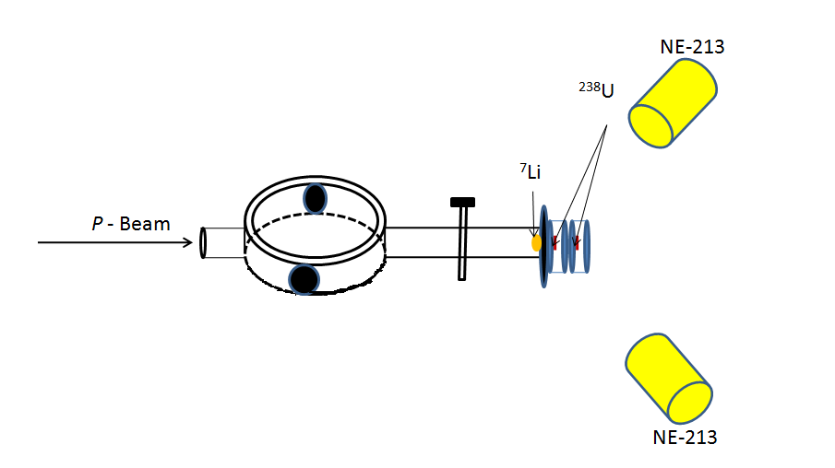
Schematic of Experimental Setup:
5”dia x2” thick
Glass Slab
flux: ῀2 x 10⁷neutrons /cm²/s at sample position

Slide 10
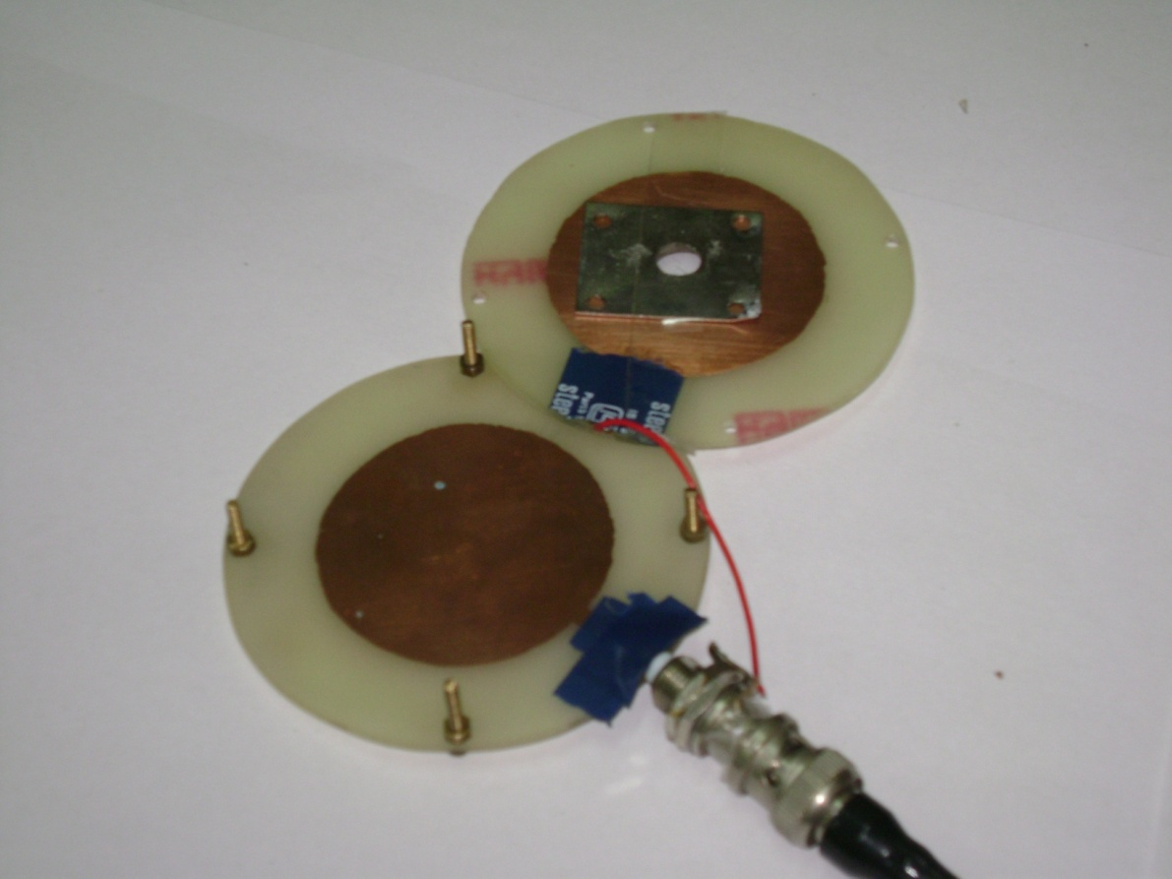
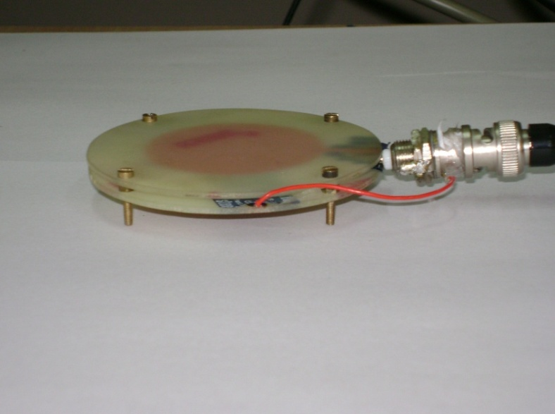
Fission Ionization Chamber

Slide 11
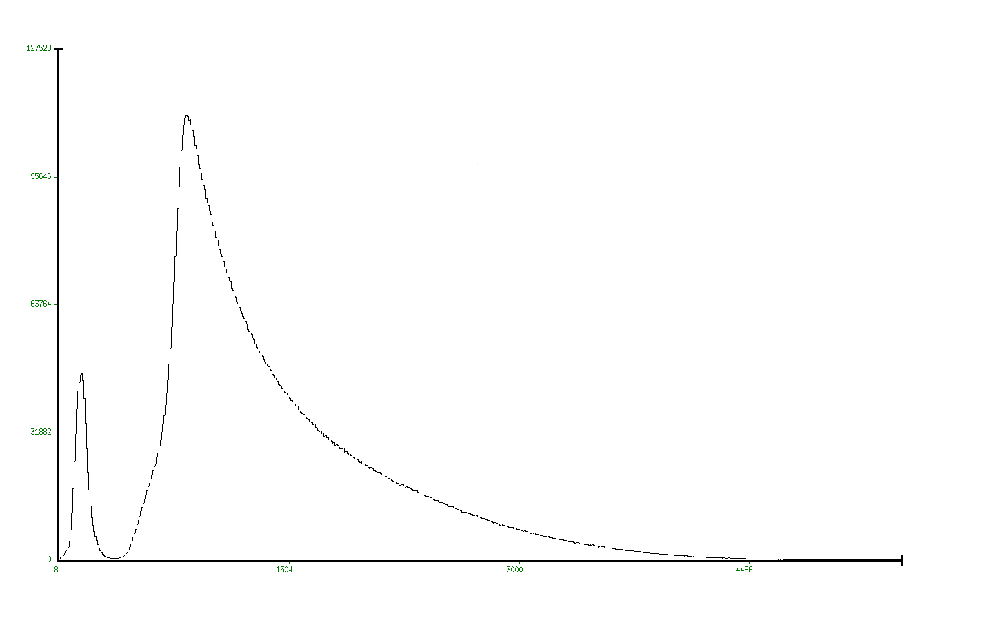
Typical Fission Fragment spectrum for ²⁵²Cf obtained
using small fission detector
FF

Slide 12

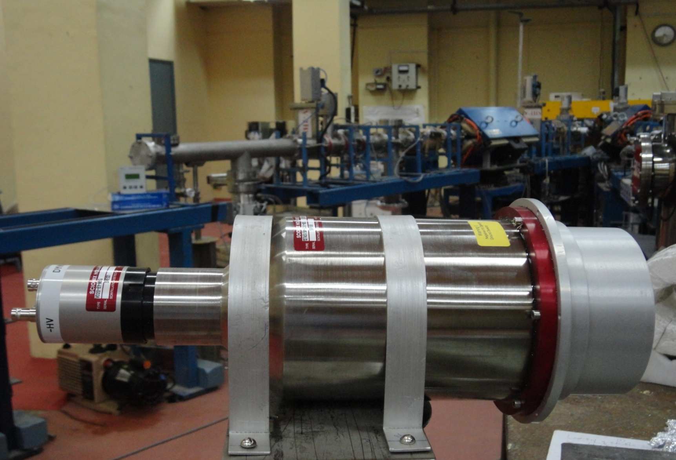
i) Typical view of a NE-213 neutron detector.
ii) Front view of a PSD module used for n-γ discrimination.

Slide 13
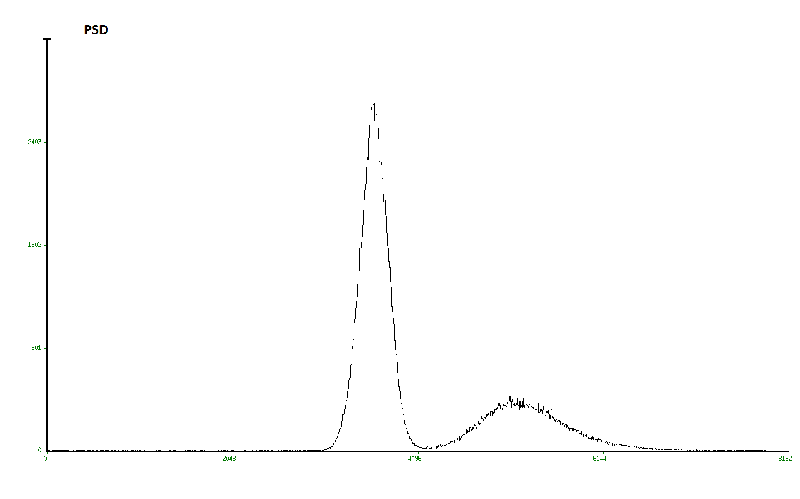
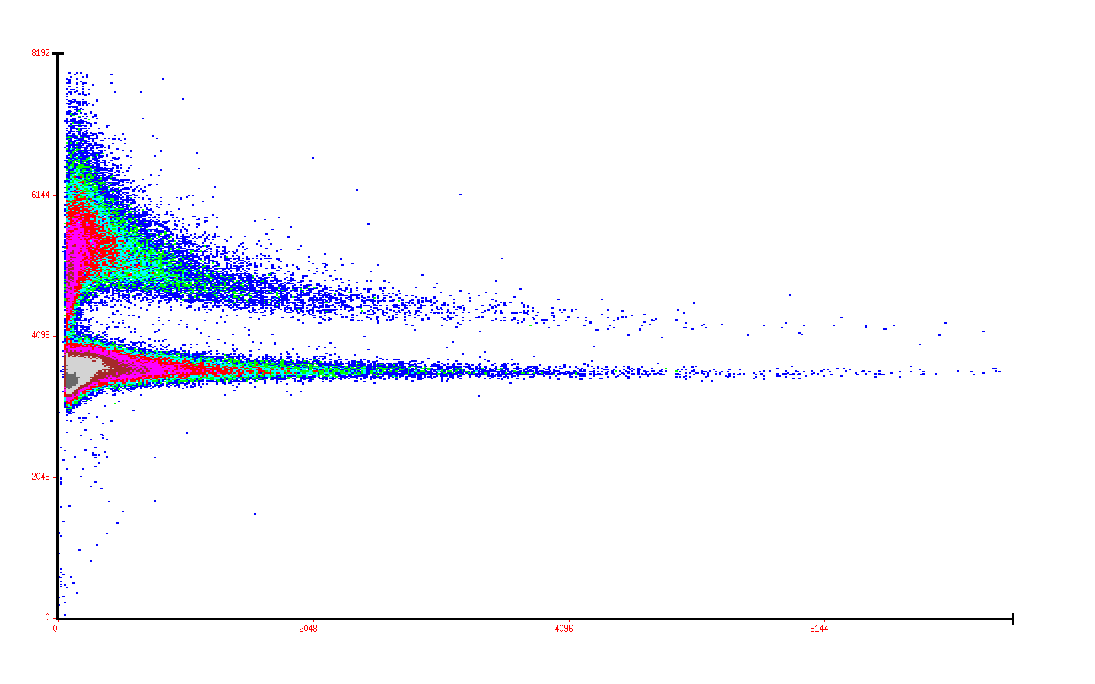
Typical Pulse shape discrimination (PSD) spectrum obtained using NE-213 Organic Scintillation Detector for 252Cf Spontaneous fission source
PSD
γ
Pulse height Vs PSD spectrum
n
γ
n

Slide 14
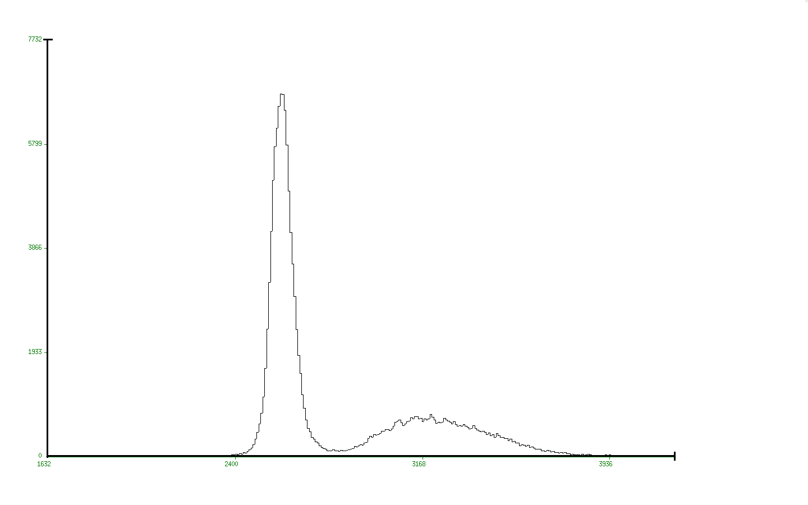
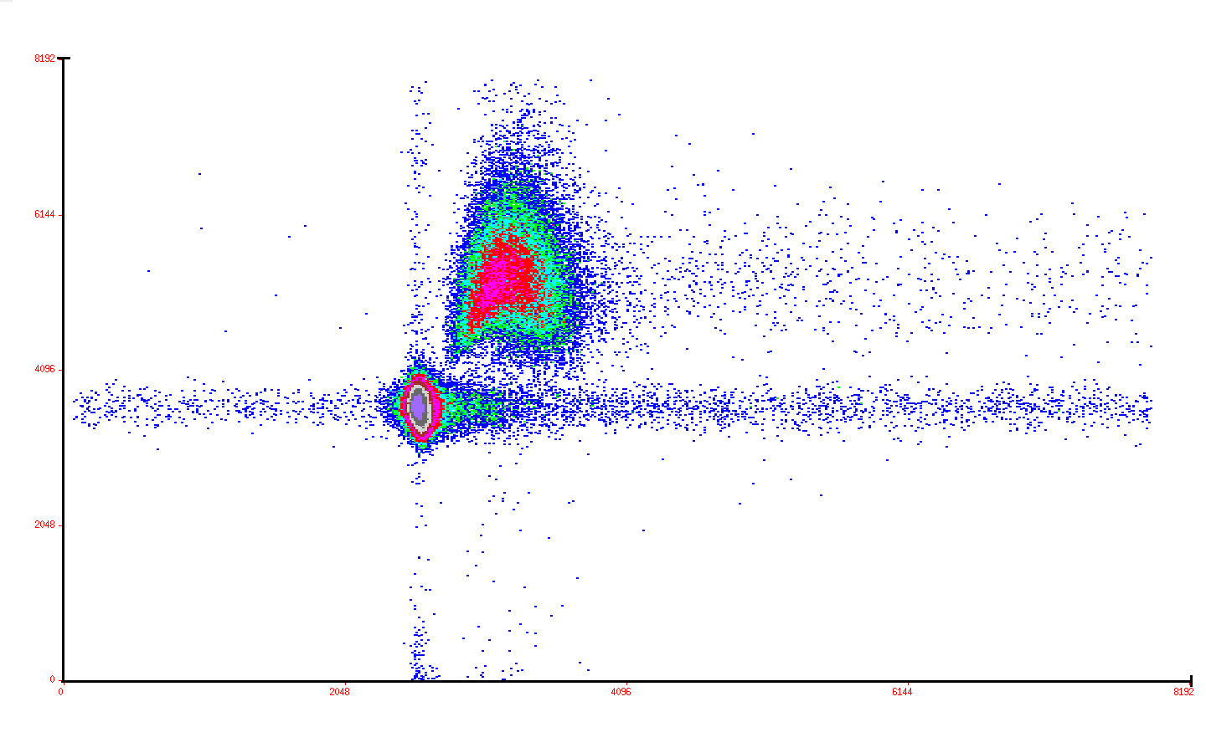
Typical Time of Flight spectrum obtained for 70 cm flight path using
NE-213 Detector
TOF Vs PSD spectrum
TOF
γ
n
γ
n

Slide 15
Threshold : 140keV
Fig: Efficiency as a function of neutron kinetic energy.

Slide 16
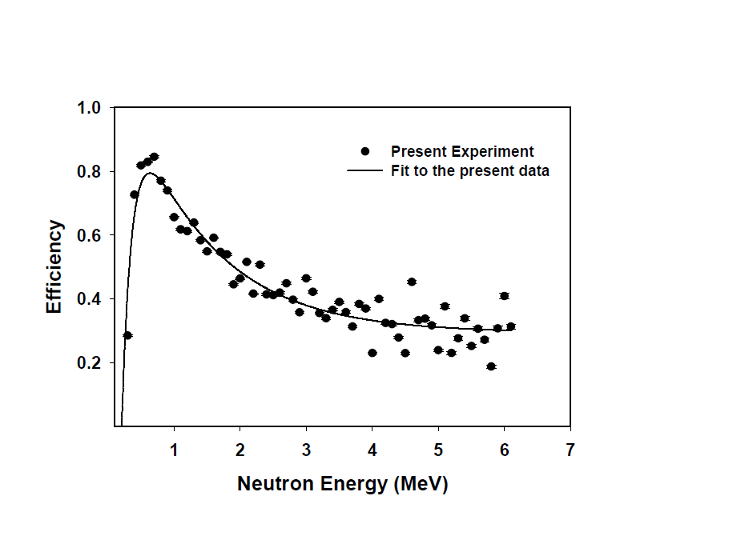
30 keV threshold

Slide 18
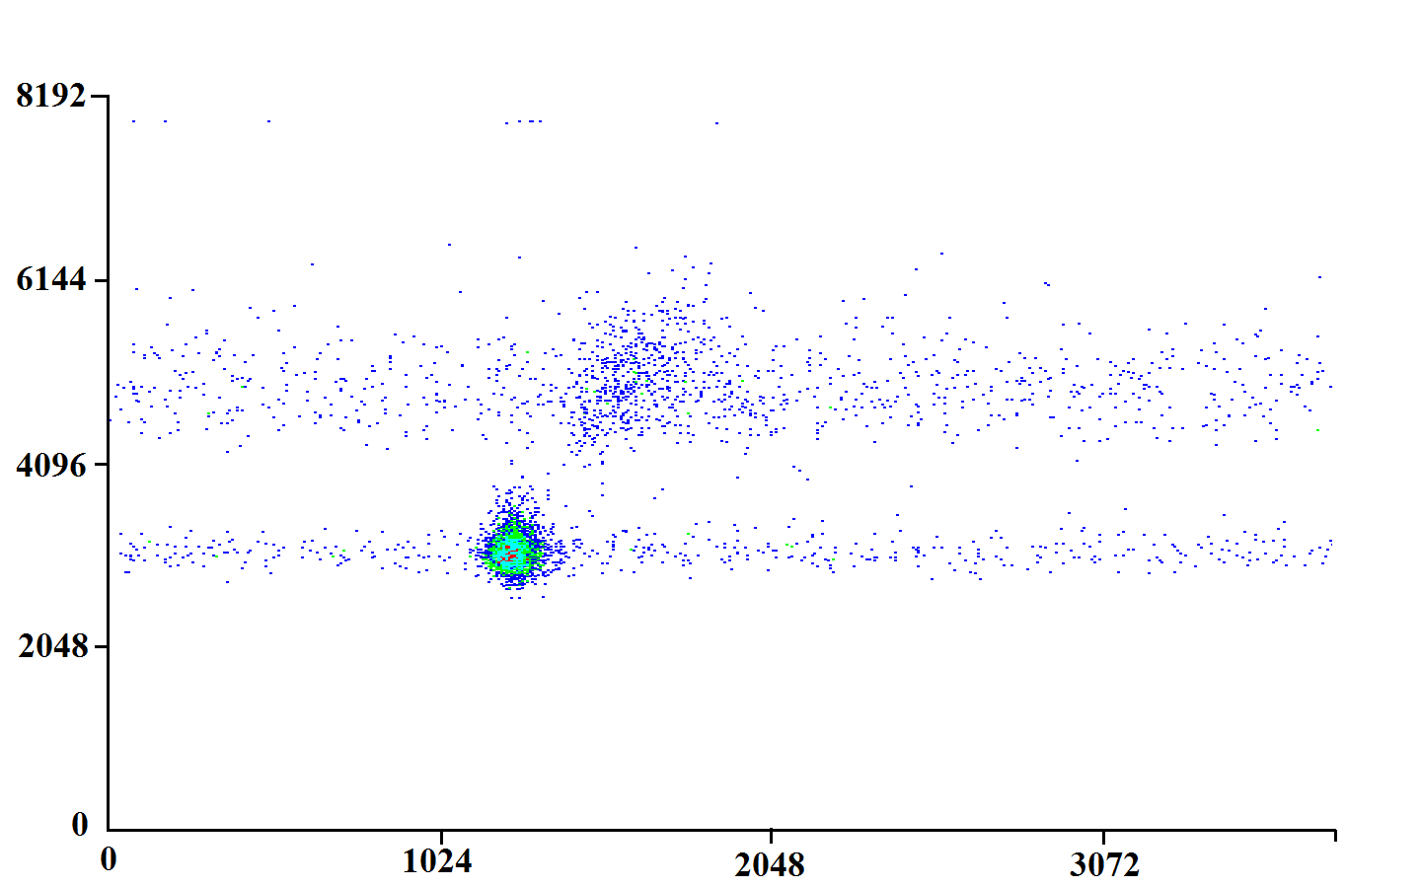
238U(n,f) at E_{n}=3.0 MeV
TOF vs PSD

Slide 19
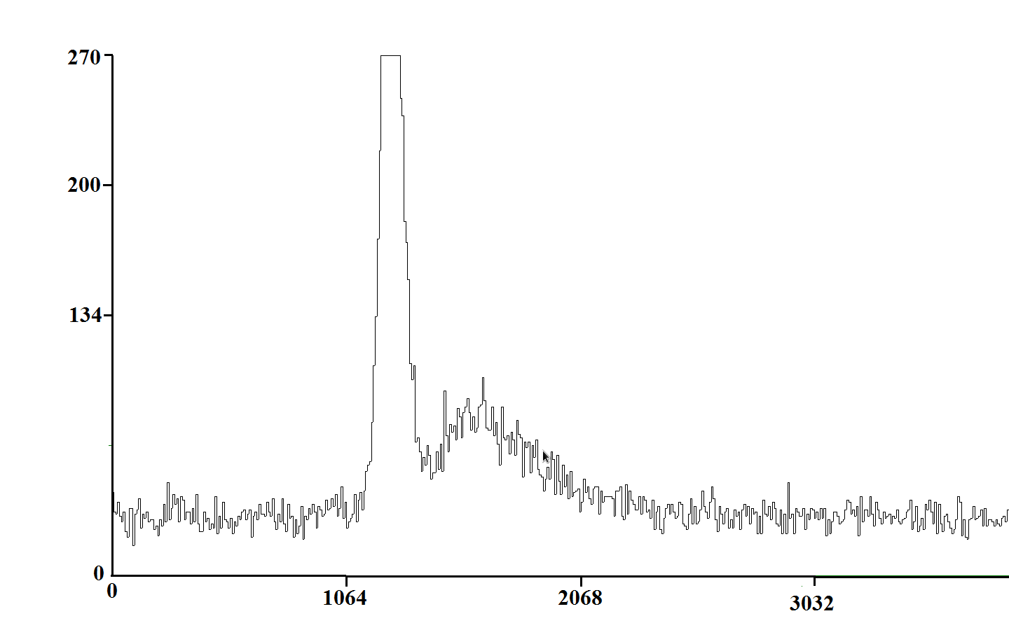
Gamma
Neutron
TOF

Slide 20
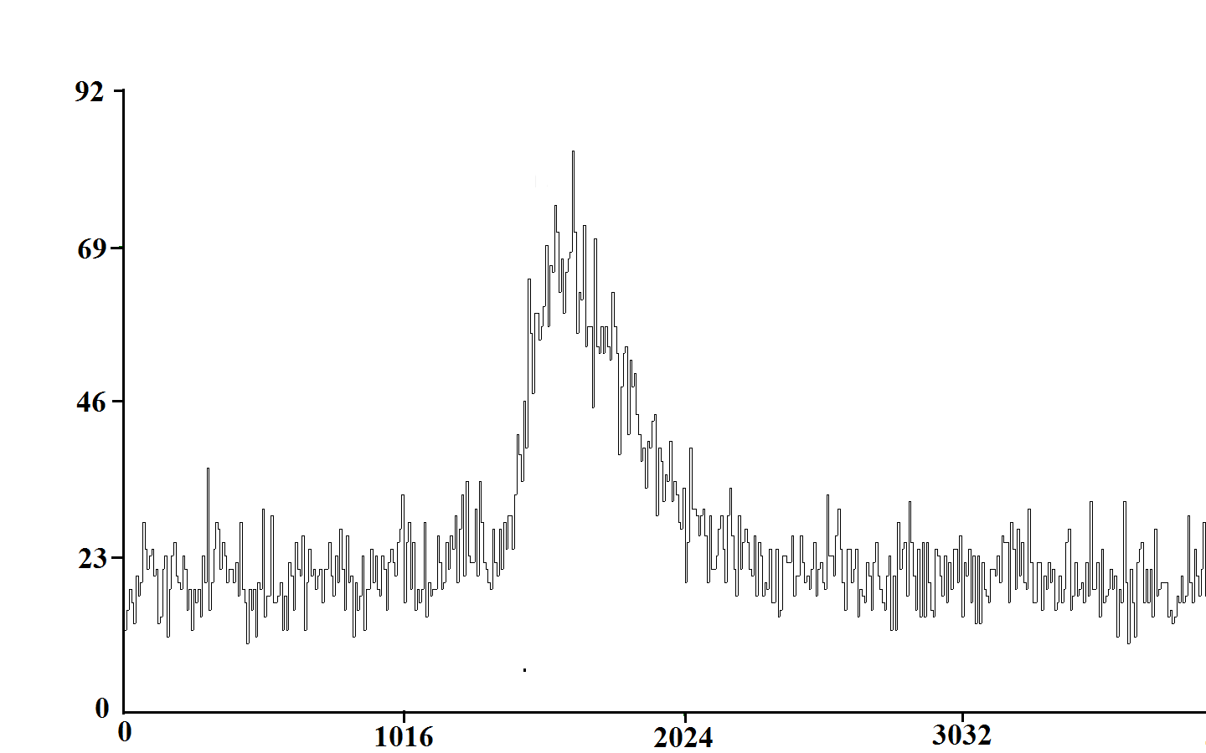
Neutron after PSD gate
TOF

Slide 21
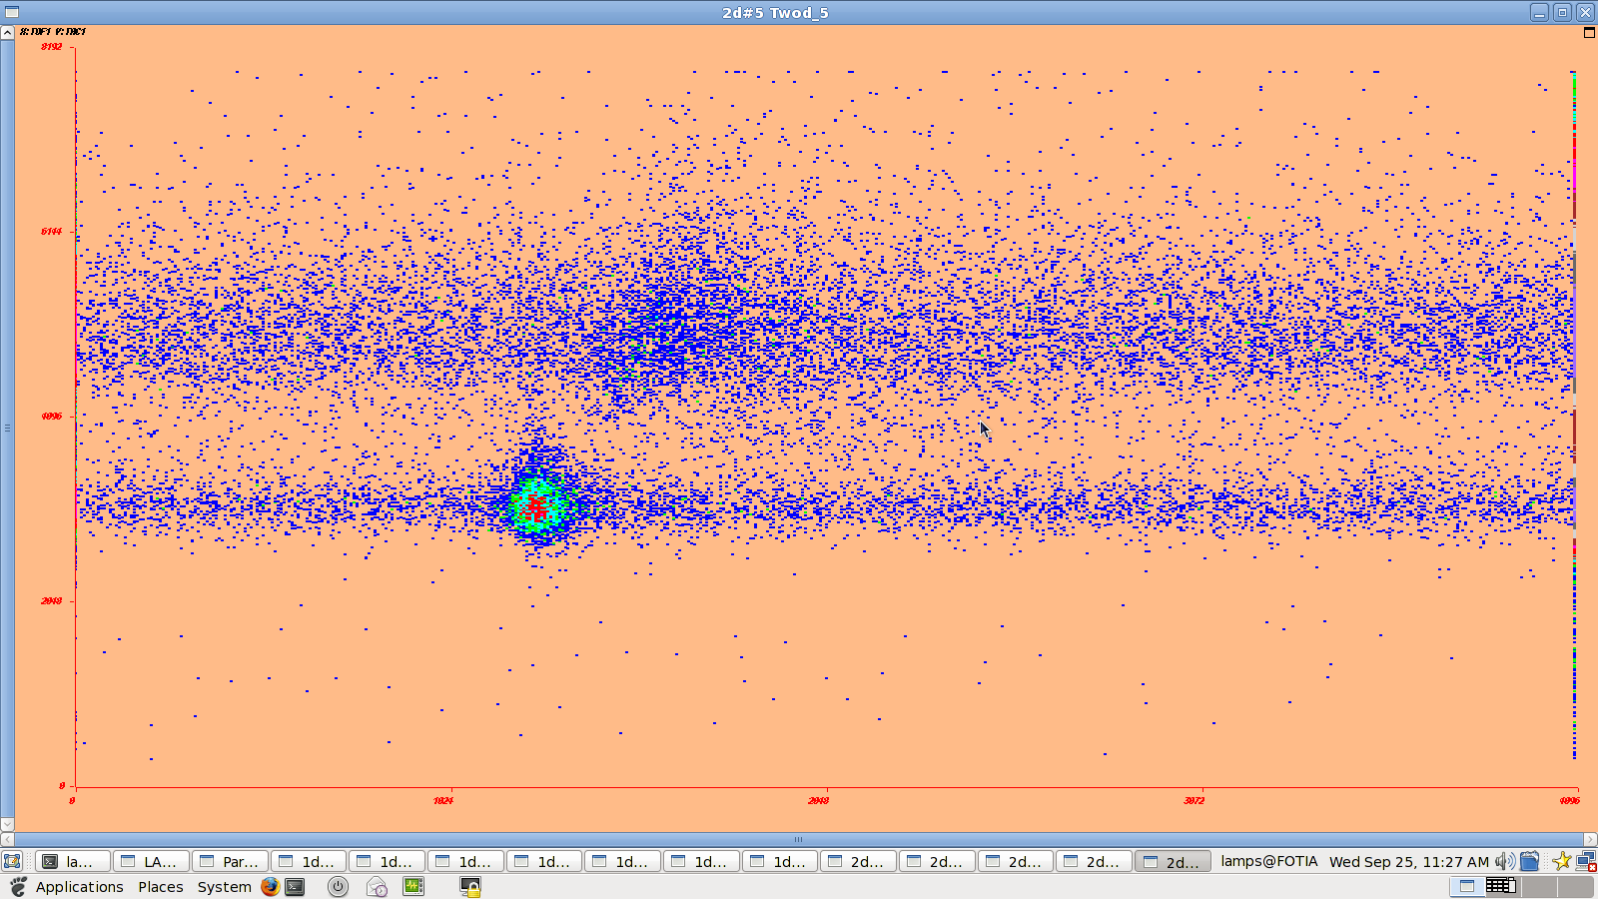
238U(n,f) at 2.5 MeV
TOF vs PSD

Slide 22
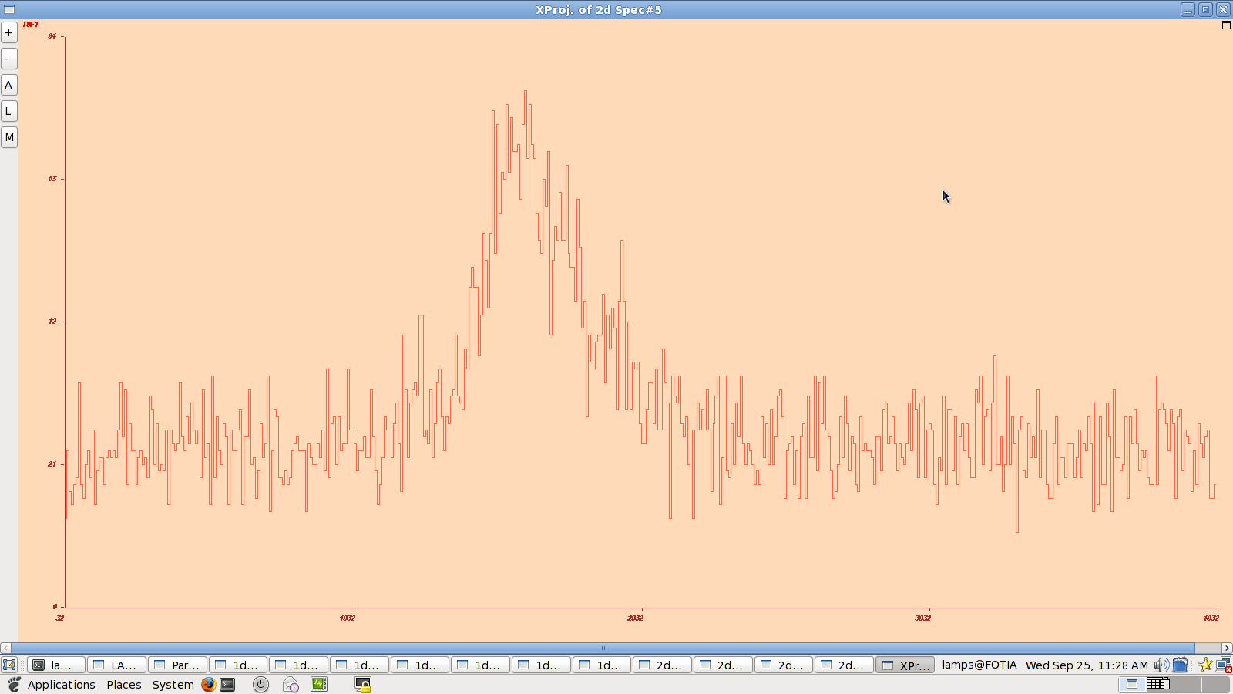
En=2.5 MeV
Neutron after PSD gate
TOF

Slide 24
ENDF VII.1

Slide 25
ENDF VII.1

Slide 26
Cai Chonghai and Shen Qingbiao,
. Nucl. Data Prog., CNIC-00412, No. 3
(1990) 29.

Slide 27
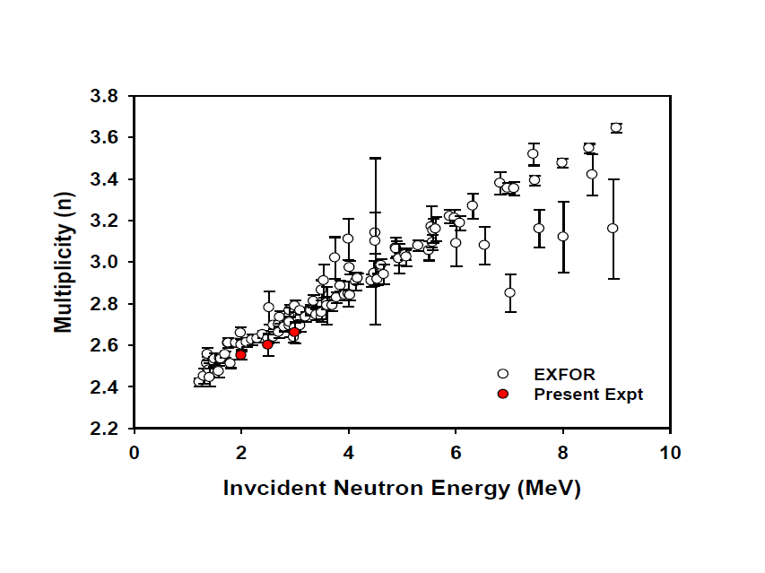

Slide 28
Further work is in progress to repeat 2.0 MeV measurement
and also to improve the statistics for ²⁵²Cf data for
reducing uncertainties in efficiency data.
Collaborators:
VV Desai
B.K.Nayak
SV Suryanarayana
Arun Agarwal
Notes:
al

Slide 29
THANK YOU

