Slide 1
Improvement of PFNS Data in EXFOR
Naohiko Otsuka
IAEA Nuclear Data Section
for International Network of Nuclear Reaction Data Centres (NRDC)
1

Slide 2
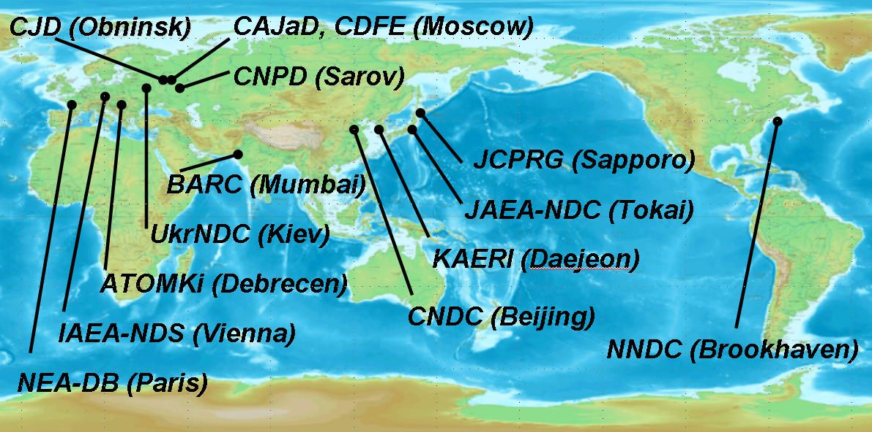



Nuclear Reaction Data Centres (NRDC)
Otsuka (Almaty)
14 centres from 8 countries and 2 international organisations
(China, Hungary, India, Japan, Korea, Russia, Ukraine, USA, NEA, IAEA)
Collaborating for EXFOR compilation under the auspices of IAEA NDS

Slide 3
Contents
Addition of PFNS data to EXFOR
Improvement of quantity indication (REACTION)
Coding of multi-parametric PFN quantities
A question – prompt (PR) or not?
Better access to PFNS data in EXFOR
TASKS from the 2nd RCM to NDS:
  “Clean-up EXFOR entries for PFNS, and study improvements over existing format to include additional, multi-parametric data such as <nu>(A,TKE) [IAEA NDS]”

Slide 4
Recent Addition of PFNS data to EXFOR
NRDC has put a high priority to add PFNS to EXFOR for the CRP.
New entries from new experiments (data from authors)
X4# | Author | Lab. | Reference | Nuclide | En
14290 | S. Noda | LANL | PRC 83(2011)034604 | U235, Pu239 | 1 – 8 MeV
14350 | A. Enqvist | LANL | PRC 86(2012)064605 | U235 | 0.5-600 MeV
31692 | N. Kornilov | KFKI | NSE 165(2010)117 NSE 168(2011)73 | U235 | 100 K
(Nikolay Kornilov kindly answered to various questions from NDS during compilation. )
New entries from old experiments (data digitized from figures)
X4# | Author | Lab. | Reference | Nuclide | En
14278 | V.P. Poenitz | ANL | 82ANTWERP p465 | Cf252 | Spon
23175 | C. Budtz-Jørgensen | IRMM | NPA 490(1988)307 | Cf252 | Spon

Slide 5
Recent Addition of PFNS data to EXFOR
New entries from old experiments (data from authors)
X4# | Author | Lab. | Reference | Nuclide | En
41582 | Uy.I. Kolevatov | IPPE | FEI-913 (1979) | Cf252 | Spon
41589 | L.V. Drapchinsky | KRI | ISTC-1828-01 | Am241 | 3 – 15 MeV
 |  |  |  | Am243 | 3 – 15 MeV
 |  |  |  | Cm243 | Thermal
Updated entries with data newly received from authors
X4# | Author | Lab. | Reference | Nuclide | En
13982 | P. Staples | LANL | NPA 591(1995)41 | U235, Pu239 | 0.5-3.5 MeV
41340 | G.S. Boykov | KRI | 97Trieste p1310 | Cm244, Cm246 | Spon
41421 | B. Gerasimenko | KRI | 2002Tsukuba p362 | Pu240, Pu242 | Spon
 |  |  |  | Am242m, Cm245 | Thermal
Red nuclide: Only one experimental work for PFNS is in EXFOR.

Slide 6
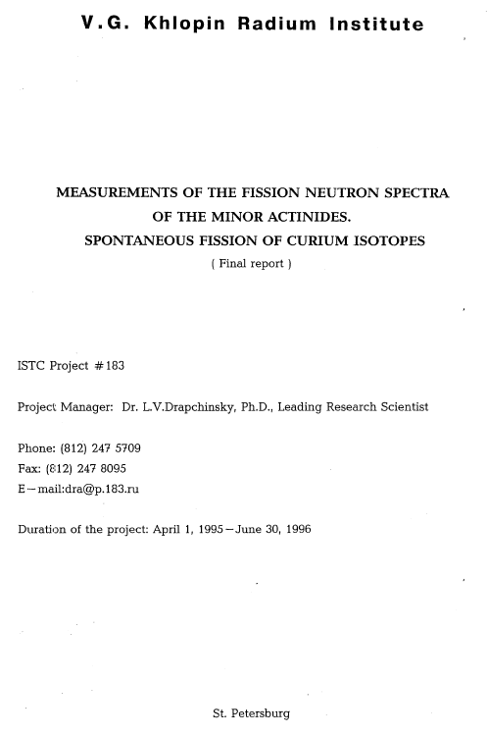
Drapchinsky’s MA (Pu, Am, Cm) PFNS Data
3 ISTC projects (183, 183B, 1828) for minor actinide PFNS have been known.
JAEA informed NO in March 2009 that they needed permission of the project manager to release numerical data.
NO tried to reach the manager (Leonard Drapchinsky) through Radium Institute, ISTC etc., in 2009-2010, not successful…

Slide 7
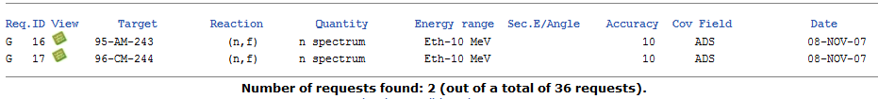
Drapchinsky’s MA (Pu, Am, Cm) PFNS Data
Finally Stanislav Simakov (NDS) found the phone number of his home, and got permission in Oct. 2011.
K. Shibata (JAEA) prepared ASCII data file from these reports, and provided them to NDS (on behalf of Drapchinsky).
NO compiled them in EXFOR format. They were included in database in Sept. 2012 (more than 3 years since initial request!)

Slide 8
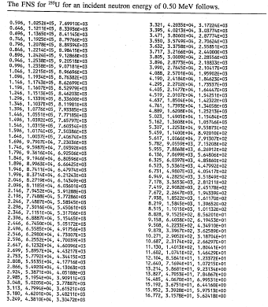
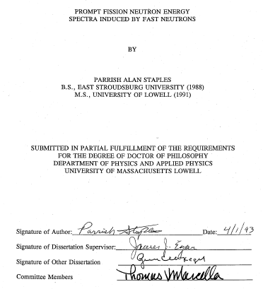
Staple’s Tabulated Data (²³⁵U, ²³⁹Pu)
NO could reach Parrish Staples (DOE) thanks
to Bob Height (LANL) in May 2010.
Parrish kindly provided us his thesis which was
very useful to improve the EXFOR entry 13982.

Slide 9
Improvement of Quantity Indication (REACITON)
Variety in expression of PFNS were assessed, and the REACTION rule was established (Memo CP-D/701, May 2011).
REACTION | Quantity
98-CF-252(0,F),PR,NU/DE | PFNS (neutrons/MeV/fission)
98-CF-252(0,F),PR,NU/DE,,REL | PFNS in arbitrary unit
98-CF-252(0,F),PR,NU/DE,,MXD | PFNS relative to Maxwellian spectrum
98-CF-252(0,F),PR,NU/DE,,NPD | PFNS normalized to 1 (probability distribution)
98-CF-252(0,F),PR,NU/DE,,RRE | PFNS relative to sqrt(En)
Clean-up by CJD, NDS, NEA DB and NNDC was completed in April 2012.

Slide 10
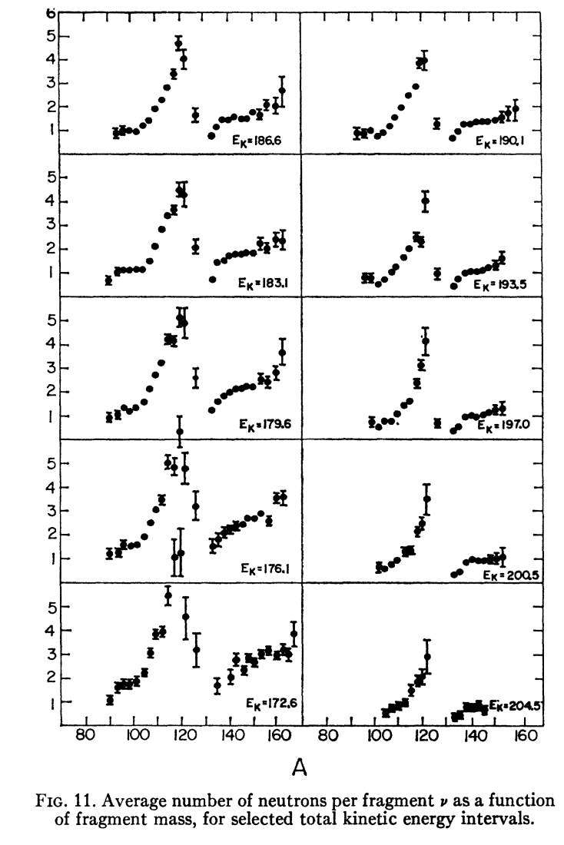
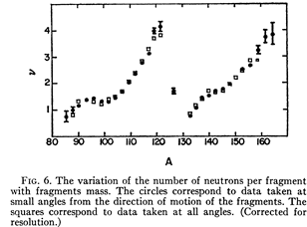
Coding of Multi-Parametric PFN Quantities
There was no coding rule for quantities of neutrons emitted
from a fragment A.
at given TKE.
Example:
ν(A): multiplicities of neutrons from fragment A
ν(A,TKE): multiplicities of neutrons from fragment A
at TKE
H.R. Bowman et al.,
Phys.Rev.129(1963)2133
(EXFOR 14065)

Slide 11
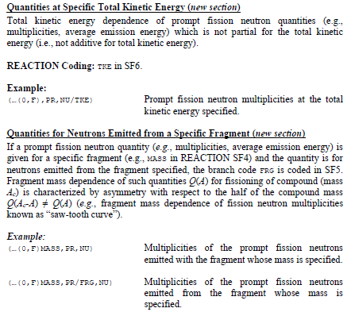
Coding of Multi-Parametric PFN Quantities
Some articles were examined to understand the definition of typical quantity. (Patrick Talou helped at this stage.)
Coding rule was discussed with Otto Schwerer (NNDC, an expert of EXFOR coding).
The coding rule was finally established in Sept. 2013 (Memo CP-D/807)

Slide 12
Coding of Multi-Parametric PFN Quantities
Example of REACTION codes with new rule
(98-CF-252(0,F)MASS,PR,NU)
Multiplicity of neutrons emitted from both fragments. Fragment mass is given.
(98-CF-252(0,F)MASS,PR/FRG,NU)
Multiplicity of neutrons emitted from a fragment which mass is specified.
(98-CF-252(0,F)MASS,PR/TKE,NU)
Multiplicity of neutrons emitted from both fragments at TKE. Fragment mass is given.
Until completion of revision based on this rule, several REACTION codes may be seen for a given quantity … (inconsistency)

Slide 13
Open question: prompt (PR) or not?
EXFOR compilers have been asked to put PR in REACTION when the authors explicitly mention “prompt” in the article.
(98-CF-252(0,F),PR,NU) “prompt fission neutron multiplicity”
(98-CF-252(0,F),,NU) “fission neutron multiplicity”
This rule has been applied to all fission neutron quantities for many decades. What do you think about this EXFOR tradition? I want to know opinions of experts …

Slide 14
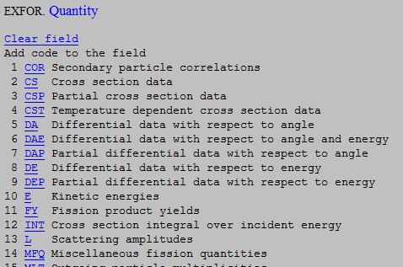
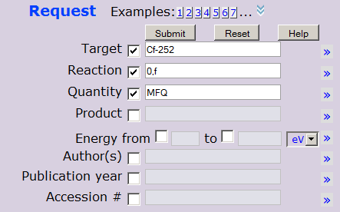
Better Access to PFN Data Sets in EXFOR
A trouble for EXFOR beginners
Probably beginners cannot identify
MFQ “Miscellaneous Fission Quantities”
as a key to search fission neutron quantities. Better to use
“Fission neutron quantities”?
I want to know opinions of experts…

Slide 15
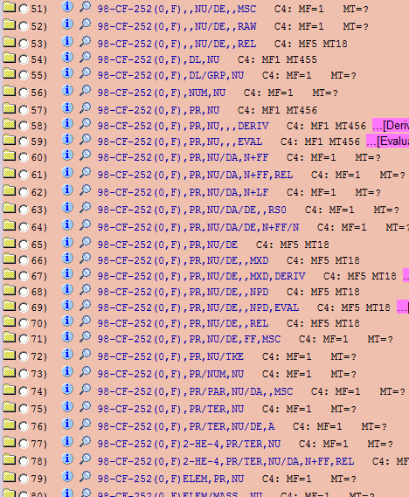
Better Access to PFN Data Sets in EXFOR
A trouble for EXFOR experts
Comment from Denise
Neudecker and Patrick Talou
(April, 2013)
very long list

Slide 16
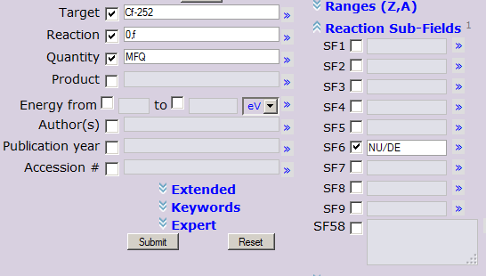
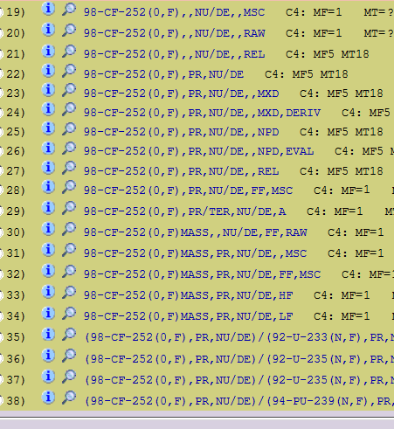
Better Access to PFN Data Sets in EXFOR
Use of “Reaction Sub-Fields” is useful for narrowing.
NU/DE: spectrum
But I know that it is impossible for users to
Remember all abbreviations for quantities
of your interest ..
rather short list

Slide 17
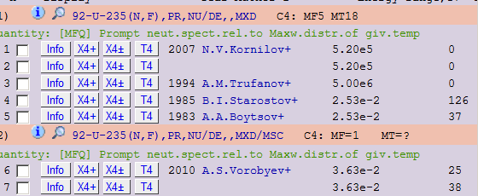
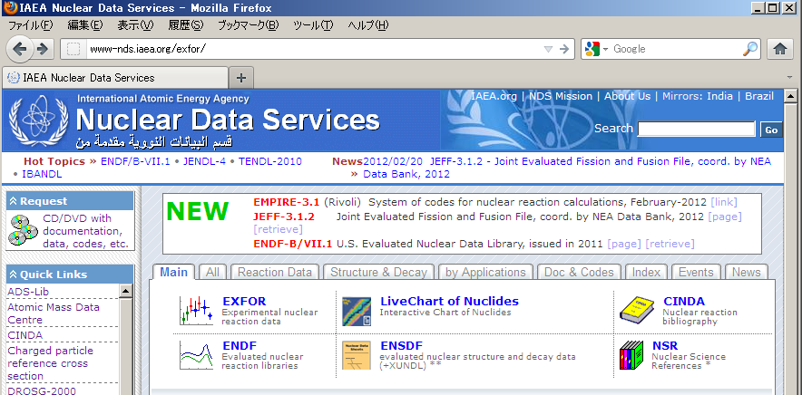
My Dream: EXFOR a là Google
Exfor
IAEA NDS
U-235 PFNS relative to Maxwellian
Search

Slide 18
Summary
Many new PFNS data for actinides have been added to EXFOR.
REACTION codes for simple PFNS were standardized and revision was completed.
Coding of multi-parametric PFN quantities (e.g., ν(A,TKE)) was recently fixed. Revision is on going.
NDS recognizes access to EXFOR data sets must be simplified. (Very challenging task).
NDS also tries to improve EXFOR for other fission quantities (incl. prompt gamma, ternary fission). Helps of some CRP participants (e.g., Stephan Oberstedt, Olivier Serot) have been essential.

