Slide 1
Standard evaluation potential issues?
SACS and absolute cross sections
R. Capote, Deputy Section Head
Nuclear Data Section
https://www-nds.iaea.org/standards

Slide 2
Outlook
Review of potential issues in Standards (n,f)
Clean integral quantities: Spectrum Averaged Cross Section (SACS)
SACS in GMA and resulting SACS (using STD)
Mannhart evaluation of experimental SACS
Suggested actions

Slide 3
NIFFTE collaboration (TPC fission)
~ +2% ratio
Pu9f/U5f
From arXiv: 2107.02881v1 by L. Snyder et al

Slide 4
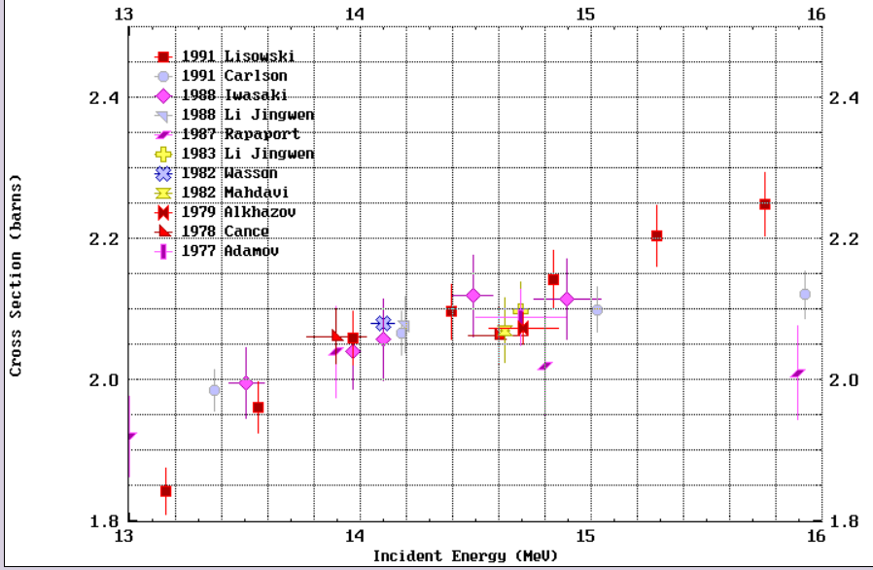
14 MeV (n,f) measurements – U235
USU = 1.2%
²³⁵U(n,f) near 14 MeV
spread ~ 0.5%
TNC: ²³⁵U(n_{th},f): 587±1.4 (0.23%)

Slide 5
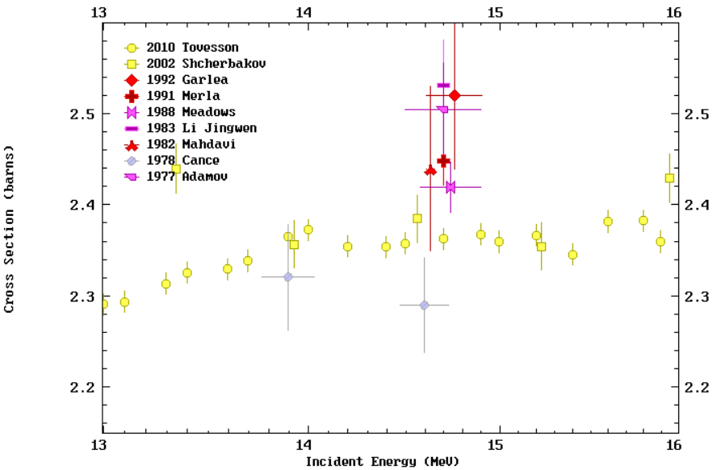
14 MeV (n,f) measurements – Pu239
²³⁹Pu(n,f) near 14 MeV
much larger spread !
TNC: ²³⁹Pu(n_{th},f) 752±2.2 (0.3%)

Slide 6
Spectral indexes (SI) in crit. assemblies
Potential inconsistencies:
UMF vs PMF
PMF001 vs PMF006
Spectrum
Result of complex integral experiments in assemblies
From R. Casperson presentation at US CSWEG, Nov. 2021

Slide 7
Spectral indexes (SI) in crit. assemblies
Own analysis, exp. data from ENDF/B-VII.1 paper, exp. B evaluated by Hansen
SI ≡ SACS ratio | Calculated (ENDF/B-VIII.0) ~ STD 2017 | Measured | C/E
Pu9f/U5f | 1.3841 (1.7%) | 1.4152(1.0%) | 0.978
U8f/U5f | 0.1584 (1.7%) | 0.1643 (1.0%) | 0.972
Np7/U5f | 0.8338 (2.1%) | 0.8516 (1.4%) | 0.979
HMF001
(Godiva)
SI ≡ SACS ratio | Calculated (ENDF/B-VIII.0) ~ STD 2017 | Measured | C/E
Pu9f/U5f | 1.3615 (1.7%) | 1.3847 (0.9%) | 0.985
U8f/U5f | 0.1450 (1.7%) | 0.1492 (1.1%) | 0.972
Np7/U5f | 0.7751 (2.1%) | 0.7804 (1.3%) | 0.993
HMF028
(Flaptop-U)

Slide 8
Spectrum Averaged Cross Section (SACS)
$$SACS(i)= \frac{\int{σi\left(E\right)φ\left(E\right)dE}}{\int{φ\left(E\right)dE}}$$
being $φ\left(E\right)$ the neutron spectrum and $σi\left(E\right)$ the cross section of the reaction i. Typically $\int{φ\left(E\right)dE}$=1
Neutron spectra $φ\left(E\right)$can be the reference ones:
²⁵²Cf(sf) PFNS,²³⁵U(n_{th},f) PFNS (defined in STD)
Or other well-known spectra of interest:
e.g., reactors, critical assemblies (e.g., PMF001, HMF001)
Spectral index i,j (SI) ≡ SACS(i)/SACS(j)

Slide 9
SACS in GMA and Standard SACS
SACS in ²⁵²Cf(sf) PFNS – the only integral data used in the Neutron Standard (GMA) fit, in particular:
SACS(²³⁹Pu(n,f)), SACS(²³⁵U(n,f)), ²³⁹Pu(n,f)≡Pu9f, ²³⁵U(n,f)≡U5f
Typical absolute SACS uncertainty ~1.5%, SACS ratio ~ 0.8%
Data used in GMA fit (from Pronyaev), SACS only, no ratio
Data set 575: Adamov 1982 SACS(U5f) 1.254 b (1.56%)
Data set 576: Heaton (Memo Grundle) 1982 SACS(U5f) 1.216 b (1.64%)
Data set 674: Heaton 1982 SACS(Pu9f) 1.824 b (1.67%)
Data set 517: Schroeder 1984 SACS(U5f) 1.234 b (1.46%)
Data set 614: Schroeder 1984 SACS(Pu9f) 1.844 b (1.43%)
SACS(Pu9f)/SACS(U5f): Heaton 82 - 1.5 , Schroeder 84 – 1.494
Standard SACS: SACS(U5f)=1.227 b (1.2%); SACS(Pu9f)=1.798 b (1.3%):
STD ratio SACS(Pu9f)/SACS(U5f)= 1798/1227=1.465 (1.8%) (C/E: 0.976)

Slide 10
SACS in GMA and Standard SACS
Data used in GMA fit (from Pronyaev), SACS only (barn), no ratio
Data set 575: Adamov 1982 SACS(U5f) 1.254 (1.56%)
Data set 576: Heaton (Memo Grundle) 1982 SACS(U5f) 1.216 (1.64%)
Data set 674: Heaton 1982 SACS(Pu9f) 1.824 (1.67%)
Data set 517: Schroeder 1984 SACS(U5f) 1.234 (1.46%)
Data set 614: Schroeder 1984 SACS(Pu9f) 1.844 (1.43%)
Standard SACS: SACS(U5f)=1.227 (1.2%); SACS(Pu9f)=1.798(1.3%):
STD ratio SACS(Pu9f)/SACS(U5f)= 1798/1227=1.465 (1.8%) (C/E: 0.976) EVID1
Experimental SACS(Pu9f)/SACS(U5f) ratios in ²⁵²Cf(sf) PFNS:
1.502(0.9%) Grundl-Gilliams INDC(NDS)-146, p.244
1.500(1.6%) Heaton et al 1976
1.500(0.8%) Schroeder et al, JANS 50 (1985) 154
Unfortunately GMA can not use SACS ratio (to be improved)

Slide 11
International Reactor Dosimetry and Fusion File
nds.iaea.org/IRDFF (IRDFF-II)
A. Trkov et al, Nucl. Data Sheets 163 (2020) 1-108
119 metrology reactions including Pu9f, U5f, U8f, Np7f
29 neutron benchmark fields for validation including:
²⁵²Cf(sf) PFNS evaluated by W. Mannhart
²³⁵U(n_{th},f) PFNS evaluated by IAEA (Trkov, Pronyaev, RC)
Evaluation of experimentally measured SACS in
neutron fields 1) and 2) – see Tables 18 (Cf) and 20 (U5)

Slide 12
SACS: Mannhart evaluation
Uses own developed code Bayes (executable available)
based on D.L. Smith least-square toolkit. The code is capable
of dealing with SACS absolute and ratio measurements.
Input database for Mannhart evaluation available
=> full reproducibility
Original input database included SACS of activation and
fission cross sections:
Original Mannhart evaluation as adopted in IRDFF-II:
SACS in ²⁵²Cf(sf) PFNS: U5f = 1210(1.2%); Pu9f = 1812(1.4%)
SACS in ²³⁵U(n_{th},f) PFNS: U5f = 1217(1.2%); Pu9f = 1831(1.6%)
Pu9f/U5f ratio in ²⁵²Cf(sf) PFNS: 1.497 (excellent agreement with data)
Pu9f/U5f ratio in ²³⁵U(n_{th},f) PFNS: 1.504
STD ratio SACS(Pu9f)/SACS(U5f)= 1798/1227=1.465 (1.8%) (C/E: 0.976)
Experimental SACS(Pu9f)/SACS(U5f) ratios in ²⁵²Cf(sf) PFNS:
1.502(0.9%) Grundl-Gilliams INDC(NDS)-146, p.244
1.500(1.6%) Heaton et al 1976
1.500(0.8%) Schroeder et al, JANS 50 (1985) 154

Slide 13
Experimental evidence of potential issues
SACS | STD 2017 (ENDF/B-VIII.0) | Mannhart (IRDFF-II) | RATIO
U235f | 1226.7 (1.21%) | 1210 (1.2%) | 1.014
U238f | 321.5 (1.29%) | 325.7 (1.6%) | 0.987
Pu239f | 1797.8 (1.25%) | 1812 (1.4%) | 0.992
SACS Ratios | STD 2017 (ENDF/B-VIII.0) | Mannhart (IRDFF-II) | RATIO
Pu9f/U5f | 1.465 | 1.4975 | 0.978
U8f/U5f | 0.262 | 0.269 | 0.973
SACS in ²⁵²Cf(sf) PFNS field: clean integral data
Mannhart evaluation vs GMA

Slide 14
Suggest to use not only SACS in ²⁵²Cf(sf), but also SACS in ²³⁵U(n_{th},f) PFNS fields

Slide 15
Experimental evidence of potential issues
SACS | STD 2017 (ENDF/B-VIII.0) | Mannhart (IRDFF-II) | RATIO
U235f | 1225.3 (1.3%) | 1217 (1.1%) | 1.007
U238f | 306.2 (1.4%) | 309.4 (1.1%) | 0.990
Pu239f | 1793.3 (1.3%) | 1831 (1.6%) | 0.979
SACS Ratios | STD 2017 (ENDF/B-VIII.0) | Mannhart (IRDFF-II) | RATIO
Pu9f/U5f | 1.463 | 1.504 | 0.972
U8f/U5f | 0.250 | 0.254 | 0.984
SACS in ²³⁵U(n_{th},f) PFNS field: clean integral data
Mannhart evaluation vs GMA

Slide 16
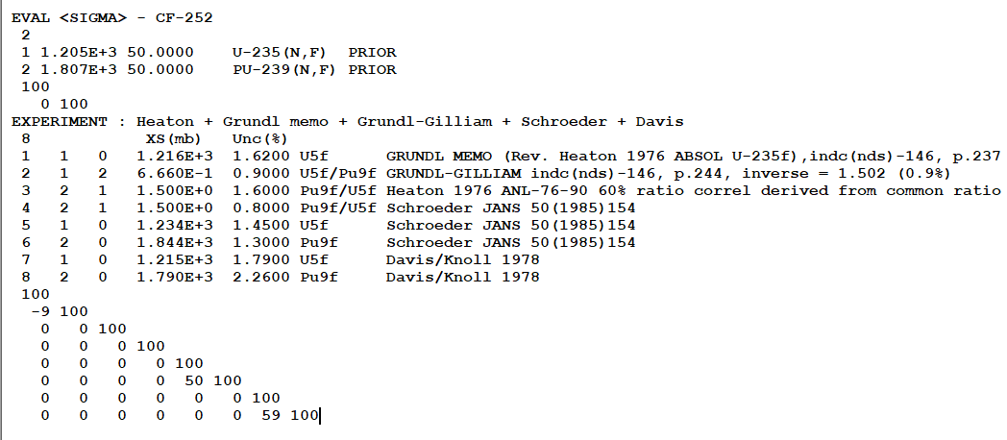
SACS: Updated Mannhart evaluation
Uses own developed code Bayes (executable available) based on D.L. Smith
least-square toolkit. The code deals with SACS absolute and ratio meas.
Input database for Mannhart SACS evaluation in Cf revised
Activation data removed
All available SACS (nf) including ratios added
Checked that Np7f and U8f do not affect results for U5f and Pu9f
New evaluation verified by GMA (identical results for the same input data)

Slide 17
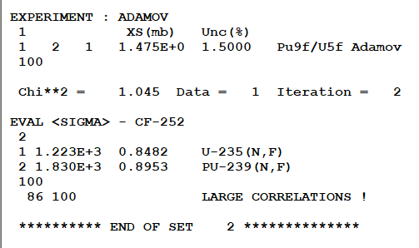
SACS: Updated Mannhart evaluation
Uses own developed code Bayes (executable available) based on D.L. Smith
least-square toolkit. The code deals with SACS absolute and ratio meas.
Input database for Mannhart SACS evaluation in Cf revised
Activation data removed
All available SACS (nf) including ratios added
Checked that Np7f and U8f do not affect results for U5f and Pu9f
New evaluation verified by GMA (identical results for the same input data)

Slide 18
SACS: Updated Mannhart evaluation
Uses own developed code Bayes (executable available) based on D.L. Smith
least-square toolkit. The code deals with SACS absolute and ratio meas.
Input database for Mannhart SACS evaluation in Cf revised
Activation data removed
All available SACS (nf) including ratios added
Checked that Np7f and U8f do not affect results for U5f and Pu9f
New evaluation verified by GMA (identical results for the same input data)
Original Mannhart evaluation as adopted in IRDFF-II:
SACS in ²⁵²Cf(sf) PFNS: U5f = 1210(1.2%); Pu9f = 1812(1.4%)
Pu9f/U5f ratio in ²⁵²Cf(sf) PFNS: 1.497 (Consistent with data)
New Evaluation
SACS in ²⁵²Cf(sf) PFNS: U5f = 1223(0.8%); Pu9f = 1830(0.9%)
Pu9f/U5f ratio in ²⁵²Cf(sf) PFNS: 1.496 (New is consistent with old and with data)
Standards
SACS in ²⁵²Cf(sf) PFNS: U5f = 1227(1.2%); Pu9f = 1797.8(1.3%)
Pu9f/U5f ratio in ²⁵²Cf(sf) PFNS: 1.465

Slide 19
Summary
There are some indications of issues in (n,f)
standards and/or reference XS
Most serious one is the discrepancy between
SACS ratio in Cf and U5 PFNS
Actions:
Implement SACS ratio in GMA-Python
Update SACS database in GMA input
Add U-238 data to constrain U-238(n,f) evaluation
Understand the impact of SACS ratio data on the evaluation
Review the absolute cross sections in the GMA
database

