Slide 1
²³⁵U PFNS for Standards
A. Trkov, R. Capote, V. Pronyaev
NDS, IAEA, Vienna, Austria

Slide 2
Outline
Objective
Selection of data
Methodology
  Basic principles
  Basis function fitting
  Model-independent fitting
Results
Conclusions

Slide 3
Objective
Prepare ²³⁵U(n_{th,f}) PFNS for use as secondary neutron field standard (in addition to ²⁵²Cf(sf) PFNS)
Provide the spectrum in tabular form, as well as in ENDF-6 format
The ²³⁵U(n_{th,f}) spectrum should be the basis for spectra included in general purpose evaluated nuclear data files

Slide 4
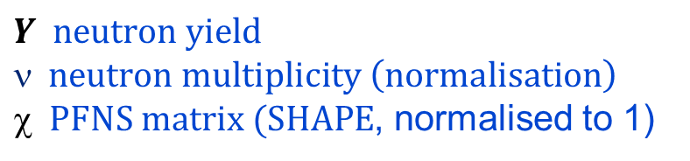

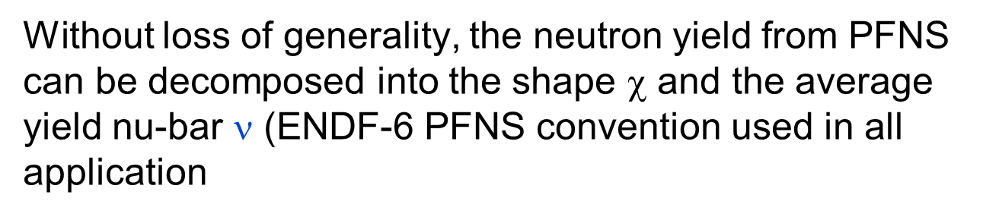

What is being evaluated?
Without loss of generality, the neutron yield from PFNS can be decomposed into the shape $$ and the average yield nu-bar $$ (ENDF-6 PFNS convention used in all application
$$Y=$$
$$Y neutron yield$$
$$ neutron multiplicity \left(normalisation\right)$$
$ PFNS matrix (SHAPE$, normalised to 1)
$$\left(\frac{δY}{Y}\right)2=\left(\frac{δν}{ν}\right)2+\left(\frac{δχ}{χ}\right)2$$

Slide 5
Selection of data (primarily ratio to Cf)
Lead Author | EXFOR Entry No. | Comment
B.I.Starostov,ET.AL. (85) | 40930006(4) | Flag 4 only (similar to Boytsov), others = ratio
A.Lajtai,ET.AL. (85) | 30704003 | E < 0.16 MeV (Li glass eff)
N.Kornilov*,ET.AL. (10) | 31692006 | Ratio to Cf-252(sf)
Wang Yufeng,ET.AL. (89) | 32587002 | E > 1.3 MeV
V.N.Nefedov1*,ET.AL. (83) | 40871011 | Ratio to Cf-252(sf)
V.N.Nefedov2*,ET.AL. (83) | 40871012 | Ratio to Cf-252(sf)
B.I.Starostov*,ET.AL.(83) | 40872007 | Ratio to Cf-252(sf)
A.S.Vorobyev*,ET.AL. (13) | 41597002 | Ratio to Cf-252(sf)

Slide 6
Methodology – Basic Principles
All data used as “shape data”
Scaling of all data to a reference data set in the overlapping region using chosen norm (reliable data set that overlaps with all others)
Fitting of the data by GLSQ
Extrapolation and normalisation of the distribution
Normalisation of the covariance matrix

Slide 7
Methodology – Scaling (notes)
Re-scaling of data affects nu-bar, not shape
Minimises differences between different measurements in the overlapping region (depends slightly on the chosen norm)
Without re-scaling the normalisation errors in different data sets may introduce a bias in the final fit of the distribution
Dependence on the selected reference data set washed out by iterations

Slide 8
Model Problem
 | Set1* | Unc1* |  | Set2* | Unc2* |  | Set3* | Unc3*
x | y |  | x | y |  | x | y
1.0 | 5.80 | 0.12
1.5 | 7.90 | 0.16
2.0 | 9.50 | 0.19 | 2.0 | 9.00 | 0.18
3.0 | 11.00 | 0.22 | 3.0 | 10.50 | 0.21
 |  |  | 4.0 | 10.00 | 0.2 | 4.0 | 9.50 | 0.19
 |  |  |  |  |  | 5.0 | 7.10 | 0.14
 |  |  |  |  |  | 5.5 | 5.20 | 0.10
 |  |  |  |  |  | 6.0 | 2.90 | 0.06
Uncertainties (all sets):
5% | Systematic
2% | Statistical

Slide 9
Model Problem - Truth: y= -x (x - 6.5)

Slide 10
Model Problem - Bias

Slide 11
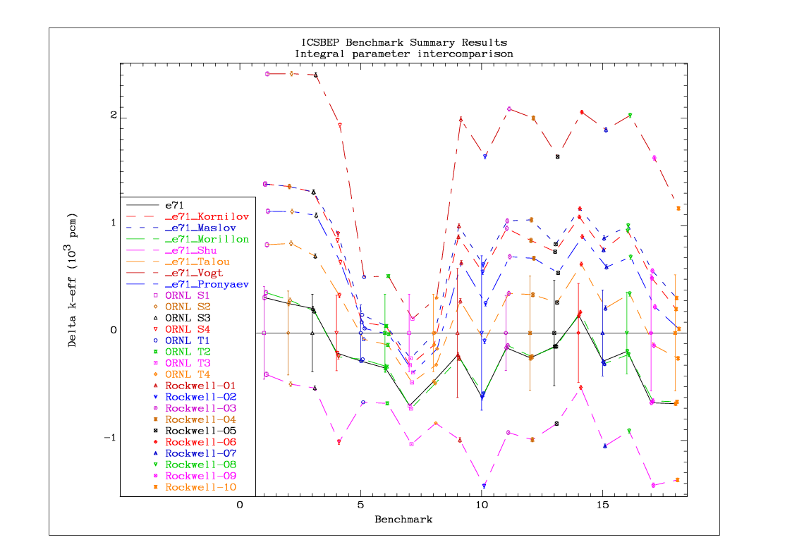
Bias implications – Average Energy
E_{aver}[MeV]
_{Maxw 1.98 (T=1.32)}
_{Maslov 1.96 Semi-empirical}
_{Morillon 1.97 LANL model}
Shu 2.08 Semi-empirical
_{Talou 2.00 LANL model}
_{Vogt 1.91 MC Freya}
_{Pronyaev 2.00}

Slide 12

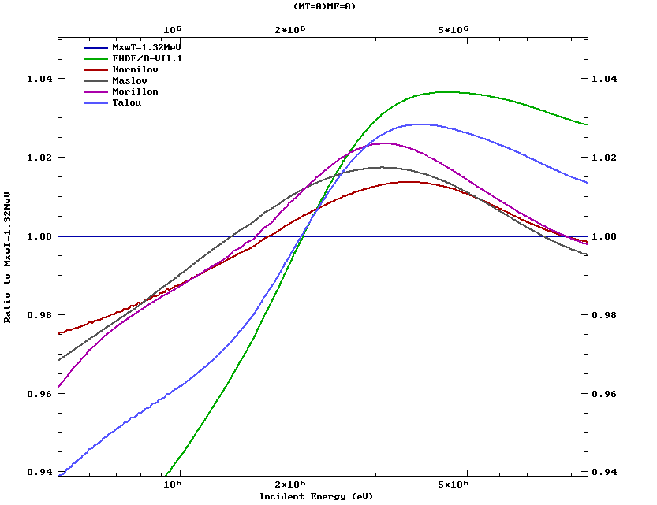
Average Energy of Neutrons in PFNS
Cumulative average energy integral:
Ratio to Maxwellian at 1.32 MeV

Slide 13
Methodology – Iterations
Optimum scaling parameters can be obtained simultaneously in the GLSQ procedure – no iterations necessary (SCALE approach by Kornilov)
GLSQ solution of data with initial scaling is a better approximation to the “truth” – data can be rescaled to the fitted distribution and the GLSQ fit repeated iteratively to convergence (NDS-IAEA approach)

Slide 14
Methodology – Basis Function Fitting
Linear combination of Maxwellian and Watt trial functions (presented at CW2014 Workshop in Santa Fe)
SCALE basis function (ref. N. Kornilov, shown to introduce a bias)
Implications: bias may be introduced if trial functions depend on few parameters (1 for SCALE) or do not form a complete set – relevant for all evaluations using models

Slide 15
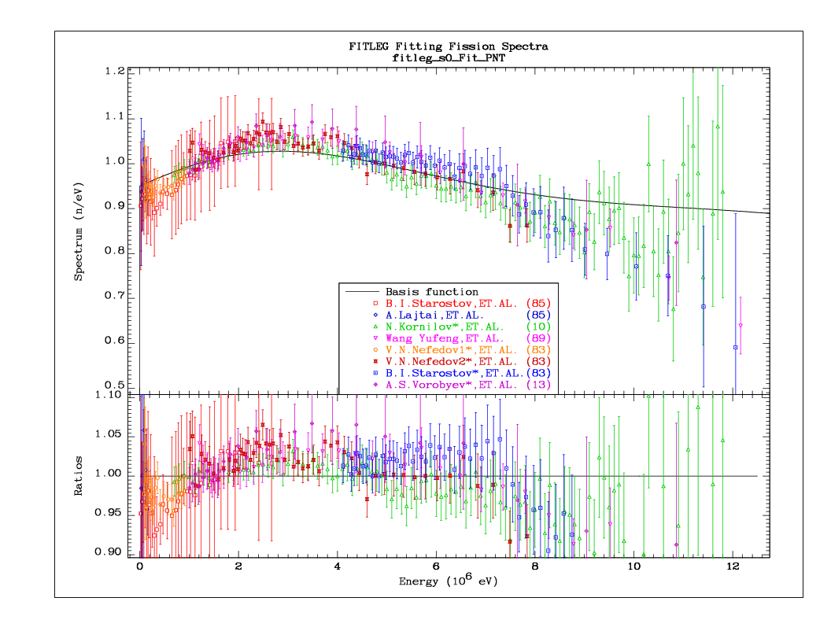
SCALE_0 (fixed data) , par=E_{av}

Slide 16
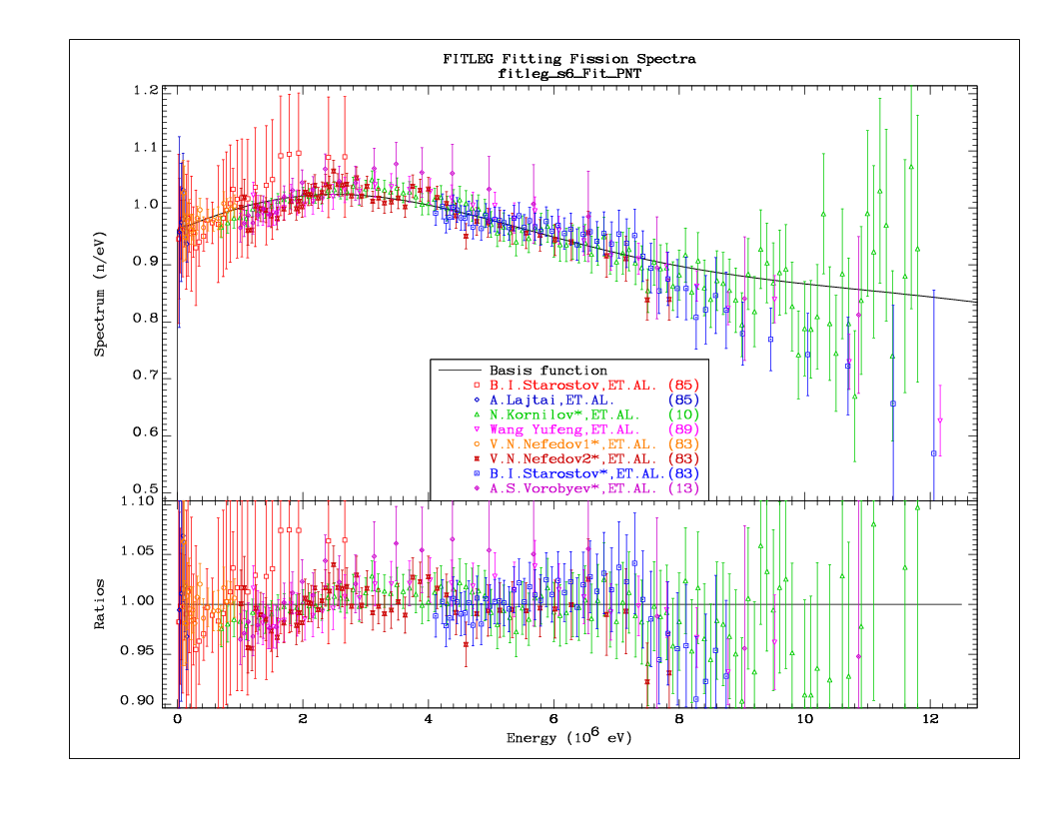
SCALE_6 (iterated solution), par=E_{av}

Slide 17
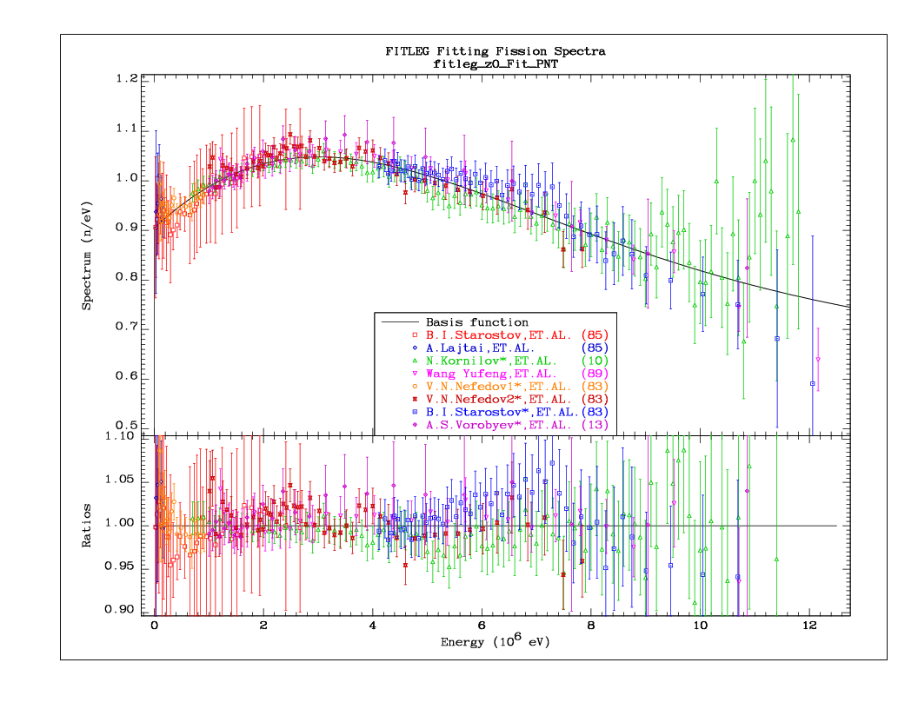
Basis (PNT_0, fixed norm.) , 4 params

Slide 18
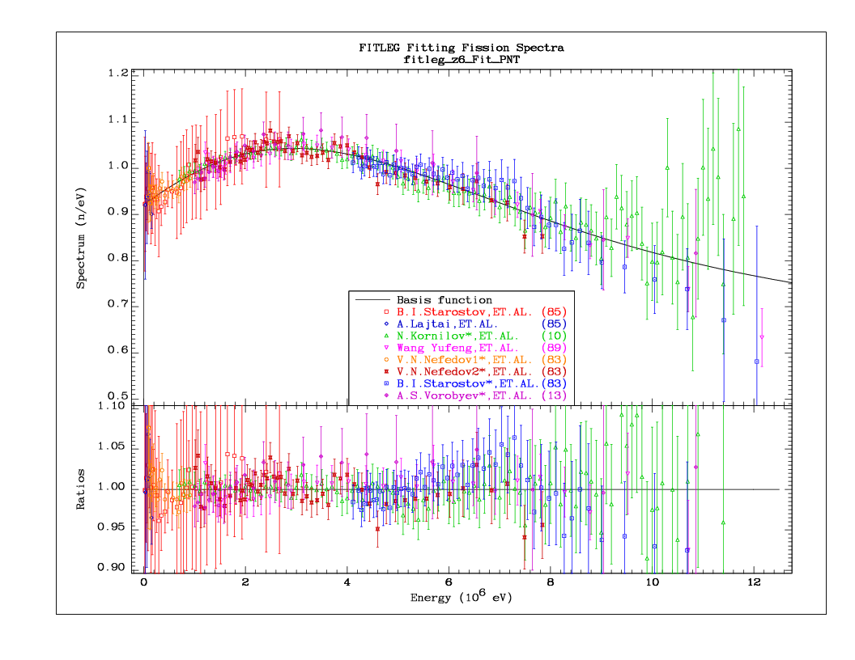
Basis (PNT_6, iterated) , 4 params

Slide 19
Methodology – Model Independent Fitting
Initial scaling to the reference data set (Kornilov)
Non-informative prior: Basis function fit, 100% uncertainty, no correlations
GLSQ fit with GANDR
Normalisation of the distribution and covariance matrix
Optional: renormalisation of data to the GANDR solution – Iterations to convergence

Slide 20
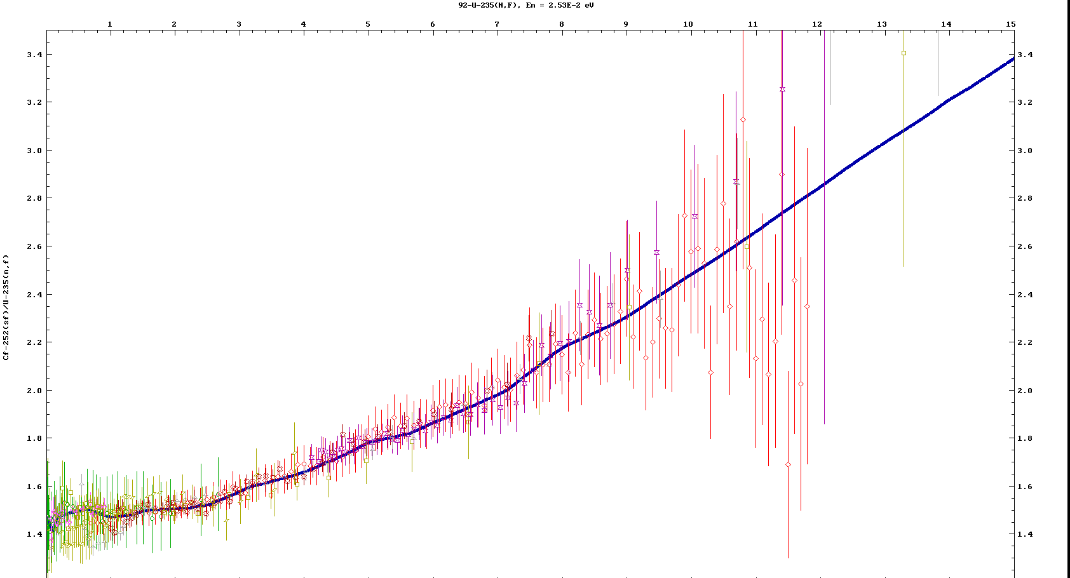
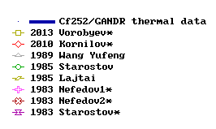
²³⁵U(n_{th},f) PFNS GANDR evaluation
Energy [MeV]
²⁵²Cf(sf)/²³⁵U(n,f)
new expers
unlikely

Slide 21
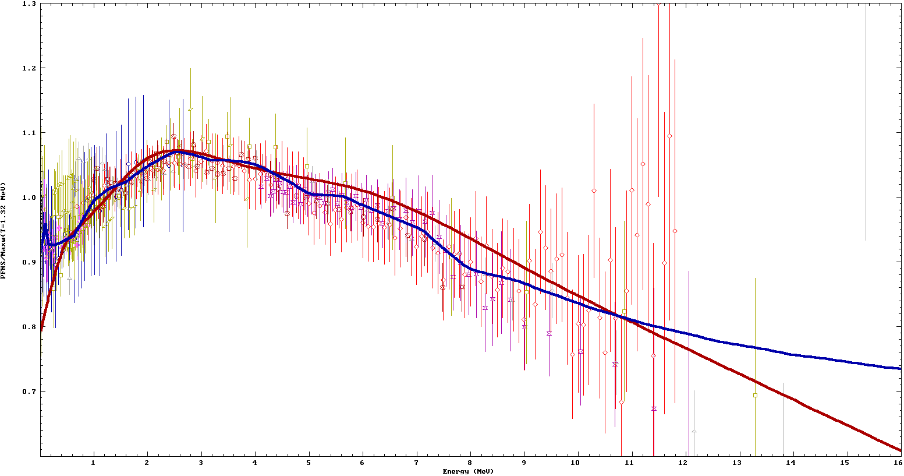
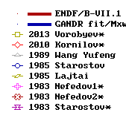
²³⁵U(n_{th},f) PFNS GANDR fit (lin E)
PFNS ²³⁵U (n,f)/Maxw(T=1.32 MeV)
E_{aver}(GANDR)= 2.000(9)
E_{aver}(B/VII.1) = 2.03

Slide 22
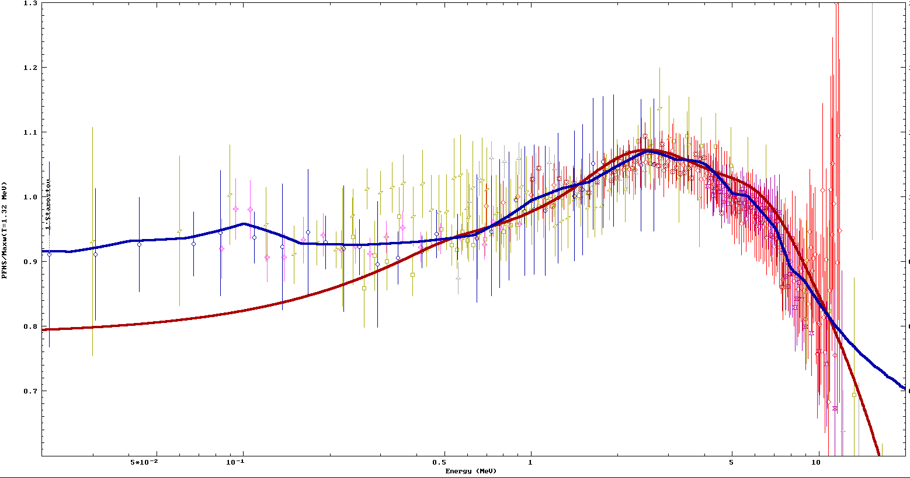
²³⁵U(n_{th},f) PFNS GANDR fit (log E)
PFNS ²³⁵U (n,f)/Maxw(T=1.32 MeV)
E_{aver}(GANDR)= 2.000(9)
E_{aver}(B/VII.1) = 2.03

Slide 23
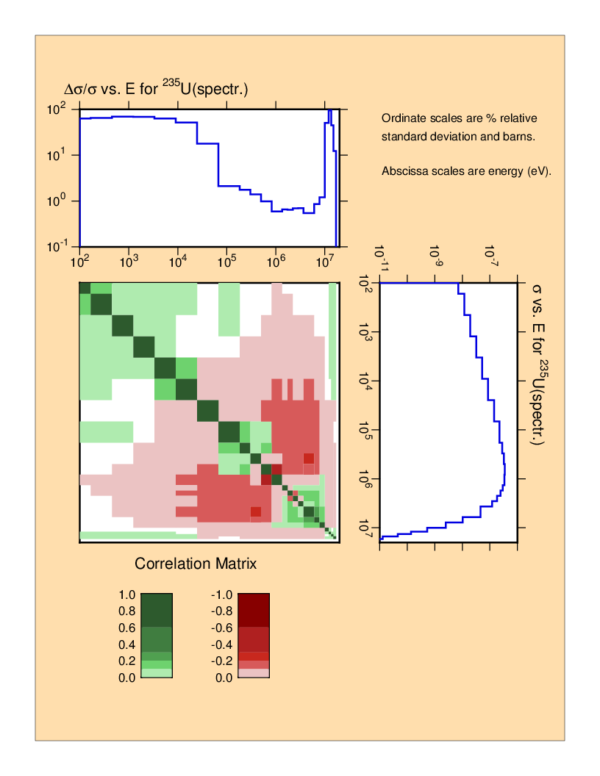
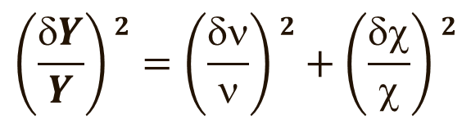
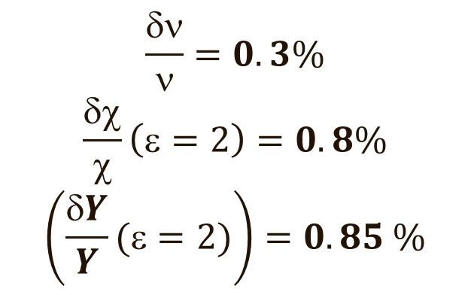
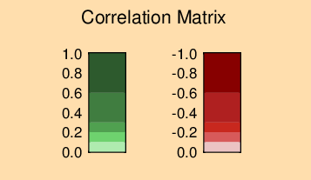
GANDR evaluation: uncertainty analysis
0.8% uncertainty
Non-model fit

Slide 24
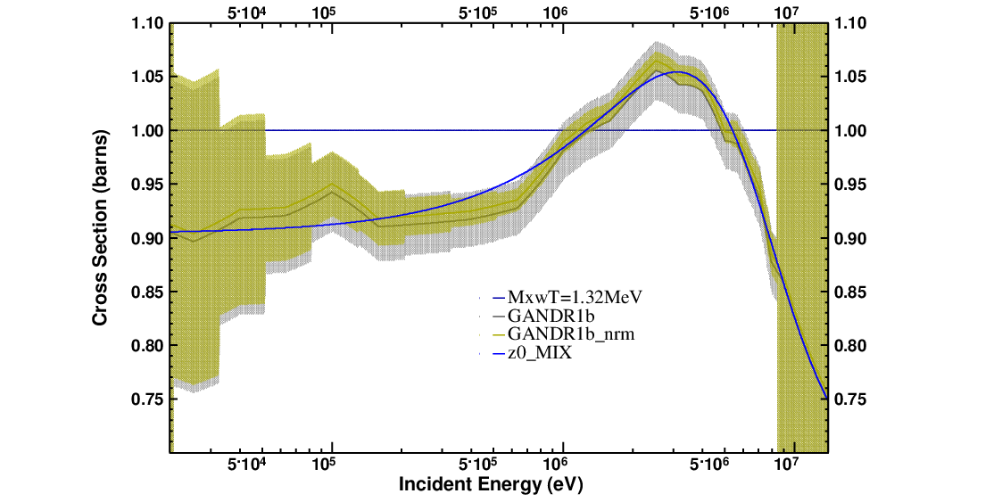
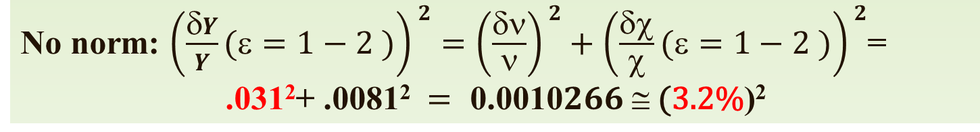
GANDR fit without normalisation
6.4%
²³⁵U(n,f)/Tmaxw(1.32 MeV)
No norm: $\left(\frac{δY}{Y}(ε=1−2 )\right)2=\left(\frac{δν}{ν}\right)2+\left(\frac{δχ}{χ}(ε=1−2 )\right)2\text{=}$
$$\text{.}\text{0}\text{31}\text{2}\text{+ .}\text{0}\text{081}\text{2} = \text{0}\text{.}\text{0010}266 ≅ \text{(}\text{3}\text{.}\text{2}\text{\%}\text{)}\text{2}$$

Slide 25
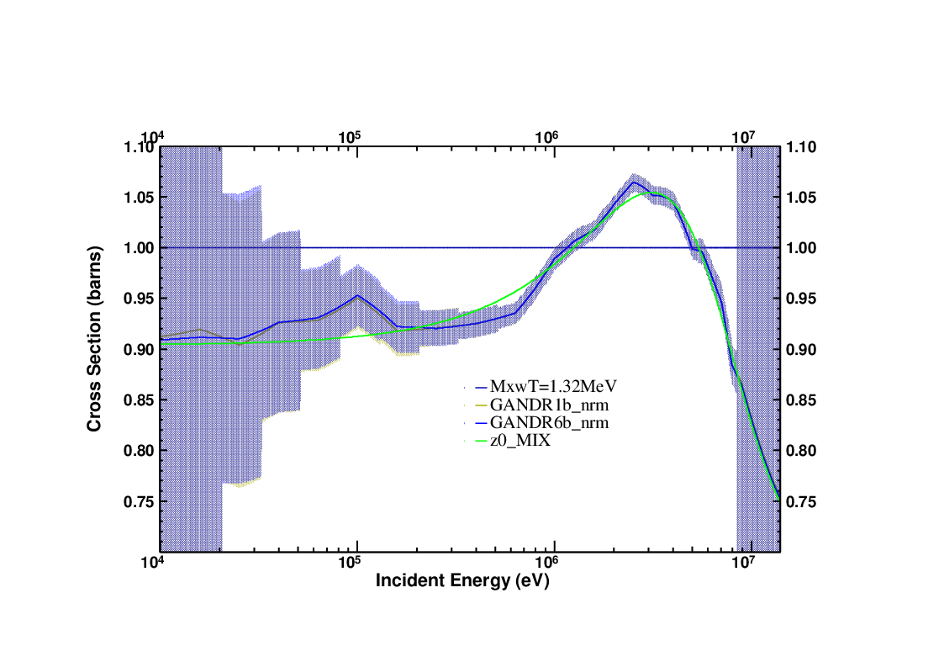
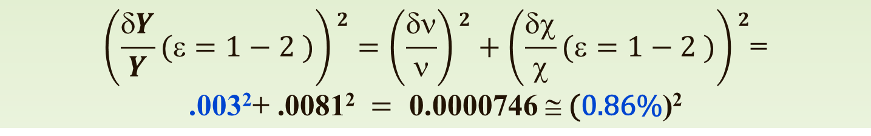
Iterated GANDR fit with normalisation
1.72%
²³⁵U(n,f)/Tmaxw(1.32 MeV)
__ Maxw. (T=1.32)
--- GANDR (1 iter., normal.)
--- GANDR (6 iter., normal.)
__ PNT fit (z0_MIX)
$$\left(\frac{δY}{Y}(ε=1−2 )\right)2=\left(\frac{δν}{ν}\right)2+\left(\frac{δχ}{χ}(ε=1−2 )\right)2\text{=}$$
$$\text{.}\text{0}\text{0}\text{3}\text{2}\text{+ .}\text{0}\text{081}\text{2} = \text{0}\text{.}\text{0000746} ≅ \text{(}\text{0}\text{.}\text{86}\text{\%}\text{)}\text{2}$$

Slide 26
Features of the GANDR fit
Little change with iterations (robust)
Minimum PFNS uncertainty 0.8% almost equal to the minimum yield uncertainty
In the tails the PFNS uncertainty is equal to the prior (no measured data, no model correlations)

Slide 27
GLSQ: GANDR vs. GMA
GANDR
    Fits piecewise-linear correction function
    Solution is continuous
    No need for a fixed energy grid of measured data
    Scaling factors cannot be included as fitting parameters → iterative solution
    No ratio data
GMA
    Data on fixed energy grid, ratio or shape ratio
    Easy inclusion of experimental correlations
    Easy inclusion of cross-material correlations

Slide 28
Methodology – use of Integral Data
May be used for the prior (E_{50%}> 10 MeV)
Spectrum-averaged cross sections (SPA)
Ratios of SPA in ²⁵²Cf/²³⁵U spectra (Kobayashi)
Experimental conditions (fission plates preferred to reactor core measurements, size of the experimental cavity, possible (γ,n) contribution)
Analysis of multiple scattering and room-return corrections (Kobayashi, Mannhart)
Integral data trend could be used to validate SPA measurements or PFNS.

Slide 29
PFNS validation using dosimetry data

Slide 30
Conclusions
GANDR fit – model for gaining experience
GMA – a comprehensive fit could be used for standards (smoothing?)
E_{av}=2.00±0.01 MeV (current estimate)
Fit also undertaken for incident neutron energies up to 2 MeV, minor increase in average energy observed

