Slide 1
Improving reaction modeling
E. Bauge, P. Chau, M. Dupuis, S. Hilaire, S. Péru, O. Roig, P. Romain
CEA, DAM, DIF, France
December 2017 post-CIELO meeting

Slide 2
Nuclear Reaction Modeling
Consists in using a physical model to calculate evaluated data, with parameters values driven by experimental data.
Evaluated
Data
Parameter
Libraries
Physical Model
Parameters
Observables
Experimental
Data
E. Bauge et al., Eur. Phys. J. A 48, 113 (2012)

Slide 3
Model deficiencies
Pour personnaliser le pied de page et la date :
« Insertion / En-tête et pied de page »
Personnaliser la zone de de pied de page
Cliquer sur appliquer partout
Ex: ²³⁹Pu(n,2n) xs shape from GEANIE exp. cannot be reproduced
by models.
²³⁹Pu(n,2n)
Assuming expt. is right
If not: Fix expt. !
2 options :
Short term:
Quantify model defects into covariances
Longer term:
Improve theory

Slide 4
Potential sources of uncertainties in nuclear reaction modeling
Pour personnaliser le pied de page et la date :
« Insertion / En-tête et pied de page »
Personnaliser la zone de de pied de page
Cliquer sur appliquer partout
What is the path forward to get better model calculations ?
What are the known imperfections in nuclear models ?
What are the “cutting edge” models that should improve agreement with expt.?
➔ Examples of recent model developments with potential to:
- Improve agreement with data.
- Calculate model parameter values from microscopic theory
- Reduce the adjustment dynamics of model parameters
(not use unphysical values to achieve agreement).

Slide 5
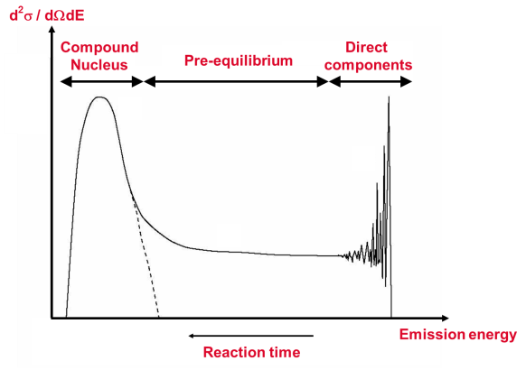
Models sequence for continuum calculations
Direct (shape) elastic
Elastic
σ_{Reaction}
σ_{NC}
OPTICAL
MODEL
PRE-EQUILIBRIUM
COMPOUND
NUCLEUS
Fission
T_{lj}
Inelastic
Direct components
(n,n’), (n,α),
(n,γ), etc…

Slide 6
OMP / direct reactions

Slide 7
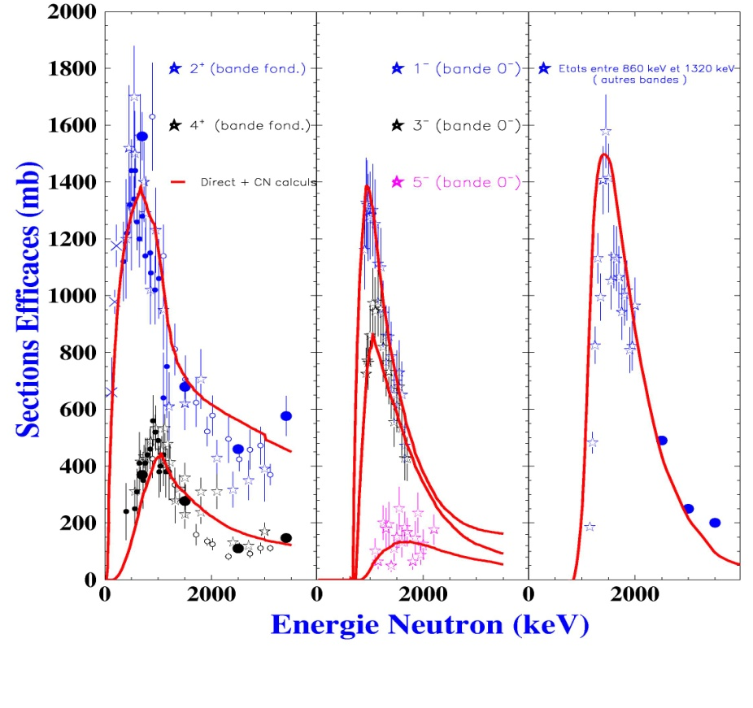
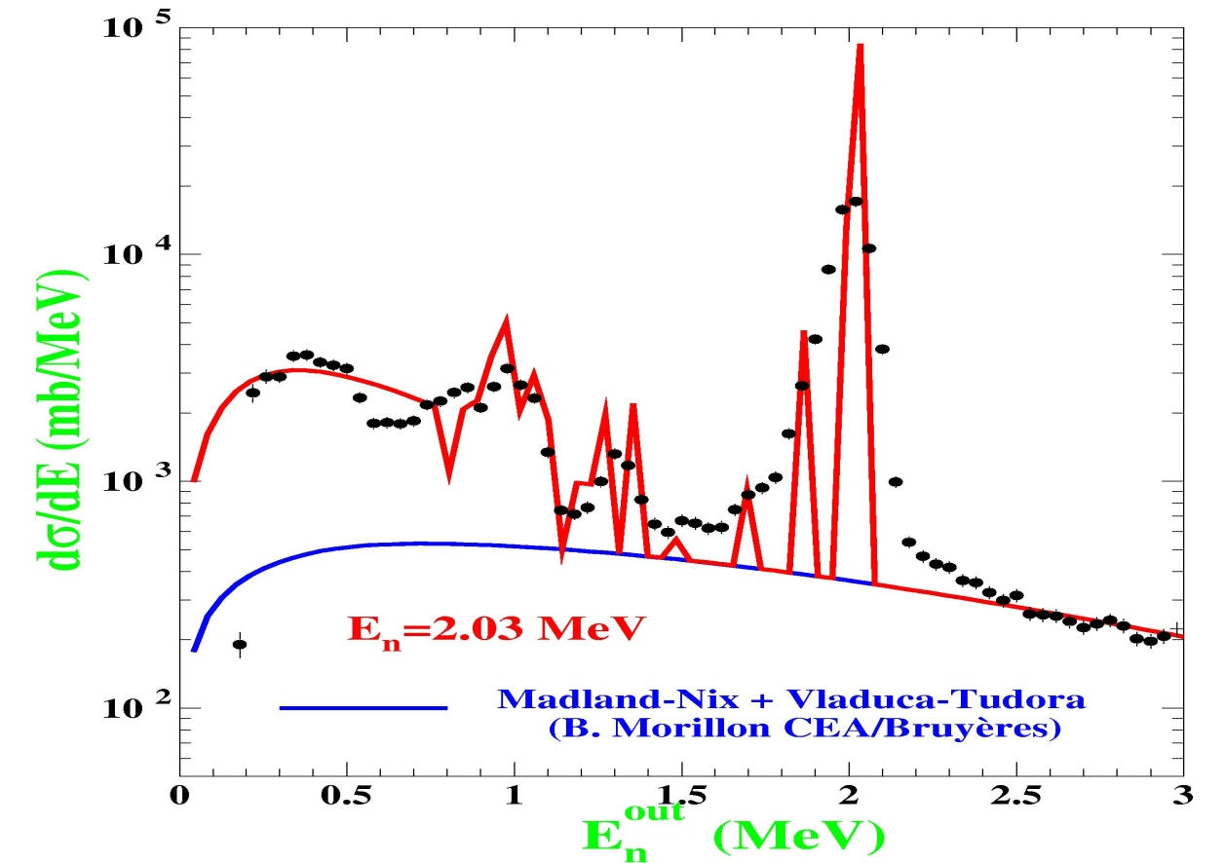
OMP : Impact of coupled channels

Slide 8
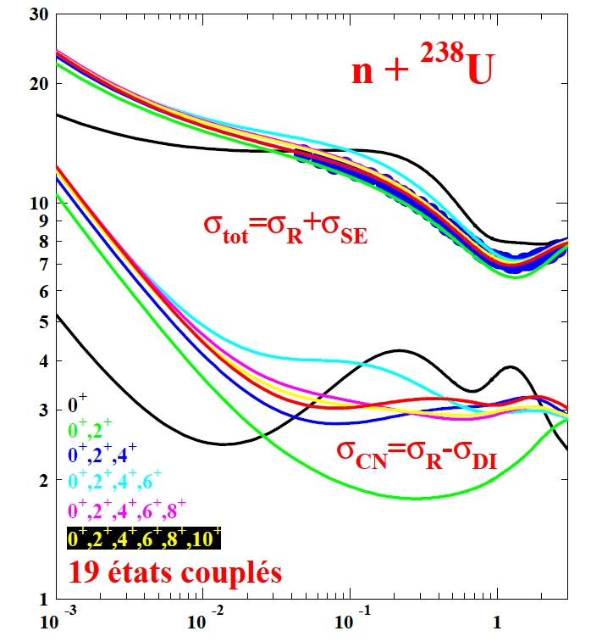
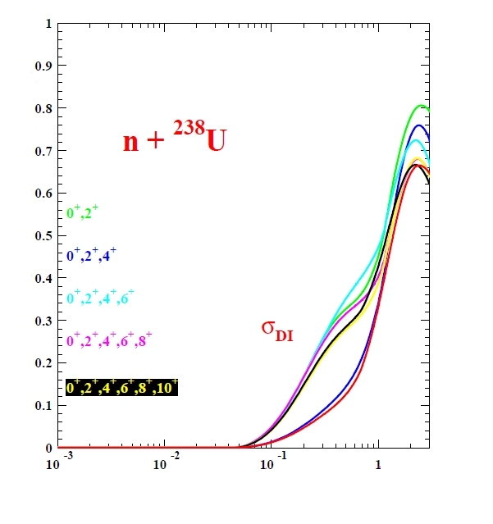
OMP: saturation of the coupling scheme
Cross section (barn)
19 coupled levels
Incident neutron energy (MeV)

Slide 9
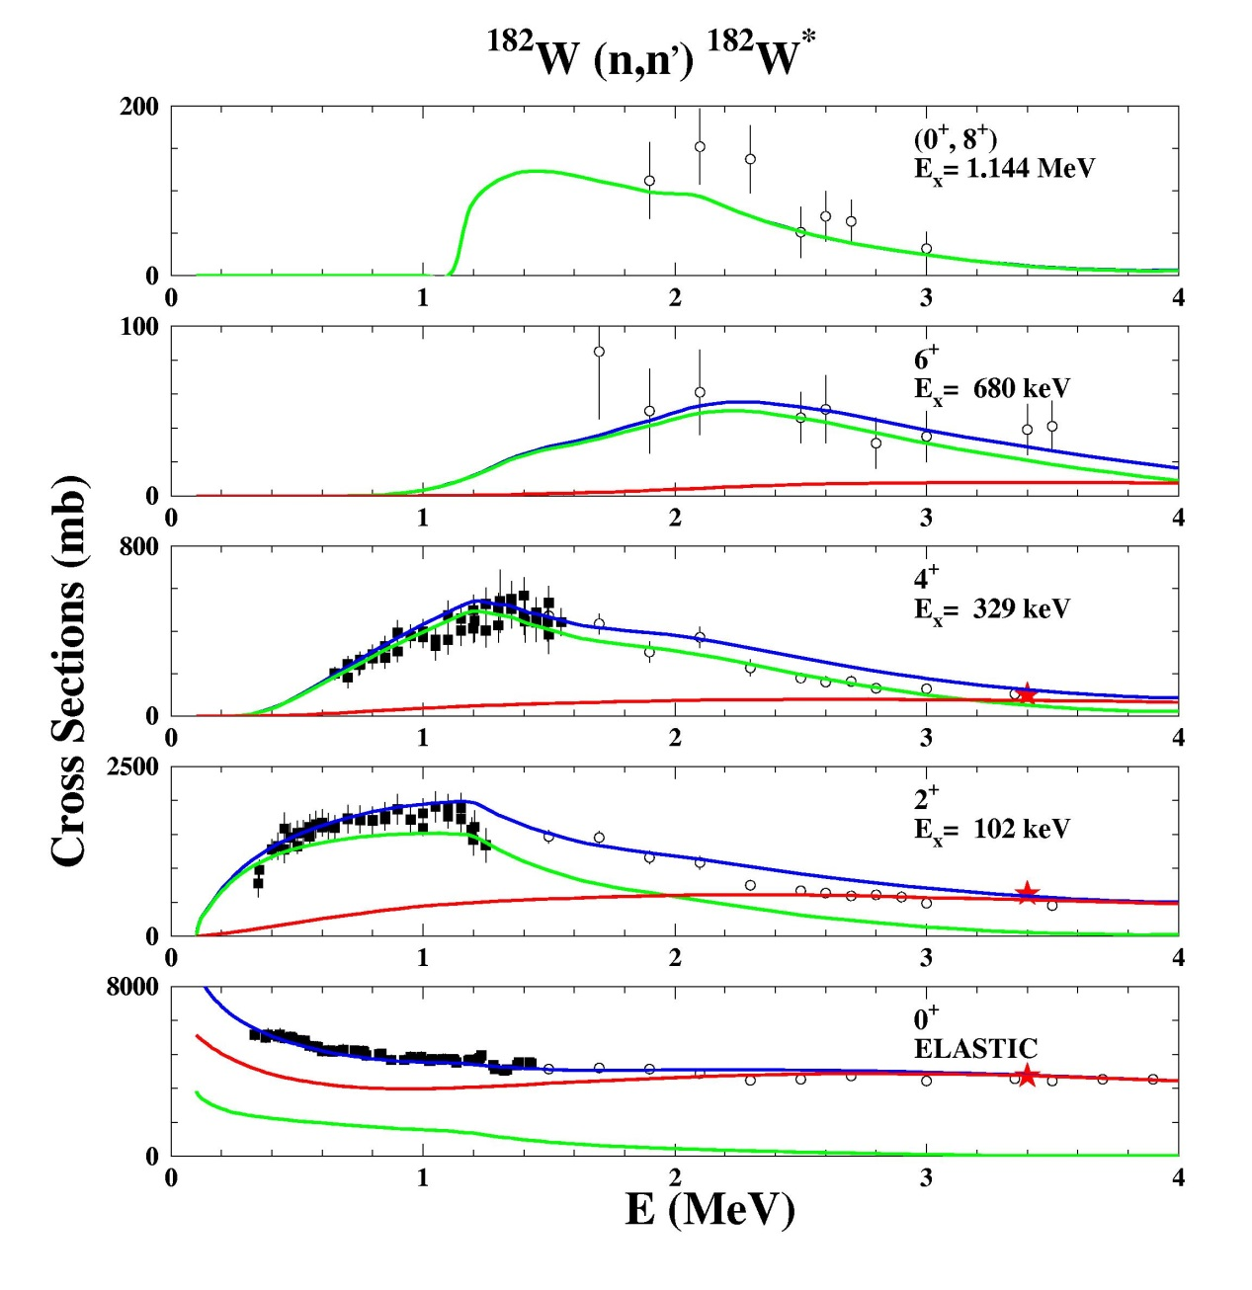
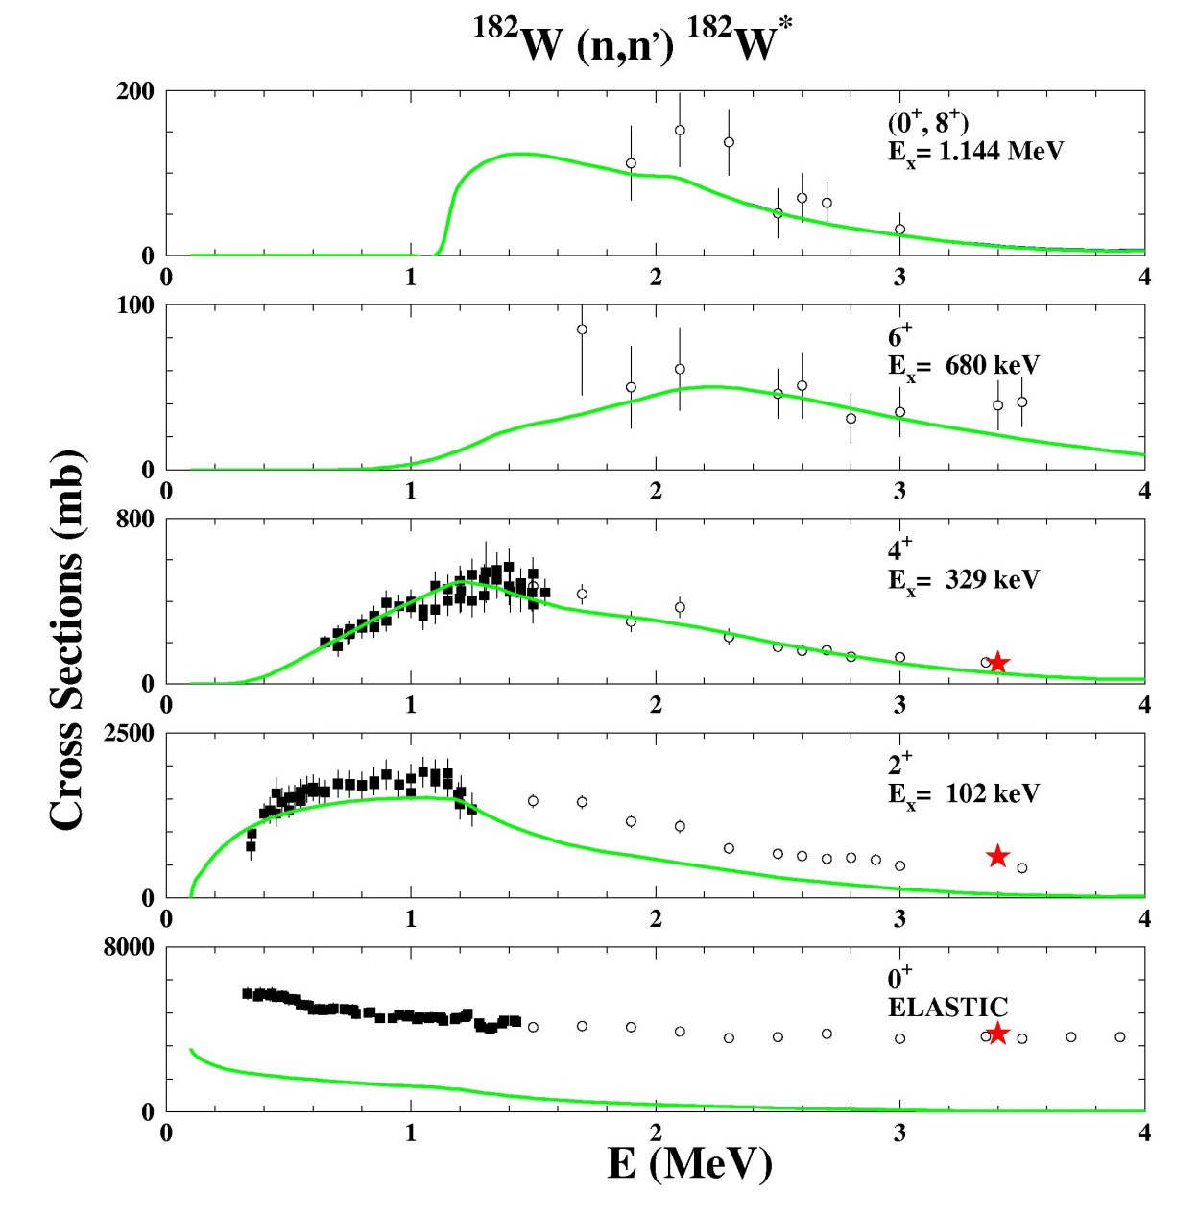
Impact of deformation : Excitation functions
Compound nucleus component
Compound nucleus component
Direct component
Sum
Cross sections (mb)

Slide 10
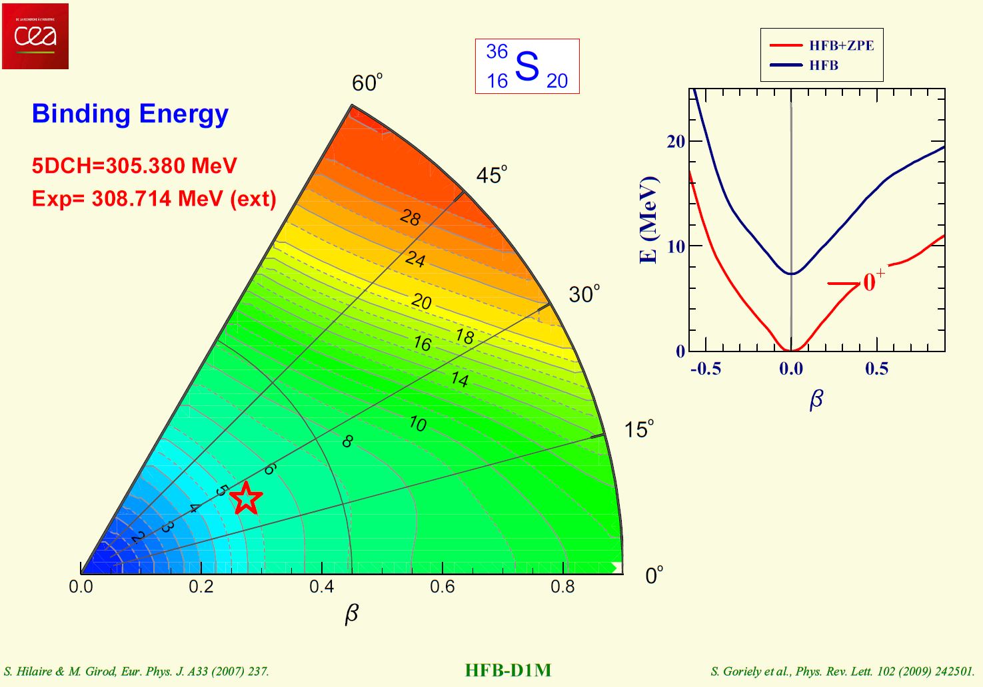
Semi microscopic OMP:
Impact of detailed structure description
Structure with 5DCH (GCM) probably not perfect
QRPA option could be more appropriate

Slide 11
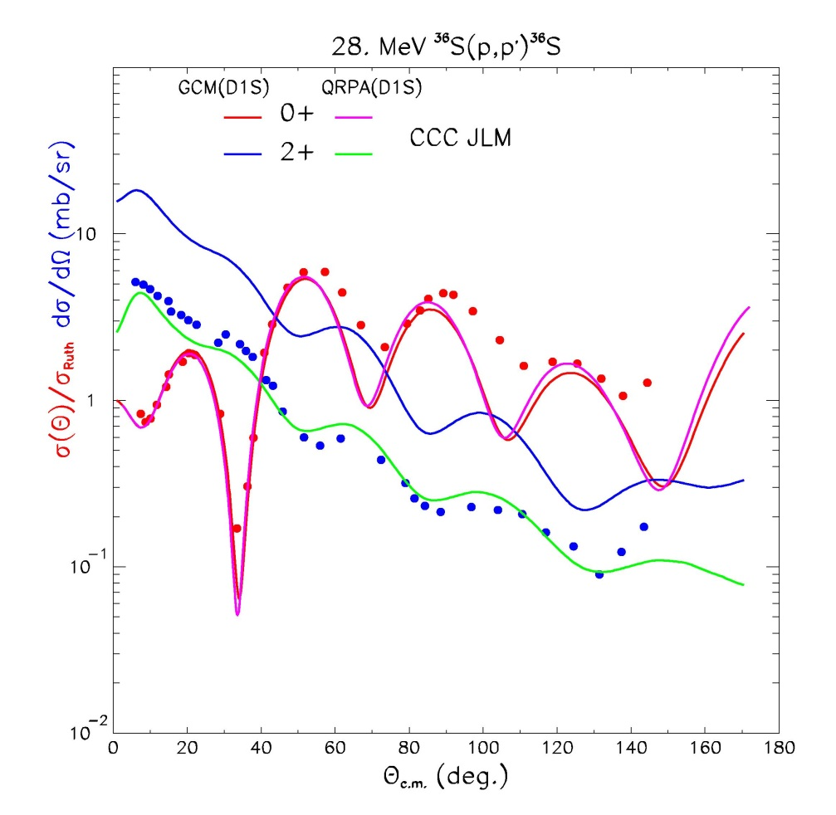
Semi microscopic OMP:
Impact of detailed structure description

Slide 12
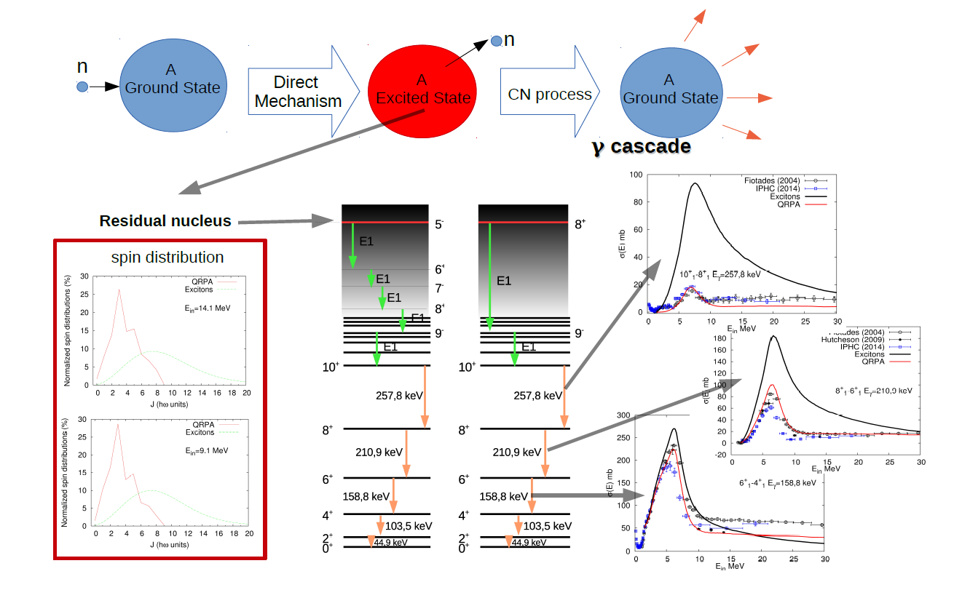
Compound nucleus spin distributions: effect of direc and pre equilibrium reactions

Slide 13
Statistical model

Slide 14
Hauser-Feschbach formalism and
Channel width fluctation factor
I_{A} + s_{a} + l_{a}
^{max}
(2J+1)
π
Σ
Σ
σ_{ab} =
k_{a}
(2I_{A}+1) (2s_{a}+1)
²
π = ±
J=| I_{A} – s_{a} |
J + I_{A}
j_{a} + s_{a}
J + I_{B}
j_{b} + s_{b}
Σ
Σ
Σ
Σ
j_{a}= | J – I_{A} |
l_{a}= | j_{a} – s_{a} |
j_{b}= | J – I_{B} |
l_{b}= | j_{b} – s_{b} |
T Jπ
T Jπ
T
T
Jπ
a, l_{a} , j_{a}
b, l_{b} , j_{b}
W
δ_{π} (a)
δ_{π} (b)
Σ
a, l_{a} , j_{a} , b, l_{b} , j_{b}
T Jπ
T
c, l_{c} , j_{c}
c

Slide 15
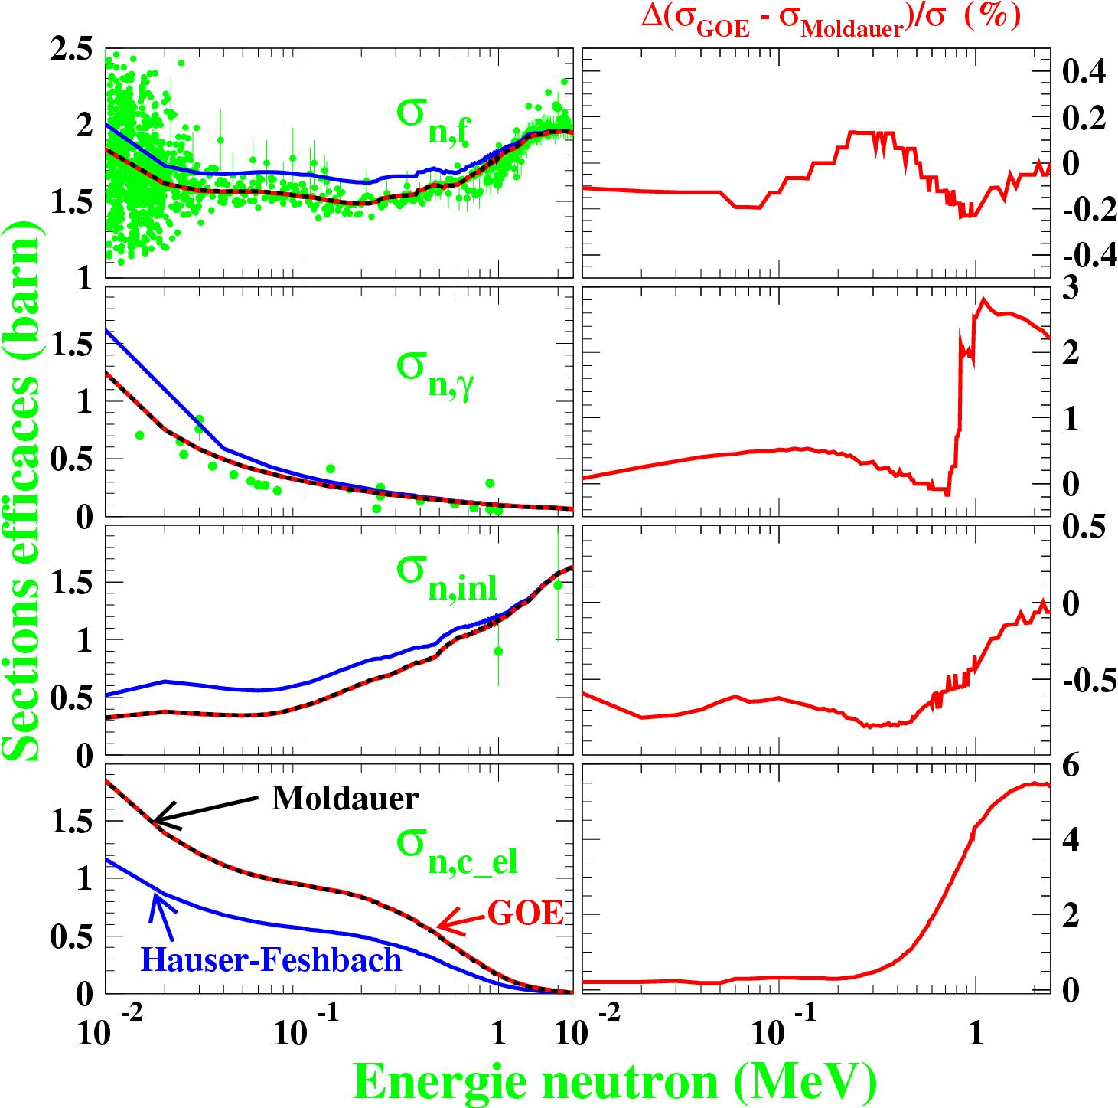
THE COMPOUND NUCLEUS MODEL
(flux redistribution illustration)

Slide 16
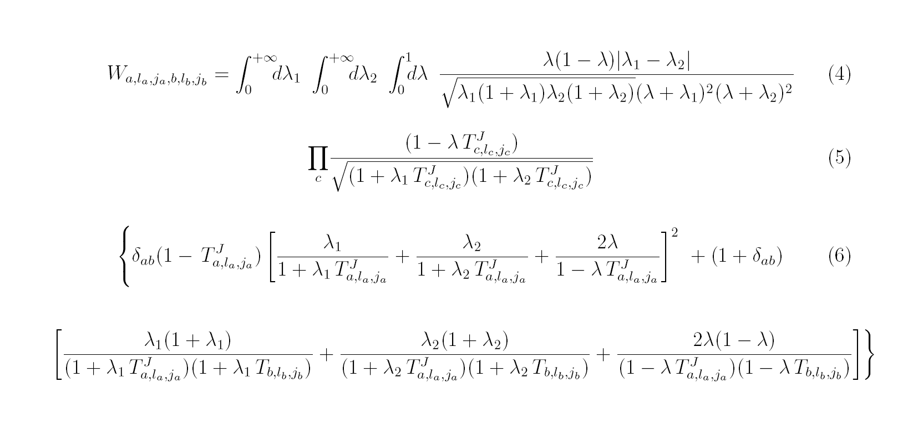
The Moldauer fluctuation factor
OK for a diagonal S matrix (no coupled channels)
Not correct if off-diagonal S matrix elements are significant

Slide 17
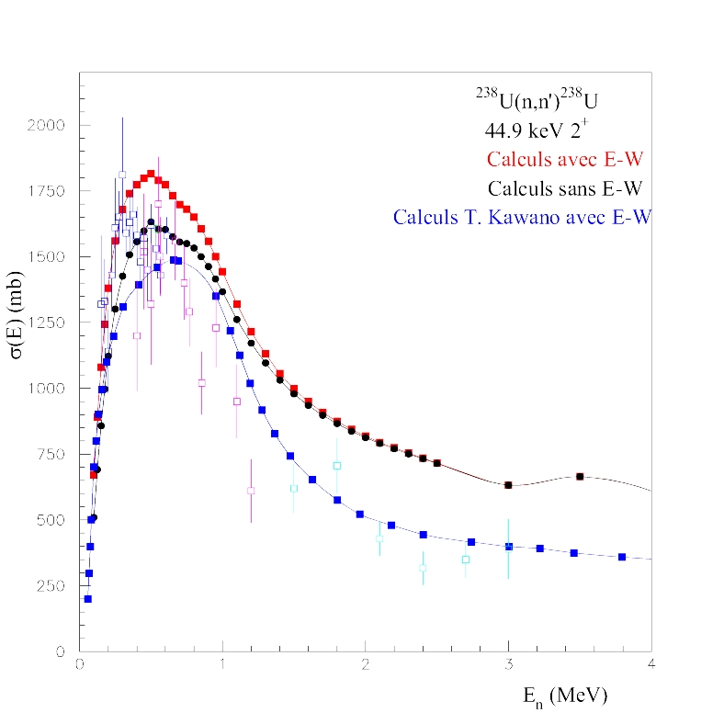
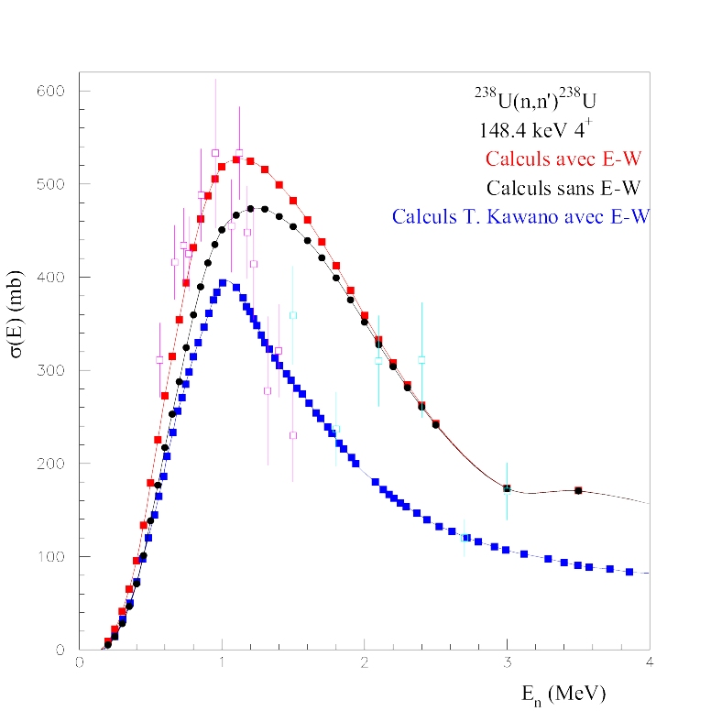
The Engelbrecht-Weidenmüller transformation
(strongly coupled inelastic levels)
Optical model re-optimisation required !

Slide 18
Level densities

Slide 19
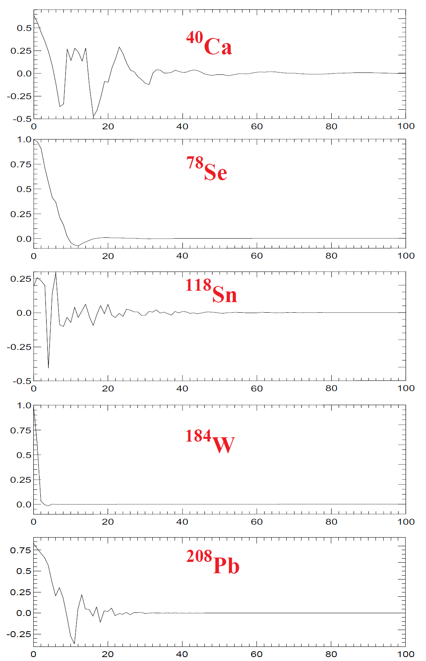
LEVEL DENSITIES
(parity distributions)
Parity asymetry
Excitation energy (MeV)

Slide 20
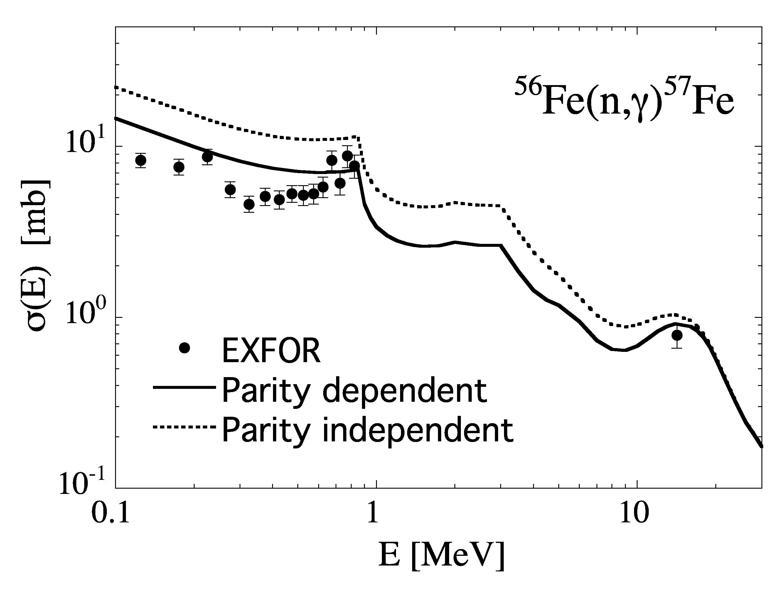
LEVEL DENSITIES
(parity non equipartition)

Slide 21
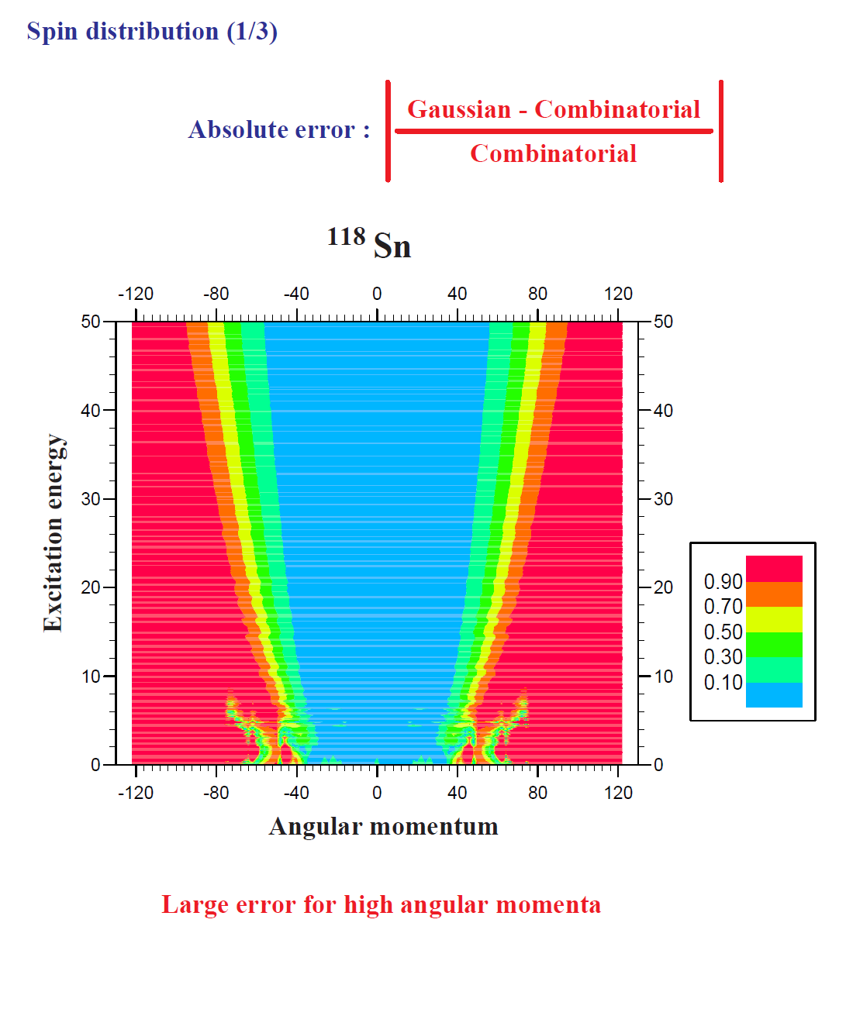
LEVEL DENSITIES
(spin distribution : combinatorial method vs Gaussian law)
⇒ significant deviations at low energy and high momentum

Slide 22
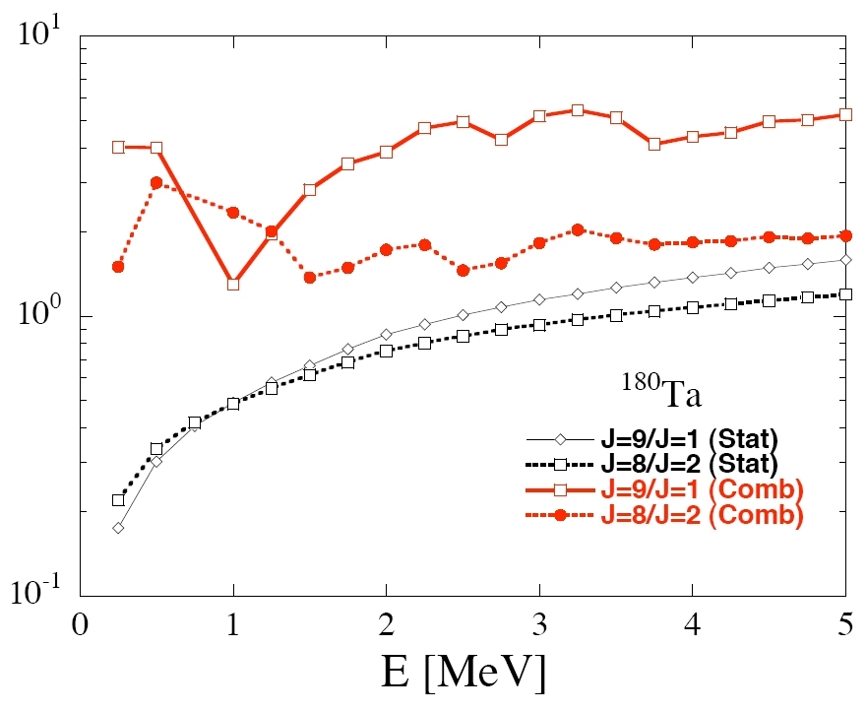
LEVEL DENSITIES
(non-Gaussian spin distribution)
Non-statistical feature imply significant deviations from the usual gaussian spin dependence

Slide 23
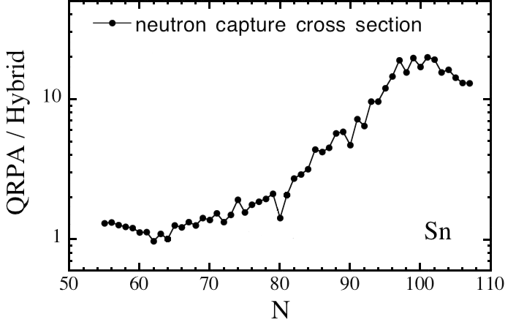
IMPACTS ON CROSS SECTIONS
(Exotic nuclei)
Capture cross section @ E_{n}=10 MeV for Sn isotopes
Weak impact close to stability but large for exotic nuclei

Slide 24
Gamma Strength functions

Slide 25
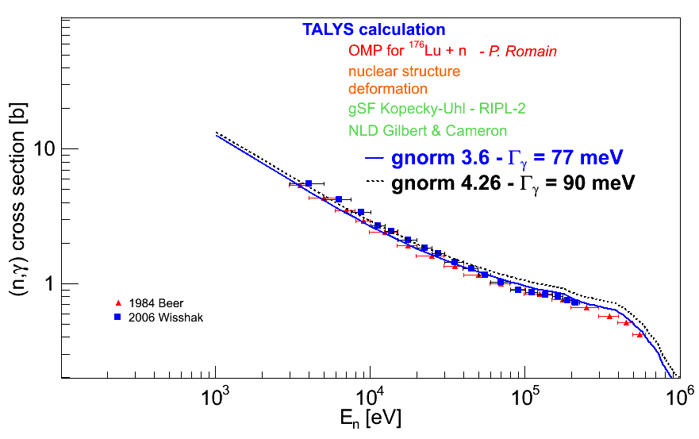
Gamma strength functions:
Normalization of of-the-shelf models
Normalisation method for thermal neutrons
experiment
B_{n}
∫
C Σ Σ Σ T^{kl}(e) ρ(B_{n}-e,J_{f},π_{f}) S(k,l,J_{i},p_{i}, J_{i},π_{f}) de =
1
<T_{g}>=
C
2π <Γ_{γ}> r(B_{n})
J_{i},π_{i}
kl
J_{f},π_{f}
D₀
0
<Γ_{γ}>_{exp.} = 63 ± 14 meV
S.F Mughabghab (2007)

Slide 26
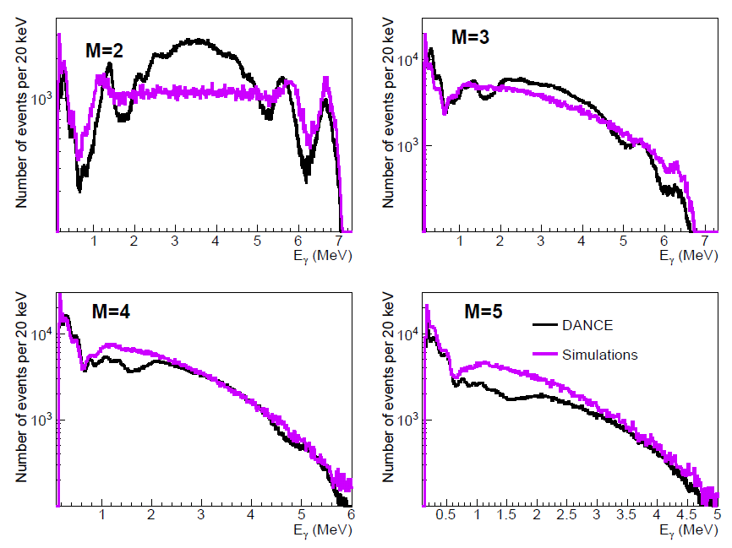
Test of adjusted strength functions with extra experimental constraints
Capture cross section OK
BUT gamma spectra constrained by multiplicity not reproduced !

Slide 27
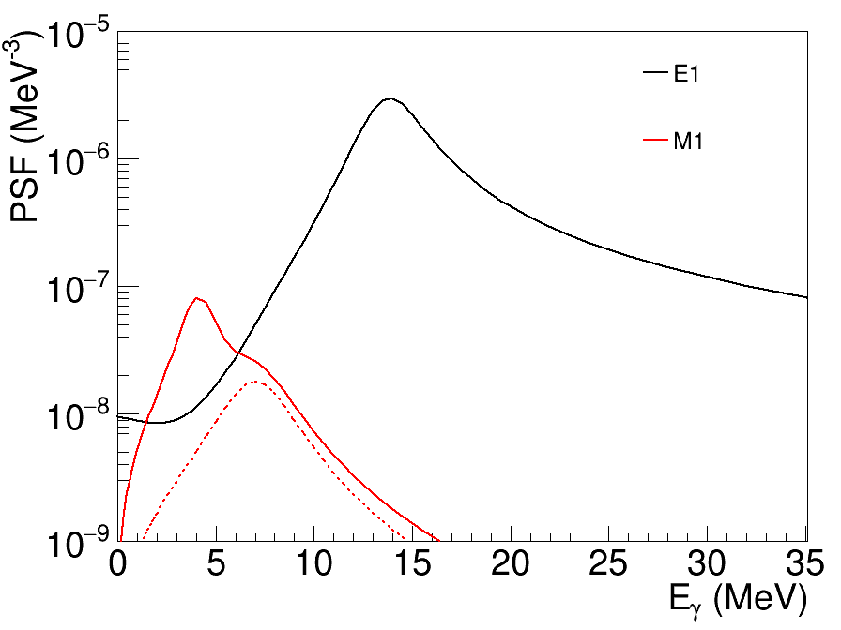
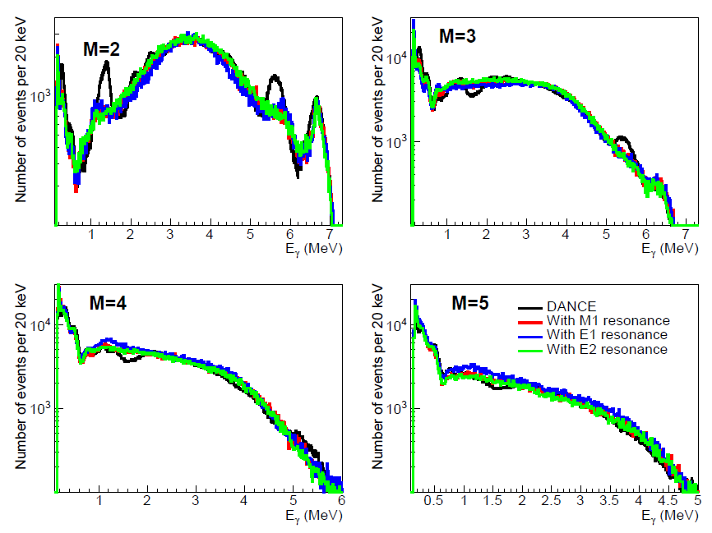



Test of adjusted strength functions with extra experimental constraints
Capture cross section OK but gamma spectra constrained by multiplicity not reproduced
Much better agreement introducing a new resonance at energies around 4 MeV
(E1 or E2 pygmy resonance or M1 scissor mode)
Kopecky-Uhl
M1 mode « scissor »
SLO

Slide 28
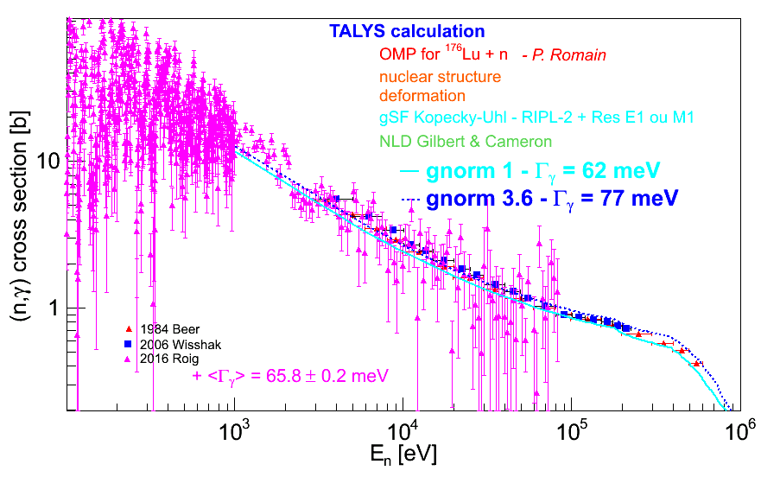
Test of adjusted strength functions with extra experimental constraints
Capture cross section OK + gamma spectra OK and no more arbitrary normalization

Slide 29
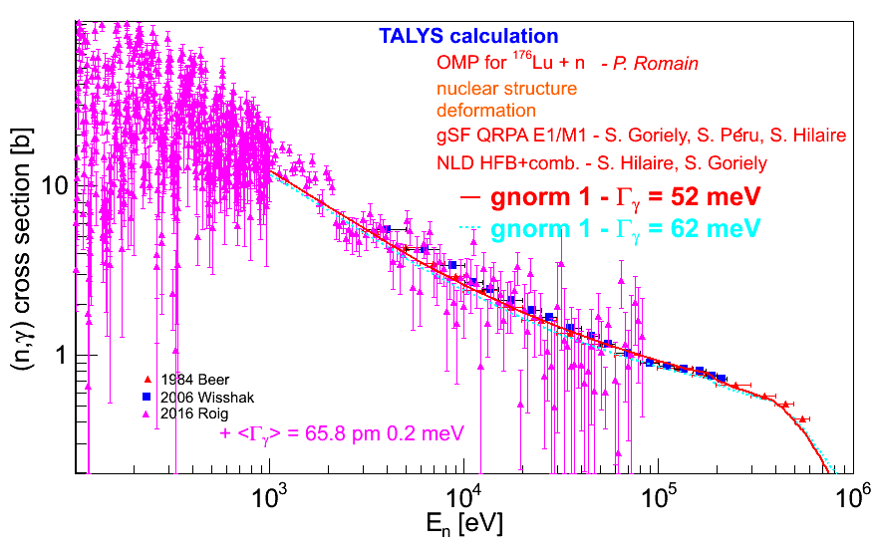
Test of adjusted strength functions with extra experimental constraints
What about QRPA microscopic calculations?
Capture cross section OK + gamma spectra OK and no more arbitrary normalization
Γγ can be calculated from microscopic models

Slide 30
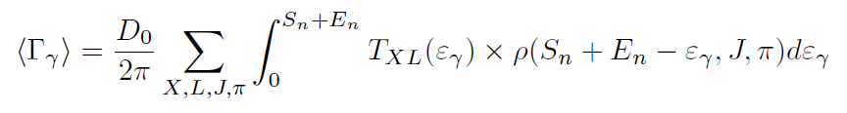
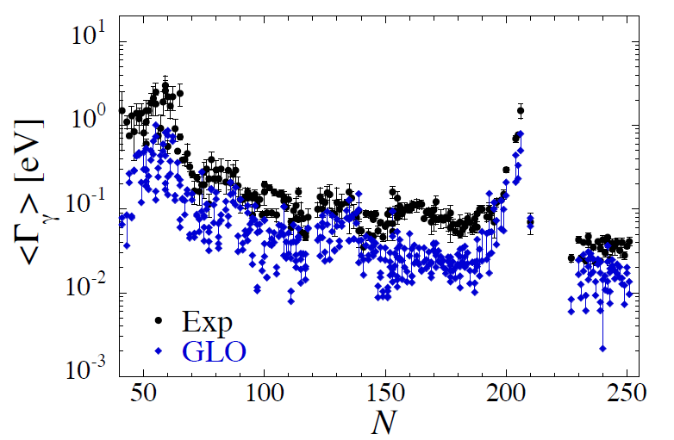
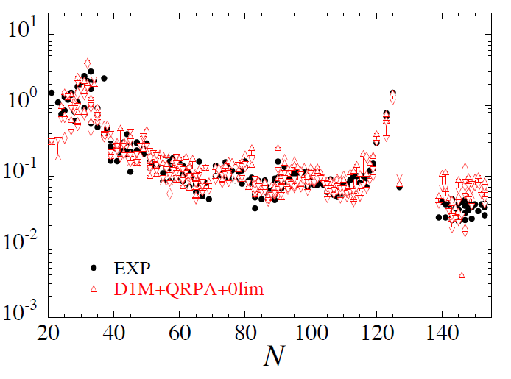
Γγ : of-the-shelf models vs microscopic calculations

Slide 31
Fission transmission

Slide 32
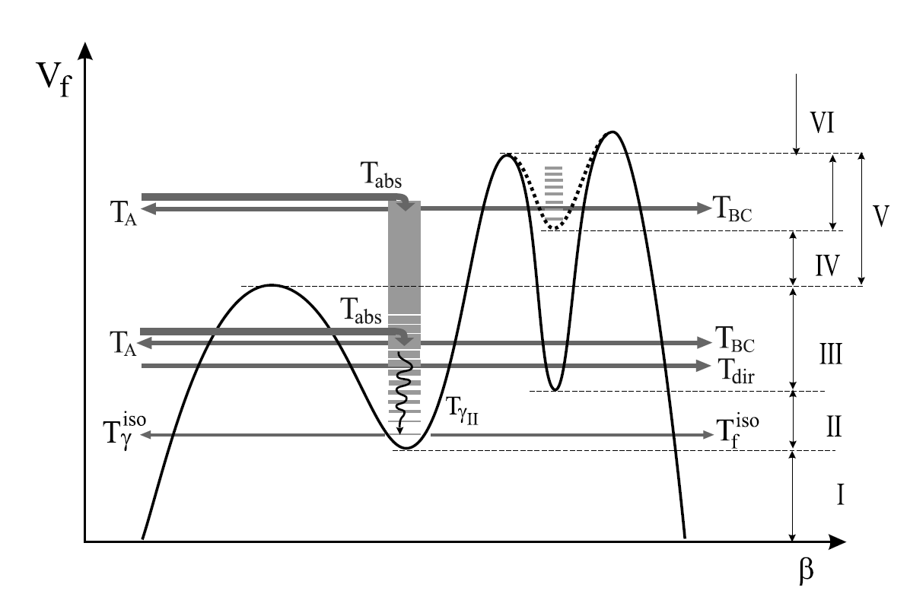
FISSION CROSS SECTIONS
(multiple humped barriers fission transmission coefficients
with maximum complexity)
See in Sin et al., PRC 74 (2006) 014608
Bjornholm and Lynn, Rev. Mod. Phys. 52 (1980) 725.

Slide 33
FISSION CROSS SECTIONS
(impact of class II and class III states)

Slide 34
FISSION CROSS SECTIONS
(impact of class II and class III states)

Slide 35
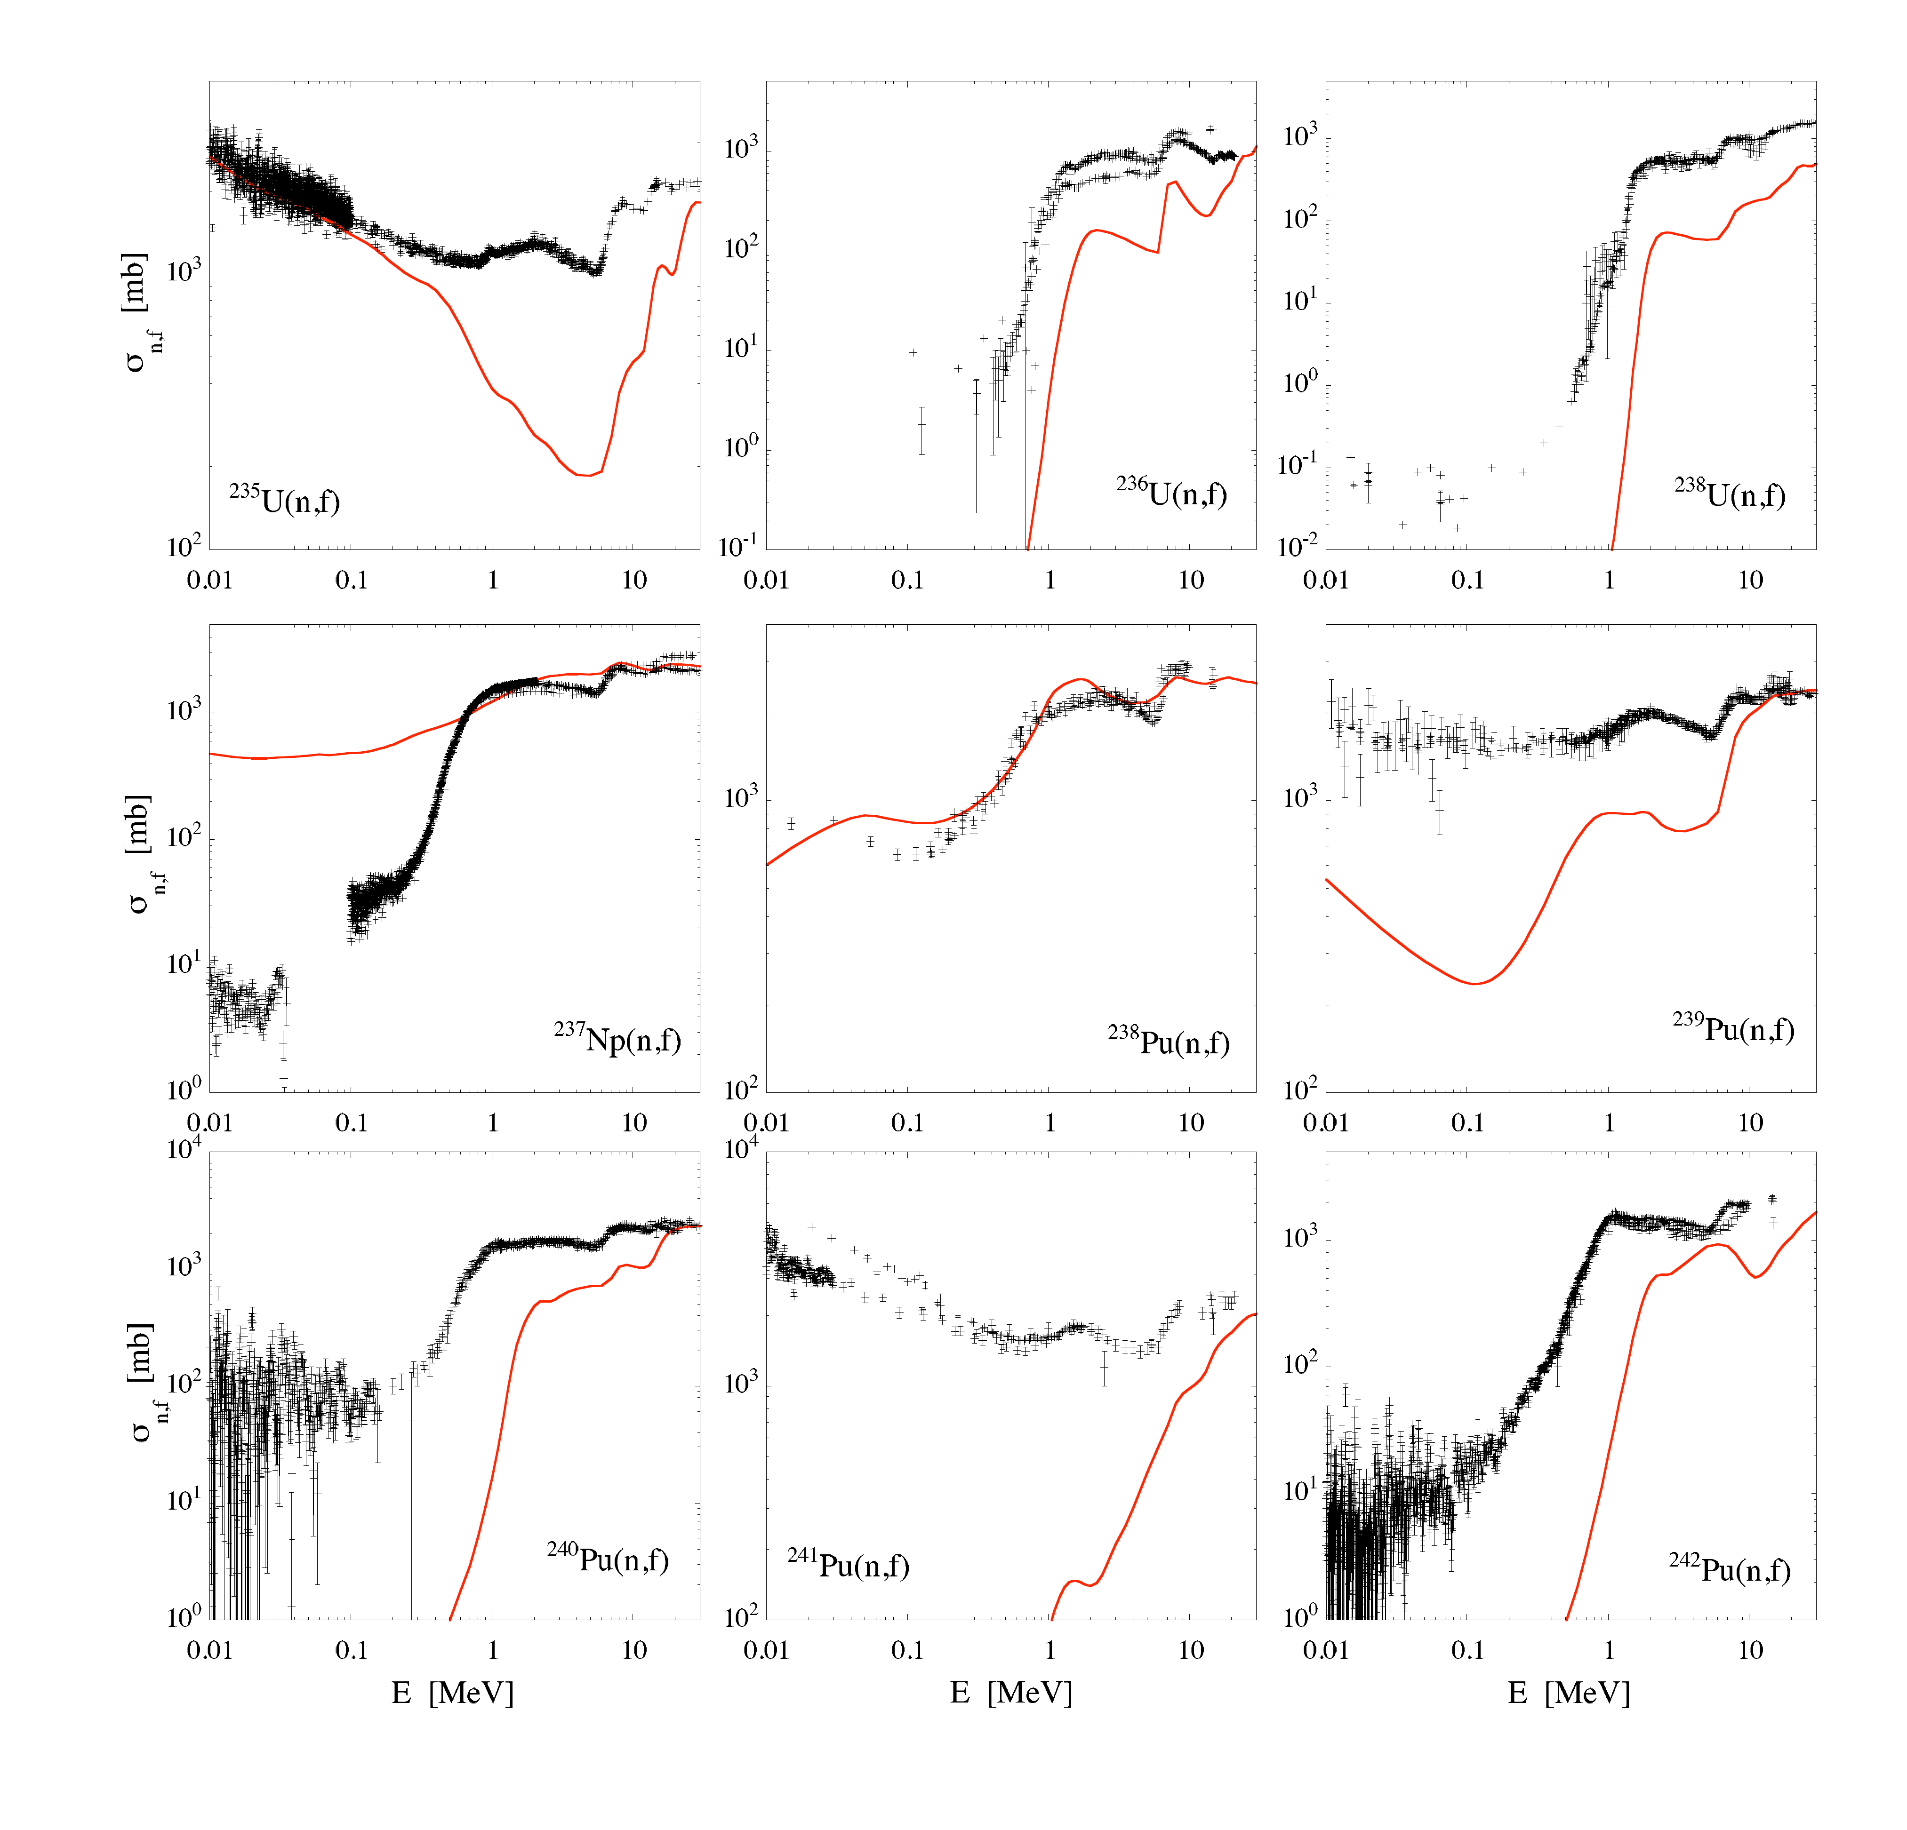
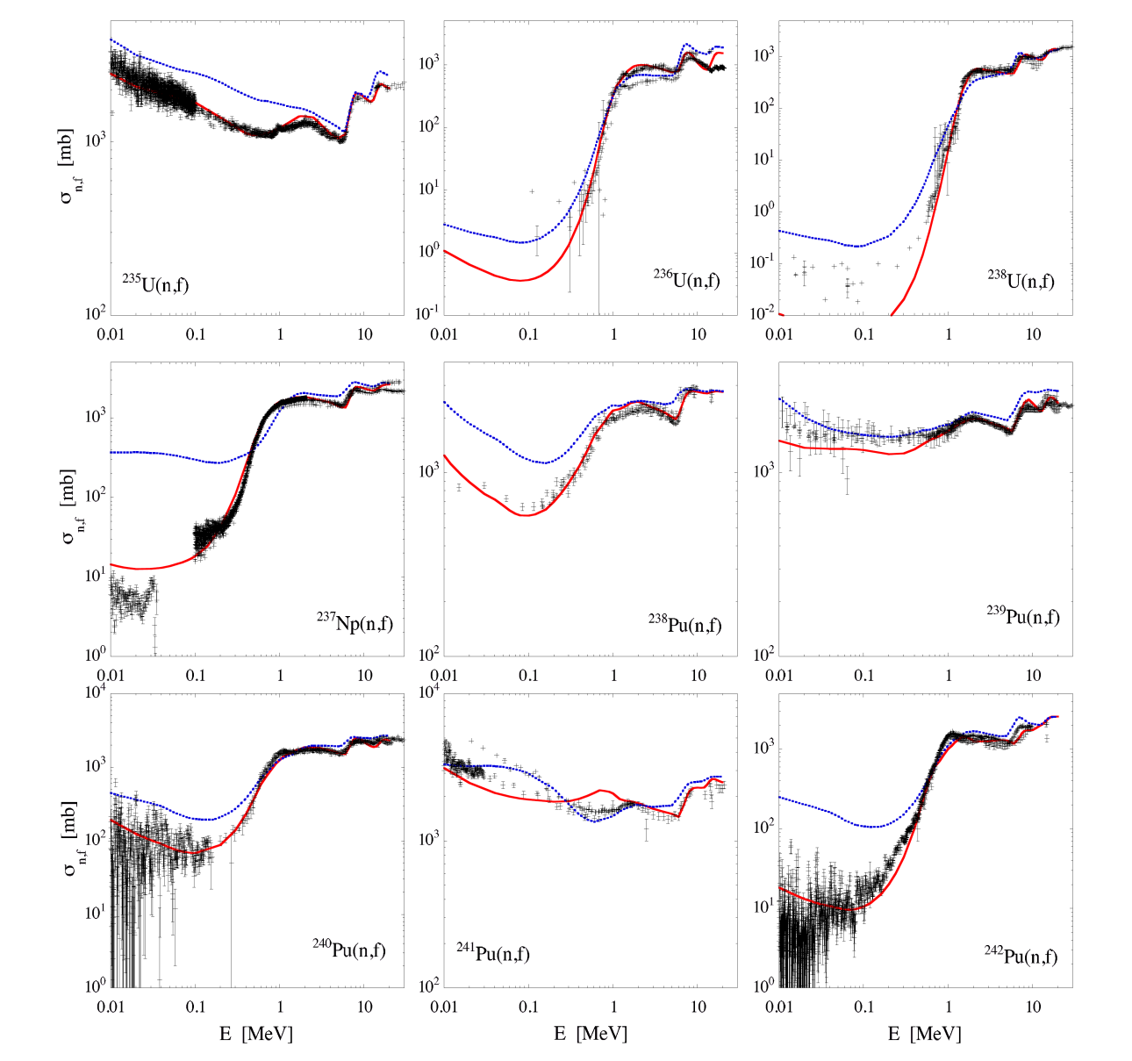
FISSION CROSS SECTIONS
(Microscopic approaches)
Microscopic fission cross sections
Fission barriers
adjusted for
each target
Fission barriers
adjusted for
each type of target
- odd-odd
- odd-even
- even-odd
- even-even
Default calculations not sufficient for applications.
Not ridiculous after few adjustments.

Slide 36
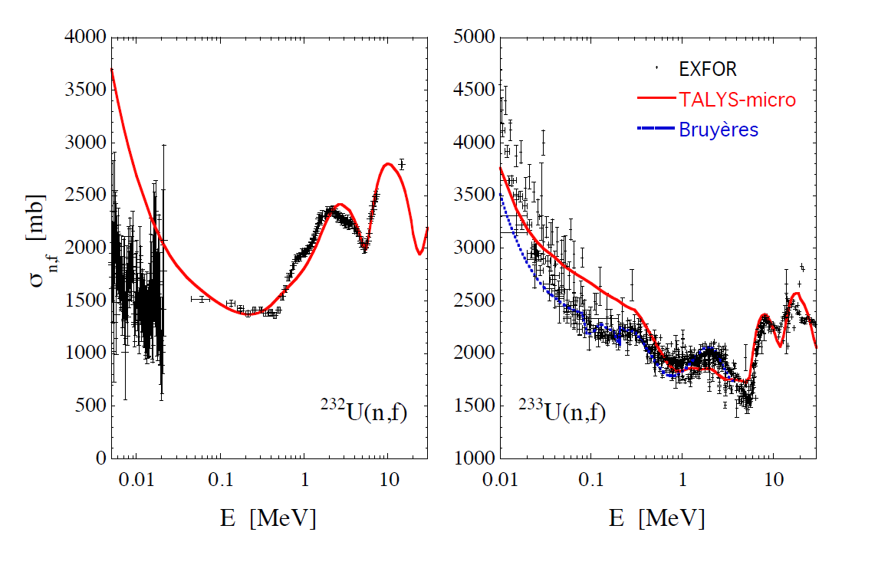
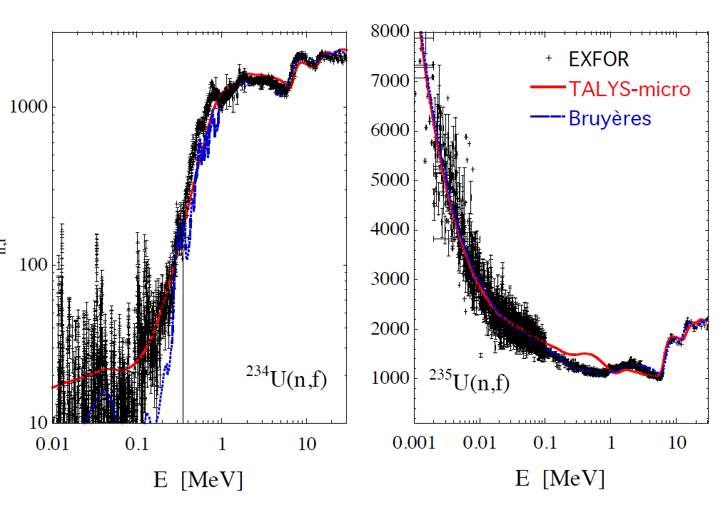
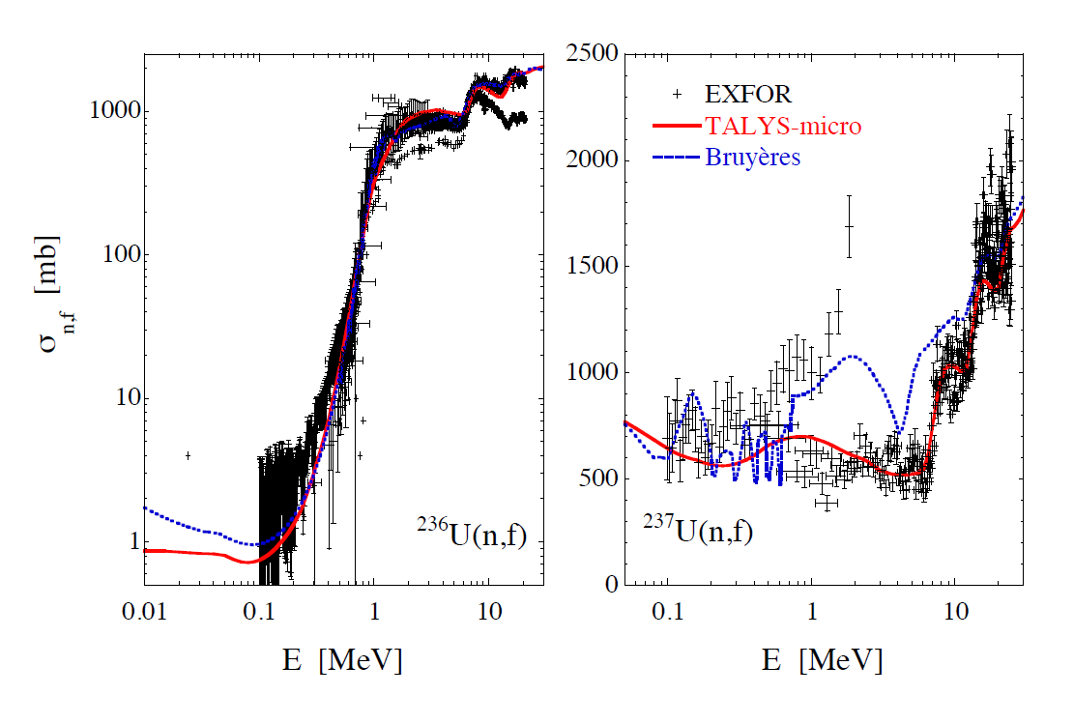
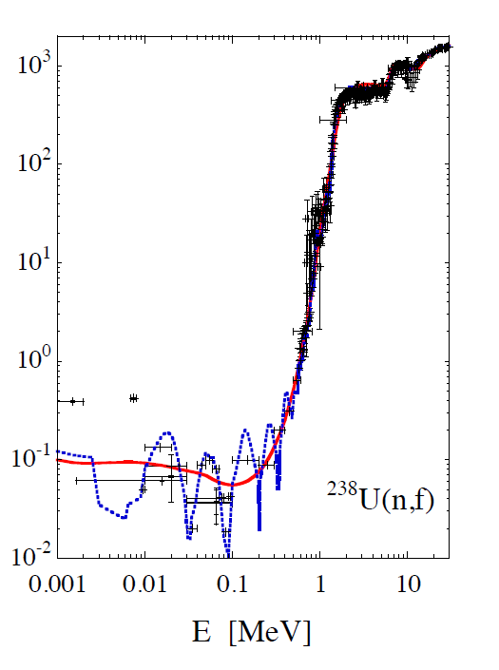
FISSION CROSS SECTIONS
(Microscopic approaches)
Barrier height
Adjustments:
Less than 10%

Slide 37
FISSION CROSS SECTIONS
(Microscopic approaches)

Slide 38
Summary
● Using better models allows to better reproduce experimental data
Ex: OMP, Statistical models, Level densities, Γγ, fission transmission
● Microscopic models are able to compute model ingredients from
nuclear interaction + many body formalism (no adjustment)
● Use of better (more microscopic) reduce the dynamics of model
parameter adjustment.
+ parameter values more physical
- fine adjustments still needed for optimal agreement with data
Ex: OMP, level densities, Γγ, fission transmission
● Examples shown for cross sections in the continuum
but conclusions also relevant for PFNS, PFGS, and in the resonance region
Quantification of model defects into the covariance matrix is needed
BUT using better models will reduce the amplitude of such defects.

Slide 39
Direction
Département
Service
Commissariat à l’énergie atomique et aux énergies alternatives
Centre de Saclay | 91191 Gif-sur-Yvette Cedex
T. +33 (0)1 XX XX XX XX | F. +33 (0)1 XX XX XX XX
  Etablissement public à caractère industriel et commercial | RCS Paris B 775 685 019

Slide 40
NEUTRONS AND GAMMAS
(FIFRELIN model)
Monte Carlo approach designed to deal with fission fragment decay
fragment’s mass sampled from exp. or theory
fragment’s kinetic energy sampled from exp. or theory
fragment’s charge sampled from Wahl model (Z=Z_{CN}/A_{CN} * A)
fragment’s spin distribution sampled from level density law
excitation energy sharing following temperature ratio law adjusted on saw tooth
Budtz-Jorgensen 1988
Hambsch-2009
Bowman-19663
FIFRELIN
A_{L} = A_{CN} - 132
A_{H} = 132
R_{T}(A) = T_{L}/T_{H}
A_{L} = A_{H} = A_{CN} / 2
A_{L} = 78
A_{H} = A_{CN} - 78
1.0
A_{H}
A_{CN}/2
132
A_{CN} - 78
Details in Phys. Rev. C 82 (2010) 054616.

Slide 41
NEUTRONS AND GAMMAS
(FIFRELIN : neutron multiplicity and energy)
Average prompt neutron multiplicity as a function of pre-neutron mass
Average prompt neutron energy in CM as a function of pre-neutron mass
Budtz-Jorgensen 1988
Hambsch-2009
Bowman-19663
FIFRELIN
$$\overline{ν}\left(A\right)$$
<e>$\left(A\right)$
2010 result
FIFRELIN
(-W model)
FIFRELIN
(-HF model)
Courtesy O. Litaize

Slide 42
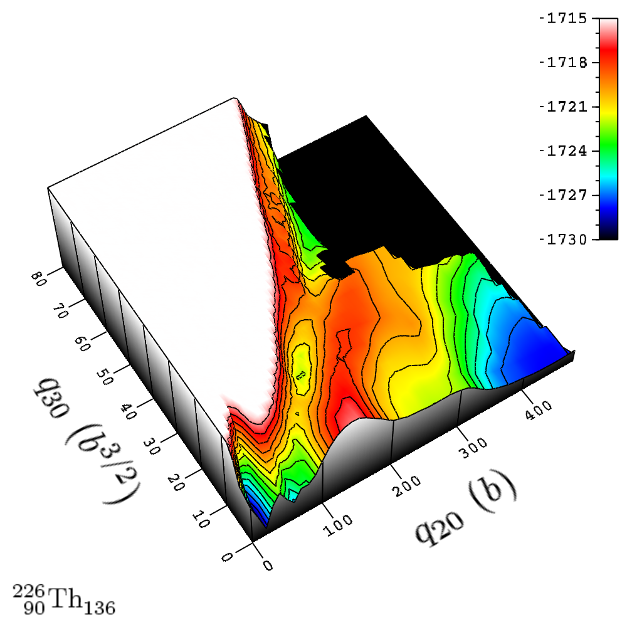
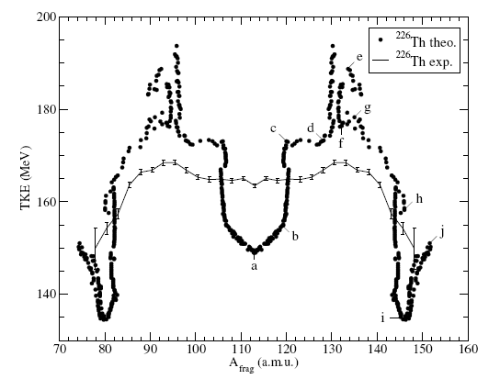
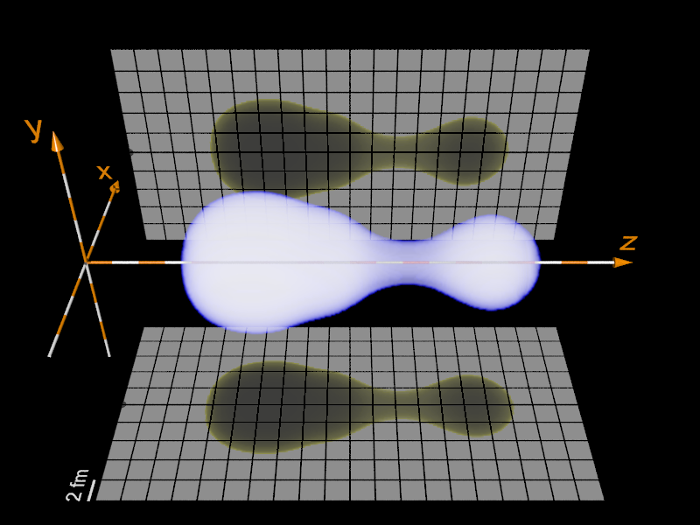
Microscopic fission models

Slide 43
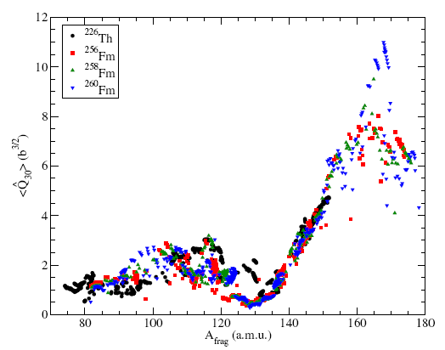
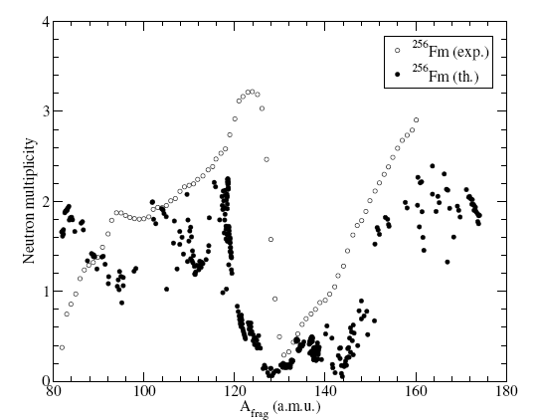
Microscopic fission
Q20 Deformation
Q30 Deformation
Deformation energy
Neutron multiplicity (simplistic)

