Slide 1
Post-CIELO challenges in actinide evaluations
Roberto Capote
Deputy Head, Nuclear Data Section
International Atomic Energy Agency
Department for Nuclear Sciences and Applications
Long-term International Collaboration to Improve Nuclear Data Evaluation and Evaluated Data Files
IAEA HQ, Vienna, 18-21 December 2017

Slide 2
OUTLOOK
IAEA PFNS CRP impact on future evaluations
and proposed work
Identified deficiencies in U-238 data
Discrepancies in Th-232(n,f) evaluations/data

Slide 3
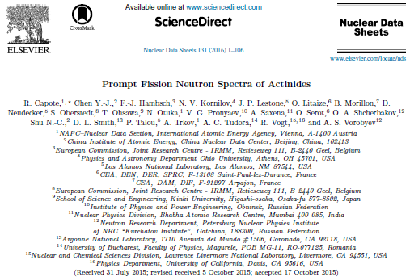
PFNS evaluation challenges
IAEA Coordinated Research Project 2008-2014
Nuclear Data Sheets 131 (2016) 1-106

Slide 4
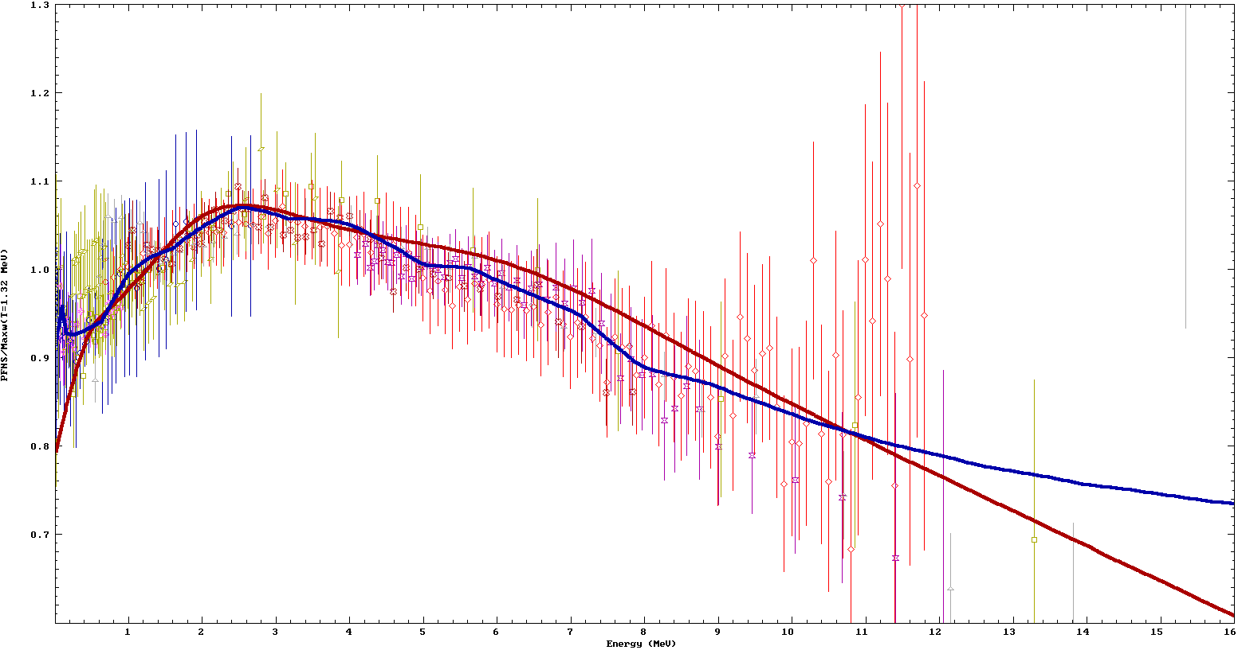
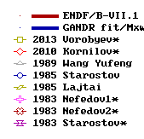
²³⁵U(n_{th},f) PFNS non-model evaluation
A.Trkov & R.C., Phys. Procedia 64 ( 2015) 48
R.C. et al., Nucl. Data Sheets 131 (2016) 1
$$∆\overline{Eaver}=−30 keV$$
⁹⁰Zr(n,2n)
SACS
PFNS ²³⁵U(n,f) / Maxw(T=1.32 MeV)
E_{aver}(GANDR)= 2.000(9)
E_{aver}(GMA)= 2.000(10)
E_{aver}(Talou,Madland-Nix model)= 2.001
E_{aver}(B/VII.1,JENDL-4,JEFF) = 2.03 MeV
E(MeV) 3 4 5 6 7 8 9 10 11 12 13 14 15

Slide 5
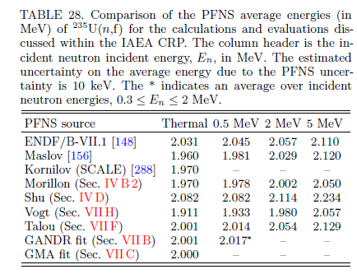
PFNS average energy ²³⁵U(n,f)
ΔE_{av}=
-30 keV
(-1.5%)
non-model
fit
Non-model PFNS eval.-> new RP, nubar

Slide 6
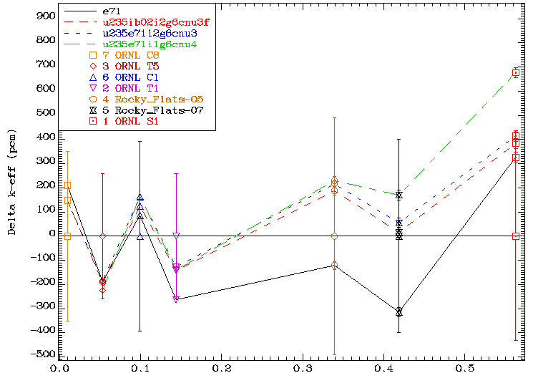
nubar fluctuations: k_{eff} vs ATLF
RP i1
RP i2
Gwin-Magnusson
ATLF
High leakage

Slide 7
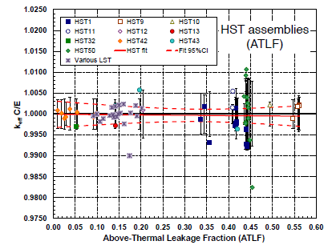
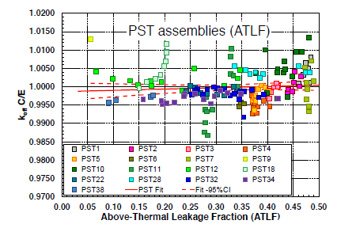
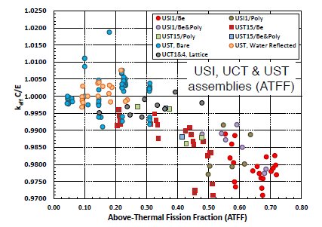
Brown et al,
Nucl. Data Sheets 148, 1 (2018)
U-235 & Pu-239
CIELO
U-235
Pu-239
U-233

Slide 8
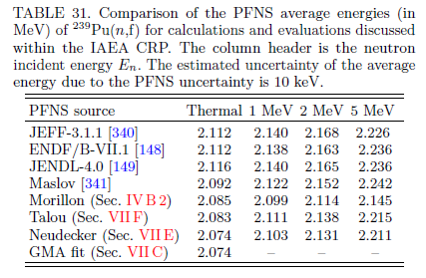
PFNS average energy ²³⁹Pu(n,f)
ΔE_{av}=
-30 keV
(-1.8%)
non-model
fit
Non-model PFNS eval.-> new RP, nubar !

Slide 9
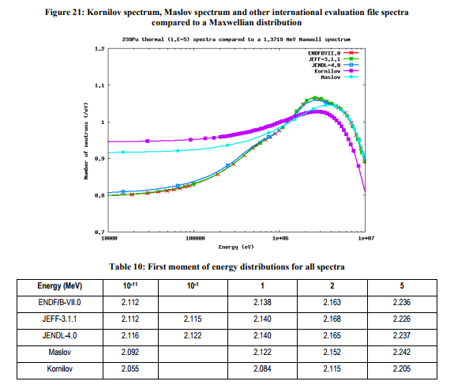
WPEC SG34 study: PFNS impact
PFNS ΔE_{av} : 0.01
E_{av}
Kornilov: 2.084
Neudecker: 2.074
GMA: 2.074

Slide 10
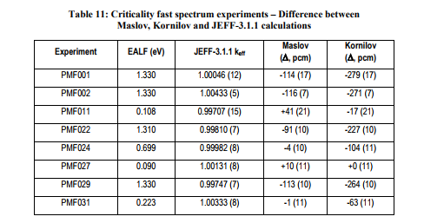
WPEC SG34 study: PFNS impact
PFNS ΔE_{av} : 0.01
E_{av}
Kornilov: 2.084
Neudecker: 2.074
GMA: 2.074
Fast assemblies ~ -250 pcm

Slide 11
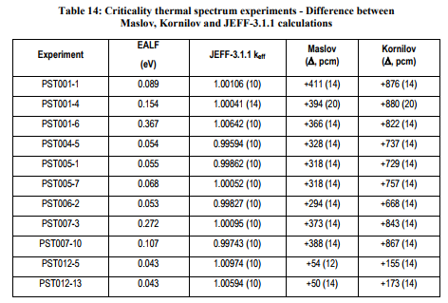
WPEC SG34 study: PFNS impact
PFNS ΔE_{av} : 0.01
E_{av}
Kornilov: 2.084
Neudecker: 2.074
GMA: 2.074
High leakage solutions ~+800 pcm

Slide 12
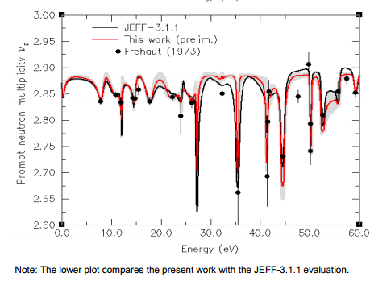
WPEC SG34 study: PFNS impact

Slide 13
PFNS high energy tail (E_{n}>10 MeV)
SACS derived by
interpolation in <E>

Slide 14
PFNS high-energy dependence confirmed

Slide 15
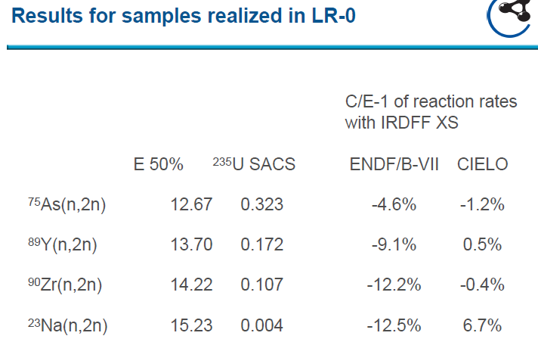
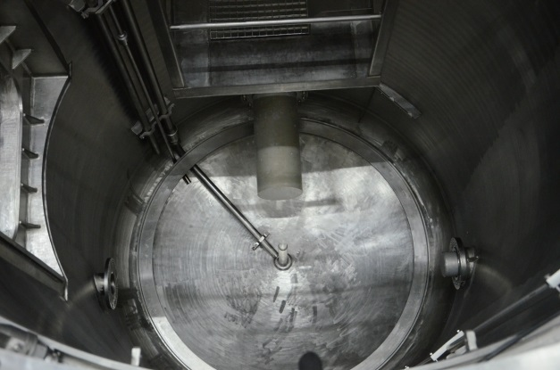
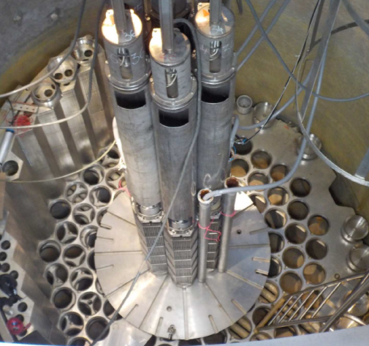
PFNS high-energy dependence confirmed
Charles Univ,
Prague,
Zero power
reactor
Courtesy: M. Kostal, Rez, @IRDFF 3rd RCM, IAEA CRP, March 2017

Slide 16
Summary
²³⁵U(n_{th},f) PFNS for Eout>10 MeV fixed from SACS[⁹⁰Zr(n,2n)]
High-energy ²³⁵U(n_{th},f) PFNS dependence confirmed experimentally
SACS [n,x]{²⁵²Cf(sf)}/SACS[n,x]{²³⁵U(n_{th},f)} ratio systematics used to predict the SACS[²³⁸U(n,2n)] in ²³⁵U(n_{th},f) PFNS (=14.8mb)
(need experimental confirmation)
Predicted SACS[²³⁸U (n,2n)] in ²³⁵U(n_{th},f) PFNS confirmed by a new IAEA CIELO evaluation of ²³⁸U and differential experiments
SACS[²⁷Al(n,a)] and SACS[⁹⁰Zr(n,2n)] in ²³⁹Pu(n_{th},f) and ²³³U(n_{th},f) PFNS predicted (need experimental confirmation)
Reevaluation of neutron induced reactions on ²³³U and ²³⁹Pu needed and proposed with focus on RR/URR

Slide 17
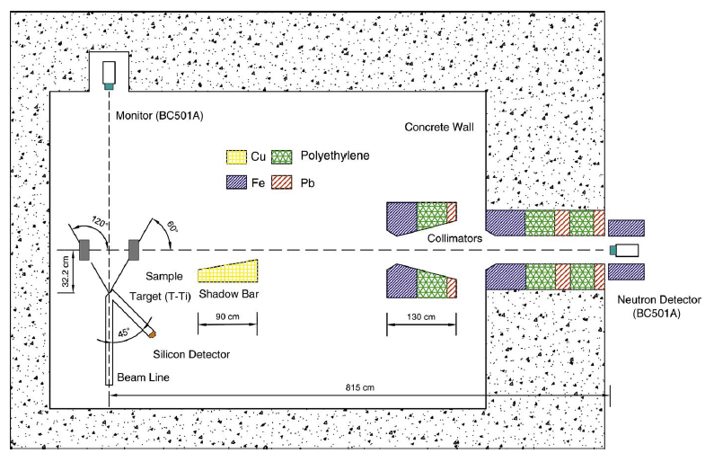
CIAE TOF, Key laboratory for ND
Q. Sun et al, Fus. Eng. Des. 125 (2017) 9-17

Slide 18
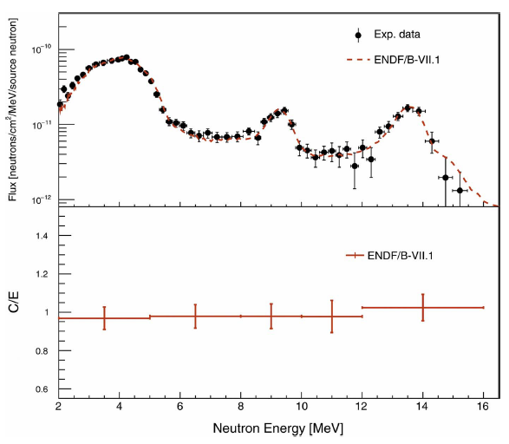
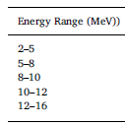
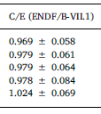
Polyethylene (C₂H₄)_{n}, 60⁰, STD benchmark
Q. Sun et al, Fus. Eng. Des. 125 (2017) 9-17

Slide 19
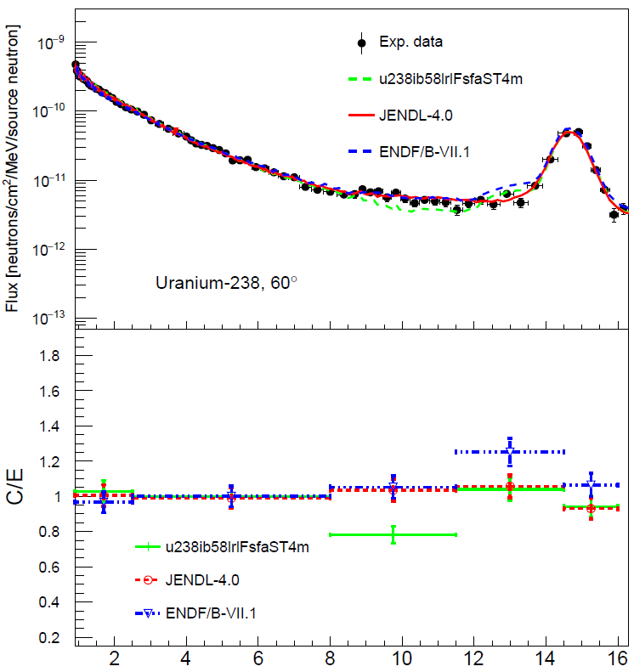
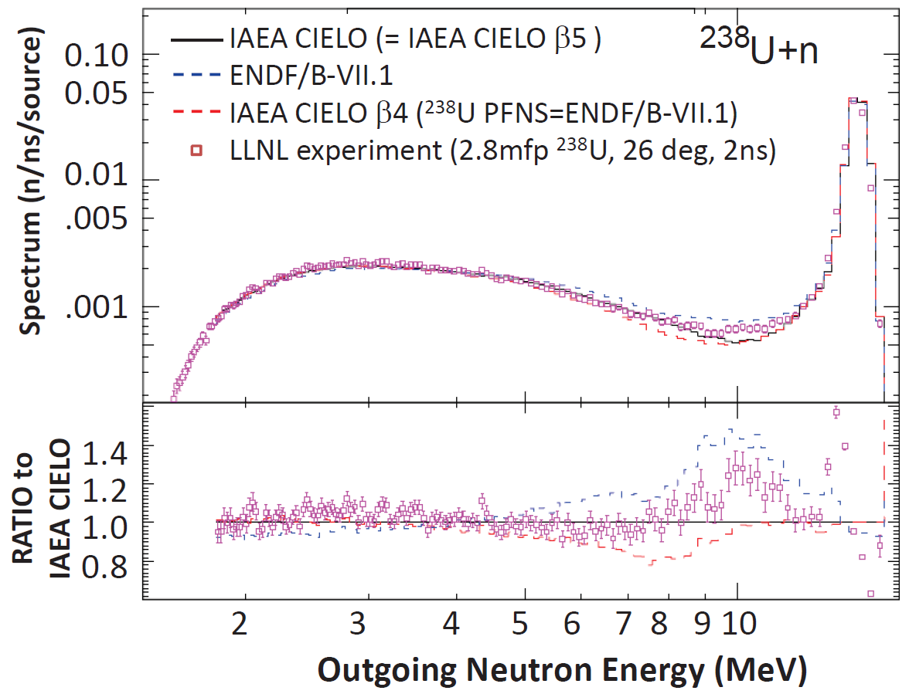
(IAEA CIELO)
U, 10x10x5, 60⁰
Similar to RPI
quasi-diff. results
(IAEA CIELO)

Slide 20
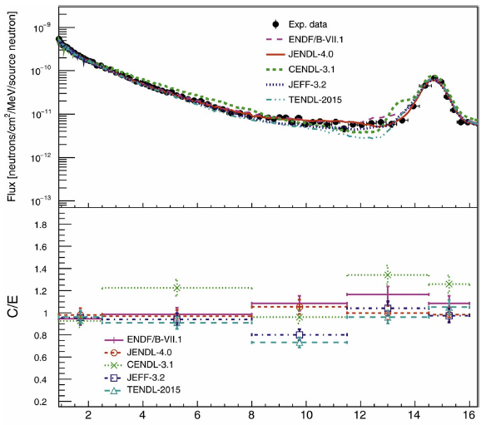
JENDL-4
U, 10x10x11 (thickest), 60⁰
Q. Sun et al, Fus. Eng. Des. 125 (2017) 9-17

Slide 21
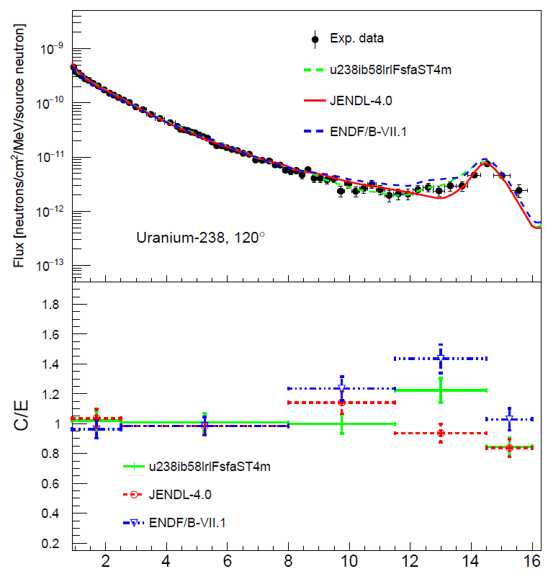
(IAEA CIELO)
IAEA CIELO
U, 10x10x5, 120⁰
(IAEA CIELO)

Slide 22
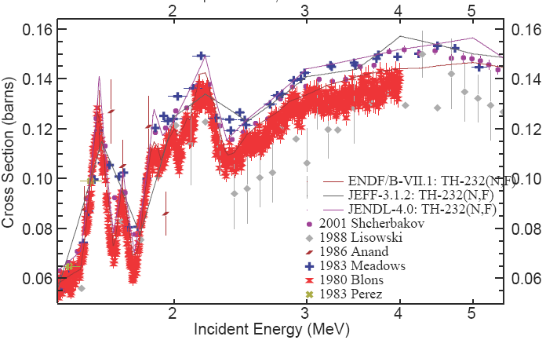
²³²Th evaluation discrepancy, new exp?

Slide 23
Summary
Reevaluation of the ²³⁸U inelastic to the continuum for 4-6 MeV excitation energy needed, experiments show larger cross sections at forward angles (direct reactions)
Reevaluation of ²³²Th of importance for Th/U fuel cycle

