Slide 1

⁵⁷Fe neutron inelastic scattering
The interplay between experiment and theory
A. Negret, C. Borcea, M. Boromiza, A. Olacel
Horia Hulubei National Institute for Physics and Nuclear Engineering, Bucharest-Magurele, ROMANIA
M. Sin
University of Bucharest, Faculty of Physics, Bucharest-Magurele, ROMANIA
R. Capote
Nuclear Data Section, International Atomic Energy Agency, Vienna, AUSTRIA
Ph. Dessagne, M. Kerveno
CNRS, Universite de Strasbourg, UMR7178, IPHC, Strasbourg, FRANCE
N. Nankov, A.J.M. Plompen, C. Rouki
European Comission, Joint Research Center, Geel, BELGIUM
IAEA, December 2017

Slide 2
A. Negret – 57Fe(n,n’)
Summary
⁵⁷Fe: why?
Experimental setup
Specific difficulties
Results
Conclusions
IAEA, December 2017

Slide 3
A. Negret – 57Fe(n,n’)
⁵⁷Fe: why?
Experimental setup
Specific difficulties
Results
Conclusions
IAEA, December 2017

Slide 4

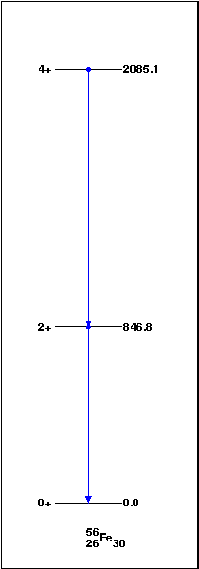
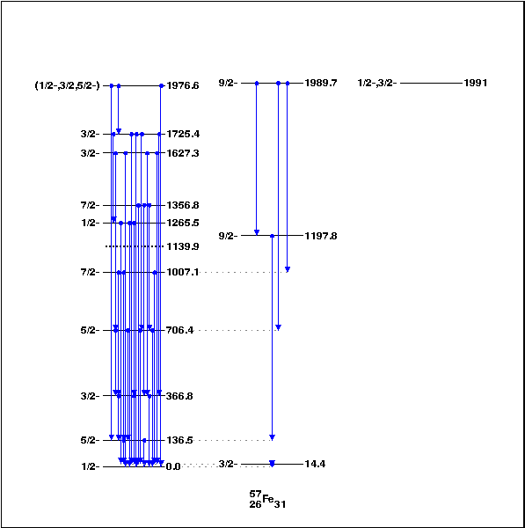
A. Negret – 57Fe(n,n’)
Why ⁵⁷Fe?
Iron is an essential structural material for all nuclear installations.
Inelastic scattering is the main mechanism allowing neutrons to slow down.
At small energies the inelastic scattering occurs only on ⁵⁷Fe.
IAEA, December 2017

Slide 5
A. Negret – 57Fe(n,n’)
Why ⁵⁷Fe?
Iron is an essential structural material for all nuclear installations.
Inelastic scattering is the main mechanism allowing neutrons to slow down.
At small energies the inelastic scattering occurs only on ⁵⁷Fe.
When a ^{nat}Fe target is used, at high energies the ⁵⁶Fe(n,nγ) is “contaminated” by ⁵⁷Fe(n,2nγ):
⁵⁶Fe + n
⁵⁶Fe* + n
⁵⁷Fe + n
⁵⁶Fe* + 2n
when E_{n} > S_{n}(⁵⁷Fe) = 7.6 MeV
IAEA, December 2017

Slide 6
A. Negret – 57Fe(n,n’)
⁵⁷Fe: why?
Experimental setup
Specific difficulties
Results
Conclusions
IAEA, December 2017

Slide 7
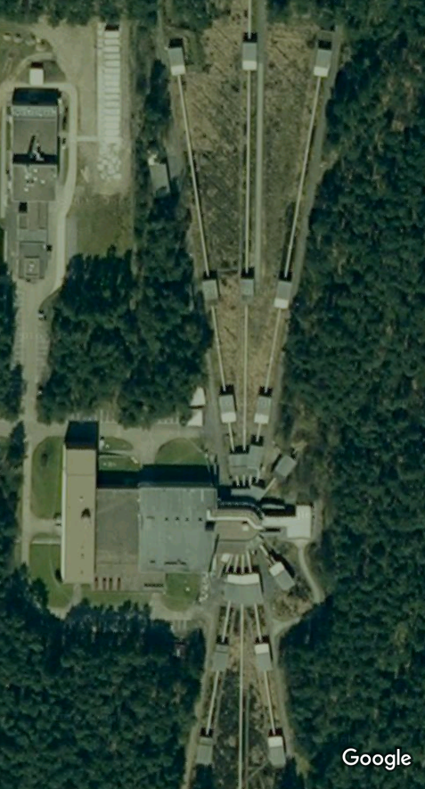
A. Negret – 57Fe(n,n’)
Experimental setup and method
Pulsed neutron source
GELINA of EC-JRC Geel
Sample to be measured +
detection system GAINS
Electron linac (140 MeV) + ²³⁸U target
Pulse width ~1 ns
Repetition rate: 800 Hz
Energy range: 0 – 20 MeV
Gamma flash from
bremsstrahlung
Flight path: 200 m
(~550 neutrons/cm²s)
200 m flight path
Neutron source
IAEA, December 2017

Slide 8
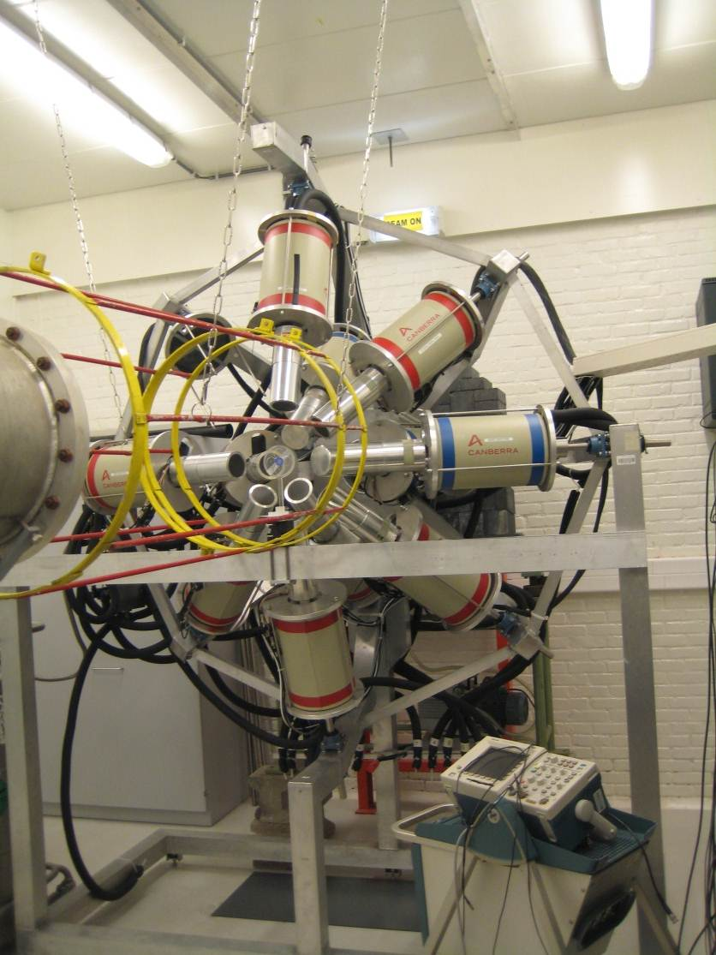
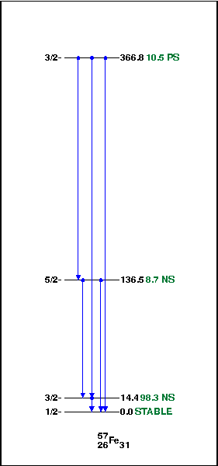
A. Negret – 57Fe(n,n’)
Experimental setup and method
GAINS: Gamma array for Inelastic neutrons scattering
12 HPGe detectors, able to measure:
Very precisely the energy of γ rays
The time of γ rays with a precision of 10 ns => neutron energy
One Fission Chamber (²³⁵U) for beam monitoring
Experimental method: γ spectroscopy + time of flight
Primary experimental result:
γ-production cross sections.
Then, knowing the level scheme, we determine:
Level cross sections
Total inelastic cross section.
IAEA, December 2017

Slide 9
A. Negret – 57Fe(n,n’)
⁵⁷Fe: why?
Experimental setup
Specific difficulties
Results
Conclusions
IAEA, December 2017

Slide 10
A. Negret – 57Fe(n,n’)
⁵⁷Fe: the problems
Issues:
expensive, very thin target (this is also the
case for ⁵⁴Fe).
first level at 14 keV.
conversion coefficient α = 8.5(3)
level half-life T_{1/2} = 98.3(3) ns
IAEA, December 2017

Slide 11
A. Negret – 57Fe(n,n’)
γ spectroscopy at 14 keV
14 keV
7 keV
IAEA, December 2017

Slide 12
A. Negret – 57Fe(n,n’)
⁵⁷Fe: why?
Experimental setup
Specific difficulties
Results
Conclusions
IAEA, December 2017

Slide 13
A. Negret – 57Fe(n,n’)
γ−production cross sections
IAEA, December 2017

Slide 14
A. Negret – 57Fe(n,n’)
What is missing?
The first transition (14.4 keV) could not be observed.
The total inelastic cross section could not be built.
IAEA, December 2017

Slide 15
A. Negret – 57Fe(n,n’)
Called a theoretician: “Help!”
If a consistent calculation could reproduce perfectly the γ−production cross sections that we measured then perhaps we could also trust the 14.4-keV γ-production cross section.
IAEA, December 2017

Slide 16
A. Negret – 57Fe(n,n’)
Tuned EMPIRE calculations
1. The nonelastic cross section was adjusted with an energy dependent factor (0.7 @ 0.1 MeV – 1 @ 3 MeV) in order to correct the optical model prediction.
2. Some level population cross sections were adjusted to compensate for the impossibility of considering a large number of transitions between discrete levels. This adjustment may also compensate for possible deficiencies of the level scheme (wrongly assigned J^{π} or branching ratios)
IAEA, December 2017

Slide 17
A. Negret – 57Fe(n,n’)
Total inelastic cross section…
… obtained as an interplay between experiment and theory
IAEA, December 2017

Slide 18
A. Negret – 57Fe(n,n’)
One more word:
the theoretical total inelastic cross section
IAEA, December 2017

Slide 19
A. Negret – 57Fe(n,n’)
⁵⁷Fe: why?
Experimental setup
Specific difficulties
Results
Conclusions
IAEA, December 2017

Slide 20
A. Negret – 57Fe(n,n’)
Conclusions
We performed a ⁵⁷Fe(n,n’) cross section measurement using γ spectroscopy,
The first transition in ⁵⁷Fe, Eγ=14.4 keV remained inaccessible,
We called a theoretician and asked for help,
The theoreticians did their best and tuned EMPIRE predictions on the experimentally determined γ-production cross sections,
We generated a kind of hybrid nuclear data, as an interplay between experiment and theory,
We still wish to measure the 14.4-keV transition:
  ⁵⁷Fe(p,p’γ) at IFIN-HH,
  ⁵⁷Fe(n,n’γ) at JRC-Geel, with planar detectors.
IAEA, December 2017

Slide 21
A. Negret – 57Fe(n,n’)
One word on ¹⁶O inelastic: ¹⁶O(n,n’) and ¹⁶O(p,p’)
E_{γ} = 6128.6 keV
¹⁶O(n,n’γ) ¹⁶O(p,p’γ)
PRELIMINARY DATA
IAEA, December 2017

