Slide 2
JEFF, EU-projects and JRC involvement
Arjan Plompen
IAEA, 18 December 2017

Slide 3
Contents
JEFF and CIELO
EU projects
JRC involvement

Slide 4
Short history
JEFF – 3.2, 5 March 2014.
JEFF – 3.3T0/T1, 19 Feb 2016 (Decision Nov. 2015).
JEFF – 3.3T2, June 2016
JEFF – 3.3T3, March 2017
JEFF – 3.3T4, June 2017
JEFF – 3.3, 20 November 2017
JEFF – 4.0, time frame to discuss (2020-2022)

Slide 5
JEFF-3.3 is a substantial change
New major actinides (Morillon, Romain, De Saint Jean, Leal)
New thermal scattering data (April 2017, Cantargi, Granada , Marquez Damian, Noguere)
Radioactive Decay Data File (Oct. 2016, M. Kellett & O. Bersillon, JEF/DOC-1792)
New FY file (UKFY3.7)
New covariances, larger subset of MTs, some proposals still not ENDF format
Removal of legacy files, update of adopted files to latest release.
Increased reliance on TENDL for completeness and decay heat (D. Rochman, M. Flemming)
Improved gamma-data and energy balance for emission (C. Jouanne, R. Perry, G. Noguere, O. Serot, …)
Restoration of 8 group structure for delayed neutrons (P. Leconte)
New Cu files (Pereslavtsev, Leal)
Many issues resolved (many contributors)

Slide 6
JEFF-3.3 is a substantial change
g,p,d,t,h,a files TENDL-2017
Activation file TENDL-2017
dpa file, KIT/Konobeev (modifications to transport files UNED/Sauvan)

Slide 7
JEFF-4.0
We want JEFF-4 to be a fundamental change
Best knowledge for users
Completeness
Agreed ways of integrating contributions
Version and documentation control
Use modern tools for inspection and checking
Use modern tools for benchmarking and validation
Eliminate limitations (formats, correlated emissions)

Slide 8
Challenges for evaluated data libraries
Evaluated Best available knowledge for the user.
Completeness All available knowledge for the user.
Reliability Success should be independent of the application.
Accuracy Uncertainties less than 5%, 2%, … 0.3%.
Covariances Users need to know how good the data are. They need to handle that knowledge quantitatively for propagating uncertainty and for safe margins.

Slide 9
Best available knowledge.
Best science, as complete as we can, for applications
  Either from models or from experiment.
  Evaluators must judge which should prevail.
  We must master assembling files with best input for its parts.
  Checking is absolutely essential.
  Automation will continue to mature further as a means.

Slide 10
Success stories in our field: ND standards
Carlson et al. NDS110(2009)3324
R-matrix Wigner et al.
GLSQ
GLSQ fit of tables to many data
R-matrix model fit to many data
¹H(n,n), ⁶Li(n,t), ¹⁰B(n,α), ^{nat}C(n,n), ¹⁹⁷Au(n,g), ²³⁵U(n,f), ²³⁸U(n,f)
²³⁸U(n,g), ²³⁹Pu(n,f)

Slide 11
Mosteller suite testing of JEFF-3.3Tn
F. Michel Sendis (NEA)

Slide 12
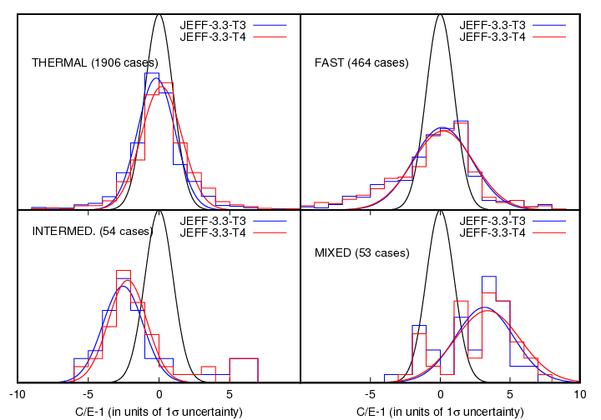
JEFF-3.3Tn testing against ICSBEP
S. van der Marck (NRG)

Slide 13
Best available knowledge
We need to agree on what we know best and how to reflect that in the files.
We should compromise as little as possible.

Slide 14
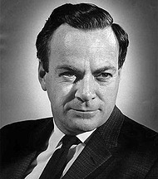
Theory, experiments, evaluation
“It doesn't matter how beautiful your theory is, it doesn't matter how smart you are. If it doesn't agree with experiment, it's wrong”
“We have learned a lot from experience about how to handle some of the ways we fool ourselves. One example:
  Millikan measured the charge of the electron by an experiment with falling oil drops, and got an answer which we know not to be quite right.
  It’s interesting to look at the history of measurements of the charge of the electron, after Millikan. If you plot them as a function of time, you find that one is a little bigger than Millikan’s, and the next one’s a little bit bigger... until finally they settle down to a number which is higher.”
“... when you have a wide range of people who contribute without looking carefully at it, you don’t improve your knowledge of the situation by averaging.”
R.P. Feynman
1918-1988

Slide 15
List of best knowledge: experimental - μ
Neutron data standards (new release)
Derived data standards (new release; ²³⁸U(n,g), ²³⁹Pu(n,f))
Thermal constants (new release)
IRDFF dosimetry reactions
Supporting datasets: nu-bar(E_{n}), total cross sections, scattering lengths, fission, nu-del, spectrum, capture, scattering, secondary emission … data. (depending on uncertainty and database consistency)

Slide 16
Best knowledge – modeling - completeness
A>20?: TALYS / TENDL
Light nuclei: no single solution
  np many solutions, nd standard is only one
  pp many solutions, we should pick one
  gd, nd, pd many models, good database
  g/n/p/d/a+(^{3,4}He, ^{6,7}Li, ⁹Be, ^{10,11}B, ^{12,13}C, ¹⁶O, ¹⁹F, ²³Na, ^{24,25,26}Mg, ²⁷Al, ²⁸Si)
^{24,25,26}

Slide 17
Best knowledge – modeling - completeness
Incident particle libraries
  TENDL has g,n,p,d,t,h,a libraries
  Of interest to
    fission applications (certainly g,n,p,a)
    fusion (multistep activation,radiation source term)
    accelerator applications
    Medical applications

Slide 18
Best knowledge – modeling - completeness
Libraries limit completeness
  Random files
  Format limitations (strive to eliminate)
  Correlated sequential/instantaneous emissions
  Covariances for FY, thermal scattering, …

Slide 19
Fission yields
Support for new evaluation is very fragile
Considerable new experimental and modeling efforts
Database needs to be secured
Evaluation process needs to be secured
Alignment with radioactive decay data evaluation is critical
Completeness is possible using GEF
Resolution needed between accuracy from experiment and complete modeling (similar to reaction evaluations)

Slide 20
Radioactive decay data
Support for new evaluation is very fragile
Considerable new experimental efforts
New experimental data are only partly used
Evaluation process needs to be secured

Slide 21
Nuclear mass, structure and decay
Lacking a systematic approach
Masses
  AMDC to be adopted
  Complement with NACRE/Goriely for exotic nuclei?
Nuclear structure and decay (gamma and neutron)
  No consistent approach
  TALYS/TENDL uses an ENSDF subset provided through RIPL
  Consistency with RDD evaluation not automatic and should be enforced
  ENSDF evaluations vary in quality and reliability

Slide 22
Thermal scattering
Important new modeling developments.
Some new experimental data.
Only partly on board in JEFF-3.3.
We should fully adopt the new modeling as it is supported by old and new data, better than JEFF-3.3.
Use available covariance information.

Slide 23
List of priority issues to work on
Major actinides
Minor actinides
Structural materials
Fission products
Materials of interest to accelerator, medical, security applications
Automation
File generation

Slide 24
Two step approach
Evaluation based on microscopic data only
Associated covariances + TENDL approach (weights)
Evaluation including adjustment to integral data
Careful checking this works without inadvertent distortion
Works like high accuracy ratio data (k-eff)
Include more than k-eff alone

Slide 25
We need your priority issues and work program for JEFF-4
We encourage you to use the HPRL to express them.
This is very important as the HPRL has been instrumental in getting EU ND programs funded. It is again central in the new call for ND projects by the EC (DG-RTD).
We should take the unique opportunity of the 26 October call with deadline 27 September 2018 to align JEFF development with EU projects.

Slide 26
EURATOM Work program 2018
Info day, 9 November 2017, EC/CDMA, Brussels
European Commission Decision C(2017)7123, 27 October-2017 http://ec.europa.eu/research/participants/data/ref/h2020/wp/2018-2020/euratom/h2020-wp1820-euratom_en.pdf
NFRP-2018-4: Improved nuclear data for energy and non-energy modelling applications
NFRP-2018-7: Availability and use of research infrastructures for education, training and competence building

Slide 27
JEFF-4
We need to build our bridge between science and application together in our mutual interest.
Looking forward to your ideas and contributions!

Slide 28
JRC contribution
Experimental work
Fe
Fe-54(n,n’g), Fe-57(n,n’g), Fe-54(n,n), Fe(n,n)
Possibly: Fe-56(n,n’g) and Fe-56(n,n)
Possibly: transmission of Fe vs thickness

Slide 29
JRC contribution
Experimental work
Uranium-238
(n,g) above 100 keV.
Evaluation process (GMA, uncertainties, covariances)

Slide 30
JRC contribution
Experimental work
Au(n,n’g) (standard)
Evaluation process with GMA: unc/cov analysis

Slide 31
JEFF-CIELO-JRC-EU
Collaboration should improve
Actinides cannot be treated separately in the final analysis (benchmark performance)
Background should be set before fine adjustment of actinides (O, tsl, …)
Theory developments to finalize before final stage
Integration of work, automation thereof has priority
Considerable MA work not on board
Considerable FY & DD work not on board

