Slide 1
A Short Presentation on some the Progress Made since WPEC Sub-group 25
A.A. Sonzogni, E.A. McCutchan
National Nuclear Data Center, BNL
P. Dimitriou
Nuclear Data Section, IAEA

Slide 2
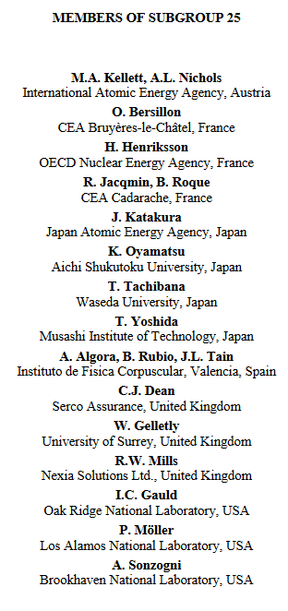
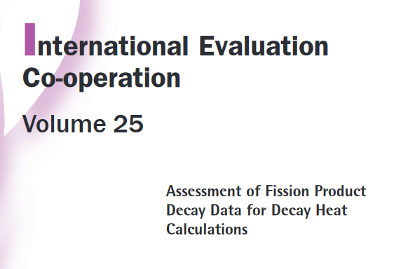
International Collaborations in Nuclear Structure and Decay Data

Slide 3
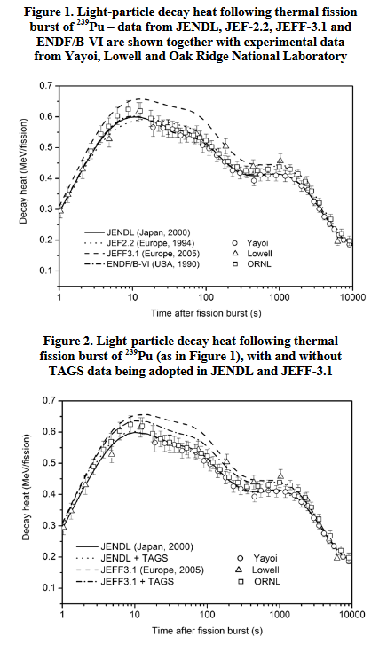
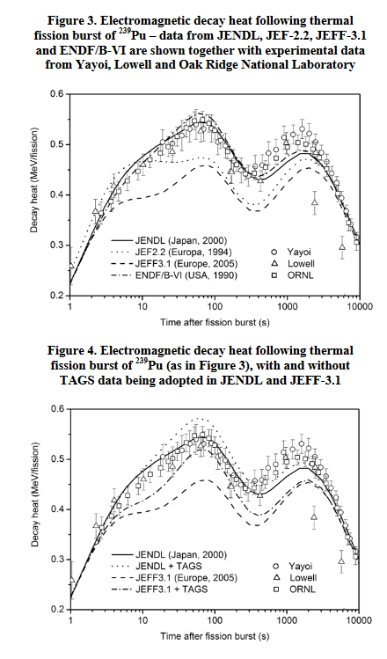
Background:
Effects of TAGS data from Greenwood et al. (INL) to better predict decay heat.
A priority list of nuclides with deficient decay data was produced.

Slide 4
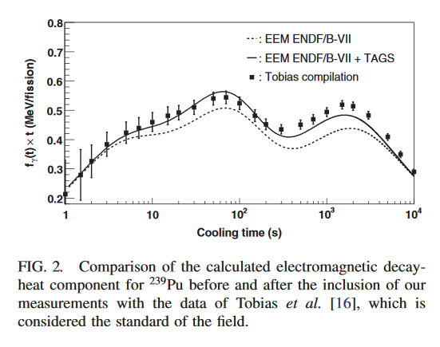
Results:
Considerable improvement in the ²³⁹Pu decay heat improvement just by improving the decay data of 7 nuclides:
^{102,104,105,106,107}Tc, ¹⁰⁵Mo, and ¹⁰¹Nb

Slide 5
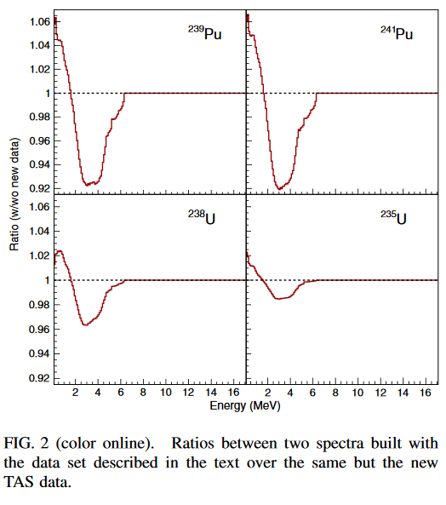
Spin-off:
Improved agreement with measured electron spectra following fission → relevant to reactor antineutrino experiments.

Slide 6
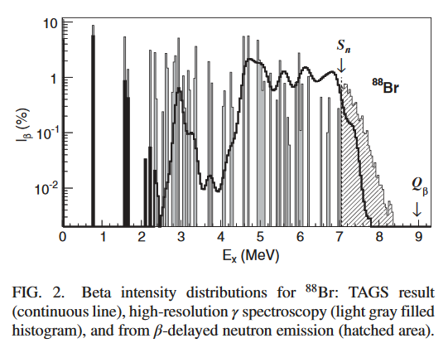
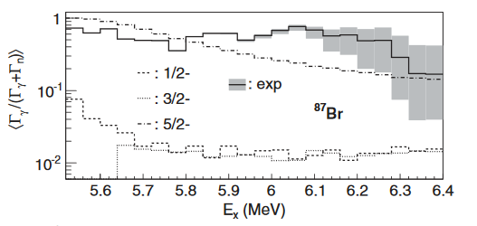
Another Spin-off:
Realization that the competition between gamma and neutron emission has shell effects.

Slide 7
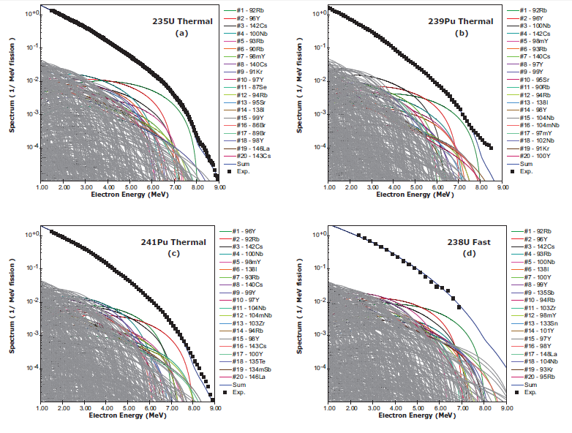
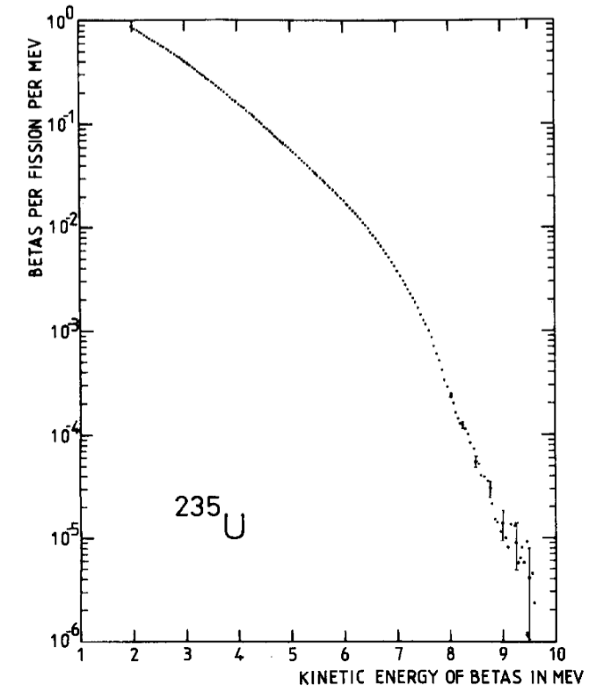
ENDF/B-VIII.0 Decay Data
Effect of including TAGS data in electron spectra
K. Schreckenbach et al., PLB 160, 325 (1985)
A.A. Sonzogni, T.D. Johnson, E.A. McCutchan, PRC91, 011301(R) (2015)

Slide 8
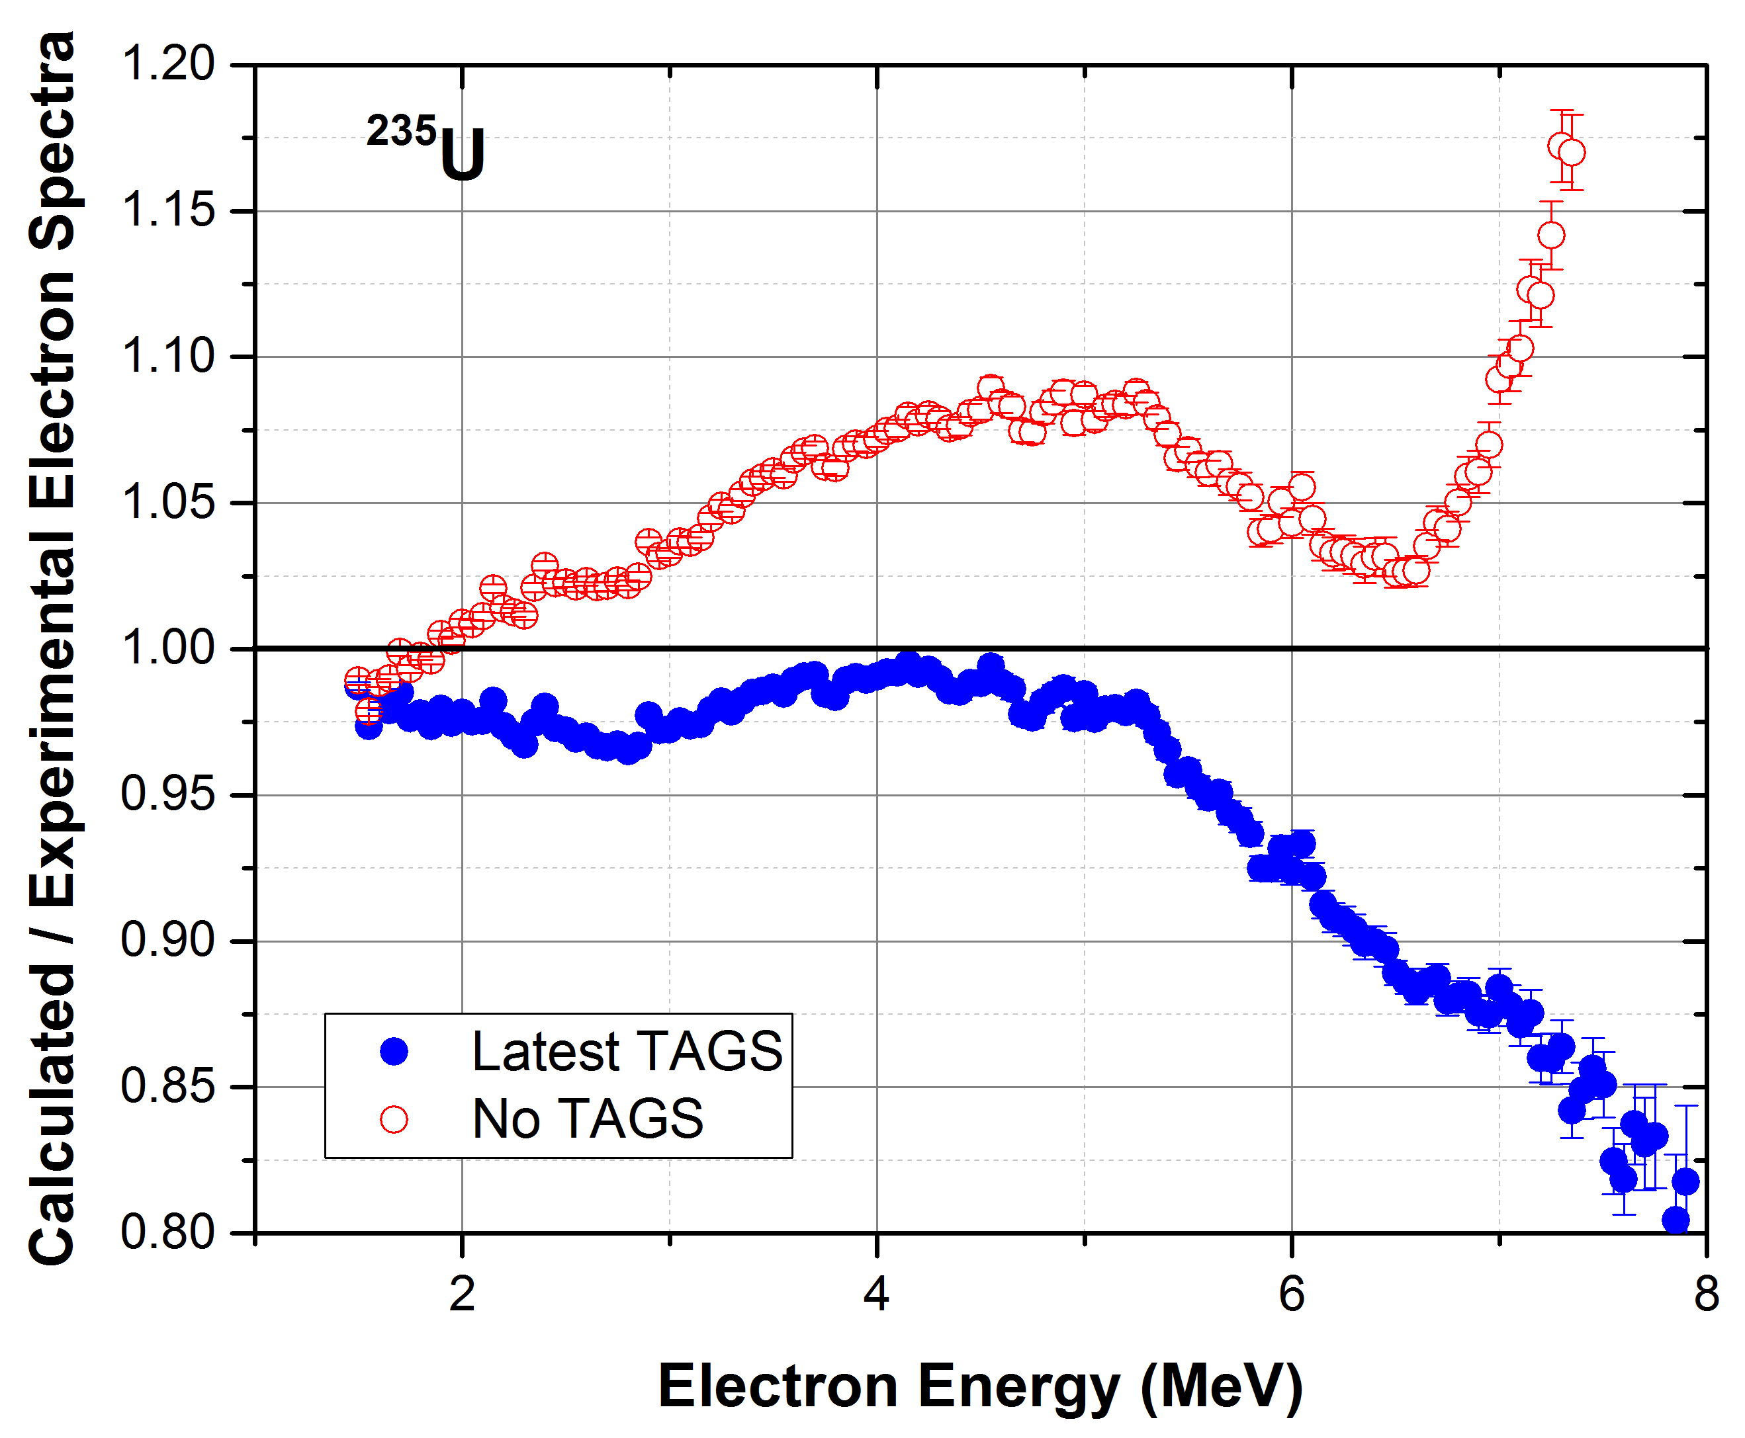
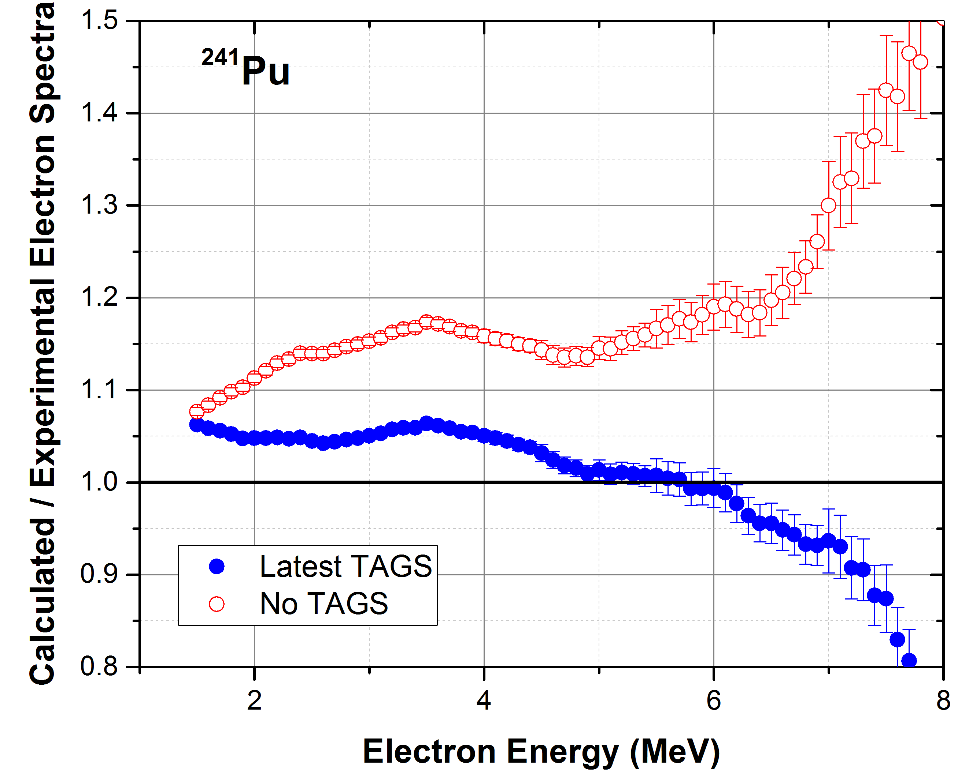
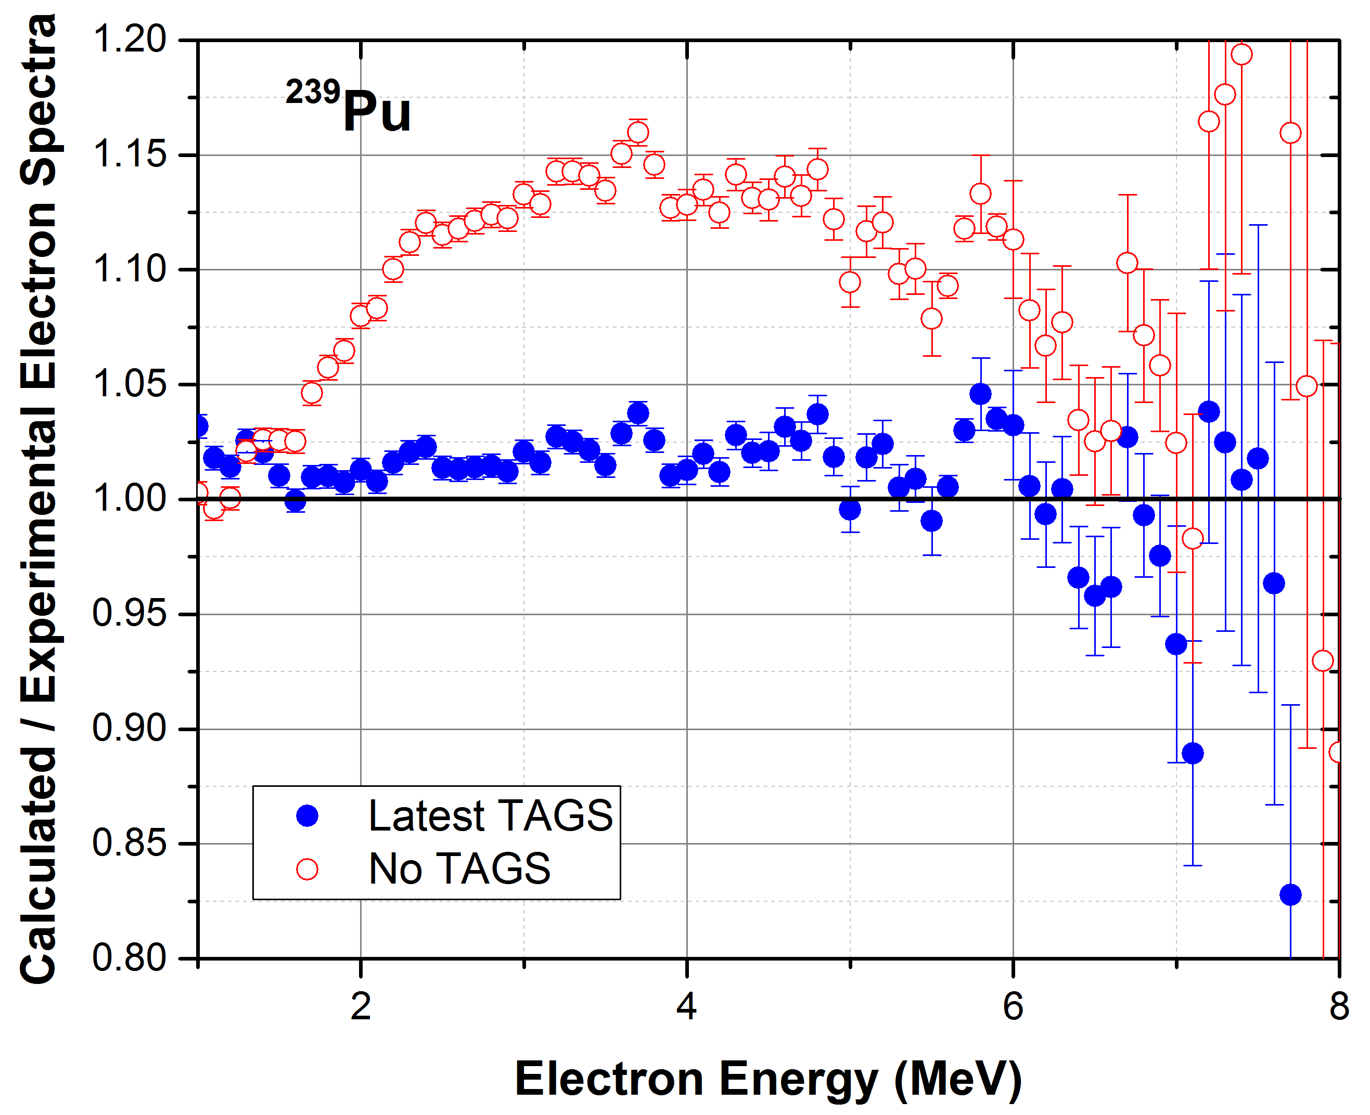
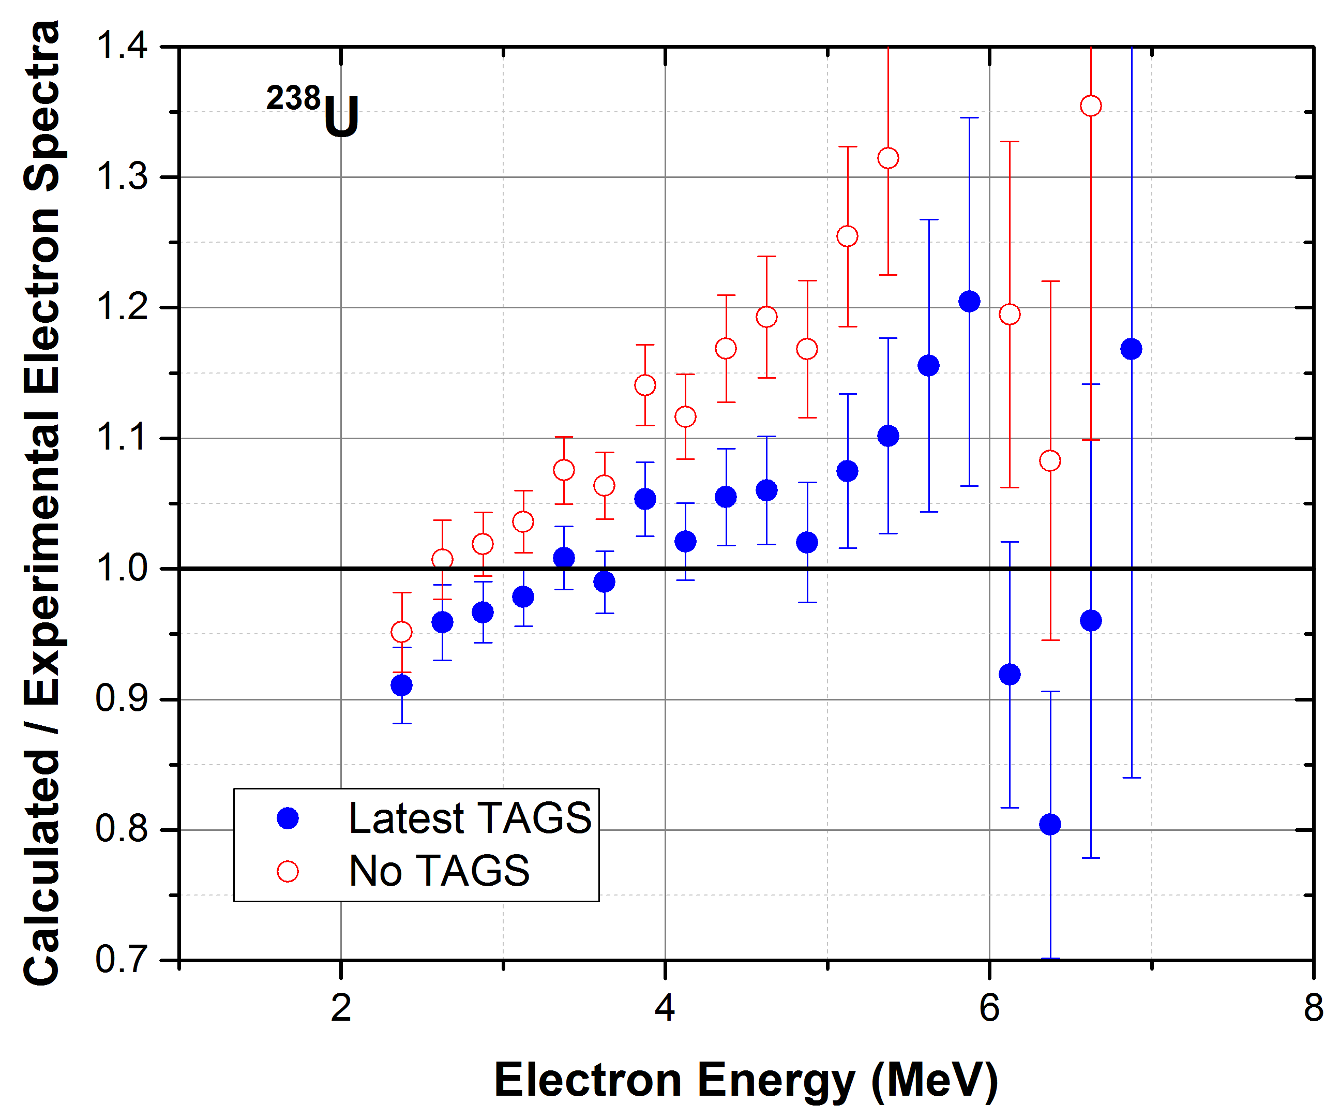
ENDF/B-VIII.0 Decay Data
Effect of including TAGS data in electron spectra

Slide 9
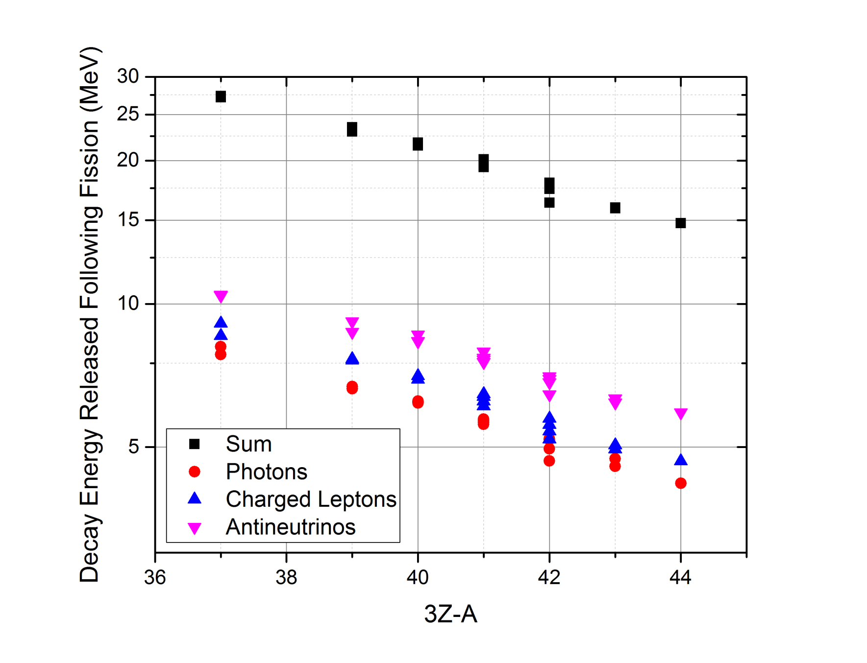
ENDF/B-VIII.0 Decay Data
Effect of including TAGS data, improved Total Decay Energy and EEM, ELP and EAN systematics

Slide 10
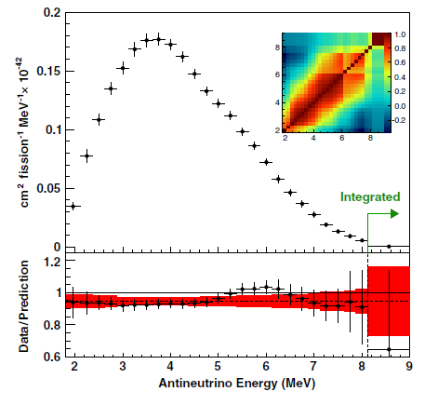
Where do we need Fission Yields and Decay Data?
Latest Daya Bay Antineutrino Spectrum
Missing 5.4 +- 2.2% of the total number of electron antineutrinos at around 500m from the reactor. Consistent with earlier analysis of reactor experiments.
This deficit is not accounted for in the three flavors oscillations.
There is a distortion in the energy spectrum with respect to the prediction.
F.P. An et al, PRL 116, 061801 (2016)

Slide 11
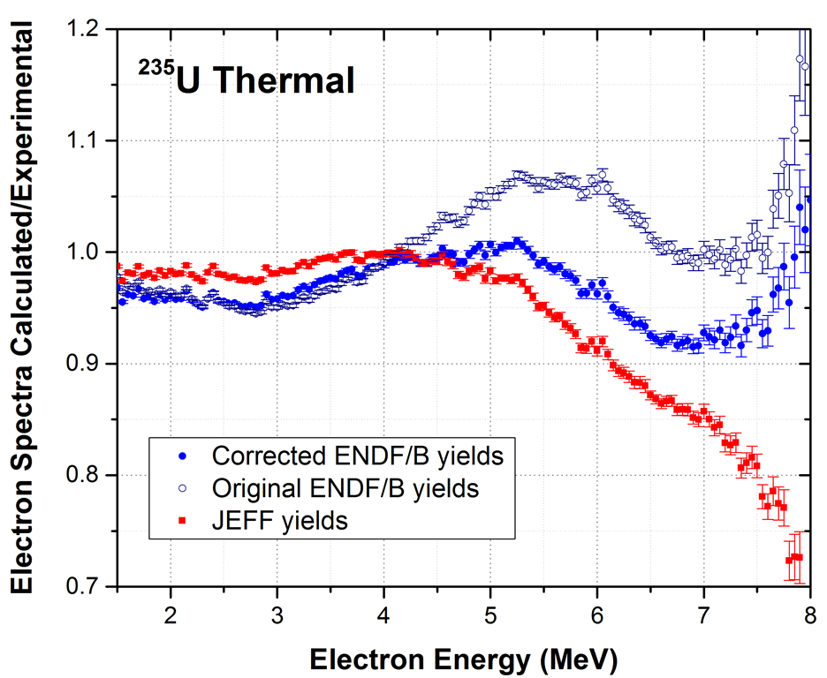
Fission Yield Effects
It has been known for a while that ENDF/B and JEFF fission yields were producing different results.
We perform corrections to the ENDF/B yields to account for a) better decay data, b) improved isomeric ratios, c) anomalous yields.
With corrected yields:
No electron excess
Better agreement with JEFF yields.
A.A. Sonzogni, E.A. McCutchan, T.D. Johnson, P. Dimitriou, PRL 116, 132502 (2016).

Slide 12
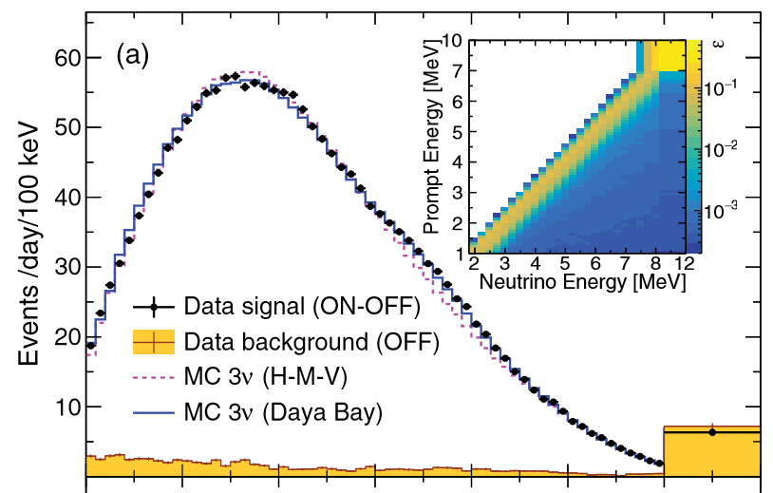
Fine Structure
(FY and decay data together)
NEOS data, 30 m from a power reactor
There seems to be structure?
Ko et al, PRL 118, 121802 (2017)

Slide 13
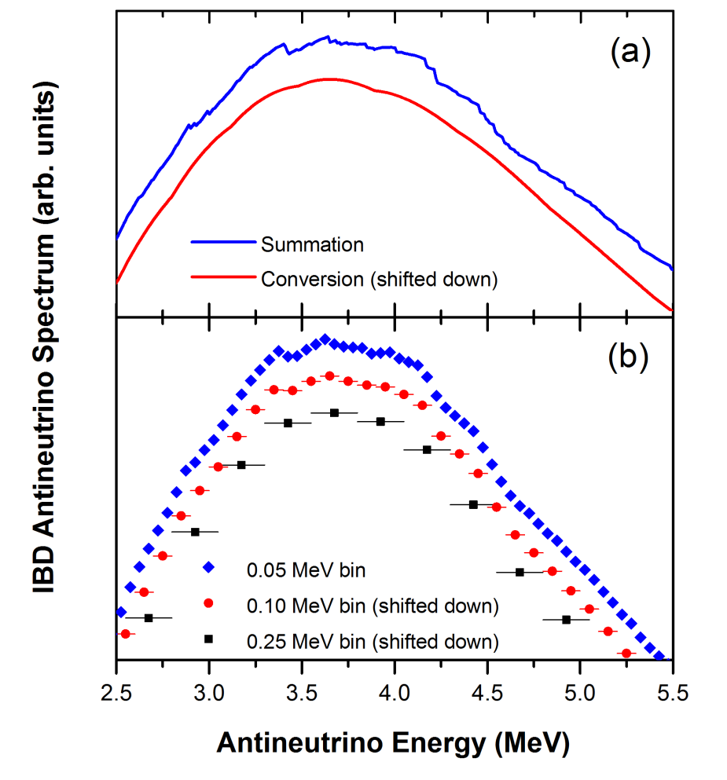
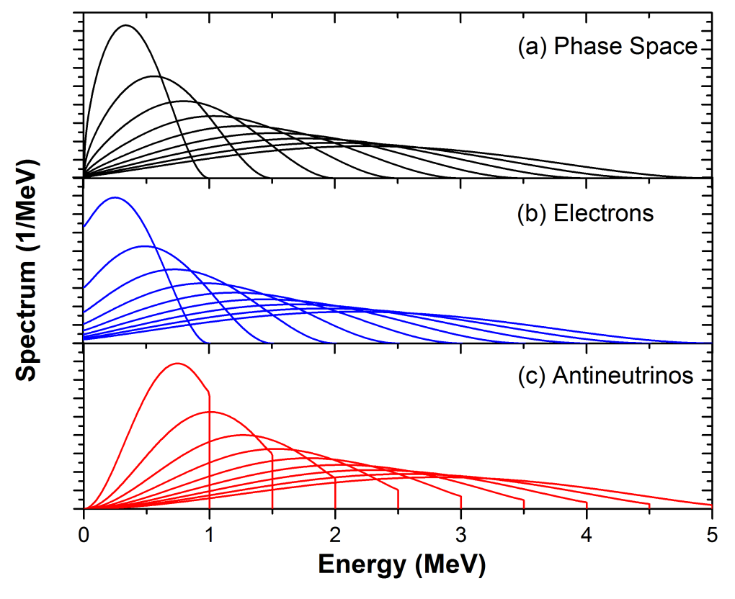
Fine Structure in Antineutrino Spectrum
Electron Spectrum:
Fermi Function
Other corrections

Slide 14
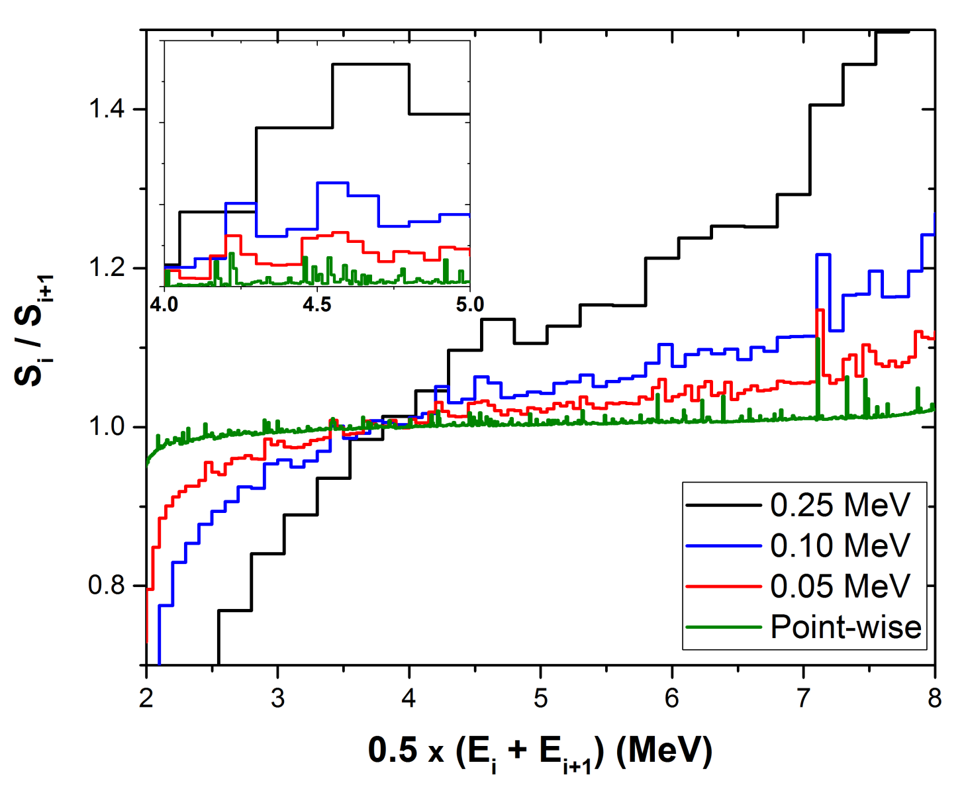
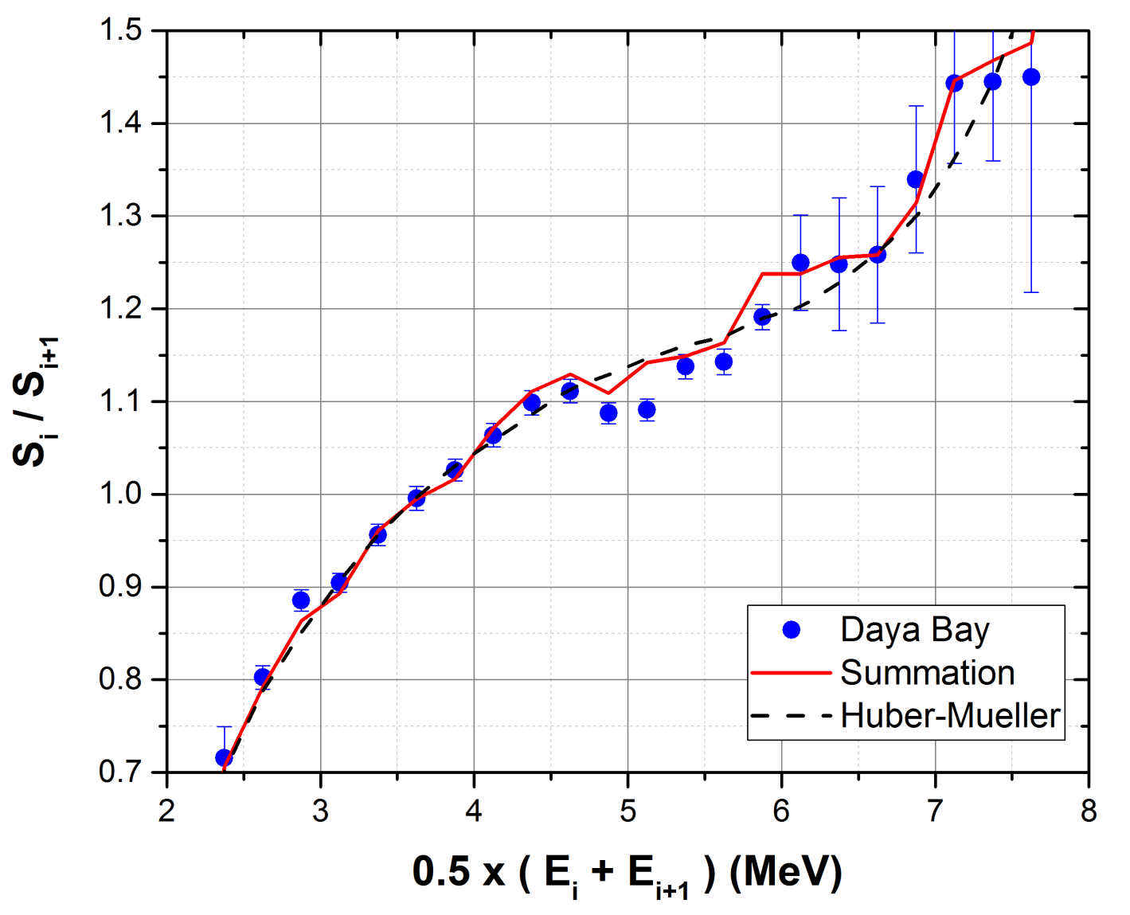
How to reveal Fine Structure?
Ratio of adjacent points:
R_{i}=S_{i}/S_{i+1}
Surprisingly, even with a 0.25 MeV binning a structure can be seen.
Structure observed in Daya Bay data, covariance matrix crucial for analysis.

Slide 15
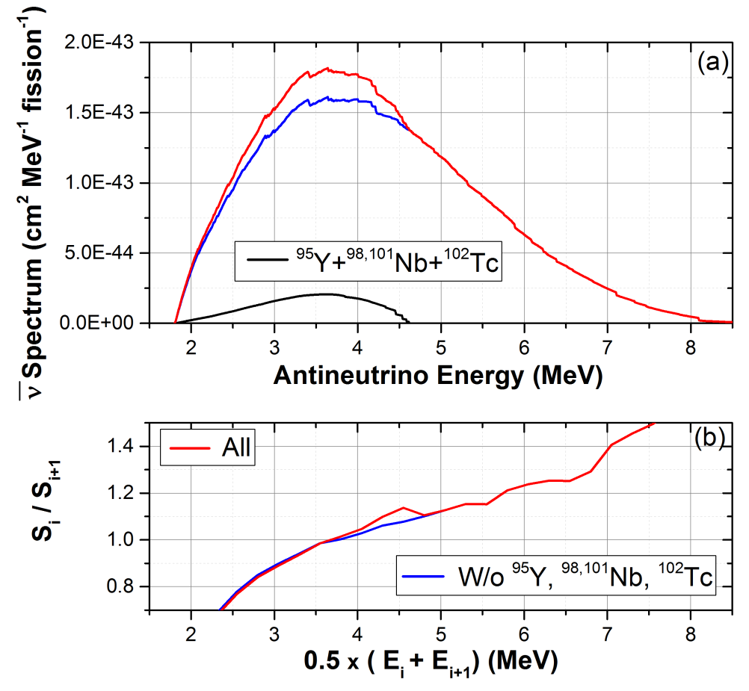
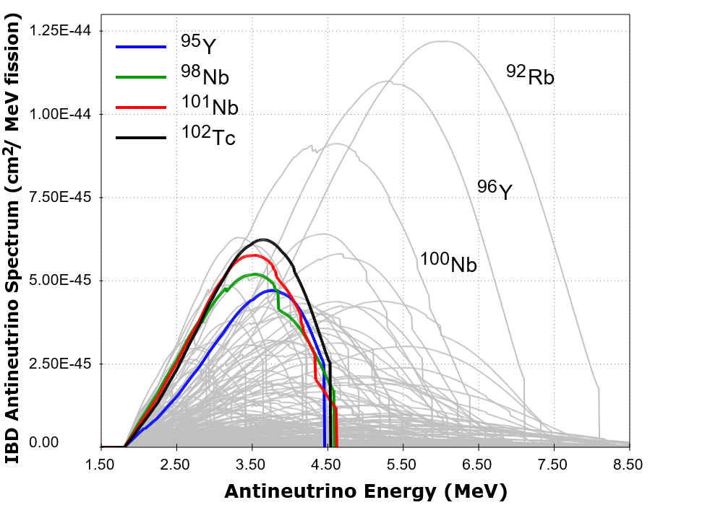
Nuclides behind fine structure
Incidentally, ¹⁰²Tc yields in ENDF/B need to be corrected.
For more details, see:
A.A. Sonzogni, M. Nino, E.A. McCutchan arXiv:1710.00092

Slide 16
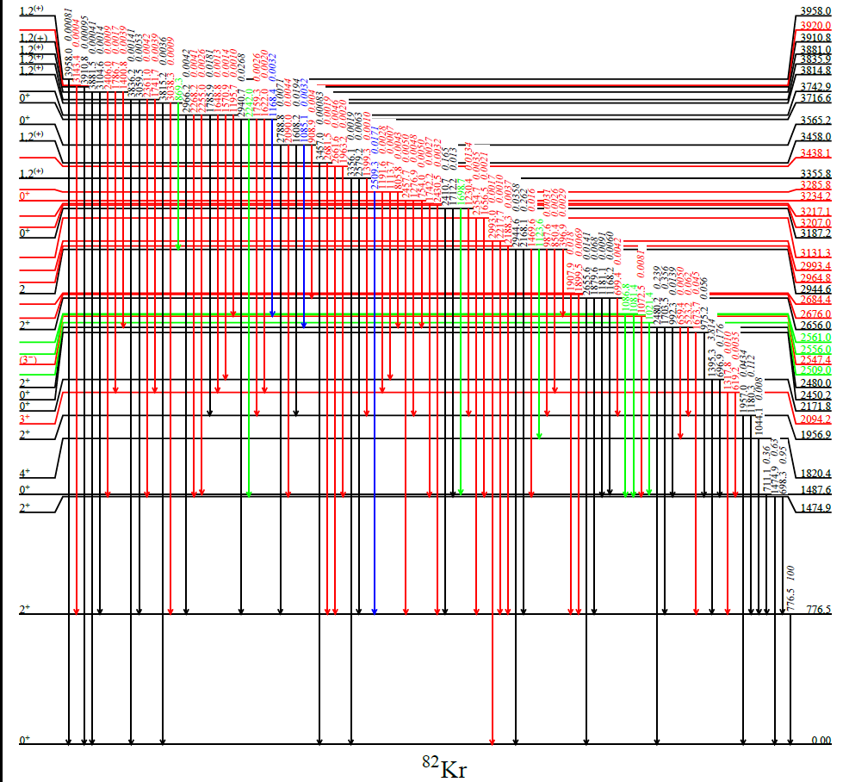
Highly precise decay data for medical radioisotopes
Experimental campaigns by BNL and ANL to improve the decay data for radionuclides used in nuclear medicine. Some results already in ENSDF.
Example, revised decay scheme of ⁸²Rb
New
Confirmed
Removed
Moved
M. Nino et al, Phys. Rev. C 93, 024301 (2016).

Slide 17
Conclusions
Updated the VII.1 decay data sub-library for VIII.0
Plan a major upgrade in VIII.1, including the latest T_{1/2} and P_{n} values from the IAEA CRP
Will also include the recent results on precise decay measurements for medical isotopes.
Decay Data link Independent Fission Yields and Cumulative Fission Yields.
Looking forward to participate in the future IAEA CRP on Fission Yields.

