Slide 1
Nuclear Evaluation Issues at LLNL
− some preliminary considerations
CIELO2 Inaugural Meeting,
IAEA Vienna, Austria.
Ian Thompson
December, 2017

Slide 2
Data Issues . . .
Specific targets
  ⁹Be, ²³³U, ²³⁸Pu, minor actinides
  Charged-particle reactions (e.g. R-matrix resonances)
Classes of Reactions
  (n,n’) direct to states with E* ≈ 2 – 5 MeV (e.g. in actinides)
  (n,γ) primary gammas for neutron energies above thermal.
  Breakup reactions (e.g. with d, ⁶Li, ⁷Li, ⁹Be, . . . above thresholds)
New Data
  Correlated emissions (e.g. energies, angles, sequences, times, . . .)
What new experiments, what new evaluations?
  ²³³U(n,2n), ²³⁸U(n,γ), ²³⁵U(γ,f), ²³⁸U(γ,f), ²³⁹Pu(γ,f), ²⁴⁰Pu(γ,f) at HIGS ?
Need better validated covariances (not discussed)

Slide 3
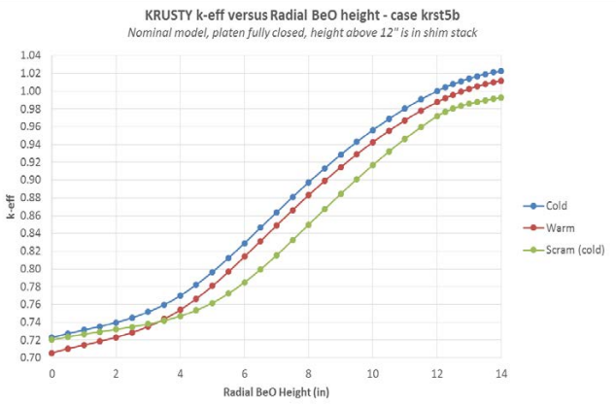
Specific targets: n + ⁹Be
From the ENDF/B-VIII.0 paper:
In sharp contrast to the Fe bearing assemblies noted above
  there is considerable spread in these Be assembly results.
  It is difficult to imagine what combination of nuclear data changes could reduce this spread and
  it seems more likely that new criticality experiments done to modern QA standards are needed
KRUSTY - using BeO in kilopower reactors for NASA:
Calculations
still topical.
https://beyondnerva.wordpress.com/2017/11/19/
krusty-first-of-a-new-breed-of-reactors-kilopower-part-ii/

Slide 4
Specific targets: n + ²³³U
(maybe)
No (n,2n) or (n,n’) data
  Except (n,n’) to 40 and 92 keV inelastic states.
  ENDF/B-VIII.0 adapted from JENDL-4
This makes it difficult to constrain Hauser-Feshbach models at fast energies and above.
Problem: ²³³U(n,2n) ²³²U* does not produce many distinctive gammas for easy identification inactivation measurements e.g. at TUNL

Slide 6
Charged-particle Reactions
Charged-particle reactions should be included in our premier nuclear reaction databases.
  Needed for many applications in materials sciences and NIF diagnostics.
Existing evaluations:
  IBANDL libraries already at IAEA, but not integrated with ENDF.
  LLNL and LANL have their own evaluations, some now contributed.
  Future work should use best-practice R-matrix evaluations,
  matched to Hauser-Feshbach models for higher incident energies.
IAEA already has consultants meetings for these purposes.
  Plan better integration with ENDF and GNDS data formats.

Slide 7
Classes of Reactions: (n,n’)
Actinide evaluations often have
(n,n’) reactions to ‘fake states’.
  These are 2+ and 3- states above
  most known discrete levels, to 5 MeV
  Calculated in simplified DWBA with
  β₂ or β₃ strengths parameters
  fitted e.g. to Baba (n,n’) data for ²³⁸U.
These reactions contribute to (n,n’) cross sections,
but by a direct pre-equilibrium process.
  These cross sections are top-sliced from reaction cross-section
  before compound-nucleus decays are calculated.
  Changes the pie before fission and statistical (n,n’) decays compete!
    Fission is changed, but with no changes to fission barriers
  Makes it much easier to fit fission data for a 1st/2nd/3rd chance chain.
But why are they there! What theory predicts them?
  Dupuis et al (PRC, 2011) explain them with RPA excitations for ⁹⁰Zr and ²⁰⁹Pb targets.
  Need generalization and extension to deformed actinides.
  Extrapolate to minor actinides?

Slide 8
Classes of Reactions: primary (n,γ)
Primary gammas are the most distinctive product of neutron reactions on nuclei, especially for fast neutrons above thermal.
ENDF/B-VIII.0 has improved gamma production data.
  For example n + ²³⁵U evaluation has clearer primary and decay data.
Can we do the same for other targets?
Are experiments sufficient?

Slide 9
Delayed Fission Gamma & Neutron Emissions?
(DFNS and DFGS)
DFNS exists.
But the data are very noisy,
Poor at low emission energies.
DFGS do not exist.
But would be very useful for experiment and detector modeling.

Slide 10
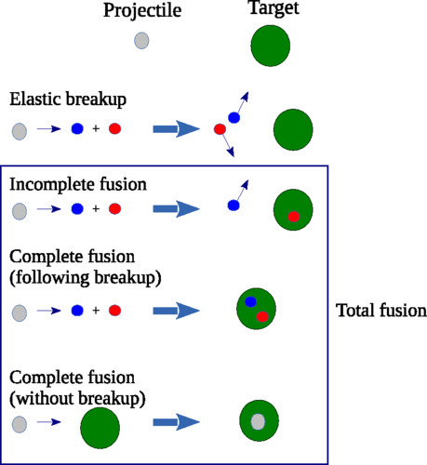
Data for nuclear exit correlations
Nuclear Evaluations with Exit Correlations
  Energy correlations to conserve energy (in each event)
  Angular correlations to conserve momentum
  Details of deuteron reactions on targets:
    Breakup, partial fusion, complete fusion, transfer reactions
    Need to know which compound-nucleus produced ---
  Triple-differential cross-sections of breakup & (n,2n)
So far, we have only ‘singles’ distributions
  Conserve energy and momentum only on average
  Easier to put correlations in Monte-Carlo simulations than Sn.
  Kalbach-Mann pre-equilibrium based on systematics, not theories.
One step:
  Extend data formats to include triple-differential cross sections d³𝛔/dE_{p}d𝝮_{p}d𝜙

Slide 11
Breakup Reactions
Breakup reactions produce correlated 3-body final states
  Reactions with d, ⁶Li, ⁷Li, ⁹Be soon put us above thresholds for breakup.
Some of these can be approximated by cascading 2-body decays
  Used at LLNL for d + α breakup via {⁵He ⇾ α+n} or {⁵Li ⇾ α+p} decays.
  Brune, Hale et al have extend R-matrix theory to these reactions
    recently for the t+t ⇾ α+n+n reaction.
When these can be described in evaluation formats,
then we are encouraged to calculate models to fit data,
and contribute comprehensive cross sections to data libraries.
So far, many R-matrix evaluations stop at 3-body thresholds.
Maybe use 3-body models from few-body physics researchers:
  For example: hyperspherical harmonic expansions.

Slide 12
Conclusions
These are some of the open problems seen at LLNL.
  I have not mentioned fission reactions.
We need to discuss which can be solved by
  New evaluations
  New experiments.

