Slide 1
On Cross Section Correlations, Uncertainty Reduction and Calibration from Integral Data
A.Trkov, R.Capote, O. Cabellos
IAEA, Vienna, Austria
ETSII/UPM Madrid, Spain

Slide 2
Background
Current IAEA CIELO covariances based on measured differential data lead to large uncertainties in criticality benchmarks (Δk_{eff}~1-2%)
Small calibration of mean values have been employed to improve C/E without changing ND uncertainties
Close alignment with benchmark values does not mean low uncertainty (e.g., HEU bare assemblies have a spread of ~1.5% in spite of quoted low uncertainties)
Some correlations are not present in differential data, but appear only when integral data are introduced
e.g., nu-bar and fission cross section
Such correlations are (likely) benchmark-dependent
Such correlations reduce Δk_{eff}

Slide 3
Model
Consider a grossly simplified 1-group toy model of a criticality benchmark:
$$k_{eff}=\frac{υΣ_{f}}{Σ_{f}+Σ_{c}+Σ_{i}+L}$$
f=fission; c=capture; i=inelastic, L=leakage
Consider 3 benchmarks:
Godiva (<E>=700 keV, very hard spectrum)
Big_Ten (<E>=40 keV, hard spectrum)
HISS (<E>=1 keV, soft intermediate spectrum)
Eq. (1):

Slide 4
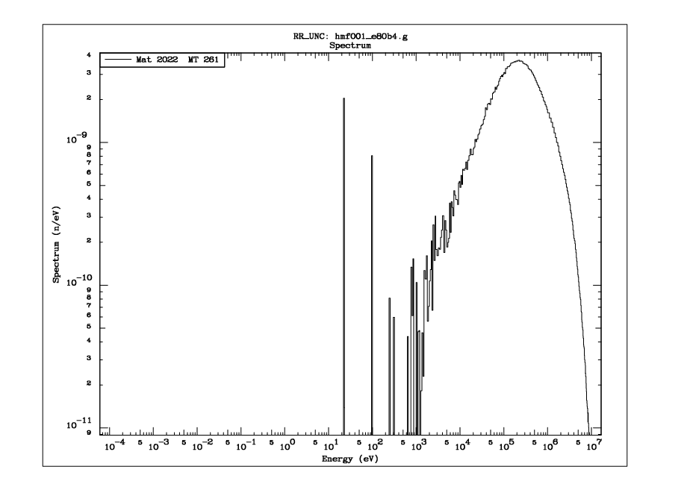
Godiva

Slide 5
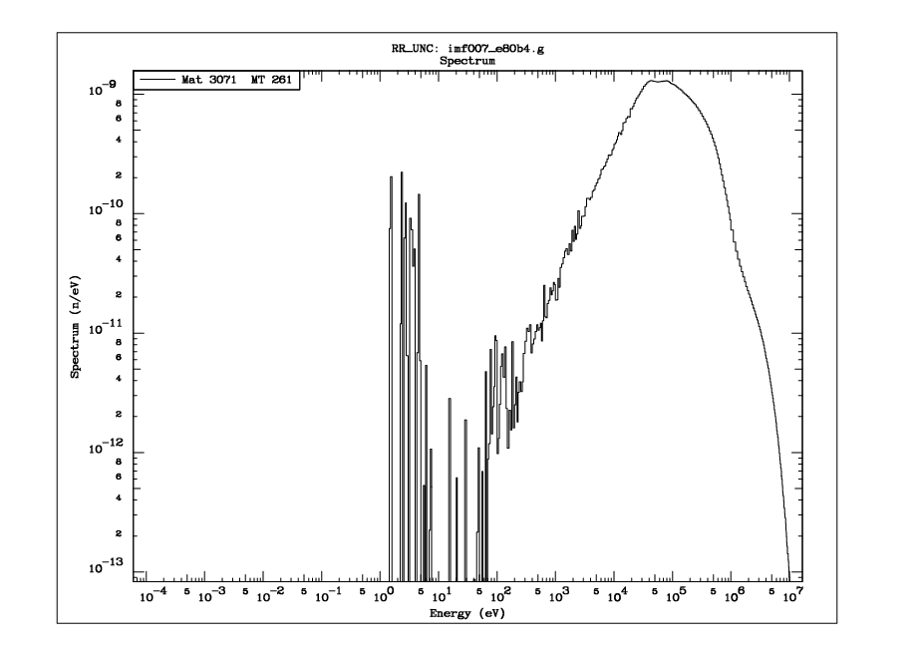
Big Ten

Slide 6
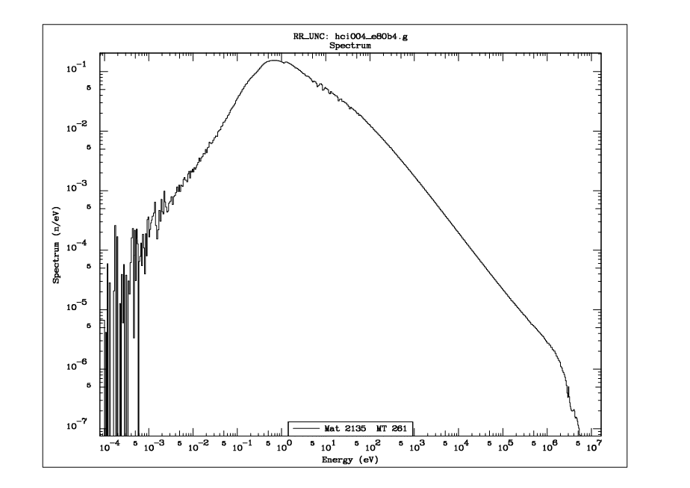
HISS

Slide 7
Simple model input data
 | Godiva | Big_Ten | HISS
νΣ_{f} [b] | 3.22379 | 3.40604 | 21.43619
ν | 2.59155 | 2.48734 | 2.42695
Σ_{f} [b] | 1.24396 | 1.36935 | 8.83258
Σ_{c} [b] | 0.14236 | 0.27764 | 4.42019
Σ_{i} [b] | 1.61269 | 1.06276 | 0.55585
Δν [%] | 0.50 | 0.50 | 1.00
ΔΣ_{f} [%] | 1.21 | 1.21 | 0.26
L | 0.22390 | 0.68086 | 7.30392
k_{eff} (MC) | 1.00027 | 1.00445 | 1.01533
Δk_{eff} (exp) [pcm] | 200 | 140 | 800
k_{eff} (exp) | 1.00000 | 1.00455 | 1.00000
Cross sections averaged over benchmark spectra and the corresponding uncertainties were calculated with the RR-UNC code using “e80b4” data and MCNP calculated benchmark spectra. The k_{eff} uncertainties are 2-sigma benchmark values.

Slide 8
Simple model-based correlations (due to integral benchmark data)
Correlations are derived from Monte Carlo sampled k_{eff} using Eq.(1)
with the integral constrain that k_{eff}(sampled) = k_{eff}(MC) ± Δk_{eff} (exp) ).rnd
where rnd is a random number in the range [-1:1]
Corr. Coef. ν -Σ_{f} | Godiva | Big_Ten | HISS | E-range
Total | -0.929 | -0.963 | -0.189 | Full range
Fast | -0.928 | -0.963 | -0.306 | E[>1MeV]
Epi-Hi | -0.928 | -0.963 | -0.487 | E[1keV:1MeV]
Epi-Lo | -0.955 | -0.926 | -0.167 | E[1eV:1keV]
Thermal | -0.180 | -0.180 | -0.180 | Standards-2017
Correlation coefficients are calculated with cross sections averaged over different parts of the spectrum as indicated.
The thermal value is taken from Standards-2017.

Slide 9
Reduction in uncertainties (due to integral benchmark data)
Energy range | Godiva Δν[%] | Big_Ten Δν[%] | HISS Δν[%] | Differential (Initial)Δν[%]
Total | 0.29 | 0.29 | 0.46 | 0.50
Fast | 0.29 | 0.29 | 0.27 | 0.50
Epi-Hi | 0.29 | 0.29 | 0.49 | 0.50
Epi-Lo | 0.39 | 0.21 | 0.46 | 1.00
Energy range | Godiva ΔΣ_{f} [%] | Big_Ten ΔΣ_{f} [%] | HISS ΔΣ_{f} [%] | Differential (Initial)ΔΣ_{f}[%]
Total | 0.51 | 0.50 | 0.15 | 1.21
Fast | 0.49 | 0.47 | 0.64 | 1.22
Epi-Hi | 0.52 | 0.51 | 0.52 | 1.22
Epi-Lo | 0.64 | 0.34 | 0.13 | 1.10

Slide 10
Reduction in k_eff uncertainties
Uncertainty estimates with NDaST before and after the introduction of $υ$ - $Σ_{f}$ correlations in U-235
k_eff Uncertainty
 | Initial | Final
Godiva | 1043 | 868
Big_Ten | 1099 | 949
HISS | 649 | 263

Slide 11
Dependence on mean values (calibration effect)
The HISS benchmark has an offset of ~1500pcm in the calculated k_{eff}
Calibrating k_{eff} to 1 (changing the evaluation mean values to get k_{eff}=1, while preserving uncertainties) has a minimal effect on derived uncertainties and correlations for cross sections (“adjusted”)
Increasing the mean value of ν by 0.2% without changing the uncertainty has a similarly negligible effect on uncertainties and correlations

Slide 12
Dependence on mean values (HISS)
Corr. Coef. ν -Σ_{f} | k-eff=1 | ν+0.2% | Nominal | E-range
Total | -0.188 | -0.188 | -0.189 | Full
Fast | -0.298 | -0.298 | -0.306 | E[>1MeV]
Epi-Hi | -0.479 | -0.479 | -0.487 | E[1keV:1MeV]
Epi-Lo | -0.166 | -0.166 | -0.167 | E[1eV:1keV]
Δν [%] | k-eff=1 | ν+0.2% | Nominal | Differential (Initial) [%]
Total | 0.47 | 0.47 | 0.46 | 0.50
Fast | 0.27 | 0.27 | 0.27 | 0.50
Epi-Hi | 0.49 | 0.49 | 0.49 | 0.50
Epi-Lo | 0.47 | 0.47 | 0.46 | 1.00
Δ
ΔΣ_{f} [%] | k-eff=1 | ν+0.2% | Nominal | Differential (Initial) [%]
Total | 0.15 | 0.15 | 0.15 | 1.21
Fast | 0.64 | 0.64 | 0.64 | 1.22
Epi-Hi | 0.52 | 0.52 | 0.52 | 1.22
Epi-Lo | 0.13 | 0.13 | 0.13 | 1.10
Implicit correlations due to calibration are negligible !!

Slide 13
Observations on $υ$ to $Σ_{f}$correlations
Correlations are different for different critical systems
Correlations are energy-dependent
There exists some similarity between different systems
Uncertainties of $υ$ and $Σ_{f}$ also undergo a significant reduction
Uncertainties and correlations are insensitive to changes in the evaluated mean values, no implicit (hidden) correlations are observed

Slide 14
Conclusions
Introducing correlations from considering experimental integral constrains (criticality benchmarks) may reduce the calculated uncertainties but:
Correlations depends on selected benchmark
Due to benchmark-dependence additional correlations (and reduced parameter uncertainties) should only be applied in derived files
(Small) changes to mean values (calibrations) do not introduce correlations – these are introduced only when new information is added (e.g. integral experiment data)

