Slide 1
Recommendations from CRP on beta-delayed neutron emission
P. (Vivian) Dimitriou
Nuclear Data Section
International Atomic Energy Agency

Slide 2
IAEA CRP on Reference Database for beta-delayed neutron emission (2013-2017)
Microscopic
Compile the existing beta-delayed neutron data: half-lives T_{1/2}, neutron emission probabilities (P_{n}) and neutron spectra for individual precursors
(T_{1/2},P_{n}) for over 600 precursors
2. Evaluate existing (T_{1/2},P_{n}) data – recommend standards for P_{n} and reference neutron spectra
3. Produce systematics and theoretical models to extrapolate results to unknown nuclei
4. Provide priority list for new measurements
Macroscopic
1. Sensitivity studies of delayed nu-bars, delayed neutron spectra, and neutron emission rates with respect to bDN (T_{1/2}, P_{n})
2. Validate new recommended (T_{1/2},P_{n}) values against integral measurements of
nu-bars, <T> and delayed-neutron spectra
3. Re-evaluate the beta-delayed neutron reactor constants in 6- and 8-group format for energy applications and include them in database

Slide 3
U-235 (thermal neutron induced fission)
Validation of new (T_{1/2},P_{n}) evaluated library
c/o: V. Piksaikin

Slide 4
U-238 (fast neutron induced fission)
c/o: V. Piksaikin

Slide 5
Pu-239 (thermal neutron induced fission)
c/o: V. Piksaikin

Slide 6
Some conclusions
With new CRP (T_{1/2},P_{n}) overall trend is to get increased values of ν_{d}
More experimental data available in last 10-15 yrs (at least 35 new non-zero P_{n})
Some of the ‘culprits’ are being scrutinized
Small uncertainties due to simplistic error propagation (no correlations)
FYs (IFY and CFY) have largest contributions to uncertainties
Need to look at FYs carefully

Slide 7
Endorsement of Recommendation for CRP
31st Meeting of the
International Nuclear Data Committee, 27-30 June 2016
Objective: improve existing evaluated Fission Product Yields (FPY)
Scope:
Compilation of all new FFY and FPY experimental data
Improve systematics and models
Incorporate new knowledge in FPY evaluations: correct errors and inconsistencies, update evaluations, provide reliable estimate of uncertainties
Agree on treatment of covariances, provide FPY covariance data and propose suitable format for inclusion in ENDF-6
Validation of new evaluations
U-235; Pu-239; U-238; Cf-252
Participant countries: Belgium, China, Finland, France, Germany, India, Japan, Russia, Sweden, UK, USA

Slide 8
Recommendation of 6- and 8-group constants (Piksaikin et al, IPPE, Obninsk)
Last recommendation: WPEC/SG-6, 1999 - Based on best existing data sets
New measurements of delayed-neutron decay curves for: U-233 fast, 235 thermal and fast, 236 fast, 238 fast; Pu-239 thermal and fast; Th-232 fast; Am-241 fast, Np-237 fast
Energy dependence
Measurements of aggregate delayed-neutron spectra (U-235 thermal)
New 6-group and 8-group fits: ν_{d}, <T>
New systematics with predictive power (U-235;U-238;Pu-239)

Slide 9
Systematics of DN relative abundances in 8-group model using (Ac-2Z) parameter
U isotopes only
DN group 1 DN group 2
a_{i}= exp[c_{i}+b_{i}(Ac-2Z)]

Slide 10
Relative abundances of U isotopes for Groups 3-8

Slide 11
Results of prediction of DN parameters for uranium isotopes lna_{i}=c_{i}+b_{i}(Ac-2Z) a_{i}= exp[c_{i}+b_{i}(Ac-2Z)]
Group Number | C_{i} | B_{i}
lna1 | 17.33212 | -0.39826
lna2 | 3.406616 | -0.10198
lna3 | 9.173554 | -0.22445
lna4 | 3.281613 | -0.09323
lna5 | -2.73211 | 0.029697
lna6 | -18.6346 | 0.31009
lna7 | -8.97534 | 0.123161
lna8 | -24.8399 | 0.407238

Slide 12
Results of prediction of DN parameters for uranium isotopes lna_{i}=c_{i}+b_{i}(Ac-2Z) a_{i}= exp[c_{i}+b_{i}(Ac-2Z)]
 | U232 | U233 | U234 | U235 | U236 | U237 | U238
Half-life, s | Relative abundances
55.6 | 6.26878 | 4.20941 | 2.82656 | 1.89800 | 1.27448 | 0.85580 | 0.57466
24.5 | 4.99364 | 4.50949 | 4.07227 | 3.67745 | 3.32090 | 2.99893 | 2.70817
16.3 | 2.62882 | 2.10031 | 1.67805 | 1.34068 | 1.07114 | 0.85579 | 0.68373
5.21 | 1.43866 | 1.31059 | 1.19392 | 1.08764 | 0.99082 | 0.90262 | 0.82226
2.37 | 0.66095 | 0.68087 | 0.70139 | 0.72254 | 0.74431 | 0.76675 | 0.78986
1.04 | 0.03334 | 0.04546 | 0.06198 | 0.08452 | 0.11525 | 0.15715 | 0.21428
0.424 | 0.02240 | 0.02534 | 0.02866 | 0.03242 | 0.03666 | 0.04147 | 0.046911
0.195 | 0.00147 | 0.00221 | 0.00332 | 0.005 | 0.00751 | 0.01129 | 0.016966
<T>, s | 14.2608 | 12.3608 | 10.6796 | 9.18353 | 7.84142 | 6.63028 | 5.537861
<T>, recommended data | 14.35 | 12.38 |  | 9.1 | 7.37 |  | 5.3
<T>, Wilson et al. | 14.439 | 12.36 | 10.487 | 7.541 |  | 6.896 | 5.05

Slide 13
Comparison of the average half-life obtained by different methods
Experimental data, Microscopic approach, Systematics

Slide 14
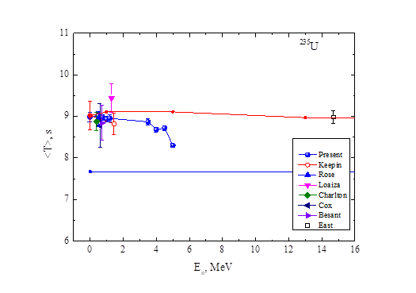
Energy dependence
JEFF-3.1.1
ENDF/B-VII.1

Slide 15
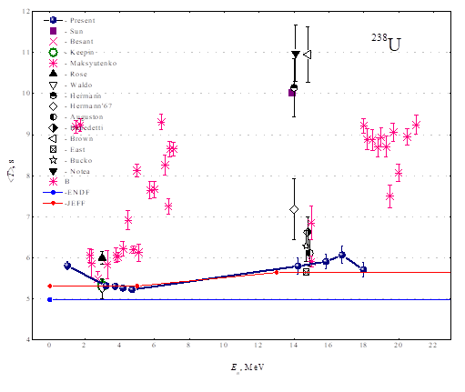
Energy dependence

Slide 16
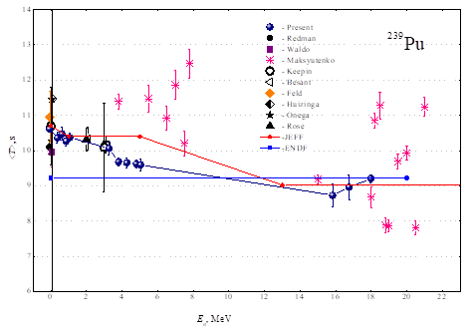
Energy dependence

Slide 17
Summary
New data on aggregate delayed neutrons allow for improvement of
Systematics
Energy dependence
Energy spectra
This will lead to new recommendations for 6- and 8-group constants
Work will be published in CRP final report (Nuclear Data Sheets)
CRP website: www-nds.iaea.org/beta-delayed-neutron

Slide 18
Thank you!
Notes:
Thank you!

Slide 19
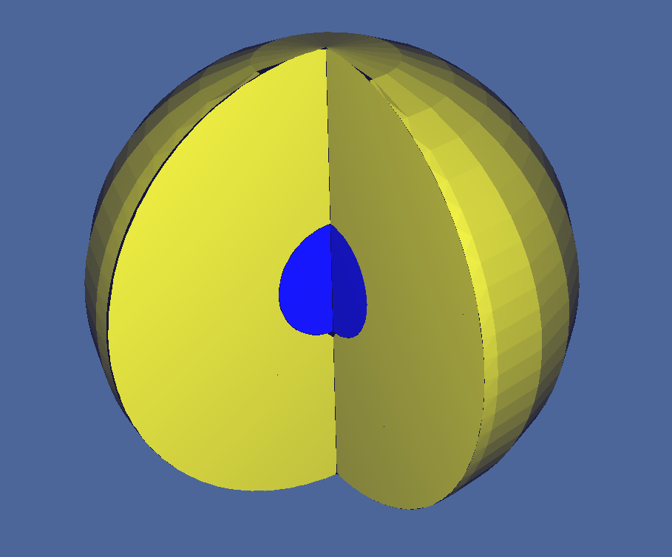
TOPSY (HEU-MET-FAST-028)
²³⁵U sphere covered with a natural U reflector
Dimensions:
r (core) = 6.1156 cm
r (reflector) = 24.1242 cm
Composition:
Core: ²³⁵U (93.24 wt%), ²³⁸U (5.74 wt%) and ²³⁴U
Reflector: natural U
k_{eff} (exp) = 1,0000 ± 0,0030
β_{eff} (exp) = 665 ± 13 pcm
natural U
HEU core

Slide 20
TOPSY (HEU-MET-FAST-028)
Results
 | k_{eff} | β_{eff} (pcm)
Experimental | 1.00000(300) | 665(13)
ENDF/B-VII.1 | 1.00286(2) | 695(5)
ENDF/B-VII.1 (v01) | 1.00336(2) | 736(5)
ENDF/B-VII.1 (v02) | 1.00484(2) | 882(6)
JEFF-3.2 | 1.00506(2) | 705(5)
JEFF-3.2 (v01) | 1.00472(2) | 666(5)
JEFF-3.2 (v02) | 1.00557(2) | 747(5)

Slide 21
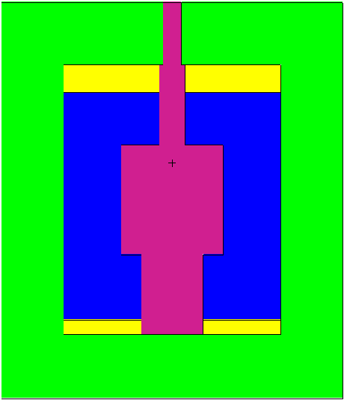
BIG TEN (IEU-MET-FAST-007)
Big cylindrical reactor. The core is composed by 10 wt% ²³⁵U cylinders with different radii and is surrounded by an homogenized highly enriched + natural U cylinder. There are two separated natural U annular plates and it has a depleted U cylinder as reflector
Composition:
U(10): ²³⁸U (89.7 wt%), ²³⁵U (10.2 wt%), ²³⁶U and ²³⁴U
HEU and ^{nat}U: ²³⁸U (89.5 wt%), ²³⁵U (10.3 wt%), ²³⁶U and ²³⁴U
Natural U: ²³⁸U (99.3 wt%), ²³⁵U (0.7 wt%) and ²³⁴U
Depleted U: ²³⁸U (99.8 wt%), ²³⁵U (0.2 wt%), ²³⁶U and ²³⁴U
10 wt% U
HEU and U-nat
natural U
Depleted U

Slide 22
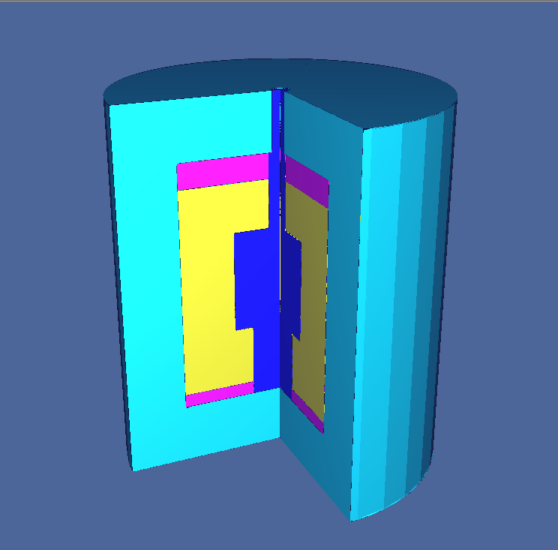
BIG TEN (IEU-MET-FAST-007)
Dimensions:
r = 41.91 cm
L = 96.428 cm
k_{eff} (exp) = 1.00490 ± 0.00080
β_{eff} (exp) = 720 ± 7 pcm
3D plot (colors changed)
10 wt% U
HEU and U-nat
natural U
Depleted U

Slide 23
BIG TEN (IEU-MET-FAST-007)
Results
 | k_{eff} | β_{eff} (pcm)
Experimental | 1.00490(800) | 720(7)
ENDF/B-VII.1 | 1.00468(1) | 725(3)
ENDF/B-VII.1 (v01) | 1.00479(1) | 736(5)
ENDF/B-VII.1 (v02) | 1.00611(1) | 865(4)
JEFF-3.2 | 1.00432(1) | 750(3)
JEFF-3.2 (v01) | 1.00402(1) | 729(4)
JEFF-3.2 (v02) | 1.00463(1) | 799(4)

Slide 24
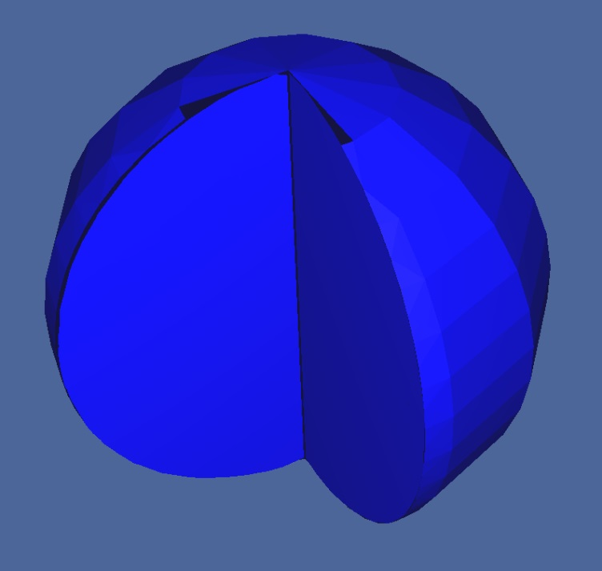
JEZEBEL (PU-MET-FAST-001)
Bare Pu sphere
Dimensions:
r = 6.385 cm
Composition:
Core: ²³⁹Pu (95.2 at%), ²⁴⁰Pu (4.5 at%), ⁶⁹Ga (0.6 at%), ⁷¹Ga and ²⁴¹Pu (0.3 at%)
k_{eff} (exp) = 1.0000 ± 0.0011
β_{eff} (exp) = 194 ± 10 pcm
Pu core

Slide 25
JEZEBEL (PU-MET-FAST-001)
Results
 | k_{eff} | β_{eff} (pcm)
Experimental | 1.00000(110) | 194(10)
ENDF/B-VII.1 | 0.99870(1) | 185(1)
ENDF/B-VII.1 (v01) | 0.99990(1) | 180(1)
ENDF/B-VII.1 (v02) | 1.00006(1) | 197(2)
JEFF-3.2 | 1.00021(1) | 190(1)
JEFF-3.2 (v01) | 1.00034(1) | 194(2)
JEFF-3.2 (v02) | 1.00064(1) | 224(2)

