Slide 1
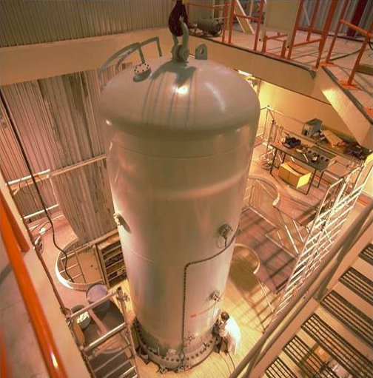
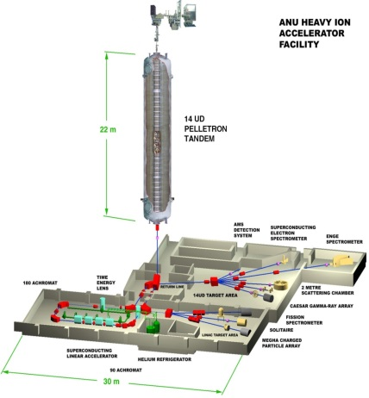
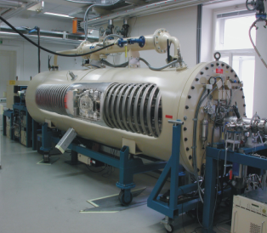
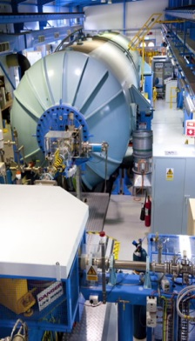
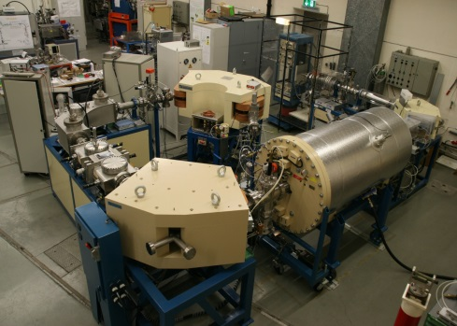
Recent AMS measurements on neutron-induced reactions + outlook
in collaboration with:
KIT (Karlsruhe): F. Käppeler, I. Dillmann
IRMM / Geel: A. Plompen, A. Krasa
IKI Budapest: T. Belgya, L. Szentmiklosi
TU Vienna: M. Bichler
TSL Uppsala: A. Prokofiev et al.
ANU (Canberra): L.K. Fifield, S. Tims, M. Froehlich
VERA (Vienna): K. Buzcak, F. Quinto, P. Steier, S. Winkler, C. Lederer
ETH Zurich: M. Christl, J. Lachner
ANSTO/Sydney: M. Hotchkis
Univ. Heidelberg: J. Lippold
IAEA: R. Capote , V. Semkova
A. Wallner
The Australian National University (ANU)
AMS
neutrons
+ BR1 / ILL / FRM-2 / SARAF …

Slide 2
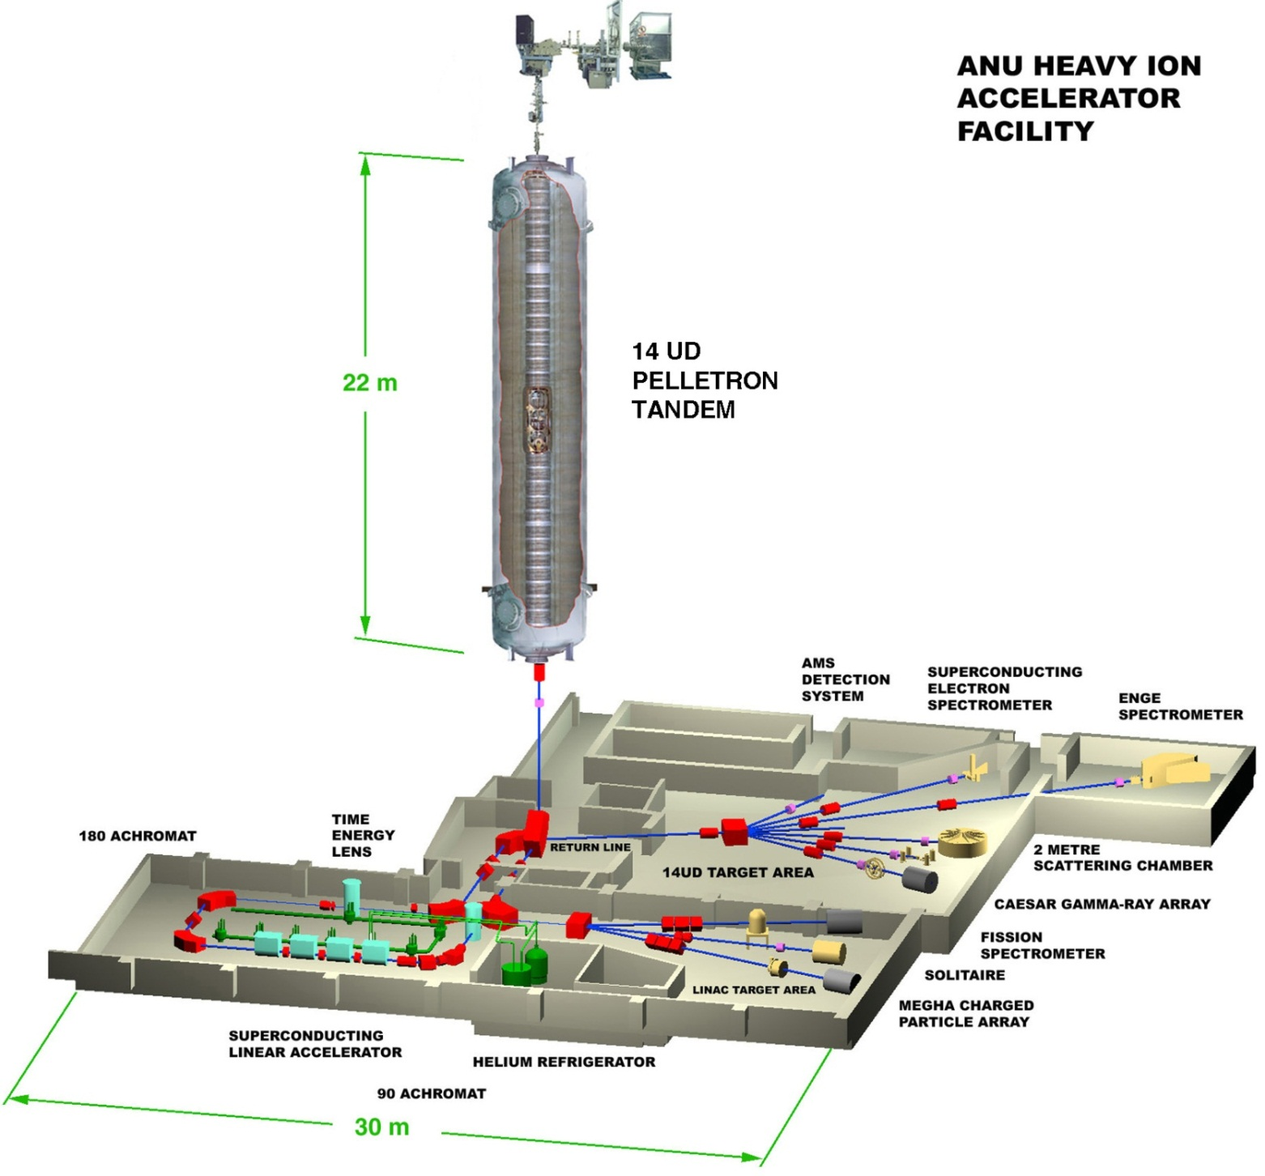
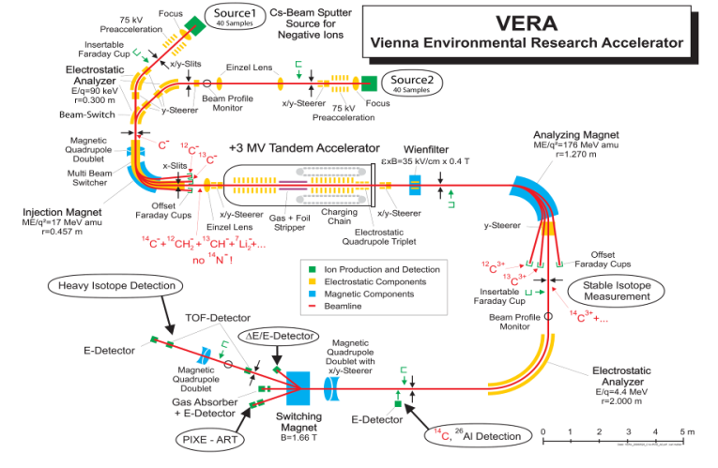
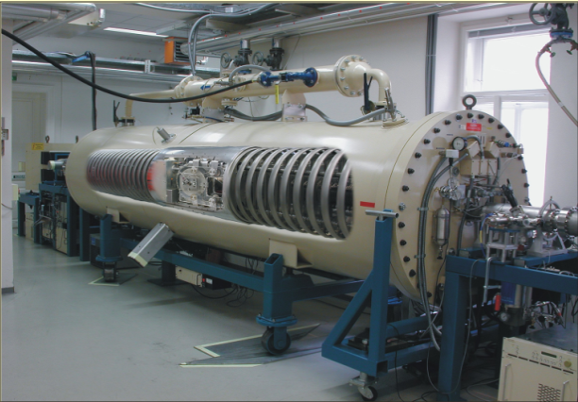
Accelerator mass spectrometry (AMS)
= single atom counting

Slide 3
Some radionuclides measured with AMS
⁵⁵Fe 2.7 years
³H 12.3
⁴⁴Ti 60
⁶³Ni 100
³²Si 140
³⁹Ar 269
¹⁴C 5 730
⁵⁹Ni 75 000
⁴¹Ca 104 000
⁸¹Kr 230 000
⁷⁹Se 280 000
³⁶Cl 301 000
²⁶Al 720 000
¹⁰Be 1 388 000
⁶⁰Fe 2 600 000
⁵³Mn 3 600 000
¹⁸²Hf 8 900 000
¹²⁹I 17 000 000
²³⁶U 23 000 000
²³⁹⁻²⁴⁴Pu, ²⁴⁷Cm - 81 000 000
fundamental physics
applied sciences
new: ⁵⁵Fe, ⁶⁸Ge, ⁹³Zr, ⁹⁹Tc, ¹⁰⁶Pd, ¹³⁵Cs, ¹⁴⁶Sm, ²⁰²Pb, ^{210m}Bi, ²²⁶Ra, ²²⁹Th, stable…

Slide 4


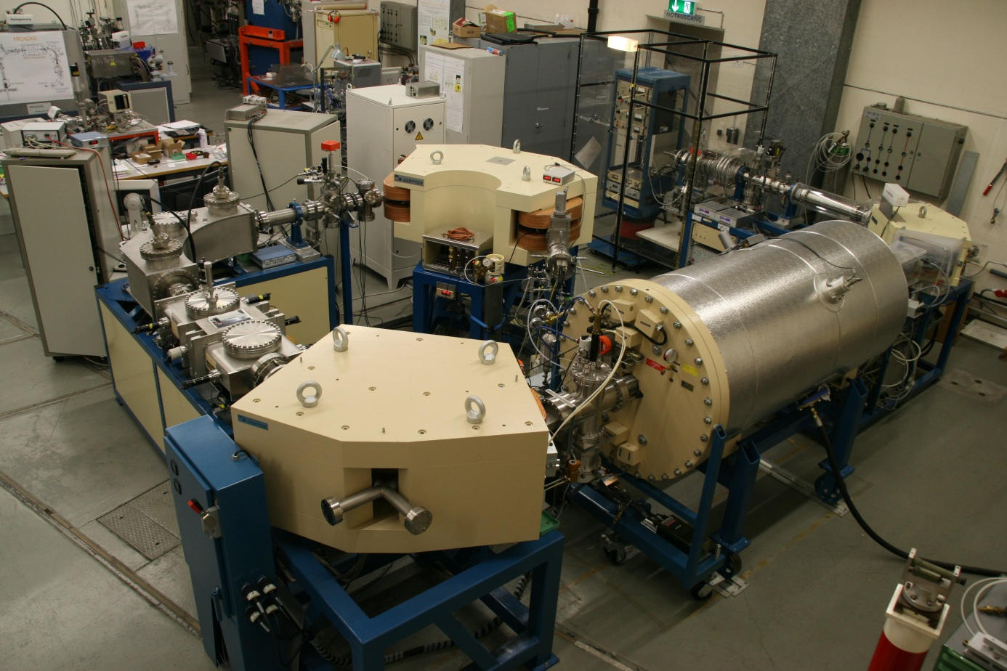

AMS at different labs
ANU/Canberra
Vienna
ANSTO Sydney
ETH Zurich

Slide 5
Activation (I) → AMS-Measurement (II)
fusion / fission / ADS products / nuclear astrophysics
(I) Neutron irradiations:
  IRMM Geel: 7 MV Van de Graaff: (T(p,n)³He: E_{n} = 0.5 – 2.5 MeV)
  IRMM Geel: 7 MV Van de Graaff: (D(d,n)³He: E_{n} = 2 – 5 MeV)
  IRMM Geel: 7 MV Van de Graaff: (T(d,n)⁴He: E_{n} = 18 – 22 MeV)
  IK Karlsruhe: 3.7 MV Van de Graaff: ⁷Li(p,n)⁷Be: 25 keV Maxwell- Boltzmann, 120 keV, 180 keV, 500 keV, ...)
  TU Dresden/Rossendorf: 300 kV (T(d,n)⁴He: E_{n} = 13.3 – 14.9 MeV)
  Atominstitut Vienna: research reactor, thermal neutrons
  IKI Budapest: thermal neutrons; cold neutrons
(I) Most resent neutron irradiations:
  BR1 / ILL Grenoble / FRM II Munich: thermal neutrons; cold neutrons
  SARAF / Israel: 25 – 40 keV neutrons; Maxw. Boltzmann broad distribution
II) atom counting of the reaction products using the most sensitive technique of AMS

Slide 6
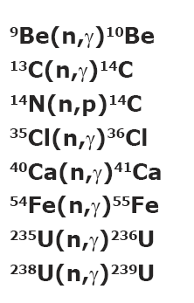
keV activations (KIT) & AMS

Slide 7
JRC: 0.5 – 5 MeV neutron spectrum

Slide 8
JRC/Geel – fast neutron spectrum

Slide 9
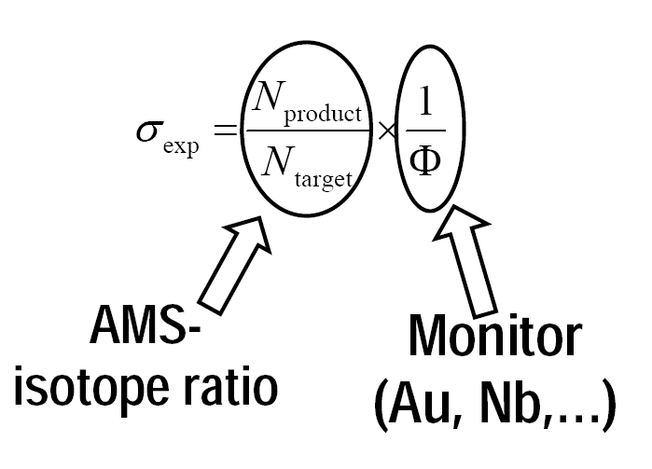
How to derive cross sections?
AMS: mg samples
AMS: single atom counting
AMS
monitor reaction (Au)

Slide 10
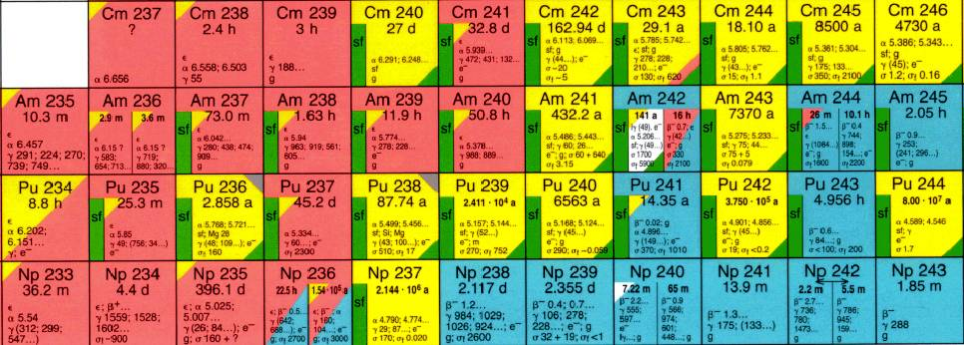
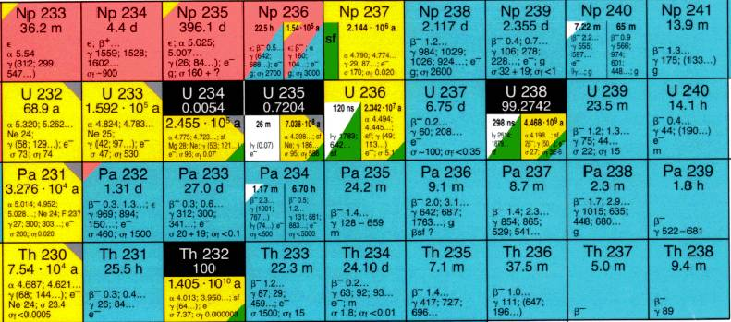
²³⁶U & ²³⁹U: Production & Decay
²³⁶U: t_{1/2} = 23.4 Myr
²³⁹U: t_{1/2} = 23.5 min
²³⁹Np: t_{1/2} = 2.35 days
²³⁹Pu: t_{1/2} = 24.1 kyr

Slide 11
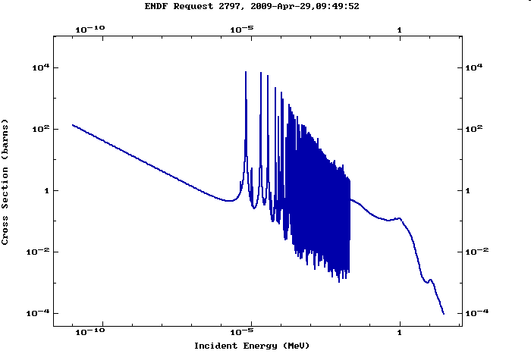
²³⁸U(n,γ)²³⁹U -> ²³⁹Np -> ²³⁹Pu (24 kyr)
IKI
FZK
IRMM
²³²Th(n,γ)²³³Th -> ²³³Pa -> ²³³U (159 kyr)- simultaneously

Slide 12
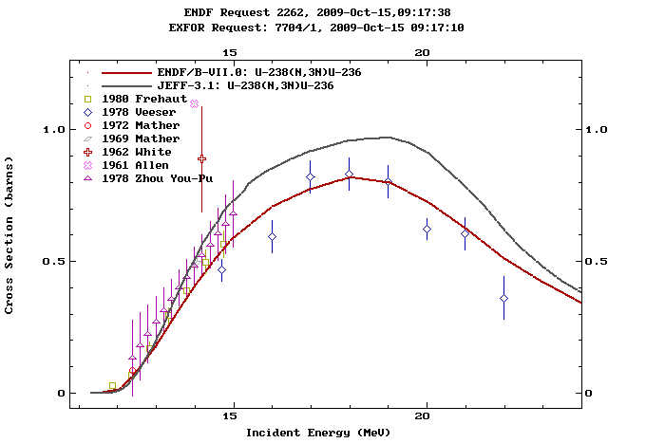
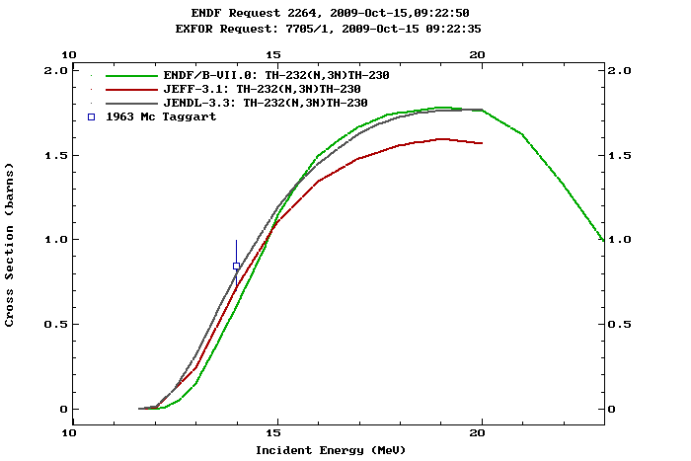
Fast neutron induced reactions: Th / U
IRMM
IRMM
U/Th simultaneously – the same geometry – the same fluence – (n,3n), (n,4n), (n,2n), (n,α) in the same irradiation

Slide 13
²³²Th & ²³⁸U: Production & Decay: (n,x)
fast n
²³¹Th: t_{1/2} = 25.5 h
²³¹Pa: t_{1/2} = 32.8 kyr
²²⁹Th: t_{1/2} = 7.88 kyr
²³⁶U: t_{1/2} = 23.4 Myr
²³⁷U: t_{1/2} = 6.75 days
²³⁷Np: t_{1/2} = 2.14 Myr

Slide 14
Analytical Strategy - Th
Sample
²³⁸U and ²³³Pa spike
Chemical separation of Th / Pa & U
AMS
²²⁹Th / ²³²Th
²³¹Pa / ²³³Pa
²³³U / ²³⁸U
²³²Th(n,4n)²²⁹Th
²³²Th(n,2n)²³¹Th
²³²Th(n,γ)²³³Th
²³²Th(n,α)²²⁹Ra

Slide 15
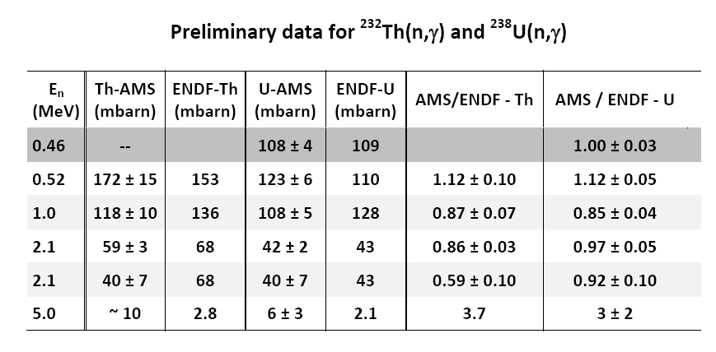
Status ²³²Th(n,γ)²³³Th & ²³⁸U(n,γ)²³⁹U for 0.5 / 1.0 / 2.1 / 5.0 MeV
AMS @ ANU finished - for both reactions and all energies
AMS ratio measurements: uncertainties 5% – 15%
still pending: careful check of neutron energy distribution for final fluence / cross section values
o) low energy component in the distribution
o) T(p,n) reaction for neutron production (0.5, 1.0 & 2.1 MeV)
o) D(d,n) reaction for neutron production (2.1 & 5.0 MeV)
IRMM & AMS at the ANU
Notes:
The ²³⁸U(n,γ) cross-section values show discrepancies between the different evaluations and they differ also to experimental data above 2 MeV. The evaluations themselves exhibit differences of 10% (ENDF vs JEFF) for neutron energies around 500 keV and this steadily increases to 30% at 3 MeV and to 50% at 5 MeV (see Fig.1). For Th similar conclusions can be drawn: The experimental data points show a larger scatter and no experiments are listed in EXFOR for energies above 2.7 MeV (Fig. 2).
¹⁹⁷Au(n,g) cross section standard
Above 2 MeV the normalization will be to the H(n,n)H and/or U-235/238 standard cross sections by using a transfer detector. For the entire energy range this will imply the use of the time-of-flight technique and/or the distance variation method using activation foils (Au, In, Fe) checked against a primary fluence standard (H(n,n)H and one of ²³⁵U(n,f) and ²³⁸U(n,f)).

Slide 16
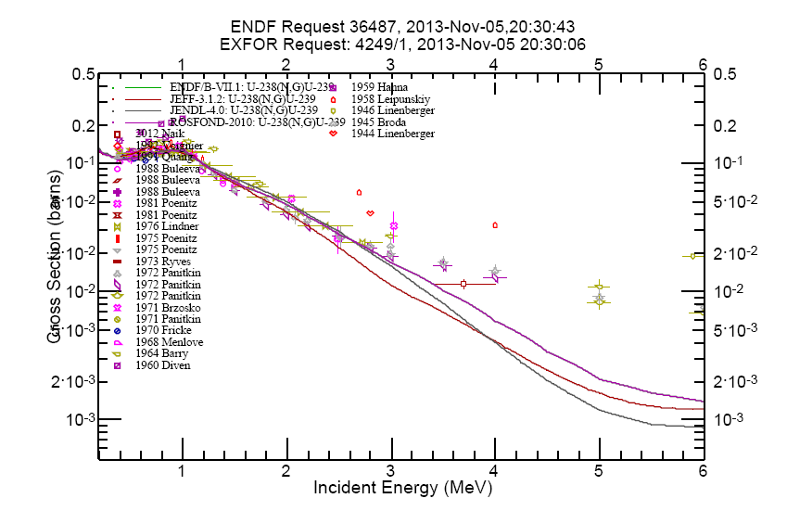
²³⁸U(n,γ)²³⁹U

Slide 17
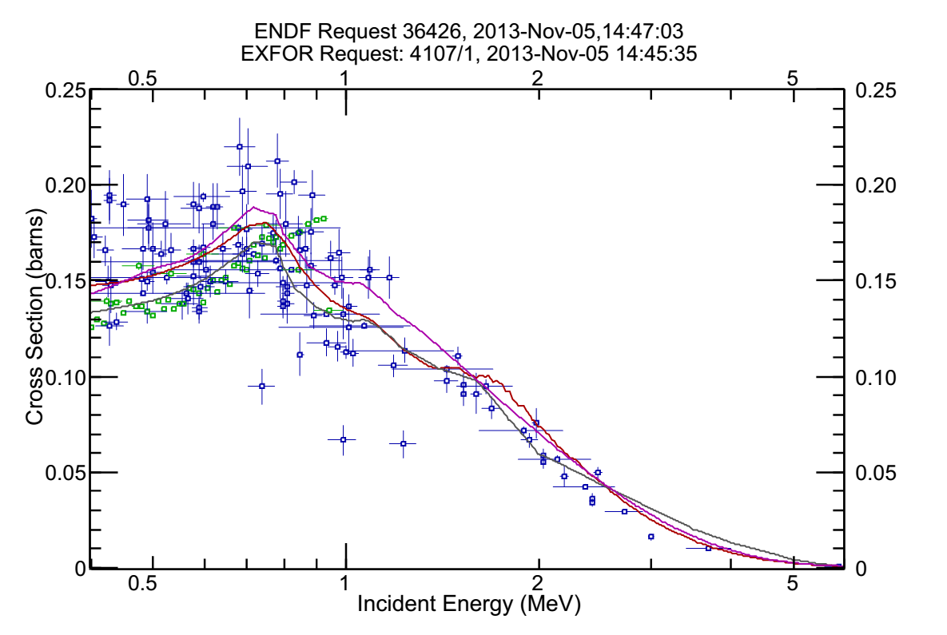
²³²Th(n,γ)²³³Th

Slide 18
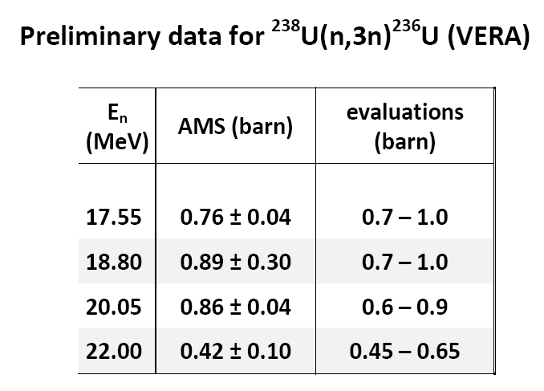
First results - ²³⁸U(n,3n)²³⁶U
17.55 and 20.05 MeV: AMS 2-3% reproducibility
Recently at CIAE another AMS measurement for 14 MeV

Slide 19
New AMS results: ²³⁸U(n,3n)

Slide 20
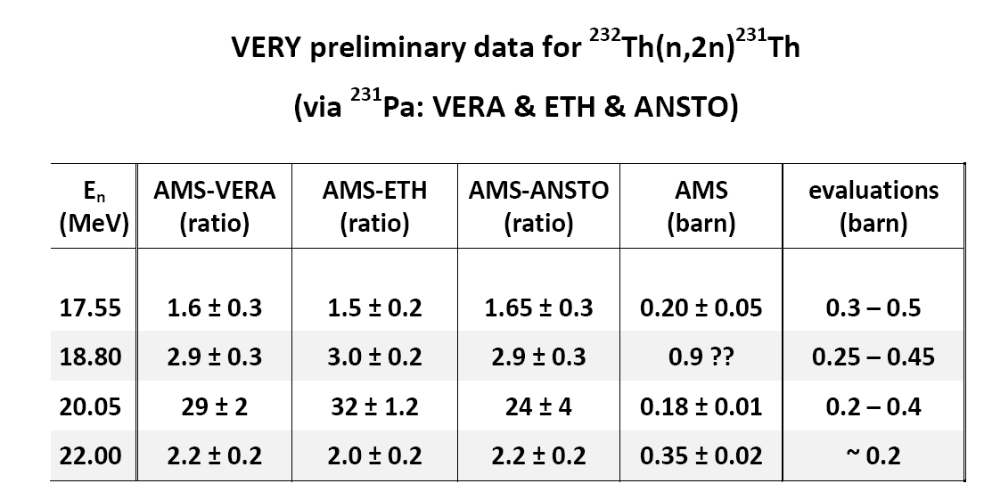
First results - ²³²Th(n,2n)²³¹Th
17.55 MeV: AMS finished - 3x AMS (Vienna, Zurich, Sydney)
18.80 MeV: AMS finished - 3x AMS (Vienna, Zurich, Sydney)
20.05 MeV: AMS finished - 3x AMS (Vienna, Zurich, Sydney)
22.00 MeV: AMS finished - 3x AMS (Vienna, Zurich, Sydney)
17.55 - 22 MeV: AMS 2 – 6 % reproducibility

Slide 21
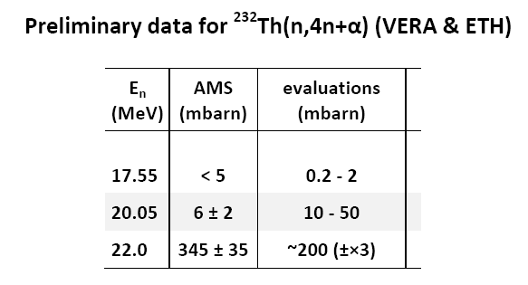
First results - ²³²Th(n,4n+α)²²⁹Th

Slide 22
First results - ²³²Th(n,4n+α)²²⁹Th

Slide 23
¹³C(n,γ) and ¹⁴N(n,p) & AMS of ¹⁴C

Slide 24
⁵⁴Fe(n,γ)⁵⁵Fe
Anchor point!
complements TOF data

Slide 25
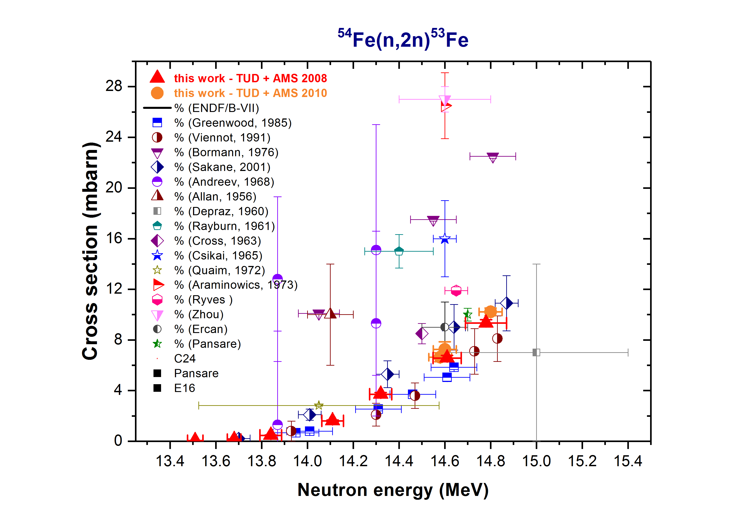

Slide 26
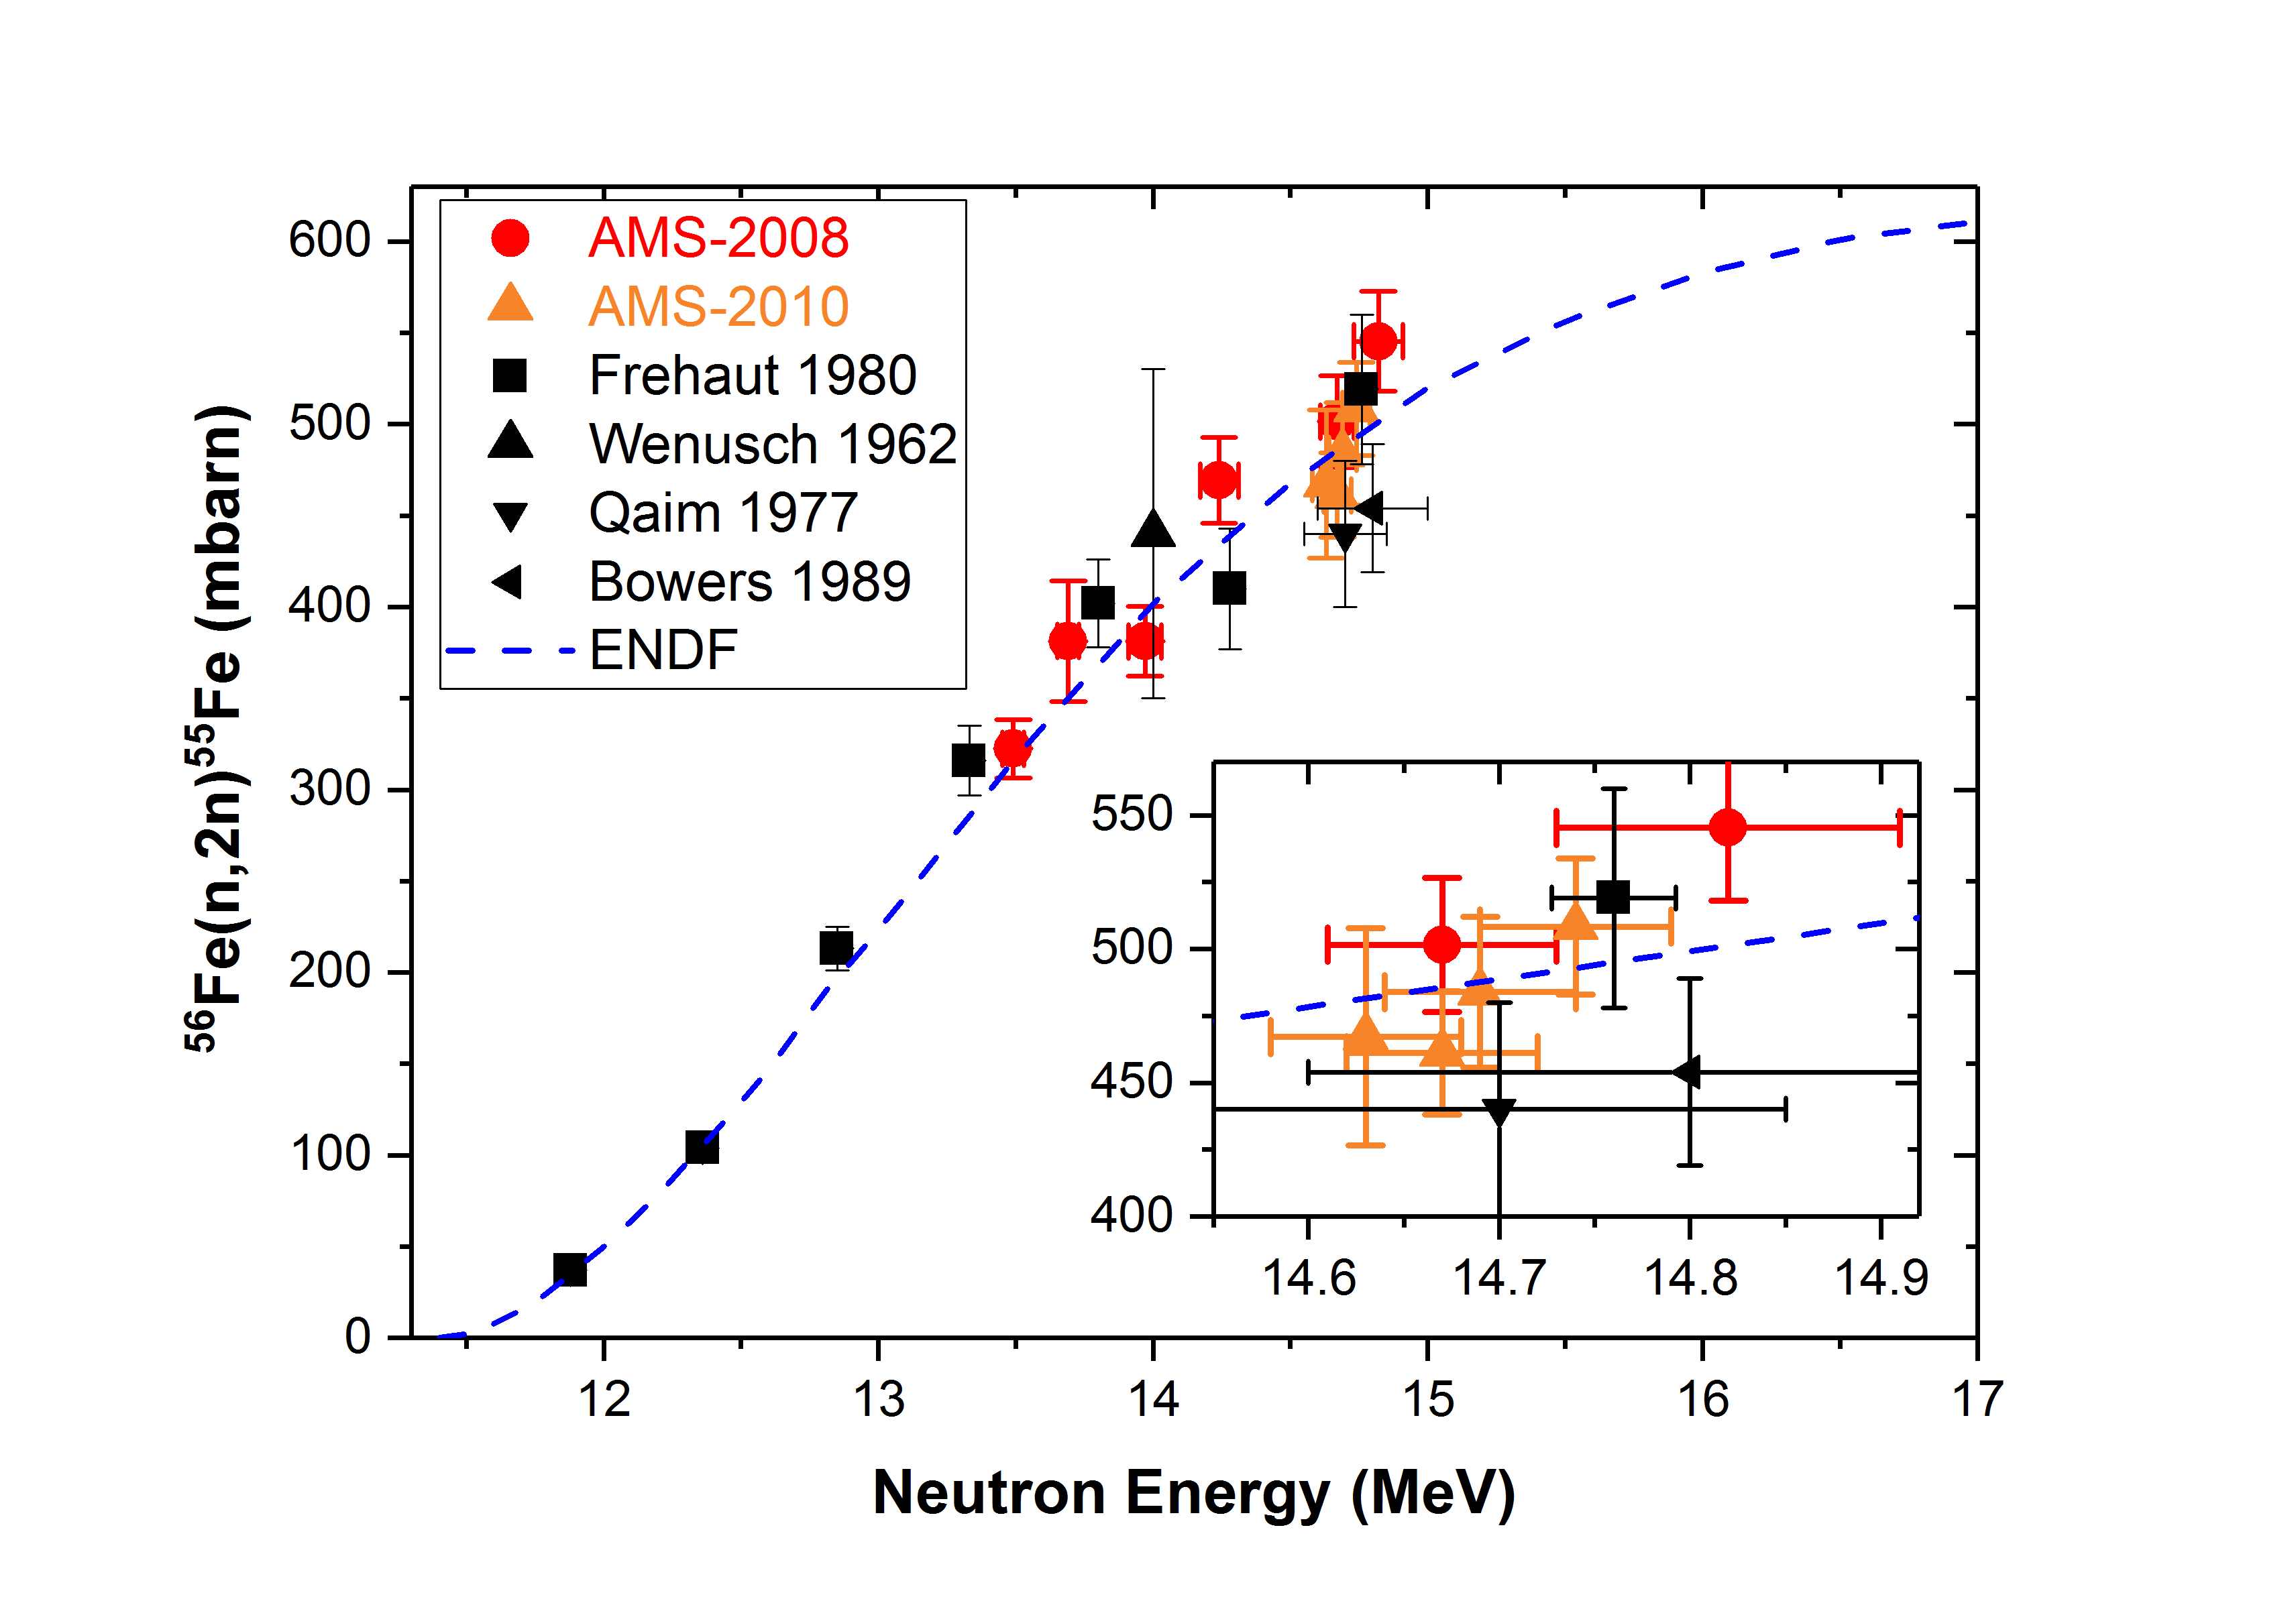

Slide 27
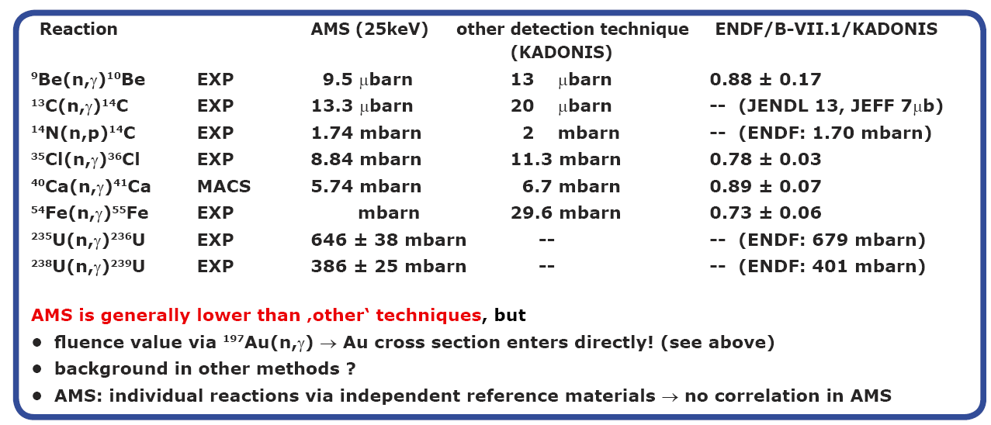
Comparison AMS – other meas. / ENDF
AMS data (not U) relative to Au- Ratynski-Käppeler for 25 keV
all activations with the same geometry at KIT – as used in “Ratynski & Käppeler

Slide 28
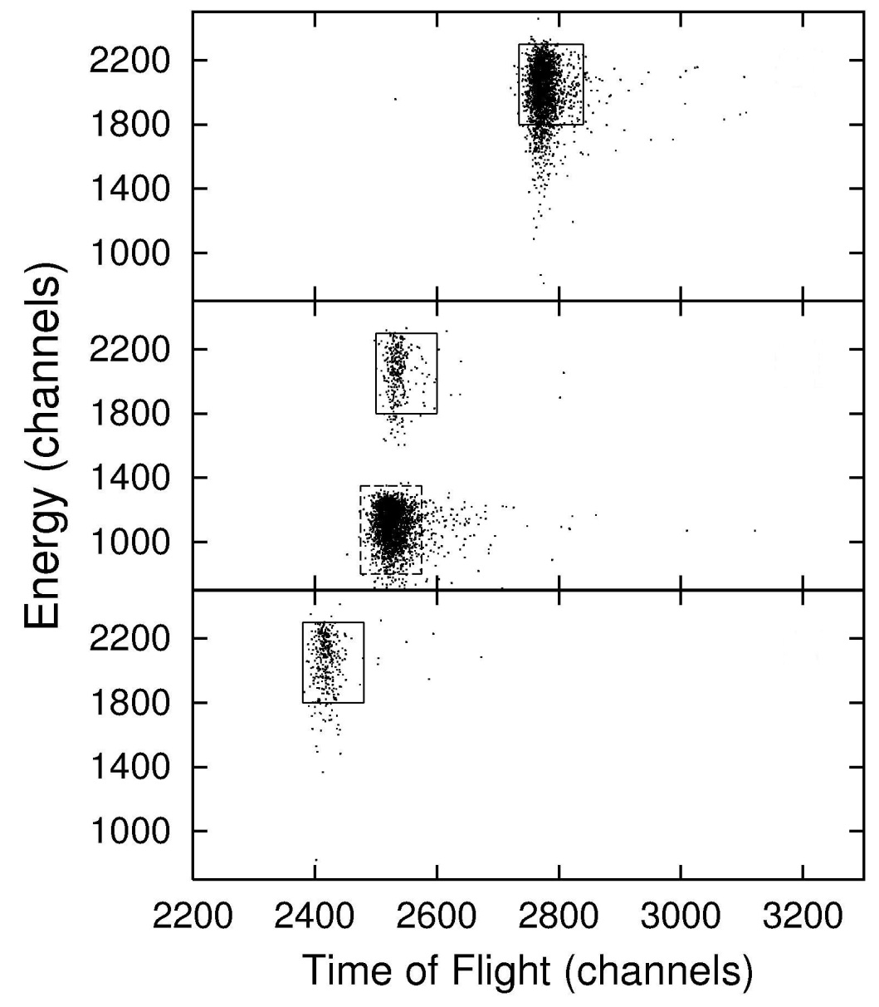
typical AMS-spectrum for Pu measurements
²⁴²Pu⁵⁺
clear isotope separation -
Pu: no isotopic interference
U-sensitivity: ²³⁶U/²³⁸U<10⁻¹²
²³⁹Pu⁵⁺
Significant improvements in AMS in the last few years
Sensitivity increased by >> 10×
Efficiency improved by > 10-100×
Reproducibility < 2-3 %

Slide 29
Measurement of Cross Sections
Online method
detection of prompt γ-rays of reaction product (characteristic)
(or: recoil separator technique)
if continous E-distribution: + TOF
all reaction products accessible
radioactive beams
Offline method
activation technique: prior irradiation
quasi-stellar spectrum at once
sensitive technique
  detect reaction / products
  needs radioactive samples (not too long half-life)
  atom counting (AMS)
  related to few applications
  most sensitive
different systematic uncertainties involved

Slide 31
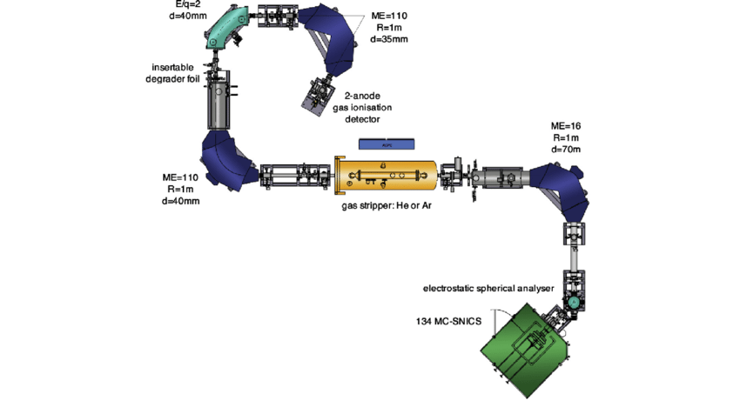
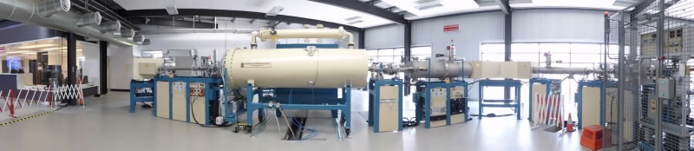
²⁴⁴Pu AMS measurement:
Collaboration Mike Hotchkis (ANSTO)
Pu extracted with mg Fe
Analysed for all Pu isotopes
Anthropogenic: ^{239,240,241}Pu
Spike: ²⁴²Pu
Interstellar & anthropog.: ²⁴⁴Pu
overall efficiency: 0.5 – 1%
Sensitivity: 10⁻²¹ g Pu / sample!

Slide 32
Conclusion
AMS represents an independent method for studying nuclear reactions leading to long-lived radionuclides
direct method: atom counting as isotope ratio; i.e. no sophisticated data reduction or corrections required
not a universal method – AMS is used for some 30 radionuclides
if it can be applied – usually very (the most) sensitive method
can serve as a tool to provide some anchor points

Slide 33
AMS for PFNS – mapping the high energy part? –
SPA data via integral experiments
AMS - reaction products long-lived
long-term activations possible
threshold reactions – probe the poorly known high-energy tail of U/Cf spectra
possible candidates:
  ²⁷Al(n,2n)²⁶Al (E_{th}=13.56 MeV)
  ²³⁸U(n,3n)²³⁶U; [²³⁸U(n,2n)²³⁷U->²³⁷Np] (E_{th}=11.33 MeV)
  ⁵⁶Fe(n,2n)⁵⁵Fe (E_{th}=11.40 MeV)
  ⁵⁴Fe(n,2n)⁵³Fe -> ⁵³Mn (E_{th}=13.65 MeV)
  ⁵⁵Mn(n,2n)⁵⁴Mn (312 days)
  ⁵²Cr(n,2n)⁵¹Cr (27.7 days)

Slide 35
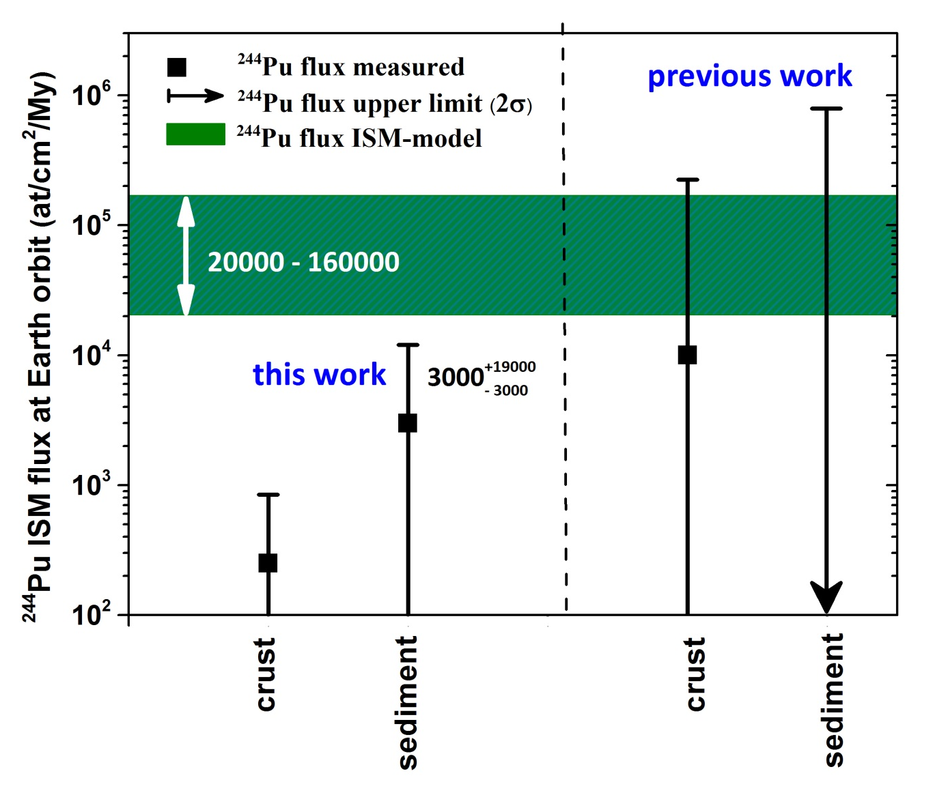
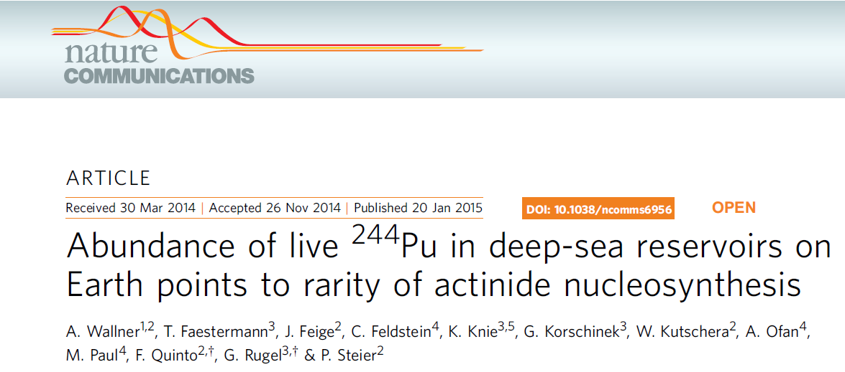
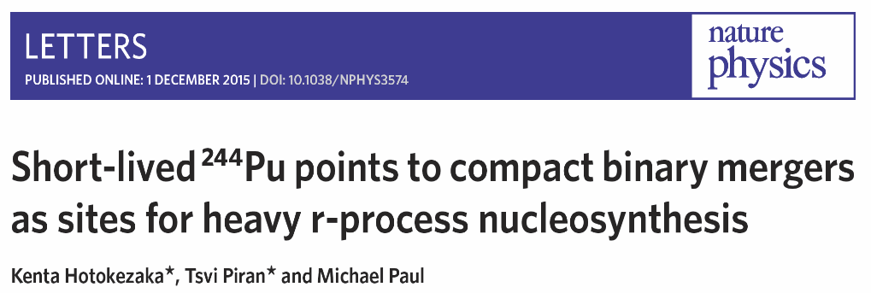
²⁴⁴Pu (t_{1/2}=80 Myr)
100:1 estimated vs measured
²⁴⁴Pu in terrestrial crust (+ AMS at Vienna):
crust: dust collection over 25 Myr
²⁴⁴Pu: time window - alive a few 100 Myr
neutron star mergers or other rare process
→ Actinides on Earth (U, Pu, … may be from a rare event!
Other planets:
x) Earth’s core heating!
x) Nuclear technology

Slide 36
Comparison AMS – other meas. / ENDF
AMS data (not U) relative to Au- Ratynski-Käppeler for 25 keV
all activations with the same geometry at KIT – as used in “Ratynski & Käppeler

Slide 37
AMS: limitations
isotope ratios (e.g. ²³⁶U/²³⁸U) measured:
  interference with background: < 10⁻¹² for ²³⁶U
    isobaric interference (e.g. ²³⁵UH) – not an issue for AMS
    isotopic interference (e.g. ²³⁵U, ²³⁸U): e.g. ²³⁶U/²³⁸U < 10⁻¹²
    possibly m/q interference (count-rate interference - detector busy)
number of nuclei in sample
  determines statistical uncertainty
  typical overall efficiency: 10⁻² - 10⁻⁴

Slide 38
Examples - limitations
U: isotope ratios
20 mg irradiated with 10¹⁵ n; 700 mb
²³⁶U/²³⁵U = 7*10⁻¹⁰
²³⁶U/²³⁸U = 5*10⁻¹²
N₂₃₆ = 3*10⁸ -> AMS: > 10⁵ counts in detector
U: number of nuclei; example: ²³⁸U(n,γ)²³⁹U -> (0.5 h) -> ²³⁹Np -> (2.4 d) -> ²³⁹Pu (t_{1/2} = 24 000 a)
N₂₃₉ = 10⁷ ! (required for AMS counting -> >10⁴ detected)
σφ = 1barn*10¹⁵ n cm⁻²
= 10⁻⁹
N₂₃₈ = N₂₃₉ / σφ (required U-atoms)
= 10¹⁶ ats (4 ug material) + extraction of ²³⁹Pu from U-bulk (with well-known spike)

Slide 39
Extension to other minor actinides
U: isotope ratios
20 mg irradiated with 10¹⁵ n cm⁻²; 700 mb
²³⁶U/²³⁵U = 7*10⁻¹⁰
²³⁶U/²³⁸U = 5*10⁻¹² (natural sample)
N₂₃₆ = 3*10⁸ atoms -> AMS: ~ 10⁶ counts in detector
Am: example: ²⁴¹Am(n,γ)^{242g}Am -> (16h) -> ²⁴²Cm (163 d)
N₂₄₂ = 10⁶ ! (required for AMS counting -> ≈ 10⁴ detected)
σφ = 700 mb*10¹⁵ n cm⁻²
= 7*10⁻¹⁰
N₂₄₁ = N₂₄₂ / σφ
= 10¹⁵ ats (< 1 ug material) + !! Extract Cm from Am-bulk!!
(400 cts ... 5 % statistics: 10¹⁵ ats (< 0.1 µg!) ↔ Ion source contamination! (²⁴¹Pu)

Slide 41

²⁴⁴Pu (t_{1/2}=80 Myr)
100:1 estimated vs measured
²⁴⁴Pu in terrestrial crust (+ AMS at Vienna):
crust: dust collection over 25 Myr
²⁴⁴Pu: time window - alive a few 100 Myr
neutron star mergers or other rare process

Slide 42
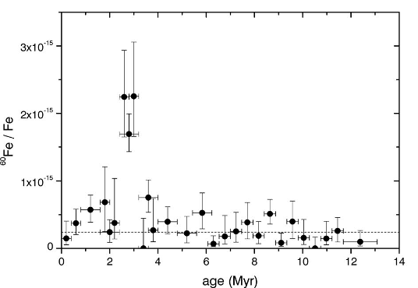
⁶⁰Fe from sediments and crusts
⁶⁰Fe flux
Knie et al. 2004
Deep-sea sediments
Deep-sea crusts
Deep-sea nodules
Nature 2016

Slide 43
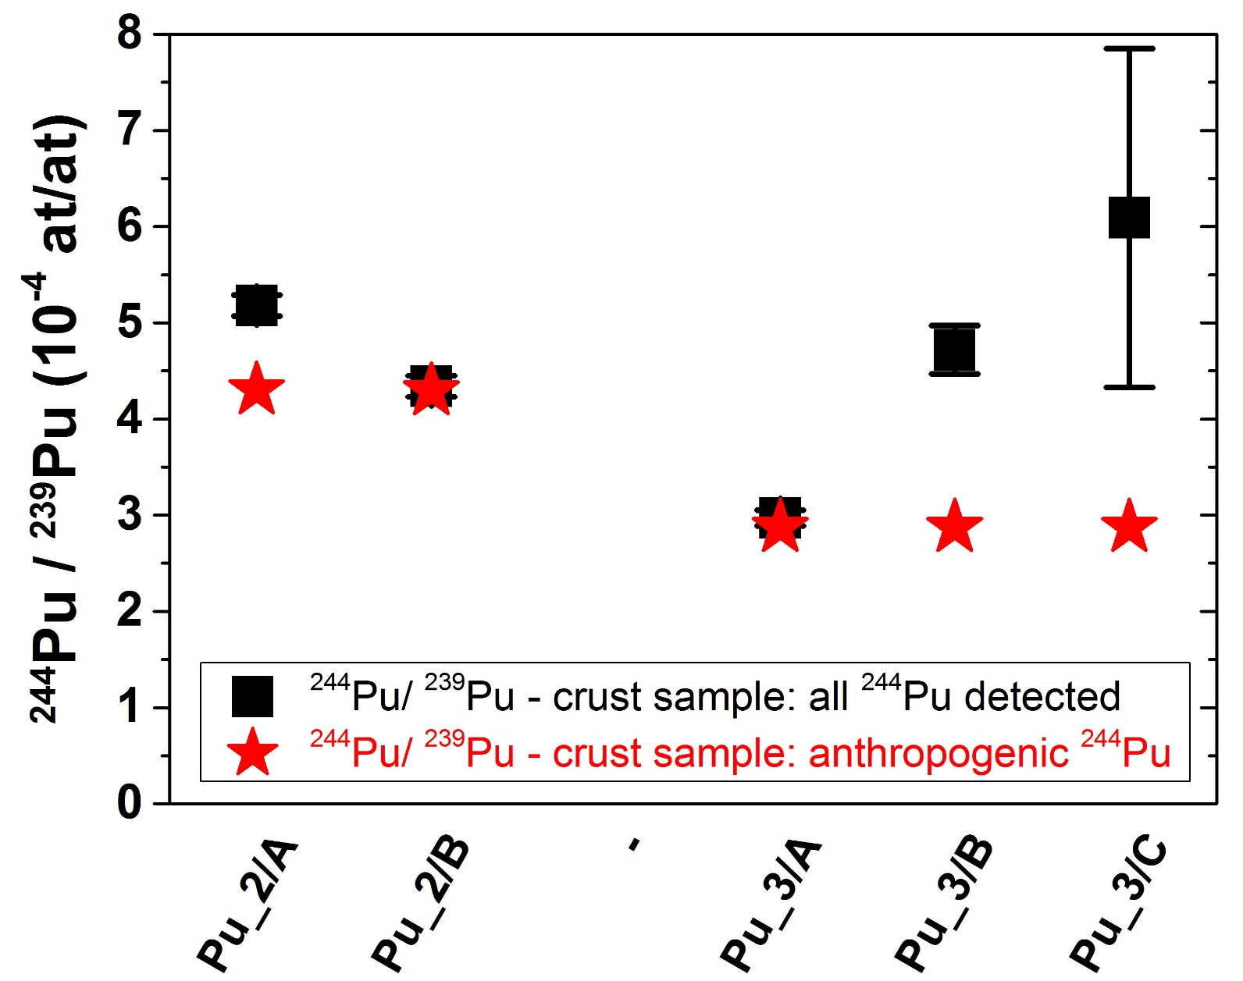
New ²⁴⁴Pu data – new Crust2 and 3

Slide 45

ANU (15 MV) - Canberra
VERA (3 MV) - Vienna

Slide 46
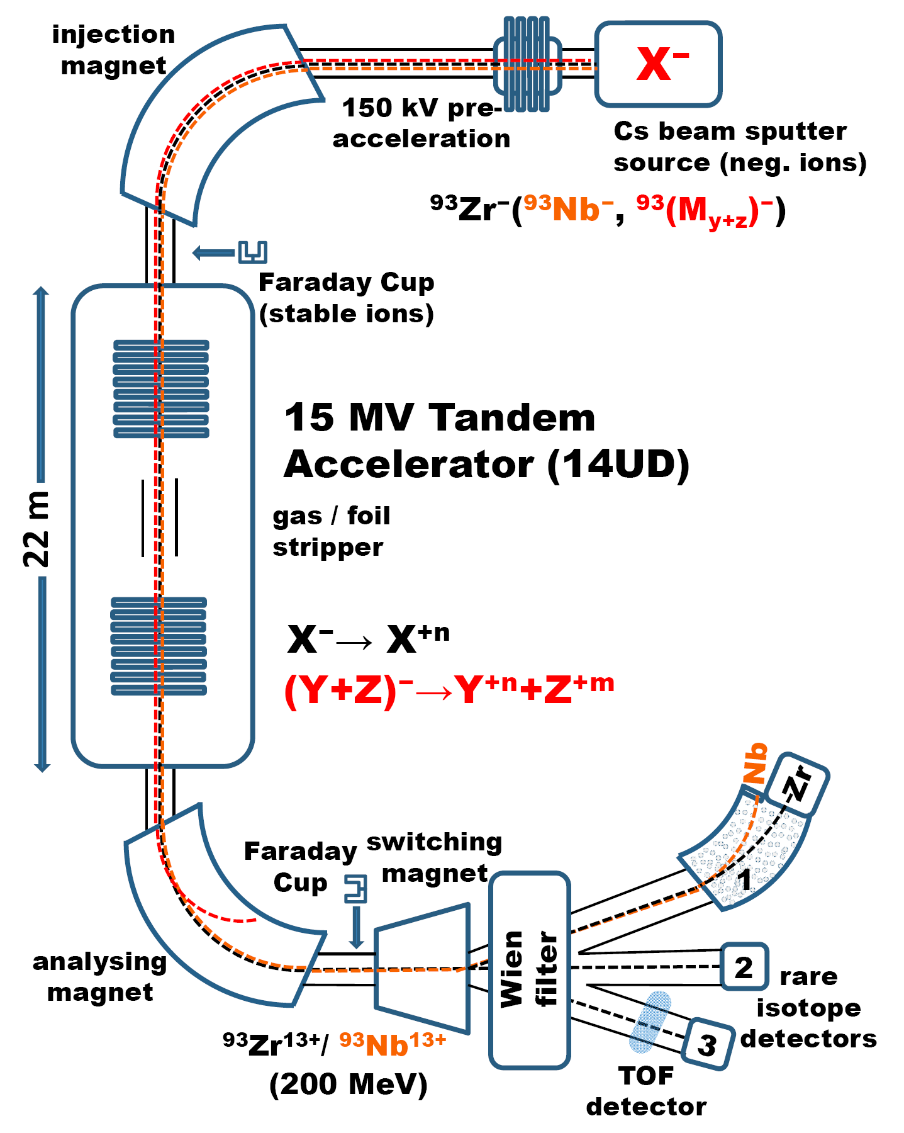
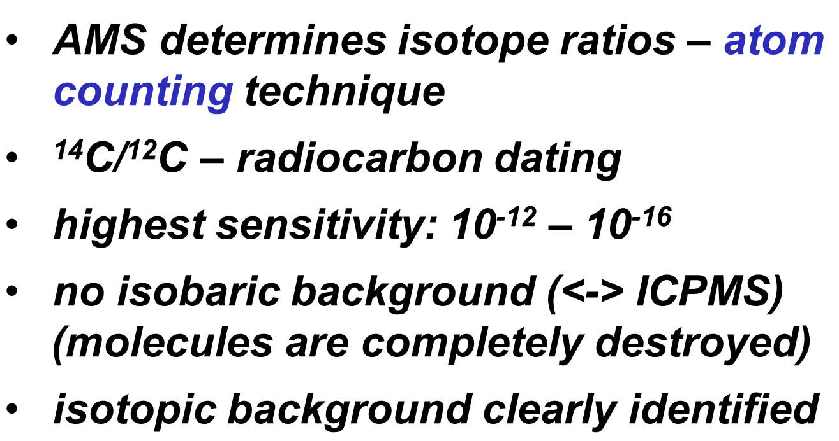
ANU’s AMS facility

Slide 47


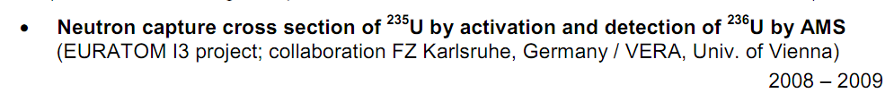
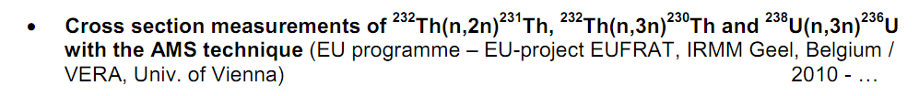
European collaborations
AMS in Vienna/VERA or at the ANU – neutron activations at IRMM / KIT / BRR / PTB

Slide 48
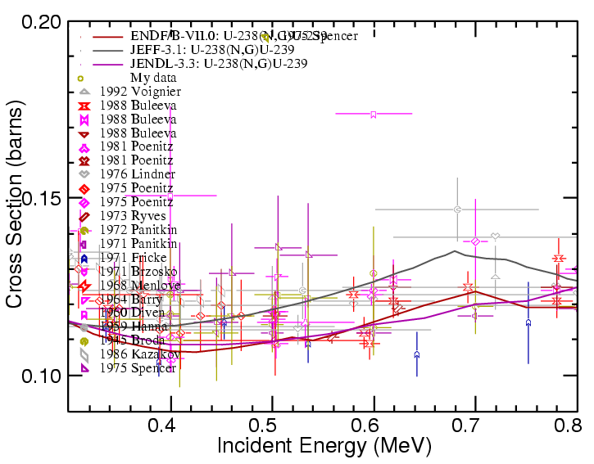
Motivation: ^{235,8}U(n,x)/ ²³²Th(n,x): E_{n}>thermal
ratio of capture to fission of the fissile isotopes
existing data: via TOF and detections of prompt γ-rays
multiple scattering corrections due to large sample size in previous exp.?
HPRL (NEA) listed
discrepancies above thermal E_{n}
activation + AMS (accelerator mass spectrometry) is an independent method; no influence from fission channel
new method – very sensitive → independent uncertainties
MANTRA: Cross-Sections from Th to Cf with AMS – ANL
X. Wang et al: ²³⁸U(n,3n) at 14 MeV – CIAE

Slide 49
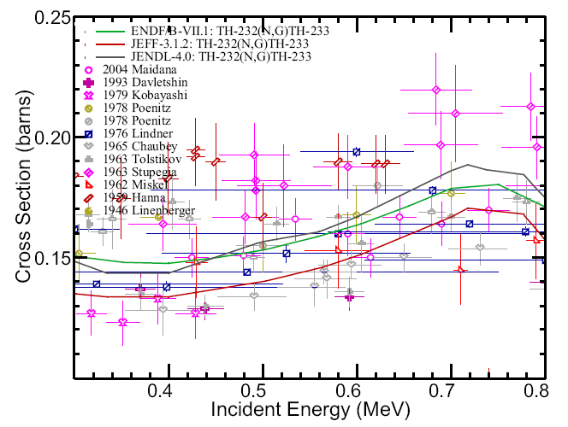
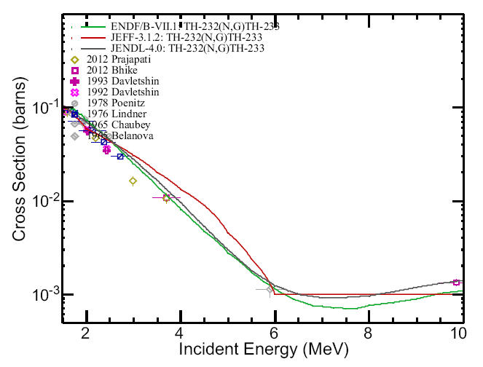
²³²Th(n,γ)²³³Th
0.3 – 0.8 MeV 1.5 – 10 MeV

Slide 50
(n,3n) for ²³⁸U and ²³²Th

Slide 52
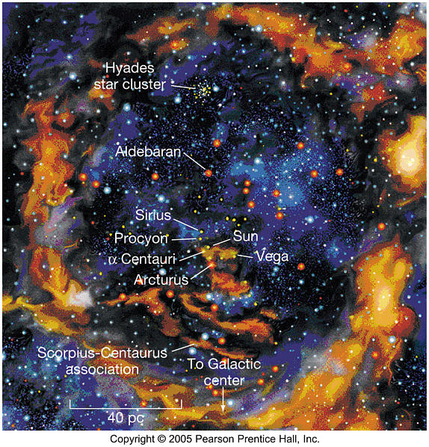
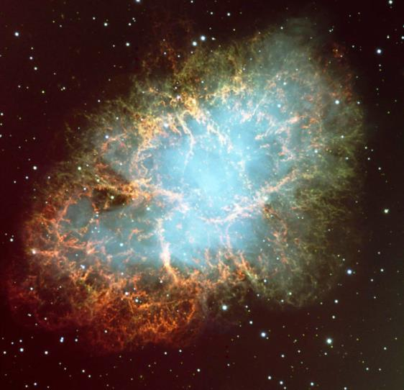
Extraterrestrial Radionuclides on Earth
Can we find isotopic fingerprints of the ISM (interstellar medium) in terrestrial archives?
Radionuclides contain time information as they can serve as radioactive clocks!

Slide 53
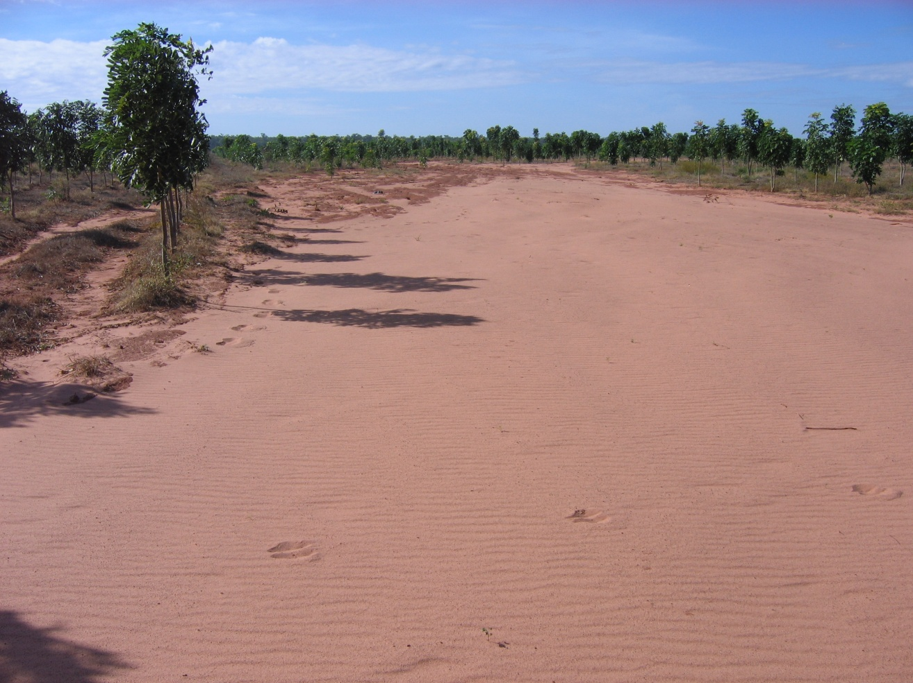
A mahogany plantation near Darwin
– the result of 140 mm of rain in 24 hours
Plutonium-labelled soil in motion

Slide 54
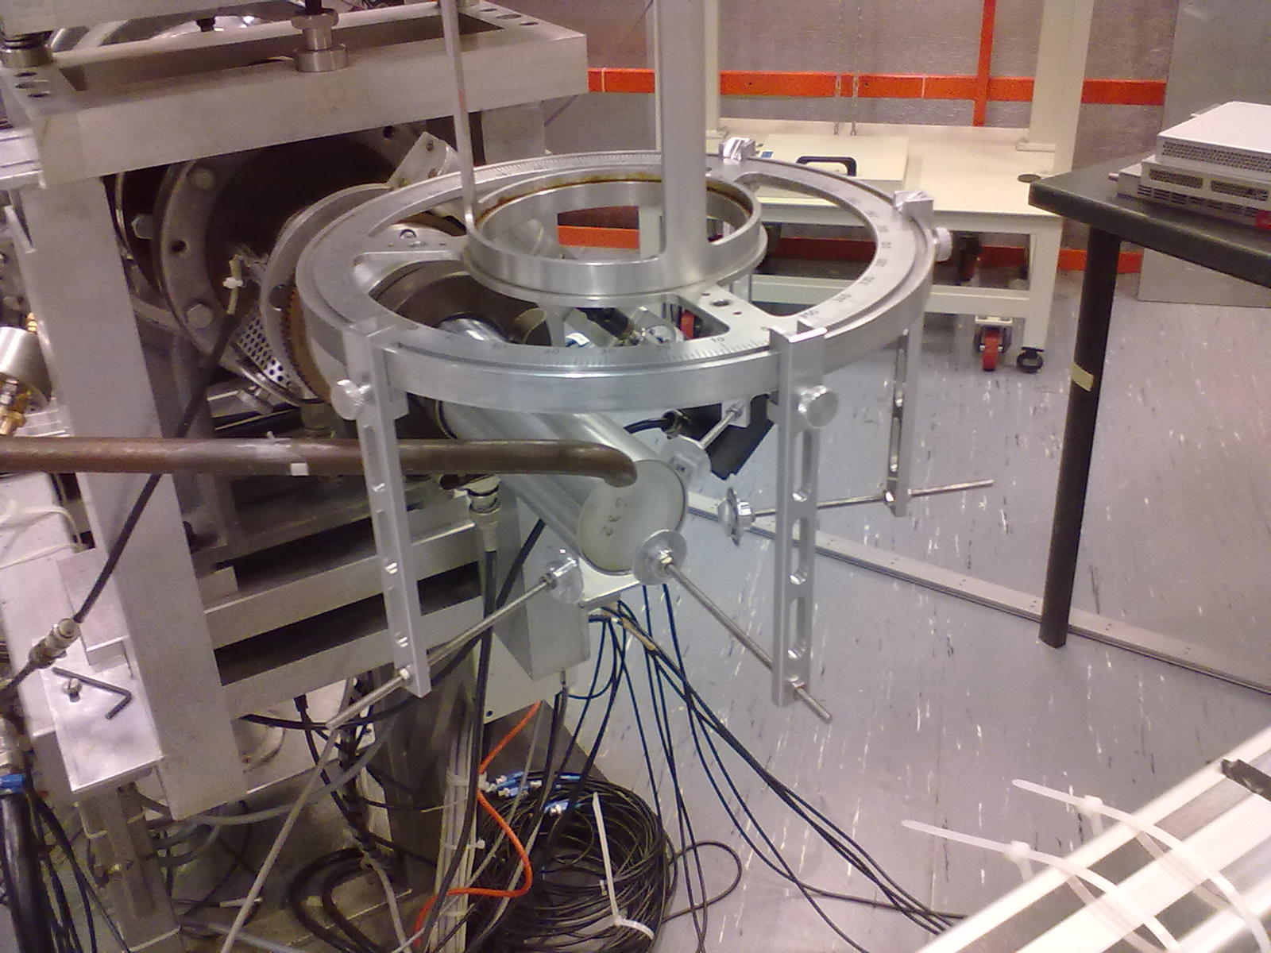

Slide 55
Status ²³²Th(n,γ)²³³Th & ²³⁸U(n,γ)²³⁹U for 0.5 / 1.0 / 2.1 / 5.0 MeV
AMS @ ANU finished - for both reactions and all energies
AMS ratio measurements: uncertainties 5% – 15%
still pending: careful check of neutron energy distribution for final fluence / cross section values
o) low energy component in the distribution
o) T(p,n) reaction for neutron production (0.5, 1.0 & 2.1 MeV)
o) D(d,n) reaction for neutron production (2.1 & 5.0 MeV)
AMS at the ANU
Notes:
The ²³⁸U(n,γ) cross-section values show discrepancies between the different evaluations and they differ also to experimental data above 2 MeV. The evaluations themselves exhibit differences of 10% (ENDF vs JEFF) for neutron energies around 500 keV and this steadily increases to 30% at 3 MeV and to 50% at 5 MeV (see Fig.1). For Th similar conclusions can be drawn: The experimental data points show a larger scatter and no experiments are listed in EXFOR for energies above 2.7 MeV (Fig. 2).
¹⁹⁷Au(n,g) cross section standard
Above 2 MeV the normalization will be to the H(n,n)H and/or U-235/238 standard cross sections by using a transfer detector. For the entire energy range this will imply the use of the time-of-flight technique and/or the distance variation method using activation foils (Au, In, Fe) checked against a primary fluence standard (H(n,n)H and one of ²³⁵U(n,f) and ²³⁸U(n,f)).

Slide 56
²³⁸U(n,γ)²³⁹U

Slide 57
²³²Th(n,γ)²³³Th

Slide 58
First results - ²³⁸U(n,3n)²³⁶U
17.55 MeV: AMS finished - ± 2%
20.05 MeV: AMS finished - ± 2%
! Preliminary data: ca. 3-4x previous values ? – 17.55 MeV: “σ = (2.69 ± 0.05) barn“
– 20.05 MeV: “σ = (3.05 ± 0.05) barn”
?
1 set of experimental data or no data at all.
Fluence! ↔ number of neutrons/sample

Slide 59
First results - ²³²Th(n,2n)²³¹Th
17.55 MeV: AMS finished - 3x AMS (Vienna, Zurich, Sydney)
18.80 MeV: AMS finished - 3x AMS (Vienna, Zurich, Sydney)
20.05 MeV: AMS finished - 3x AMS (Vienna, Zurich, Sydney)
22.00 MeV: AMS finished - 3x AMS (Vienna, Zurich, Sydney)
(pending: normalisation)

Slide 60
First results - ²³²Th(n,4n+α)²²⁹Th

Slide 61
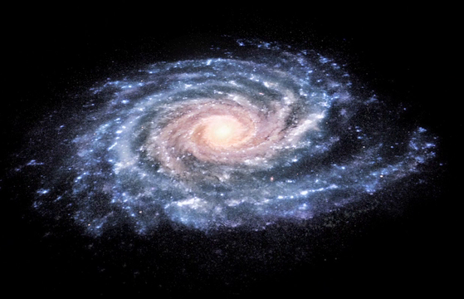
ESA/NASA
SN-rate in our galaxy:
2 per century
1 SN per 3 Myr within 100 pc to Earth
galaxy
diameter: 40,000 pc (130,000 Lyr)

Slide 62
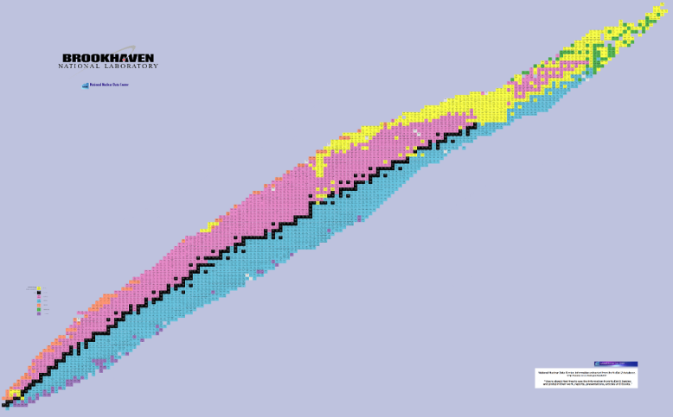
²⁴⁴Pu – monitor of heavy r process nucleosynthesis
Z
s & r process
r process only
Neutron capture:
slow neutron capture (s process)
rapid neutron capture (r process)
N

Slide 63
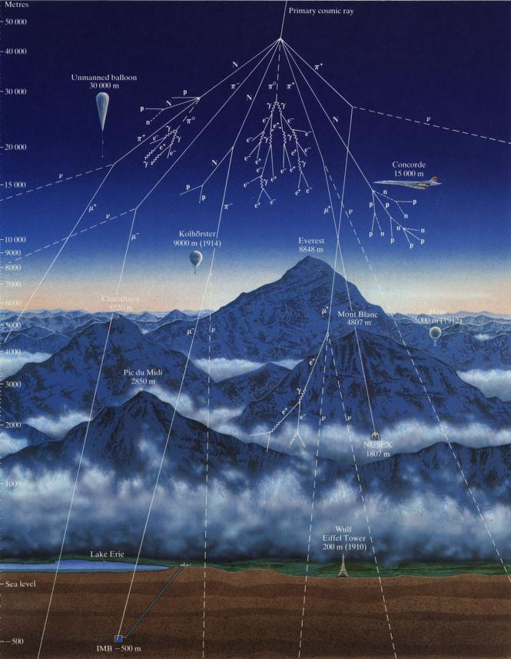
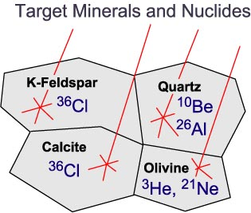
Cosmogenic nuclides
e.g. ⁷Be, ¹⁰Be, ¹⁴C, ²¹Ne, ²⁶Al, ³⁶Cl from O, N, Ar
Earth and Space Science
• Terrestrial cosmogenic nuclide production
• Atmospheric processes
• Paleoclimatology
• Geomorphology
• Neotectonics
• Glaciology
• Hydrology (ground water dating)
• Cosmic ray exposure of meteorites
• Solar variability

Slide 64
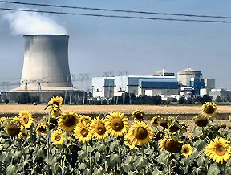
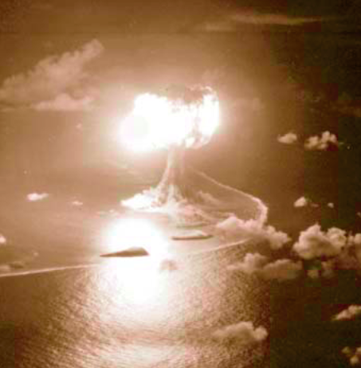
Pu, U in Environmental Samples Motivation
Pu & U isotopic composition: "fingerprint" of different sources (anthropogenic)
    atmospheric weapons testing
    direct discharge of radioactive wastes
    accidental release
    minor sources: … low-level radioactive waste disposal, slight leakage from nuclear power plants
    erosion studies via Pu-spikes from 60ies (soil and sediment transport & movement)
    Nuclear forensics, uranium exploration, biological uptake of actinides, ocean currents, …

Slide 65
Isotope ratios
and: ^{238,241,242,244}Pu/²³⁹Pu, ²³⁶U/²³⁸U in the environment as sensitive markers
-- fingerprints --

Slide 66

Summary / Status

Slide 67
Summary / Status

Slide 68

Comparison with recent high precision GELINA data and n_TOF (2016)
25 keV: KIT & AMS: 391 +- 17 mbarn
25 keV: GELINA: 407 +- 10 mbarn
n_TOF: ²³⁸U(n,γ) – new data 1 eV – 700 keV; see F. Mingrone:
    25 keV: very good agreement
    0.46 MeV: KIT/AMS is 10% lower
    0.52 MeV: JRC/AMS is close to n_TOF

Slide 69

²³⁸U(n,γ)²³⁹U - new data

Slide 70



(II) Nucleosynthesis in the laboratory
(I) sample exposure
stellar nucleosynthesis → laboratory studies
e.g. activation
(II) AMS: analysis

Slide 71

Fe – AMS data
addendum:
new data: 14 – 20 MeV
long-lived reaction
products:
  ⁵⁶Fe(n,2n)⁵⁵Fe
  ⁵⁴Fe(n,2n)⁵³Fe [→ ⁵³Mn]
  ⁵⁴Fe(n,γ)⁵⁵Fe
  ⁵⁴Fe(n,np+d)⁵³Fe → ⁵³Mn
  ⁵⁸Ni(n,α)⁵⁵Fe
⁵⁵Fe - AMS: ± 2%

Slide 72


⁵³Fe / ⁵³Mn
⁵³Mn: t_{1/2} = 3.7 My

