Slide 1
Evaluating multipole mixing ratio from conversion electron data
Tibor Kibèdi
Tibor Kibèdi, Dep. of Nuclear Physics, Australian National University
28-Apr-2015, IAEA NSDD Workshop

Slide 2
Conversion coefficients
Electron conversion
Transition probability
  λ_{T} = λ_{γ} + λ_{K} + λ_{L} + λ_{M}…… + λ_{π}
Conversion Coefficient
e⁻ - e⁺
pair
γ-ray
M
L
K
Mixed transition
or using the Mixing ratio
Special class: M1+E2+E0 …
Tibor Kibèdi, Dep. of Nuclear Physics, Australian National University
28-Apr-2015, IAEA NSDD Workshop

Slide 3
Using BrIcc
Put all BrIcc and BrIccMixing files into one directory
Include this folder into the “PATH” variable
Set the “BrIccHome” variable to point to this folder
Windows installation script will do it automatically
Use the “SET” command to verify these settings
BrIcc and BrIccMixing are console applications and should run from a console terminal window from any directory
Always use the latest version!
Basic help can be obtained by “bricc ?” and “briccmixing ?”
Examine - calculation report file (“BrIcc.lst”)
  - records to be INSERTED, DELETED or
  REPLACED (“Cards.new”)
Tibor Kibèdi, Dep. of Nuclear Physics, Australian National University
28-Apr-2015, IAEA NSDD Workshop

Slide 4
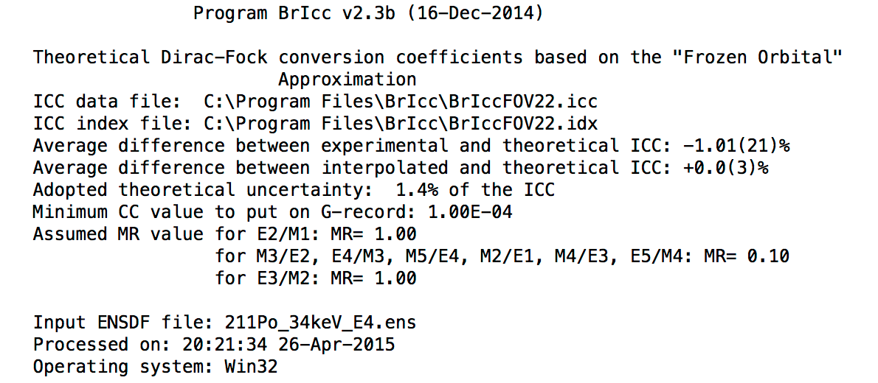
BrIcc - Calculation report
Can be changed
Tibor Kibèdi, Dep. of Nuclear Physics, Australian National University
28-Apr-2015, IAEA NSDD Workshop

Slide 5
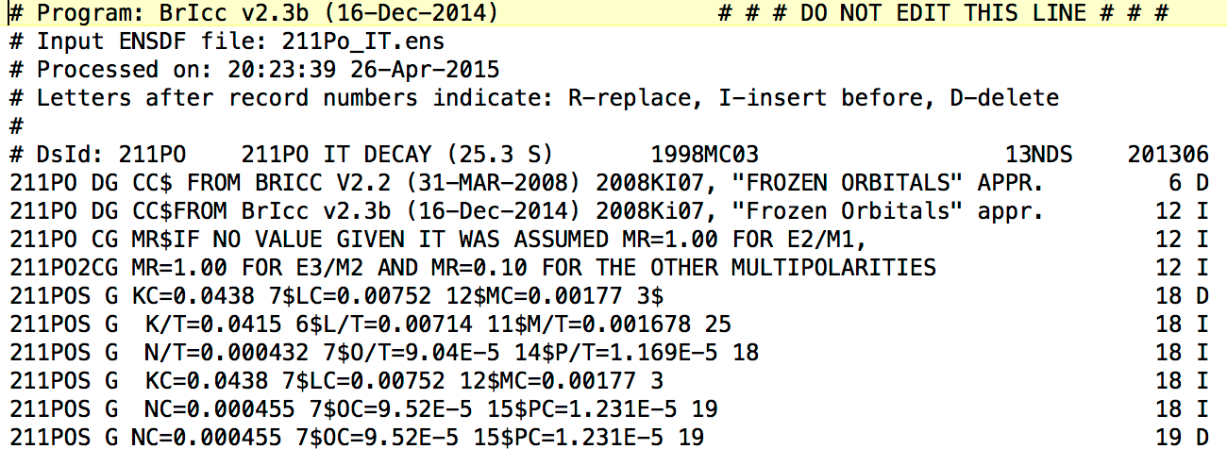
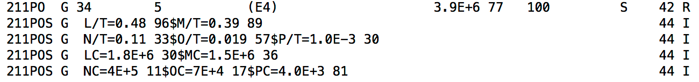
BrIcc – new cards
Versions since 31-Mar-20008
9-Jul-2008, 20-Jan-2009, 19-Oct-2009, 18-Apr-2011, 13-Aug-2011, 9-Oct-2012, 29-Mar-2013, 28-Jun-2013, 7-Aug-2013,
16-Dec-2014
Tibor Kibèdi, Dep. of Nuclear Physics, Australian National University
28-Apr-2015, IAEA NSDD Workshop

Slide 6
BrIcc – new cards
CC-DCC_L overlaps with ZERO
Non-Physical
Balraj Sing (26-Sep-2012)
6.5E+6 50
in ENSDF
Tibor Kibèdi, Dep. of Nuclear Physics, Australian National University
28-Apr-2015, IAEA NSDD Workshop

Slide 7
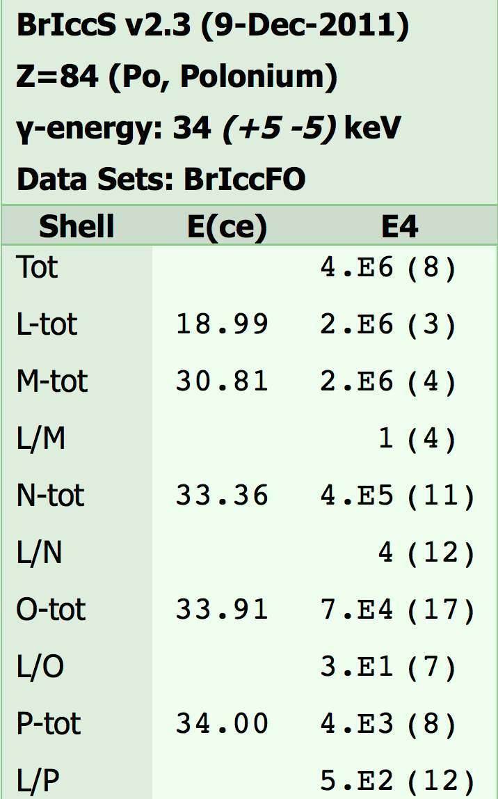
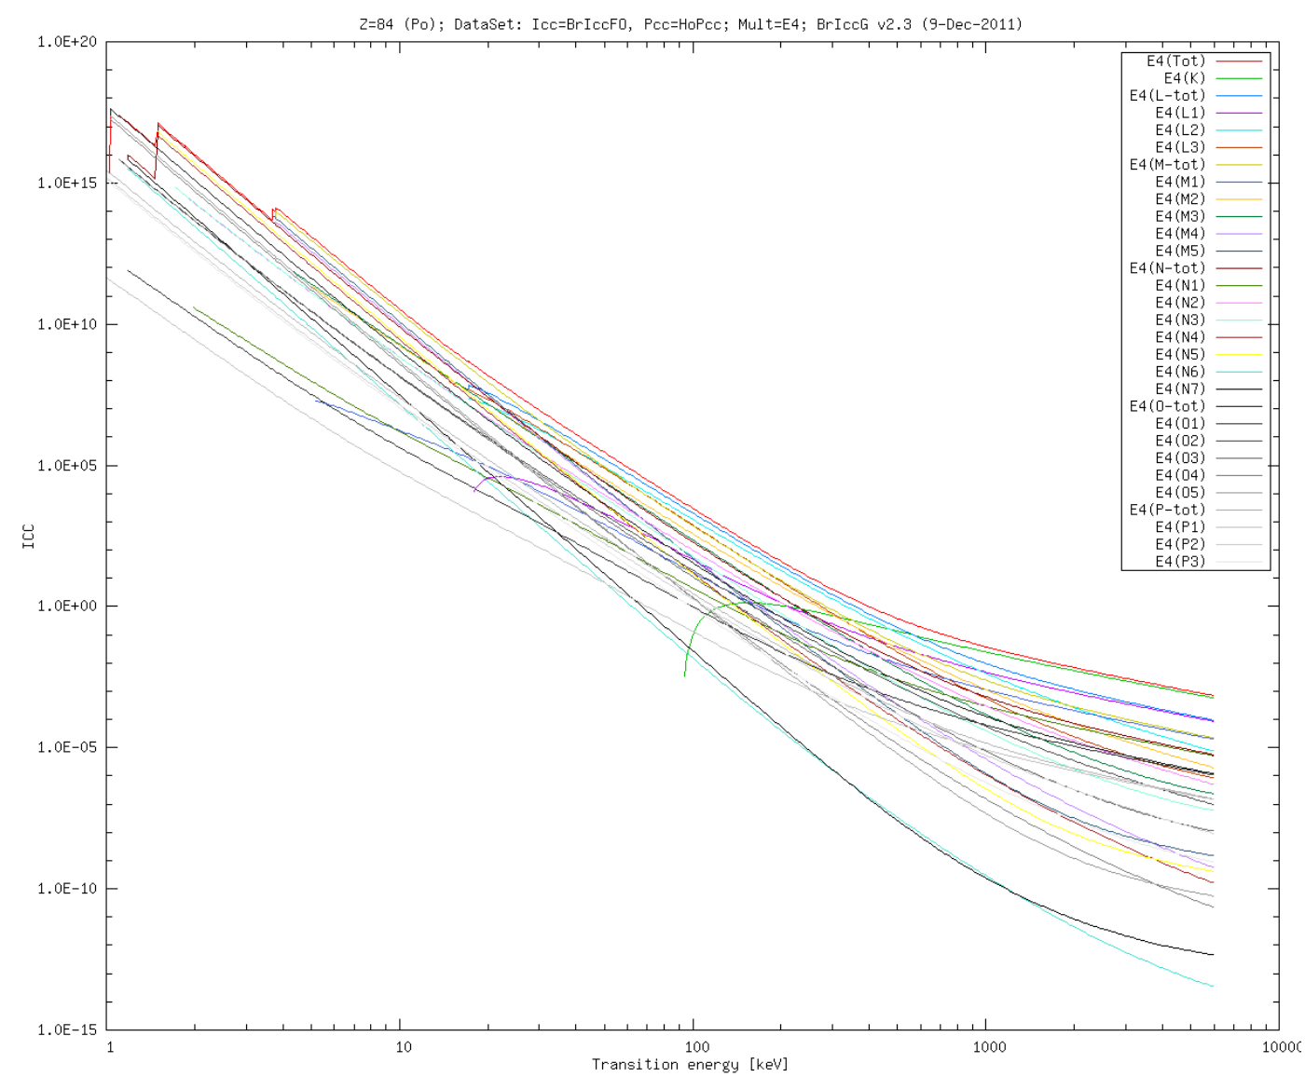
Check uncertainties
34(5) keV E4 transition in ²¹¹Po
Tibor Kibèdi, Dep. of Nuclear Physics, Australian National University
28-Apr-2015, IAEA NSDD Workshop

Slide 8
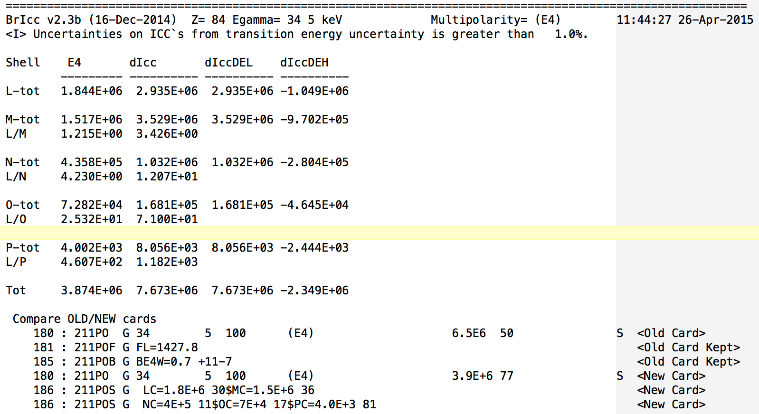
How BrIcc handles uncertainties
34(5) keV E4 transition in ²¹¹Po
α_{T} = 1.53E6 (35+5 keV)
CC = 3.87E6 (34 keV)
α_{T} = 1.16E7 (35-5 keV)
CC±DCC overlaps with zero!
Tibor Kibèdi, Dep. of Nuclear Physics, Australian National University
28-Apr-2015, IAEA NSDD Workshop

Slide 9
How BrIcc handles uncertainties
34(5) keV E4 transition in ²¹¹Po
Log scale
α_{T} = 1.53E6 (34+5 keV)
CC = 3.87E6 (34 keV)
α_{T} = 1.16E7 (34-5 keV)
Tibor Kibèdi, Dep. of Nuclear Physics, Australian National University
28-Apr-2015, IAEA NSDD Workshop

Slide 10
How BrIcc handles uncertainties
34(5) keV E4 transition in ²¹¹Po
Log scale
α_{T} = 1.53E6 (35+5 keV)
CC = 3.87E6 (34 keV)
α_{T} = 1.16E7 (35-5 keV)
CC = [1.16E7 + 1.53E6] / 2
CC = 6.57E+6
DCC = [1.16E7 - 1.53E6] / 2
CC = 5.04E+6
Adopt CC= 6.6E+6 50
Edit “Cards.new” before running
“bricc 211Po_IT.ens merge”
6.5E+6 50
in ENSDF
Tibor Kibèdi, Dep. of Nuclear Physics, Australian National University
28-Apr-2015, IAEA NSDD Workshop

Slide 11
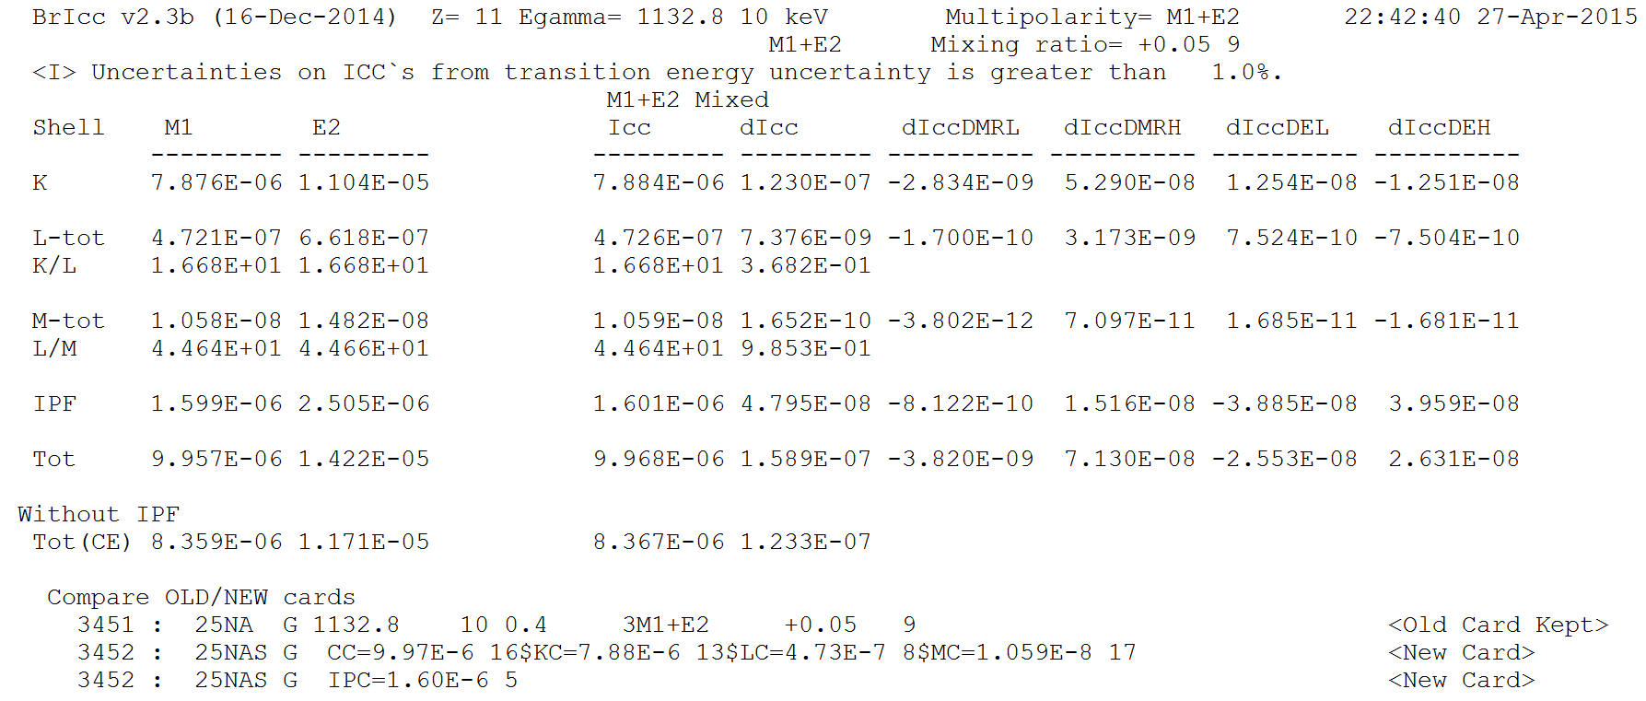
How BrIcc handles uncertainties
1754.9(6) keV M1+E2 transition in ¹⁶O
Unc from MR
Pure
mixed
Unc from E
CC < 1E-4 !
Tibor Kibèdi, Dep. of Nuclear Physics, Australian National University
28-Apr-2015, IAEA NSDD Workshop

Slide 12
Using BrIccMixing
BrIccMixing can be used to determine the ABSOLUTE value of the multipole MIXING RATIO, “MR”
BrIcc and GnuPlot (http://www.gnuplot.info) to be installed
Available on myENSDF
Accepts various types of measured data with symmetric uncertainties; free format, NDS uncertainties:
  “NSR-key”(max 20 char) “SHELL” “VAL” “UNC” “TYPE”
  1968GeZW L1/L3 23.0 16 R
  Conversion coefficients (Absolute values, A):
      K, L2, M23 (M2 + M3)
  Ratios of conv. coeff. or intensities (Relative values, R):
      K/L, L12/M34 ([L1+L2]/[M3+M4])
  Mixing ratios(Absolute values, A):
      MR
Tibor Kibèdi, Dep. of Nuclear Physics, Australian National University
28-Apr-2015, IAEA NSDD Workshop

Slide 13
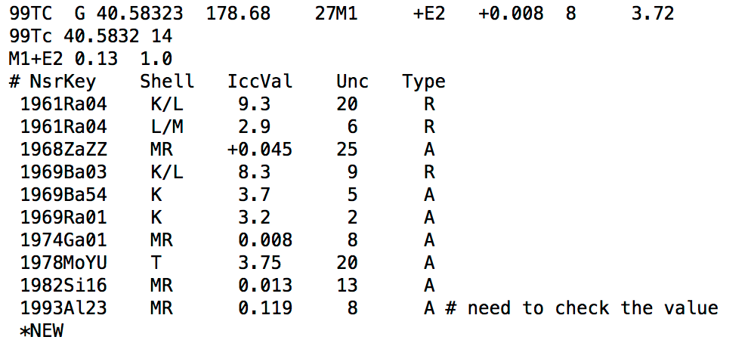
BrIccMixing – Input file
Titile
Transition to load BrIcc table and
Specity multipolarity
Comments
New dataset
Tibor Kibèdi, Dep. of Nuclear Physics, Australian National University
28-Apr-2015, IAEA NSDD Workshop

Slide 14
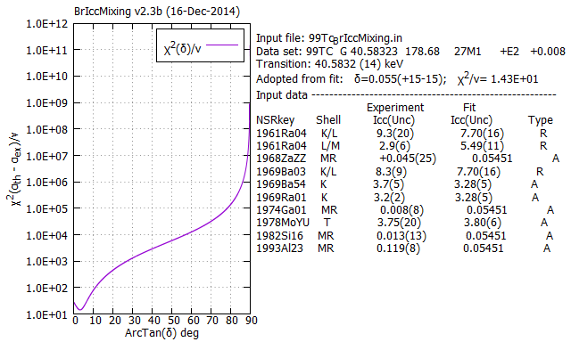
Running BrIccMixing
briccmixing 99Tc_BrIccMixing.in :
Method of solution
(a) CFIT 1980Ry04
(b) Searching Χ²/ν v.s. MR
  hyper surface
Find Χ²/ν minimum ➔ MR
Find DMR_L & DMR_H where
  Χ²/ν risen by 1
Tibor Kibèdi, Dep. of Nuclear Physics, Australian National University
28-Apr-2015, IAEA NSDD Workshop

Slide 15
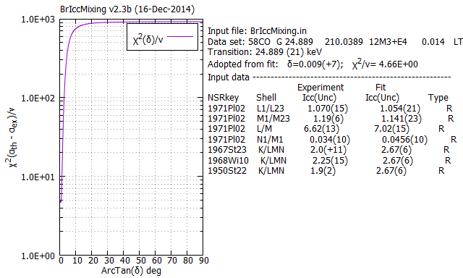
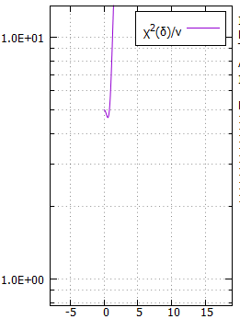
Running BrIccMixing
Find minimum, but no lower limit
Tibor Kibèdi, Dep. of Nuclear Physics, Australian National University
28-Apr-2015, IAEA NSDD Workshop

Slide 16
Measuring conversion coefficients
Tibor Kibèdi, Dep. of Nuclear Physics, Australian National University
28-Apr-2015, IAEA NSDD Workshop

Slide 17
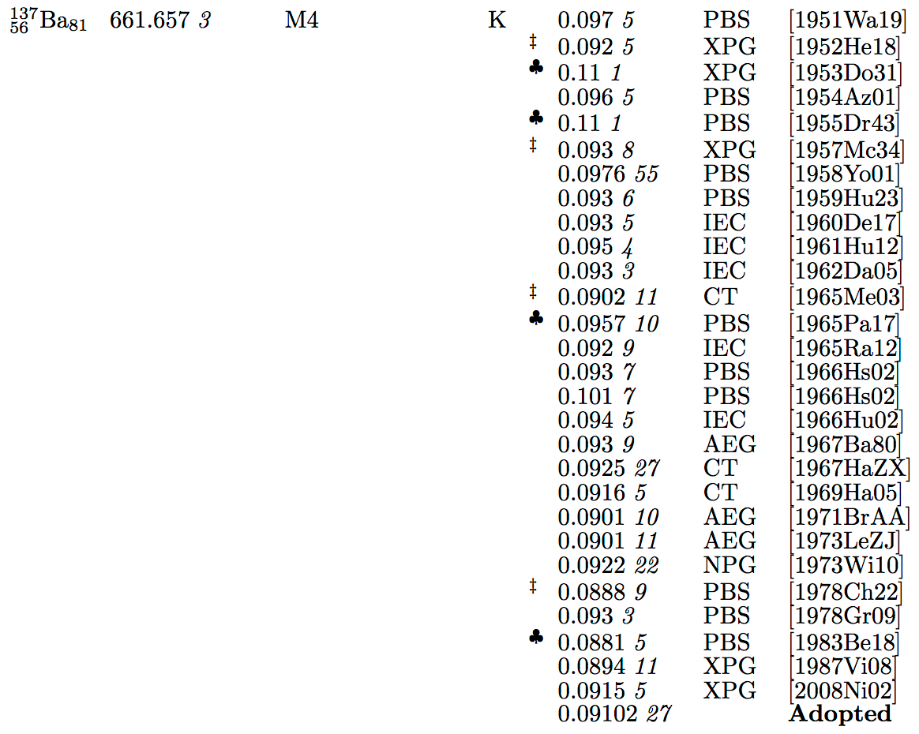
Measuring conversion coefficients
1952He18 reported EKC=XPG; 0.095 5
  Assuming Ω_{K}(Ba)=0.87 1
Using Ω_{K} (Ba)=0.900 4 (1996SCo6)
EKC=0.092 5
Tibor Kibèdi, Dep. of Nuclear Physics, Australian National University
28-Apr-2015, IAEA NSDD Workshop

Slide 18
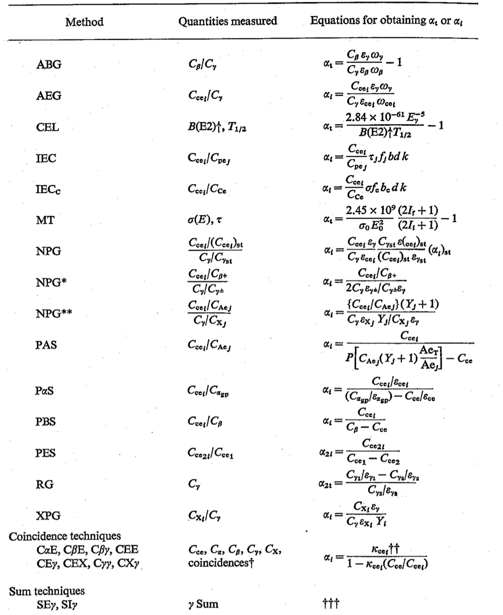
Measuring conversion coefficients see In Proc. Internal Conversion Process, ed.by Hamilton, J.H., North-Holland, 1975
Tibor Kibèdi, Dep. of Nuclear Physics, Australian National University
28-Apr-2015, IAEA NSDD Workshop

