Slide 1
Decay Scheme Normalizations

Slide 2
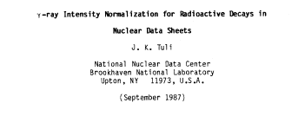
Reference Material

Slide 3
Relevant Quantities Needed to Deduce
NR – relative photon intensity to photons / 100 decays
NT – relative transition intensity to transitions / 100 decays
Above are through the particular decay branch
BR – Convert intensity / 100 decay through this decay branch to intensity per 100 decays of the parent
NB – relative beta and ec intensities to intensities per 100 decays through this decay branch
NP – convert per 100 delayed transition intensities to per 100 decays of the precursor

Slide 4
Decay Scheme Normalization Quantities
NR
NT
BR
NB
NP
Relative Intensity | Normalization Factor | Absolute Intensity
Iγ x | NR x BR | =%Iγ
I (tot) x | NT x BR | =%I (tot)
Iβ (or ε or α) x | NB x BR | = % Iβ (or ε or α)
Iβn (or Iεp) x | NP x BR | = % Iβn (or Iεp)
Beta and ec are usually given as per 100 parent decays.
Since NBxBR, NB=1/BR

Slide 5
Initial Observations
There is good documentation on how to normalize decay schemes … but information on how that translates in use of NR, BR, NB, etc is lacking
Would be more convenient if everything was in one place
I don’t understand the policy for particle transition intensities
Examples are meant to be learning exercises, not criticisms…attempt at anonymity (apologies if I failed)

Slide 6
Times have changed

Slide 7
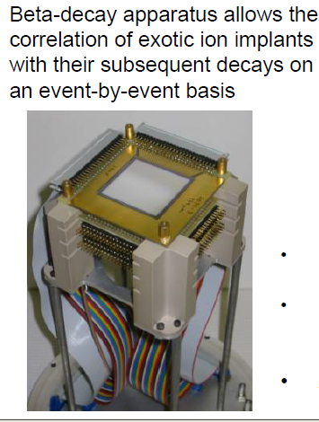
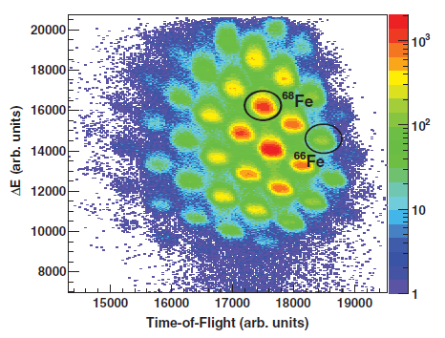
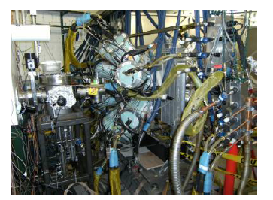
The Future
# of ions counted individually

Slide 8
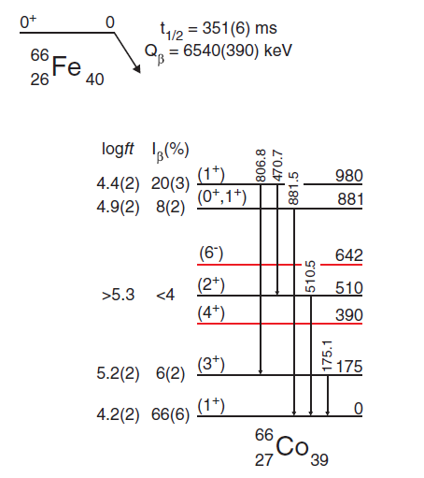
But a Careful Review is Still Required
BR=
1
1
NR=
For excited levels:
Iβ=ΣI(γ+ce)(out)-ΣI(γ+ce)(in)
15(3)
5(2)
8(3)
For ground state :
20(4)
Iβ=100-ΣI(γ+ce)(gs)
8(3)
14(2)
14(2)-15(3) = -1 (4) → <3
6(2)
6(2)-5(2) = 1 (3) → <4
100 – 6(2) – 14(2) – 8(3) = 72 (5)

Slide 9
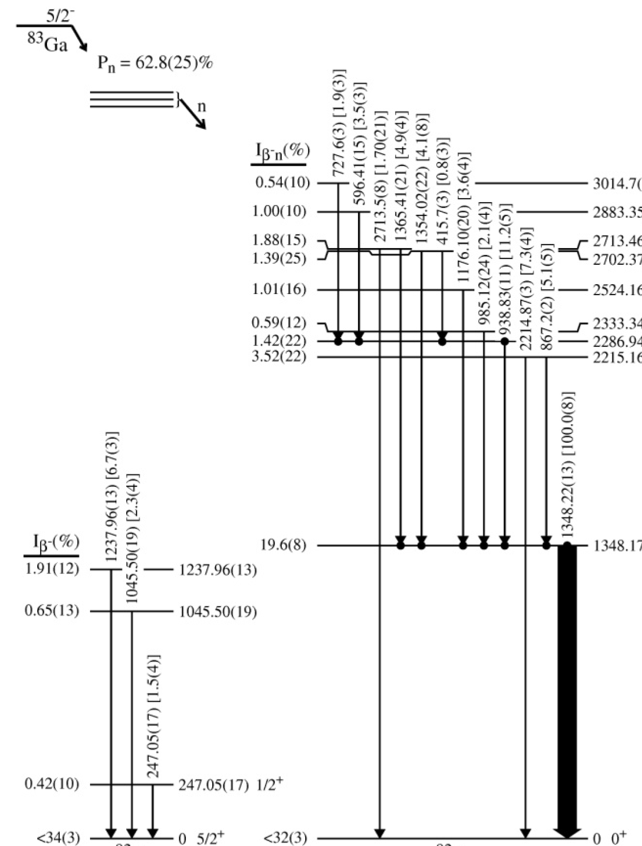
B- and B-N Example
Absolute Intensity 1348γ = 28.4(10) %
N = %Iγ / Iγ
NR=
BR=
0.284 (10)
1.0
Beta feedings are
6.7*0.284 = 1.9
2.3*0.284 = 0.65
1.5*0.284 = 0.42
GS feeding
100-Pn-ΣI(γ+ce)(gs)
100-62.8-1.9-0.65-0.42
<34

Slide 10
Absolute Intensity of 1348γ = 28.4(10) %
NR=
BR=
0.284 ?
0.628 ?

Slide 11
The details
This is Pn
BR=0.628
28.4 is Iγ per 100 decays
Through the decay branch, you need :
0.284/0.628 = 0.425
NR=0.425

Slide 12
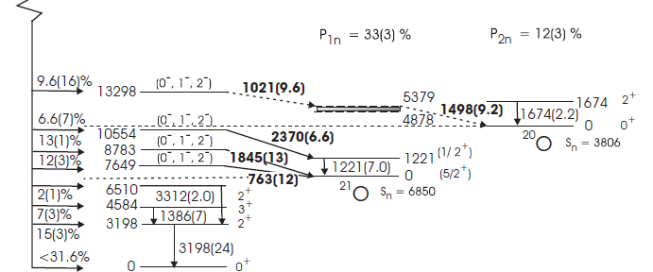
How to define NP?
Example of B-N and B-2N Decay

Slide 13
Start with the “easy” beta-decay
Intensities are again given
as Absolute Ig / 100 decays
NR = 1
BR = 1
Keeping in mind that Pn=33% and P2n=12%
GS Beta Feeding is
100-Pn-P2n-ΣIγ(to gs)
100-33-12-24
< 32

Slide 14
The B-N Branch

Slide 15
Branching ratio is given
BR=0.33 3
Neutron and Gamma Intensities given in absolute units
What are NR and NP?
NP=3.03
NR=1.0

Slide 16
The details
This is Pn
BR=0.33
Iγ is given per 100 decays
Through the decay branch, you need :
NR = 1.0/0.33
NR=3.03
NP= ?

Slide 17
Finally the B-2N Branch
NR = ?
BR = ?
NP = ?

Slide 18
Particle Transition Intensities?
What is the policy for delayed particles?

Slide 19
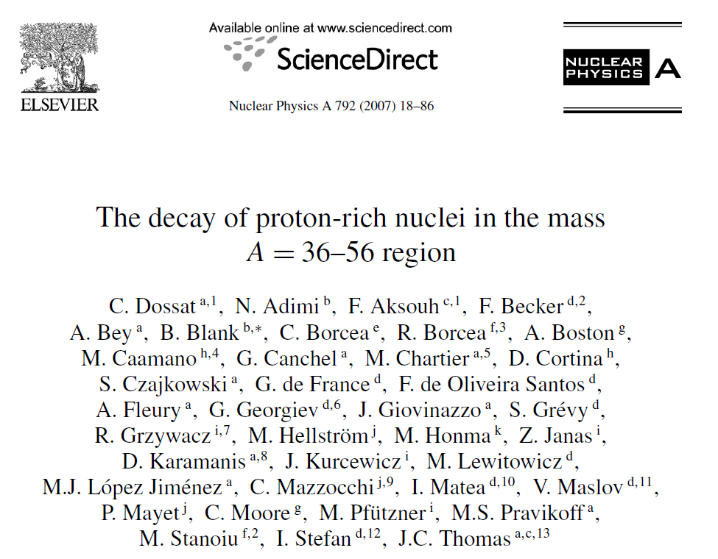
Move to the other side of stability
Studied mainly β-delayed proton emission
Data on 26 nuclei ranging from Ca-36 to Zn-56
No consistent treatment of this data in ENSDF !!

Slide 20
One way …
NP=1.0
BR= 0.884
NR=1.0

Slide 21
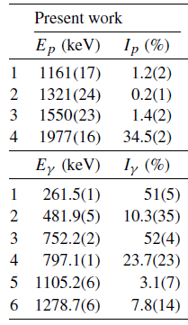
Or another…
%ECP=56.7(4)
BR=0.567
NP=0.567
NR=1.0

Slide 22
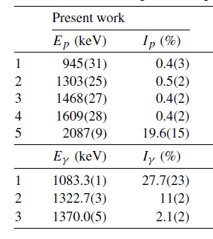
Or another…
BR=1
NP=1
NR=1

Slide 23
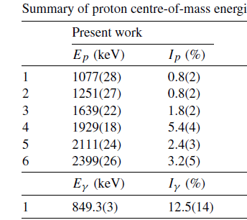
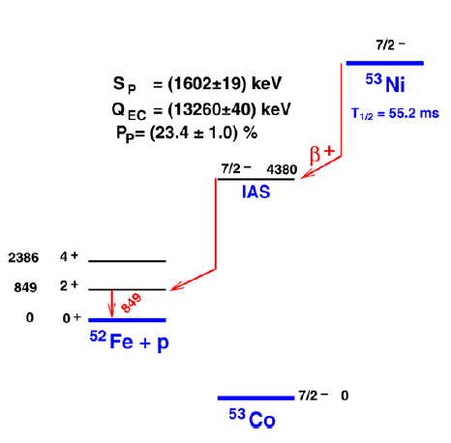
The answer is …
NR =
BR =
NP =

Slide 24
Use of Annihilation Radiation
I(γ±) = relative annihilation radiation intensity
X_{i} = intensity imbalance at the ith level
We want to isolate the β_{i}⁺ feeding
X_{i} = ε_{i} + β_{i}⁺
X_{i} = β_{i}⁺ (1+r_{i})
β_{i}⁺ = X_{i} / (1+r_{i})
r_{i}= ε_{i} / β_{i}⁺
(theoretical)

Slide 25
Use of Annihilation Radiation
r_{i}= ε_{i} / β_{i}⁺
(theoretical)
How many γ± do we expect?
I(γ±) = [ β_{o}⁺ + Σ β_{i}⁺ ] *2
I(γ±) = 2 [ X_{o}/(1+r_{o}) + Σ X_{i} /(1+r_{i}) ]
7.5/(1+0.068/1.8) = 7.23
I(γ±) = 795 (80)
8.3/(1+0.071/2.0) = 8.02
2.3(3)
(100-6.0-7.5)/(1+0.44/21.2)
= 84.7
7.5(8)
6.0(6)
100
7.2+8.0+84.7 = 99.9

Slide 26
Use of Annihilation Radiation
Solve for X_{o}
99.9
I(γ±) = 2 [ X_{o}/(1+r_{o}) + Σ X_{i} /(1+r_{i}) ]
X_{o}/(1+r_{o}) = (795/2) – 99.9 = 297.6
X_{o} = 297.6*(1+[1.01/73]) = 301.8
I(γ±) = 795 (80)
(X_{o} + Σ I(γ+ce)(to gs))*N = 100
(301.8+100)*N = 100
N = 0.25

Slide 27
IT Decay Normalization
Usually easy, since whatever comes out of the isomer has to reach the g.s.
Many options:
I(γ+ce) values
ΣI(γ+ce)(to gs) = 100
2.7
1.8
0.47
4.2
N=100/(3.4+0.47) = 25.8
3.4
ΣI(γ+ce)(out 199) = 100
N=100/(2.7+1.8) = 22.2
ΣI(γ+ce)(out 148) = 100
What’s N?
Does it matter if not balanced?
N=100/(4.2+0.47) = 21.4

Slide 28
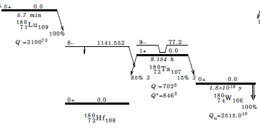
Decay related question
¹⁸⁰Hf is stable, but long lived isomer can beta decay
Policy is to put gs to gs Q value for the decay
FMTK and Webtrend do not like this

Slide 29
Pn=62.8
Calculation of beta feedings
1.9*0.284 = 0.54
3.5*0.284 = 1.00
Etc…
Calculation of gs feeding
Pn- Σof all excited feeding
62.8-0.54-1.00-1.88-1.39-1.01-0.59-1.42-3.52-19.6
<32

