Slide 1

Nuclear structure information from
cross section measurements
Negret, C. Borcea, A. Olacel
Horia Hulubei National Institute for Physics and Nuclear Engineering,
Bucharest-Magurele, ROMANIA
A.J.M. Plompen
European Comission, Joint Research Center, Institute for Reference Materials and Measurements,
Geel, BELGIUM
ENSDF Workshop, IAEA, April 2015

Slide 2
A. Negret – Nuclear structure information from cross section measurements
Summary
Neutron inelastic cross section measurements using GAINS at EC-JRC-IRMM
What can we learn?
Examples
Conclusions
ENSDF Workshop, IAEA, April 2015

Slide 3
A. Negret – Nuclear structure information from cross section measurements
Cross section measurements with GAINS
Neutron inelastic cross section measurements using GAINS at EC-JRC-IRMM
What can we learn?
Examples
Conclusions
ENSDF Workshop, IAEA, April 2015

Slide 4
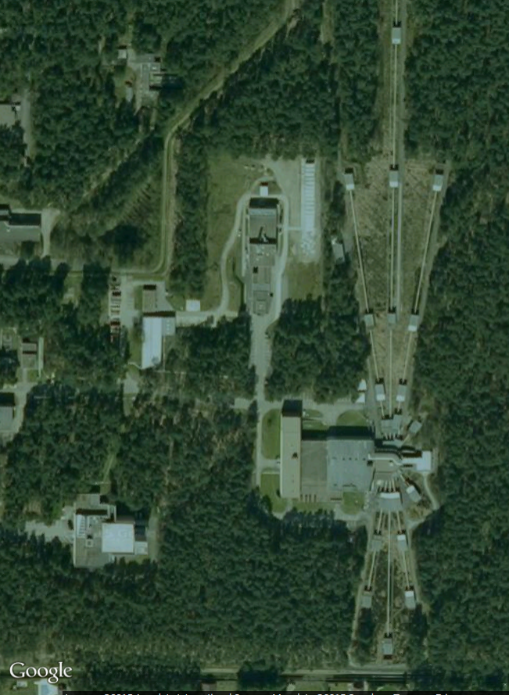
A. Negret – Nuclear structure information from cross section measurements
GELINA (Geel Linear Accelerator):
the white neutron source
Neutron source: GELINA
(white flux 100 keV – 20 MeV), operated by EC-JRC-IRMM, Geel, Belgium
TOF technique (200 m flight path):
  Amplitude ⬄ gamma energy
  Time ⬄ neutron energy
ENSDF Workshop, IAEA, April 2015

Slide 5
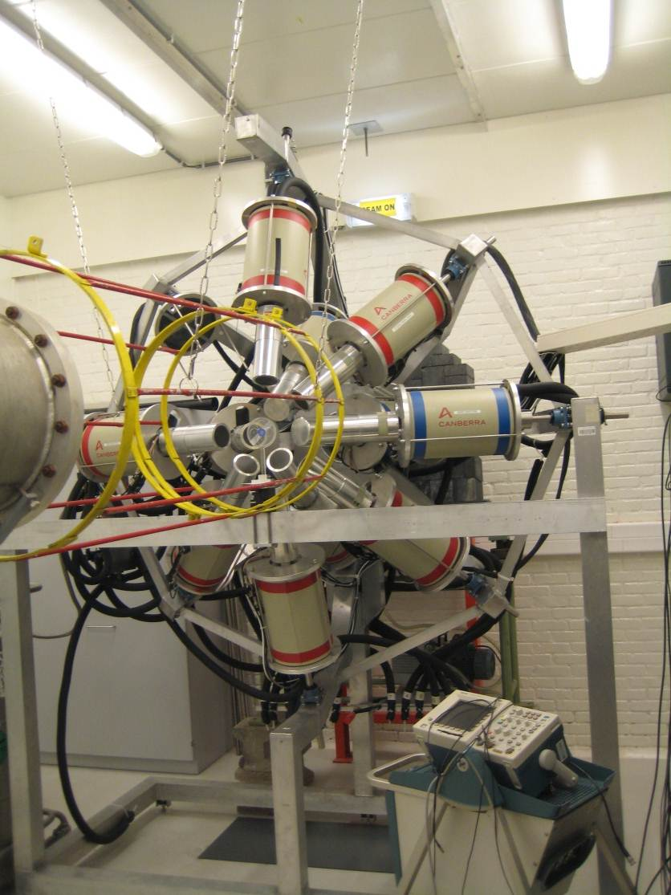
A. Negret – Nuclear structure information from cross section measurements
GAINS:
Gamma Array for Inelastic Neutron Scattering
Array of 12 HPGe detectors (ε=100%) used for highly precise neutron inelastic cross section measurements.
TOF technique (200 m flight path):
  Amplitude ⬄ gamma energy
  Time ⬄ neutron energy
Digitizer-based acquisition
(Acqiris DC440, 420 MS/s, 12 bits)
Beam monitoring: ²³⁵U Fission chamber
ENSDF Workshop, IAEA, April 2015

Slide 6
A. Negret – Nuclear structure information from cross section measurements
GAINS:
Basic Idea of data analysis
Amplitude ⬄ gamma energy
  Time ⬄ neutron energy
ENSDF Workshop, IAEA, April 2015

Slide 7
A. Negret – Nuclear structure information from cross section measurements
GAINS:
The gamma spectroscopy used to determine
X(n,n’γ)X cross sections
12 x HPGE yield
FC yield
HPGe Efficiency:
Monte-Carlo simulation
FC Efficiency
Gamma Production cross sections
ENSDF: level scheme
Total inelastic cross section
Level cross sections
ENSDF Workshop, IAEA, April 2015

Slide 8
A. Negret – Nuclear structure information from cross section measurements
Experim. result: γ production cross sections
(= excitation functions)
  ²⁸Si(n,n’γ)²⁸Si
ENSDF Workshop, IAEA, April 2015

Slide 9
A. Negret – Nuclear structure information from cross section measurements
Experim. result: level cross sections,
total inelastic cross section
  ²⁸Si(n,n’γ)²⁸Si
ENSDF Workshop, IAEA, April 2015

Slide 10
A. Negret – Nuclear structure information from cross section measurements
What can we learn
Neutron inelastic cross section measurements using GAINS at EC-JRC-IRMM
What can we learn
Examples
Conclusions
ENSDF Workshop, IAEA, April 2015

Slide 11
A. Negret – Nuclear structure information from cross section measurements
What can we learn: assignment of γs to levels
  ²⁸Si(n,n’γ)²⁸Si
ENSDF Workshop, IAEA, April 2015

Slide 12
A. Negret – Nuclear structure information from cross section measurements
What can we learn: branching ratios
  If two gammas decay from the same level:
  Their gamma production cross section has the same shape
  The ratios of gamma production cross sections for each point is the branching ratio.
  So we actually can determine the branching ratio for each neutron energy (about 2000 values).
  ²⁸Si(n,n’γ)²⁸Si
ENSDF Workshop, IAEA, April 2015

Slide 13
A. Negret – Nuclear structure information from cross section measurements
Examples
Neutron inelastic cross section measurements using GAINS at EC-JRC-IRMM
What can we learn
Examples
Conclusions
ENSDF Workshop, IAEA, April 2015

Slide 14

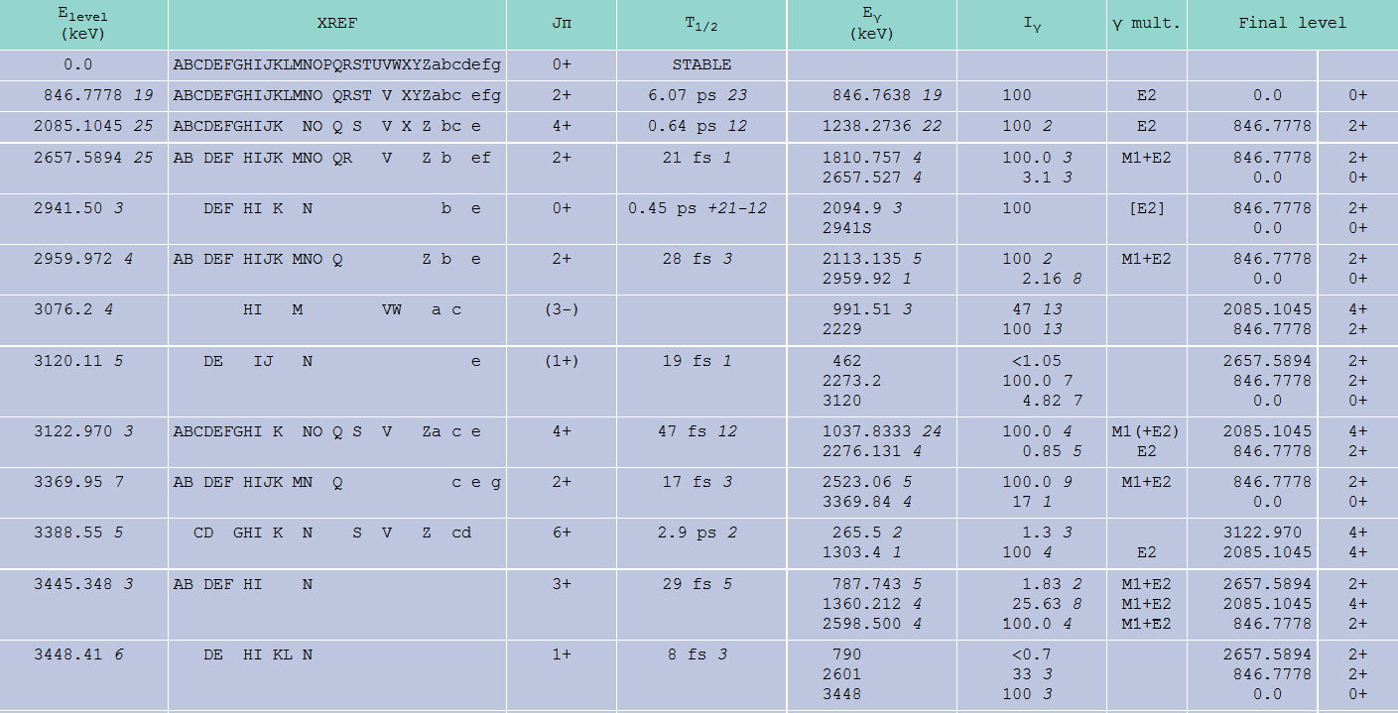
A. Negret – Nuclear structure information from cross section measurements
The 3-, 3076.2 keV level in ⁵⁶Fe
We did ⁵⁶Fe(n,n’γ)⁵⁶Fe and were able to build level cross sections for all low lying levels…
Except this one:
ENSDF Workshop, IAEA, April 2015

Slide 15
A. Negret – Nuclear structure information from cross section measurements
The 3-, 3076.2 keV level in ⁵⁶Fe
E_{γ}=991 keV
ENSDF Workshop, IAEA, April 2015

Slide 16
A. Negret – Nuclear structure information from cross section measurements
Branching ratios in ²⁰⁶Pb
γs coming from the same level have similar shapes (and of course the same threshold).
The proportionality factor is the branching ratio.
In ²⁰⁶Pb(n,n’γ)²⁰⁶Pb, for several levels, we saw more then one decaying γ.
E_{L}=1684.0 keV
E_{L}=2196.7 keV
ENSDF Workshop, IAEA, April 2015

Slide 17
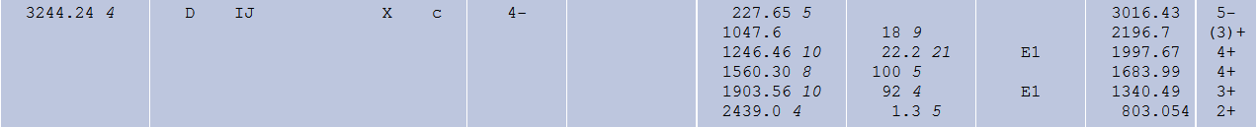
A. Negret – Nuclear structure information from cross section measurements
Branching ratios in ²⁰⁶Pb
In ²⁰⁶Pb(n,n’γ)²⁰⁶Pb, for several levels, we saw more then one decaying γ:
37.5(7)
100
100
78.9(12)
58.4(19)
24.6(18)
100
81.6(14)
100
36.9(39)
100
100.3(25)
ENSDF Workshop, IAEA, April 2015

Slide 18
A. Negret – Nuclear structure information from cross section measurements
The 2041-keV transition in ²⁰⁶Pb
  Possible source of neutron-induced background for neutrinoless double beta decay experiments [Q_{ββ}(⁷⁶Ge)=2039.06 keV]
  E_{th} ≈ 3 MeV
ENSDF Workshop, IAEA, April 2015

Slide 19
A. Negret – Nuclear structure information from cross section measurements
Conclusions
Neutron inelastic cross section measurements using GAINS at EC-JRC-IRMM
What can we learn
Examples
Conclusions
ENSDF Workshop, IAEA, April 2015

Slide 20
A. Negret – Nuclear structure information from cross section measurements
Conclusions
Neutron inelastic cross section data produced at GELINA could contain
nuclear structure information valuable for ENSDF:
- level and gamma transition sequence
- branching ratio
Other pieces of information like Eγ values are actually ignored due to the fact that the primary purpose of this experimental effort is directed towards production of precise reaction.
ENSDF Workshop, IAEA, April 2015

