Slide 1
When latest data differ from earlier ones: An example of ¹⁸⁷Hg
Shamsuzzoha Basunia
Lawrence Berkeley National Laboratory
Berkeley, CA 94720
Specialized Evaluators Workshop
IAEA, Vienna, April 27-29, 2015

Slide 2
Motivation and Outline
Sharing
Difficulties/experiences
Ground state and isomeric state pairs:
J^{π} and half-life: ENSDF vs. NUBASE
With an example of ¹⁸⁷Hg
Procedures to follow
List of inverted pairs
Review/Update data sets
Other items

Slide 3
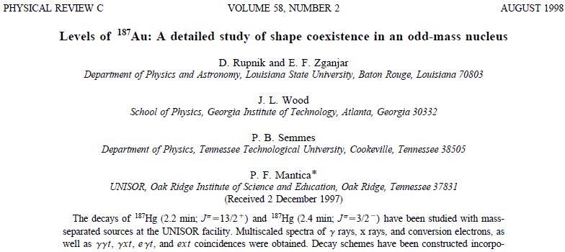
An example of ¹⁸⁷Hg
A=187 around 2008
Phys. Rev. C58, 771, 1998 (1998Ru04)

Slide 4
Parents
¹⁸⁷Hg EC Decay (2.4 min)
Parent: 0.0 J^{π} = 3/2- Half-life - 2.4 min
¹⁸⁷Hg EC Decay (1.9 min)
Parent: : 0.0 + x J^{π} = 13/2+ Half-life – 1.9 min
Earlier Evaluation - 1991

Slide 5
NUBASE 1997 and 2003
Both NUBASE 1997 and 2003
Consistent order for GS and Isomer
J^{π} and half-life for GS and Isomers were switched compared to ENSDF

Slide 6
¹⁸⁷Hg half-lives (1970Ha18)
From observed 5035 keV 20 and 4870 keV 20 alpha groups

Slide 7
Placement of α groups
Improved decay scheme of ¹⁸³Pt from new measurements
¹⁸³Au EC Decay – 1989Ro21, 1984Ma41
(HI,xny) reaction – 1990Ny02

Slide 8
¹⁸⁷Hg α Decay
Q_{α}=5230 keV 14
J^{π}=13/2(+)
0.0+x keV T_{1/2} = 2.1 m
59 keV 16 (AMU 2012)
%α > 0.025
4870α
¹⁸⁷Hg
T_{1/2} = 1.9 m
J^{π}=(13/2+)
GS J^{π}=3/2(-)
316.9 keV
%α > 0.012
Not in scale
5035α
J^{π}=3/2-
84.7 keV
¹⁸³Pt
GS J^{π}=1/2-

Slide 9
Consequences
In 1998Ru04
Probably personal knowledge of J^{π} and mixed with T_{1/2} in ENSDF
Once published – special attention needed by evaluators
Solution
Checking/Updating ENSDF files (if mass chain review delated)

Slide 10
Procedures to follow
Update
Related data (in this case ¹⁸⁷Hg alpha decay data)
Source of data
From new measurement?
From any other references?
Earlier evaluations
Check NUBASE for ground and isomeric states
Communication
With authors

Slide 11
Other example
2002An19
33 keV 15 (2005We11)
19 keV 10 (AMU-2012)
11 keV 11 (AMU-2003)

Slide 12
List of Inverted Pairs
28 Ground and Isomer pairs – ENSDF vs. NUBASE
⁶⁰V (2013), ¹⁰²Y (2009), ¹¹⁴Tc (2012), ¹¹⁹Ag (2009), ¹²⁰In (2002),
¹²⁴La (2008), ¹²⁹Pr (2014), ¹³⁴Pm (2004), ¹³⁶Pm (2002), ¹³⁷Pm (2006),
¹⁴⁵Tb (2009), ¹⁵⁰Tm (2013), ¹⁵⁴Pm (2009), ¹⁶⁰Ta (2005), ¹⁶⁷Re (2000),
¹⁸⁴Bi (2010), ¹⁸⁵Bi (2006), ¹⁸⁶Tl (2003), ¹⁸⁷Hg (2009), ¹⁸⁷Pt (2009),
¹⁸⁸Bi (2002),¹⁹²At (2006), ²⁵³Lr (2006), ²⁵⁶Md (1999), ²⁵⁷Db (1999),
²⁶¹Rf (2009), ²⁶⁵Sg (2009), and ²⁷¹Ds (2005)
Review/Fix
Respective mass chain evaluator
For consistency with NUBASE

Slide 13
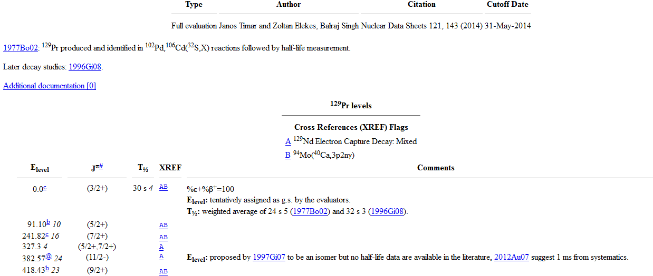
¹²⁹Pr

Slide 14
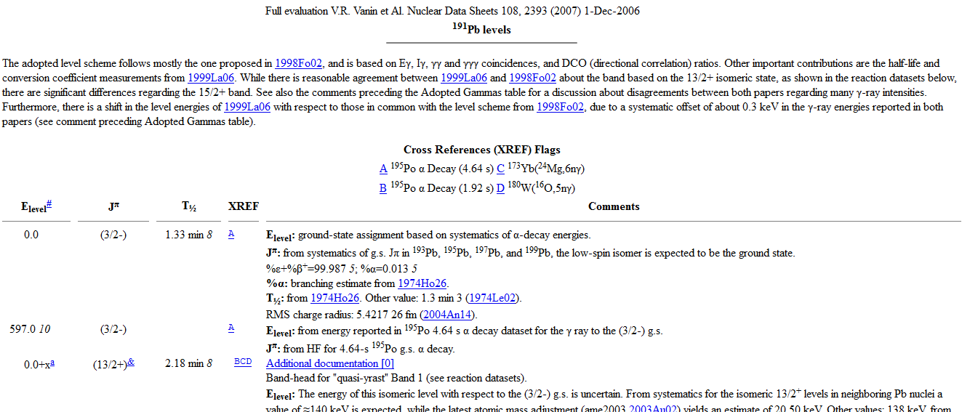
¹⁹¹Pb

Slide 15
Other items
Q value
³¹Ar B+3p Decay
Daughter ²⁸Si
Calculate using mass table
Gamow Teller (GT) strengths
‘Beta/EC Record’ vs. ‘Level Record’
2014Or04 (⁵⁶Zn EC Decay)
1987Ma19 - ²⁶Mg(p,n)
Both report GT strengths

Slide 16
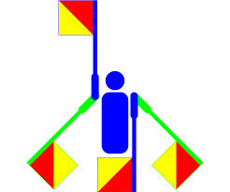
Thank You

