Slide 1
Discussion about RadD and Some other Questions
Sukhjeet Singh Dhindsa
Department of Physics,
Maharishi Markandeshwar University Mullana
Haryana- India

Slide 2
Comment by F.Kondev
Comments and Suggestions for New Code: RadD
“It would be useful that the developers provide a Makefile (for Unix based computers) the way a code needs to be compiled”
Our Response
We prepared Makefile for this code and it is working successfully.
But I guess Makefile is very useful if there are too many programs or too many commands are required to be executed for desired output. But in present case only one or two commands are required.

Slide 3
Comment by Dr. F.Kondev
Comments cont…
“It may be useful to combine ELE.in as a data structure in a subroutine, rather than reading the file separately. Same could be applied to the 98Ak04.in data file. Both should be easy to implement”
Our Response
We have successfully combined ELE.in and 98Ak04 in a data structure statement within the source code (RadD.for).

Slide 4
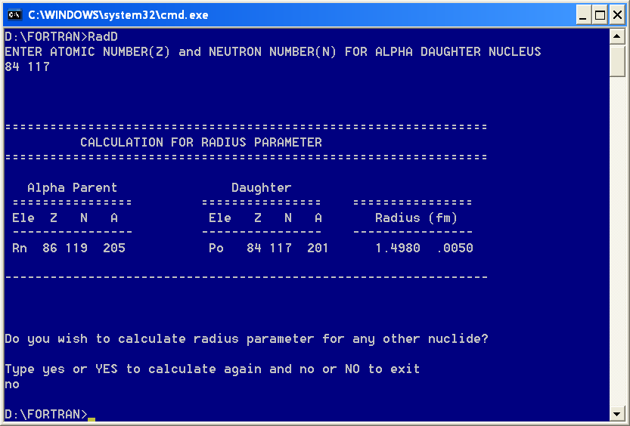
Comment by Dr. F.Kondev
“It would be much easier from the user point of view on input to ask only for the parent nuclide, in a free format line 208PB, 208Pb, 208pb,PB208, Pb208 or pb208, and then the program should figure out what is N,Z for the parent and daughter - this should be easy to implement.”
Comment by Dr. Balraj Singh
“Also as I mentioned earlier if possible it would be better to enter daughter A value and symbol for element: e.g for 195Bi alpha decay to 191Tl, one should be able to enter A=191, element symbol TL; now one needs to do a bit of arithmetic before entering data. You already have a table of element symbols for identification, but of the course the code needs to change to recognize relate symbols to Z value and calculate N=A-Z.”
Our Response
Since it is the daughter nucleus for which radius parameter is being calculated by this code. So, I think it will be good to enter daughter A value and symbol (as suggested by Dr. Balraj Singh) but with free format (as suggested by Dr. F. Kondev), otherwise one have to do little arithmetic before entering the numbers.
.

Slide 5
Interpolation ?
Is it reliable to use some interpolation techniques to deduce the missing ro values ?
Newton’s Interpolation , Langrange’s Interpolation etc

Slide 6
Steps for Changes in ALPHAD Code
The existing ALPHAD program reads an ENSDF-formatted file and produces a report of the hindrance factors, theoretical half-lives, and R0's calculated by the program.
We specify R0 on an ALPHA comment record by “HF” in columns 10 and 11 and a dollar sign (“$”) in column 12 or blanks in columns 12 through 19. The first value and uncertainty in columns 20 through 80 preceded by an R (“ R” case insensitive) and an equal sign (“=“) or approximate sign (“ AP”) will be taken as R0.
I should insert Table 1-IV (radius parameters for odd-even,even-odd, odd-odd and
even-even) in existing program as a data structure .
When this code reads the given ENSDF, It should identify Z and N of the alpha
daughter nuclei and choose the appropriate radius parameter from above data
structures
It should follows the same route as earlier ALPHAD code

Slide 7
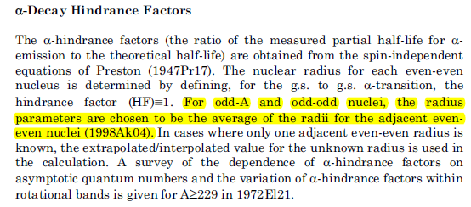
Existing Policy
Is it possible to assign a key number to set 1 (Writeup + Table I, Table II and Table III) of our RadD package and put that key number in existing policy as:
For odd-A and odd-odd nuclei the radius parameters (new key number) are deduced by taking average of radii for adjacent even even nuclei (1998Ak04)

Slide 8
Status of Magnetic Rotational Band Compilation
Updates for existing systems listed in Table of MR bands, Dec. 2006
Nuclide | Ref | Updates in the form of
⁸²Rb | 2009Yu10 | Extension up to higher spin values. Observation of new band(s) g factor and life time measurements Confirmation of spin parity assignments Some theoretical papers also appeared after Dec. 2006, which which confirm earlier configuration assignments, band crossing and spin parity assignments.
⁸³Rb | 2009Sc22
¹⁰³Ag | 2008Ra06
¹³⁹Sm | 2008Pa36
¹⁹³Pb | 2011Ba02
¹⁹⁴Pb | 2009Ku03
¹⁹⁸Bi | 2014Pa53
¹¹³In | 2012Ma18
¹⁰⁸Cd | 2010Ro15

Slide 9
New MR bands appeared after Dec. 20, 2006
Nuclide | Reference | Brief Details
⁵⁸Fe | 2012St06 | 02 bands (8 - 12) and (8 - 15)
⁶⁰Ni | 2008To15 | 04 bands (9⁻ - 15⁻), (11⁺ - 17⁺), (11⁺ - 17⁺) and (9⁻ - 13⁻)
⁸⁵Sr | 2014Ku19 | 01 band (21/2⁺ - 31/2⁺)
⁸⁶Y | 2013Li33 2009RU03 | 01 band (11⁻ - 21⁻)
¹⁰⁶Ag | 2010He05 | 01 band (12⁺ - 22⁺)
¹⁰⁷Ag | 2014Ya02 | 02 bands(21/2⁺ - 37/2⁺) and (19/2⁻ - 33/2⁻)
¹⁰⁷ Cd | 2015Ch05 | 01 bands (31/2⁻ - 49/2⁻)
¹⁰⁷In | 2010Ne05 | 01 band (19/2⁻ - 39/2⁻)
¹⁰⁹In | 2012Ne03 | 01 band (19/2⁻ - 33/2⁻)
¹¹²In | 2012Tr11 2011He04 2009Li66 | 01 band (8⁺ - 19⁺)
¹¹⁴In | 2012Li38 | 01 band (11⁺ - 16⁺)

Slide 10
New MR bands appeared after Dec. 20, 2006
Nuclide | Reference | Remarks
¹³²La | 2013Ku07 | They conflict with earlier assigned MR bands by Acta Phys. Pol. B 40, 647, 2009 and suggest they are not the MR bands
¹³⁸Ce | 2009Bh04 | 01 band (15⁻ - 22⁻)
¹³⁹Pm | 2012ZH47 2010Zh12 2009Dh01 | Total 02 bands (25/2⁻ - 37/2⁻) and (35/2⁻ - 47/2⁻) The energy ordering of Gamma rays reported in 2009Dh01 is different from 2012ZH47, 2010Zh12
¹⁴²Sm | 2014Ra03 | 01 band (16⁻ - 22⁻)
¹⁴³Eu | 2014Ra18 | 02 bands (41/2⁻ - 51/2⁻) and (35/2⁺ - 47/2⁺)
¹⁴⁴Tb | 2014Ch22 | 01 band (16⁺ - 19⁺)
¹⁴⁴Dy | 2010Pr04 2009Su09 | 02 bands (15⁻ - 25⁻), (13⁻ - 21⁻)
¹⁹⁴Tl | 2012Pa16 | 01 band (16⁻ - 21⁻ )
²⁰¹At | 2015Au01 | 01 band (23/2⁻ - 37/2⁻)
²⁰⁴At | 20008Ha39 | 01 band without confirmed spin and parity
Total 28 new MR Bands in 21 new systems
Total 178 MR Bands in 76 nuclides available in earlier compilation Dec. 2006

Slide 11
Literature Issues
Access of secondary references is the main problem.
Is it possible to get ALL the secondary reports required for a
given mass chain either from NNDC or from any other source?
Is it possible that an evaluator may submit all the secondary
reports (used for a particular mass chain) to NNDC, so that next
evaluator of that mass chain may get folder containing secondary
reports used by previous evaluator.

Slide 12
THANKS

Slide 13
Status of A=226 Mass Chain
There are total 10 nuclides in this mass chain and 8 out of which have been checked and updated. The literature upto March 31, 2015 has been consulted. For remaining two nuclides, namely Ra and Th, the old entries have been checked but three new data sets one for Ra and two for Th are yet to be included in main ENSDF.

Slide 14
Comment by F.Kondev
Comments and Suggestions from evaluators on the
improvement of input database
“Akovali work is 17 years old and many new data, especially for proton-rich and heavy nuclei, are available for even-even nuclei. It would be very useful if a search on ensdf and xundl is made for even-even nuclei looking for the ‘HF$’ where the r₀ is available for favored decay (e.g. HF=1.0) and compile the corresponding r₀ values. One my enforce at the same time that hindrance factor of 1.0 appears on the A record for the favored decay - this should be not very difficult to implement”
Is it possible to do above search through Nudat or we have to scan all the even-even nuclei individually to compile above mentioned even-even radii or we have to write a code to extract required ro values from ENSDFs and XUNDLs.

