Slide 1
Technical Issues Observed in Recent Evaluations : Take 2

Slide 2
General thoughts and outline
Yes, I am copying Murray
I learn as much from reviewing evaluations as from actually working on evaluations
Few examples of quick checks
Using the EVP editor to help

Slide 3
What’s wrong with these pictures?
Glance through band drawings:
very easy to spot miss assigned or missing FLAGS

Slide 4
Which one doesn’t belong?
From a mass chain evaluation in rare-earth region:
Quickly scan through references:
Easy way to pick up typos in keynumbers

Slide 5
Decay Scheme normalizations

Slide 6
My Pet Peeve

Slide 7
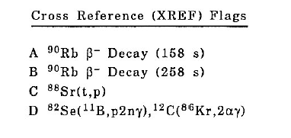
More Detailed Checks
Alejandro’s EVP Editor
Several useful features for checking evaluations
As an example … ⁹⁰Sr studied in 4 ways
Note: I have purposely introduced the errors

