Slide 1
Super Precise Data

Slide 2
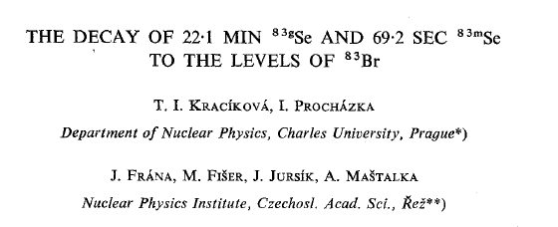
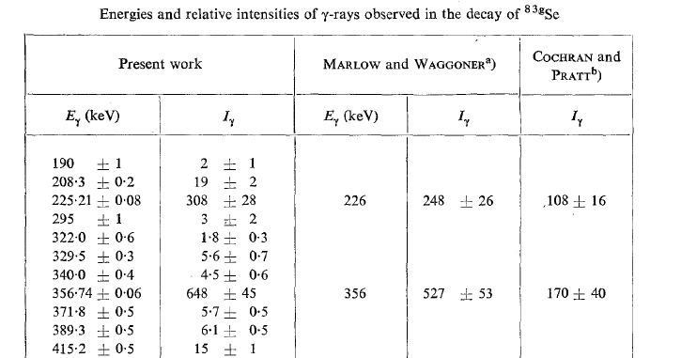
Status of ⁸³Se decay, prior to 2015
Data from two main references : 1974Kr27 and 1973Fe08
1974Kr27
ΔEγ ~0.2 keV (or worse)
ΔIγ ~5%
(or worse)

Slide 3
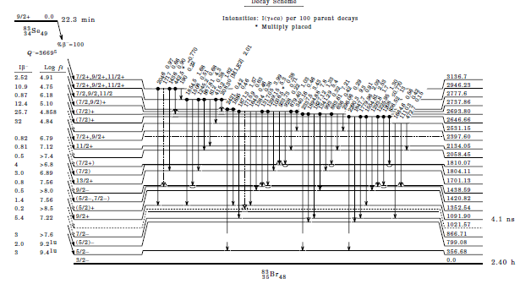
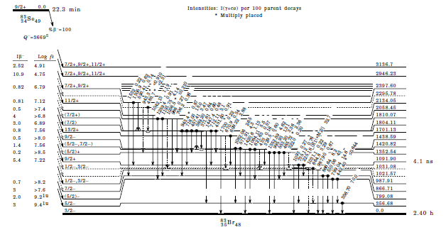
Decay Scheme Rather Well Established

Slide 4
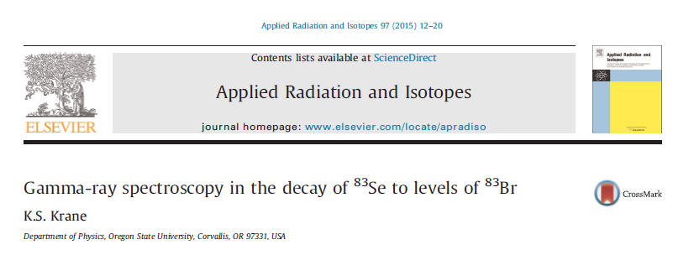
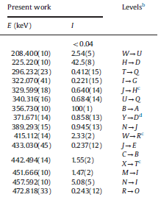
Recent measurement to be incorporated
Uncertainties as low as
ΔEγ = 0.01 keV
ΔIγ ~ 1%

Slide 5
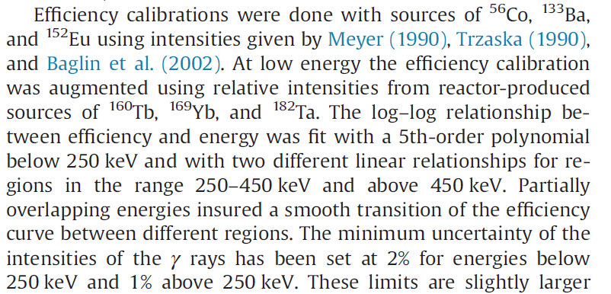
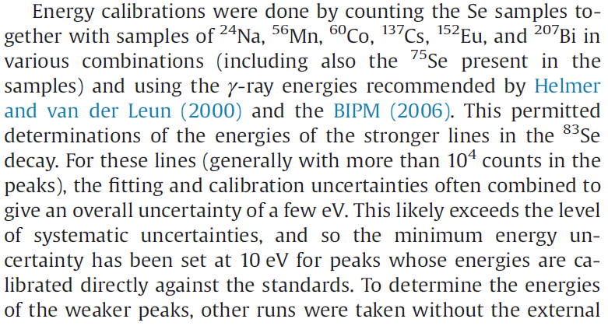
Uncertainties well documented

Slide 6
GTOL is not happy

Slide 7
How to combine these measurements?
Must adopt the newer Krane values ??
Weighted average has no impact here
What about merging in the Adopted Values??
Arbitrarily increase uncertainties?

