Slide 1

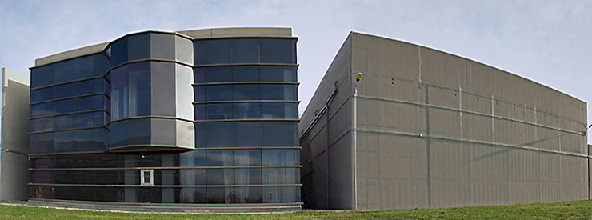
The CMAM “Centro de Micro Análisis de Materiales”
Universidad Autónoma de Madrid
Presented by: Ángel Muñoz-Martin
Meeting of the CRP
“Development of a Reference database for Particle Induced Gamma ray Emission (PIGE) Spectroscopy”
Vienna 16-20 may 2011

Slide 2
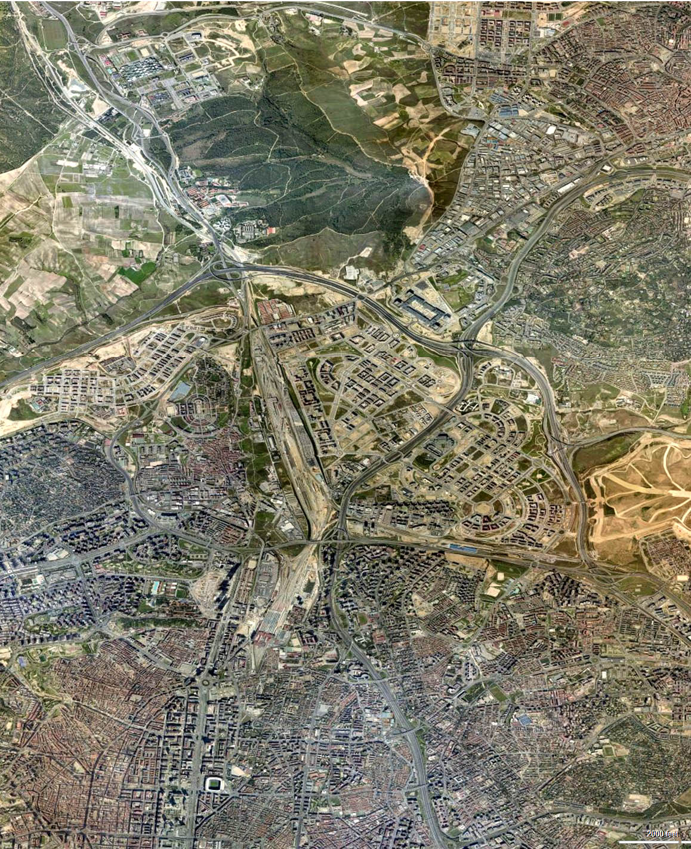
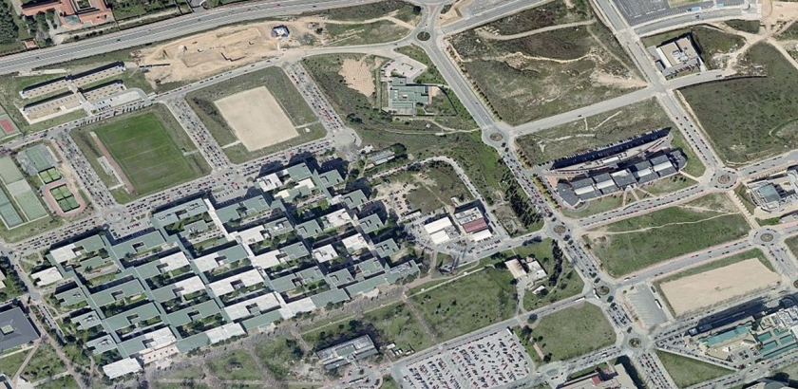
UAM
Mailing Address
Centro de Microanálisis de Materiales
Calle de Faraday 3,
Universidad Autónoma de Madrid
Campus de Cantoblanco
E-28049, Madrid, Spain
Phone number
(+34) 91 497 3621 (Switchboard)
Fax number
(+34) 91 497 3623
Email Address
cmam@uam.es
WEB page
http://www.cmam.uam.es
Notes:
The campus is CEI

Slide 3

Research areas
Nanoscience and Advanced Materials
  41 groups located at or near the UAM+CSIC Campus. 9 of the 20 most relevant condensed matter physicists in Spain (H index above 32)
Biology and Biomedicine
  Largest scientific community in Spain (and one of the largest in Europe) devoted to Biology, Biomedicine and Biotechnology
Theoretical Physics and Mathematics

Slide 4
CMAM is a research facilty @ CEI UAM-CSIC
60% for CMAM scientific personnel doing their own research and developing new Ion beam techniques
40% beamtime for external research institutions and private companies

Slide 5
C. Heritage
Advanced materials
Energy
MATERIALS
Health
Cooperation

Slide 6
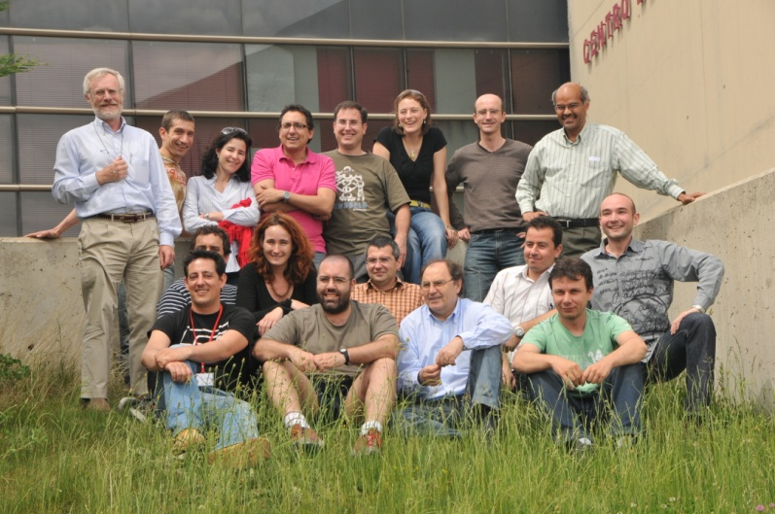
Staff
A staff of 23:
10 scientists,
3 PhD students,
8 technicians,
2 administrative

Slide 7
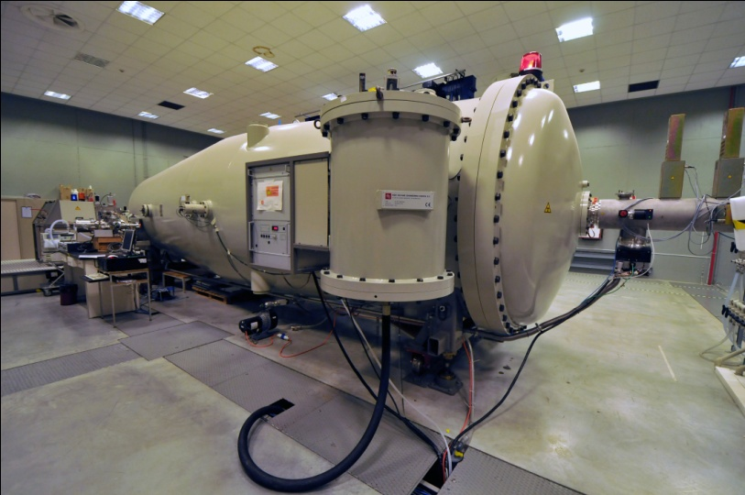
5MV Tandem accelerator
Very low ripple <50V @ 5MV
2 ion sources:
  Duoplasmatron
  Sputtering
Notes:
First Coaxial High Current Tandetron Accelerator using the Cockcroft-Walton power supply system to reach 5MV

Slide 8
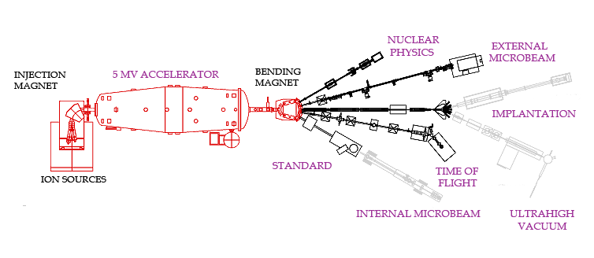
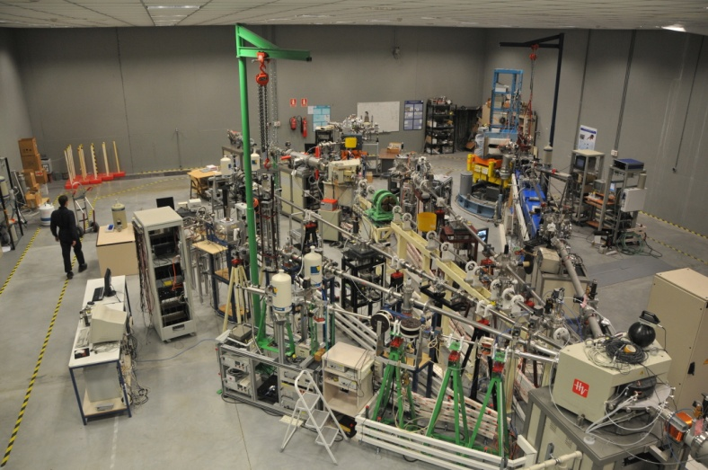
Beamlines
Standard
External μ−beam
ERDA-ToF
Nuclear Physics
Under commissioning
  Implantation,
  UHV-line,
  Internal μ−beam

Slide 9
Time distribution | 2009 |  | 2010
Usable shifts | 644 |  | 600
Reallocated from previous periods | 68 |  | 17
Maintenance shifts | 118 |  | 96
Buffer shifts | 60 |  | 71
Reserved comissioning shifts | 69 |  | 60
Available shifts | 329 | 526 | 356 | 504

Slide 10
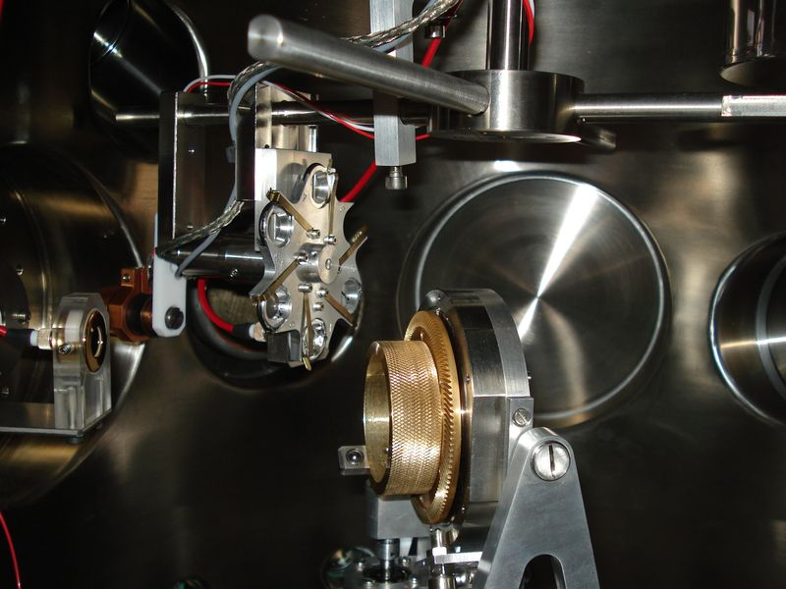
Standard beamline
Classical IBA techniques
(RBS, RBSc, ERDA, NRA)
IBMM over small areas

Slide 11
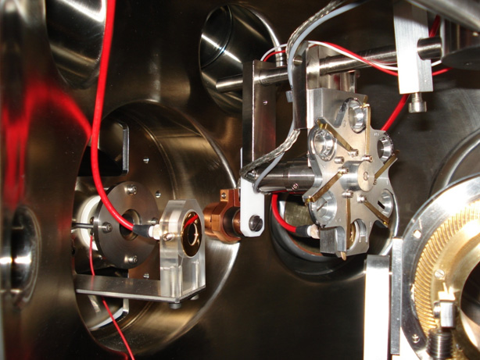
Standard beamline
In vacuum chamber
4 axis goniometer
Two charged particles detectors (fixed & movable). For the movable one it is possible to define different solid angles and change absorber foils.
A high sensitivity optical camera
A special viewport for far-infrared (thermal) camera
A few ports are available for coupling a HPGe detector for gamma rays.

Slide 12
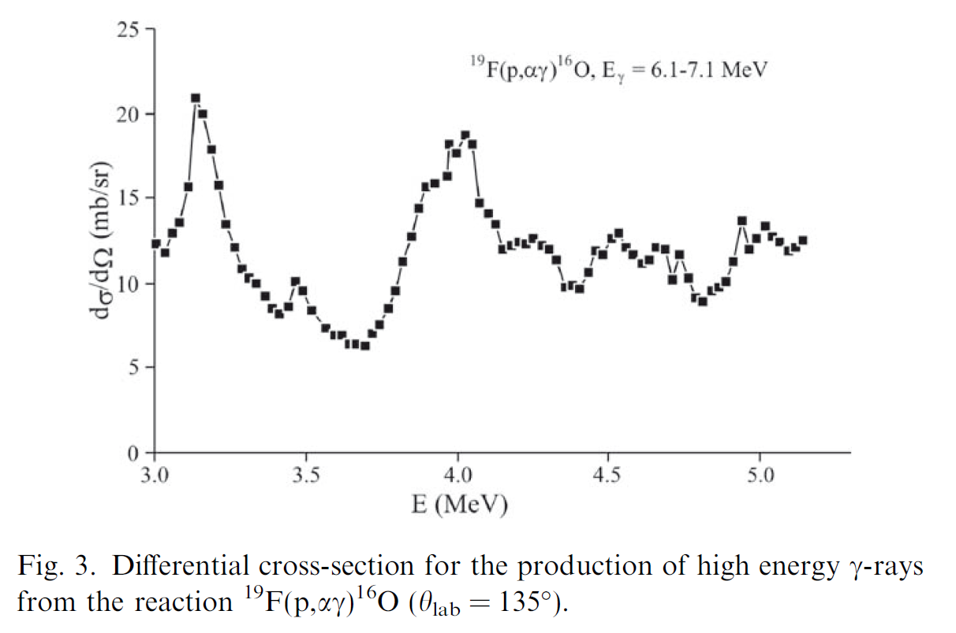
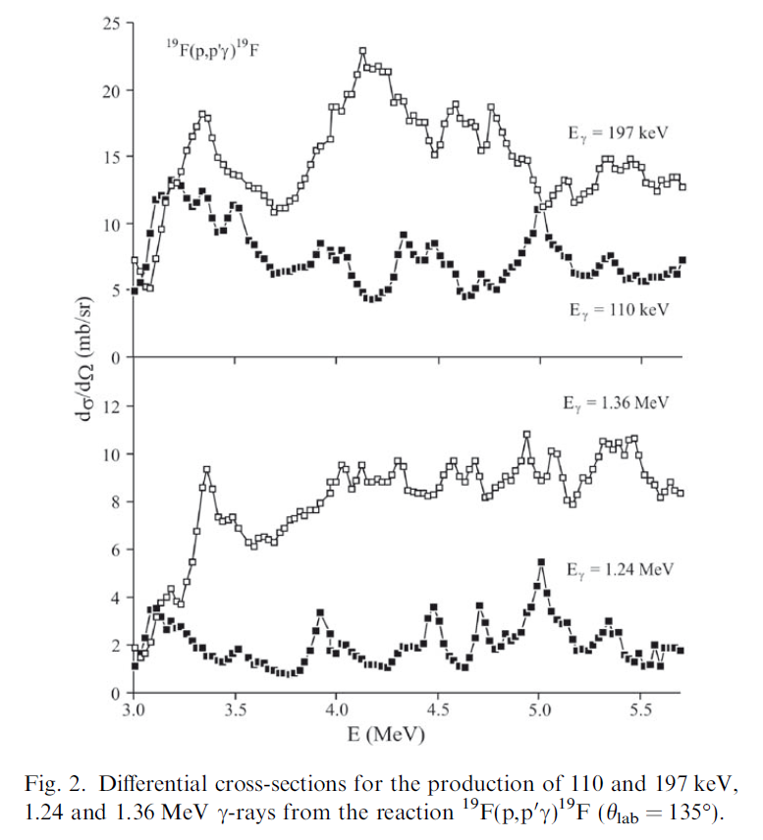
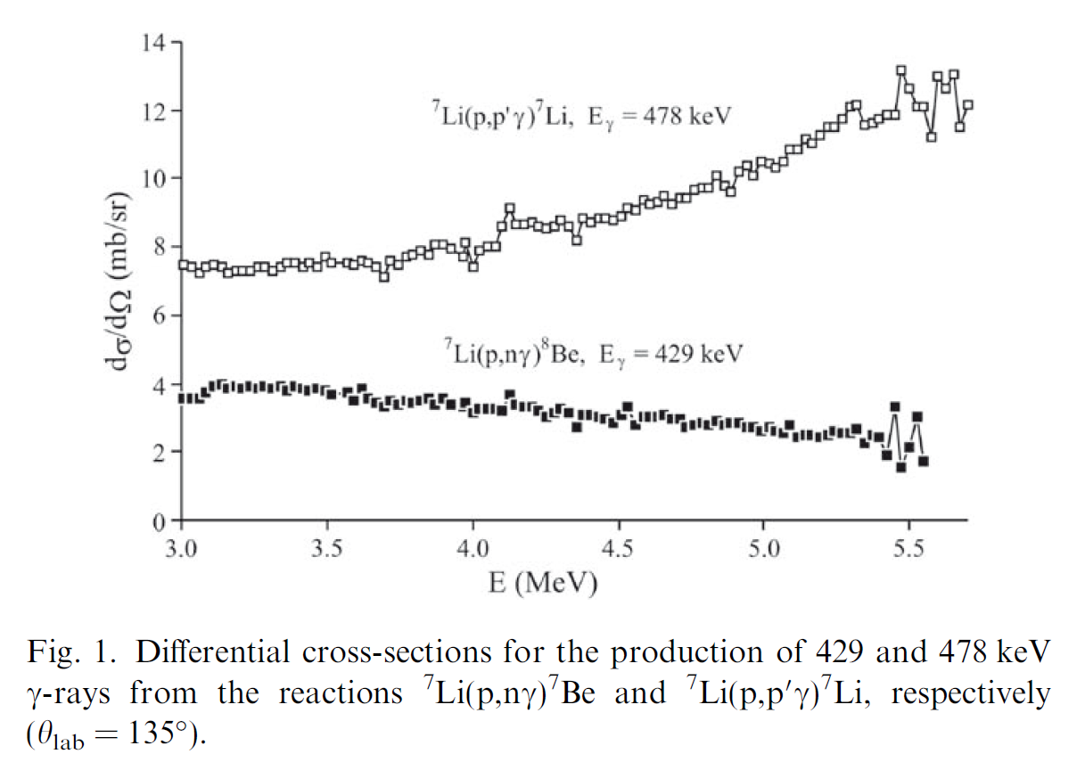
Measurements of γ-ray emission induced by protons on fluorine and lithium
A.Caciolli, G.Calzolai, M.Chiari, A.Climent-Font, M.T.Fernández , G.Garcia F.Lucarelli, S.Nava, A.Zucchiatti Nucl. Instr. & Meth.B249(2006)98-100

Slide 13
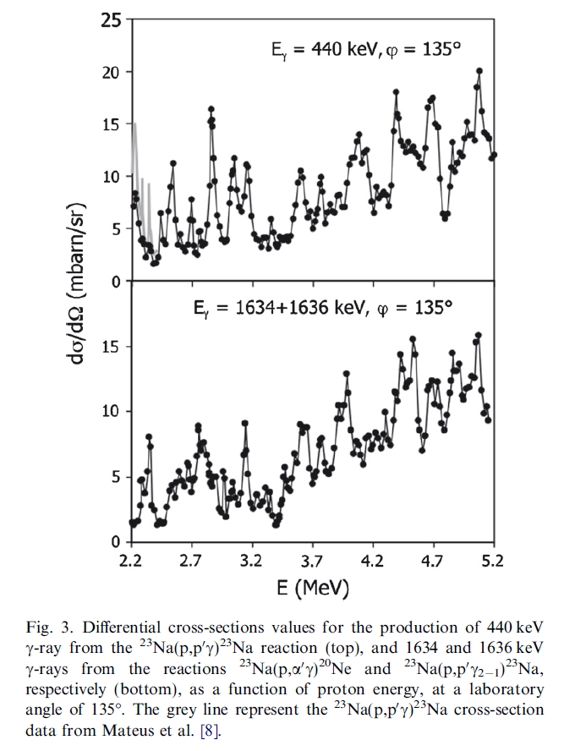
Proton elastic scattering and proton induced γ-ray emission cross-sections on Na from 2 to 5 MeV
A.Caciolli, G.Calzolai, M.Chiari, A.Climent-Font, G.Garcia, F.Lucarelli, S.Nava Nucl. Instr. & Meth.B266(2008)1392-1396

Slide 14
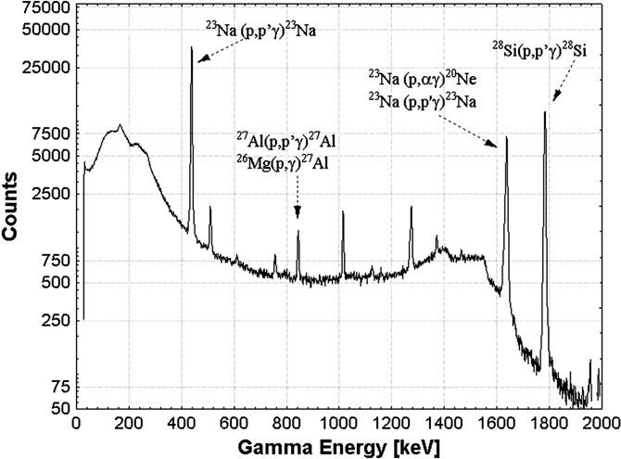
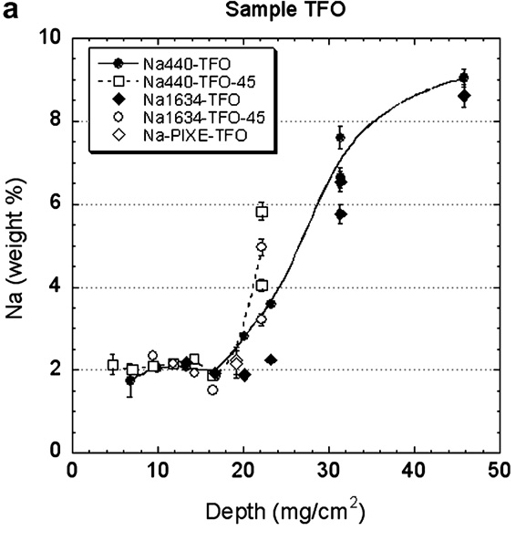
Quantification of sodium in ancient Roman glasses with ion beam analysis
Depth profiling of Na by changing energy of the beam and comparing with a NIST standard

Slide 15
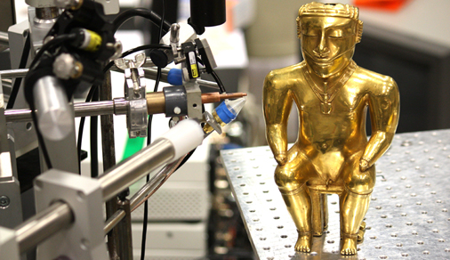
External μbeam
Used mainly to perform IBA in art and archaeology
Environmental and material science studies have occasionally been done

Slide 16
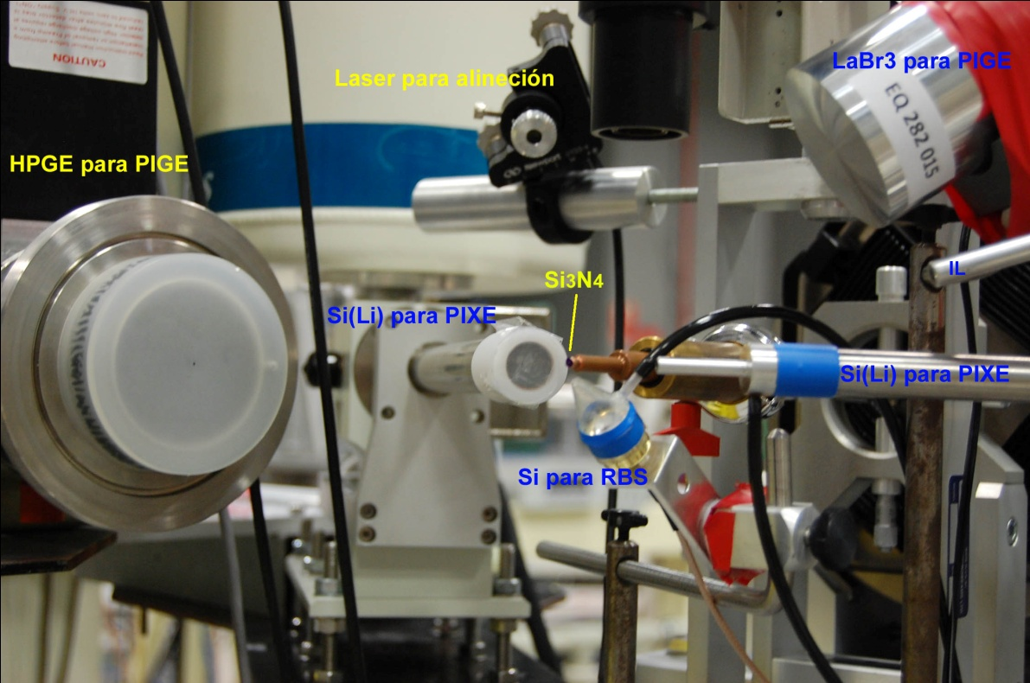
External μbeam
2 X-ray detectors for the PIXE,
1 silicon implanted blind detector, in Cornell geometry, for RBS.
For the PIGE a HPGe and a LaBr3 detectors can be installed temporarily.
The beam is extracted in air through a 0.2 μm thick Si₃N₄. In regular operation beams around 30 μm diameter are obtained.
The sample movement and position are remotely controlled

Slide 17
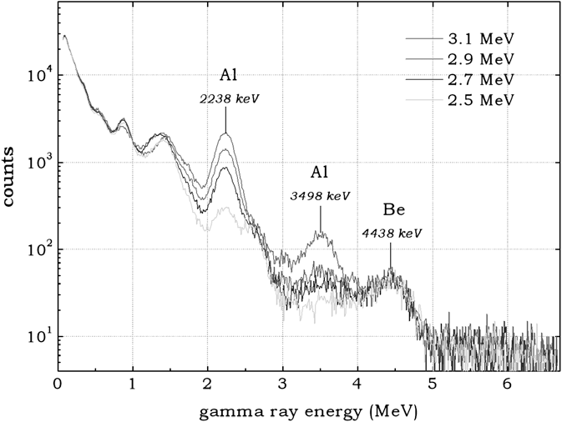
Detection of beryllium treatment of natural sapphires by NRA
The simple and non-destructive method for evidencing Be-treatment proposed here relies on the
⁹Be(α, nγ)¹²C nuclear reaction using a helium ion beam impinging on the gem placed in air and recording the 4439 keV prompt γ-ray tagging Be atoms.
P.C.Gutierrez, M.D.Ymsa, A.Climent-Font, T.Calligaro Nucl. Instr. & Meth.B268(2010)2038-2041
Notes:
In the case of a sapphire target, the cray spectrum also shows a 2235 keV line produced by aluminium through the 27Al(a, pc)30Si reaction [9,10] which can conveniently be used as a monitor of the integrated beam charge. However, the energy of the impinging He ions has to be carefully adjusted since in sapphires, due to the poor resolution of the scintillator detector used in the experiment, the 3498 keV c-rays from the decay from the second level of 30Si in the previous reaction might interfere with the searched 4439 keV c-rays.

Slide 18
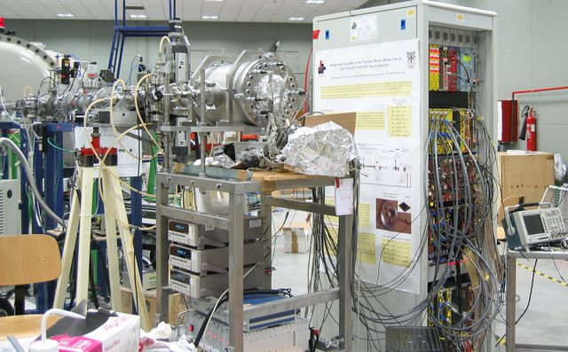
Nuclear Physics beamline
In cooperation with Spanish National Research Council (CSIC)
Used mainly for Nuclear Astrophysics and testing of new detectors
High flexibility
at the end station

Slide 19
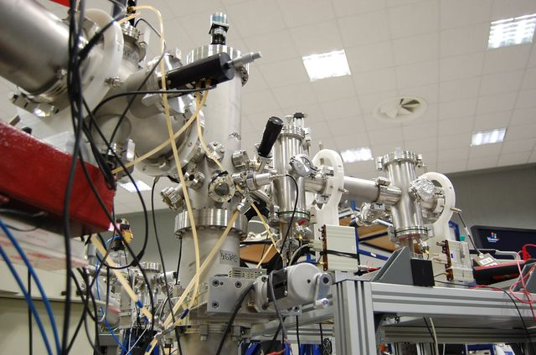
Time of Flight
Mainly used for ERDA on thin films
ToF and Energy are measured for each particle in coincidence
No overlapping
of elements

Slide 20
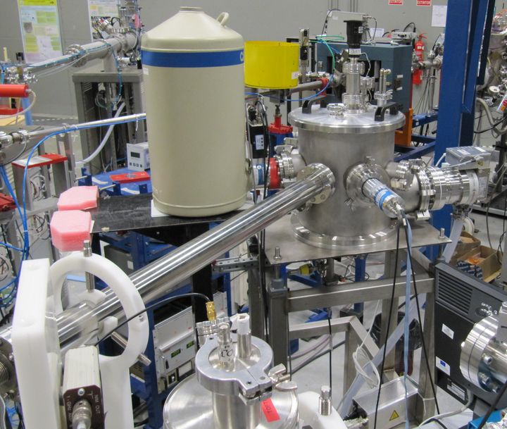
Extension of ToF beamline
A new high vacuum chamber has been added to ToF beamline
Chamber is electrically isolated (Faraday cup)
Top flange is exchangeable allowing for easy setup of experiments
Two γ rays detectors have been installed
Acquisition software can register data in list mode
Continuous record of actual current and dose
…

Slide 21
Participation in the CRP
Taking advantage of the 5MV to explore higher energies
Focus in Li, Be and F (fusion reactor materials, gemstones & environmental)
Beams: p and α

